Slide 1
Abstract Classes
BEFORE WE START
Talk to your neighbors:
Coffee or tea? Or something else?
Instructor:
Nathan Brunelle
Arohan | Ashar | Neha | Rohini | Rushil
Ido | Zachary | Sebastian | Joshua | Sean
Hayden | Caleb | Justin | Heon | Rashad
Srihari | Benoit | Derek | Chris | Bhaumik
Kuhu | Kavya | Cynthia | Shreya | Ashley
Harshitha | Kieran | Marcus | Crystal | Eeshani
Prakshi | Packard | Cora | Dixon | Nichole
Niyati | Trien | Lawrence | Evan | Cady
Ziao

Slide 2
Announcements
Creative Project 0 due tonight, Wed April 9 at 11:59pm!
See generic Creative Project rubric posted on website
Programming Assignment 0 will be released tomorrow, Thurs April 9
Focused on inheritance and abstract classes

Slide 3
Lecture Outline
Polymorphism Review
Declared vs. Actual Type
Compiler vs. Runtime Errors
Abstract Classes Review
Pre/Post conditions and commenting

Slide 4
Review: Is-a Relationships
Animal
Fish
Birds
Mammal
Reptile
Amphibian
Dog
Cat

Slide 5
Polymorphism
DeclaredType x = new ActualType()
All methods in DeclaredType can be called on x
We’ve seen this with interfaces (List<String> vs. ArrayList<String>)
Can also be to inheritance relationships
Animal[] arr = {new Dog(), new Cat(), new Bear()};
for (Animal a : arr) {
a.feed();
}

Slide 6
Compiler vs. Runtime Errors
DeclaredType x = new ActualType()
At compile time, Java only knows DeclaredType
Compiler error (CE): trying to call a method that isn’t present
Animal a = new Dog();
a.bark(); // No bark() -> CE
Can cast to change the DeclaredType of an object
((Dog) a).bark(); // No more CE
Runtime error (RE): attempting to cast to an invalid DeclaredType*
Animal a = new Fish();
((Dog) a).bark(); // Can’t cast -> RE
- Order matters! Compilation before runtime

Slide 7
Declared Type and Actual Type
DeclaredType varName = new ActualType(…);
Animal bucky = new Dog("Bucky");
Dog bucky = new Dog("Bucky");
Declared Type: Animal
Actual Type: Dog
Can call methods that makes sense for EVERY Animal
If Dog overrides a method, uses the Dog version
Declared Type: Dog
Actual Type: Dog
Can call methods that makes sense for EVERY Dog
If Dog overrides a method, still uses the Dog version

Slide 8
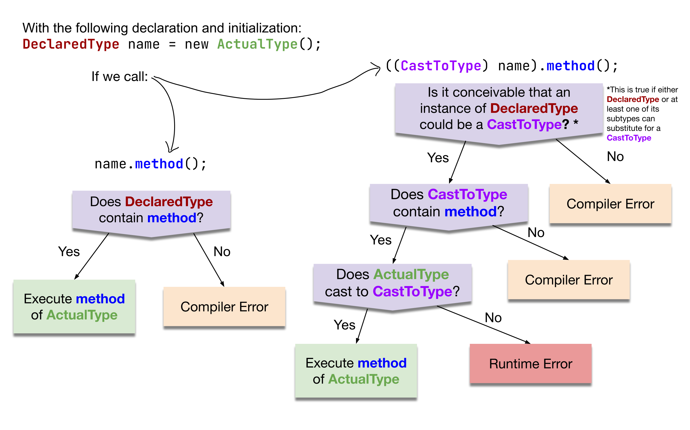
Compiler vs. Runtime Errors

Slide 9
Inheritance and Method Calls
Animal bucky = new Dog();
bucky.bark();
When compiling:
Can we guarantee that the method exists for the declared type?
Does the declared type or one of its super classes contain a method of that name?
If not… Compile Error!
Object
Compiling:
Look this way for bark
extends
“is a”
Animal
Declared Type
extends
“is a”
extends
“is a”
In this example:
When compiling, neither Animal nor Object have a bark method, so we have a compile error!
Dog
Fish

Slide 10
Overrides and Method Calls
Animal bucky = new Dog();
bucky.feed();
When running:
Use the most specific version of the method call starting from the actual type.
Start from the actual type, then go “up” to super classes until you find the method. Run that first-discovered version.
Object
extends
“is a”
Running:
Look this way for feed
Use the first implementation found
Animal
extends
“is a”
extends
“is a”
In this example:
If the Dog class overrides feed, then we’ll use the implementation in Dog. Otherwise we’ll use the one in Animal
Actual Type
Dog
Fish

Slide 11
Casting and Method Calls
When compiling:
Can we guarantee that the method exists for the Cast-to type?
Does the Cast-to type or one of its super classes contain a method of that name?
If not… Compile Error!
When Running:
Check that the Cast-to Type is either the Actual Type, or one of its super classes
Animal bucky = new Dog();
((Dog) bucky).bark();
Object
Compiling:
From cast-to type
Look this way
for bark
Running:
From actual type
Look this way
for cast-to type
Animal
Cast-to Type
Dog
Fish
Actual Type
This example has no error

Slide 12
Casting and Method Calls
When compiling:
Can we guarantee that the method exists for the Cast-to type?
Does the Cast-to type or one of its super classes contain a method of that name?
If not… Compile Error!
When Running:
Check that the Cast-to Type is either the Actual Type, or one of its super classes
Animal bucky = new Fish();
((Dog) bucky).bark();
Object
Compiling:
From cast-to type
Look this way
for bark
Running:
From actual type
Look this way
for cast-to type
Animal
Cast-to Type
Dog
Fish
Actual Type
This example has a runtime error

Slide 13
What results from the following code being executed? (1)
Compiler Error
Runtime Error
Compiles and runs without error
Animal bucky = new Dog();
bucky.bark();

Slide 14
What results from the following code being executed? (2)
Compiler Error
Runtime Error
Compiles and runs without error
Animal bucky = new Dog();
((Dog) bucky).bark();

Slide 15
What results from the following code being executed? (3)
Compiler Error
Runtime Error
Compiles and runs without error
Animal bucky = new Dog();
((String) bucky).meow();

Slide 16
What results from the following code being executed? (4)
Compiler Error
Runtime Error
Compiles and runs without error
Animal bucky = new Dog();
((Reptile) bucky).slither();

Slide 17
Lecture Outline
Polymorphism Review
Declared vs. Actual Type
Compiler vs. Runtime Errors
Abstract Classes Review
Pre/Post conditions and commenting

Slide 18
Abstract Classes
Interfaces
Abstract Classes
Classes
Mixture of Interfaces and Classes
Interface similarities:
- Can contain (abstract) method declarations
- Can’t be instantiated
Class similarities:
- Can contain method implementations
- Can have fields
- Can have constructors
Is there identical / nearly similar behavior between classes that shouldn’t inherit from one another?

Slide 19
Shape / Square / Circle Example
The starter code contains Shape, Square, and Circle classes similar to the pre-class work, as well as a Client that prints out a couple of shapes.
Add an abstract getName method to the Shape.
Add implementations of getName to Square and Circle that return "Square" and "Circle".
Add a method isEmpty to Shape that tells you whether the shape is empty (has zero area) or not.
Hint: you will need to call getArea, but it may not immediately work…
Implementing isEmpty by calling getArea works fine as is, but suppose we wanted to implement it in Circle directly. How could we do this just by looking at the fields of the Circle? Implement it this way by overriding isEmpty in Circle.
Override toString in Shape to return a similar message to what the Client prints in the starter code:
Hint: your toString can call abstract methods!
Rewrite the Client class to use the new toString on shapes.

Slide 20
Advanced OOP Summary
Abstract
Allow us to define differing levels of abstraction
Interfaces = high-level specification
What behavior should this type of class have
Abstract classes = shared behavior + high-level specification
Classes = individual behavior implementation
Inheritance allows us to share code via “is-a” relationships
Reduce redundancy / repeated code & enable polymorphism
Still might not be the “best” decision!
Interfaces extend other interfaces
(abstract) classes extend other (abstract) classes
Interfaces
Abstract Classes
Classes
Concrete
You’re now capable of designing some pretty complex systems!

Slide 21
Design in the “real world”
In this course, we’ll always give you expected behavior of the classes you write
Often not the case when programming for real
Clients don’t really know what they want (but programmers don’t either)
My advice:
Clarify assumptions before making them (do I really want this functionality?)
There’s no one right answer
Weigh the options, make a decision, and provide explanation
Iterative development: make mistakes and learn from them
Be receptive to feedback and be willing to change your mind

Slide 22
Interface versus Implementation
Interface: what something should do
Implementation: how something is done
These are different!
Big theme of CSE 123: choose between different implementations of same interface

