Slide 1
Victory Lap & Next Steps
BEFORE WE START
Talk to your neighbors:
What was your favorite thing you learned about this quarter? Why?
Instructor:
Nathan Brunelle
Arohan | Ashar | Neha | Rohini | Rushil
Ido | Zachary | Sebastian | Joshua | Sean
Hayden | Caleb | Justin | Heon | Rashad
Srihari | Benoit | Derek | Chris | Bhaumik
Kuhu | Kavya | Cynthia | Shreya | Ashley
Ziao | Kieran | Marcus | Crystal | Eeshani
Prakshi | Packard | Cora | Dixon | Nichole
Niyati | Trien | Lawrence | Evan | Cady
TAs:

Slide 2
Announcements
C3 due tonight (6/6) at 11:59pm
R7/R-Bucks due Sunday (6/8) at 11:59pm
Two forms to submit! Both on the Ed board.
Open to C3 if you need two extra days instead of another resub
Open to all assignments w/ feedback released
IPL closes end of day today (6/6)
Not open this weekend or next week
Message board will remain available
Final Exam Wednesday (6/11) @ 12:30pm-2:30pm in KNE 110/120
Seating chart now posted on the course website!
Typical rules for quizzes, note sheet (8.5” x 11” double-sided, typed or handwritten)
Please fill out course evaluation by Sunday night!

Slide 3
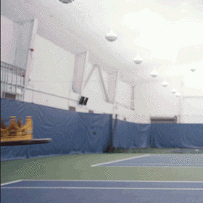
You Made It!

Slide 4
[Recap] Why 123?
To solve more complex problems by leveraging more complex programming structures / patterns
To better rationalize specific design decisions
How to “best” structure classes to reduce redundancy
Which ADT implementations are “most” appropriate to use
To understand and critically analyze intersections between Computer Science and society
Search engines, algorithmic art, machine learning, etc.
Developing informed opinions on current issues
Be a better programmer
Be a better person

Slide 5
[Recap] Topics Covered
Advanced Object-Oriented Programming (OOP)
Inheritance, Polymorphism, Abstract classes
Implementing Abstract Data Types (ADTs)
ArrayIntList (int[] elementData, int size)
LinkedIntList (ListNode front)
Java’s ArrayList & LinkedList (int size, ListNode back)
Runtime (Complexity & Big O notation)
Recursion
Recursive definitions (n! = n * (n – 1)!)
(Implicit) Base and Recursive cases
Public / private pairs
LinkedLists w/ recursion (x = change(x))
Binary Trees
Binary Search Trees (BST) & Runtime
Exhaustive Search / Recursive Backtracking
Dead ends / Choose, explore Un-choose
Machine Learning & Hashing
You’ve learned A LOT!!!
(hopefully)
Assessable content

Slide 6
Future Courses
Also: bringing computational thinking to other fields!
CSE Majors
Non-CSE Majors
Tons of options for everyone!
Self study always valid too!
Course | Overview
CSE 311 | Mathematical foundations
CSE 351 | Low-level computer organization/abstraction
CSE 331 | Software design/implementation
CSE 340 | Interaction Programming
CSE 341 | Programming languages
CSE 344 | Data Management (databases)
Course | Overview
CSE 154 | Intro to web programming
CSE 163 | Intermediate programming, data analysis
CSE 180 | Introduction to data science
CSE 373 | Data structures and algorithms
CSE 374 | Low-level programming and tools
CSE 412 | Data Visualization
CSE 416 | Intro. to Machine Learning
https://www.cs.washington.edu/academics/ugrad/current-students
https://www.cs.washington.edu/academics/ugrad/nonmajor-options/nonmajor-courses

Slide 7
Applications of CS
or “What can I do with what I learned?”
Detect and prevent toxicity online
Digitize basketball players
Help DHH people identify sounds
Figure out how to best distribute relief funds
Recognize disinformation online
Make movies
Improve digital collaboration
Fix Olympic badminton
And so much more!

Slide 8
Future Projects
At this point, you know 90% of the fundamentals you need to accomplish practically any project
Hurdle will typically be learning the syntax of a new language, using GitHub, importing external libraries, etc.
Some ideas:
Make a Minecraft mod! (Java) [link]
Make a Discord bot! (Python) [link]
Make personal website! (HTML, CSS, Javascript) [link]
Convert a project from this course into a more user-friendly application
C1, make a Graphical User Interface (GUI) [link]
P3, refine the Email class until you get an accuracy you’re happy with
Really, anything you want!!!*
*Warning: it’s often hard to tell what computers can do easily and what they struggle with…

Slide 9
Frequently Asked Questions
How can I get better at programming?
Practice!
How can I learn to X?
Search online, read books, look at examples
Start with something that already works (try github), then make changes!
What should I work on next?
Anything you can think of! (See previous slide for some ideas)
Should I learn another language? Which one?
Depends on what you want to do!
Python: Data Science & Machine Learning
JavaScript: Web Dev
C / C++: Systems Programming
What’s the best programming language?
😠 (take CSE 341/CSE 413)

Slide 10
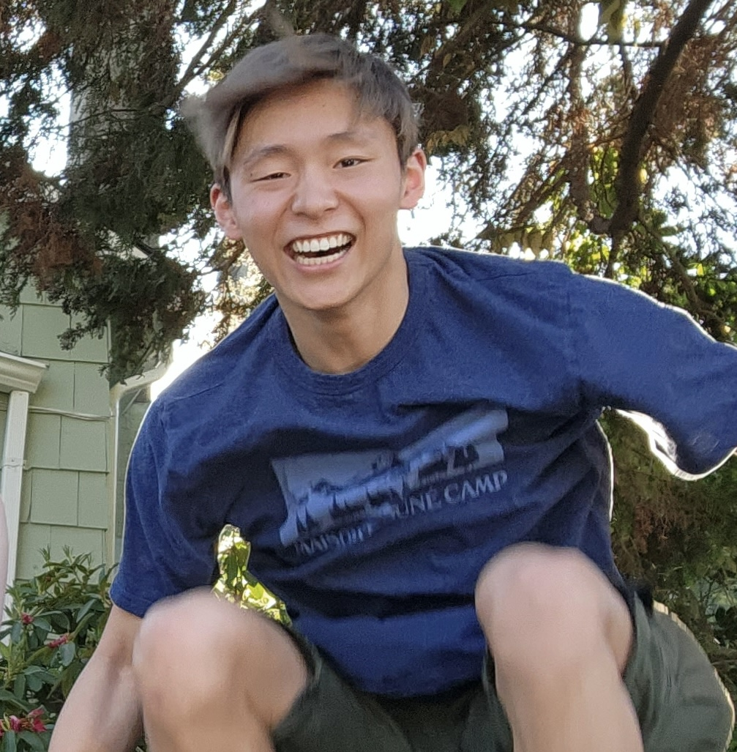
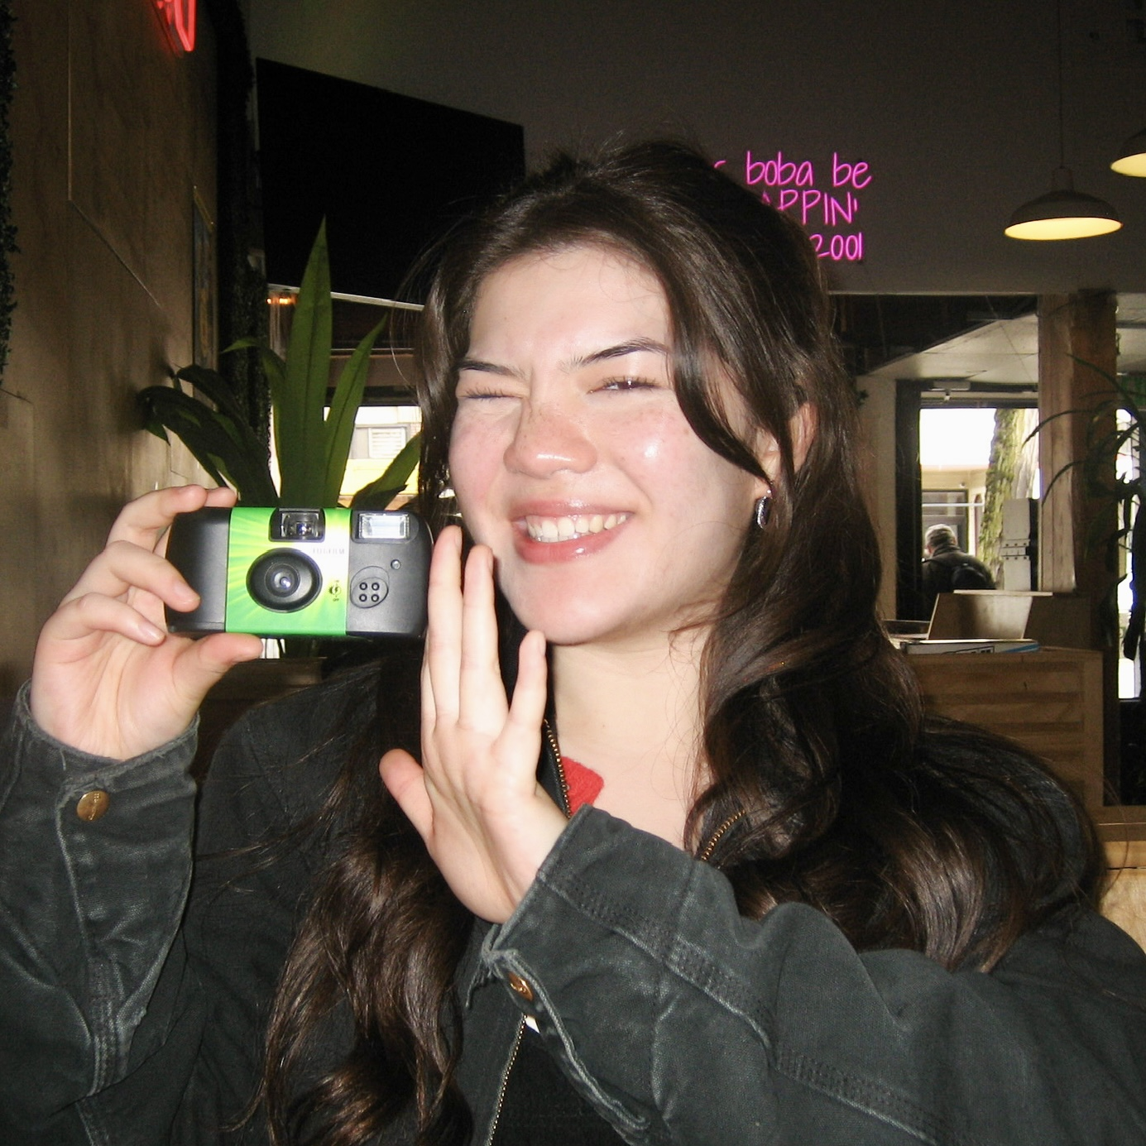
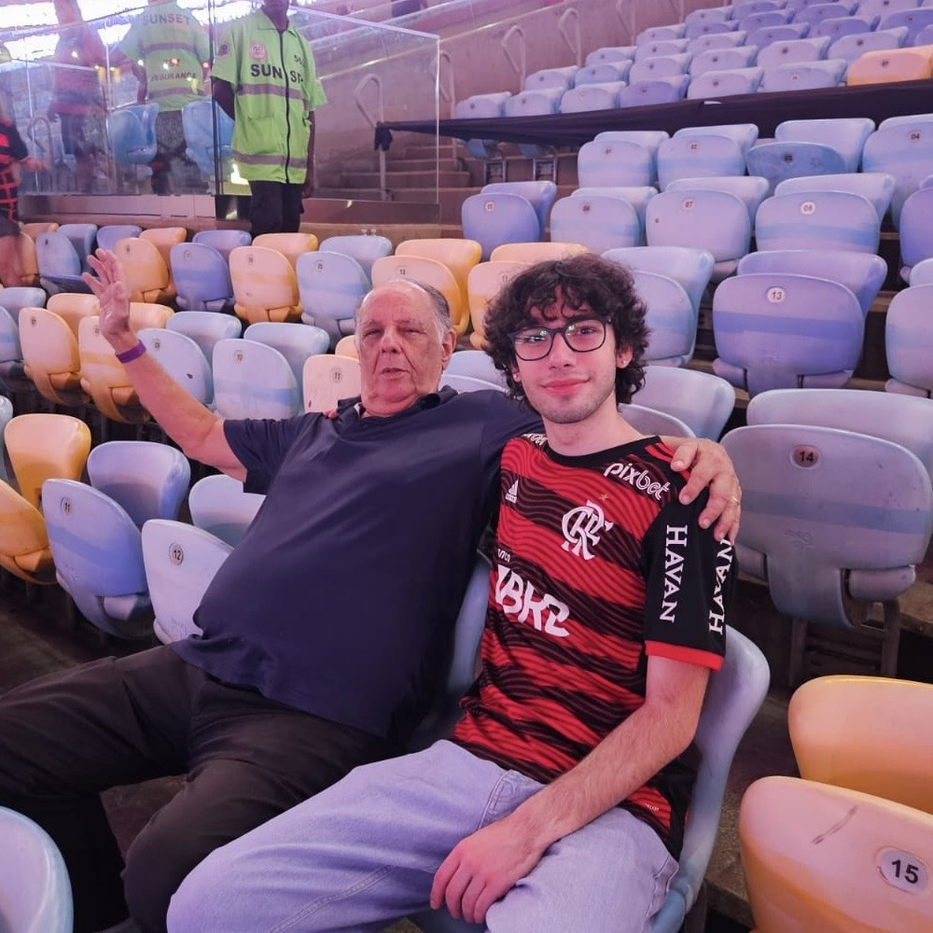
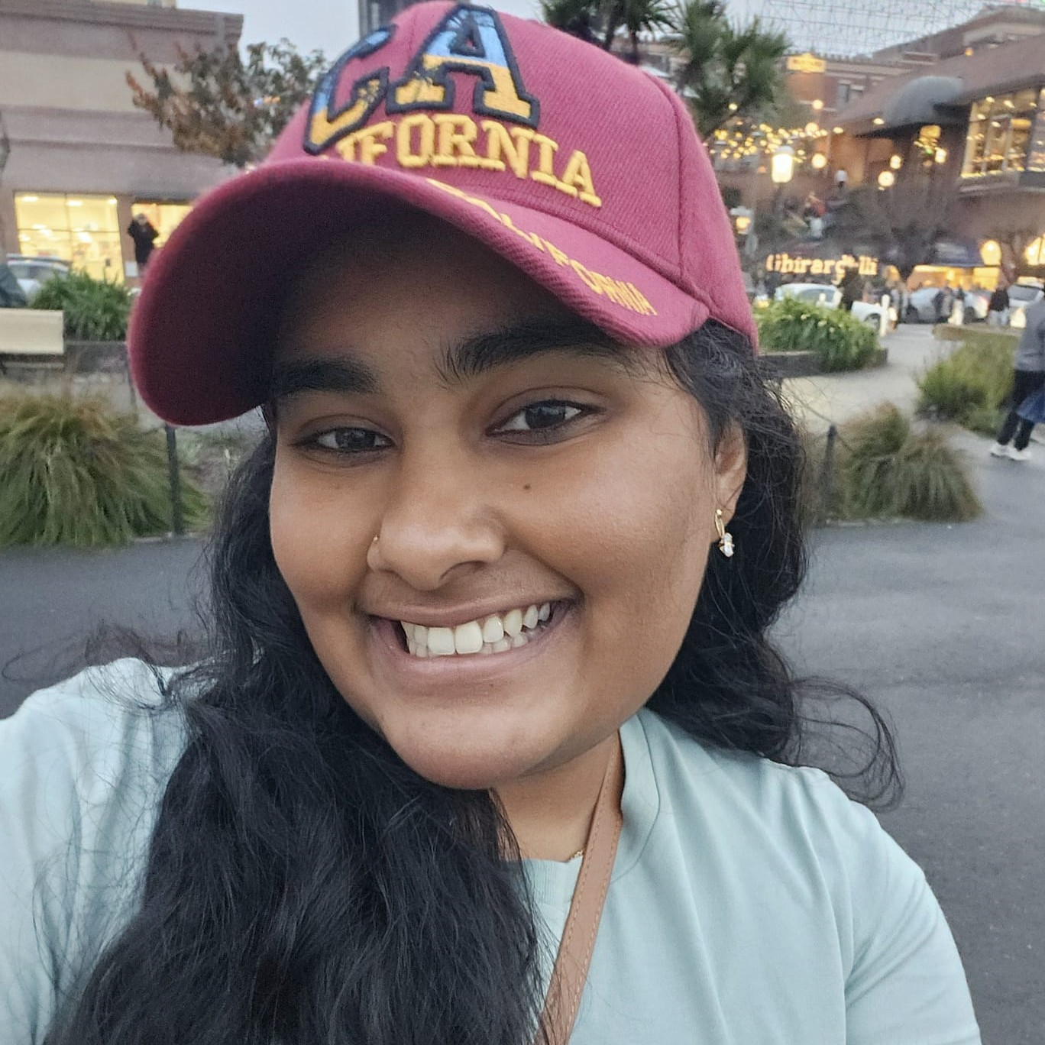
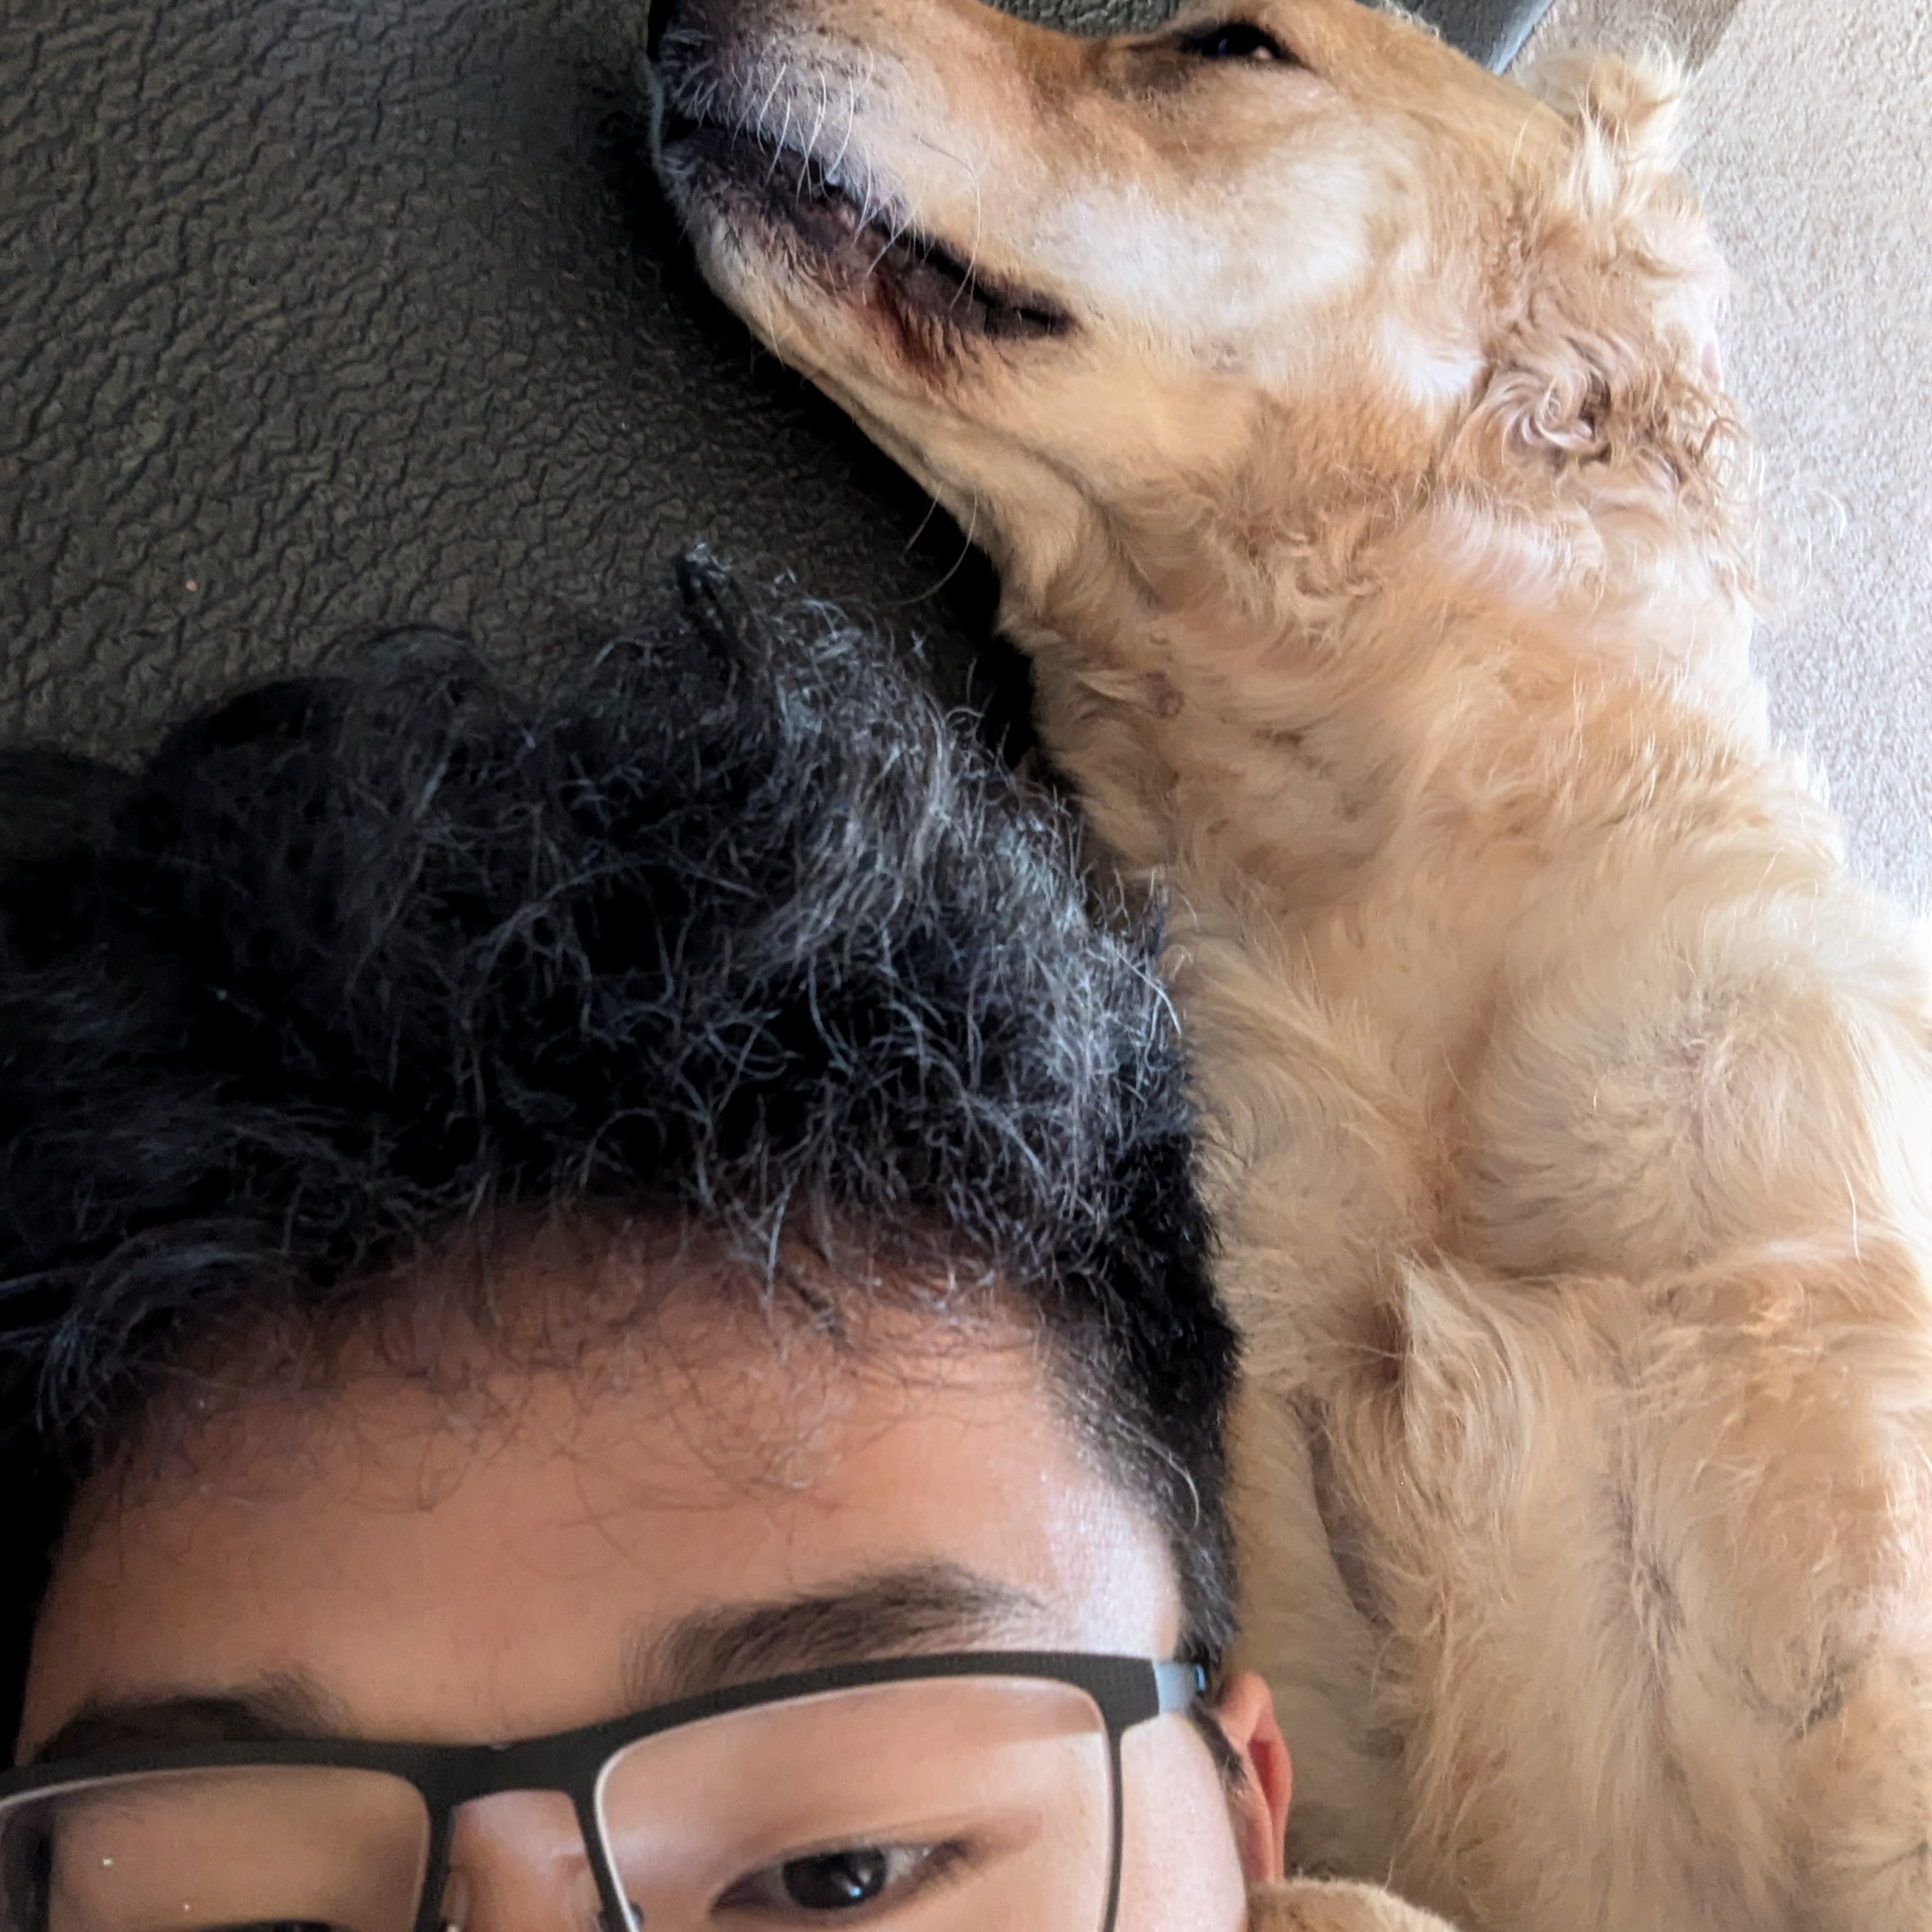
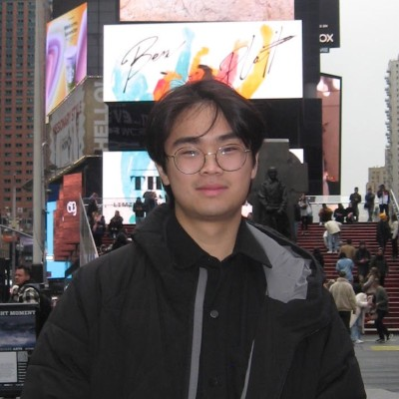
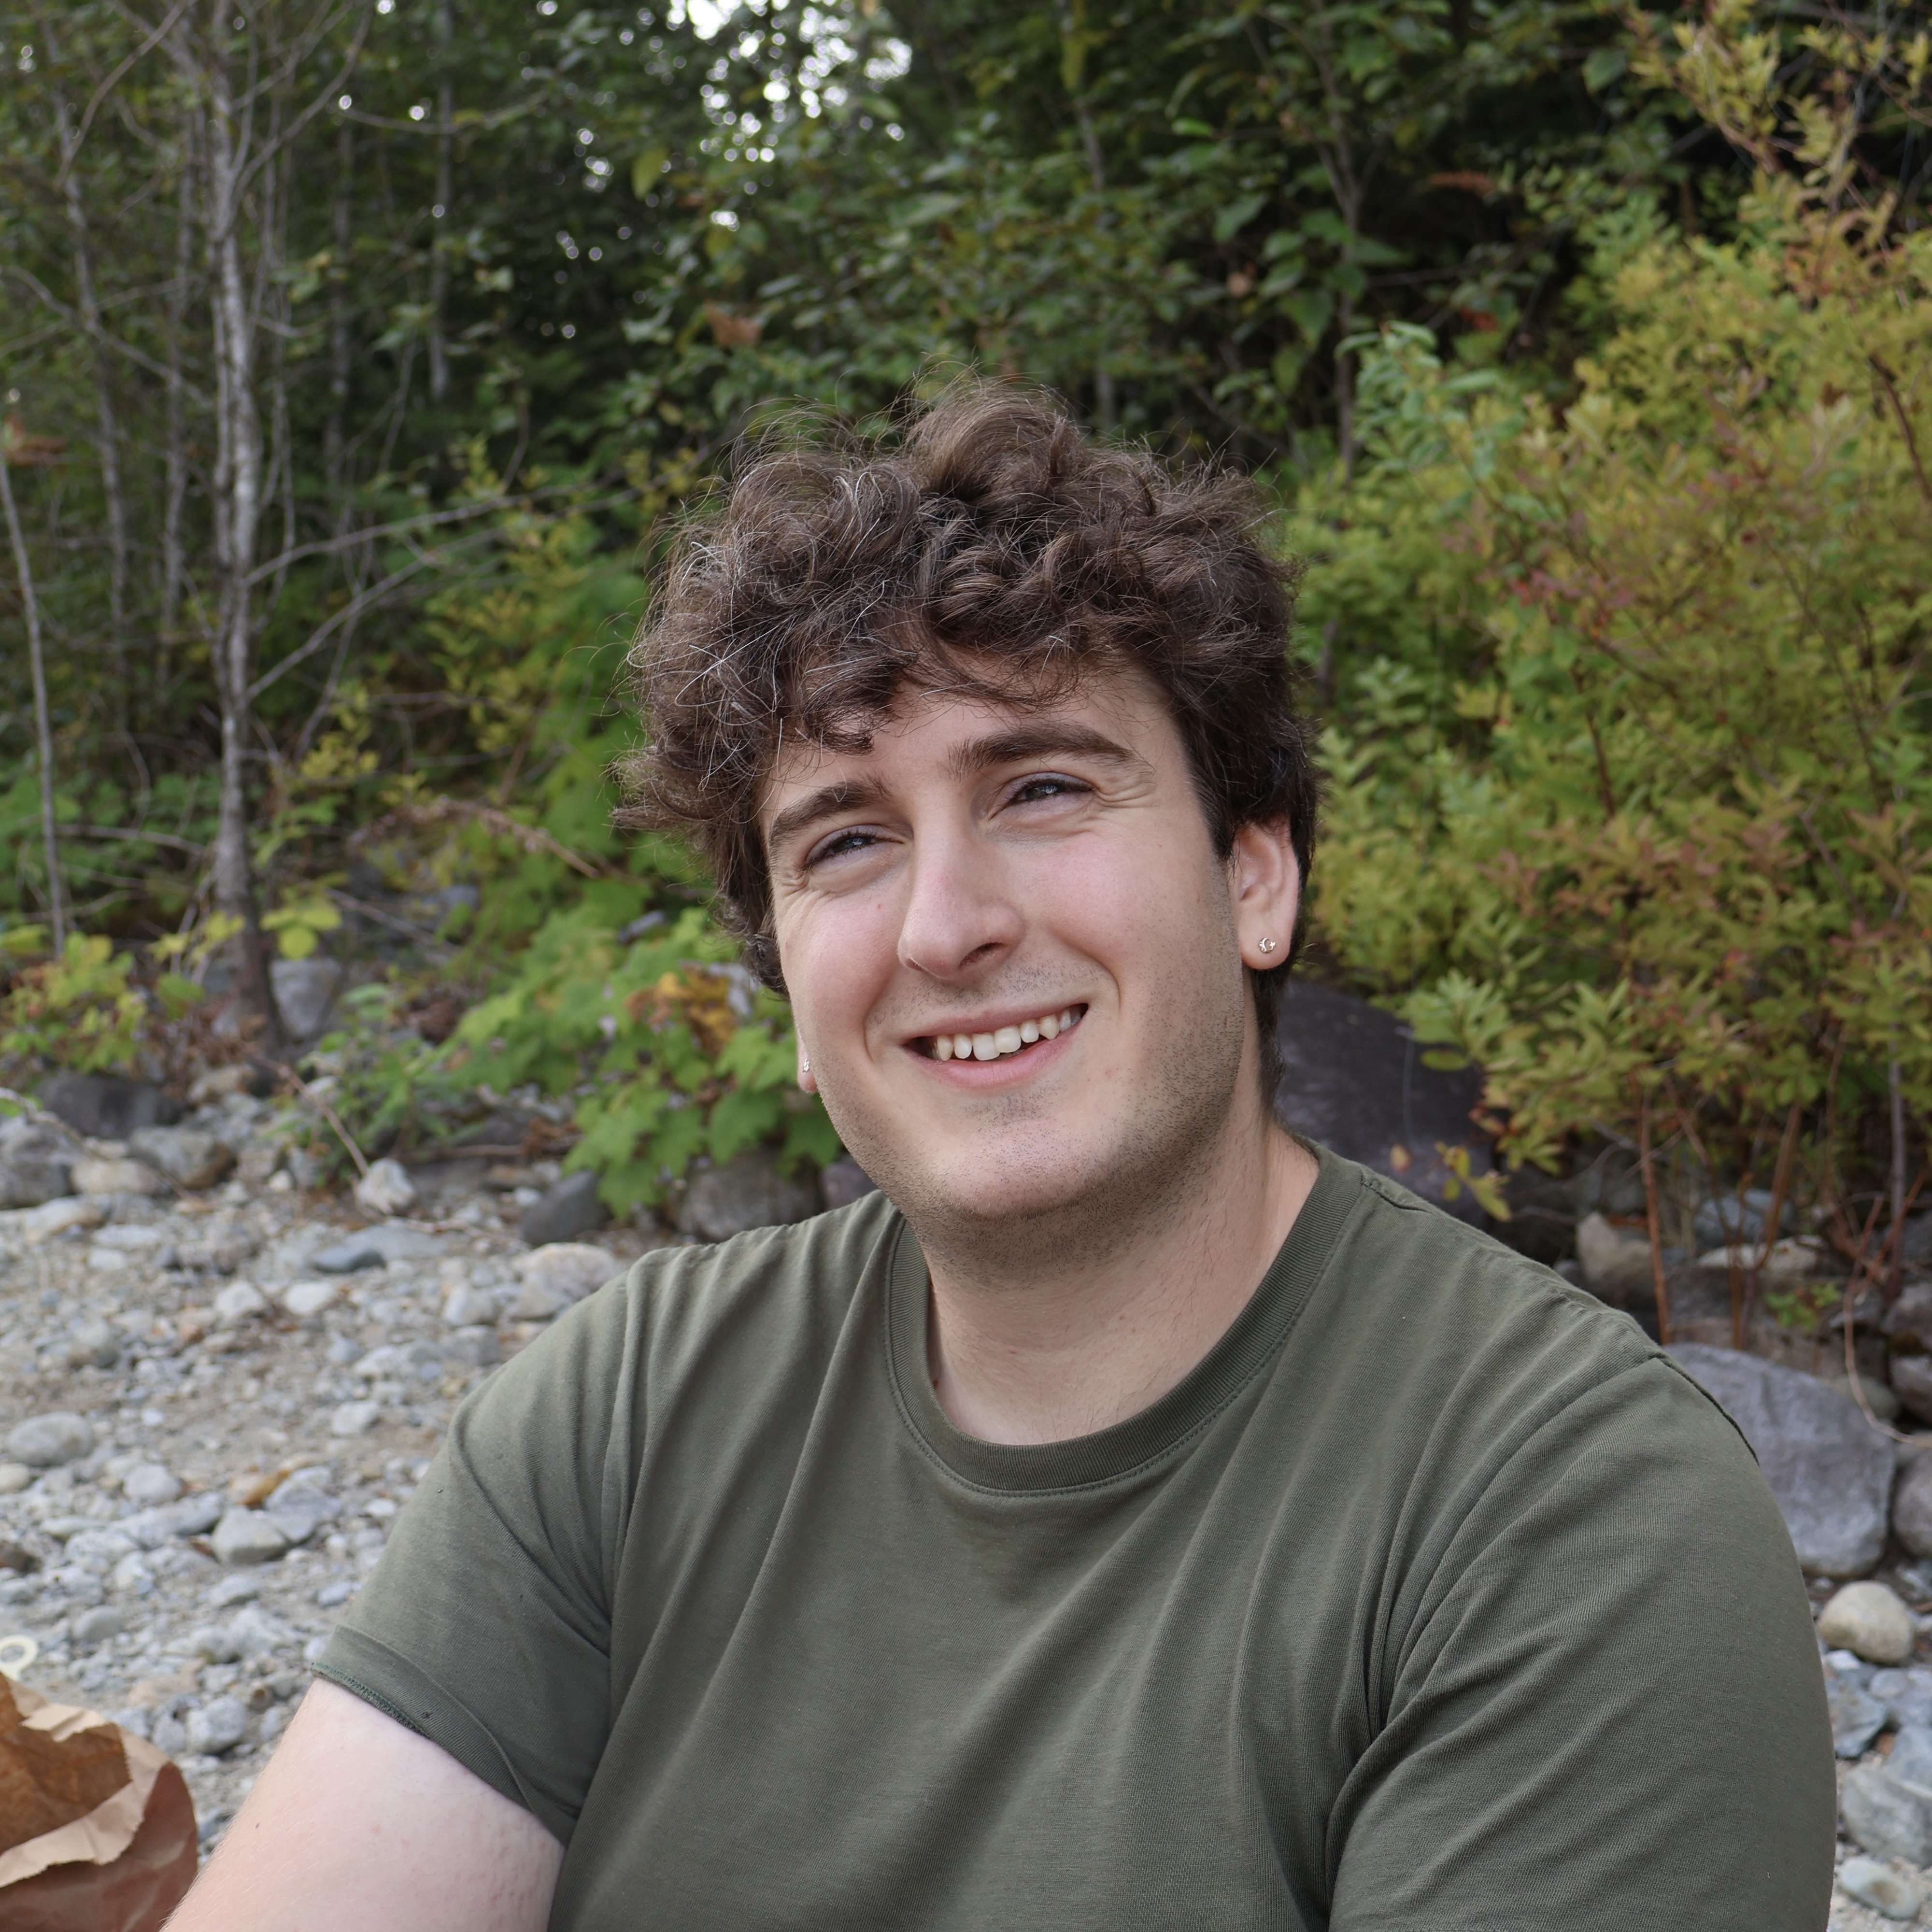
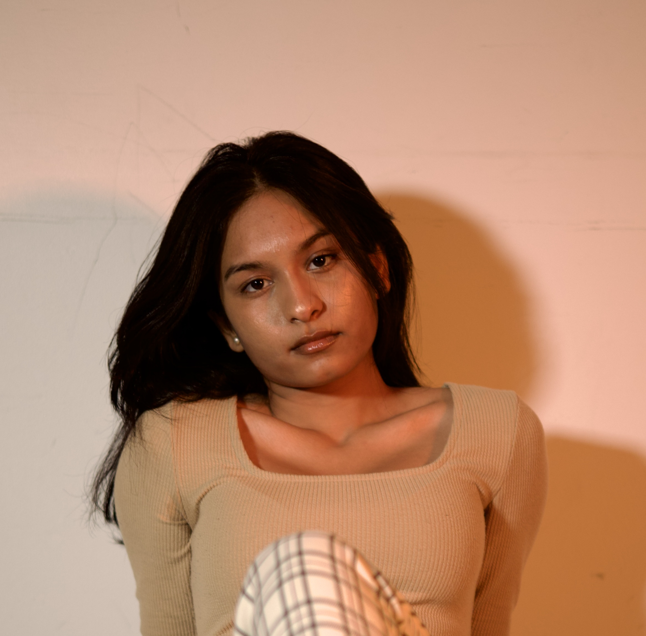
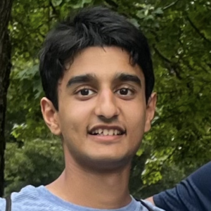
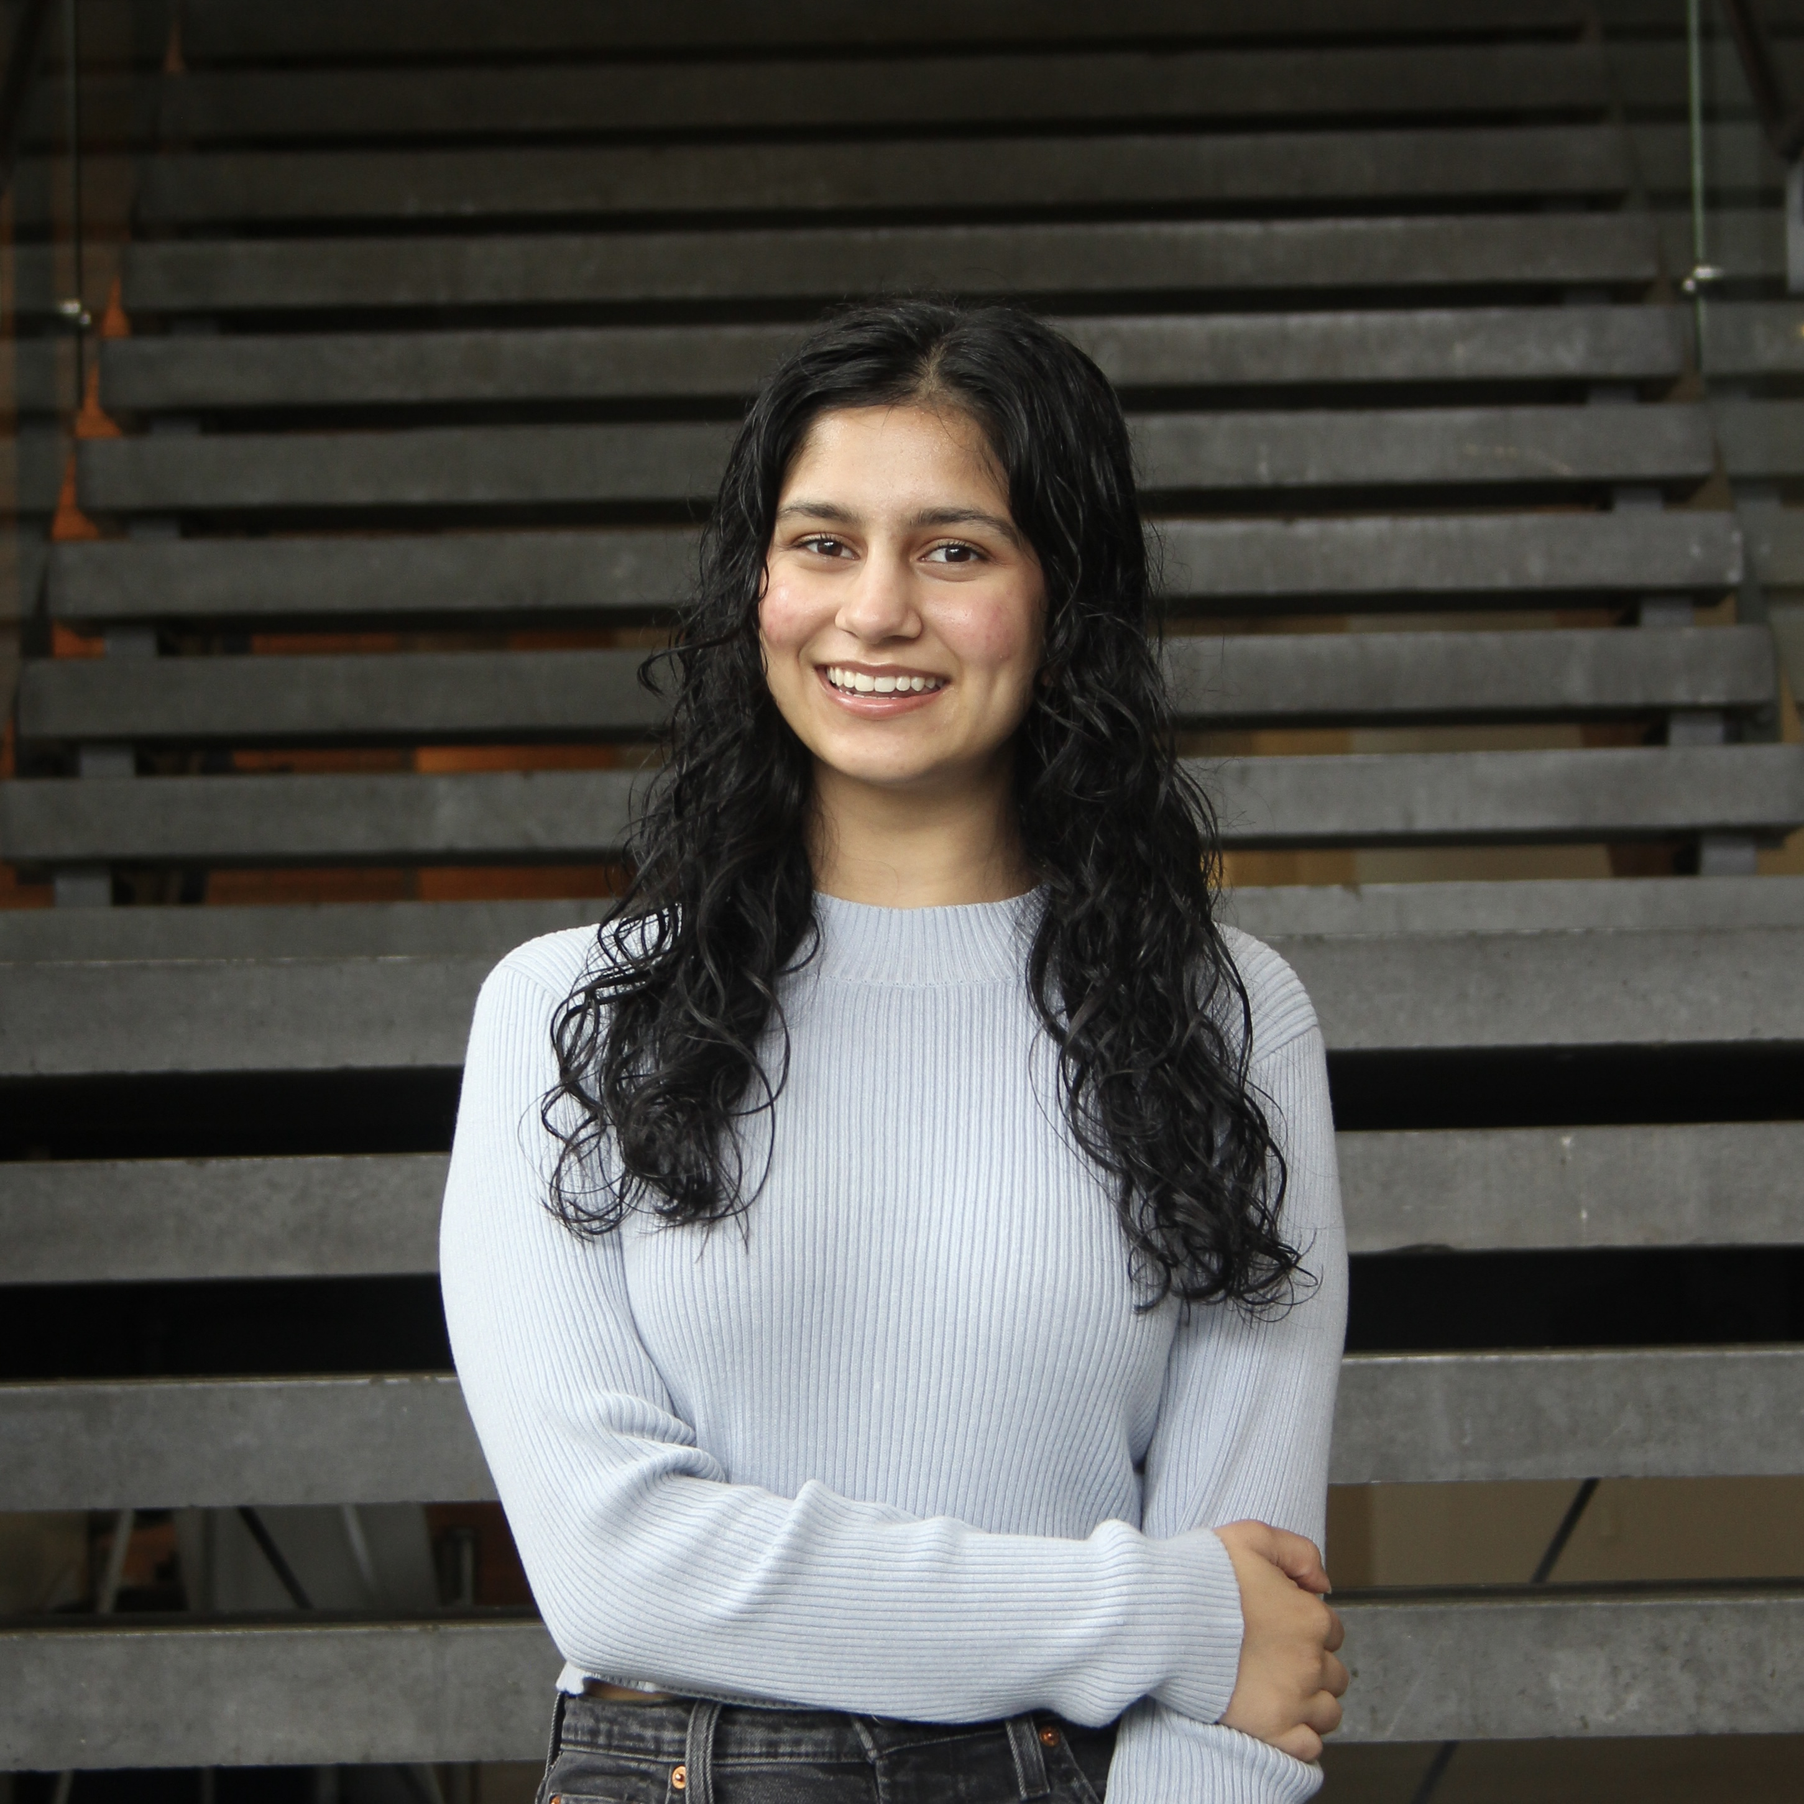
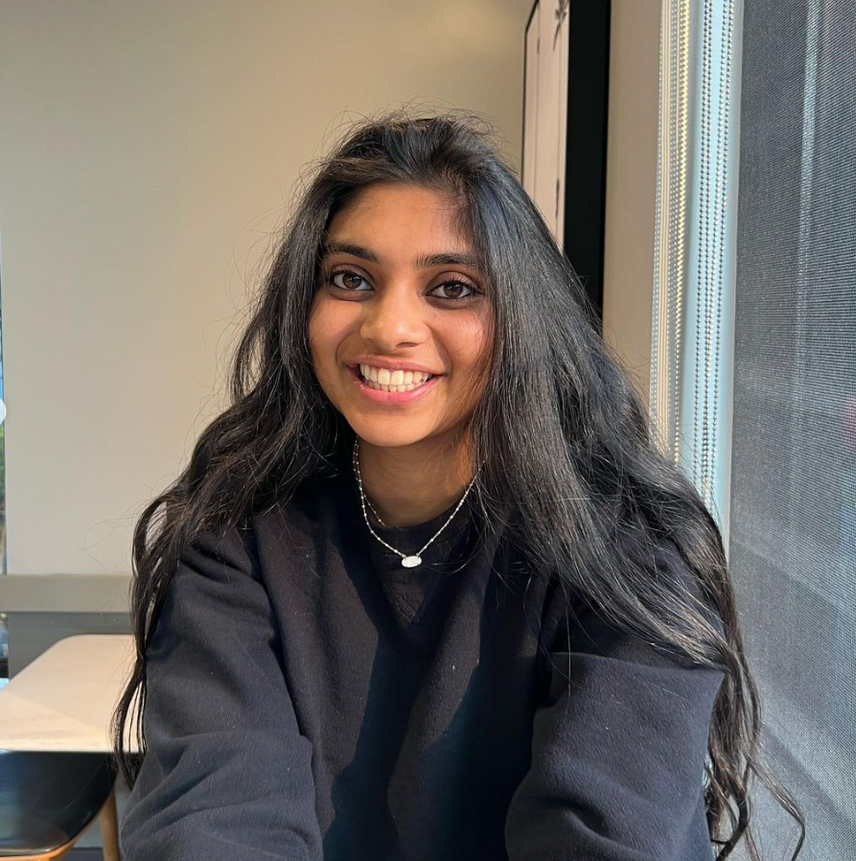
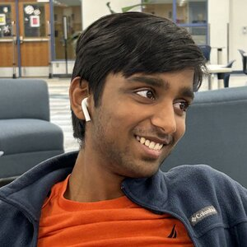
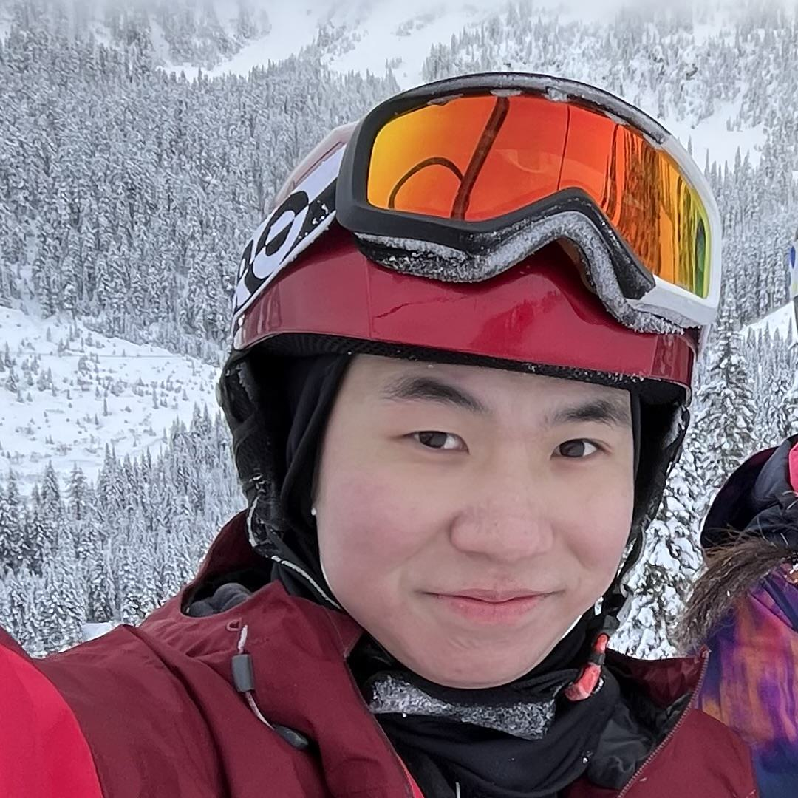
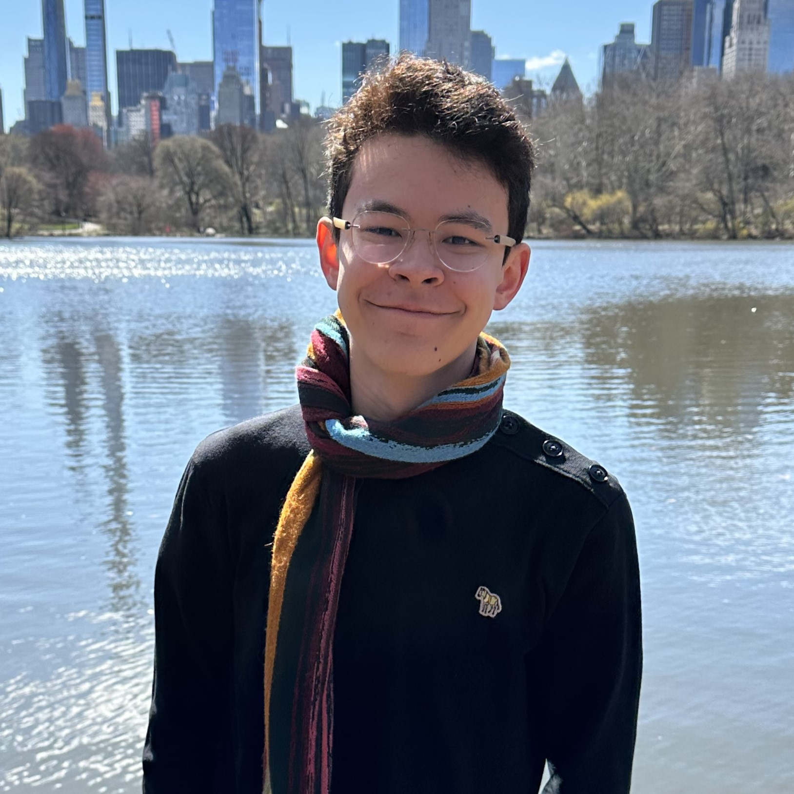
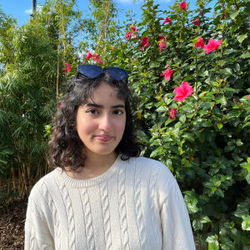
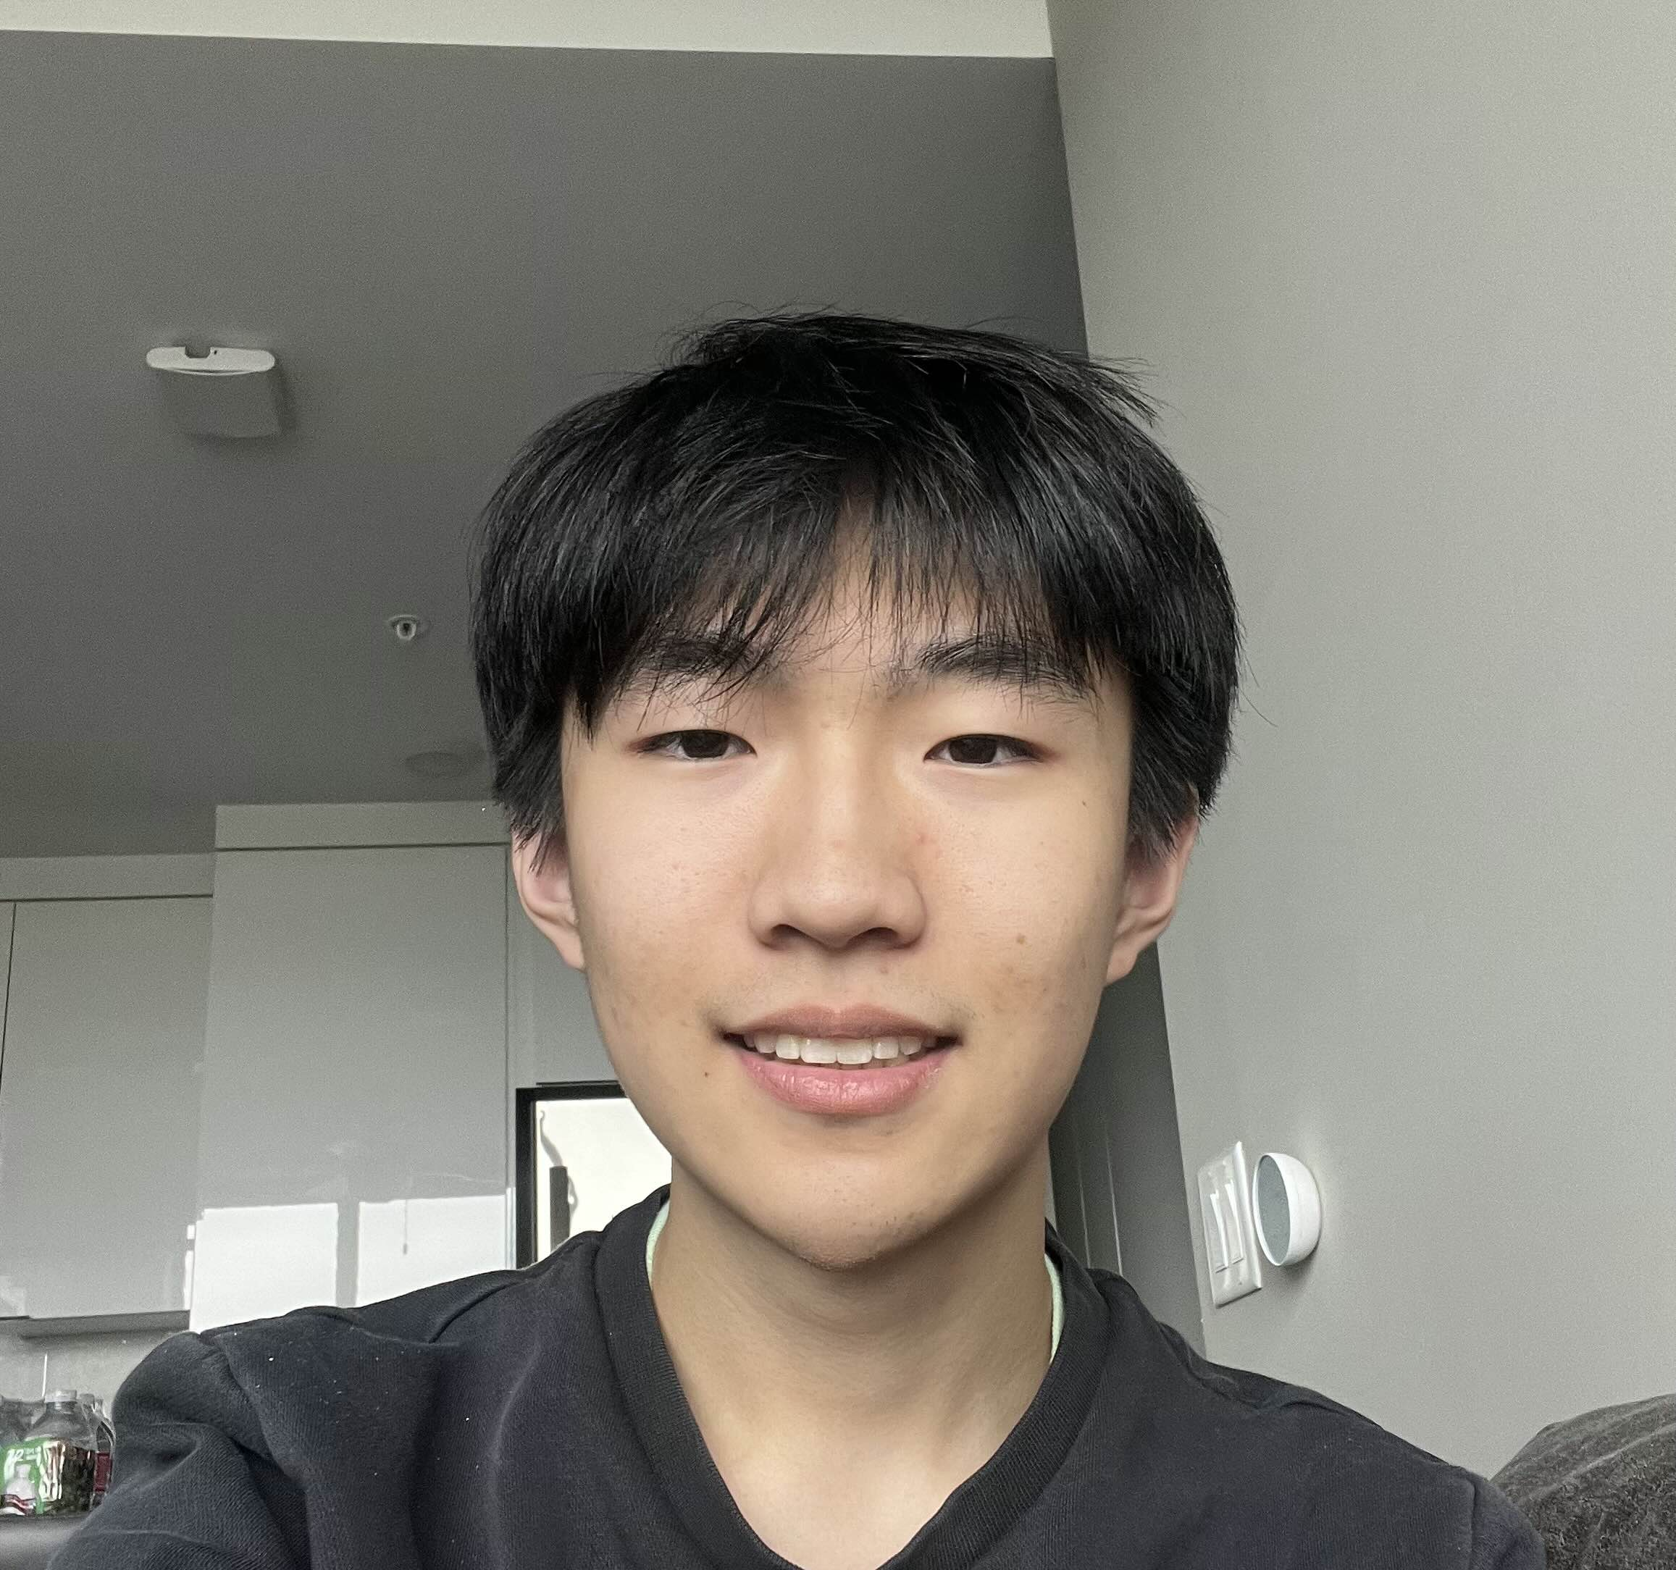
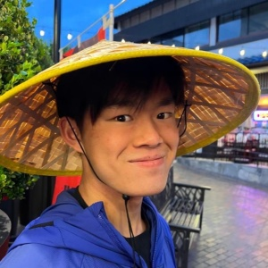
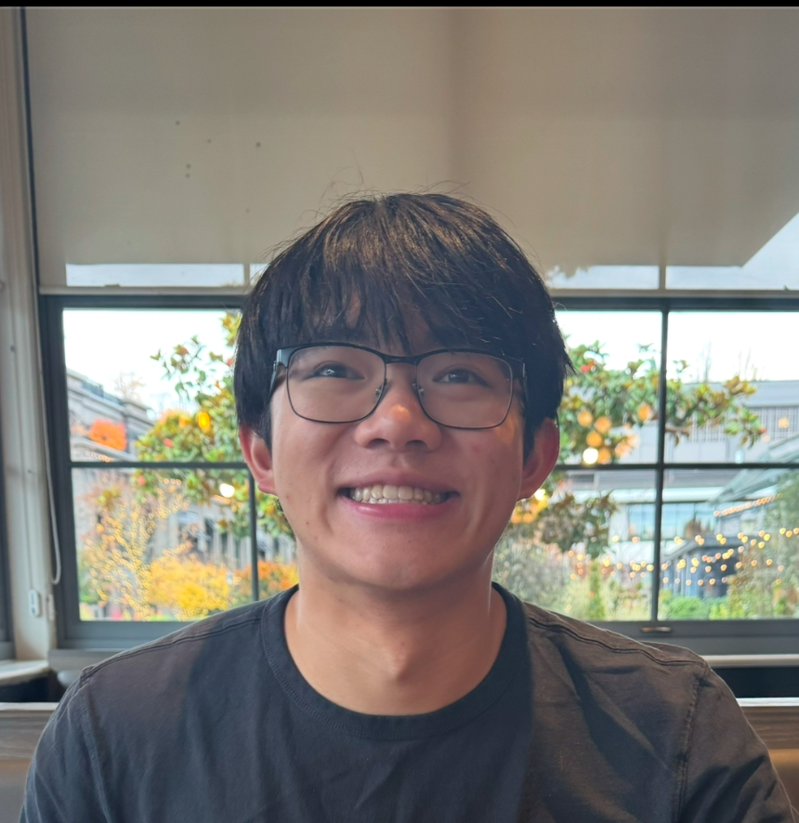
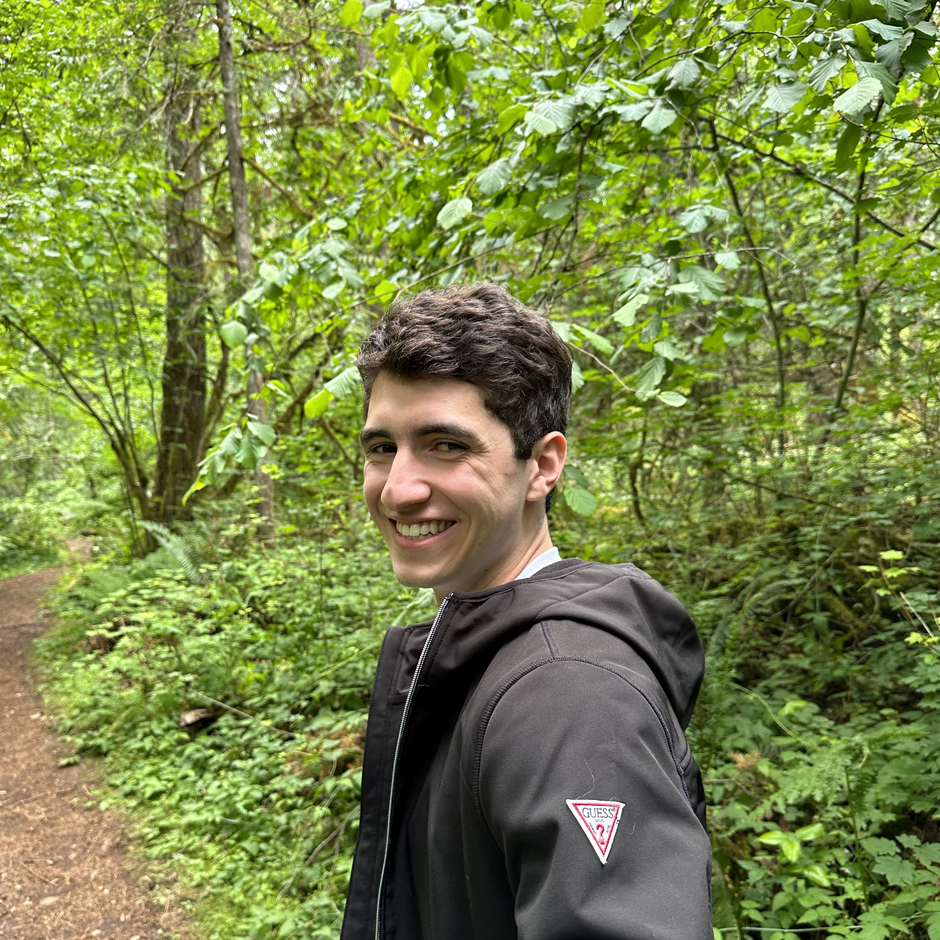
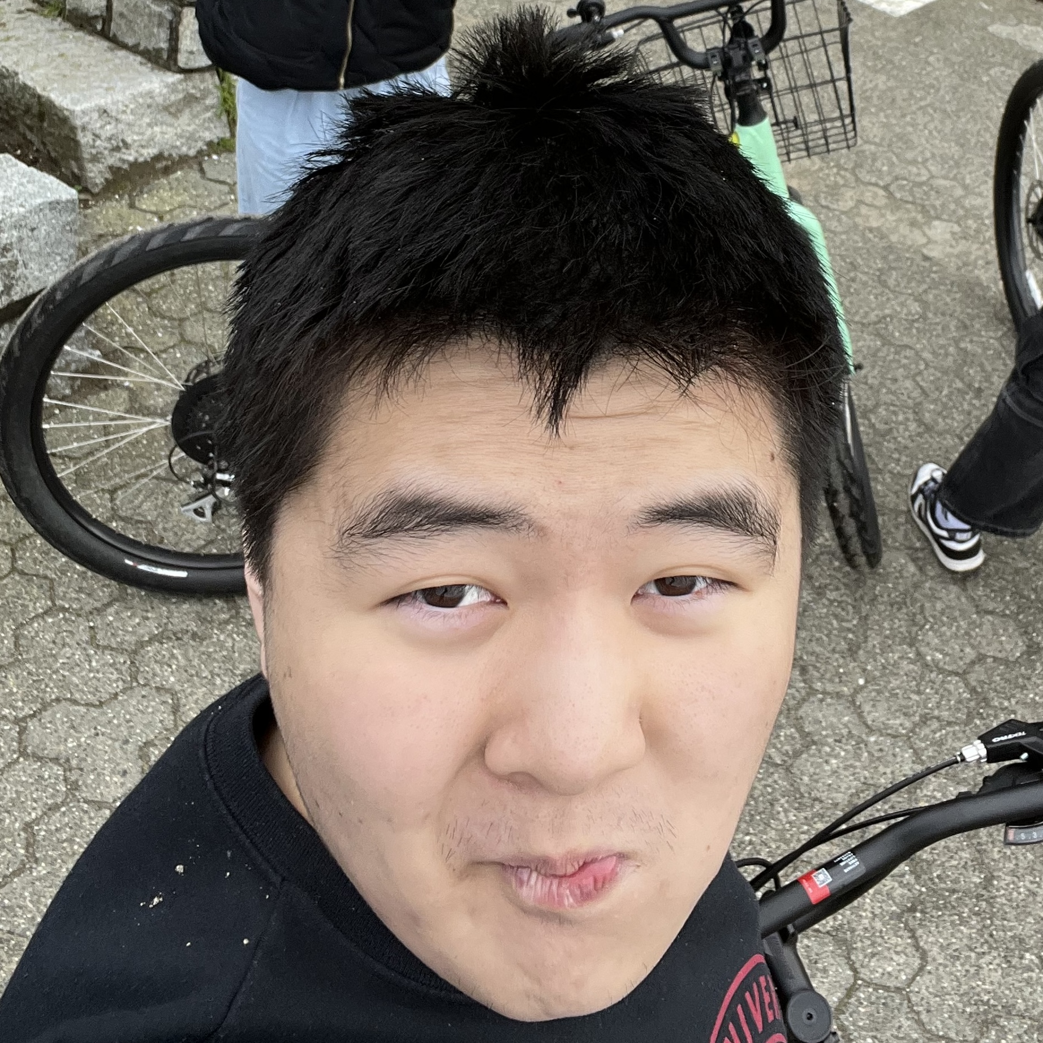
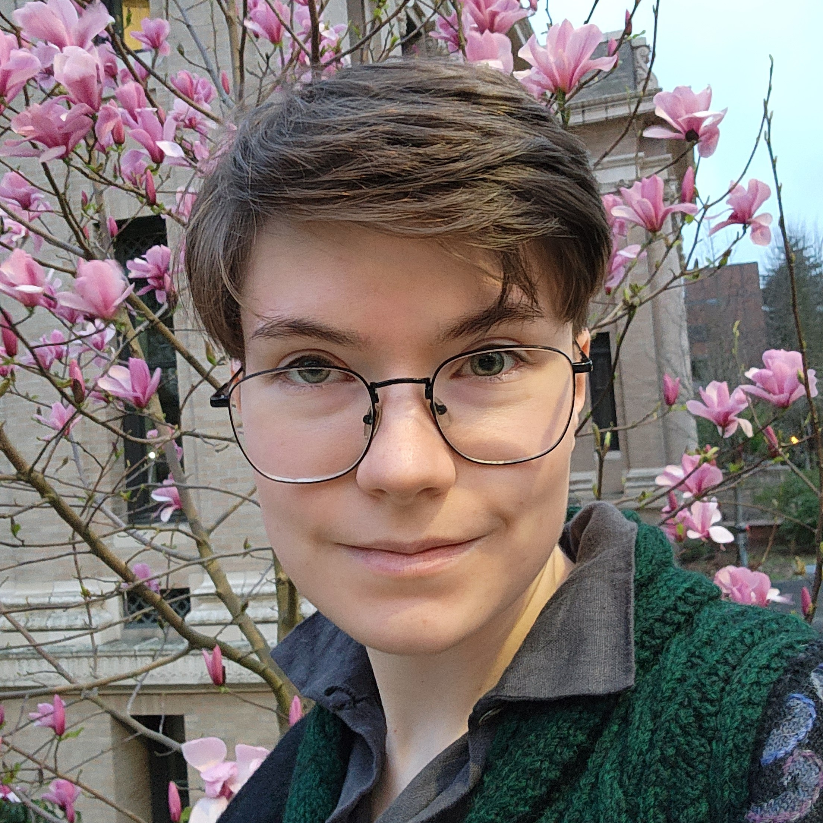
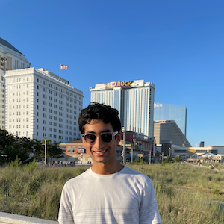
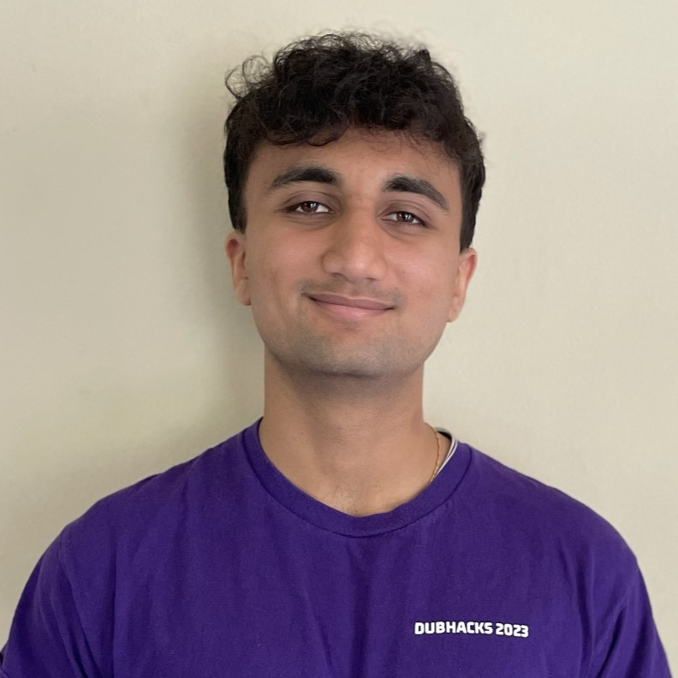
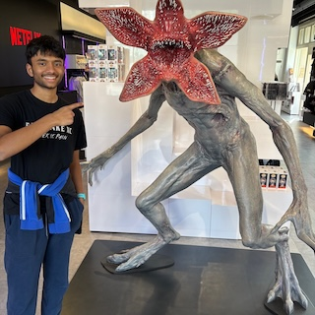
Thank your TAs!

Slide 11
Thank You!
Thank you for participating, asking questions, engaging with course materials & resources!
And thank you for the feedback if you filled out the course evaluation :)
Thank your amazing TAs!
Any final questions before we wrap?

