Slide 1
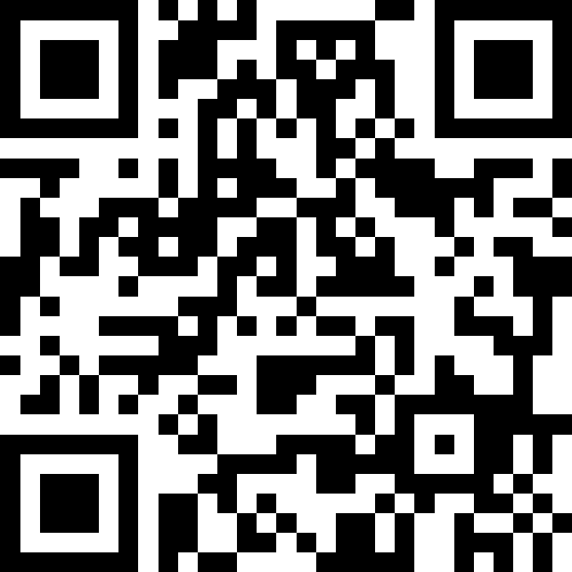
Machine Learning
BEFORE WE START
Talk to your neighbors:
What is your favorite spot on the Ave?
Instructors:
Nathan Brunelle
Arohan | Ashar | Neha | Rohini | Rushil
Ido | Zachary | Sebastian | Joshua | Sean
Hayden | Caleb | Justin | Heon | Rashad
Srihari | Benoit | Derek | Chris | Bhaumik
Kuhu | Kavya | Cynthia | Shreya | Ashley
Ziao | Kieran | Marcus | Crystal | Eeshani
Prakshi | Packard | Cora | Dixon | Nichole
Niyati | Trien | Lawrence | Evan | Cady
TAs:

Slide 2
Announcements
Programming Assignment 3 out, due next Friday! (5/30)
Resubmission 5 closes tonight
Quiz 2 next Tuesday (5/27)
Memorial Day is 5/26
  IPL closed

Slide 3
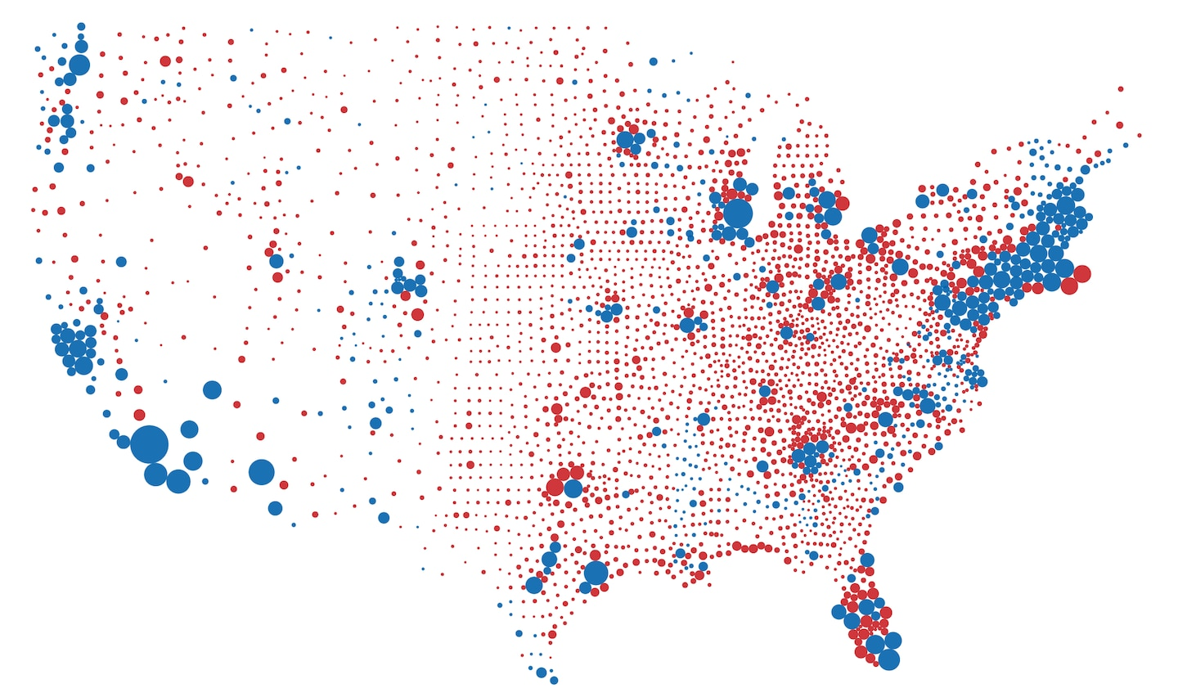

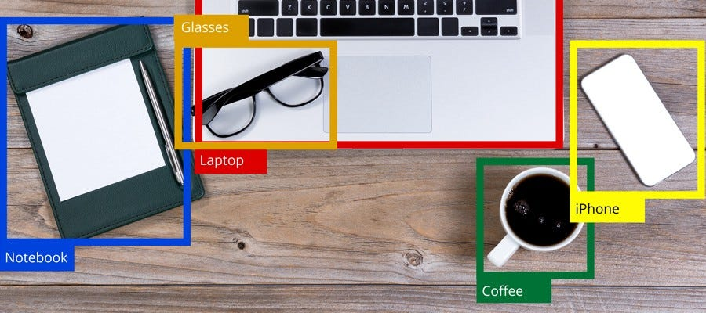


Applications of ML
Opinion Polls
  How does a population feel about an issue?
Content Recommendation
  Can we predict how much someone will like a movie based on past ratings?
Object Recognition
  Identify {Car, Road, Plane, Bird, Person} within an image?
Text Generation
  Can computers generate text written like a human?
Image Generation
  Can computers generate images from a prompt
Estimation
Prediction
Generation

Slide 4
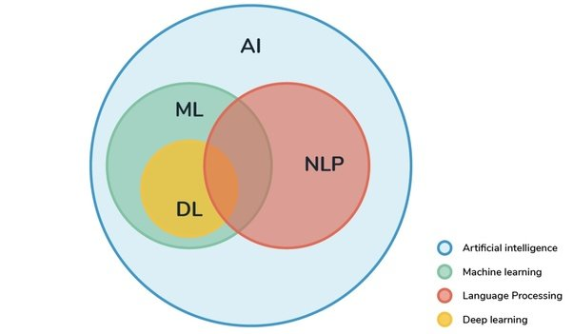
What is Machine Learning (ML)?
Subset of Computer Science concerned with “learning” data trends
  (Today’s lecture will not be tested on quizzes/exams.)
MATH!!!

Slide 5
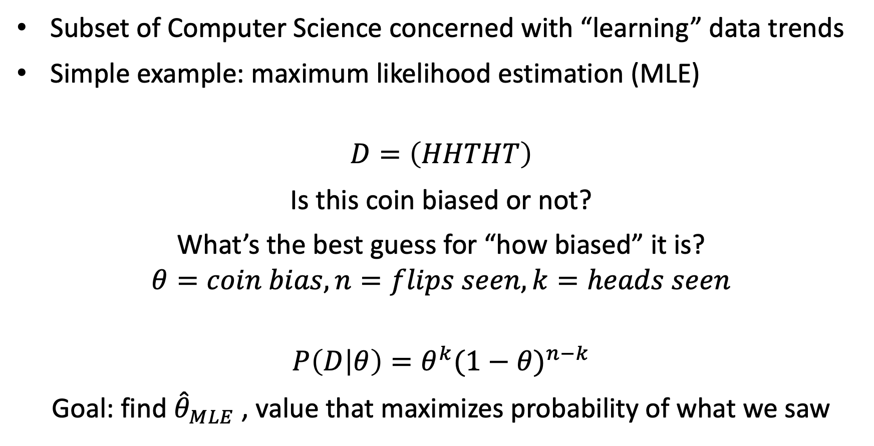
What is Machine Learning (ML)?
Subset of Computer Science concerned with “learning” data trends
Simple example: maximum likelihood estimation (MLE)
$$D=\left(HHTHT\right)$$
Is this coin biased or not?
What’s the best guess for “how biased” it is?
$$θ=coin bias, n=flips seen, k=heads seen$$
$$P\left(D | θ\right)=θ^{k}{(1−θ)}^{n−k}$$
Goal: find ${\hat{θ}}_{MLE}$ , value that maximizes probability of what we saw

Slide 6

Maximum Likelihood Estimation
$$P\left(D | θ\right)=θ^{k}{(1−θ)}^{n−k}$$
$${\hat{θ}}_{MLE}={argmax}_{θ} P(D|θ)$$
$$\frac{∂}{∂θ}\left(θ^{k}{(1−θ)}^{n−k}\right)=0$$
$$kθ^{k−1}{(1−θ)}^{n−k} − \left(n−k\right)θ^{k}{\left(1−θ\right)}^{n−k−1}=0$$

Slide 7

Maximum Likelihood Estimation
$$kθ^{k−1}{(1−θ)}^{n−k}= \left(n−k\right)θ^{k}{\left(1−θ\right)}^{n−k−1}$$
$$k(1−θ)= \left(n−k\right)θ$$
$$k=nθ$$
$${\hat{θ}}_{MLE}=k/n$$
Takeaway: There are formal, mathematical ways to verify intuition!
+ We can perform this process with more complicated distributions!

Slide 8
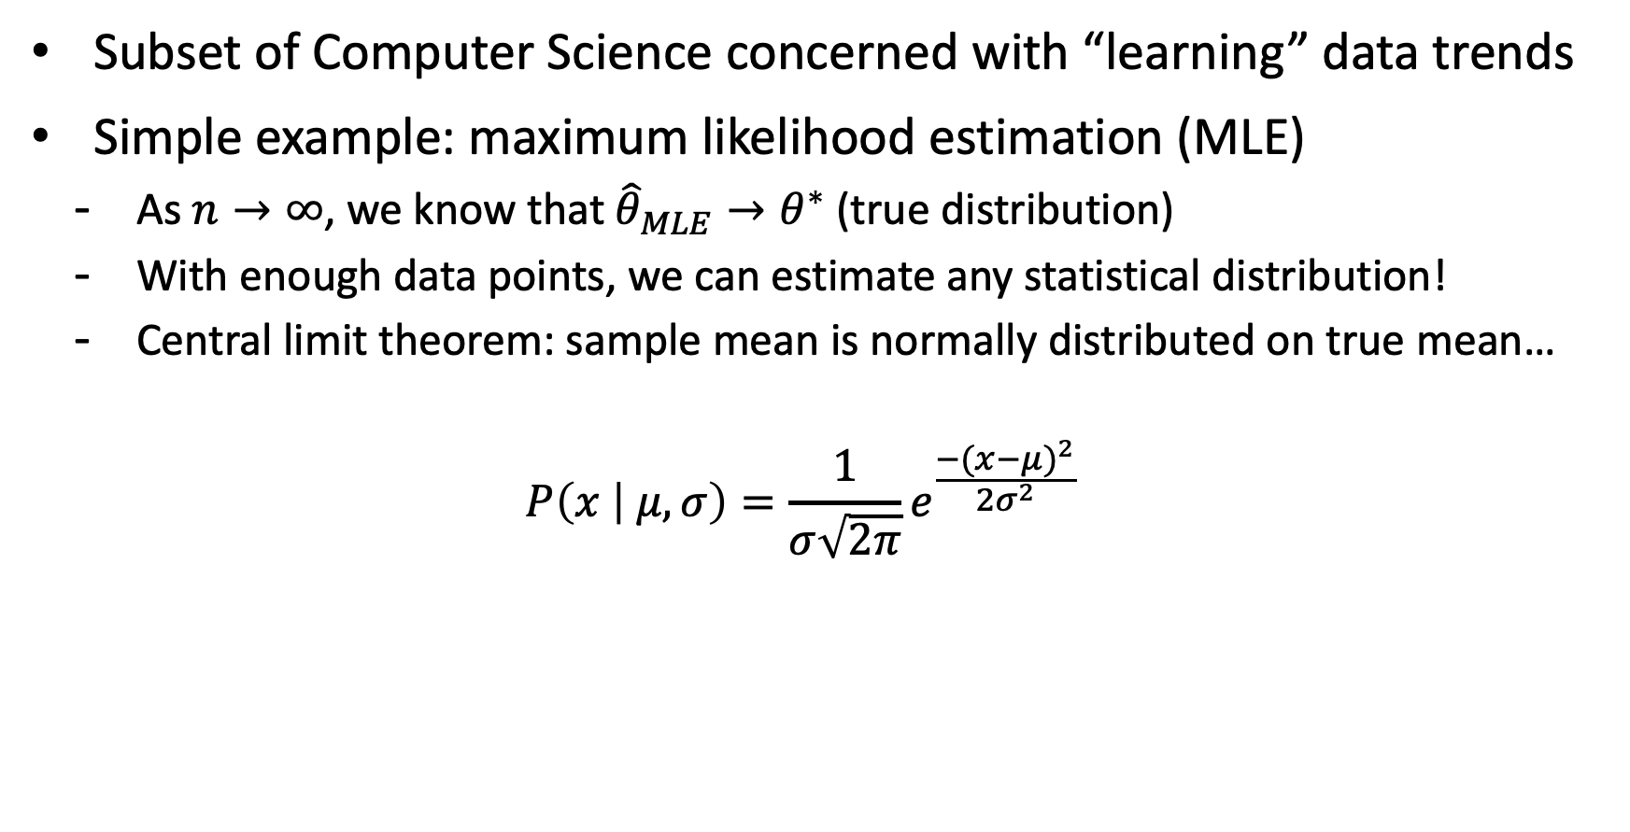
What is Machine Learning (ML)?
Subset of Computer Science concerned with “learning” data trends
Simple example: maximum likelihood estimation (MLE)
  As $n→∞$, we know that ${\hat{θ}}_{MLE}→θ^{∗}$ (true distribution)
  With enough data points, we can estimate any statistical distribution!
  Central limit theorem: sample mean is normally distributed on true mean…
  $$P\left(x | μ,σ\right)=\frac{1}{σ\sqrt{2π}}e^{\frac{{−(x−μ)}^{2}}{2σ^{2}}}$$

Slide 9
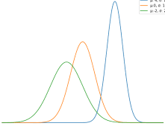
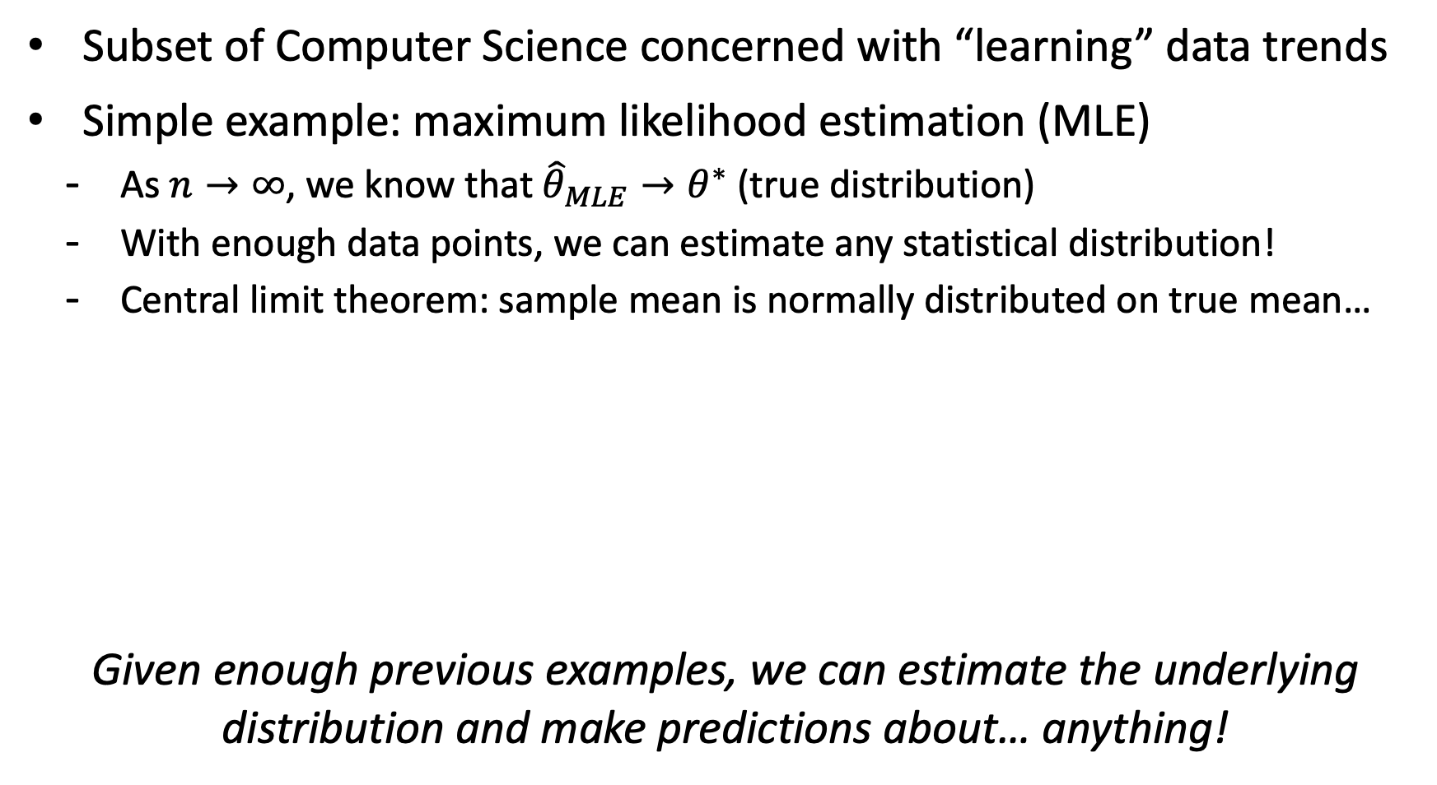
What is Machine Learning (ML)?
Subset of Computer Science concerned with “learning” data trends
Simple example: maximum likelihood estimation (MLE)
  As $n→∞$, we know that ${\hat{θ}}_{MLE}→θ^{∗}$ (true distribution)
  With enough data points, we can estimate any statistical distribution!
  Central limit theorem: sample mean is normally distributed on true mean…
Given enough previous examples, we can estimate the underlying distribution and make predictions about… anything!

Slide 10





ML Pipeline
Generally, building an ML model involves the following steps:
Notice that you can step backwards!
  ML in particular is an applied science, it’s all an experiment!
Data Collection / Sanitization
Featurization
Model Training / Tuning
Evaluation
Deployment

Slide 11

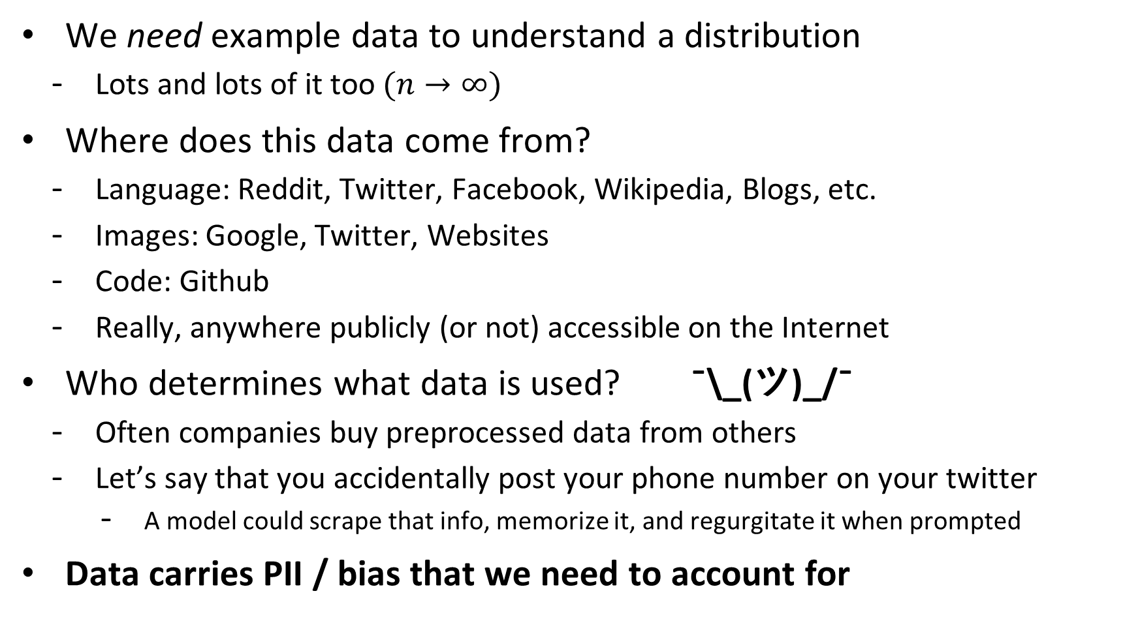
1. Data Collection
We need example data to understand a distribution
  Lots and lots of it too $(n→∞)$
Where does this data come from?
  Language: Reddit, Twitter, Facebook, Wikipedia, Blogs, etc.
  Images: Google, Twitter, Websites
  Code: Github
  Really, anywhere publicly (or not) accessible on the Internet
Who determines what data is used? ¯\_(ツ)_/¯
  Often companies buy preprocessed data from others
  Let’s say that you accidentally post your phone number on your twitter
    A model could scrape that info, memorize it, and regurgitate it when prompted
Data carries PII / bias that we need to account for

Slide 12
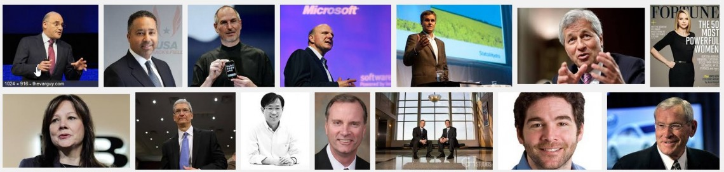
Data Bias
Image results for searching the term “CEO” on Google (2015)
  Notice anything about the results?
https://www.washington.edu/news/2015/04/09/whos-a-ceo-google-image-results-can-shift-gender-biases/

Slide 13
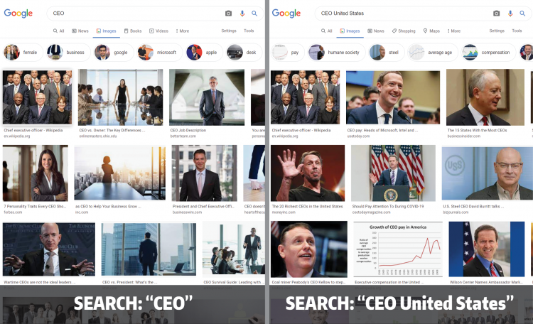
Data Bias
Fix: Image results for searching “CEO” and “CEO United States” (2022)
https://www.washington.edu/news/2022/02/16/googles-ceo-image-search-gender-bias-hasnt-really-been-fixed

Slide 14
Data Sanitization
Data carries PII / bias that we need to account for
We don’t want our model to memorize a phone number
  Let’s just remove all phone numbers from our inputs!
  Is this an effective solution?
Sanitization can be ethically gray – does it disproportionately affect subpopulations?
  Correlated features
Our models are only as strong as the data they’re built upon.
Garbage in, garbage out.

Slide 15
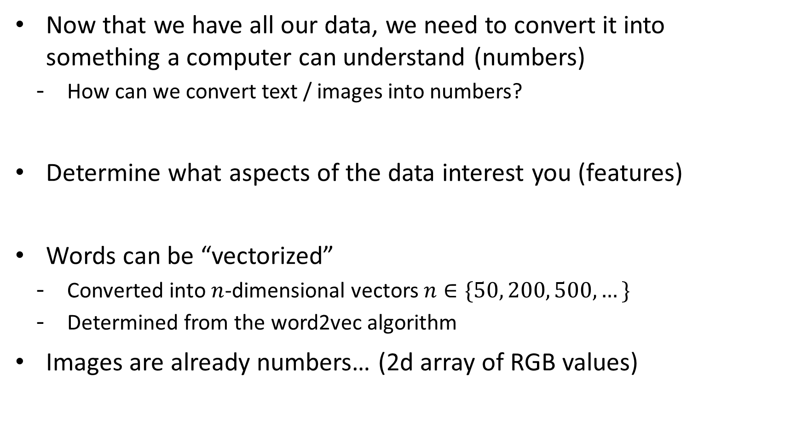
2. Featurization
Now that we have all our data, we need to convert it into
something a computer can understand (numbers)
  How can we convert text / images into numbers?
Determine what aspects of the data interest you (features)
Words can be “vectorized”
  Converted into $n$-dimensional vectors $n∈\{50, 200, 500,…\}$
  Determined from the word2vec algorithm
Images are already numbers… (2d array of RGB values)

Slide 16
Word Embeddings
We call these word vectors “embeddings” and they’re pretty interesting to mess around with
Can perform mathematical operations on them
  Find the nearest vectors to any given word (synonyms)
  Compute comparisons (dog is to puppy as cat is to ___)
    Take the difference between puppy and dog (age vector) and add it to cat
    Find the nearest vectors to the result and you’ll likely see “kitten”
These operations can further reveal bias
  man is to doctor as woman is to ______
  Any model trained from biased data points will estimate a biased distribution

Slide 17
3. Model Training
Pick some way of using data to estimate
Lots of different flavors of this
  Regression (linear, logistic)
  Neural Networks (CNNs, RNNs, Transformer, etc.)
  Nearest neighbors
  Decision trees
Provide additional computation (memory / GPUs / time) until desired result is achieved
It’s all one big experiment – try options until something sticks.
This should feel somewhat concerning…

Slide 18
4. Evaluation
Does your model actually work?
Typically we split our initial dataset into 3 different subsets:
  Train (provided to the model during training)
  Validation (used after a model has trained to compare to previous iterations)
  Test (used once a model has been chosen to see how it performs)
Determine whether or not your model is over / underfitting
Most ML applications go no further than this step
  No attempt to determine why a particular model is working well

Slide 19
5. Deployment
Put your model out into the real world and see what happens
  Does it perform the job as expected? Should further work be put into development?
At this point, often the next iteration of refinement takes place
  GPT 2.0 -> 3.0 -> 3.5 -> 4.0
  Options include:
    Collect more data, use more compute, discover better tuning, discover better model
Often, not much effort is put into understanding negative impacts
  Case in point: ChatGPT and the education system

Slide 20
ML Pipeline
That’s it – in essence, that’s how every ML model is created
Does this knowledge change your perspective on ML / AI?
Data Collection / Sanitization
Featurization
Model Training / Tuning
Evaluation
Deployment

Slide 21
SpamClassifier
Programming assignment will involve part 3 of this pipeline
  You’ll implement a decision tree capable of detecting spam emails (or other text classification)
Data Collection / Sanitization
Featurization
Model Training / Tuning
Evaluation
Deployment

Slide 22
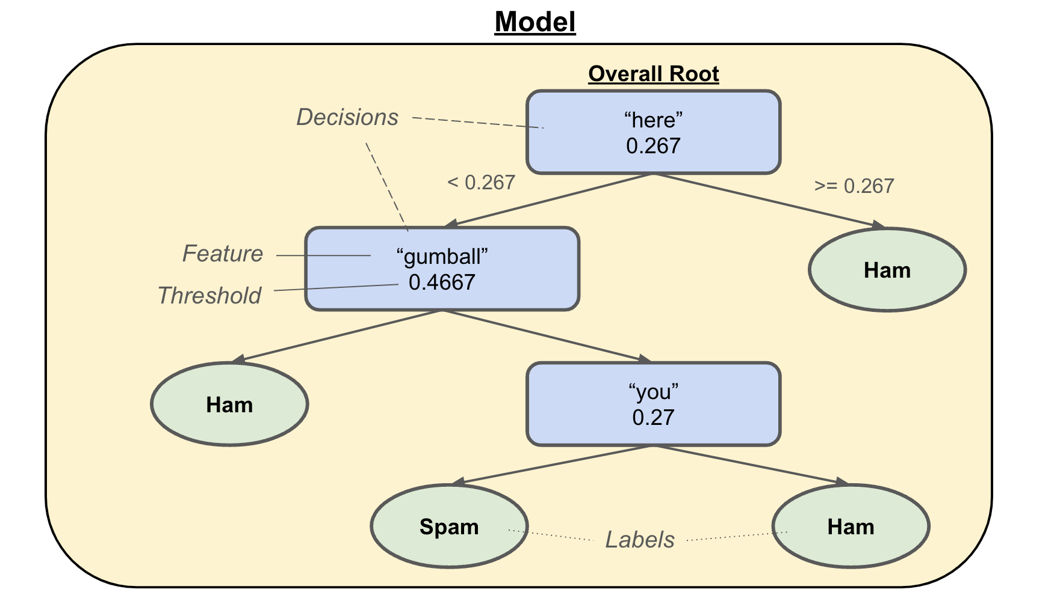
Decision Trees
Tree structure where each intermediary node contains a feature / threshold pair (decision) and leaf nodes are labels

Slide 23
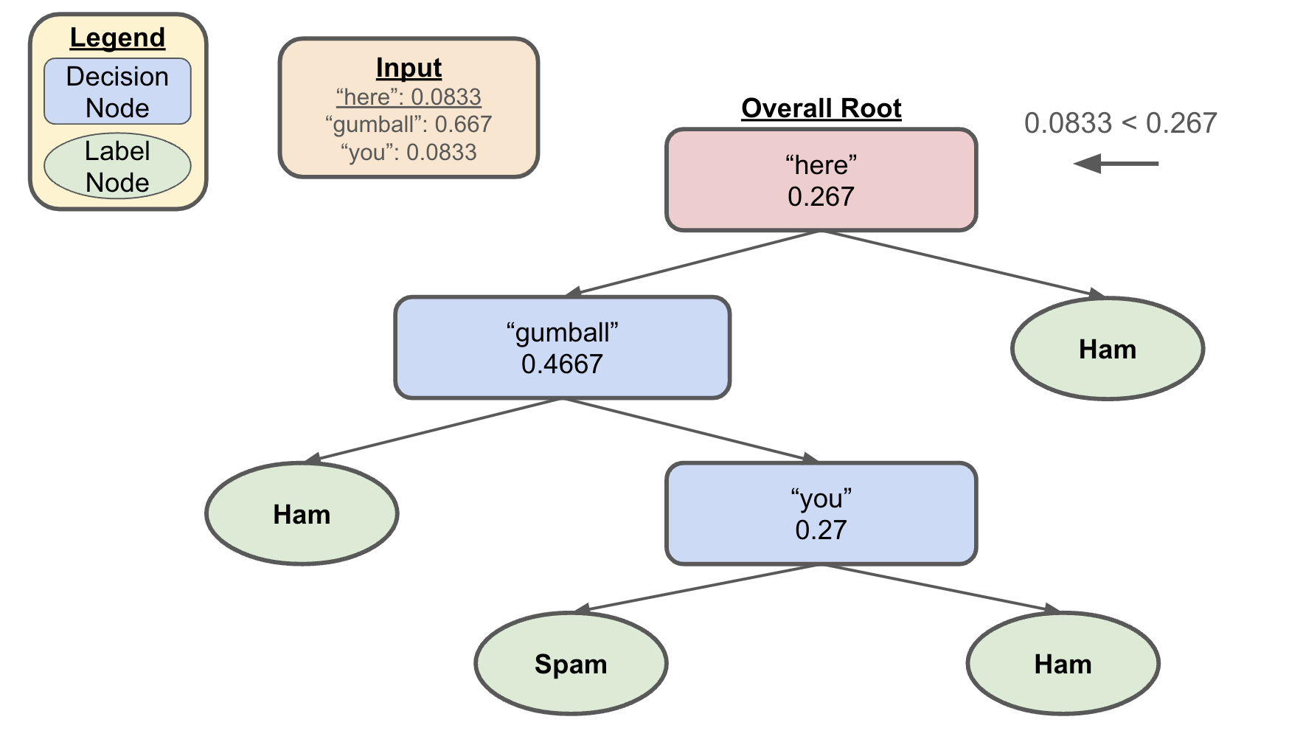
Decision Trees
Let’s say we wanted to classify the following
  here gumball gumball gumball gumball you silly gumball gumball gumball gumball doggo

Slide 24
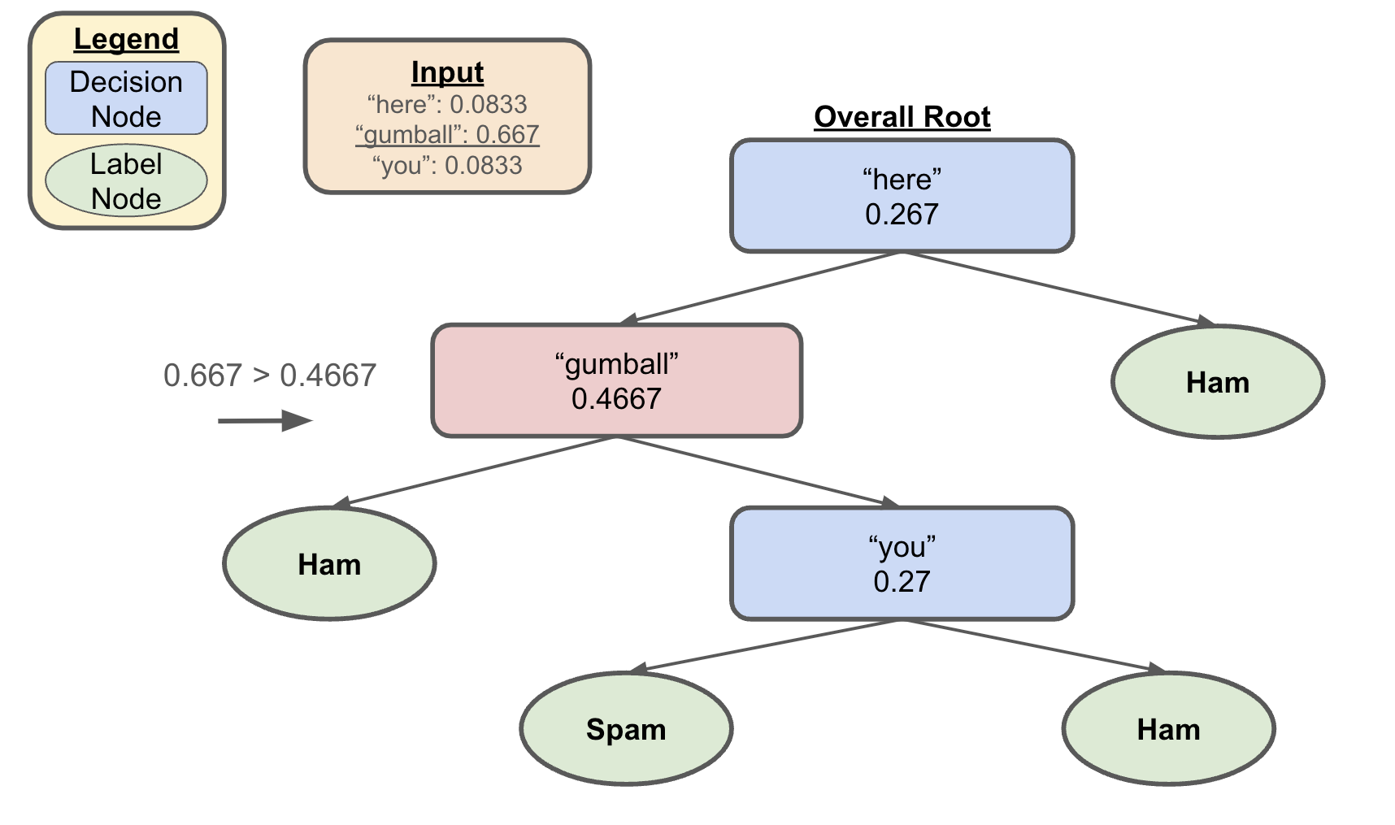
Decision Trees
Let’s say we wanted to classify the following
  here gumball gumball gumball gumball you silly gumball gumball gumball gumball doggo

Slide 25
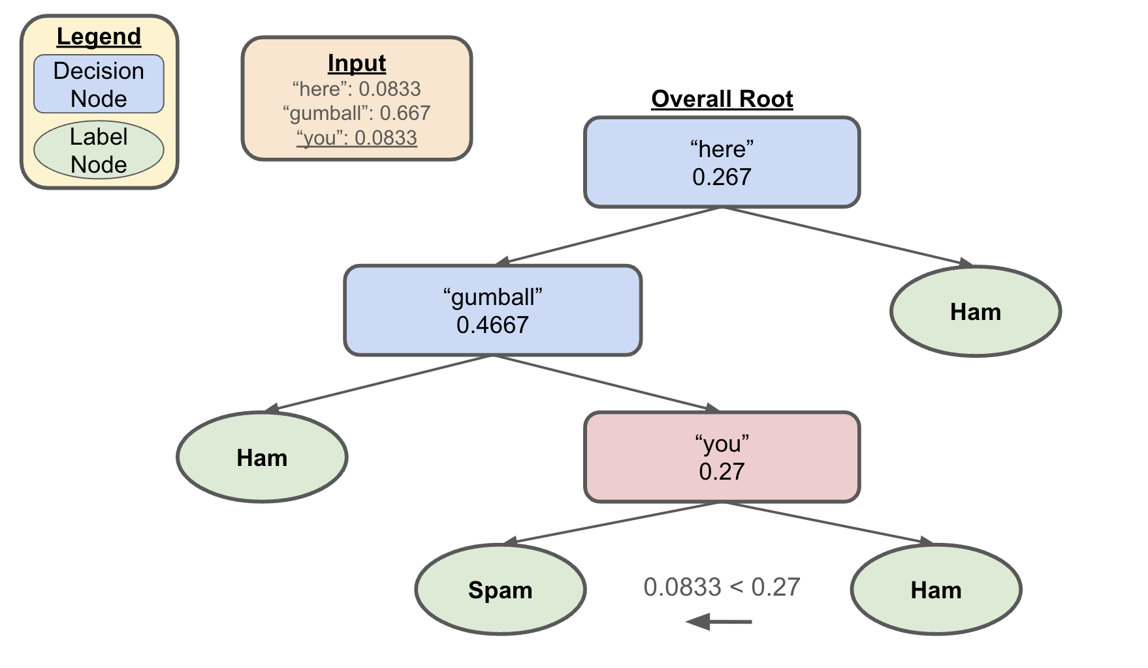
Decision Trees
Let’s say we wanted to classify the following
  here gumball gumball gumball gumball you silly gumball gumball gumball gumball doggo

Slide 26
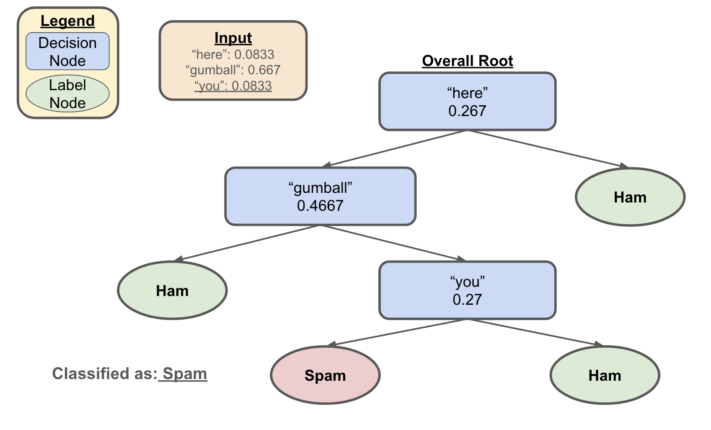
Decision Trees
Let’s say we wanted to classify the following
  here gumball gumball gumball gumball you silly gumball gumball gumball gumball doggo

Slide 27
Questions to Consider
Are ML models capable of “learning”?
  i.e. is it possible to “learn” just by observing / memorizing?
  Does ChatGPT actually “understand” language?
If all output from ML models is based on previous examples, who gets credit / takes responsibility for generation?
  Think AI art and your C2 / P2 reflection responses
What harm could come from deploying ML models we don’t fully understand?
If society itself is biased, how much should we worry about the bias present in data / ML models?
  To what extent should concern about bias hinder further advancements?

