Slide 1
Inheritance; Polymorphism; Comparable
BEFORE WE START
Talk to your neighbors:
Plans for the weekend?
Instructors:
Nathan Brunelle
Arohan | Ashar | Neha | Rohini | Rushil
Ido | Zachary | Sebastian | Joshua | Sean
Hayden | Caleb | Justin | Heon | Rashad
Srihari | Benoit | Derek | Chris | Bhaumik
Kuhu | Kavya | Cynthia | Shreya | Ashley
Harshitha | Kieran | Marcus | Crystal | Eeshani
Prakshi | Packard | Cora | Dixon | Nichole
Niyati | Trien | Lawrence | Evan | Cady
Ziao
TAs:

Slide 2
Grading
Grades should reflect your proficiency in the course objectives
All assignments will be graded E (Excellent), S (Satisfactory), or N (Not yet)
Under certain circumstances, a grade of U (Unassessable) may be assigned
Final grades will be assigned based on the amount of work at each level
See the syllabus for more details

Slide 3
Collaboration Policy
When we assess your work in this class, we need to know that it’s yours.
Unless otherwise specified, all graded work must be completed individually.
Some specific rules to highlight:
do not share your own solution code or view solution code from any source – including but not limited to other students, tutors, or the internet
do not use AI tools (e.g. ChatGPT) on graded work in any capacity
See the syllabus for more details (this is very important to understand).

Slide 4
Coming up…
❓ Complete the Introductory Survey
This helps us gather data about the students taking our classes and their backgrounds, to inform future offerings.
🙋 Review Section0.5 in Ed
Includes material covered in cse121 and 122 to help review and jog your memory!
💻 The IPL opens Monday, April 7
Schedule posted soon
🔎 Creative Project 0: Search Engine out now
Due Wednesday, April 4, 11:59pm

Slide 5
Collaboration Policy
When we assess your work in this class, we need to know that it’s yours.
Unless otherwise specified, all graded work must be completed individually.
Some specific rules to highlight:
do not share your own solution code or view solution code from any source – including but not limited to other students, tutors, or the internet
do not use AI tools (e.g. ChatGPT) on graded work in any capacity
See the syllabus for more details (this is very important to understand).

Slide 6
Lecture Outline
Inheritance
Comparable
Polymorphism
Declared vs. Actual Type
Compiler vs. Runtime Errors

Slide 7
Inheritance
Connect together a “subclass” and “superclass”
Borrow / “inherit” code to reduce redundancy
super() keyword can be used just like this()
Syntax: public class Subclass extends Superclass
Should Represent “is-a” relationships
public class Chef extends Employee
public class Server extends Employee
In Java, all objects implicitly inherit from the Object class
toString(), equals(Object), etc.

Slide 8
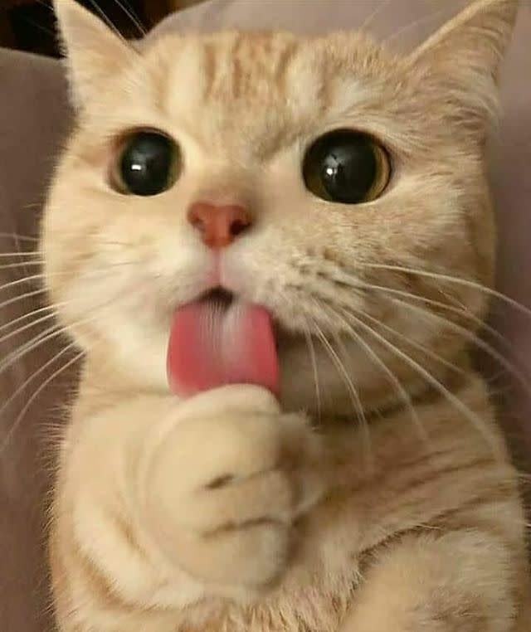
Is-a Relationships
Animal
Fish
Birds
Mammal
Reptile
Amphibian
Dog
Cat

Slide 9
PCM Review
sli.do #cse123A

Slide 10
Lecture Outline
Inheritance
Comparable
Polymorphism
Declared vs. Actual Type
Compiler vs. Runtime Errors

Slide 11
Comparable
Comparable<E> is an interface that allows implementers to define an ordering between two objects
Used by TreeSet, TreeMap, Collections.sort, etc.
One required method:
public int compareTo (E other);
Returned integer falls into 1 of 3 categories
< 0: this is “less than” other
= 0: this is “equal to” other
> 0: this is “greater than” other
a.compareTo(b);
this
other

Slide 12
Subtraction Trick
compareTo implementation when comparing two integers (a) ascending:
This is just subtraction!
What if we wanted to sort descending?
Warning: this only works for integers! Doubles have issues with truncation.
if (this.a < other.a) -> negative number
else if (this.a > other.a) -> positive number
else -> 0
this.a – other.a
other.a – this.a

Slide 13
Lecture Outline
Inheritance
Comparable
Polymorphism
Declared vs. Actual Type
Compiler vs. Runtime Errors

Slide 14
Polymorphism
DeclaredType x = new ActualType()
All methods in DeclaredType can be called on x
We’ve seen this with interfaces (List<String> vs. ArrayList<String>)
Can also be to inheritance relationships
Animal[] arr = {new Dog(), new Cat(), new Bear()};
for (Animal a : arr) {
a.feed();
}

Slide 15
Compiler vs. Runtime Errors
DeclaredType x = new ActualType()
At compile time, Java only knows DeclaredType
Compiler error: trying to call a method that isn’t present
Animal a = new Dog();
a.bark(); // No bark() -> CE
Can cast to change the DeclaredType of an object
((Dog) a).bark(); // No more CE
Runtime error: attempting to cast to an invalid DeclaredType*
Animal a = new Fish();
((Dog) a).bark(); // Can’t cast -> RE
- Order matters! Compilation before runtime

Slide 16
Declared Type and Actual Type
DeclaredType varName = new ActualType(…);
Animal bucky = new Dog("Bucky");
Dog bucky = new Dog("Bucky");
Declared Type: Animal
Actual Type: Dog
Can call methods that makes sense for EVERY Animal
If Dog overrides a method, uses the Dog version
Declared Type: Dog
Actual Type: Dog
Can call methods that makes sense for EVERY Dog
If Dog overrides a method, uses the Dog version

Slide 17
Inheritance and Method Calls
Animal bucky = new Dog();
bucky.bark();
When compiling:
Can we guarantee that the method exists for the declared type?
Does the declared type or one of its super classes contain a method of that name?
If not… Compile Error!
Object
Compiling:
Look this way for bark
extends
“is a”
Animal
Declared Type
extends
“is a”
extends
“is a”
In this example:
When compiling, neither Animal nor Object have a bark method, so we have a compile error!
Dog
Fish

Slide 18
Overrides and Method Calls
Animal bucky = new Dog();
bucky.feed();
When running:
Use the most specific version of the method call starting from the actual type.
Start from the actual type, then go “up” to super classes until you find the method. Run that first-discovered version.
Object
extends
“is a”
Running:
Look this way for feed
Use the first implementation found
Animal
extends
“is a”
extends
“is a”
In this example:
If the Dog class overrides feed, then we’ll use the implementation in Dog. Otherwise we’ll use the one in Animal
Actual Type
Dog
Fish

Slide 19
Casting and Method Calls
When compiling:
Can we guarantee that the method exists for the Cast-to type?
Does the Cast-to type or one of its super classes contain a method of that name?
If not… Compile Error!
When Running:
Check that the Cast-to Type is either the Actual Type, or one of its super classes
Animal bucky = new Dog();
((Dog) bucky).bark();
Object
Compiling:
From cast-to type
Look this way
for bark
Running:
From actual type
Look this way
for cast-to type
Animal
Cast-to Type
Dog
Fish
Actual Type
This example has no error

Slide 20
Casting and Method Calls
When compiling:
Can we guarantee that the method exists for the Cast-to type?
Does the Cast-to type or one of its super classes contain a method of that name?
If not… Compile Error!
When Running:
Check that the Cast-to Type is either the Actual Type, or one of its super classes
Animal bucky = new Fish();
((Dog) bucky).bark();
Object
Compiling:
From cast-to type
Look this way
for bark
Running:
From actual type
Look this way
for cast-to type
Animal
Cast-to Type
Dog
Fish
Actual Type
This example has a runtime error

Slide 21
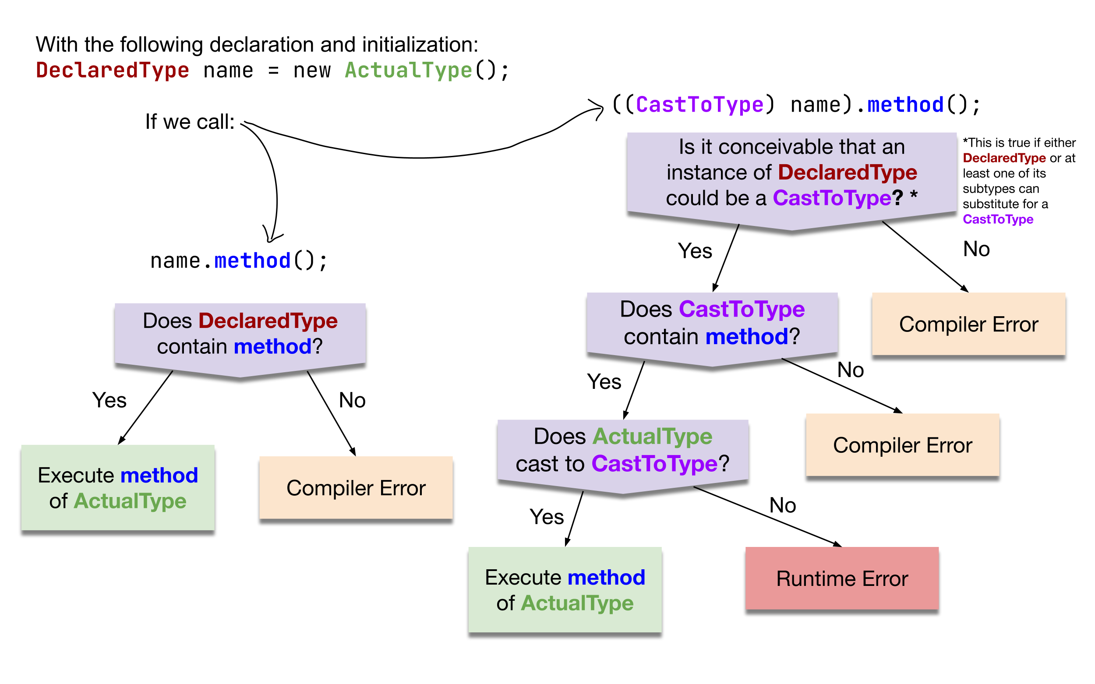
Compiler vs. Runtime Errors

