Slide 1

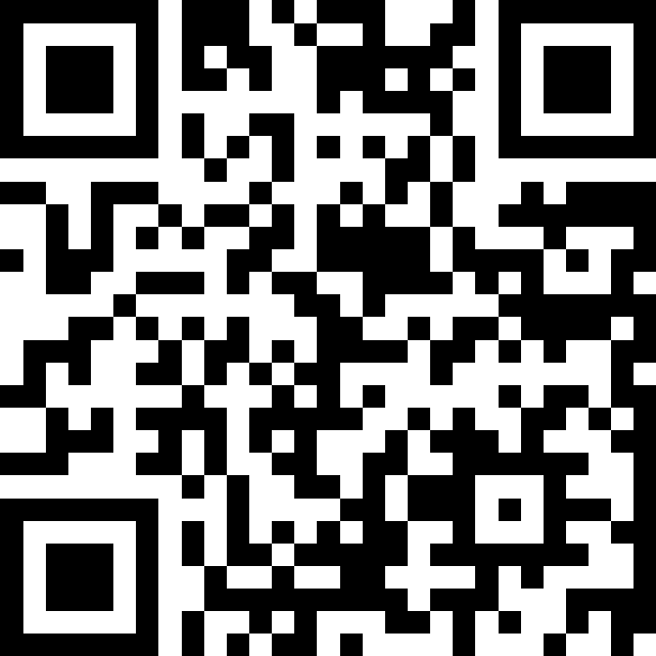
Welcome
& Syllabus
BEFORE WE START
Talk to your neighbors:
Introduce yourself to your neighbor!
What is your name? Major? What have you been up to the past week?
Instructor:
Nathan Brunelle
TAs:
Arohan | Ashar | Neha | Rohini | Rushil
Ido | Zachary | Sebastian | Joshua | Sean
Hayden | Caleb | Justin | Heon | Rashad
Srihari | Benoit | Derek | Chris | Bhaumik
Kuhu | Kavya | Cynthia | Shreya | Ashley
Harshitha | Kieran | Marcus | Crystal | Eeshani
Prakshi | Packard | Cora | Dixon | Nichole
Niyati | Trien | Lawrence | Evan | Cady
Ziao
sli.do #cse123A
Raise hand or ask questions here!

Slide 2
Lecture Outline
Introductions
About this Course
  Course Components & Tools
  Making the Most of this Class
Assignments and Grading

Slide 3
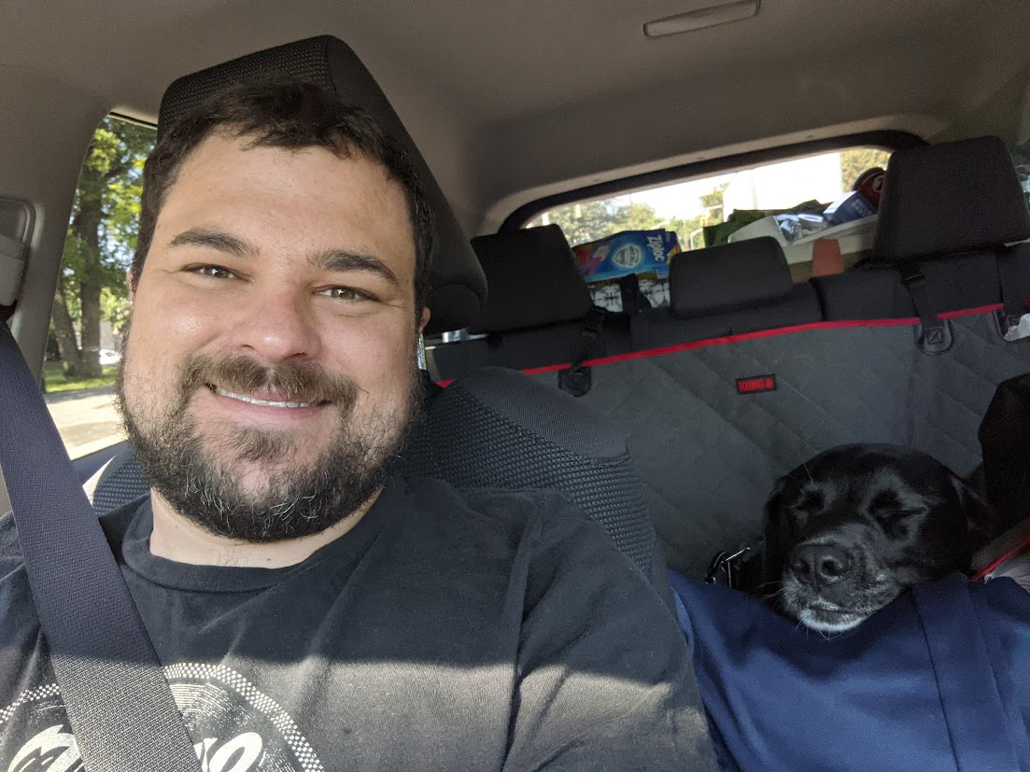
Course Staff
Instructor: Nathan Brunelle
Teaching Assistants: 41 Fantastic TAs!
  Available in section, office hours, and discussion board
  Invaluable source of information & help in this course
We’re excited to get to know you!
  Our goal is to help you succeed ☺

Slide 4
What is this Class?
CSE 121 – Computer Programming I
CSE 122 – Computer Programming II
  Data types (int, String, boolean)
  Methods / Functions
    Parameters, Returns
  Control structures
    Loops, Conditionals
  Arrays & 2D arrays
  Computational Thinking
  (language agnostic)
  Functional Decomposition
  File I/O
  Using data structures
    List, Stacks / Queues, Sets, Maps
  Object Oriented Programming
    Interfaces
CSE 123 – Computer Programming III
  Advanced Object Oriented Programming
    Comparable, Inheritance/Polymorphism, Abstract Classes
  Implementing data structures
    ArrayLists, LinkedLists, Trees
  Recursion
  Critical analysis of design

Slide 5
Why 123?
To solve more complex problems by leveraging more complex programming structures / patterns
To better rationalize specific design decisions
  How to “best” structure programs
  Which data structures are “most” appropriate to use
To understand and critically analyze intersections between Computer Science and society
  Search engines, algorithmic art, machine learning, etc.
  Developing informed opinions on current issues
Be a better programmer
Be a better person

Slide 6
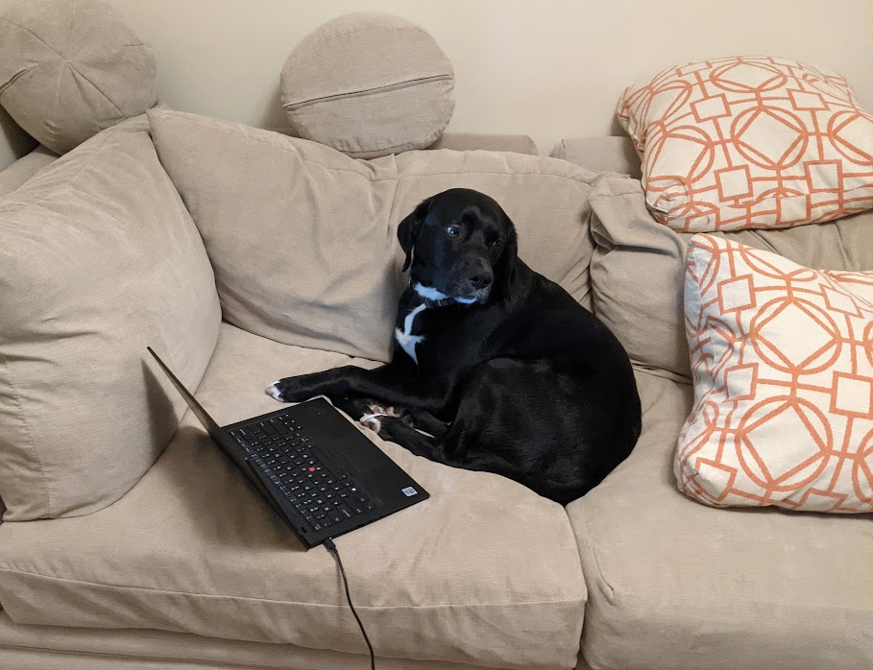
Prerequisite Knowledge
Comfort with control structures
  loops, conditionals, methods/functions
Experience with using basic data structures
  arrays, lists, sets, maps
Experience with console and file input/output
Exposure to simple object-oriented programming
  classes, interfaces
Programming experience in Java
  Or willingness to pick up on your own

Slide 7
What do you want to get out of this course?
sli.do #cse123A

Slide 8
Lecture Outline
Introductions
About this Course
  Course Components & Tools
  Making the Most of this Class
Assignments and Grading

Slide 9
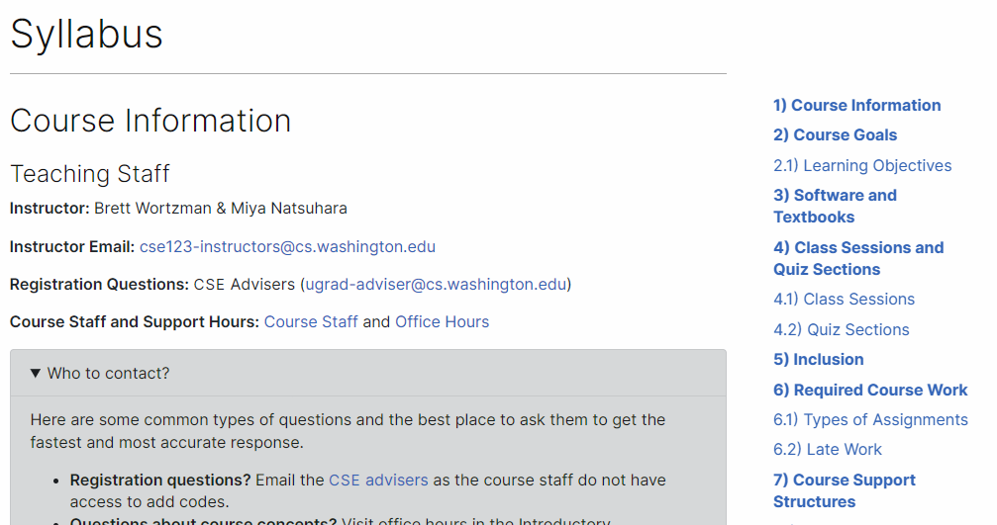
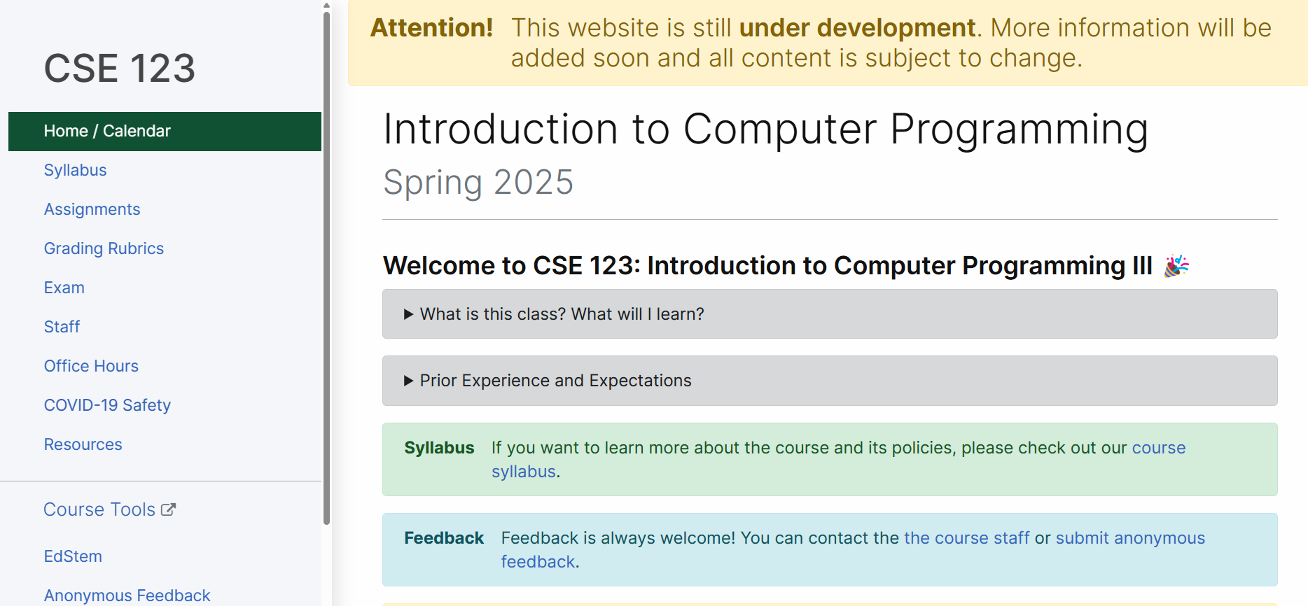
Course Website
cs.uw.edu/123
Review the syllabus!
Contains most course info – check frequently!
Announcements, Calendar, Lecture Slides, Office Hours schedule,
Staff Bios, Important Links

Slide 10
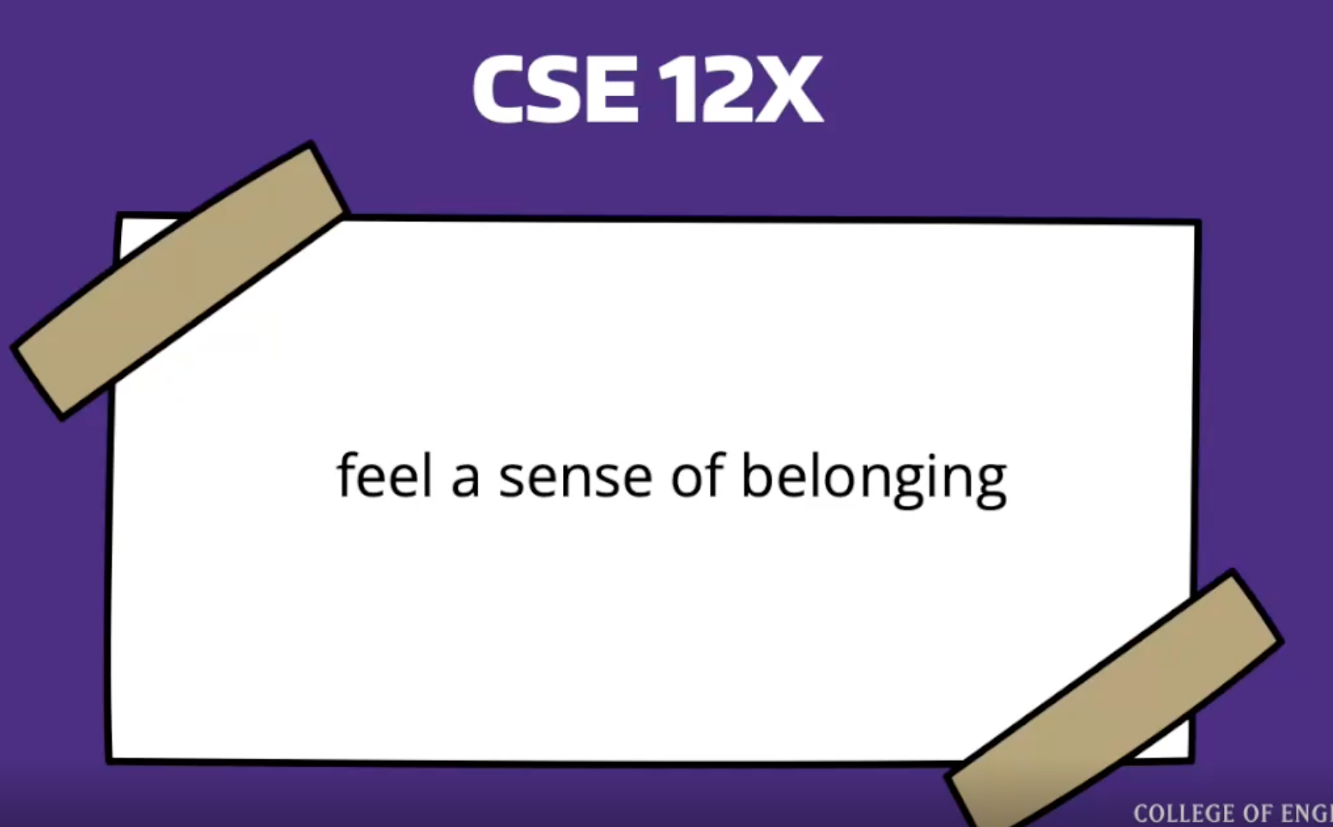
Creating an inclusive environment
Video
This is a more professional environment than hanging out with friends
Think about the impact your words can have.
Collaboration, Support, and Empathy
Check your own biases and communicate thoughtfully
Challenge unacceptable behaviors

Slide 11





Other Course Tools
My Digital Hand
Queueing in office hours
VSCode
Develop offline
Visual debugger
Ed
Community & Information
  Discussion Board
  (please ask & answer!; anonymous option)
  Announcements
Pre-Class Materials / Section Handouts
Assignments
  Online IDE
  Submit assignments
  View Feedback
Canvas
Lecture recordings
Sli.do
In-class activities
(ungraded)
No account needed

Slide 12
Lecture Outline
Introductions
About this Course
  Course Components & Tools
  Making the Most of this Class
Assignments and Grading

Slide 13

Digression: One of Nate’s Hobbies
Notes:
Brett
THIS was my first penguin.
I did everything “right”: followed instructions, looked for resources, paid attention. But I still made mistakes.
We don’t learn by watching, listening, or reading; we learn by DOING! And we almost always make mistakes along the way. Don’t expect to just show up to class, watch and listen, and get things exactly right the first time. Plan to engage, practice, and make mistakes.

Slide 14
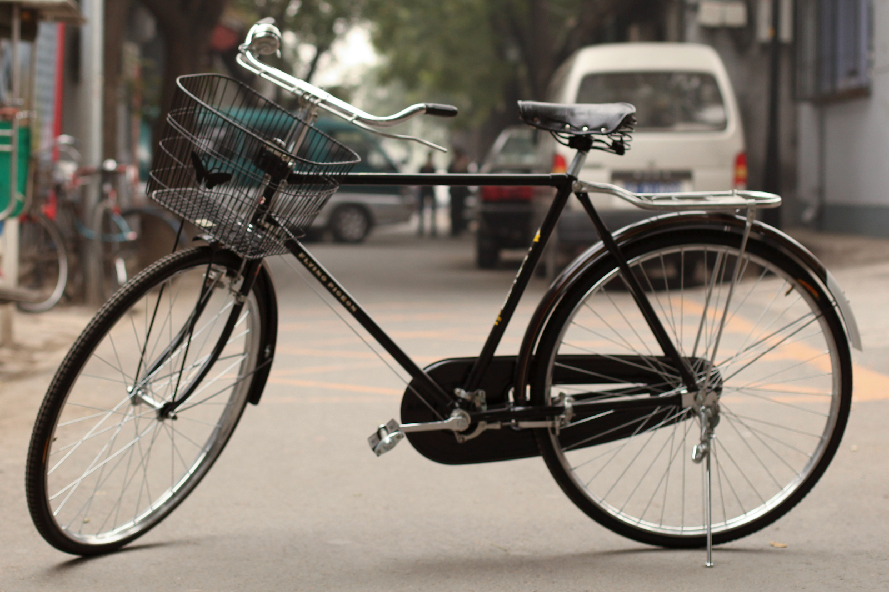
How Learning Works
Learning requires active participation in the process. It’s not as simple as sitting and listening to someone talk at you.
  Requires deliberate practice in learning by doing
  Benefits from collaborative learning
Hybrid classroom model
  Asks you to do some preparation before class in the form
  of readings and practice problems.
    Should take ~30 minutes outside of class per lesson
  Class will start with brief recap, then pick up
  where the reading and practice problems leave off.
  Attendance isn’t graded, but showing up and trying
  is the first step in succeeding in the class!
Pre-class materials are ungraded, but…
  It’s okay if you find them challenging! That means
  you are learning!

Slide 15
Learning Pattern
Pre-class Work
  Your first introduction to a topic
  Interactive components
In-class lessons
  Recap of pre-class work
  Further instruction from where it left off
  Interactive components
Section
  Review, restate, rephrase content
  Very interactive
Homework
  Learn by applying!
  We’re here to help!
Quizzes/Final Exam
  Show us what you’ve learned
Instruction
Practice
Instruction
Practice
Instruction
Practice
Practice
Instruction
Assessment

Slide 16
Getting Help
Discussion Board
  Feel free to make a public or private post on Ed
  We encourage you to answer other peoples’ questions! A great way to learn
Introductory Programming Lab (Office Hours)
  TAs can help you face to face in office hours, and look at your code
  You can go to the IPL with any course questions, not just assignments
Section
  Work through related problems, get to know your TA who is here to support you
Your Peers
  We encourage you to form study groups! Discord or Ed are great places to do that
Email
  We prefer that all content and logistic questions go on the Ed discussion board (even if you make them private). Many more students than staff!
  For serious personal circumstances, you can email Miya/Brett directly. It never hurts to email us, but if it’s a common logistic question, we may politely ask you to post on the discussion board instead.

Slide 17
Lecture Outline
Introductions
About this Course
  Course Components & Tools
  Making the Most of this Class
Assignments and Grading

Slide 18
Assignments and Grading
Our goal in the course is for you to gain proficiency the concepts and skills we teach
We assess your proficiency by asking you to apply the concepts and skills on tasks or problems
By necessity, we are assessing your work as a proxy for your proficiency

Slide 19
Assignments
Your learning in this course will be assessed in four ways:
  Programming Assignments (~biweekly, 4 total)
    Structured programming assignments to assess your proficiency of programming concepts
  Creative Projects (~biweekly, 4 total)
    Smaller, more open-ended assignments to give you space to explore
  Quizzes (3 total, in section)
    Series of problems covering all material up to that point
  Final Exam (Wednesday, June 11, 12:30-2:20)
    Final, culminating assessment of all your skills and knowledge

Slide 20
Resubmission and Ignored Quiz Problems
Learning takes time, and doesn’t always happen on the first try
One previous Programming Assignment or Creative Project can be resubmitted each week
  Must be accompanied by a write-up describing changes (via Google Form)
  Grade on resubmission will replace original grade
  An assignment can be resubmitted in the 3 cycles after feedback has been published
  Tip: Resubmit as early as possible!
We will ignore your two lowest quiz problem grades
  No special action required– we’ll do this automatically
See the syllabus for more details

Slide 21
Grading
Grades should reflect your proficiency in the course objectives
All assignments will be graded E (Excellent), S (Satisfactory), or N (Not yet)
  Under certain circumstances, a grade of U (Unassessable) may be assigned
Final grades will be assigned based on the amount of work at each level
See the syllabus for more details

Slide 22
Collaboration Policy
When we assess your work in this class, we need to know that it’s yours.
Unless otherwise specified, all graded work must be completed individually.
Some specific rules to highlight:
  do not share your own solution code or view solution code from any source – including but not limited to other students, tutors, or the internet
  do not use AI tools (e.g. ChatGPT) on graded work in any capacity
See the syllabus for more details (this is very important to understand).

Slide 23
Coming up…
🧑‍🏫 Go to your first quiz section and meet your TAs tomorrow!
  Make sure to double check MyUW for the location.
💻 Complete Pre-Class Work 1 before class on Friday!
  It will be posted and linked from the course calendar later today.
❓ Complete the Introductory Survey
  This helps us gather data about the students taking our classes and their backgrounds, to inform future offerings.

