Slide 1

Abstract Classes
BEFORE WE START
Talk to your neighbors:
Coffee or tea? Or something else?
Instructor:
James Wilcox

Slide 2
Announcements
Creative Project 0 due tonight, Wed October 1 at 11:59pm!
  See generic Creative Project rubric posted on website
Programming Assignment 0 will be released tomorrow, Thurs Oct 2
  Focused on inheritance and abstract classes

Slide 3
Lecture Outline
Polymorphism Review
  Declared vs. Actual Type
  Compiler vs. Runtime Errors
Abstract Classes

Slide 4
Polymorphism
DeclaredType x = new ActualType()
  All methods in DeclaredType can be called on x
  We’ve seen this with interfaces (List<String> vs. ArrayList<String>)
  Can also be to inheritance relationships
Animal[] arr = {new Animal(), new Dog(), new Husky()};
for (Animal a : arr) {
a.speak();
}

Slide 5
Compiler vs. Runtime Errors
DeclaredType x = new ActualType()
  At compile time, Java only knows DeclaredType
  Compiler error: trying to call a method that isn’t present
  Animal a = new Dog();
  a.bark(); // No bark() -> CE
  Can cast to change the DeclaredType of an object
  Dog d = (Dog) a;
  d.bark(); // No more CE
  Runtime error: attempting cast to type that is not a superclass of actual type
  Animal a = new Fish();
  Dog d = (Dog) a; // Can’t cast -> RE
  d.bark();
  - Order matters! Compilation before runtime

Slide 6
Declared Type and Actual Type
DeclaredType varName = new ActualType(…);
ActualType must be a subclass of (or same as) DeclaredType
Animal rufus = new Dog("Rufus");
Dog rufus = new Dog(”Rufus");
Declared Type: Animal
Actual Type: Dog
Can call methods that makes sense for EVERY Animal
If Dog overrides a method, uses the Dog version
Declared Type: Dog
Actual Type: Dog
Can call methods that makes sense for EVERY Dog
If Dog overrides a method, uses the Dog version

Slide 7
Compiling Method Calls
Animal rufus = new Dog();
rufus.bark();
When compiling:
Can we guarantee that the method exists for the declared type?
Does the declared type or one of its super classes contain a method of that name?
If not… Compile Error!
Object
Compiling:
Look this way for bark
extends
“is a”
Animal
Declared Type
extends
“is a”
extends
“is a”
In this example:
When compiling, neither Animal nor Object have a bark method, so we have a compile error!
Dog
Fish

Slide 8
Running Method Calls
Animal rufus = new Dog();
rufus.feed();
When running:
Use the most specific version of the method call starting from the actual type.
Start from the actual type, then go “up” to super classes until you find the method. Run that first-discovered version.
Object
extends
“is a”
Running:
Look this way for feed
Use the first implementation found
Animal
extends
“is a”
extends
“is a”
In this example:
If the Dog class overrides feed, then we’ll use the implementation in Dog. Otherwise we’ll use the one in Animal
Actual Type
Dog
Fish

Slide 9
Casts and Method Calls
When compiling:
Can we guarantee that the method exists for the Cast-to type?
Does the Cast-to type or one of its super classes contain a method of that name?
If not… Compile Error!
When Running:
Check that the Cast-to Type is either the Actual Type, or one of its super classes
Animal rufus = new Dog();
Dog d = (Dog) rufus;
d.bark();
Object
Compiling:
From cast-to type
Look this way
for bark
Running:
From actual type
Look this way
for cast-to type
Animal
Cast-to Type
Dog
Fish
Actual Type
This example has no error

Slide 10
Casts and Method Calls
When compiling:
Can we guarantee that the method exists for the Cast-to type?
Does the Cast-to type or one of its super classes contain a method of that name?
If not… Compile Error!
When Running:
Check that the Cast-to Type is either the Actual Type, or one of its super classes
Animal rufus = new Fish();
Dog d = (Dog) rufus;
d.bark();
Object
Compiling:
From cast-to type
Look this way
for bark
Running:
From actual type
Look this way
for cast-to type
Animal
Cast-to Type
Dog
Fish
Actual Type
This example has a runtime error

Slide 11
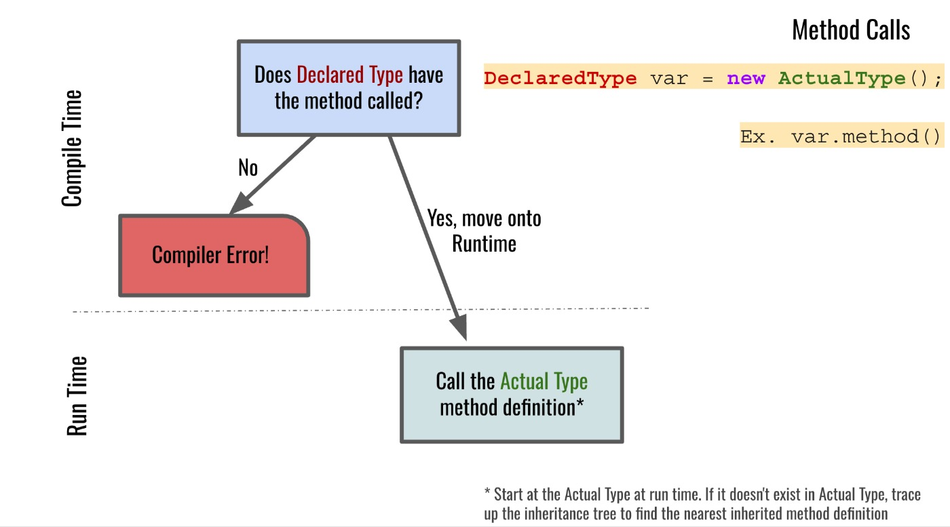
Compiler vs. Runtime Errors: Method Calls

Slide 12
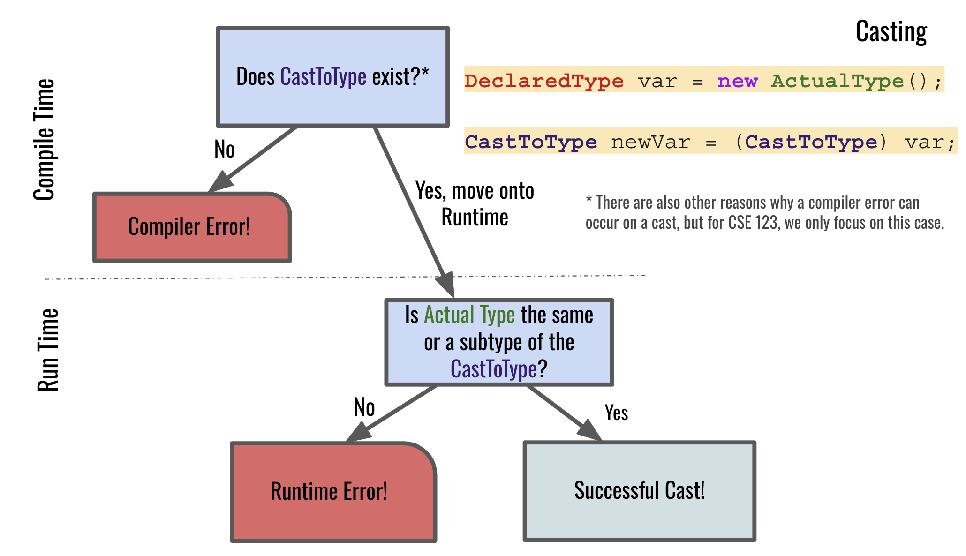
Compiler vs. Runtime Errors: Casting

Slide 13
Lecture Outline
Polymorphism Review
  Declared vs. Actual Type
  Compiler vs. Runtime Errors
Abstract Classes

Slide 14
Abstract Classes
Interfaces
Abstract Classes
Classes
Mixture of Interfaces and Classes
  Interface similarities:
    - Can contain (abstract) method declarations
    - Can’t be instantiated
  Class similarities:
    - Can contain method implementations
    - Can have fields
    - Can have constructors
Is there identical / nearly similar behavior between classes that shouldn’t inherit from one another?

Slide 15
Advanced OOP Summary
Abstract
Allow us to define differing levels of abstraction
  Interfaces = high-level specification
    What behavior should this type of class have
  Abstract classes = shared behavior + high-level specification
  Classes = individual behavior implementation
Inheritance allows us to share code via “is-a” relationships
  Reduce redundancy / repeated code & enable polymorphism
    Still might not be the “best” decision!
  Interfaces extend other interfaces
  (abstract) classes extend other (abstract) classes
Interfaces
Abstract Classes
Classes
Concrete
You’re now capable of designing some pretty complex systems!

Slide 16
Design in the “real world”
In this course, we’ll always give you expected behavior of the classes you write
  Often not the case when programming for real
  Clients don’t really know what they want (but programmers don’t either)
My advice:
  Clarify assumptions before making them (do I really want this functionality?)
  There’s no one right answer
    Weigh the options, make a decision, and provide explanation
    Iterative development: make mistakes and learn from them
    Be receptive to feedback and be willing to change your mind

Slide 17
Interface versus Implementation
Interface: what something should do
Implementation: how something is done
These are different!
Big theme of CSE 123:
choose between different implementations of same interface

