Slide 1
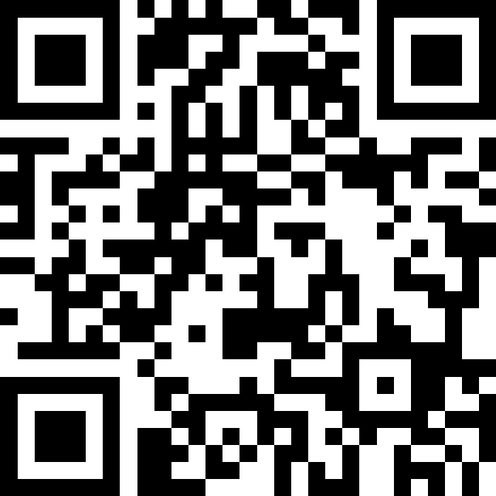
Comparable;
Inheritance; Polymorphism
BEFORE WE START
Talk to your neighbors:
Plans for the weekend?
Instructor:
James Wilcox

Slide 2
Coming up…
❓ Complete the Introductory Survey
  This helps us gather data about the students taking our classes and their backgrounds, to inform future offerings.
🙋 Two Review Sessions: Monday 9/29 1:30 and 2:30 in KNE 120
  Brief review of prerequisite material
💻 The IPL opens Monday 9/29
  Schedule posted soon
🔎 Creative Project 0: Search Engine out now
  Due Wednesday, October 1, 11:59pm

Slide 3
Lecture Outline
Comparable
Inheritance
Polymorphism
  Which version of the method gets called?

Slide 4
Comparable
Comparable<E> is an interface that allows implementers to define an ordering between two objects
  Used by TreeSet, TreeMap, Collections.sort, etc.
One required method:
  public int compareTo (E other);
Returned integer falls into 1 of 3 categories
  < 0: this is “less than” other
  = 0: this is “equal to” other
  > 0: this is “greater than” other
a.compareTo(b);
this
other

Slide 5
Subtraction Trick
compareTo implementation when comparing two integers (a) ascending:
This is just subtraction!
What if we wanted to sort descending?
Warning: this only works for integers! Doubles have issues with truncation.
if (this.a < other.a) -> negative number
else if (this.a > other.a) -> positive number
else -> 0
this.a – other.a
other.a – this.a

Slide 6
Lecture Outline
Comparable
Inheritance
Polymorphism
  Which version of the method gets called?

Slide 7
PCM Review
sli.do #cse123

Slide 8
Inheritance
Connect together a “subclass” and “superclass”
  Borrow / “inherit” code to reduce redundancy
  super() keyword can be used just like this() (in a constructor)
Syntax: public class Subclass extends Superclass
Should Represent “is-a” relationships
  public class Chef extends Employee
  public class Server extends Employee
In Java, all objects implicitly inherit from the Object class
  toString(), equals(Object), etc.

Slide 9

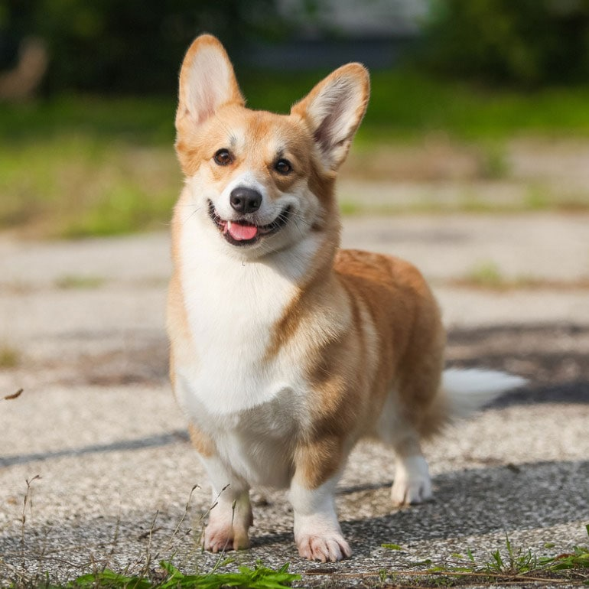


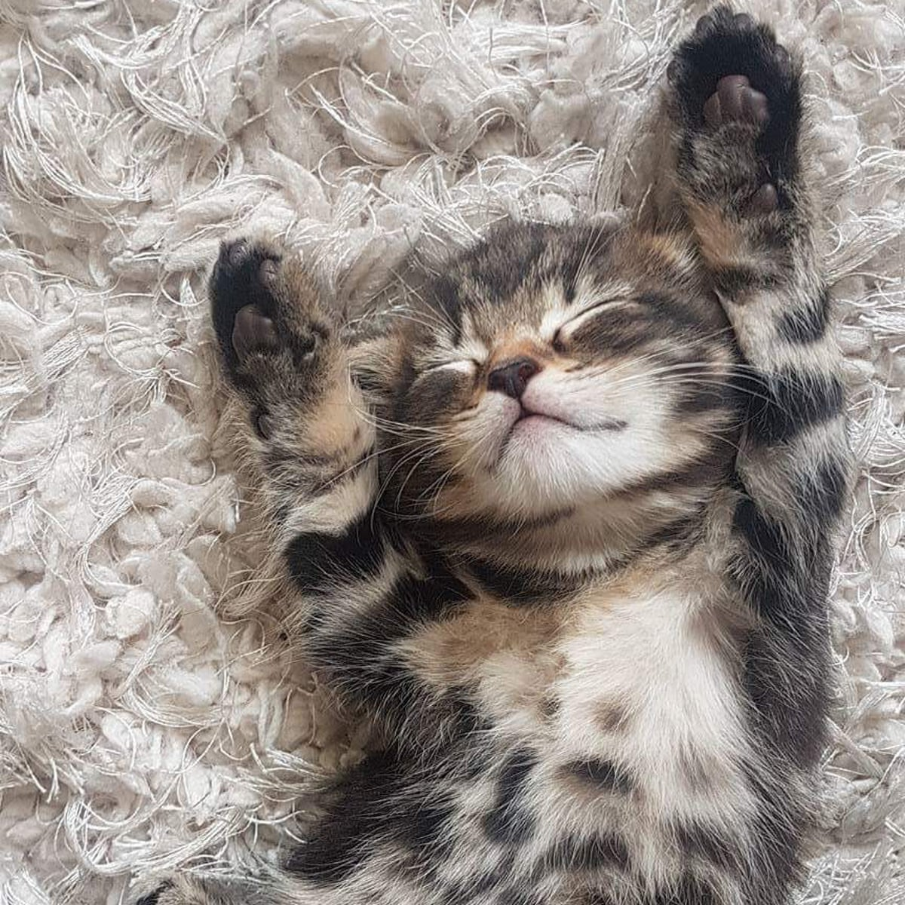
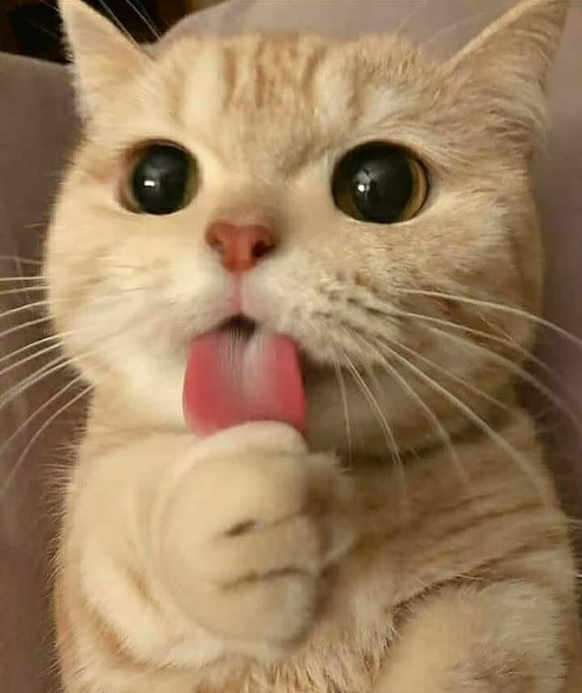
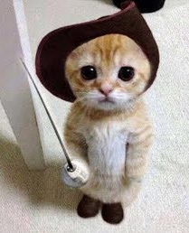
Is-a Relationships
Animal
Fish
Birds
Mammal
Reptile
Amphibian
Dog
Cat

Slide 10
The “is-a” Rule of Thumb
class A should only extend class B if an A “is-a” B in the real world
Java will not force you to follow this rule! That’s your job!

Slide 11
Inheritance Design
Typical Problem
We give you:
Description of several classes, methods, and their behavior
Your job:
Design an inheritance hierarchy that
    minimizes redundancy
    follows best practices (“is-a” test)

Slide 12
Inheritance Design
Solution Technique
Use the “is-a” test to decide which classes should extend each other
Keep an eye out for redundant code and consider whether you can reduce it even further using inheritance
  Sometimes you can’t, and that’s ok!
  The “is-a” test is more important than getting rid of all redundancy
Often more than one reasonable answer!

Slide 13
Lecture Outline
Inheritance
Comparable
Polymorphism
  Which version of the method gets called?

Slide 14
Polymorphism
Typical Problem
Animal[] arr = {new Animal(), new Dog(), new Husky()};
for (Animal a : arr) {
a.speak();
}
Suppose Animal, Dog, and Husky all implement speak.
Which version gets called on each iteration of the loop?

Slide 15
Polymorphism
Animal[] arr = {new Animal(), new Dog(), new Husky()};
for (Animal a : arr) {
a.speak();
}
DeclaredType x = new ActualType()
  Important:
  The ActualType determines what method is actually called!

Slide 16
Overrides and Method Calls
Solution Technique
Animal dubs = new Husky();
dubs.speak();
When running:
Use the most specific version of the method call starting from the actual type.
Start from the actual type, then go “up” to super classes until you find the method. Run that first-discovered version.
Animal
extends
“is a”
Running:
Look this way for speak
Use the first implementation found
Dog
extends
“is a”
In this example:
If the Husky class overrides speak, then we’ll use the implementation in Husky. If not, we’ll look in Dog and use that one if found. If not, then we’ll look in Animal.
Actual Type
Husky

Slide 17
Coming up…
❓ Complete the Introductory Survey
  This helps us gather data about the students taking our classes and their backgrounds, to inform future offerings.
🙋 Two Review Sessions: Monday 9/29 1:30 and 2:30 in KNE 120
  Brief review of prerequisite material
💻 The IPL opens Monday 9/29
  Schedule posted soon
🔎 Creative Project 0: Search Engine out now
  Due Wednesday, October 1, 11:59pm

