Slide 1
Recursive Tracing
slides adapted from Kasey Champion

Slide 2
Notes:
Brett

Slide 3
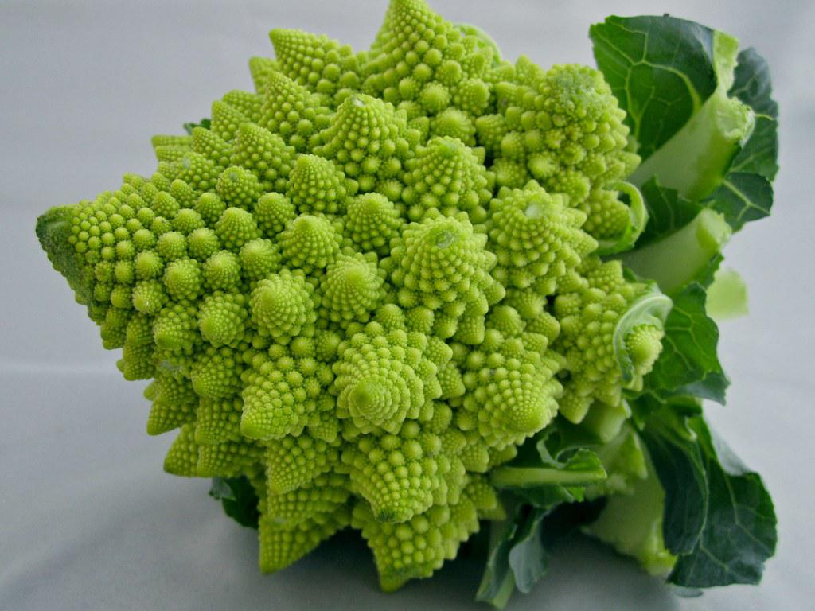
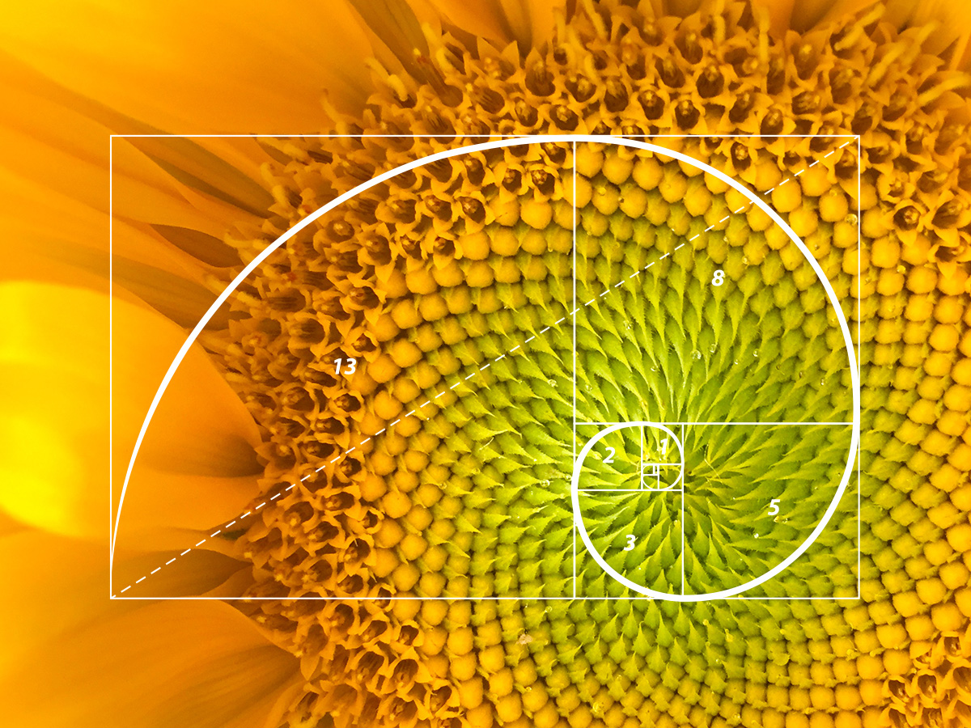
Notes:
Brett

Slide 4
Iterative Factorial
public static int iterativeFactorial(int n) {
int result = 1;
for (int i = 2; i <= n; i++) {
result *= i;
}
return result;
}
(1 * 2) = 2
result = 1
(6 * 4) = 24
(2 * 3) = 6
i = 2
3
4
Notes:
Brett

Slide 5
Recursive Factorial
public static int recursiveFactorial(int n) {
if (n == 1) {
return 1;
} else {
return n * recursiveFactorial(n – 1);
}
}
4
public static int recursiveFactorial(int n) {
if (n == 1) {
return 1;
} else {
return n * recursiveFactorial(n – 1);
}
}
3
public static int recursiveFactorial(int n) {
if (n == 1) {
return 1;
} else {
return n * recursiveFactorial(n – 1);
}
}
2
public static int recursiveFactorial(int n) {
if (n == 1) {
return 1;
} else {
return n * recursiveFactorial(n – 1);
}
}
4
4-1
1
3
3 - 1
2
2-1
Notes:
Brett

Slide 6
Recursive Factorial
public static int recursiveFactorial(int n) {
if (n == 1) {
return 1;
} else {
return n * recursiveFactorial(n – 1);
}
}
4
public static int recursiveFactorial(int n) {
if (n == 1) {
return 1;
} else {
return n * recursiveFactorial(n – 1);
}
}
3
public static int recursiveFactorial(int n) {
if (n == 1) {
return 1;
} else {
return n * recursiveFactorial(n – 1);
}
}
2
public static int recursiveFactorial(int n) {
if (n == 1) {
return 1;
} else {
return n * recursiveFactorial(n – 1);
}
}
4
4-1
1
3
3 - 1
Base Case!
2
2-1
Notes:
Brett

Slide 7
Recursive Factorial
public static int recursiveFactorial(int n) {
if (n == 1) {
return 1;
} else {
return n * recursiveFactorial(n – 1);
}
}
4
public static int recursiveFactorial(int n) {
if (n == 1) {
return 1;
} else {
return n * recursiveFactorial(n – 1);
}
}
3
public static int recursiveFactorial(int n) {
if (n == 1) {
return 1;
} else {
return n * recursiveFactorial(n – 1);
}
}
2
= 24
public static int recursiveFactorial(int n) {
if (n == 1) {
return 1;
} else {
return n * recursiveFactorial(n – 1);
}
}
4
6
1
3
2
2
1
Notes:
Brett

