Slide 1
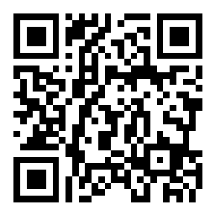
Abstract Classes
BEFORE WE START
Talk to your neighbors:
Coffee or tea? Or something else?
Music: 123 24su Lecture Tunes ☀️
Instructor:
Joe Spaniac
TAs:
Andras
Daniel
Eric
Nicole
Sahej
Trien
Zach

Slide 2
Lecture Outline
Announcements
Finishing up Lines & Graphs
Abstract Classes
Revisiting Graphs
Ciphers
Revisiting Reflections
Creative Project 1

Slide 3
Announcements
Programming Assignment 1 due Wednesday, July 3rd at 11:59 PM
Recommend getting started early (trickier assignment)
C1 grades and feedback will also be released Wednesday
General grading turnaround is ~1 week
Resubmission Cycle 1 will be released later today
Due next Friday, July 5th at 11:59pm
Eligible assignment(s): C1
Quiz 1 is Tuesday, July 2nd!
Topics: Object-Oriented Programming, Testing, Inheritance, Polymorphism
Check Ed later today for a post containing logistics and a practice quiz
Also see Check-in 1 (resources tab) for an example quiz problem

Slide 4
Lecture Outline
Announcements
Finishing up Lines & Graphs
Abstract Classes
Revisiting Graphs
Ciphers
Revisiting Reflections
Creative Project 1

Slide 5
Lecture Outline
Announcements
Finishing up Lines & Graphs
Abstract Classes
Revisiting Graphs
Ciphers
Revisiting Reflections
Creative Project 1

Slide 6
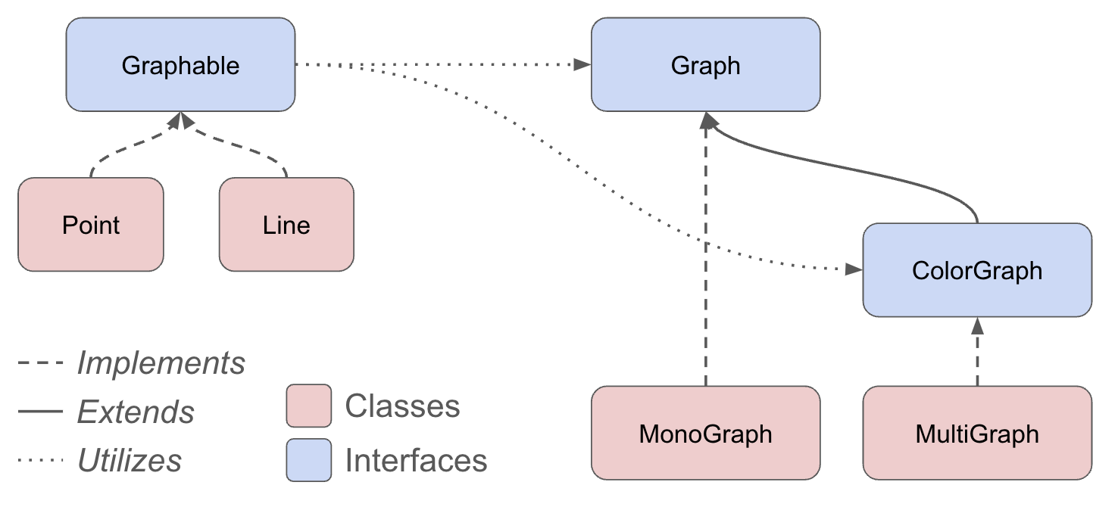
Revisiting Graphs

Slide 7
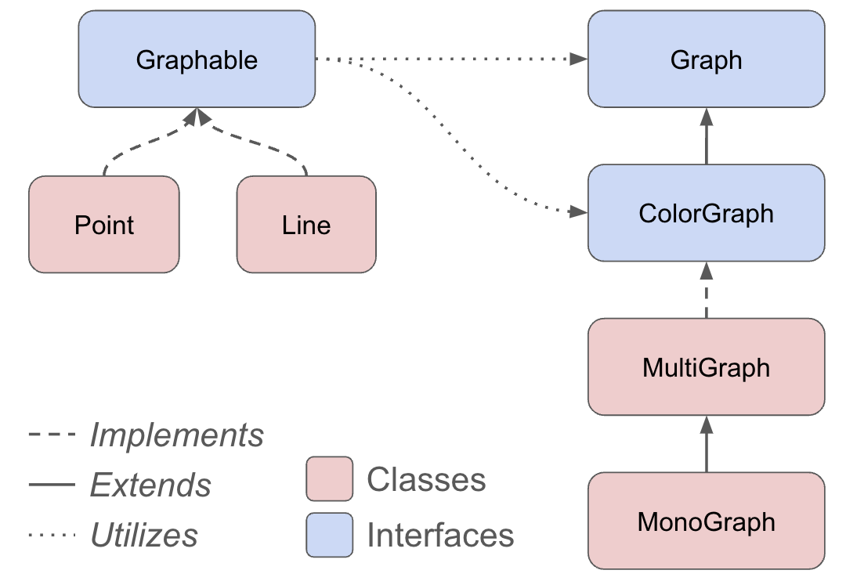
Revisiting Graphs

Slide 8
Abstract Classes
Interfaces
Abstract Classes
Classes
Mixture of Interfaces and Classes
Interface similarities:
- Can contain (abstract) method declarations
- Can’t be instantiated
Class similarities:
- Can contain method implementations
- Can have fields
Is there identical / nearly similar behavior between classes that shouldn’t inherit from one another?

Slide 9
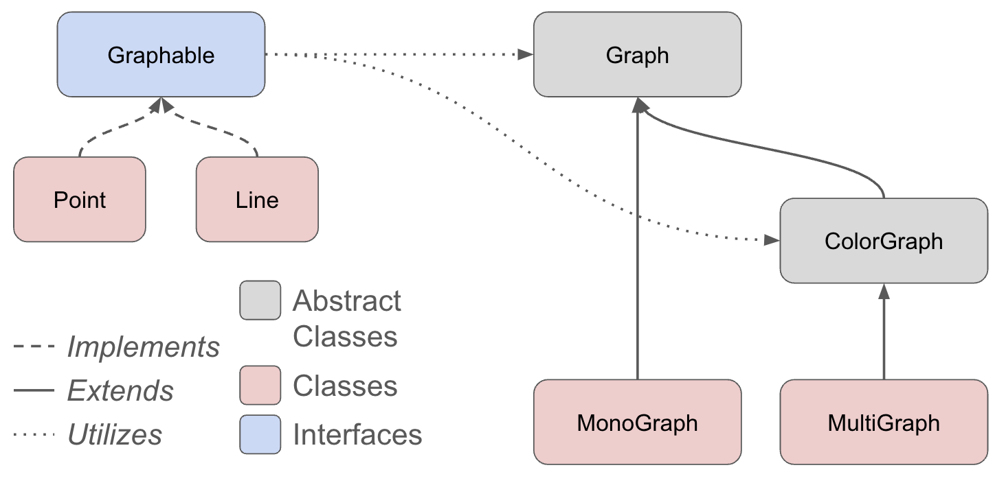
Revisiting Graphs

Slide 10
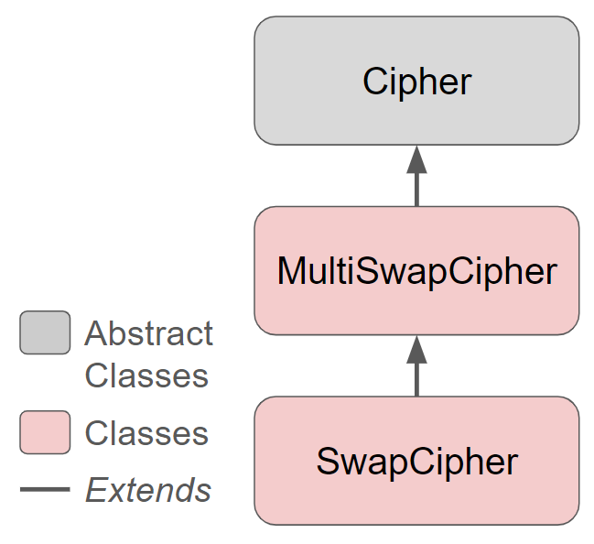
Ciphers
DeclaredType x = new ActualType();
Cipher c = new SwapCipher(‘A’, ‘B’);
c.encryptFile(“test.txt”);
encrypt/decryptFile
encrypt/decrypt
Inherited encrypt/decrypt

Slide 11
Advanced OOP Summary
Abstract
Allow us to define differing levels of abstraction
Interfaces = high-level specification
What behavior should this type of class have
Abstract classes = shared behavior + high-level specification
Classes = individual behavior implementation
Inheritance allows us to share code via “is-a” relationships
Reduce redundancy / repeated code & enable polymorphism
Still might not be the “best” decision!
Interfaces extend other interfaces
(abstract) classes extend other (abstract) classes
Interfaces
Abstract Classes
Classes
Concrete
You’re now capable of designing some pretty complex systems!

Slide 12
Design in the “real world”
In this course, we’ll always give you expected behavior of the classes you write
Often not the case when programming for real
Clients don’t really know what they want (but programmers don’t either)
My advice:
Clarify assumptions before making them (do I really want this functionality?)
Don’t let preemptive optimization make you freeze!
There’s no one right answer
Weigh the options, make a decision, and provide explanation
Iterative development: make mistakes and learn from them
Be receptive to feedback and be willing to change your mind

Slide 13
Lecture Outline
Announcements
Finishing up Lines & Graphs
Abstract Classes
Revisiting Graphs
Ciphers
Revisiting Reflections
Creative Project 1

Slide 14
Revisiting Reflections
Throughout this course, we’ll ask you to form opinions on topics
Provide exposure to issues so you can decide for yourself
Opinions aren’t formed in a vacuum
Exposure to various viewpoints reinforces/challenges perspectives
Shouldn’t be making arbitrary decisions
Rationalization is often important! (Not always necessary, but helps in communication)
Integrating reflections to in-class components
Discuss opinions, challenge assumptions, potentially change minds
Please be respectful of other people’s opinions
There are no “right” or “wrong” answers to these questions
Everyone has different experiences with the world that informs their decisions

Slide 15
C1 Reflection
Video: The Moral Bias Behind your Search Results
Q3: Do you think whoever comes up with moral rules and judgements surrounding search engine ranking results at Google should have that power / responsibility?
Q5: Do you think that software reflects the biases of the programmer? Have you ever encountered bias programs / applications?

