Slide 1
Inheritance & Polymorphism
BEFORE WE START
Talk to your neighbors:
What’d you get up to this weekend? Anything fun?
Music: 123 24su Lecture Tunes ☀️
Instructor:
Joe Spaniac
TAs:
Andras
Daniel
Eric
Nicole
Sahej
Trien
Zach

Slide 2
Lecture Outline
Announcements/Reminders
Finishing up Points & Lines
Inheritance
Polymorphism
Declared vs. Actual Type
Compiler vs. Runtime Errors
Points, Lines, and Graphs!

Slide 3
Announcements
IPL is now open!
12:30-5:30pm M-F, some availability on weekends
Check-in 1 is tomorrow, June 27th!
Just show up to your registered quiz section
OK if you can’t make it, 2/4 -> E, just email me for the activity
Quiz 1 is this upcoming Tuesday, July 2nd!
Topics: Object-Oriented Programming, JUnit, Inheritance, Polymorphism
Taken in your registered quiz section on paper
Allowed 1 sheet of 8.5”x11” paper (double-sided, can be printed)
More details on quiz logistics in Ed announcement posted soon!
Creative Project 1 (C1) is due tonight.
Submit what you have so you can get feedback (even if unfinished)
Joined class late? Use Resubmission Cycle 1 to submit it!

Slide 4
Lecture Outline
Announcements/Reminders
Finishing up Points & Lines
Inheritance
Polymorphism
Declared vs. Actual Type
Compiler vs. Runtime Errors
Points, Lines, and Graphs!

Slide 5
Lecture Outline
Announcements/Reminders
Finishing up Points & Lines
Inheritance
Polymorphism
Declared vs. Actual Type
Compiler vs. Runtime Errors
Points, Lines, and Graphs!

Slide 6
Inheritance
Connect together a “subclass” and “superclass”
Borrow / “inherit” code to reduce redundancy
super() keyword can be used just like this()
Syntax: public class Subclass extends Superclass
Should Represent “is-a” relationships
public class Chef extends Employee
public class Server extends Employee
In Java, all objects implicitly inherit from the Object class
toString(), equals(Object), etc.

Slide 7
Is-a Relationships
Animal
Fish
Birds
Mammal
Reptile
Amphibian
Dog
Cat

Slide 8
Lecture Outline
Announcements/Reminders
Finishing up Points & Lines
Inheritance
Polymorphism
Declared vs. Actual Type
Compiler vs. Runtime Errors
Points, Lines, and Graphs!

Slide 9
Polymorphism
DeclaredType x = new ActualType()
All methods in DeclaredType can be called on x
We’ve seen this with interfaces (List<String> vs. ArrayList<String>)
Can also be to inheritance relationships
Animal[] arr = {new Dog(), new Cat(), new Bear()};
for (Animal a : arr) {
a.feed();
}

Slide 10
Compiler vs. Runtime Errors
DeclaredType x = new ActualType()
At compile time, Java only knows DeclaredType
Compiler error: trying to call a method that isn’t present
Animal a = new Dog();
a.pet(); // No pet() -> CE
Can cast to change the DeclaredType of an object
((Dog) a).pet(); // No more CE
Runtime error: attempting to cast to an invalid DeclaredType*
Animal a = new Fish();
((Dog) a).pet(); // Can’t cast -> RE
- Order matters! Compilation before runtime

Slide 11
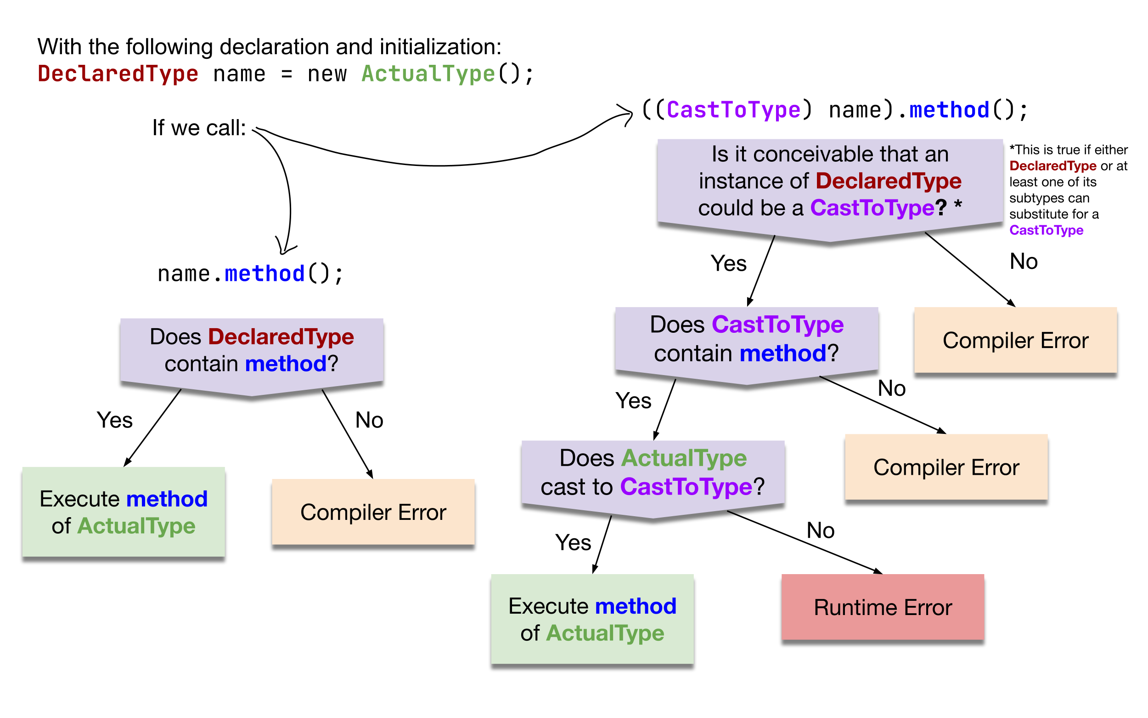
Compiler vs. Runtime Errors

Slide 12
Lecture Outline
Announcements/Reminders
Finishing up Points & Lines
Inheritance
Polymorphism
Declared vs. Actual Type
Compiler vs. Runtime Errors
Points, Lines, and Graphs!

