Slide 1
ListNodes
1
2
3
4
5
front

Slide 2
Puzzle!
1
2
3
front
// Option 1:
ListNode front2 = front.next.next;
front.next.next = null;
// Option 2:
front.next.next = null;
ListNode front2 = front.next.next;
1
2
front
3
front2

Slide 3
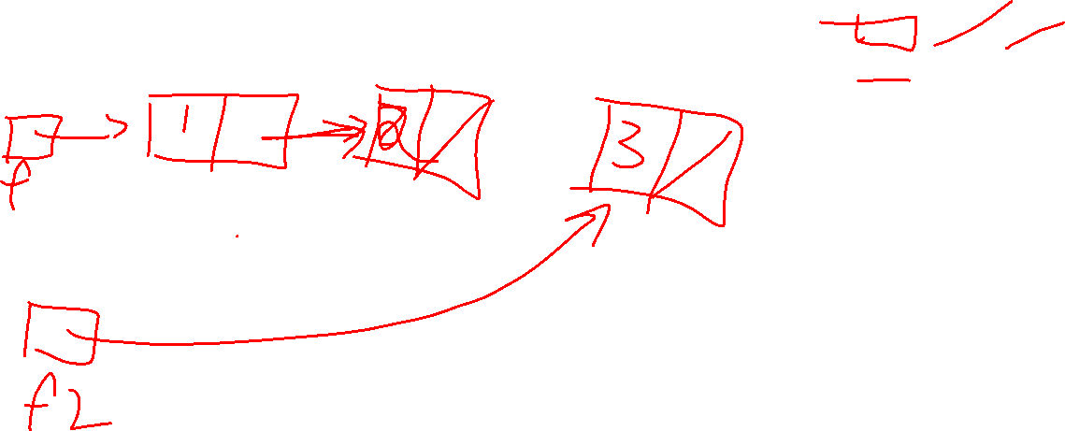
Option 1
// Option 1:
ListNode front2 = front.next.next;
front.next.next = null;

Slide 4
Option 2
// Option 2:
front.next.next = null;
ListNode front2 = front.next.next;

Slide 5
Puzzle!
1
2
3
4
front
// Option 1:
ListNode front2 = front.next.next;
front.next.next = front.next.next.next;
front2.next = null;
// Option 2:
ListNode front2 = front.next.next;
front.next.next = front.next.next.next;
1
2
4
front
3
front2

Slide 6
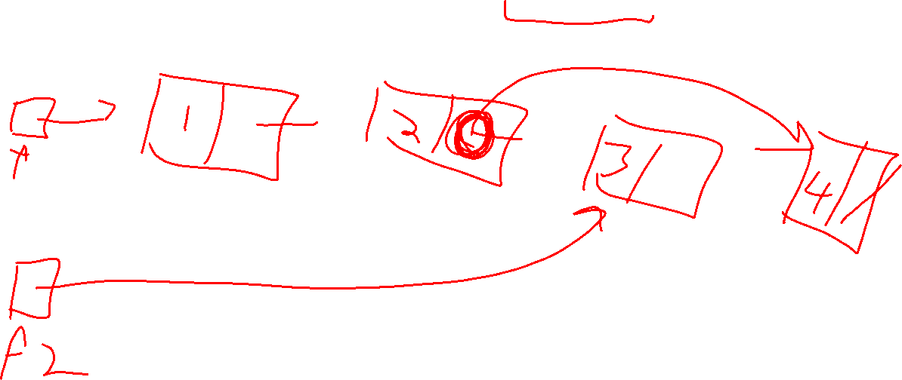
Option 1
// Option 1:
ListNode front2 = front.next.next;
front.next.next = front.next.next.next;
front2.next = null;

Slide 7
// Option 1:
ListNode x = front.next.next;
ListNode front2 = x;
x=front.next.next.next
front.next.next = front.next.next.next;
front2.next = null;

Slide 8
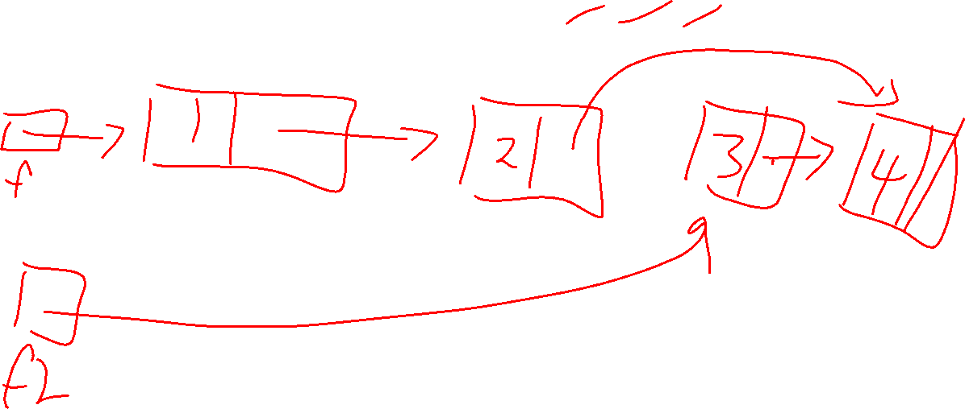
Option 2
// Option 2:
ListNode front2 = front.next.next;
front.next.next = front.next.next.next;

