Slide 1
Linked Lists and Recursion

Slide 2
Linked Lists are defined recursively!
A linked is is either:
Empty (null reference)
A ListNode with a reference to a linked list
front

Slide 3
Reading a Linked List (Recursively)
Public-private pair:
Public method:
Call private method with argument front
Private method (recursive):
If the current node is null, you’ve reached the end!
Just return (base case)
If the current node is not null, there’s more list!
“Read” the current node
Keep going! Recursive call with argument curr.next
public int readThing(){
return readThing(front);
}
private int readThing(ListNode curr){
if (curr == null){
return 0;
} else{
return 1 + readThing(curr.next);
}
}

Slide 4
Modifying a Linked List (Recursively)
public void changeList(){
front = changeList(front);
} private ListNode changeList(ListNode curr){
// The previous node will link to what we return
if (curr == null){
// End/Last case.
// Do we need to add a node here?
return new ListNode(0); //if so, return it!
} else{
// Middle Case
// Our jobs:
// 1) Modify the list at curr (e.g. add a node)
// 2) Do a recursive call, get link to the node returned
// 3) return what the previous node should link to
curr.next = changeList(curr.next);
return curr;
}
}
Public method:
Call private method with argument front
Assign return value to front
Private method (recursive):
If the current node is null, you’ve reached the end!
End/Last case!
If the current node is not null, there’s more list!
“modify” at the current node
Keep going! Recursive call with on curr.next
Assign return value to proper place

Slide 5
x = change(x)
Pattern used to modify a linked data structure
E.g. linked lists and trees (soon!)
x is a reference to the first node in the data structure
change is a method that modifies a data structure, starting from the node x
It returns the “new” first thing

Slide 6
Modifying a Linked List (Recursively)
A chain of nodes, already modified, it will link to what we return
A chain of nodes, not yet modified, we will link to what this returns
curr
What do we do with curr?
Check for base case
Modify the “neighborhood” of curr
Do a recursive call
Link to return value
Return node previous should link to

Slide 7
A chain of nodes, already modified, it will link to what we return
A chain of nodes, not yet modified, we will link to what this returns
curr
public void changeList(){
front = changeList(front);
} private ListNode changeList(ListNode curr){
if (curr == null){
return new ListNode(0);
} else{
curr.next = changeList(curr.next);
return curr;
}
}

Slide 8
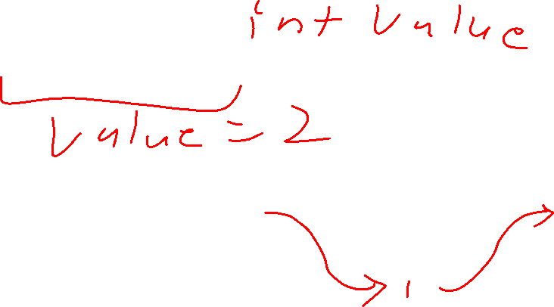
removeAll() – data doesn’t match value
A chain of nodes, already modified, it will link to what we return
A chain of nodes, not yet modified, we will link to what this returns
curr
Curr.next = removeAll(value, curr.next);
Return curr;

Slide 9
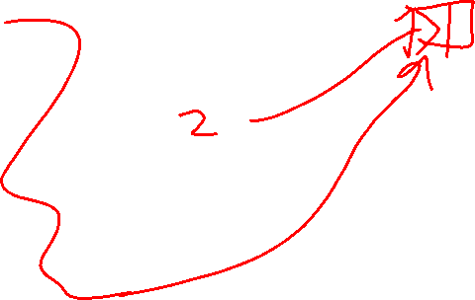
removeAll() – data matches value
A chain of nodes, already modified, it will link to what we return
A chain of nodes, not yet modified, we will link to what this returns
curr
Return removeAll(value, curr.next)

Slide 10
duplicateEvens()
A chain of nodes, already modified, it will link to what we return
A chain of nodes, not yet modified, we will link to what this returns
9
curr
We want to return curr
Curr.next = dulplicateEvens(curr.next)

Slide 11
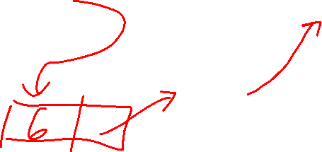
duplicateEvens()
A chain of nodes, already modified, it will link to what we return
A chain of nodes, not yet modified, we will link to what this returns
6
curr
Return new ListNode(6, curr)
Curr.next = duplicateEvens(curr.next)

