Slide 1
Welcome to CSE 123!
Nathan Brunelle
Spring 2024

Slide 2
Agenda
About us
About this course
Learning objectives
Other similar courses
Course components
Our learning model
Tools and resources
Course Website
Ed
VS Code
Assessment and grading
Collaboration
Notes:
Both

Slide 3
Agenda
About us
About this course
Learning objectives
Other similar courses
Course components
Our learning model
Tools and resources
Course Website
Ed
VS Code
Assessment and grading
Collaboration
Notes:
Both

Slide 4
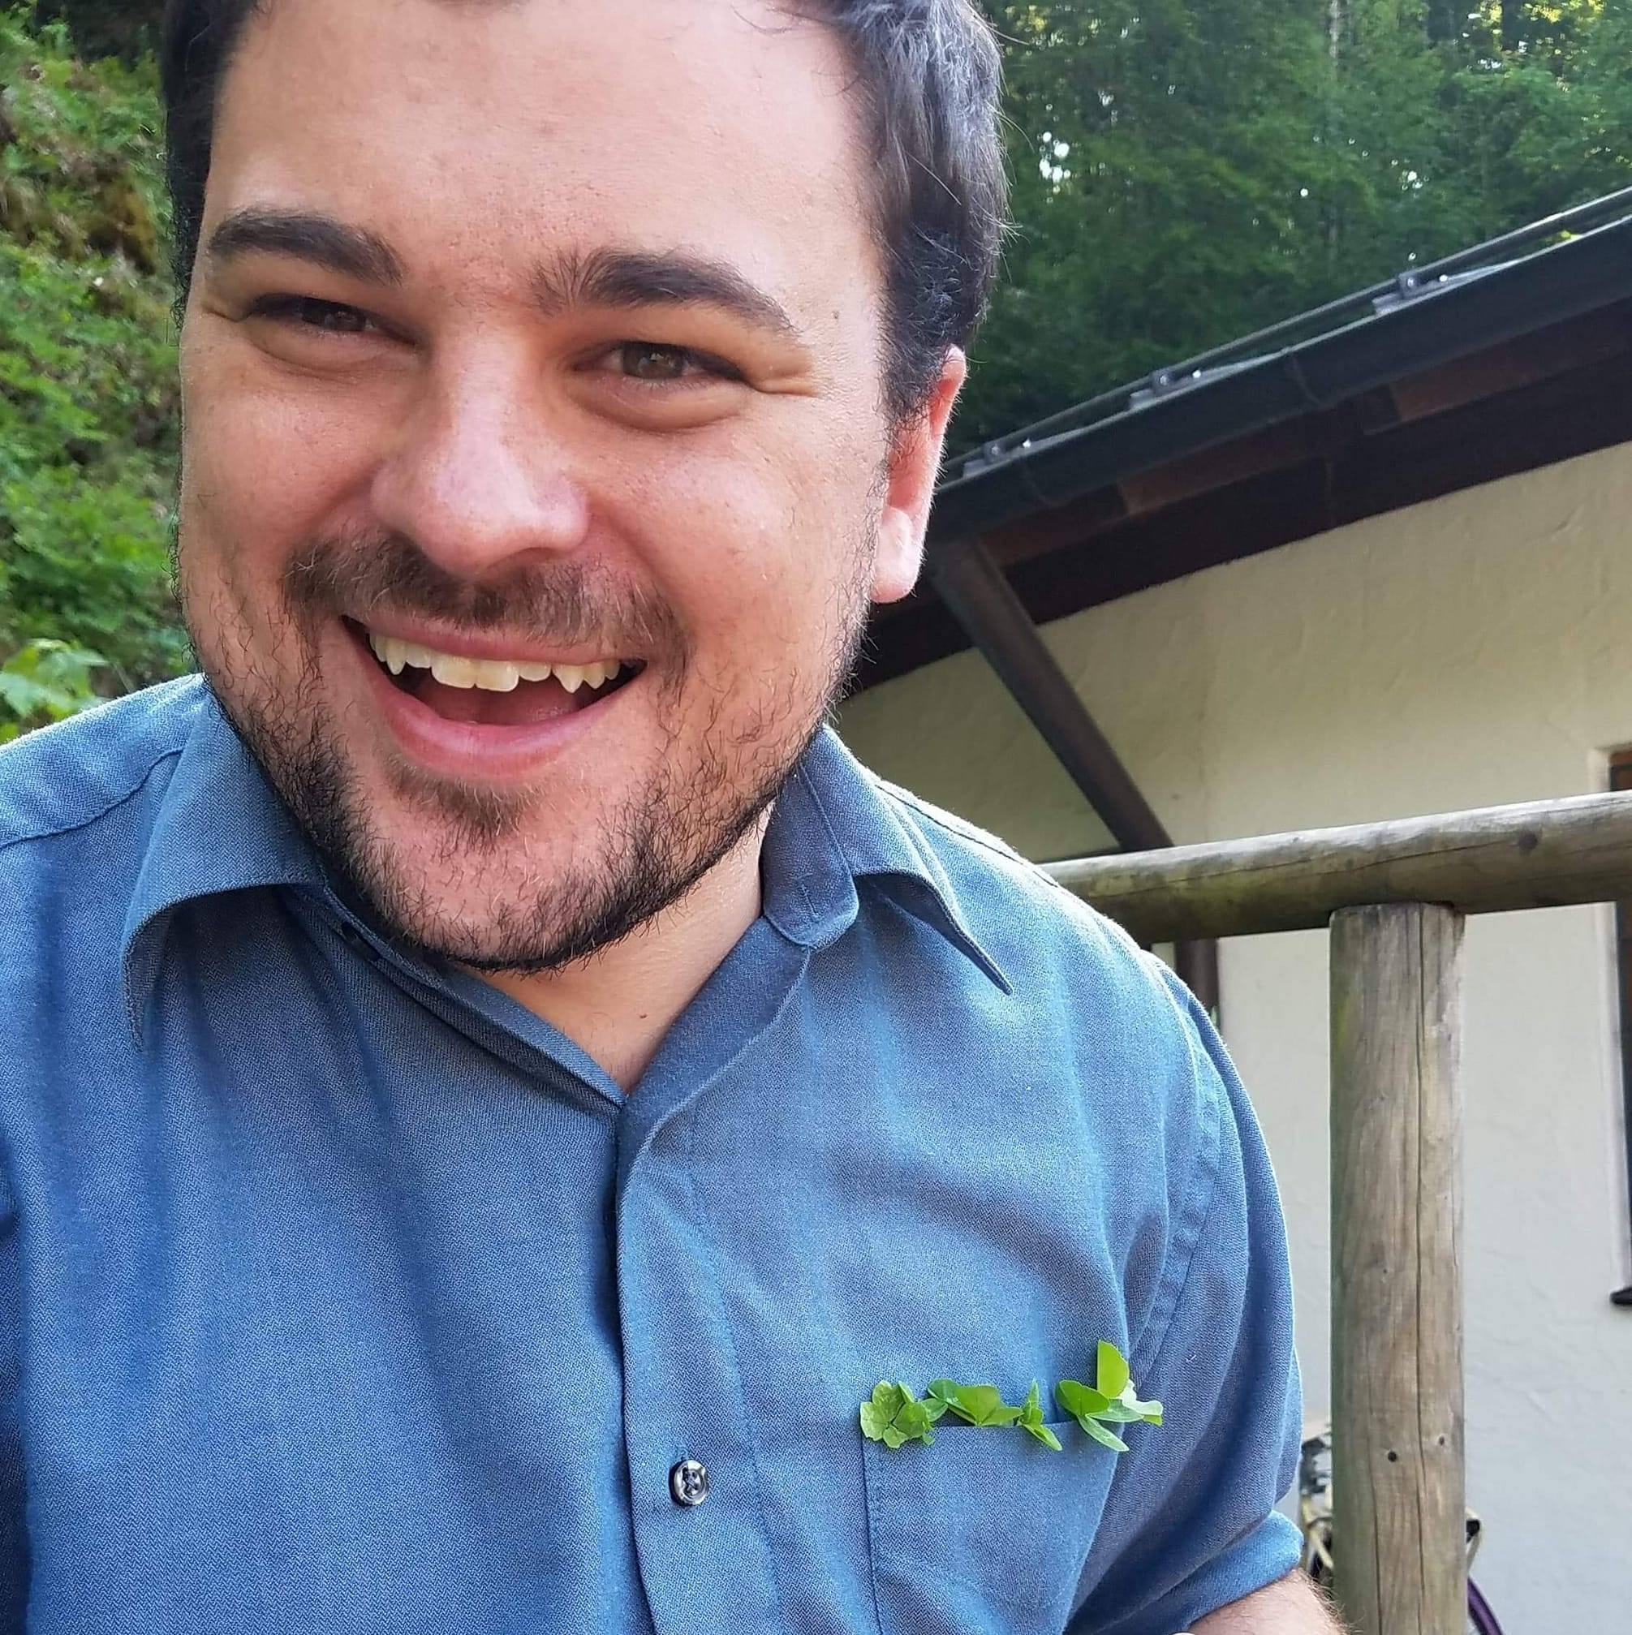
Hi, I’m Nathan! (he/him)
Associate Teaching Professor
New to UW as of Sept. 2024
First time teaching 12X
Interested in CS education/pedagogy
Previously:
Taught at U. Virginia for 6 years
Took a cross-country road trip with my spouse and dog
Taught CSE 332 (autumn 2023, winter 2024)
Notes:
Brett

Slide 5
Meet (most of) your 30 TAs!
Notes:
Both

Slide 6
Agenda
About us
About this course
Learning objectives
Other similar courses
Course components
Our learning model
Tools and resources
Course Website
Ed
VS Code
Assessment and grading
Collaboration
Notes:
Brett

Slide 7
Learning Objectives
or, “What will I learn in this class?”
Communication
Testing
Debugging
Ethics/Impact
Seven themes:
Computational Thinking
Code Comprehension
Code Writing
Notes:
Brett

Slide 8
Prerequisite Knowledge
Comfort with control structures
loops, conditionals, methods/functions
Experience with using basic data structures
arrays, lists, sets, maps
Experience with console and file input/output
Exposure to simple object-oriented programming
classes, interfaces
Programming experience in Java
Or willingness to pick up on your own
Notes:
Brett

Slide 9
Other Similar Courses
Course | Good choice if…
CSE 123 | You done a fair bit of programming, at least some of which is in Java AND You are, or want to be, in a major such as CS, CE, ECE, Info, etc. that requires Java programming OR You’re interested in creating software (whether as a hobby, side-gig, career, etc.)
CSE 122 | You’ve done some programming (roughly one course worth) in any programming language AND You are, or want to be, in a major such as CS, CE, ECE, Info, etc. that requires Java programming
CSE 143 | You took CSE 142 at UW, at a community college, or through UW in the High School
CSE 163 | You’re interested in data science and analysis OR You want to learn Python* OR You are, or want to be, in a major such as Physics, Bio, Stat, etc. where analyzing data through programming is useful
CSE 154 | You’re interested in web development (HTML, CSS, JS)
See Guided Self-Placement, Introductory Courses, and CSE 143/143X for more info
Notes:
Brett

Slide 10
Help Us Improve!
CSE 123 is very new!
We worked hard to build a course we think will be effective and supportive and help you succeed
We probably didn’t get it all right
We appreciate your patience and understanding if we need to make adjustments during the quarter
Please give us lots of feedback!
Post on Ed and/or use the Anonymous Feedback Tool
Notes:
Brett

Slide 11
Notes:
James
How many know how to ride a bike?
How many learned how to ride a bike by listening to someone talk about riding a bike, or watching someone else ride a bike?

Slide 12
Course Components
Lessons (aka Lectures)
Sections
WF, 10:30 or 2:30
Held live on campus; recordings released after
First introductions to course concepts
Mix of presentation of content and practice activities/problems
Required (but not graded) pre-work for most sessions
TuTh, various times
Led by TAs
Held live in person; not recorded
Materials will be released online afterwards
Additional review, discussion, and practice
Mostly practice problems
Attendance is not taken, but you are responsible for all material (including announcements).
Notes:
Brett

Slide 13
Agenda
About us
About this course
Learning objectives
Other similar courses
Course components
Our learning model
Tools and resources
Course Website
Ed
VS Code
Assessment and grading
Collaboration
Notes:
James

Slide 14
Course Culture and Support
Currently 600 students enrolled!
Wide range of backgrounds, interests, and goals
Support and help each other!
Form study groups
If you have a question, others almost certainly do too
Lots of ways to get support from us
Message board, IPL, section
Notes:
James

Slide 15
Course Culture and Support
Policies designed with flexibility in mind
Resubmissions, ignoring quiz problems, lecture recordings, etc.
But life and the world still happen…
Please reach out ASAP if you’re struggling or have circumstances that require extra support
Notes:
James

Slide 16
Agenda
About us
About this course
Learning objectives
Other similar courses
Course components
Our learning model
Tools and resources
Course Website
Ed
VS Code
Assessment and grading
Collaboration
Notes:
James

Slide 17
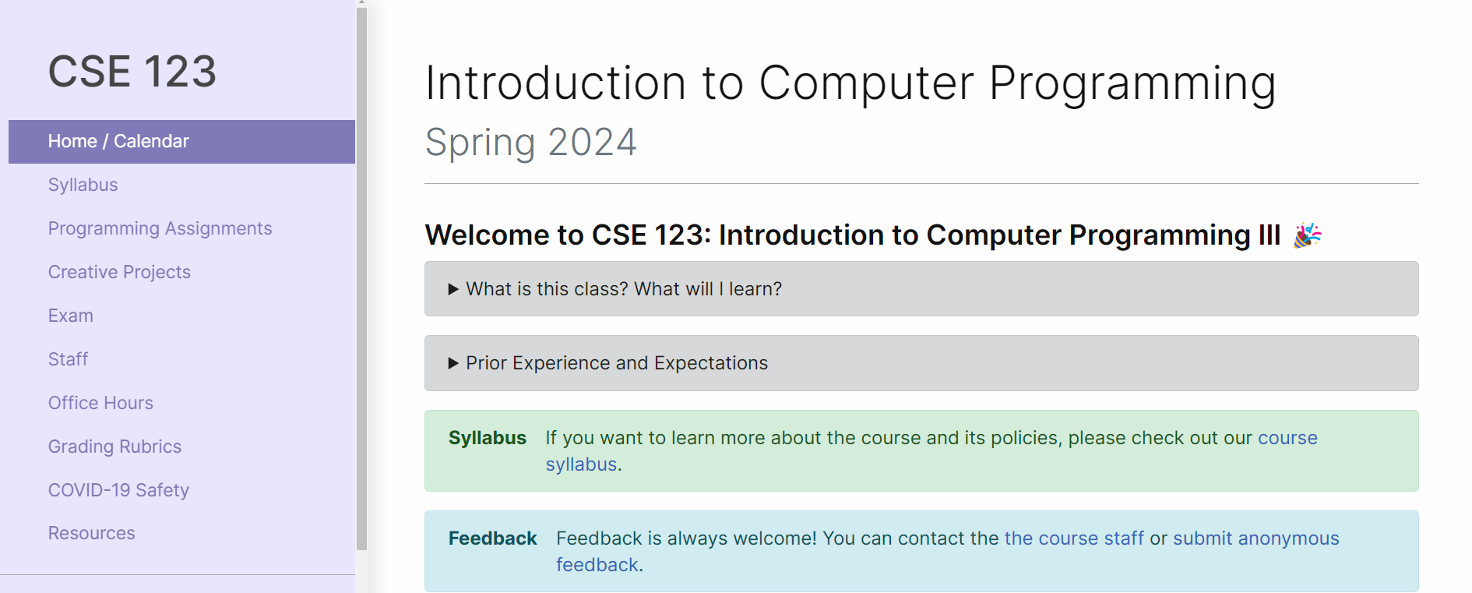
Course Website
cs.uw.edu/123
Primary source of course information (not Canvas)
Calendar will contain links to (almost) all resources
Notes:
James

Slide 18
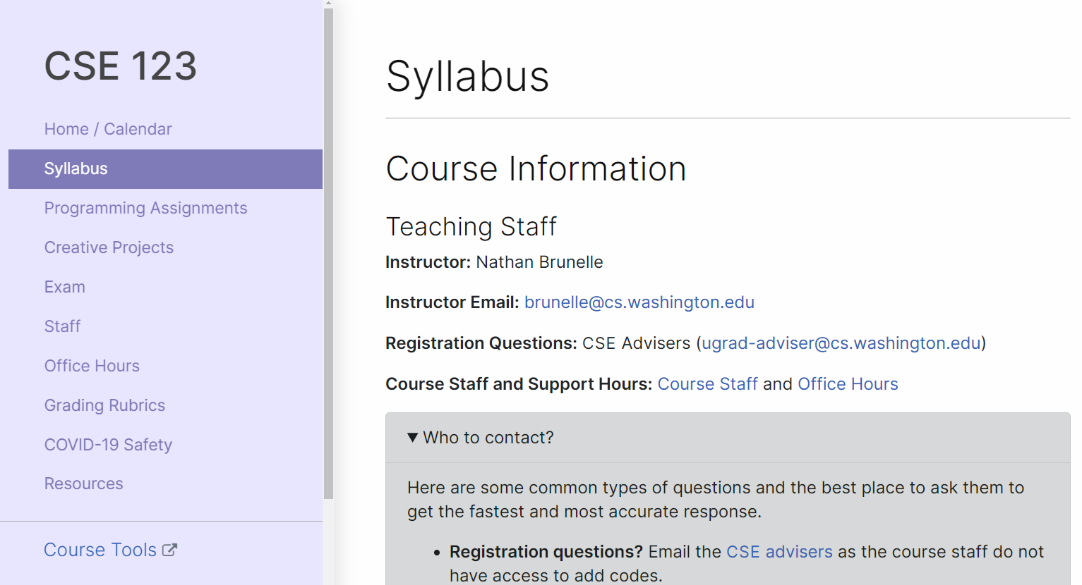
Course Website
Please review the syllabus ASAP.
Notes:
James

Slide 19
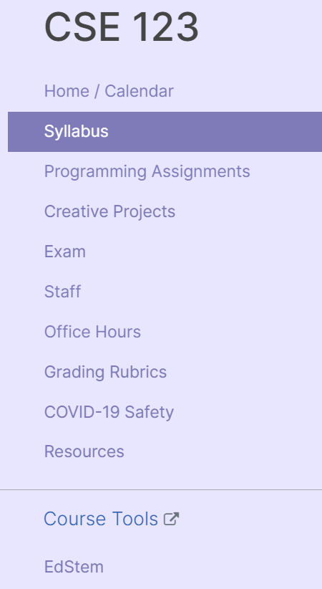
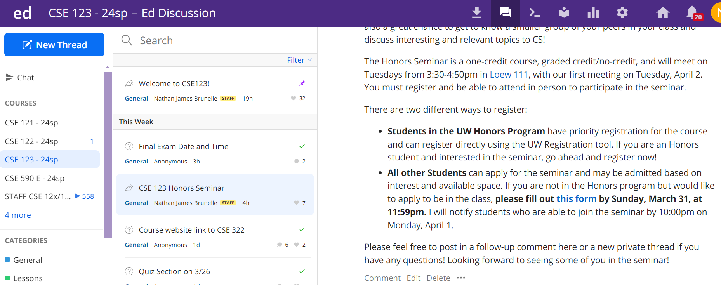
Ed
Our online learning platform
Submit graded work
Receive/View feedback
Message board
Including announcements
Notes:
James
Mention other tools coming soon: VS Code, MyDigitalHand, Sli.do

Slide 20
Questions (2:30)
Can we use break command?
What kind of help is there for brushing up on java or other CSE122 content?
Do resubmission replace the entire grade

Slide 21
Questions (10:30)
Grade calculator?
How do I determine my grade?
Final hand written?
Are all assignments submitted through Ed?
Practice tests vs section question for course prep?
IDE?

Slide 22
P0: Warmup/Review
Will be released today or tomorrow, on Ed.
Not the standard format for assignments going forward, intended to be a series of shorter review questions.
Due Wednesday (4/03)
Notes:
James

Slide 23
Demo
Notes:
Brett

Slide 24
Agenda
About us
About this course
Learning objectives
Other similar courses
Course components
Our learning model
Tools and resources
Course Website
Ed
VS Code
Assessment and grading
Collaboration
Notes:
Here on down comes next week.

Slide 25
Assignments and Grading
Our goal in the course is for you to gain proficiency the concepts and skills we teach
We assess your proficiency by asking you to apply the concepts and skills on tasks or problems
By necessity, we are assessing your work as a proxy for your proficiency

Slide 26
Assignments
Your learning in this course will be assessed in four ways:
Programming Assignments (~biweekly, 4 total)
Structured programming assignments to assess your proficiency of programming concepts
Creative Projects (~biweekly, 4 total)
Smaller, more open-ended assignments to give you space to explore
Quizzes (3 total, in section)
Series of problems covering all material up to that point
Final Exam (Monday, June 3)
Final, culminating assessment of all your skills and knowledge

Slide 27
Resubmission and Quiz Problem Drops
Learning takes time, and doesn’t always happen on the first try
One previous Programming Assignment or Creative Project can be resubmitted each week
Must be accompanied by a write-up describing changes (via Google Form)
Grade on resubmission will replace original grade
Each assignment should only be resubmitted once
You may only submit assignments <4 weeks old
We will drop your two lowest quiz problem grades
No special action required– we’ll do this automatically
See the syllabus for more details

Slide 28
Grading
Grades should reflect your proficiency in the course objectives
All assignments will be graded E (Excellent), S (Satisfactory), or N (Not yet)
Under certain circumstances, a grade of U (Unassessable) may be assigned
In some cases, not all grades will be given
Final grades will be assigned based on the amount of work at each level
See the syllabus for more details

Slide 29
Agenda
About us
About this course
Learning objectives
Other similar courses
Course components
Our learning model
Tools and resources
Course Website
Ed
VS Code
Assessment and grading
Collaboration

Slide 30
Collaboration Policy
Learning is hard, but it’s easier when you learn from each other
You are encouraged to form study groups; work together on pre-class work, practice and review; and discuss your ideas and approaches
All work you submit for grading must be predominantly and substantially your own
Work that violates policy may be withdrawn within 72 hours
See the syllabus for more details

