Slide 1

Recursion
BEFORE WE START
Talk to your neighbors:
What’s your favorite
icebreaker question? 🤔
Instructor:
James Wilcox

Slide 2
Announcements
Quiz 1 Tuesday!
  Topics: Abstract classes, Implementing data structures (ArrayLists / LinkedLists), Runtime
  Topics not on Quiz: Recursion
  Practice quiz is available!
Quiz 0 feedback will be released Friday afternoon
Programming Assignment 1 due in one week (10/30) @ 11:59pm
Resubmission Period 3 closes this Friday (10/25) @ 11:59pm
  Available assignments: C0, P0, C1
  Last opportunity to resubmit C0
Reminder: Grade guarantee calculator

Slide 3
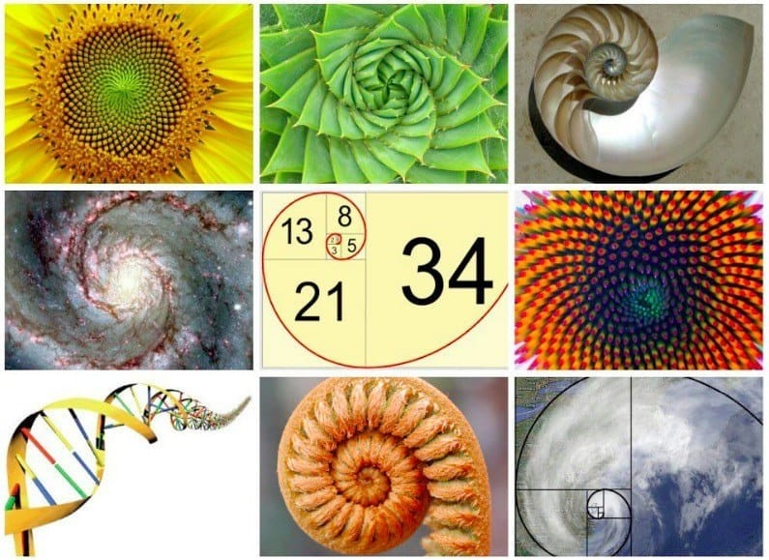

Recursion
“The repeated application of a recursive procedure or definition”
- Oxford Languages
Real-world definition: defining a problem in terms of itself
  Case in point: above definition
  Further natural examples:

Slide 4

Recursion
“The repeated application of a recursive procedure or definition”
- Oxford Languages
Real-world definition: defining a problem in terms of itself
  Case in point: above definition
  Further natural examples:

Slide 5
Recursion
“The repeated application of a recursive procedure or definition”
- Oxford Languages
Real-world definition: defining a problem in terms of itself
  Case in point: above definition
Computer science definition: when a method calls itself
  “Alternative” to iteration (can combine for powerful results)
🤔 Wouldn’t that just lead to an infinite loop?
  Yes! If you do things wrong…
  Let’s review how method calls work

Slide 6
Method Calls
Regardless how you use them, methods work the same way!
  Pause execution, finish method, return where you left off
How does Java keep track of the prior method (LIFO)?
  Something called the Call Stack

Slide 7
Call Stack
Call Stack
top
main()
Console:
bottom
public static void main(String[] args) {
mystery1();
mystery2();
}
public static void mystery1() {
System.out.println(“One”);
}
public static void mystery2() {
System.out.println(“Two”);
mystery3();
}
public static void mystery3() {
System.out.println(“Three”);
}

Slide 8
Call Stack
Call Stack
top
main()
Console:
bottom
public static void main(String[] args) {
mystery1();
mystery2();
}
public static void mystery1() {
System.out.println(“One”);
}
public static void mystery2() {
System.out.println(“Two”);
mystery3();
}
public static void mystery3() {
System.out.println(“Three”);
}

Slide 9
Call Stack
Call Stack
top
mystery1()
main()
Console:
bottom
public static void main(String[] args) {
mystery1();
mystery2();
}
public static void mystery1() {
System.out.println(“One”);
}
public static void mystery2() {
System.out.println(“Two”);
mystery3();
}
public static void mystery3() {
System.out.println(“Three”);
}

Slide 10
Call Stack
Call Stack
top
mystery1()
main()
Console:
One
bottom
public static void main(String[] args) {
mystery1();
mystery2();
}
public static void mystery1() {
System.out.println(“One”);
}
public static void mystery2() {
System.out.println(“Two”);
mystery3();
}
public static void mystery3() {
System.out.println(“Three”);
}

Slide 11
Call Stack
Call Stack
top
main()
Console:
One
bottom
public static void main(String[] args) {
mystery1();
mystery2();
}
public static void mystery1() {
System.out.println(“One”);
}
public static void mystery2() {
System.out.println(“Two”);
mystery3();
}
public static void mystery3() {
System.out.println(“Three”);
}

Slide 12
Call Stack
Call Stack
top
main()
Console:
One
bottom
public static void main(String[] args) {
mystery1();
mystery2();
}
public static void mystery1() {
System.out.println(“One”);
}
public static void mystery2() {
System.out.println(“Two”);
mystery3();
}
public static void mystery3() {
System.out.println(“Three”);
}

Slide 13
Call Stack
Call Stack
top
mystery2()
main()
Console:
One
bottom
public static void main(String[] args) {
mystery1();
mystery2();
}
public static void mystery1() {
System.out.println(“One”);
}
public static void mystery2() {
System.out.println(“Two”);
mystery3();
}
public static void mystery3() {
System.out.println(“Three”);
}

Slide 14
Call Stack
Call Stack
top
mystery2()
main()
Console:
One
Two
bottom
public static void main(String[] args) {
mystery1();
mystery2();
}
public static void mystery1() {
System.out.println(“One”);
}
public static void mystery2() {
System.out.println(“Two”);
mystery3();
}
public static void mystery3() {
System.out.println(“Three”);
}

Slide 15
Call Stack
Call Stack
top
mystery2()
main()
Console:
One
Two
bottom
public static void main(String[] args) {
mystery1();
mystery2();
}
public static void mystery1() {
System.out.println(“One”);
}
public static void mystery2() {
System.out.println(“Two”);
mystery3();
}
public static void mystery3() {
System.out.println(“Three”);
}

Slide 16
Call Stack
Call Stack
top
mystery3()
mystery2()
main()
Console:
One
Two
bottom
public static void main(String[] args) {
mystery1();
mystery2();
}
public static void mystery1() {
System.out.println(“One”);
}
public static void mystery2() {
System.out.println(“Two”);
mystery3();
}
public static void mystery3() {
System.out.println(“Three”);
}

Slide 17
Call Stack
Call Stack
top
mystery3()
mystery2()
main()
Console:
One
Two
Three
bottom
public static void main(String[] args) {
mystery1();
mystery2();
}
public static void mystery1() {
System.out.println(“One”);
}
public static void mystery2() {
System.out.println(“Two”);
mystery3();
}
public static void mystery3() {
System.out.println(“Three”);
}

Slide 18
Call Stack
Call Stack
top
mystery2()
main()
Console:
One
Two
Three
bottom
public static void main(String[] args) {
mystery1();
mystery2();
}
public static void mystery1() {
System.out.println(“One”);
}
public static void mystery2() {
System.out.println(“Two”);
mystery3();
}
public static void mystery3() {
System.out.println(“Three”);
}

Slide 19
Call Stack
Call Stack
top
main()
Console:
One
Two
Three
bottom
public static void main(String[] args) {
mystery1();
mystery2();
}
public static void mystery1() {
System.out.println(“One”);
}
public static void mystery2() {
System.out.println(“Two”);
mystery3();
}
public static void mystery3() {
System.out.println(“Three”);
}

Slide 20
Call Stack
Call Stack
top
Console:
One
Two
Three
bottom
public static void main(String[] args) {
mystery1();
mystery2();
}
public static void mystery1() {
System.out.println(“One”);
}
public static void mystery2() {
System.out.println(“Two”);
mystery3();
}
public static void mystery3() {
System.out.println(“Three”);
}

Slide 21
Method Calls
Regardless how you use them, methods work the same way!
  Pause execution, finish method, return where you left off
How does Java keep track of the prior method (LIFO)?
  Something called the Call Stack
🤔 Wouldn’t that just lead to an infinite loop?
recursion()
recursion()
recursion()
Call Stack
recursion()
recursion()
top
...
recursion()
public static void recursion() {
System.out.println(“Woah”);
recursion();
}
recursion()
recursion()
recursion()
recursion()
recursion()
main()
bottom

Slide 22
Method Calls
Regardless how you use them, methods work the same way!
  Pause execution, finish method, return where you left off
How does Java keep track of the prior method (LIFO)?
  Something called the Call Stack
🤔 Wouldn’t that just lead to an infinite loop?
  Yes! We get something called a StackOverflowException
How do we avoid infinite recursion?

Slide 23





Recursive Methods
2 components of every recursive method:
Recursive case
  Decompose problem into subproblem
  Make the actual recursive call
  Combine results meaningfully
Base case
  Simplest version of the problem
  No subproblems to break into
  Return known answer

Slide 24
Recursive Methods
2 components of every recursive method:
Recursive case
  Decompose problem into subproblem
  Make the actual recursive call
  Combine results meaningfully
Base case
  Simplest version of the problem
  No subproblems to break into
  Return known answer
If decomposing moves you closer to the base, no infinite recursion!

Slide 26

Math Examples
n! / factorial(n) = product of all positive integers <= n
Two ways of viewing this idea:
$n!=n∗\left(n−1\right)∗\left(n−2\right)∗…∗2∗1$
  Iterative approach - loop through all values and multiply together
$n!=n∗\left(n−1\right)!$
  Recursive approach – decompose into subproblem and combine
  What would our base case / simplest input ($n$) be?

Slide 27






Math Examples
n! / factorial(n) = product of all positive integers <= n
Reminder, recursive approach: $n!=n∗\left(n−1\right)!$
  Let’s trace through with a simple example 3!
$$4!=4∗3!$$
$$3!=3∗2!$$
$$2!=2∗1!$$
$$1!=1∗0!$$
$$0!=1$$

Slide 28
Math Examples
n! / factorial(n) = product of all positive integers <= n
Reminder, recursive approach: $n!=n∗\left(n−1\right)!$
  Let’s trace through with a simple example 3!
$$4!=4∗3!$$
$$3!=3∗2!$$
$$2!=2∗1!$$
$$1!=1∗0!$$
$$0!=1$$

Slide 29

Math Examples
n! / factorial(n) = product of all positive integers <= n
Reminder, recursive approach: $n!=n∗\left(n−1\right)!$
  Let’s trace through with a simple example 3!
$$4!=4∗3!$$
$$3!=3∗2!$$
$$2!=2∗1!$$
$$1!=1∗1$$

Slide 30

Math Examples
n! / factorial(n) = product of all positive integers <= n
Reminder, recursive approach: $n!=n∗\left(n−1\right)!$
  Let’s trace through with a simple example 3!
$$4!=4∗3!$$
$$3!=3∗2!$$
$$2!=2∗1!$$
$$1!=1$$

Slide 31

Math Examples
n! / factorial(n) = product of all positive integers <= n
Reminder, recursive approach: $n!=n∗\left(n−1\right)!$
  Let’s trace through with a simple example 3!
$$4!=4∗3!$$
$$3!=3∗2!$$
$$2!=2∗1$$

Slide 32

Math Examples
n! / factorial(n) = product of all positive integers <= n
Reminder, recursive approach: $n!=n∗\left(n−1\right)!$
  Let’s trace through with a simple example 3!
$$4!=4∗3!$$
$$3!=3∗2!$$
$$2!=2$$

Slide 33

Math Examples
n! / factorial(n) = product of all positive integers <= n
Reminder, recursive approach: $n!=n∗\left(n−1\right)!$
  Let’s trace through with a simple example 3!
$$4!=4∗3!$$
$$3!=3∗2$$

Slide 34

Math Examples
n! / factorial(n) = product of all positive integers <= n
Reminder, recursive approach: $n!=n∗\left(n−1\right)!$
  Let’s trace through with a simple example 3!
$$4!=4∗3!$$
$$3!=6$$

Slide 35

Math Examples
n! / factorial(n) = product of all positive integers <= n
Reminder, recursive approach: $n!=n∗\left(n−1\right)!$
  Let’s trace through with a simple example 3!
$$4!=4∗6$$

Slide 36

Math Examples
n! / factorial(n) = product of all positive integers <= n
Reminder, recursive approach: $n!=n∗\left(n−1\right)!$
  Let’s trace through with a simple example 3!
$$4!=24$$

