Slide 1
Linked Nodes
BEFORE WE START
Talk to your neighbors:
What’s your favorite data structure to use?
Instructor:
James Wilcox

Slide 2
Reference Semantics
In Java, variables are treated two different ways:
We often draw “reference diagrams” to keep track of everything
Value Semantics | Reference Semantics
Primitive types (int, double, boolean) + Strings | Object types (int[], Scanner, ArrayList)
Values stored locally | Values stored in memory, reference stored locally
Initialization copies value (many copies of value) | Initialization copies reference (only one value)
int x = 10; int y = x; y++; // x remains unchanged | int[] x = new int[5]; int[] y = x; y[0]++; // x[0] changed
x
10
y

Slide 3
Reference Semantics
In Java, variables are treated two different ways:
We often draw “reference diagrams” to keep track of everything
Value Semantics | Reference Semantics
Primitive types (int, double, boolean) + Strings | Object types (int[], Scanner, ArrayList)
Values stored locally | Values stored in memory, reference stored locally
Initialization copies value (many copies of value) | Initialization copies reference (only one value)
int x = 10; int y = x; y++; // x remains unchanged | int[] x = new int[5]; int[] y = x; y[0]++; // x[0] changed
x
10
y
10

Slide 4
Reference Semantics
In Java, variables are treated two different ways:
We often draw “reference diagrams” to keep track of everything
Value Semantics | Reference Semantics
Primitive types (int, double, boolean) + Strings | Object types (int[], Scanner, ArrayList)
Values stored locally | Values stored in memory, reference stored locally
Initialization copies value (many copies of value) | Initialization copies reference (only one value)
int x = 10; int y = x; y++; // x remains unchanged | int[] x = new int[5]; int[] y = x; y[0]++; // x[0] changed
x
10
y
11

Slide 5
Reference Semantics
In Java, variables are treated two different ways:
We often draw “reference diagrams” to keep track of everything
Value Semantics | Reference Semantics
Primitive types (int, double, boolean) + Strings | Object types (int[], Scanner, ArrayList)
Values stored locally | Values stored in memory, reference stored locally
Initialization copies value (many copies of value) | Initialization copies reference (only one value)
int x = 10; int y = x; y++; // x remains unchanged | int[] x = new int[5]; int[] y = x; y[0]++; // x[0] changed
x
y
0 | 0 | 0 | 0 | 0

Slide 6
Reference Semantics
In Java, variables are treated two different ways:
We often draw “reference diagrams” to keep track of everything
Value Semantics | Reference Semantics
Primitive types (int, double, boolean) + Strings | Object types (int[], Scanner, ArrayList)
Values stored locally | Values stored in memory, reference stored locally
Initialization copies value (many copies of value) | Initialization copies reference (only one value)
int x = 10; int y = x; y++; // x remains unchanged | int[] x = new int[5]; int[] y = x; y[0]++; // x[0] changed
x
y
0 | 0 | 0 | 0 | 0

Slide 7
Reference Semantics
In Java, variables are treated two different ways:
We often draw “reference diagrams” to keep track of everything
Value Semantics | Reference Semantics
Primitive types (int, double, boolean) + Strings | Object types (int[], Scanner, ArrayList)
Values stored locally | Values stored in memory, reference stored locally
Initialization copies value (many copies of value) | Initialization copies reference (only one value)
int x = 10; int y = x; y++; // x remains unchanged | int[] x = new int[5]; int[] y = x; y[0]++; // x[0] changed
x
y
1 | 0 | 0 | 0 | 0

Slide 8
More trains!

Slide 9
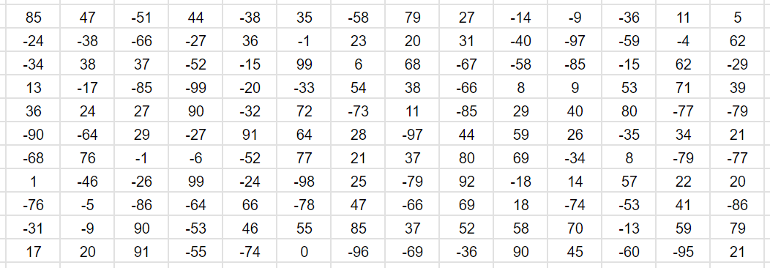
Contiguous vs. Non-contiguous
Computer memory = one really, really big array.
Memory

Slide 10
Contiguous vs. Non-contiguous
Computer memory = one really, really big array.
int[] arr = new int[10];
Memory
arr

Slide 11
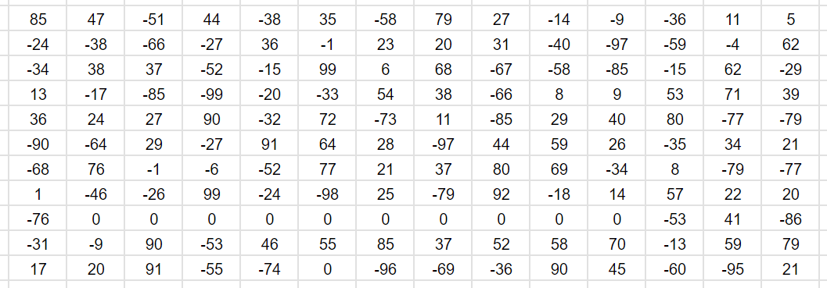
Contiguous vs. Non-contiguous
Computer memory = one really, really big array.
int[] arr = new int[10];
Memory
arr
We call this “contiguous” memory

Slide 12
Contiguous vs. Non-contiguous
Computer memory = one really, really big array.
EngineCar engine = new EngineCar(“Empire Builder”, 10,
new SleeperCar(10));
Memory
engine

Slide 13
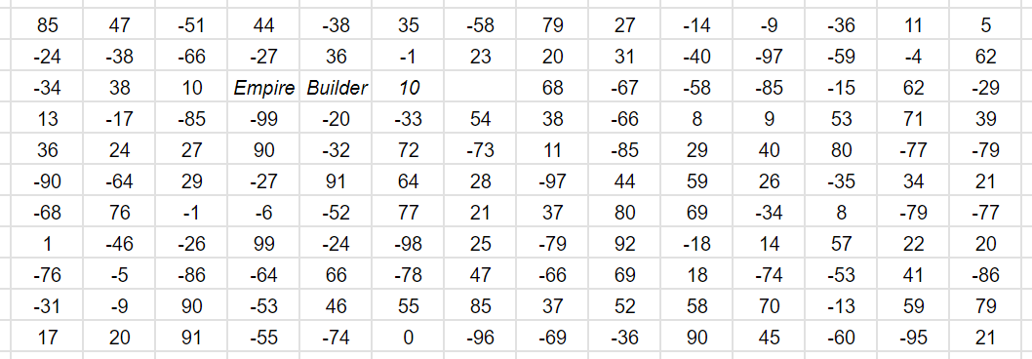
Contiguous vs. Non-contiguous
Computer memory = one really, really big array.
EngineCar engine = new EngineCar(“Empire Builder”, 10,
new SleeperCar(10));
Memory
engine

Slide 14
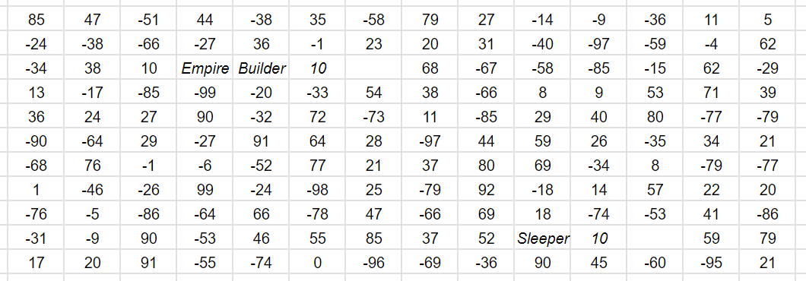
Contiguous vs. Non-contiguous
Computer memory = one really, really big array.
EngineCar engine = new EngineCar(“Empire Builder”, 10,
new SleeperCar(10));
Memory
engine

Slide 15
Contiguous vs. Non-contiguous
Computer memory = one really, really big array.
EngineCar engine = new EngineCar(“Empire Builder”, 10,
new SleeperCar(10));
Memory
engine
We call this “non-contiguous” memory

Slide 16
Contiguous vs. Non-contiguous
Computer memory = one really, really big array.
Contiguous memory = impossible to resize directly
Surrounding stuff in memory (we can’t just overwrite)
Best we can manage is get more space and copy
Non-contiguous memory = easy to resize
Just get some more memory and link it to the rest
Is it possible to create a non-contiguous List implementation?
Could make the resizing / shifting problems easier…

Slide 17
Linked Nodes

Slide 18
Linked Nodes
We want to chain together ints “non-contiguously”
A bunch of train cars where each is responsible for a single integer
Accomplish this with nodes we link together
Each node stores an int (data) and an reference to the next node (next)
data
next
node

Slide 19
ListNode
Java class representing a “node”
Two fields to store discussed state:
Fields are public?! We’ll come back to this
Why can ListNode be a field in the ListNode class?
public class ListNode {
public int data;
public ListNode next;
}

Slide 20
Iterating over ListNodes
General pattern iteration code will follow:
ListNode curr = front;
while (curr != null) {
// Do something
curr = curr.next;
}

