Slide 1
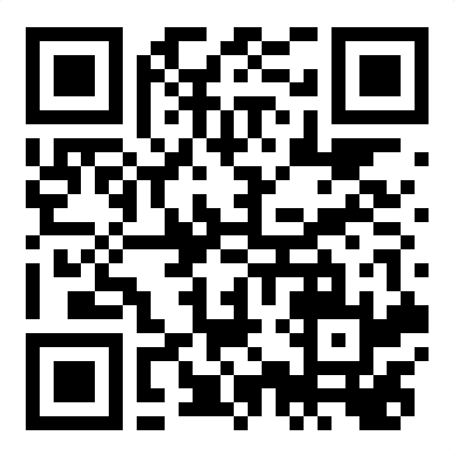
Victory Lap & Next Steps
BEFORE WE START
Talk to your neighbors:
What was your favorite thing you learned about this quarter? Why?
Instructor:
James Wilcox

Slide 2
Announcements
C3 due tonight (12/6) at 11:59pm
R8/R-James due Sunday (12/8) at 11:59pm
Two forms to submit! Both on the Ed board.
R8 open to C3 if you need two extra days instead of another resub
R-James open to all assignments w/ feedback released
IPL closes end of day today (12/6)
Not open this weekend or next week
Final Exam Tuesday (12/10) @ 12:30pm-2:30pm in KNE 120/130
Seating chart now posted on the course website!
Typical rules for quizzes, note sheet (8.5” x 11” double-sided, typed or handwritten)
Please fill out course evaluation by Sunday night

Slide 3
[Recap] Why 123?
To solve more complex problems by leveraging more complex programming structures / patterns
To better rationalize specific design decisions
How to “best” structure classes to reduce redundancy
Which ADT implementations are “most” appropriate to use
To understand and critically analyze intersections between Computer Science and society
Search engines, algorithmic art, machine learning, etc.
Developing informed opinions on current issues
Be a better programmer
Be a better person

Slide 4
[Recap] Topics Covered
Advanced Object-Oriented Programming (OOP)
Inheritance, Polymorphism, Abstract classes
Implementing Abstract Data Types (ADTs)
ArrayIntList (int[] elementData, int size)
LinkedIntList (ListNode front)
Java’s ArrayList & LinkedList (int size, ListNode back)
Runtime (Complexity & Big O notation)
Recursion
Recursive definitions (n! = n * (n – 1)!)
(Implicit) Base and Recursive cases
Public / private pairs
LinkedLists w/ recursion (x = change(x))
Binary Trees
Binary Search Trees (BST) & Runtime
Exhaustive Search / Recursive Backtracking
Dead ends / Choose, explore Un-choose
Machine Learning & Hashing
You’ve learned A LOT!!!
(hopefully)
Assessable content

Slide 5
Future Courses
Also: bringing computational thinking to other fields!
Tons of options for everyone!
Self study always valid too!
Non-CSE Majors
Course | Overview
CSE 154 | Intro to web programming
CSE 163 | Intermediate programming, data analysis
CSE 180 | Introduction to data science
CSE 373 | Data structures and algorithms
CSE 374 | Low-level programming and tools
CSE 412 | Data Visualization
CSE 416 | Intro. to Machine Learning
CSE Majors
Course | Overview
CSE 311 | Mathematical foundations
CSE 351 | Low-level computer organization/abstraction
CSE 331 | Software design/implementation
CSE 341 | Programming languages
CSE 344 | Data Management (databases)
https://www.cs.washington.edu/academics/ugrad/current-students
https://www.cs.washington.edu/academics/ugrad/nonmajor-options/nonmajor-courses

Slide 6
Future Projects
At this point, you know 90% of the fundamentals you need to accomplish practically any project
Hurdle will typically be learning the syntax of a new language, using github, importing external libraries, etc.
Some ideas:
Make a Minecraft mod! (Java) [link]
Make discord bot! (Python) [link]
Make personal website! (HTML, CSS, Javascript) [link]
Convert a project from this course into a more user-friendly application
C1, make a Graphical User Interface (GUI) [link]
P3, refine the Email class until you get an accuracy you’re happy with
Really, anything you want!!!*
*Warning: it’s often hard to tell what computers can do easily and what they struggle with…

Slide 7
Frequently Asked Questions
How can I get better at programming?
Practice!
How can I learn to X?
Search online, read books, look at examples
Start with something that already works (try github), then make changes!
What should I work on next?
Anything you can think of! (See previous slide for some ideas)
Should I learn another language? Which one?
Depends on what you want to do!
Python: Data Science & Machine Learning
JavaScript: Web Dev
C / C++: Systems Programming

Slide 8
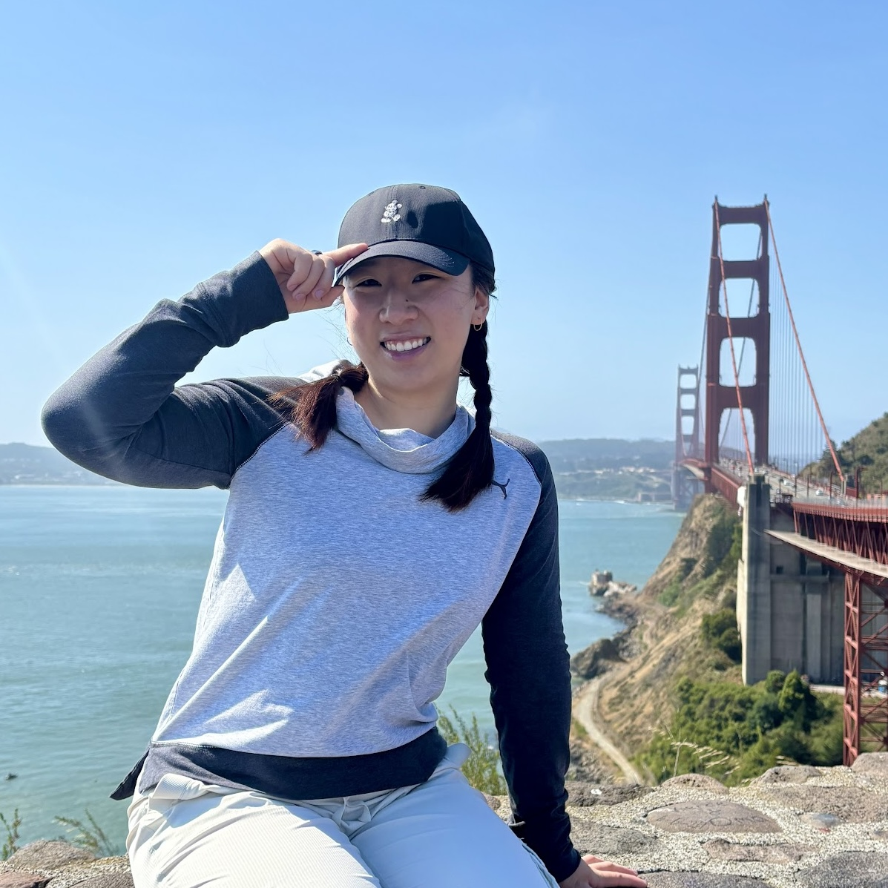
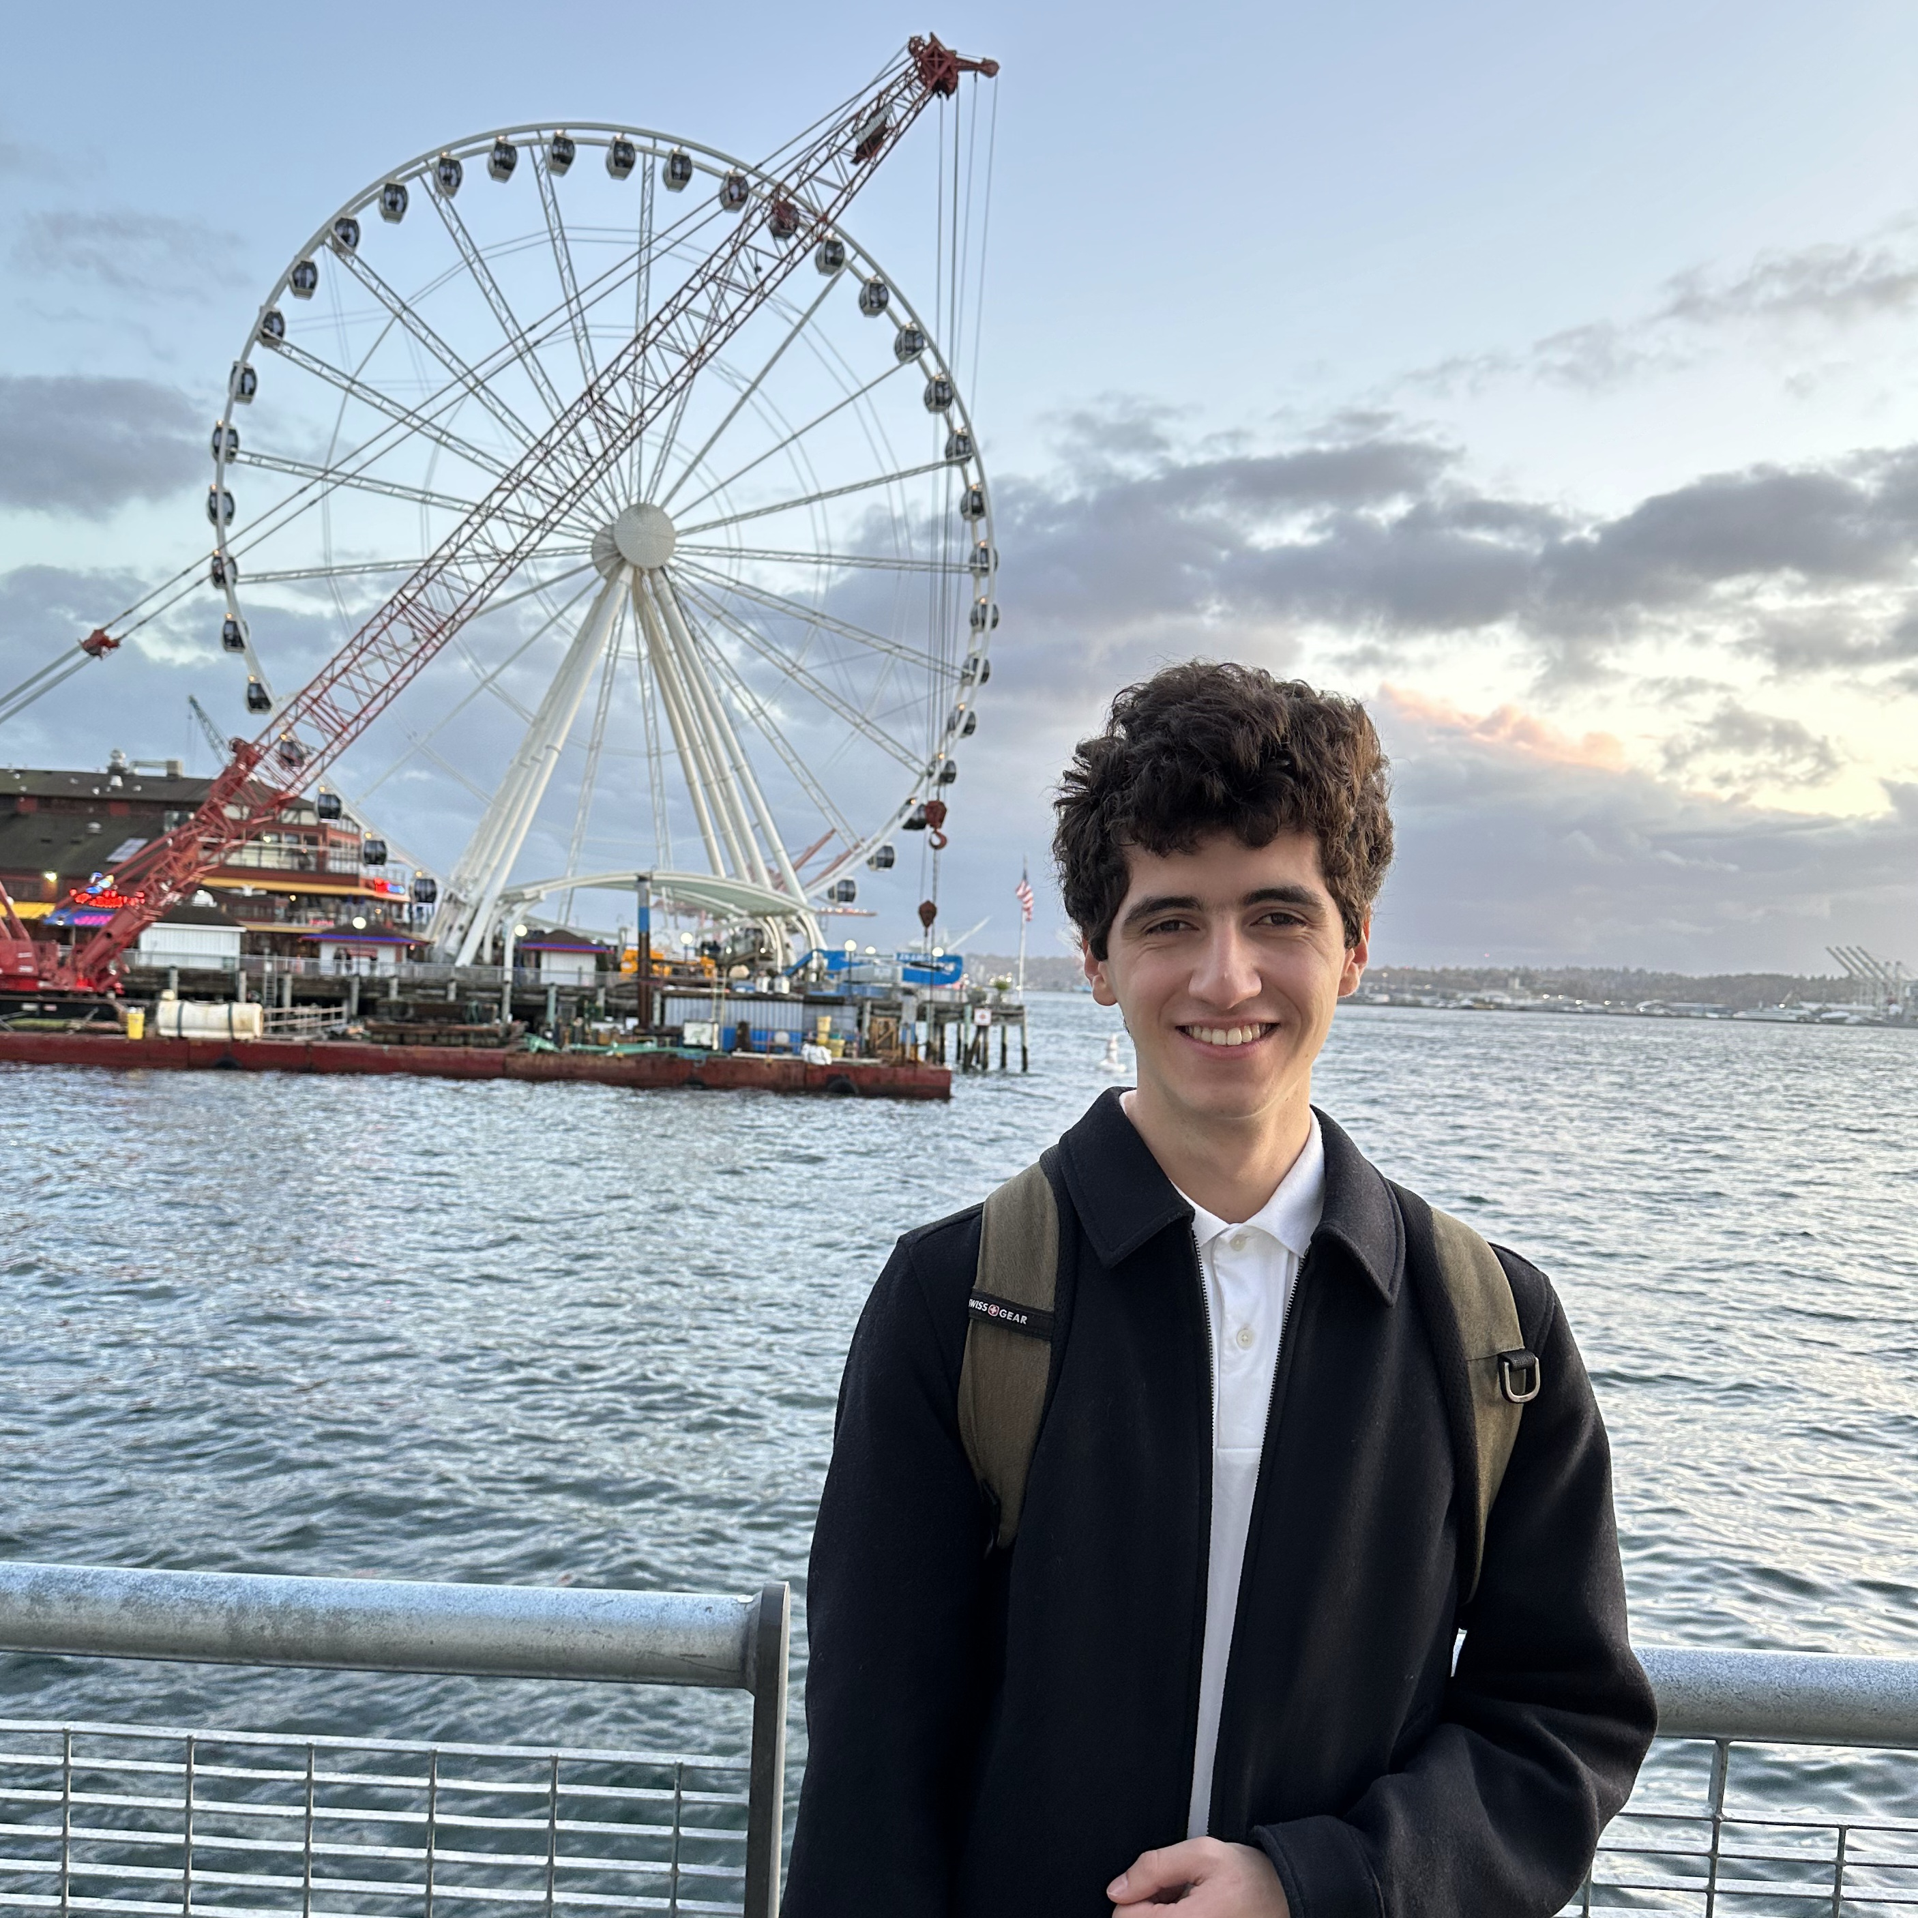
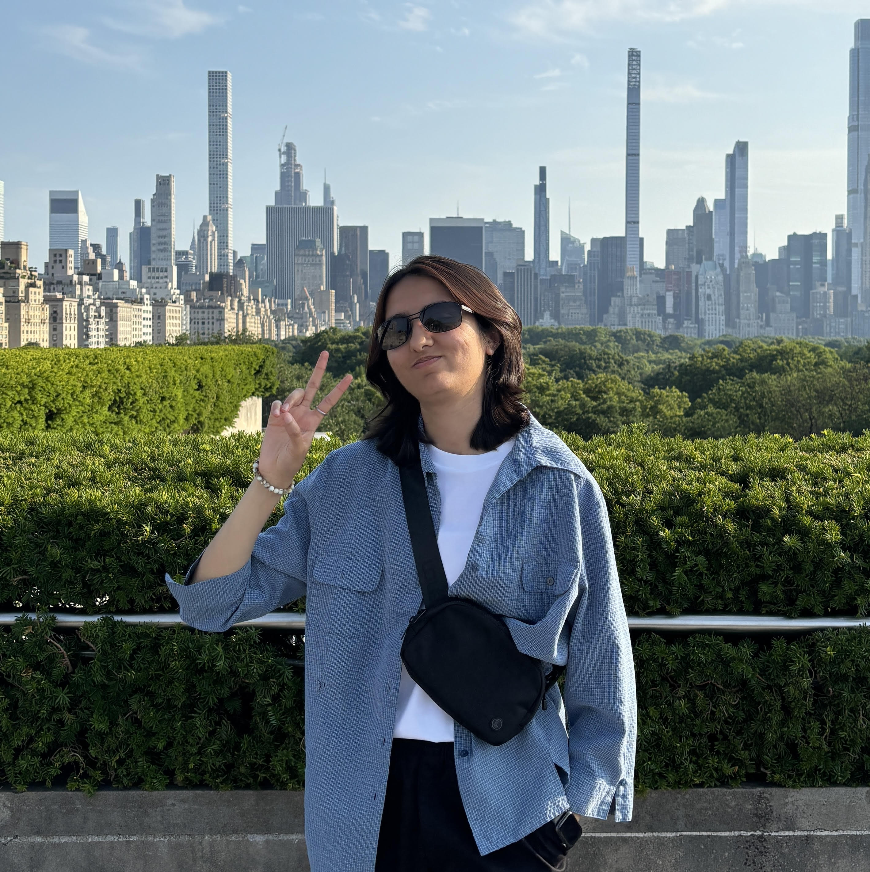
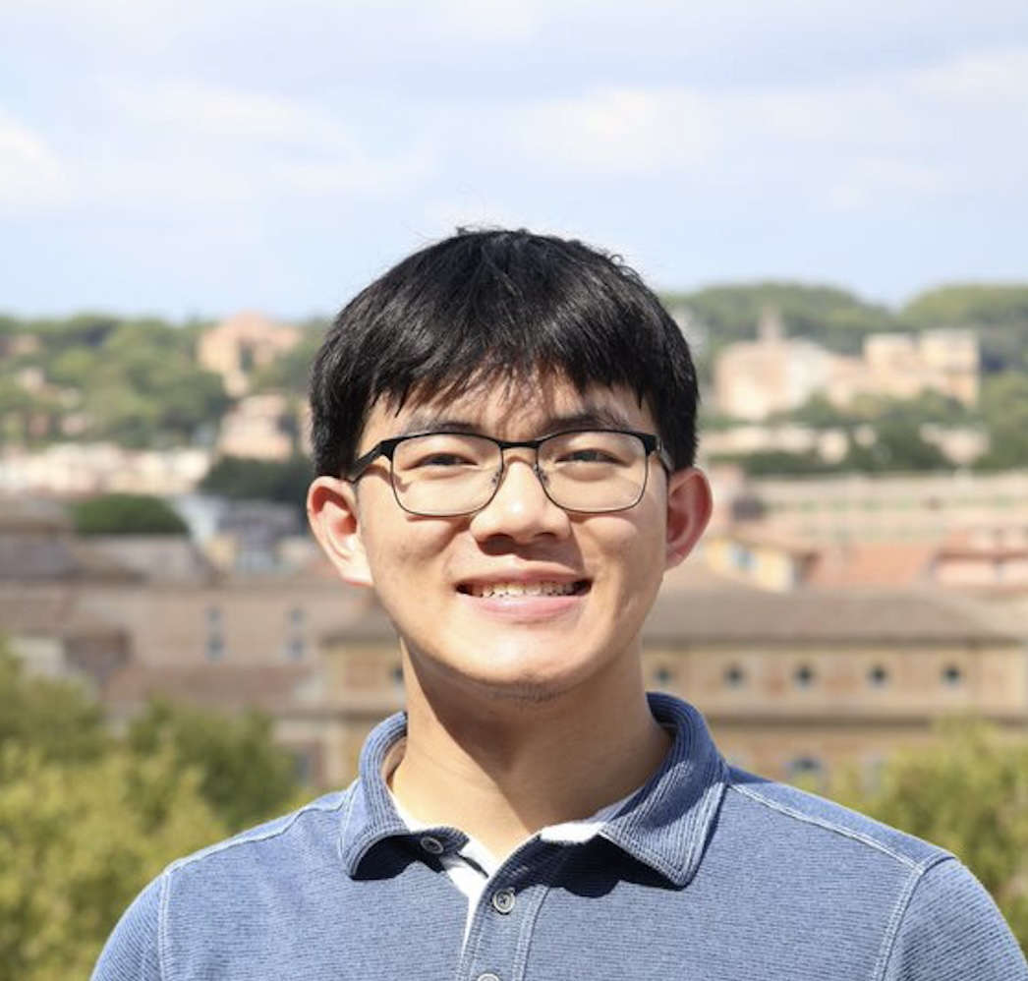
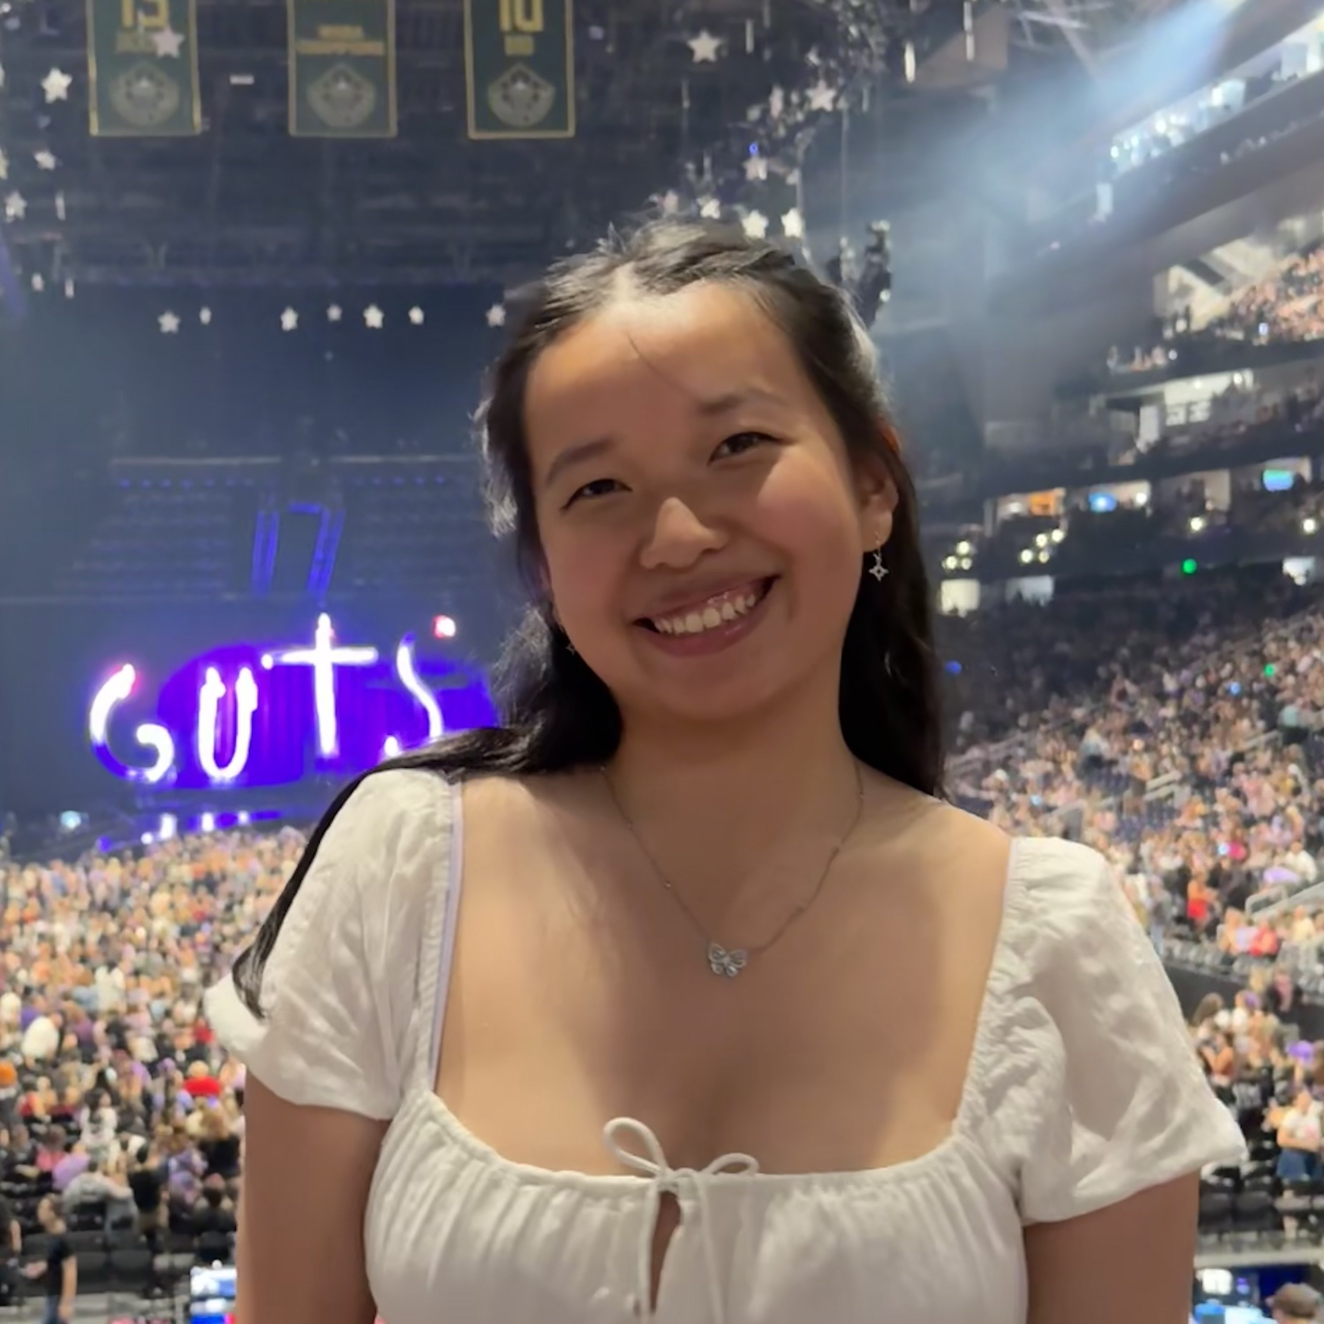
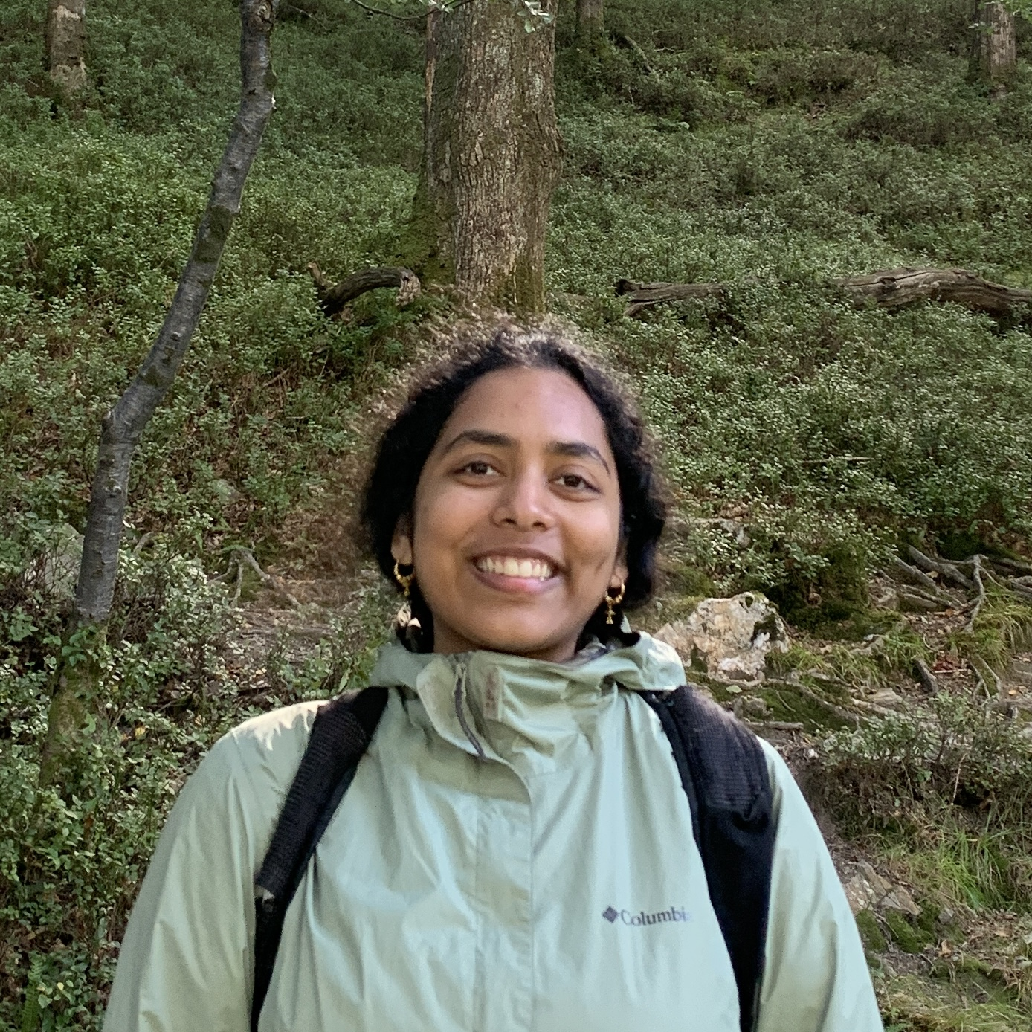
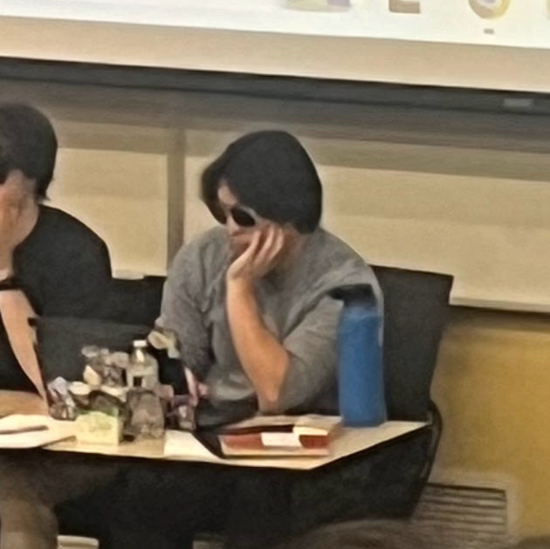
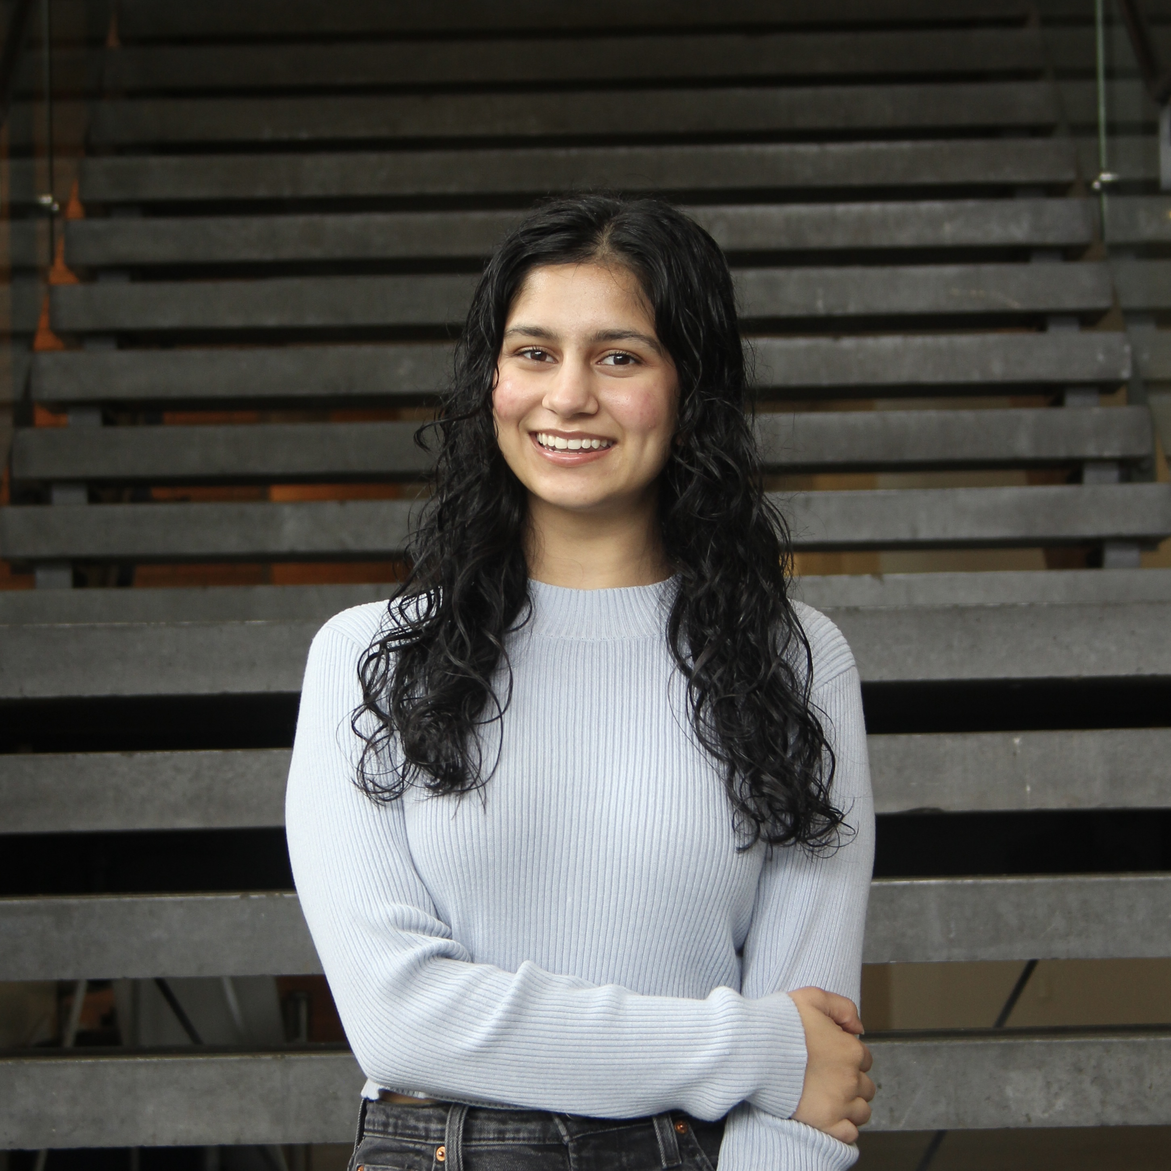
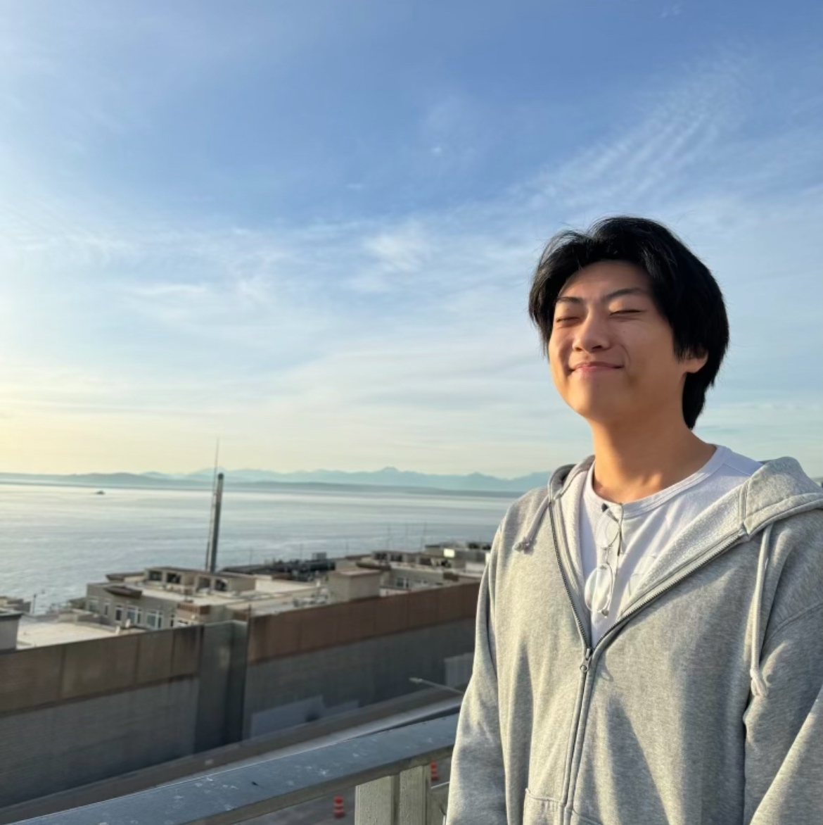
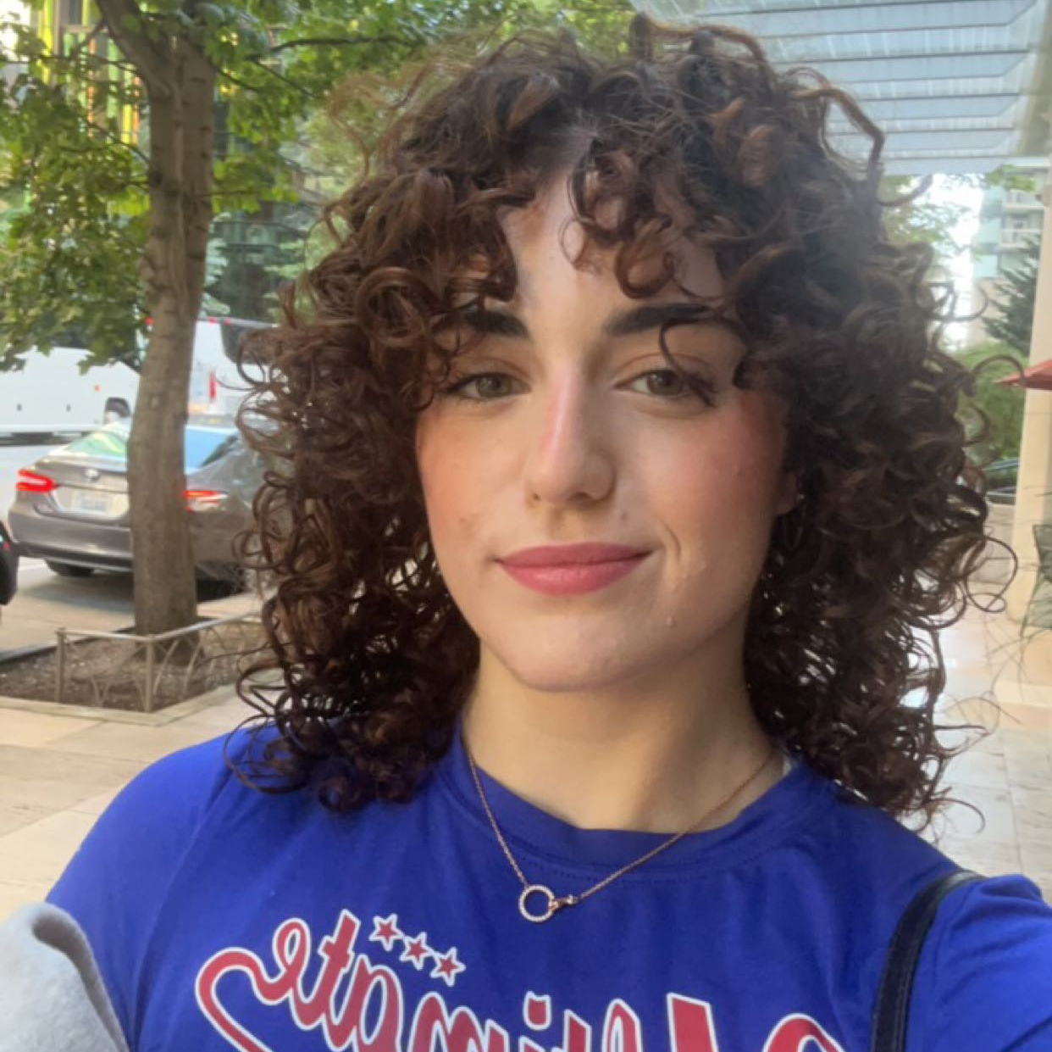
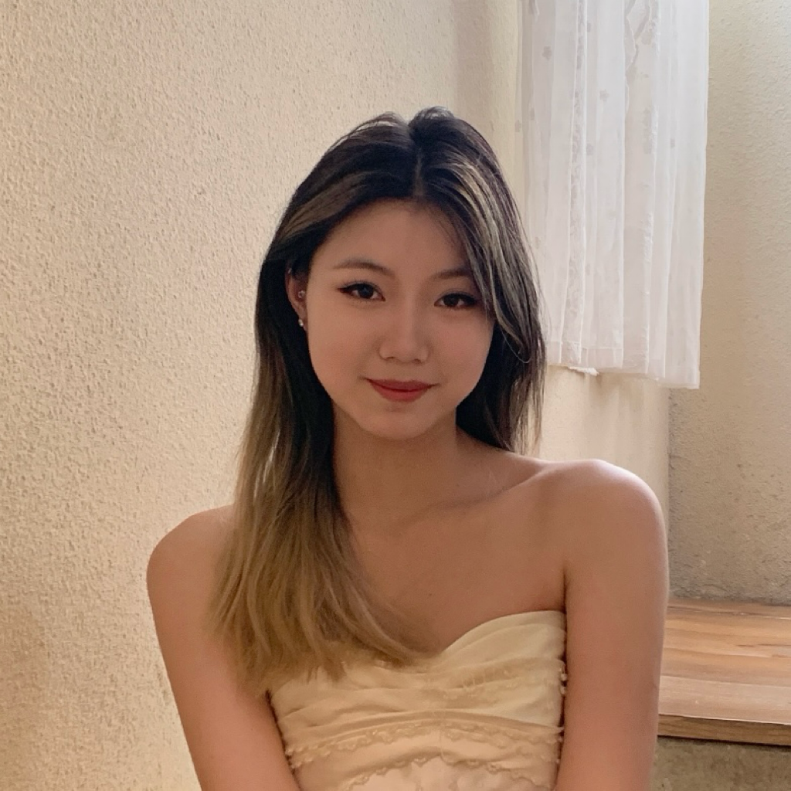
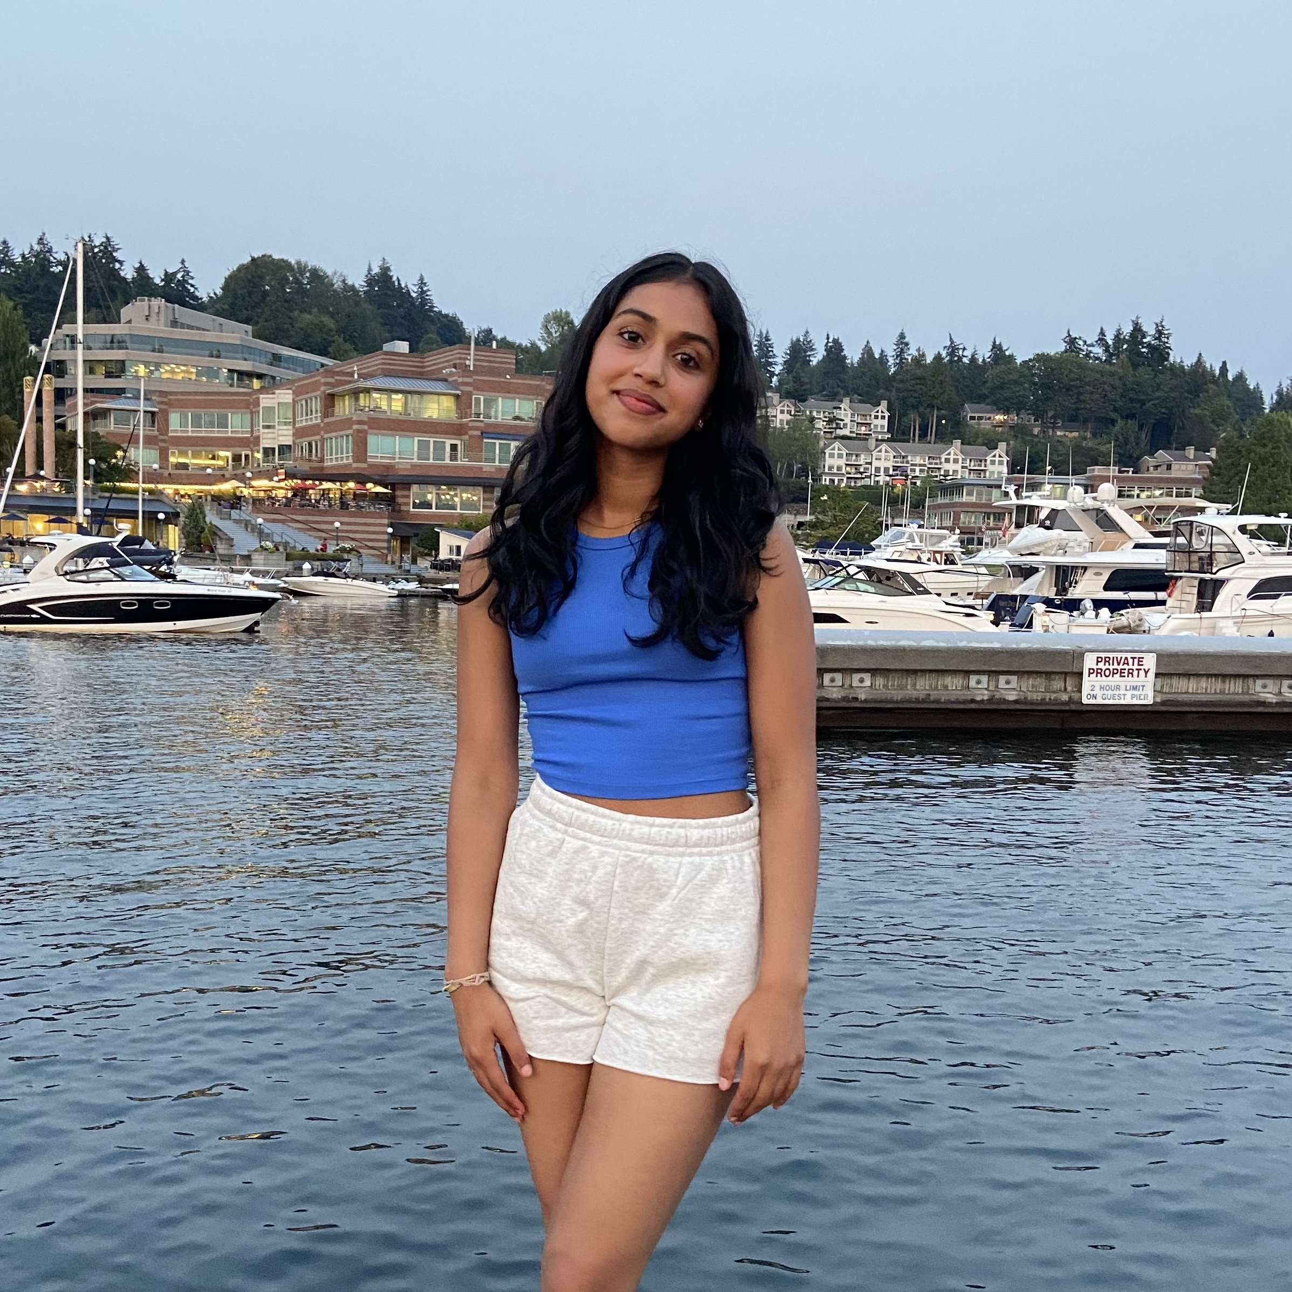
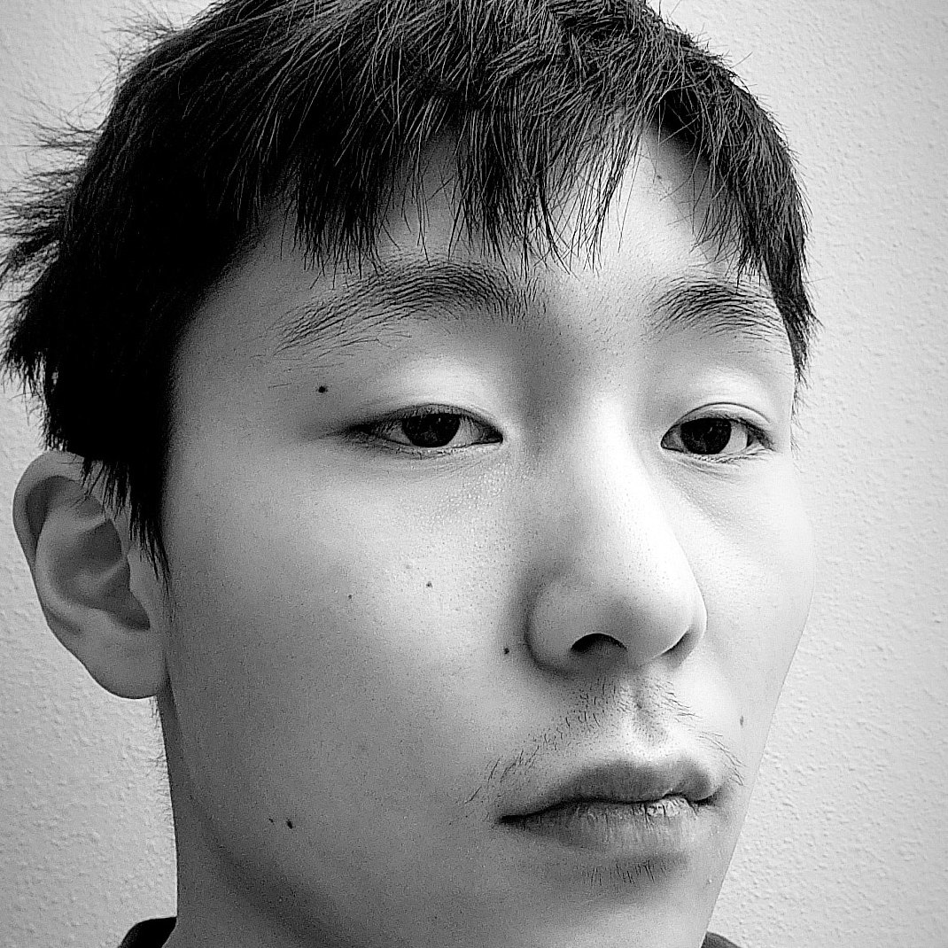
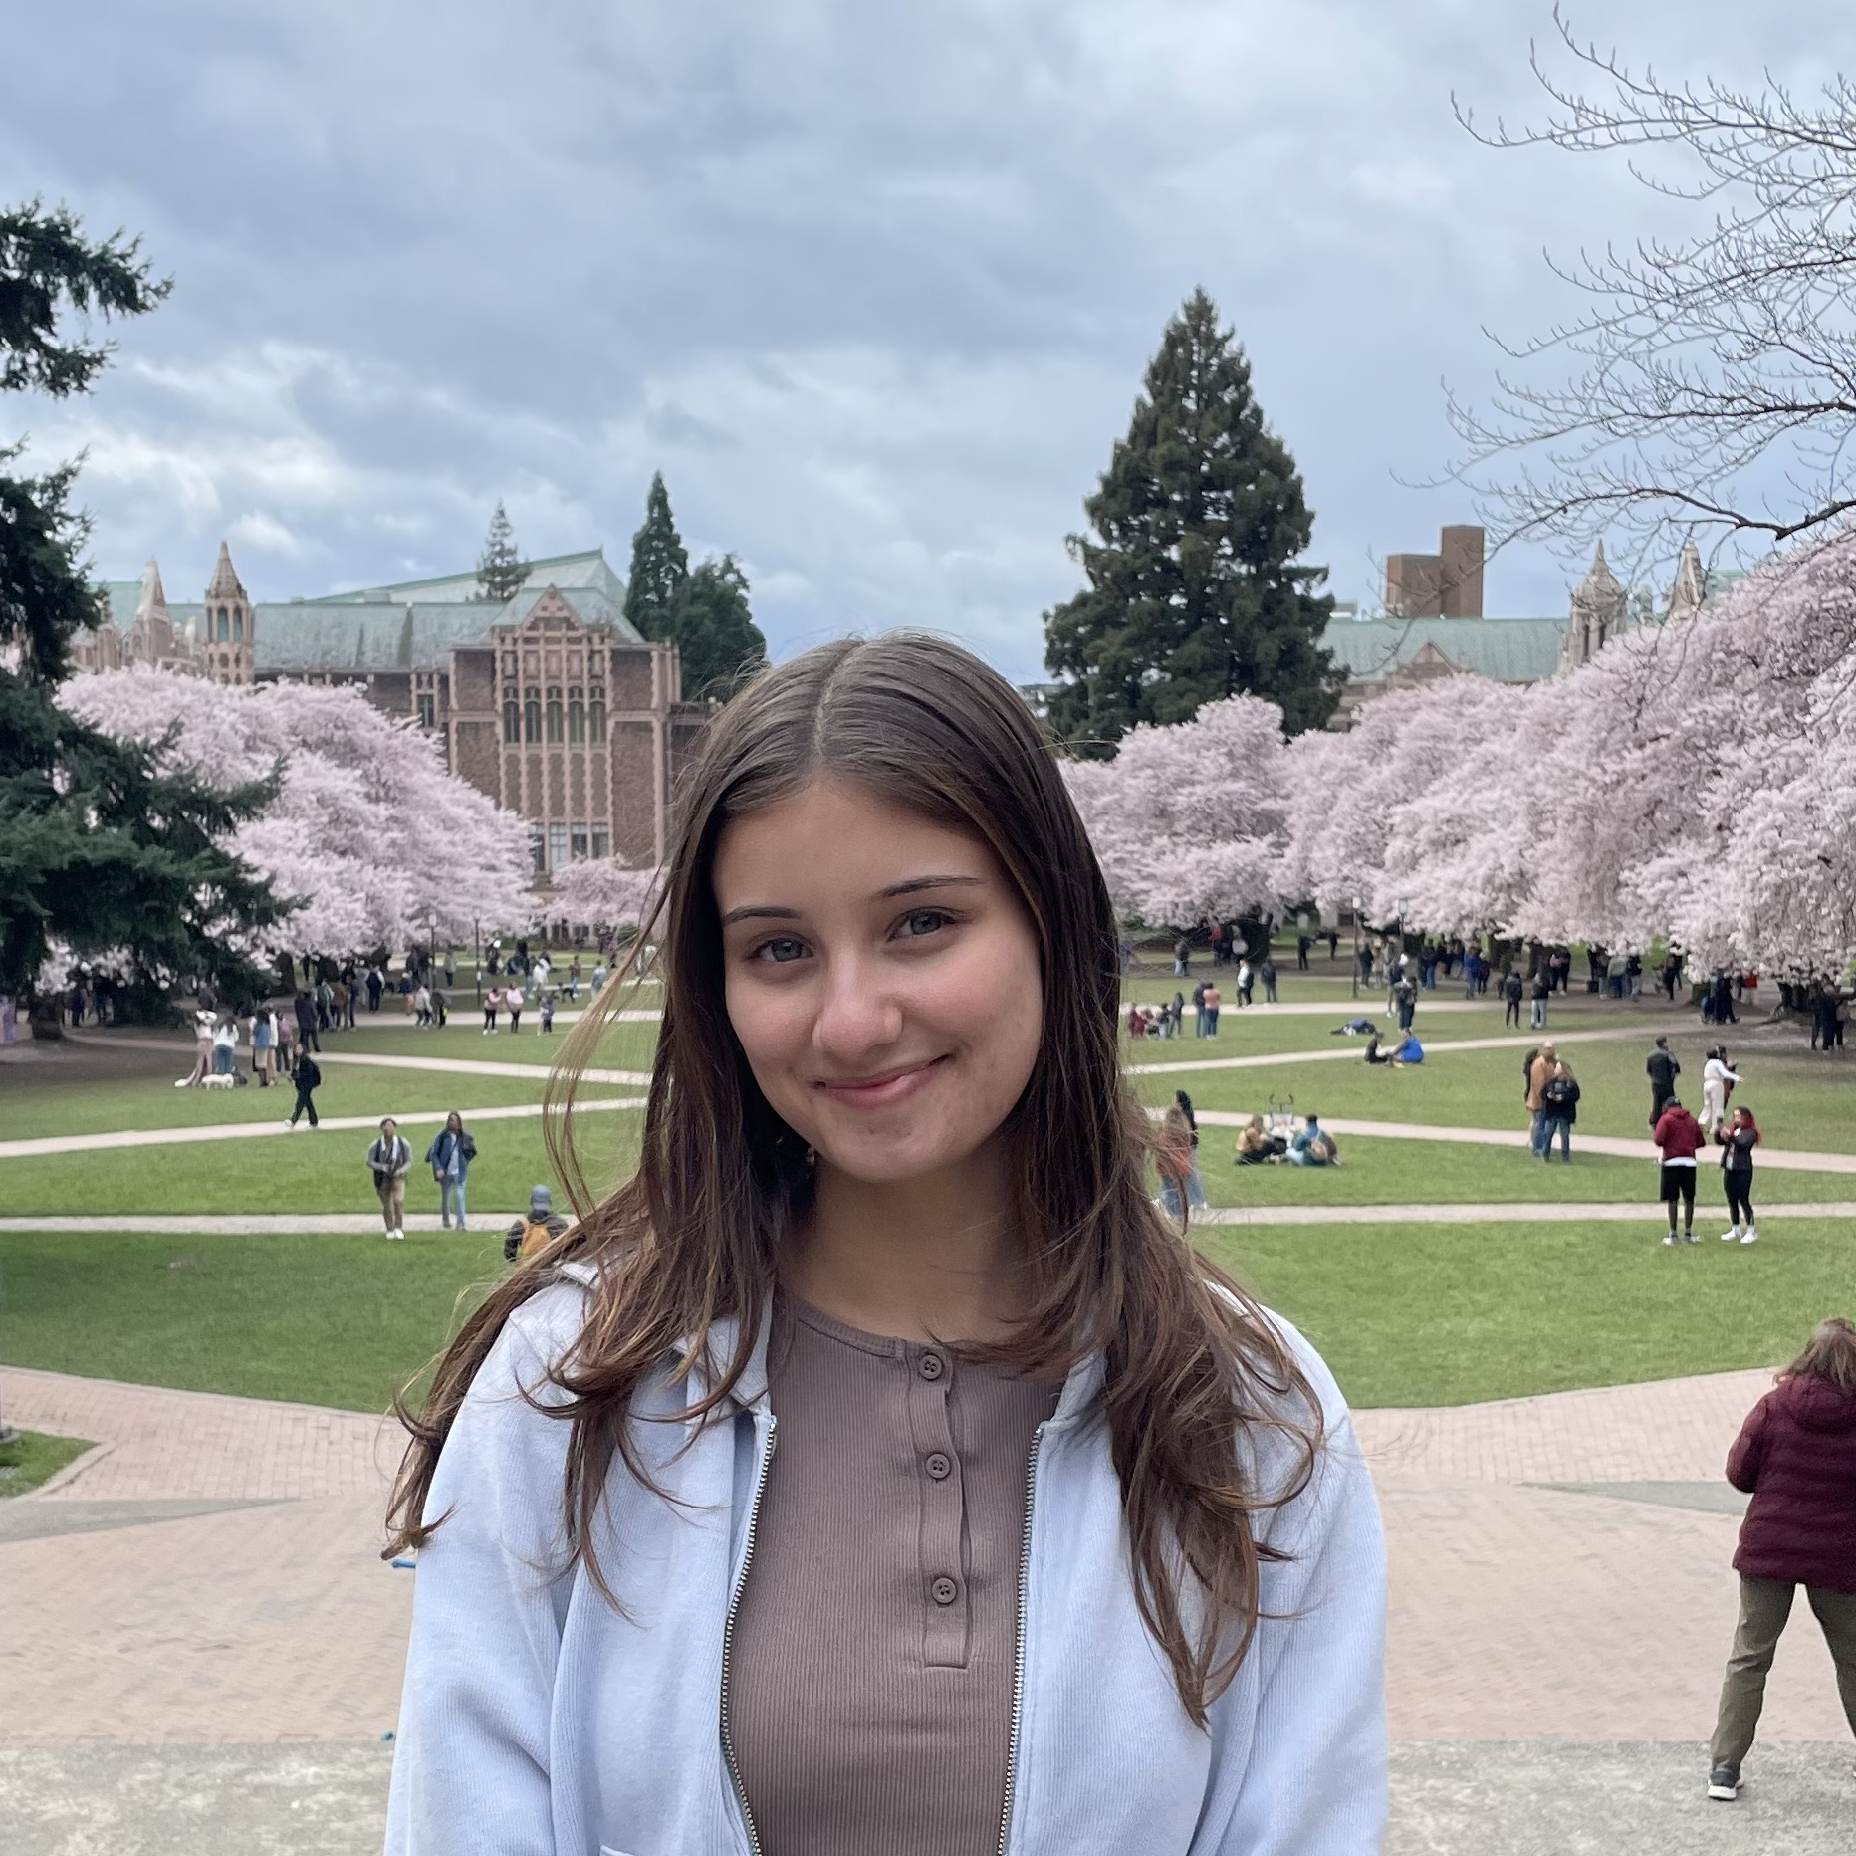
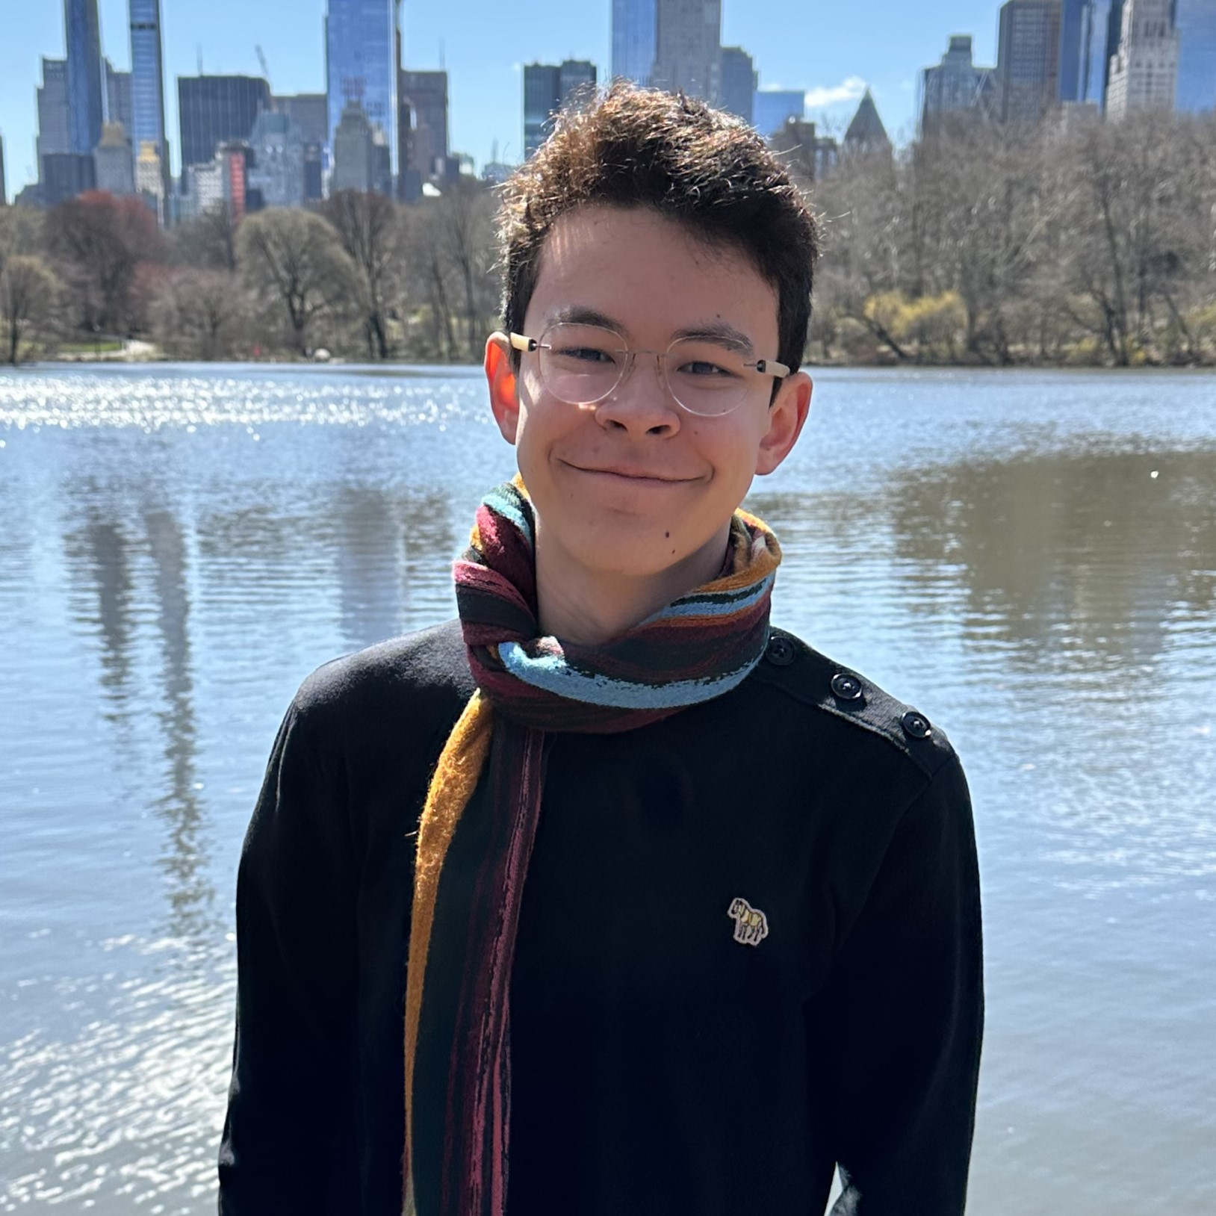
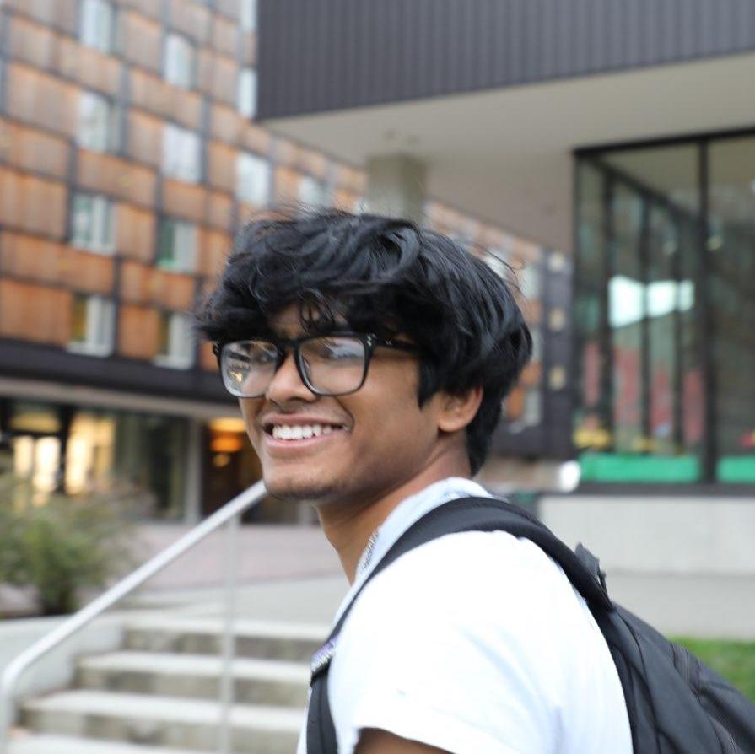
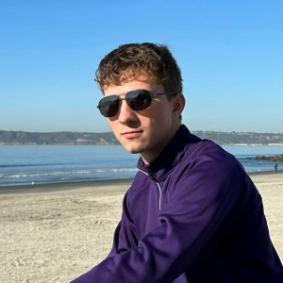
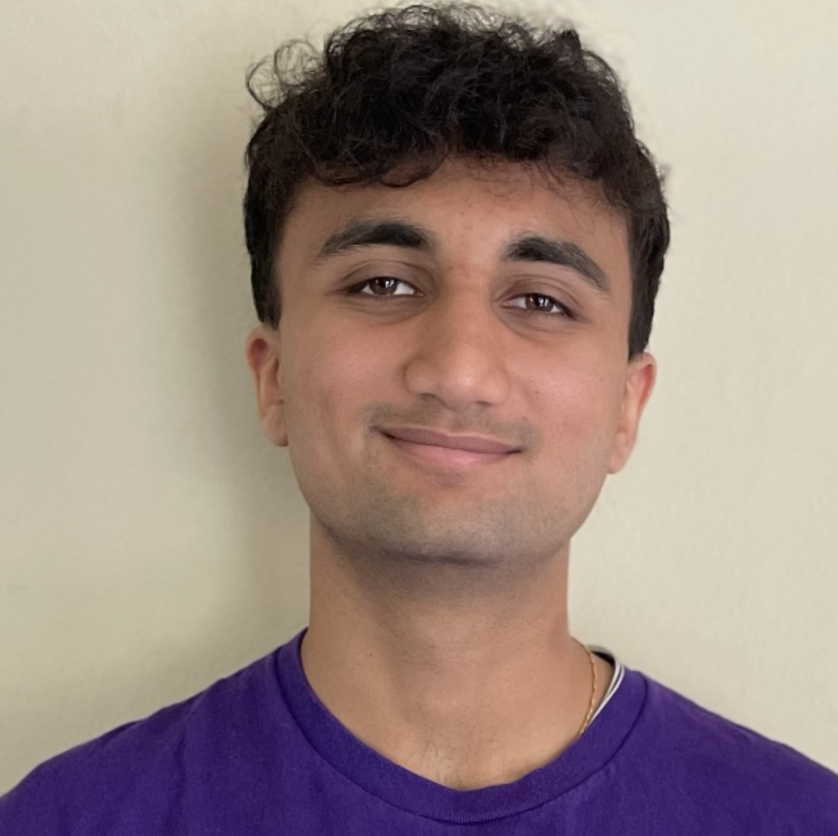
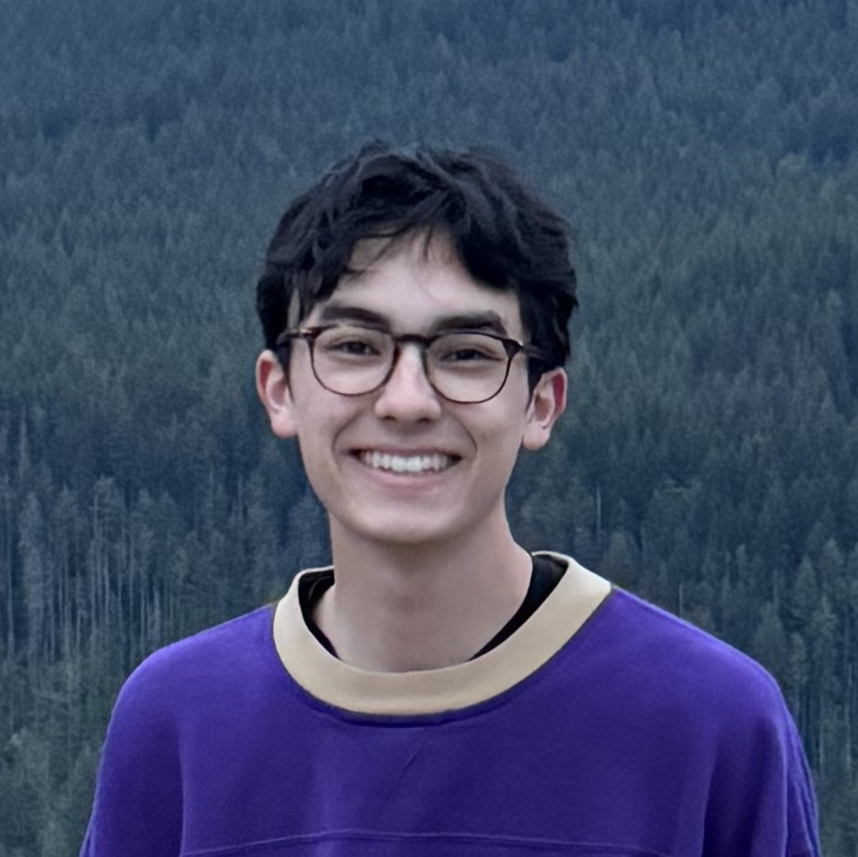
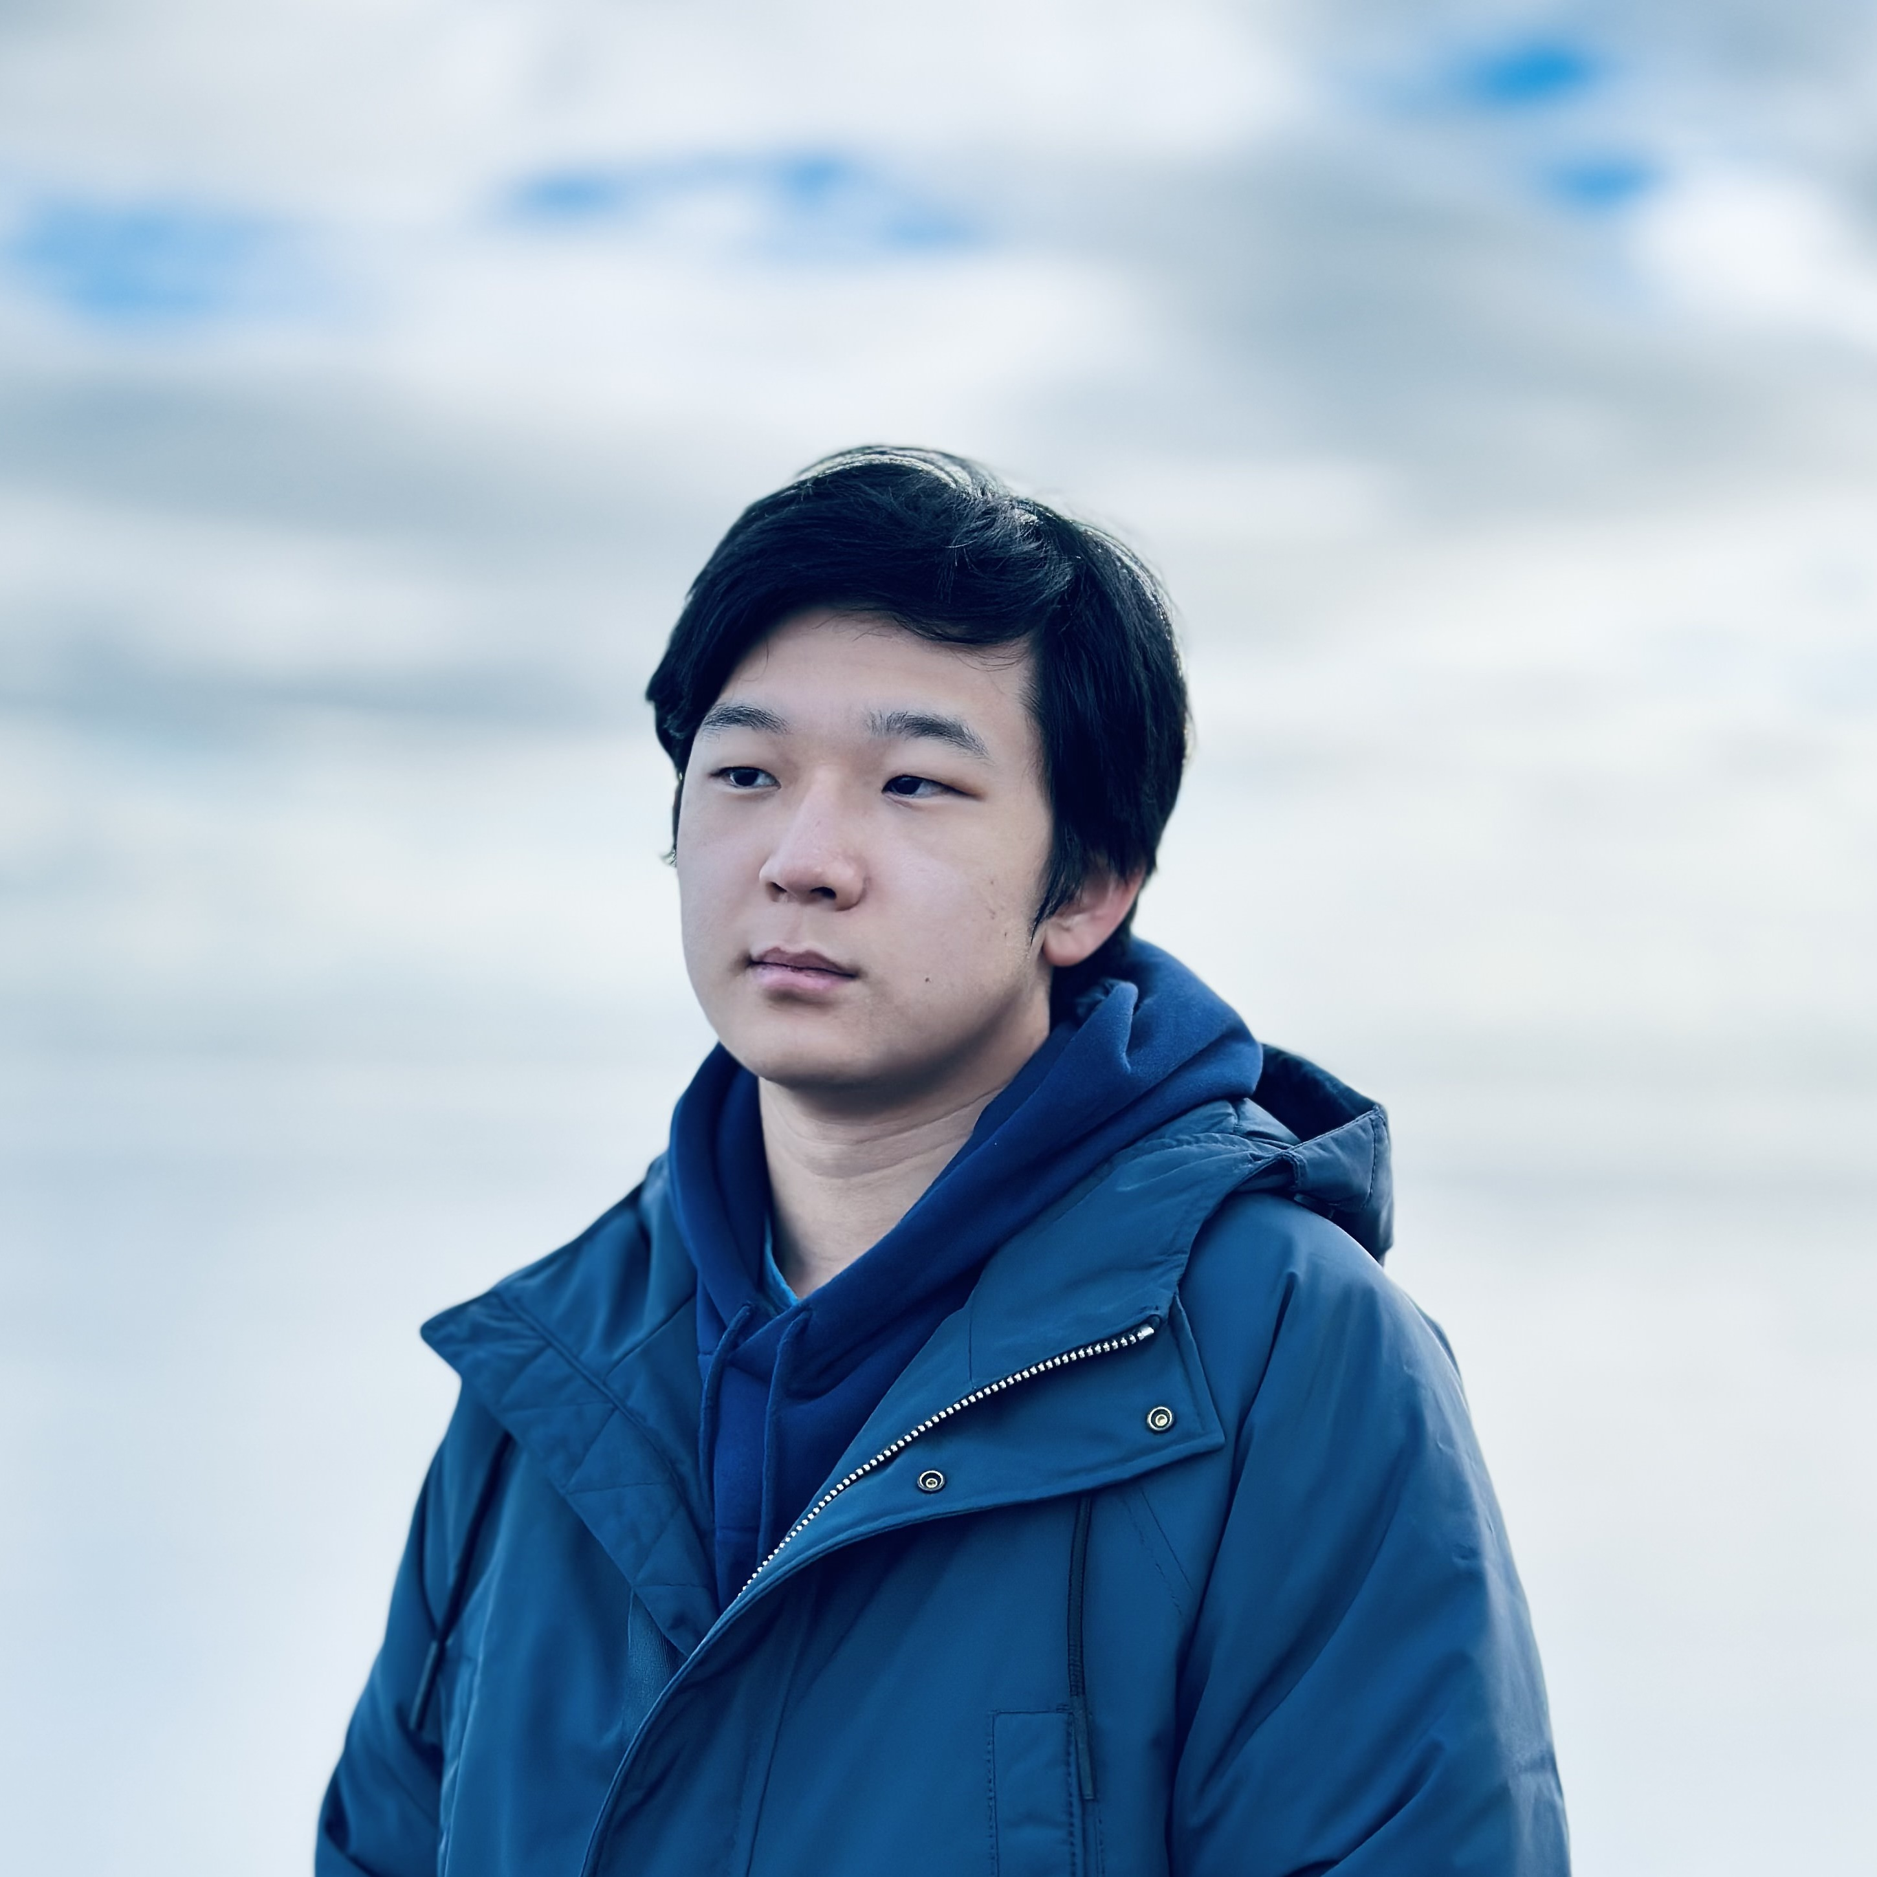
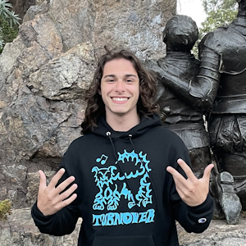
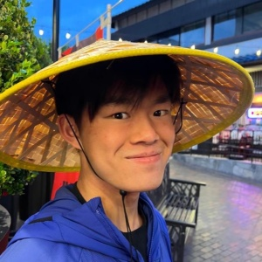
Thank You!
Thank you for participating, asking questions, engaging with course materials & resources!
And thank you for the feedback if you filled out the course evaluation :)
Thank your amazing TAs!
Any final questions before we wrap?

