Slide 1
Binary Search Trees
BEFORE WE START
Talk to your neighbors:
What’s your favorite English word? What page is it on in the dictionary?
Instructor:
James Wilcox

Slide 2
Announcements
Quiz 2 Completed! 😮‍💨
Congrats!

Slide 3
Binary Trees [Review]
We’ll say that any Binary Tree falls into one of the following categories:
1
null
Tree
Tree
Empty tree
root == null
Node w/ two subtrees
root != null
root.left / root.right = Tree
This is a recursive definition! A tree is either empty or a node with two more trees!

Slide 4
Binary Search Trees (BSTs)
We’ll say that any Binary Search Tree falls into the following categories:
x
null
> x
< x
Tree
Tree
Empty tree
root == null
Node w/ two subtrees
root != null
root.left / root.right = Tree
max(root.left) < x && min(root.right) > x
Note that not all Binary Trees are Binary Search Trees

Slide 5
Why BSTs?
Our IntTree implementation to contains(int value)
Which direction(s) do we travel if root.data != value?
Both left and right
In a Binary Search Tree, should we check both sides?
Remember, additional constraint: max(root.left) < root.data &&
min(root.right) > root.data
private boolean contains(int value, IntTreeNode root) {
if (root == null) {
return false;
} else {
return root.data == value ||
contains(value, root.left) ||
contains(value, root.right);
}
}

Slide 6
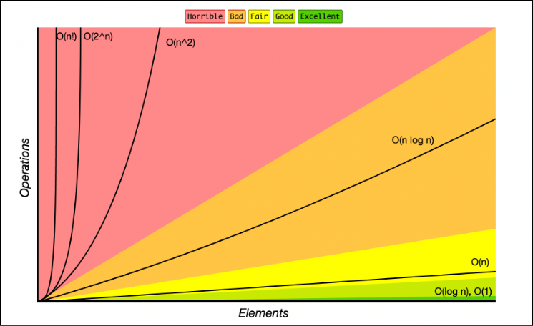
BSTs & Runtime
Contains operation on a balanced BST runs in O(log(n))
Leverages removing half of the values at each step
New runtime class unlocked!

Slide 7
BSTs & Runtime
Contains operation on a balanced BST runs in O(log(N))
Leverages removing half of the values at each step
New runtime class unlocked!
Comparison between data structures:
Let’s verify that this is true!
Operation | ArrayIntList | LinkedIntList | IntSearchTree
contains(x) | O(N) | O(N) | O(log(N))

Slide 8
BSTs & Runtime
Contains operation on a balanced BST runs in O(log(N))
Leverages removing half of the values at each step
New runtime class unlocked!
Comparison between data structures:
Let’s verify that this is true!
Operation | ArrayIntList | LinkedIntList | IntSearchTree
contains(x) | O(N) | O(N) | O(N)
O(log(N)) runtime is only guaranteed for BALANCED BSTs. Since our tree isn’t balanced, we see O(N) runtime!

Slide 9
BSTs In Java
Self-balancing BST implementations (AVL / Red-black) exist
AVL better at contains, Red-black better at adding / removing
Both the TreeMap / TreeSet implementations use self-balancing BSTs
Determines said ordering via the Comparable interface / compareTo method
Printing out shows natural ordering – preorder traversal
Complete table comparing data structures:
Operation | ArrayList | LinkedList | TreeSet
contains(x) | O(N) | O(N) | O(log(N))
add(x) | O(1*) | O(1) | O(log(N)*)
remove(x) | O(N) | O(N) | O(log(N)*)
*It’s slightly more complicated but we’ll leave that for a higher level course

