Slide 1
Inheritance & Polymorphism
BEFORE WE START
Talk to your neighbors:
Plans for the weekend?
Instructor:
James Wilcox

Slide 2
Creating an inclusive environment
Video
This is a more professional environment than hanging out with friends
Think about the impact your words can have.
Collaboration, Support, and Empathy
Check your own biases and communicate thoughtfully
Challenge unacceptable behaviors

Slide 3
Lecture Outline
Finishing up Points & Lines
Inheritance
Polymorphism
Declared vs. Actual Type
Compiler vs. Runtime Errors
Points, Lines, and Graphs!

Slide 4
Comparable
Comparable<E> is an interface that allows implementers to define an ordering between two objects
Used by TreeSet, TreeMap, Collections.sort, etc.
One required method:
public int compareTo (E other);
Returned integer falls into 1 of 3 categories
< 0: this is “less than” other
= 0: this is “equal to” other
> 0: this is “greater than” other
a.compareTo(b);
this
other

Slide 5
Subtraction Trick
compareTo implementation when comparing two integers (a) ascending:
This is just subtraction!
What if we wanted to sort descending?
Warning: this only works for integers! Doubles have issues with truncation.
if (this.a < other.a) -> negative number
else if (this.a > other.a) -> positive number
else -> 0
this.a – other.a
other.a – this.a

Slide 6
Lecture Outline
Finishing up Points & Lines
Inheritance
Polymorphism
Declared vs. Actual Type
Compiler vs. Runtime Errors
Points, Lines, and Graphs!

Slide 7
Inheritance
Connect together a “subclass” and “superclass”
Borrow / “inherit” code to reduce redundancy
super() keyword can be used just like this()
Syntax: public class Subclass extends Superclass
Should Represent “is-a” relationships
public class Chef extends Employee
public class Server extends Employee
In Java, all objects implicitly inherit from the Object class
toString(), equals(Object), etc.

Slide 8
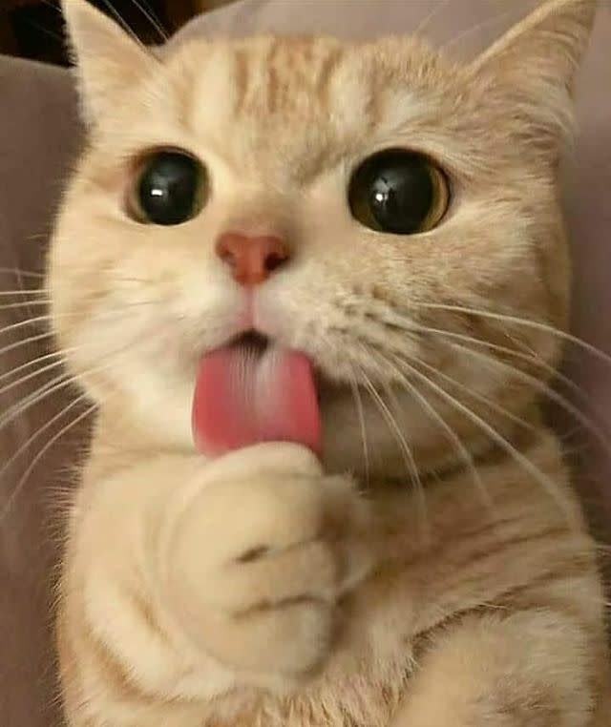
Is-a Relationships
Animal
Fish
Birds
Mammal
Reptile
Amphibian
Dog
Cat

Slide 9
Lecture Outline
Finishing up Points & Lines
Inheritance
Polymorphism
Declared vs. Actual Type
Compiler vs. Runtime Errors
Points, Lines, and Graphs!

Slide 10
Polymorphism
DeclaredType x = new ActualType()
All methods in DeclaredType can be called on x
We’ve seen this with interfaces (List<String> vs. ArrayList<String>)
Can also be to inheritance relationships
Animal[] arr = {new Dog(), new Cat(), new Bear()};
for (Animal a : arr) {
a.feed();
}

Slide 11
Compiler vs. Runtime Errors
DeclaredType x = new ActualType()
At compile time, Java only knows DeclaredType
Compiler error: trying to call a method that isn’t present
Animal a = new Dog();
a.bark(); // No bark() -> CE
Can cast to change the DeclaredType of an object
((Dog) a).bark(); // No more CE
Runtime error: attempting to cast to an invalid DeclaredType*
Animal a = new Fish();
((Dog) a).bark(); // Can’t cast -> RE
- Order matters! Compilation before runtime

Slide 12
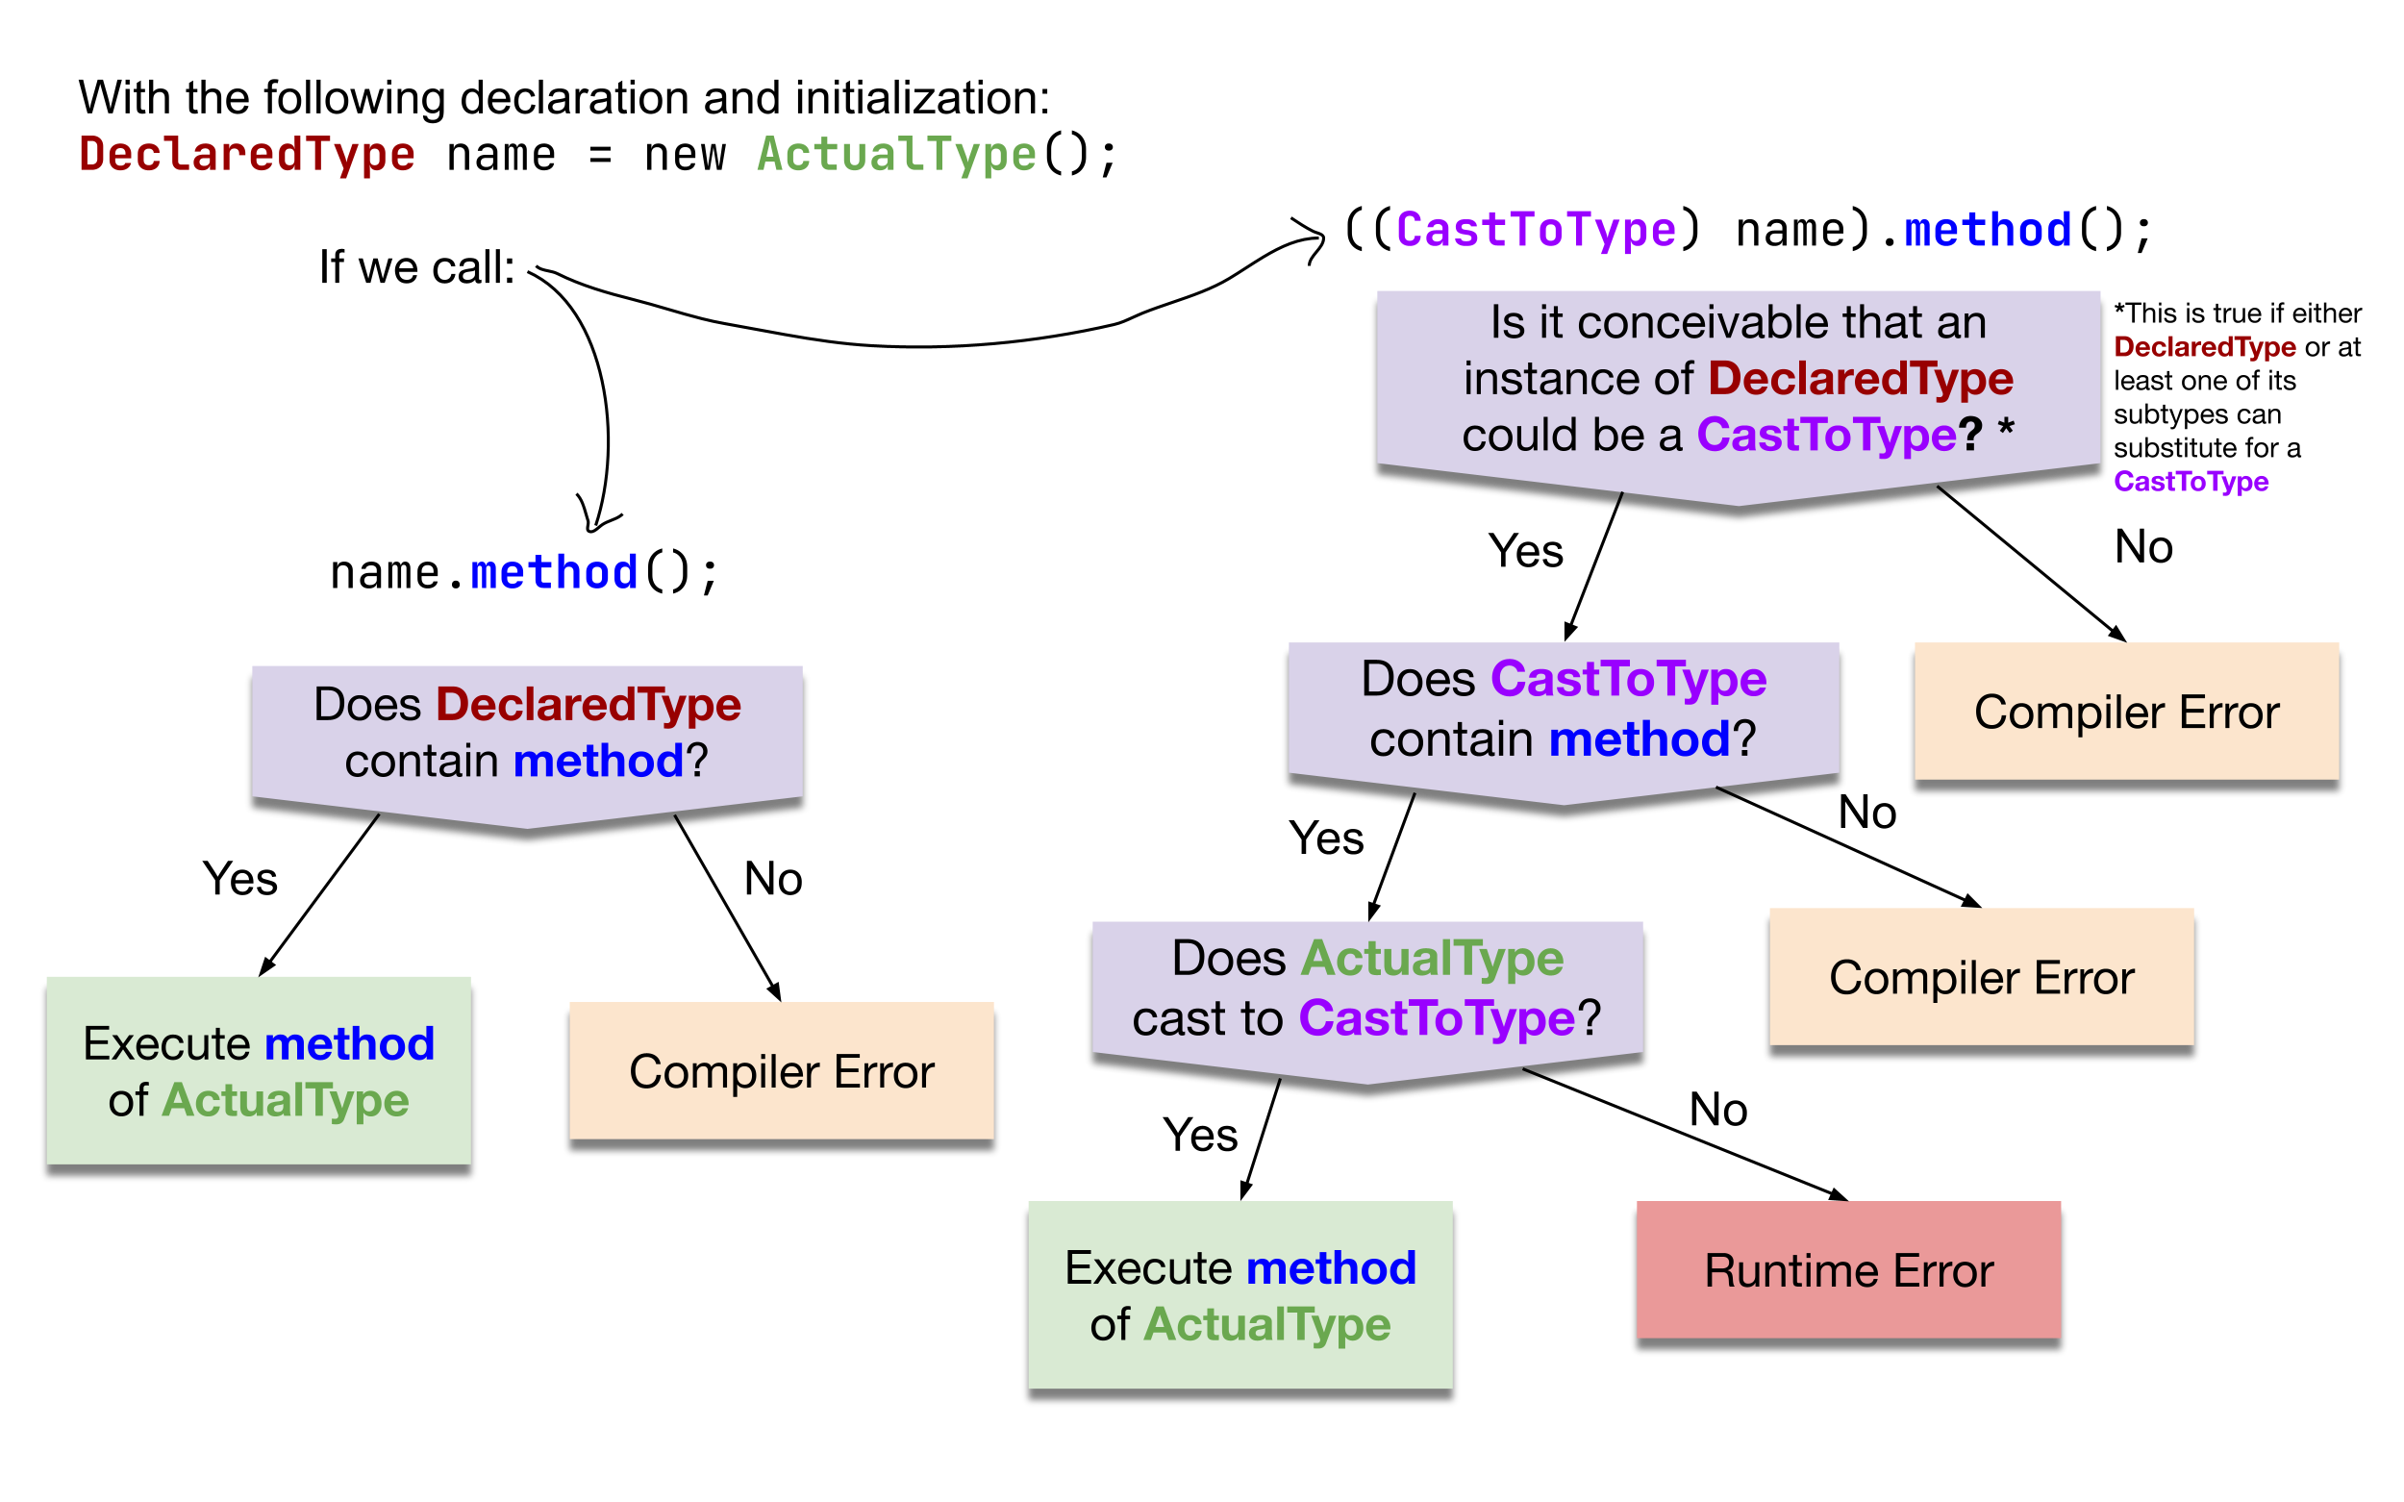
Compiler vs. Runtime Errors

Slide 13
Lecture Outline
Finishing up Points & Lines
Inheritance
Polymorphism
Declared vs. Actual Type
Compiler vs. Runtime Errors
Points, Lines, and Graphs!

