Slide 1
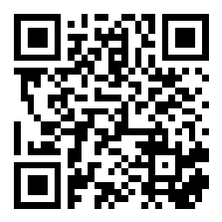
Review; Comparable!
BEFORE WE START
Talk to your neighbors:
Introduce yourself to your neighbor! What is your name? Major? What have you been up to the past week?
Instructor:
James Wilcox

Slide 2
Lecture Outline
Introductions
About this Course
Course Components & Tools
Making the Most of this Class
OOP / Junit Review
Comparable

Slide 3
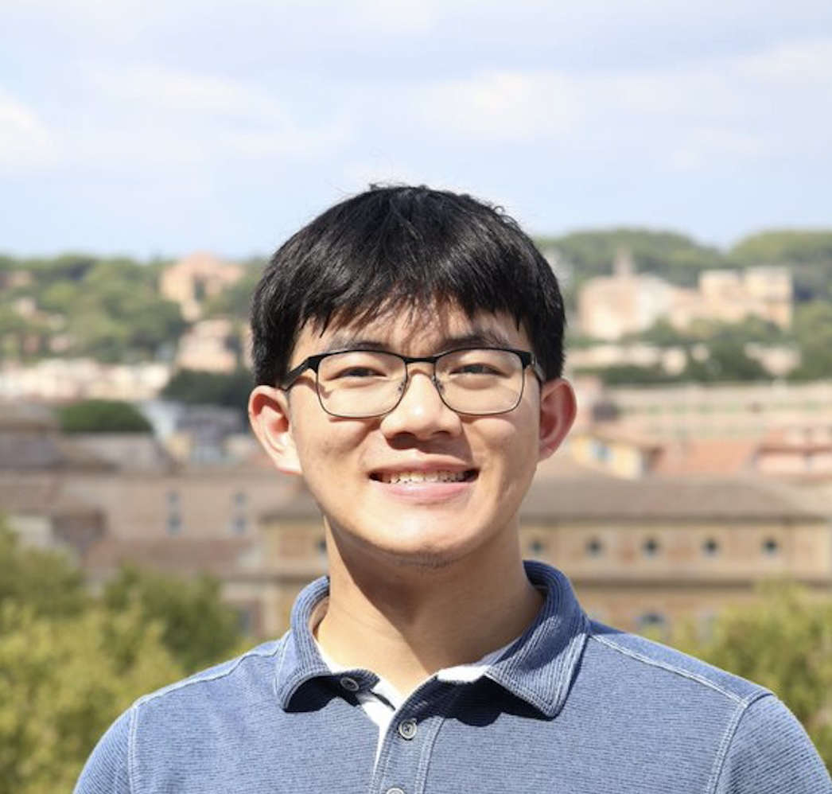
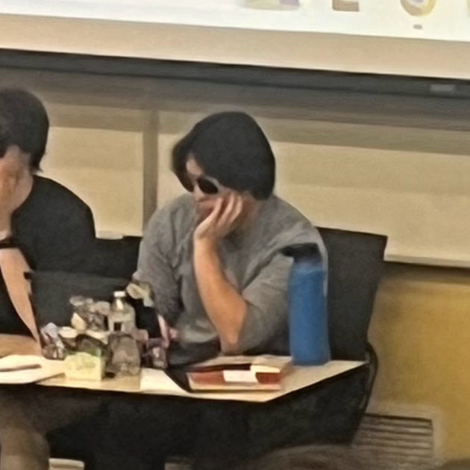
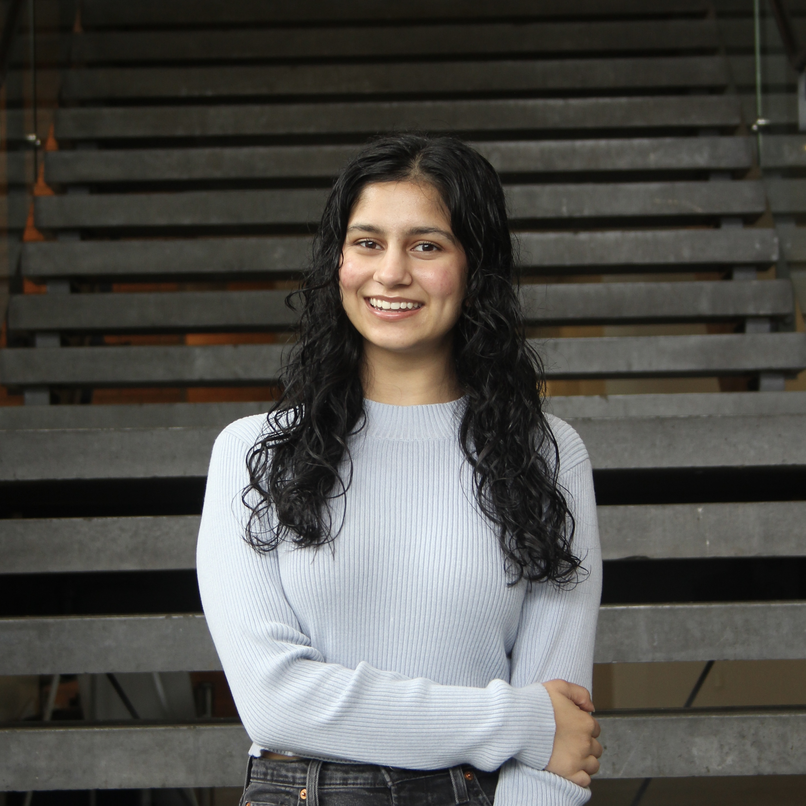
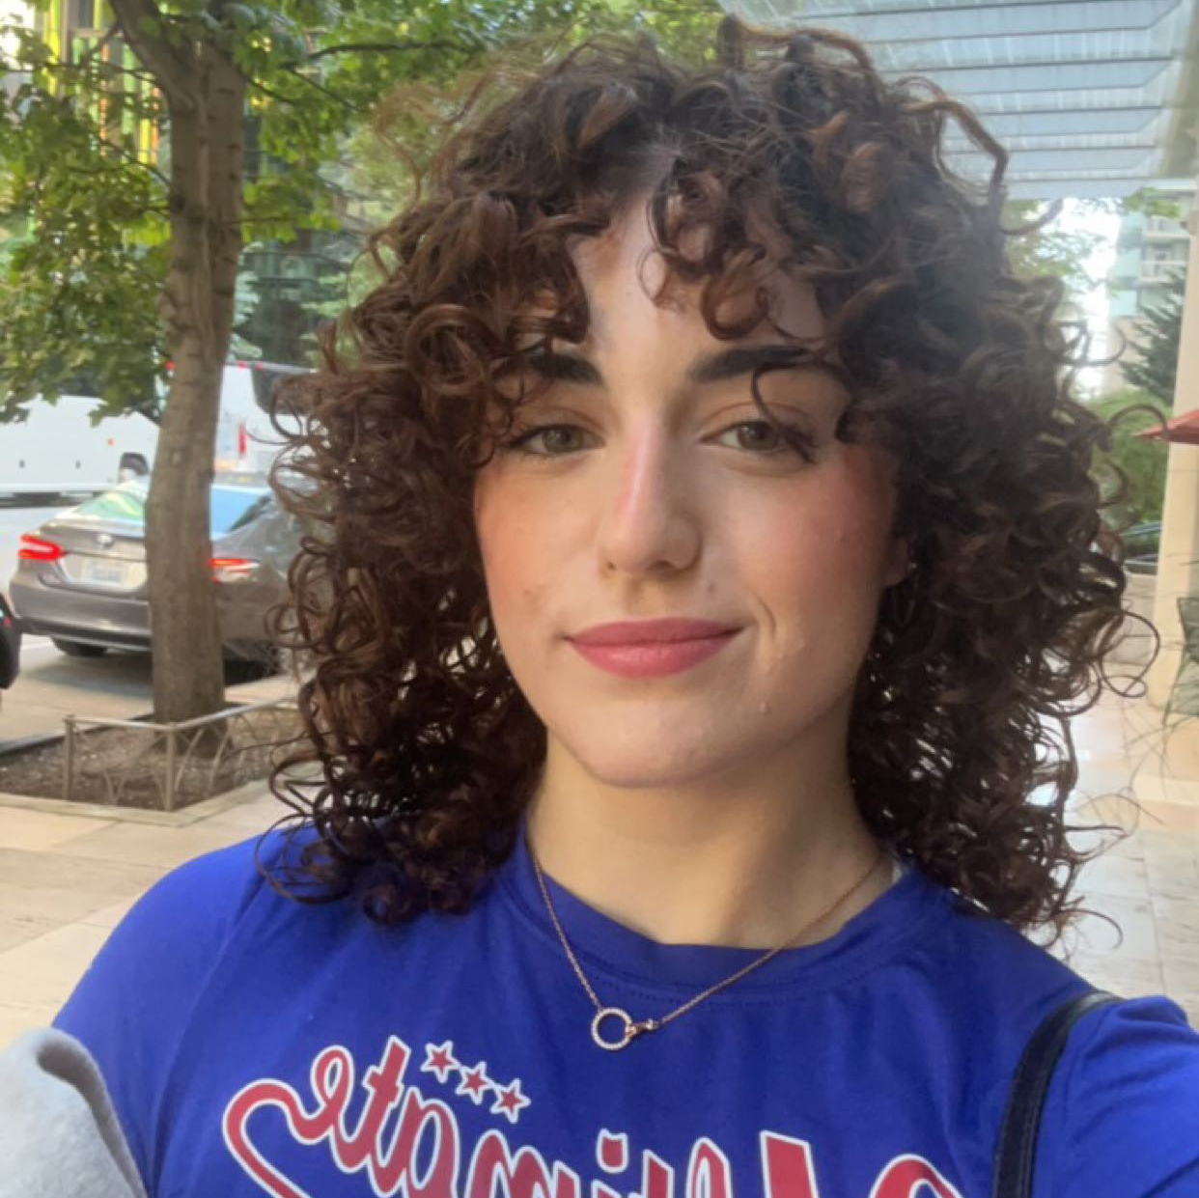
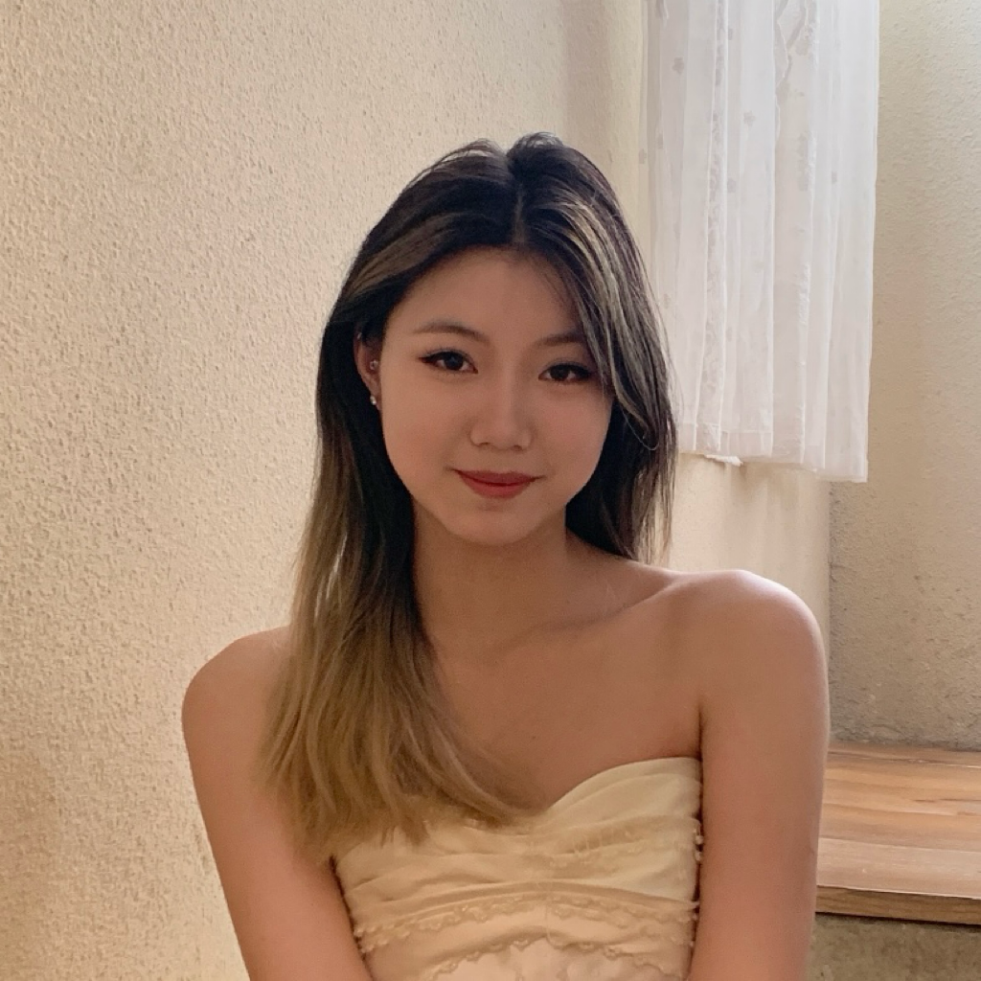
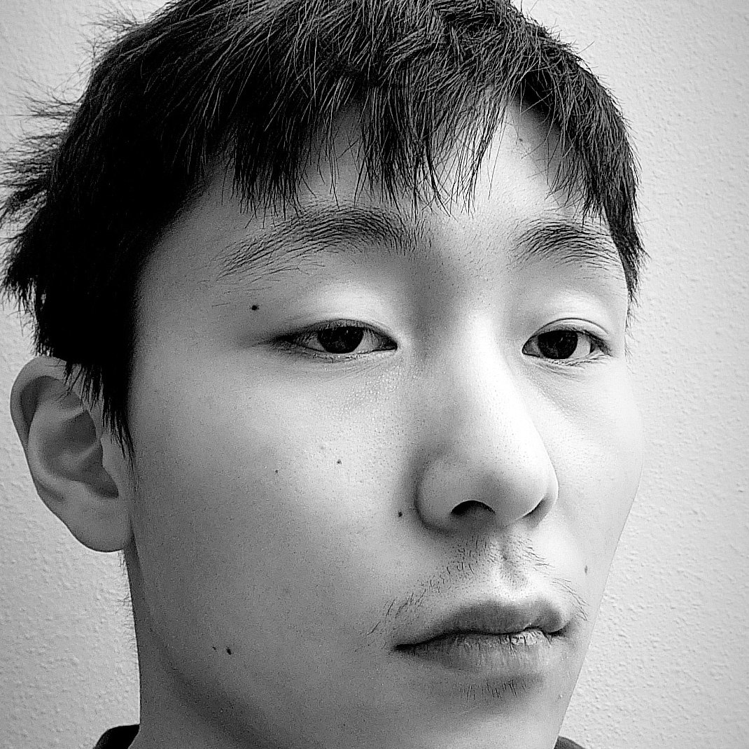
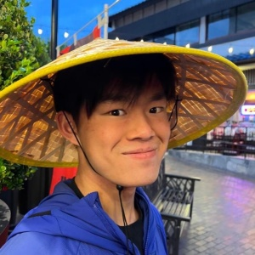
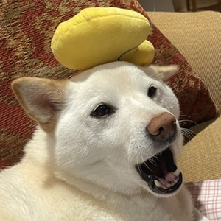
Course Staff
Instructor: James Wilcox
Feel free to call me “James”
Teaching Assistants: 31 Fantastic TAs!
Available in section, office hours, and discussion board
Invaluable source of information & help in this course
We’re excited to get to know you!
Our goal is to help you succeed ☺

Slide 4
What is this Class?
CSE 121 – Computer Programming I
CSE 122 – Computer Programming II
Data types (int, String, boolean)
Methods / Functions
Parameters, Returns
Control structures
Loops, Conditionals
Arrays & 2D arrays
Computational Thinking (language agnostic)
Functional Decomposition
File I/O
Using data structures
List, Stacks / Queues, Sets, Maps
Object Oriented Programming
Interfaces
CSE 123 – Computer Programming III
Advanced Object Oriented Programming
Comparable, Inheritance/Polymorphism, Abstract Classes
Implementing data structures
ArrayLists, LinkedLists, Trees
Recursion
Critical analysis of design

Slide 5
Why 123?
To solve more complex problems by leveraging more complex programming structures / patterns
To better rationalize specific design decisions
How to “best” structure programs
Which data structures are “most” appropriate to use
To understand and critically analyze intersections between Computer Science and society
Search engines, algorithmic art, machine learning, etc.
Developing informed opinions on current issues
Be a better programmer
Be a better person

Slide 6
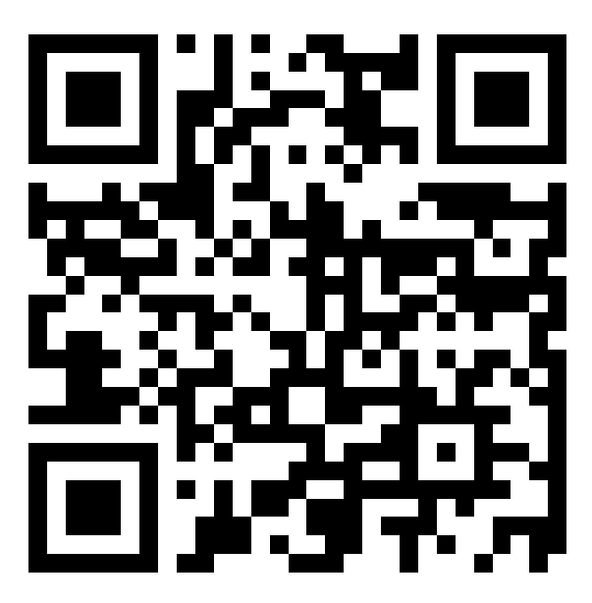
What do you want to get out of this course?
sli.do #cse123

Slide 7
Lecture Outline
Introductions
About this Course
Course Components & Tools
Making the Most of this Class
OOP / Junit Review
Comparable

Slide 8
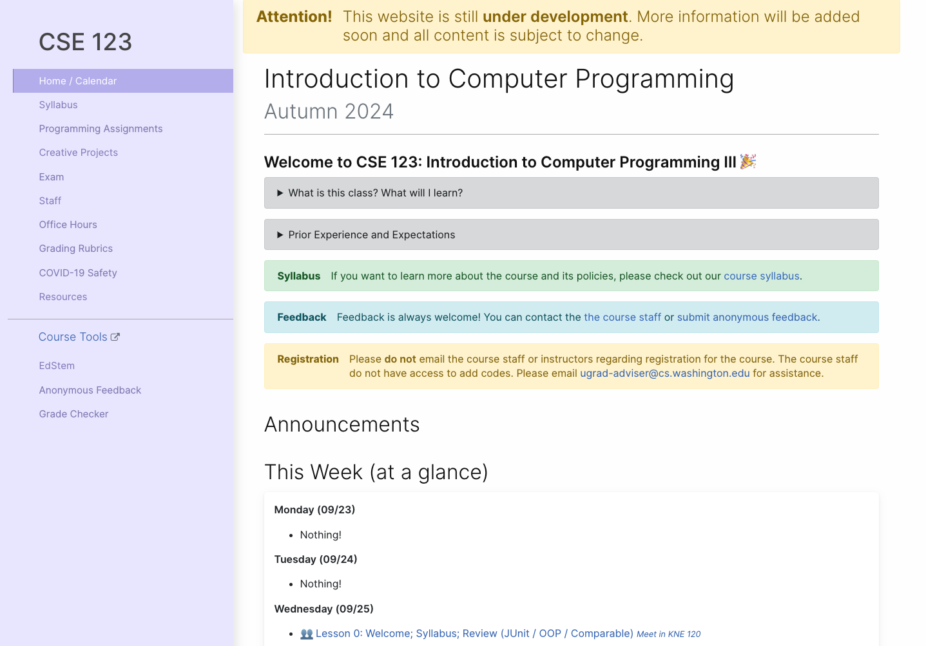
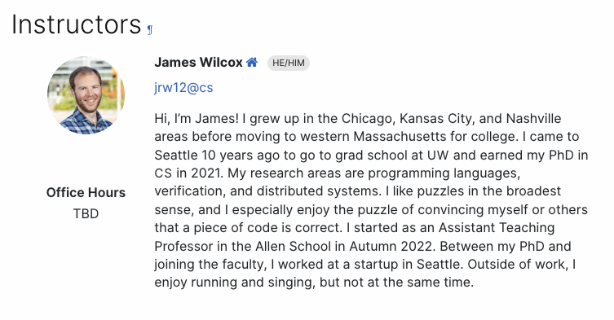
Course Website
cs.uw.edu/123
Get to know the staff
Contains most course info – check frequently!
Announcements, Calendar, Lecture Slides, Office Hours schedule, Staff Bios, Important Links

Slide 9
Creating an inclusive environment
Video
This is a more professional environment than hanging out with friends
Think about the impact your words can have.
Collaboration, Support, and Empathy
Check your own biases and communicate thoughtfully
Challenge unacceptable behaviors

Slide 10
Other Course Tools
My Digital Hand
Queueing in office hours
VSCode
Develop offline
Visual debugger
Ed
Community & Information
Discussion Board (please ask & answer!; anonymous option)
Announcements
Pre-Class Materials / Section Handouts
Assignments
Online IDE
Submit assignments
View Feedback
Canvas
Lecture recordings
Sli.do
In-class activities (ungraded)
No account needed

Slide 11
Lecture Outline
Introductions
About this Course
Course Components & Tools
Making the Most of this Class
OOP / Junit Review
Comparable

Slide 12
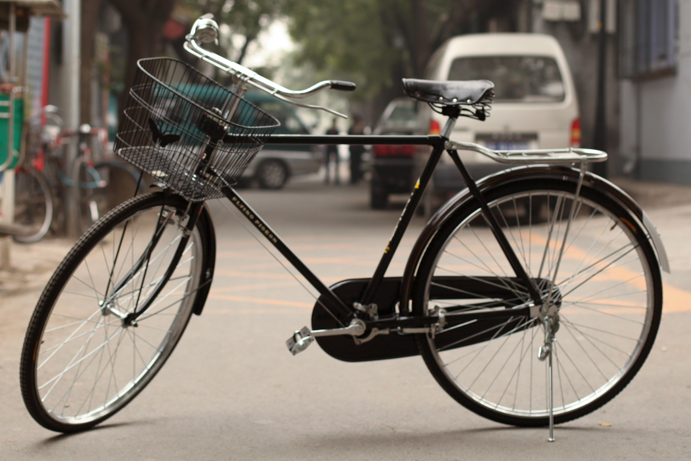
How Learning Works
Learning requires active participation in the process. It’s not as simple as sitting and listening to someone talk at you.
Requires deliberate practice in learning by doing
Benefits from collaborative learning
Hybrid classroom model
Asks you to do some preparation before class in the form of readings and practice problems.
Should take ~30 minutes outside of class per lesson
Class will start with brief recap, then pick up where the reading and practice problems leave off.
Attendance isn’t graded, but showing up and trying is the first step in succeeding in the class!
Pre-class materials are ungraded, but…
It’s okay if you find them challenging! That means you are learning!

Slide 13
Getting Help
Discussion Board
Feel free to make a public or private post on Ed
We encourage you to answer other peoples’ questions! A great way to learn
Introductory Programming Lab (Office Hours)
TAs can help you face to face in office hours, and look at your code
You can go to the IPL with any course questions, not just assignments
Section
Work through related problems, get to know your TA who is here to support you
Your Peers
We encourage you to form study groups! Discord or Ed are great places to do that
Email
We prefer that all content and logistic questions go on the Ed discussion board (even if you make them private). Many more students than staff!
For serious personal circumstances, you can email James directly. It never hurts to email us, but if it’s a common logistic question, we may politely ask you to post on the discussion board instead.

Slide 14
Lecture Outline
Introductions
About this Course
Course Components & Tools
Making the Most of this Class
OOP / Junit Review
Comparable

Slide 15
Lecture Outline
Introductions
About this Course
Course Components & Tools
Making the Most of this Class
OOP / JUnit Review
Comparable

Slide 16
Comparable
Comparable<E> is an interface that allows implementers to define an ordering between two objects
Used by TreeSet, TreeMap, Collections.sort, etc.
One required method:
public int compareTo (E other);
Returned integer falls into 1 of 3 categories
< 0: this is “less than” other
= 0: this is “equal to” other
> 0: this is “greater than” other
a.compareTo(b);
this
other

Slide 17
Subtraction Trick
compareTo implementation when comparing two integers (a) ascending:
This is just subtraction!
What if we wanted to sort descending?
Warning: this only works for integers! Doubles have issues with truncation.
if (this.a < other.a) -> negative number
else if (this.a > other.a) -> positive number
else -> 0
this.a – other.a
other.a – this.a

