Slide 1
Welcome to CSE 123!
Brett Wortzman/Kasey Champion
Winter 2023

Slide 2
Agenda
About us
About this course
Learning objectives
Other similar courses
Course components
Our learning model
Tools and resources
Course Website
Ed
Defining Classes Review
Assessment and grading
Collaboration
Notes:
Brett

Slide 3
Agenda
About us
About this course
Learning objectives
Other similar courses
Course components
Our learning model
Tools and resources
Course Website
Ed
Defining Classes Review
Assessment and grading
Collaboration
Notes:
:32
Brett

Slide 4
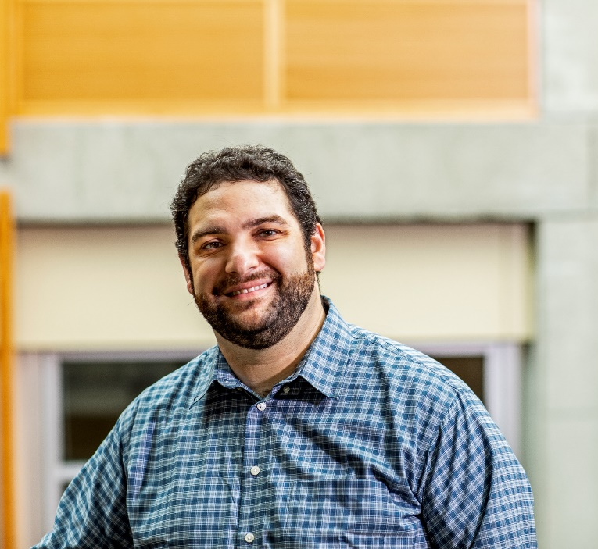
Hi, I’m Brett! (he/him)
Associate Teaching Professor
Frequent intro CS instructor
Lead designer/developer of new 12X curriculum
Also interested in CS education/pedagogy
Previously:
trained CS teachers
developed CS curriculum
taught high school CS
worked as a software engineer
Notes:
Brett

Slide 5
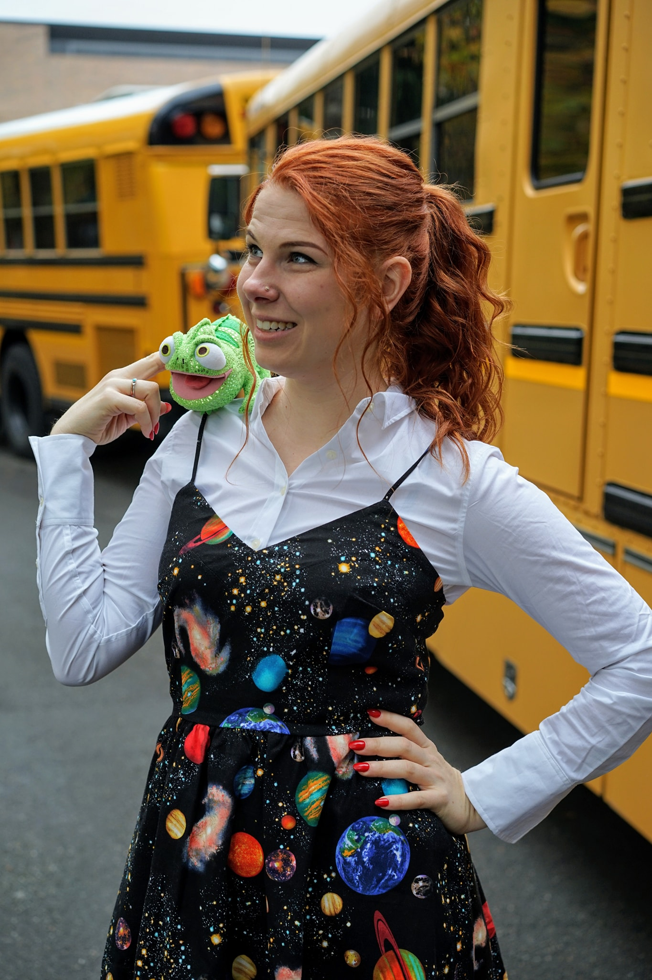
Hi, I’m Kasey! (she/her)
Part-Time Lecturer
Technical Program Manager for Chromebooks for Education at Google
Also teach CSE 492J Interview Prep seminar, CSE 373 Data Structures and Algorithms, more…
Previously:
Director of Interview Question Development at Karat
Developer, Program Manager, Content Developer at Microsoft
taught high school CS at Franklin HS in Seattle
Studied Electrical Engineering at UW
Notes:
Elba

Slide 6
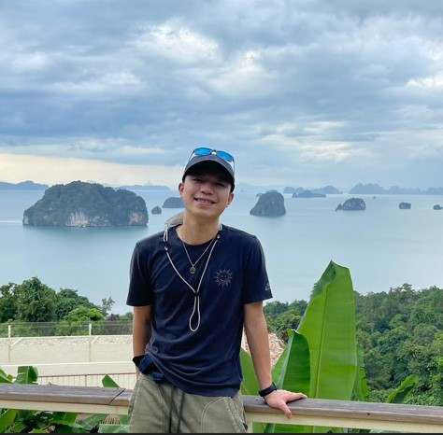
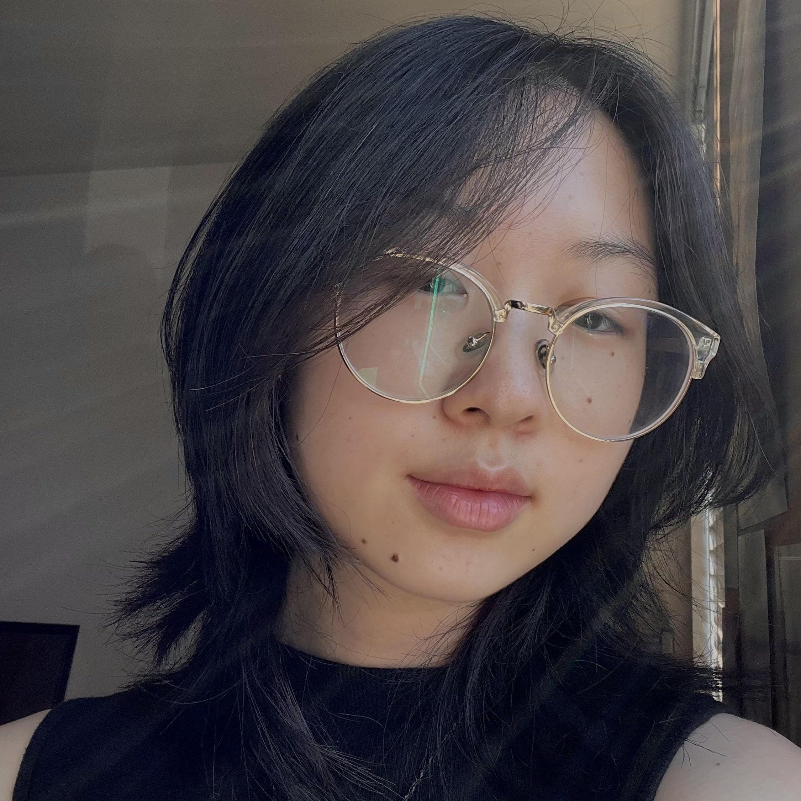
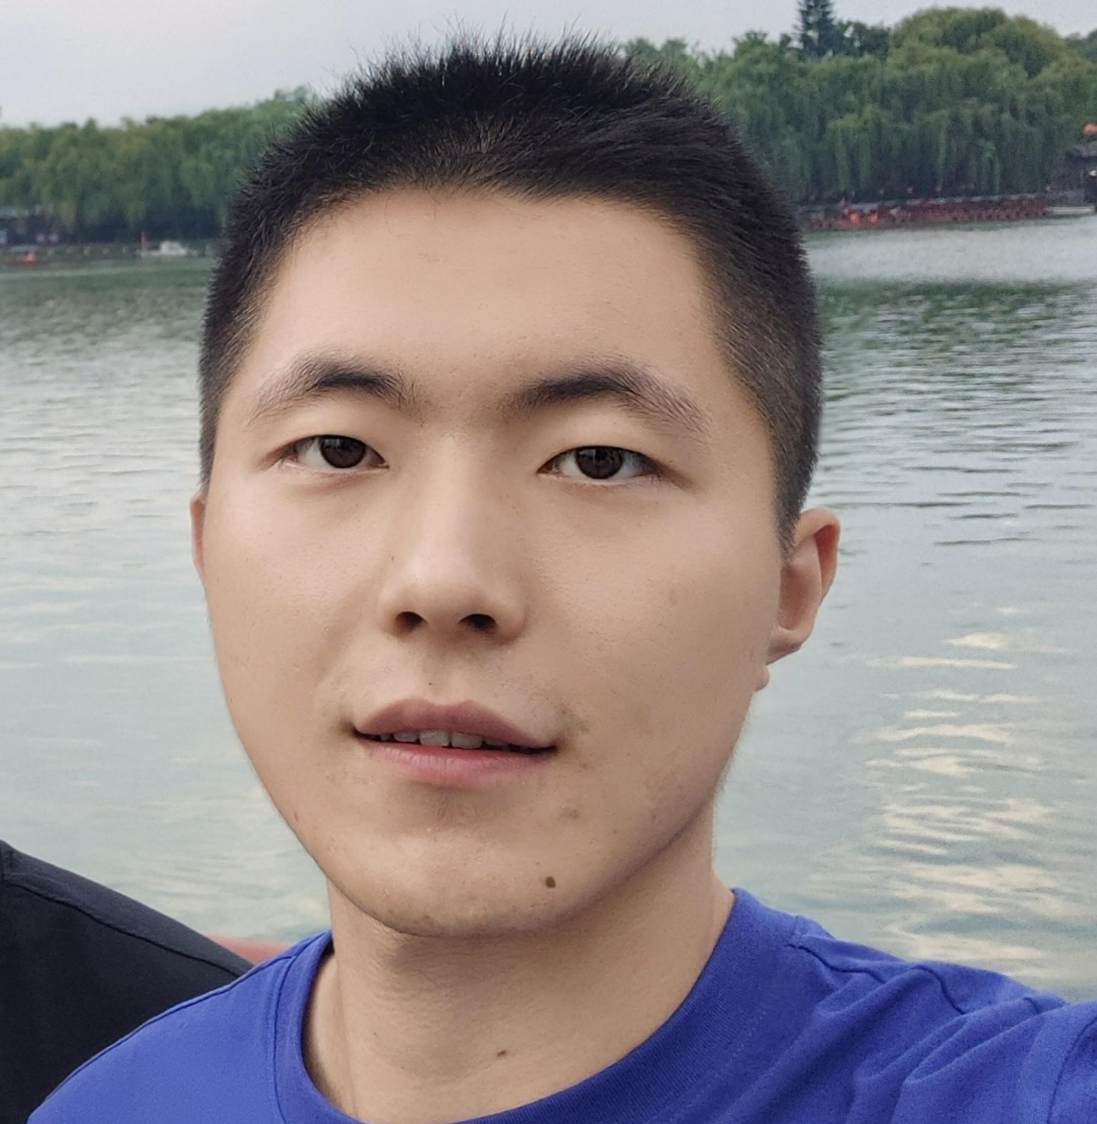
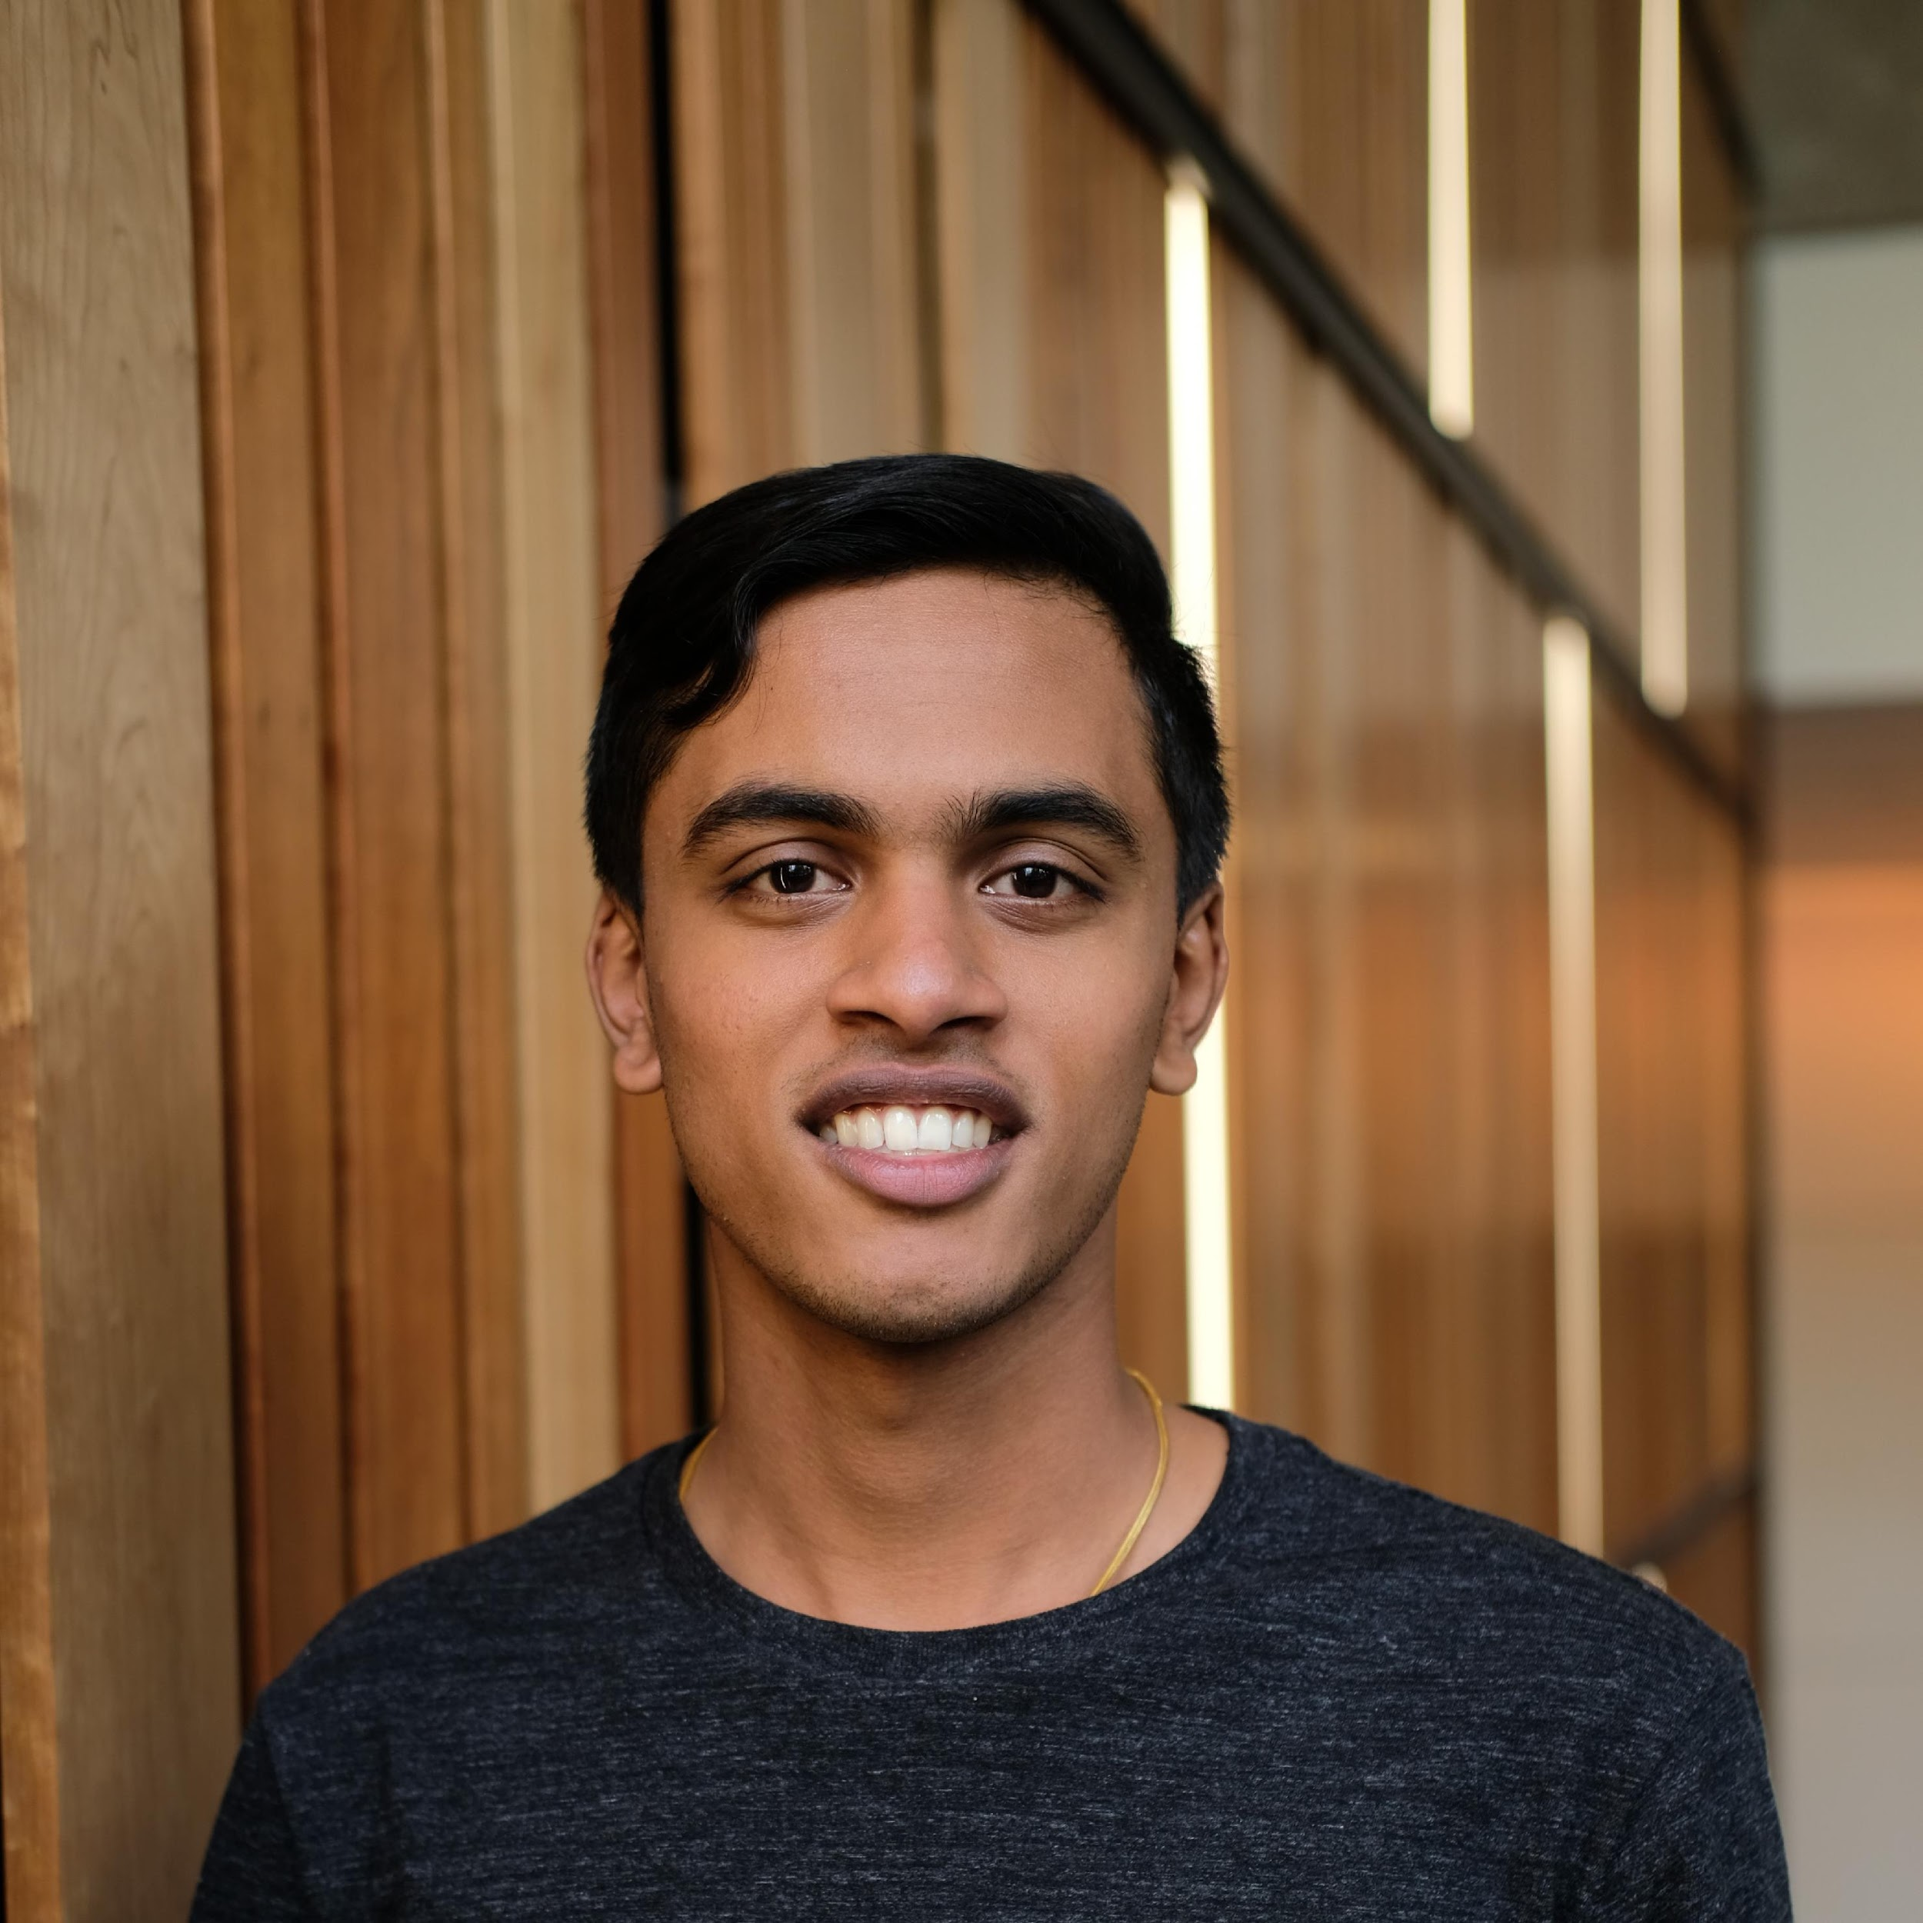
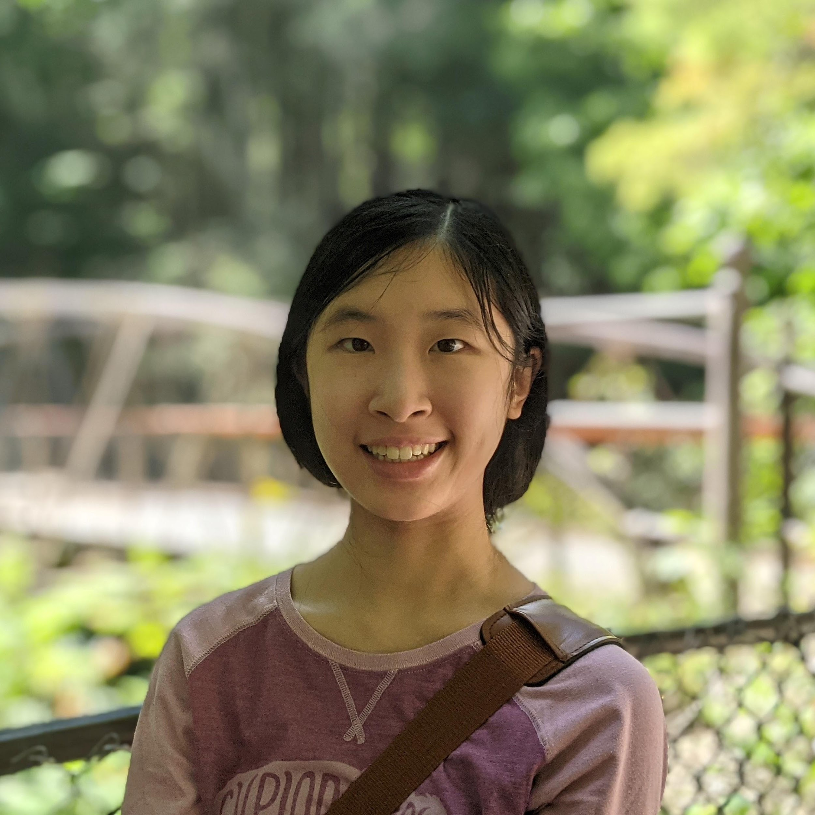
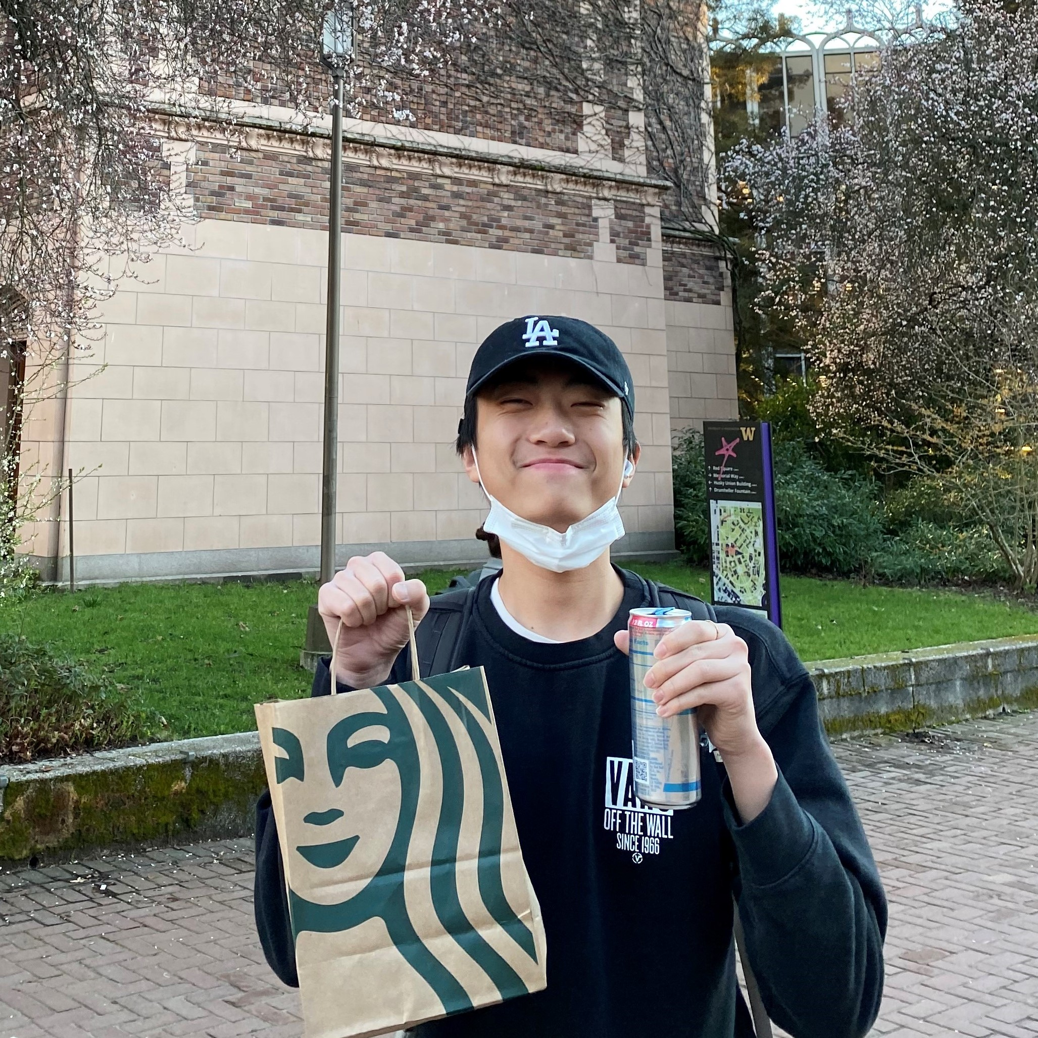
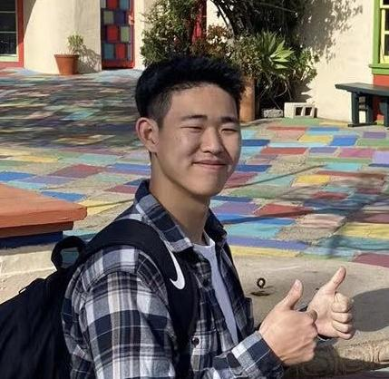
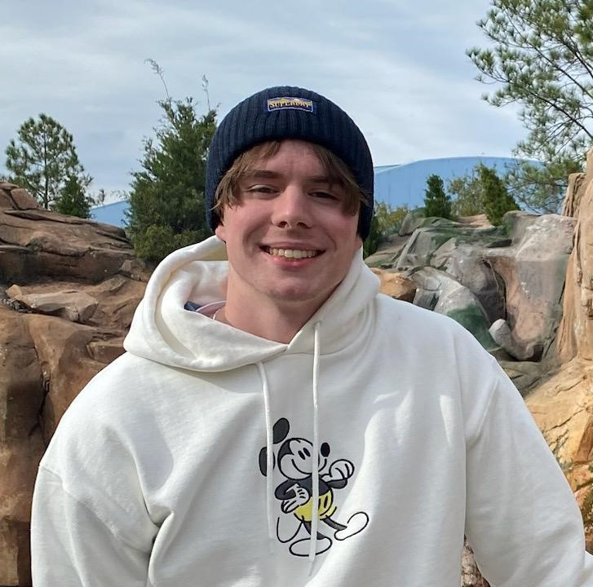
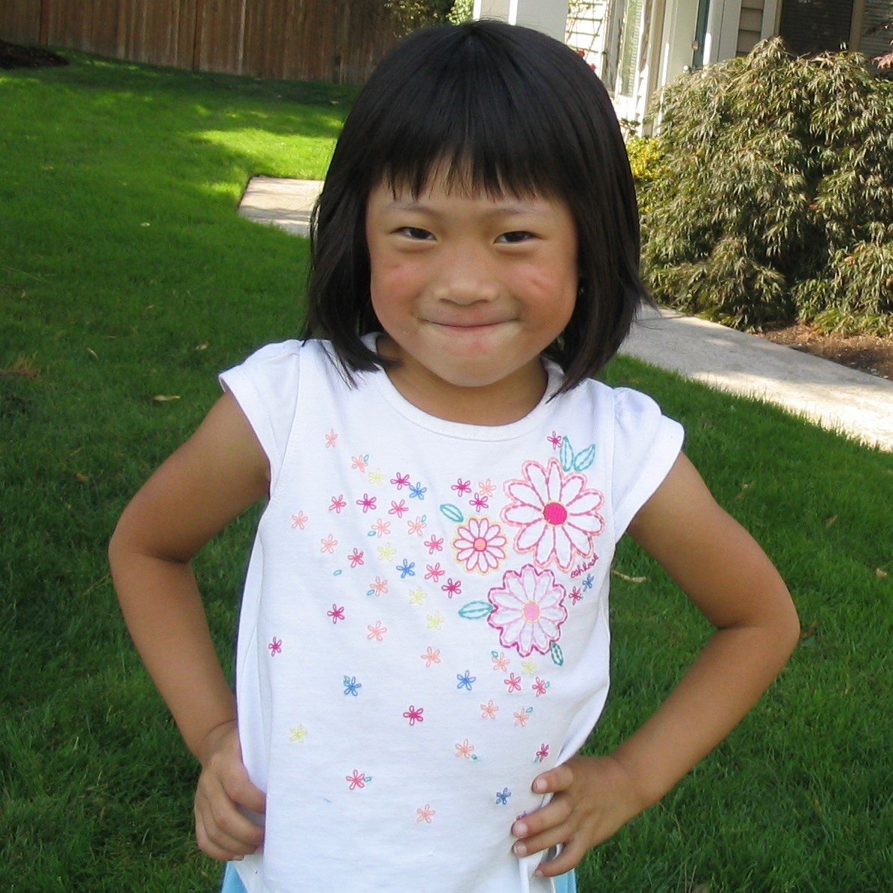
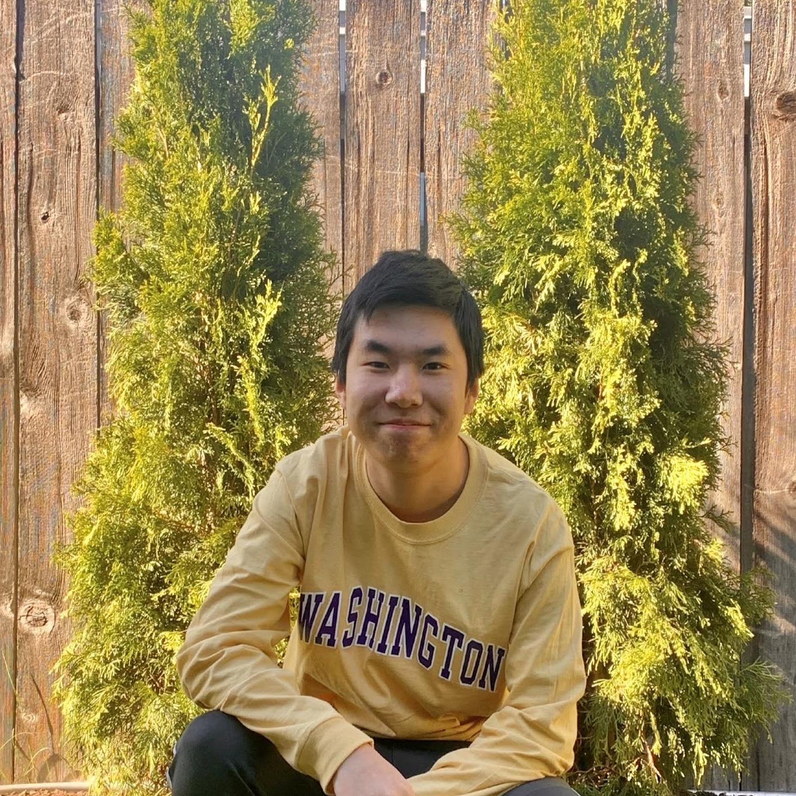
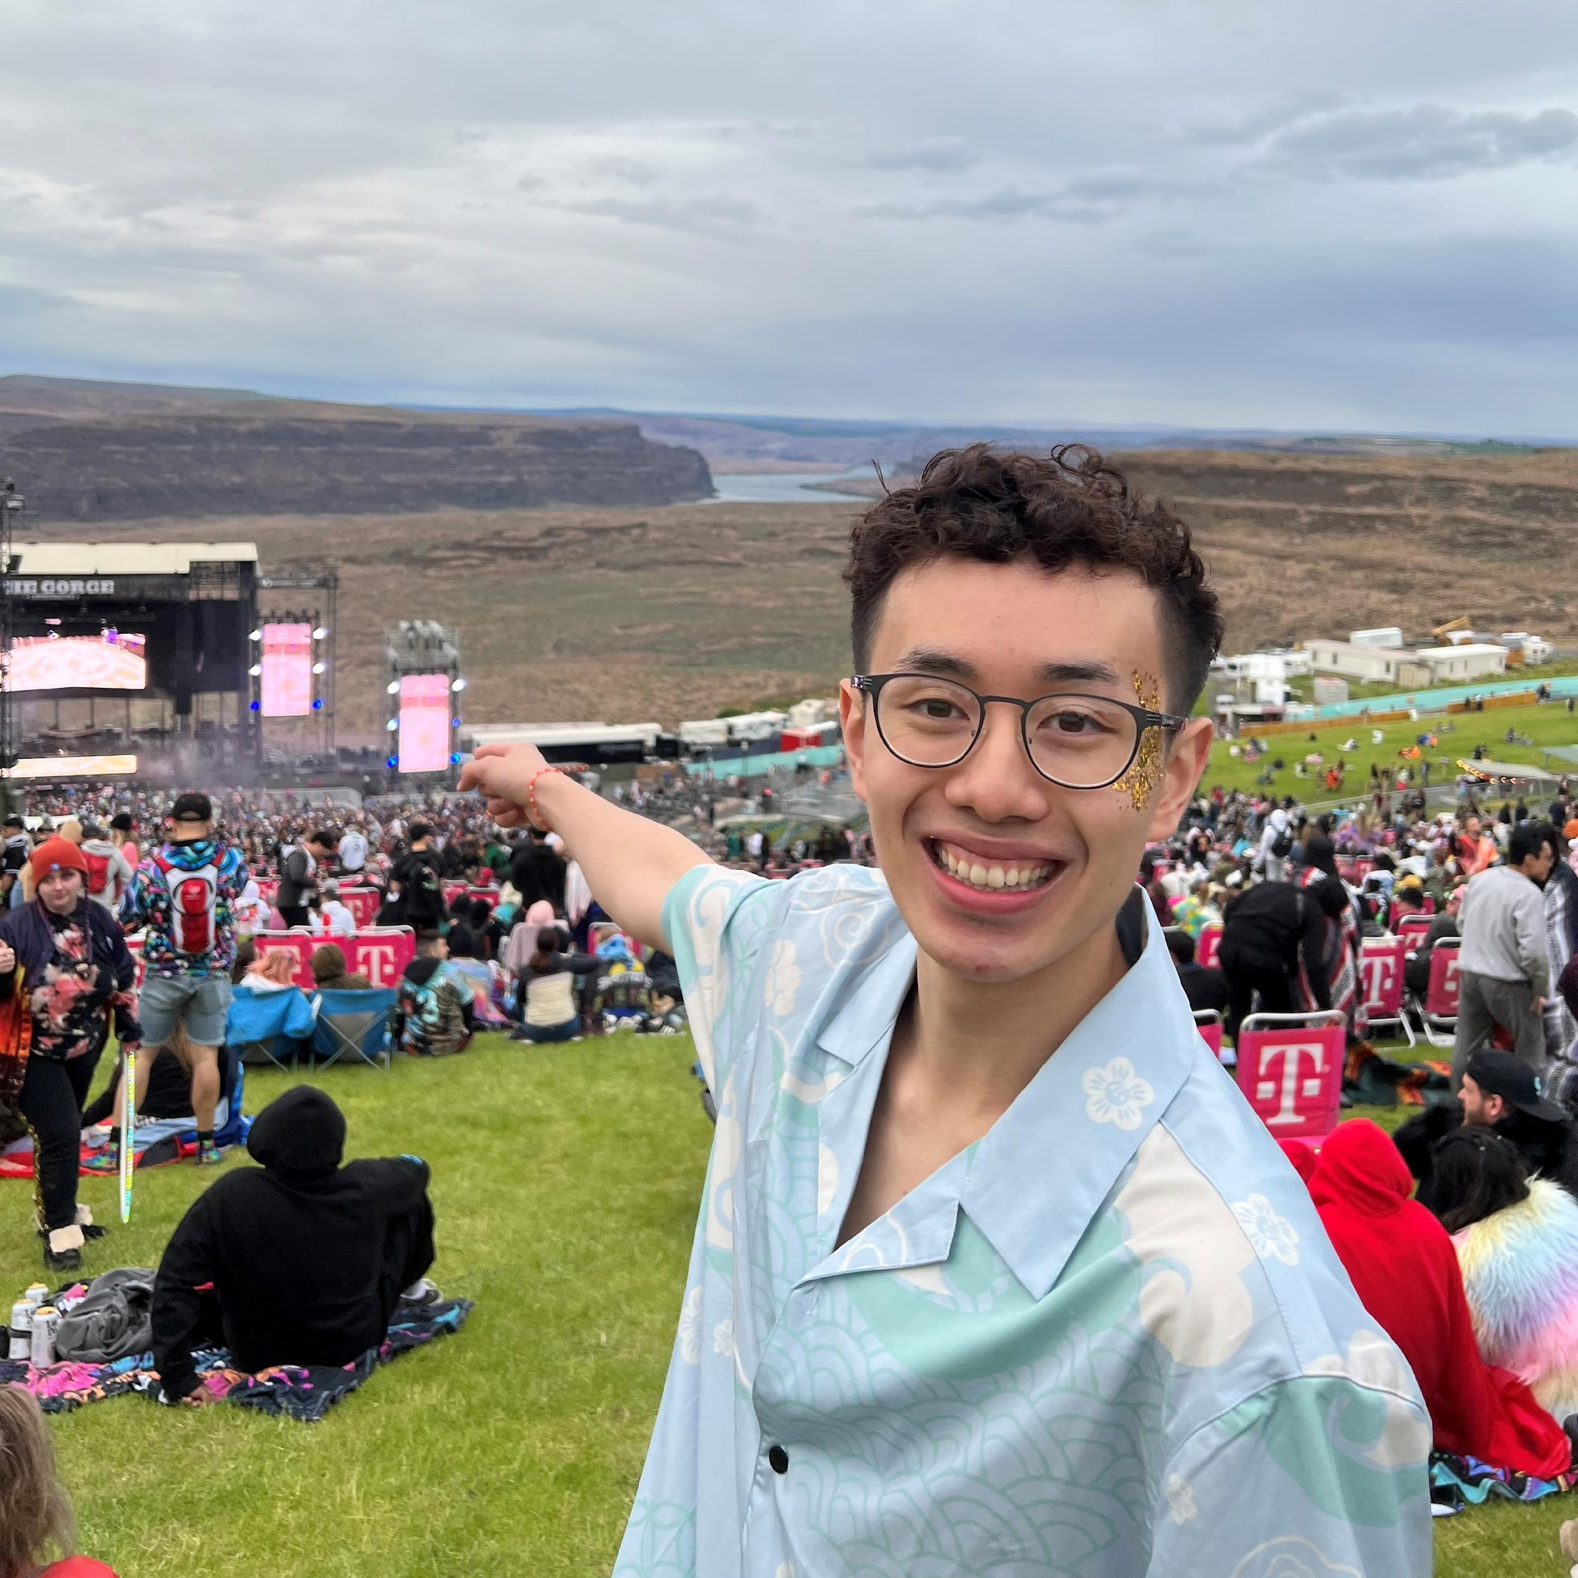
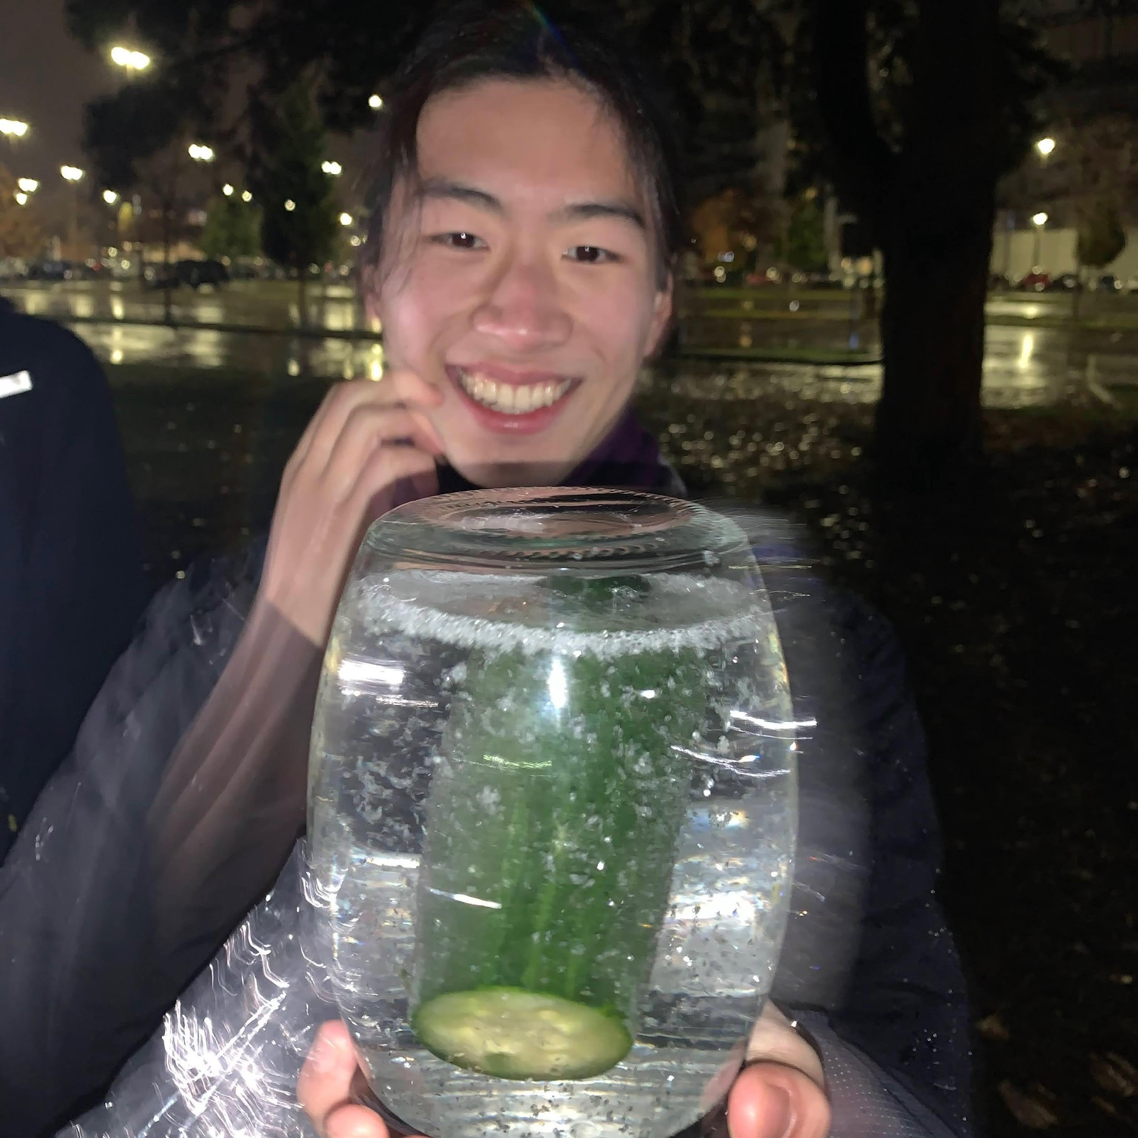
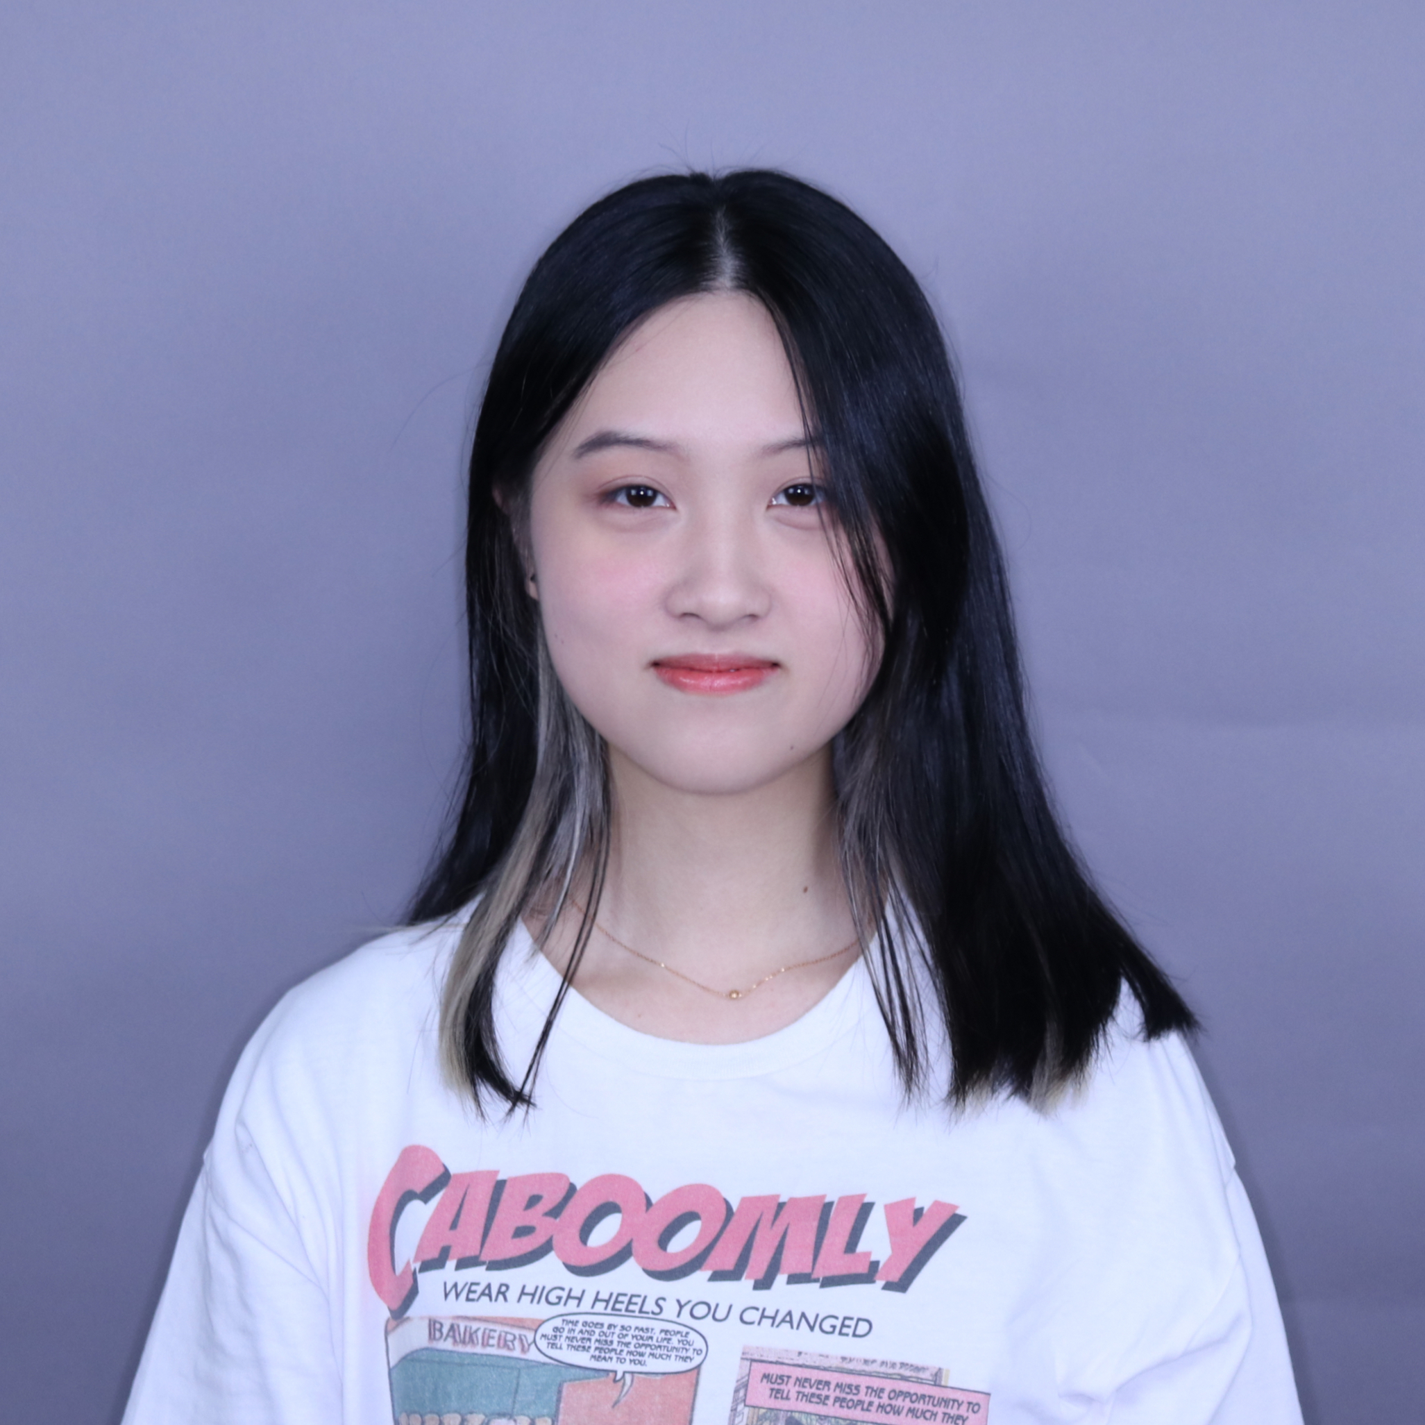
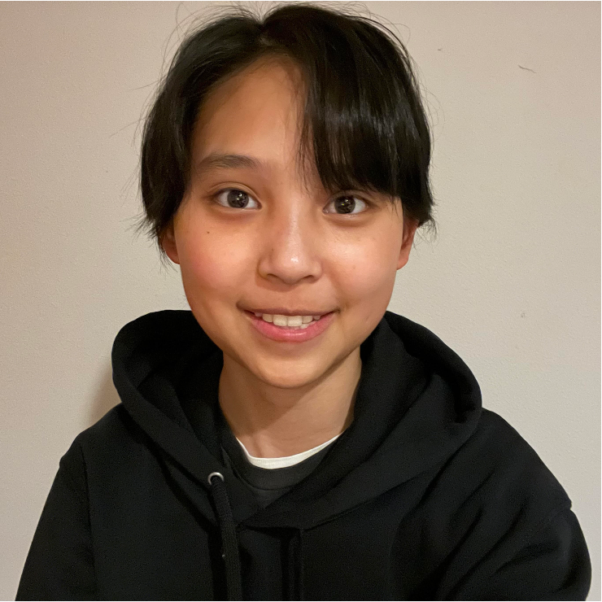
Meet (most of) your 28 TAs!
Notes:
Elba

Slide 7
Agenda
About us
About this course
Learning objectives
Other similar courses
Course components
Our learning model
Tools and resources
Course Website
Ed
Defining Classes Review
Assessment and grading
Collaboration
Notes:
:37
Brett

Slide 8
Learning Objectives
or, “What will I learn in this class?”
Seven themes:
Computational Thinking
Code Comprehension
Code Writing
Communication
Testing
Debugging
Ethics/Impact
Notes:
Brett

Slide 9
Prerequisite Knowledge
Comfort with control structures
loops, conditionals, methods/functions
Experience with using basic data structures
arrays, lists, sets, maps
Experience with console and file input/output
Exposure to simple object-oriented programming
classes, interfaces
Programming experience in Java
Or willingness to pick up on your own

Slide 10
Other Similar Courses
Course | Good choice if…
CSE 123 | You done a fair bit of programming, at least some of which is in Java AND You are, or want to be, in a major such as CS, CE, ECE, Info, etc. that requires Java programming OR You’re interested in creating software (whether as a hobby, side-gig, career, etc.)
CSE 122 | You’ve done some programming (roughly one course worth) in any programming language AND You are, or want to be, in a major such as CS, CE, ECE, Info, etc. that requires Java programming
CSE 143 | You took CSE 142 at UW, at a community college, or through UW in the High School
CSE 163 | You’re interested in data science and analysis OR You want to learn Python* OR You are, or want to be, in a major such as Physics, Bio, Stat, etc. where analyzing data through programming is useful
CSE 154 (23sp) | You’re interested in web development (HTML, CSS, JS)
See Guided Self-Placement and Introductory Courses for more info
Notes:
Brett

Slide 11
Help Us Improve!
CSE 123 is brand new!
We worked hard to build a course we think will be effective and supportive and help you succeed
We probably didn’t get it all right
We appreciate your patience and understanding if we need to make adjustments during the quarter
Please give us lots of feedback!
Post on Ed and/or use the Anonymous Feedback Tool
Notes:
Brett

Slide 12
Course Components
Lessons (aka Lectures)
Sections
WF, 12:30 or 2:30
Held live in KNE; recordings released after
First introductions to course concepts
Mix of presentation of content and practice activities/problems
Required (but not graded) pre-work for most sessions
TuTh, various times
Led by TAs
Held live in person; not recorded
Materials will be released online afterwards
Additional review, discussion, and practice
Mostly practice problems
Attendance is not taken, but you are responsible for all material (including announcements).
Notes:
Elba

Slide 13
Agenda
About us
About this course
Learning objectives
Other similar courses
Course components
Our learning model
Tools and resources
Course Website
Ed
Defining Classes Review
Assessment and grading
Collaboration
Notes:
:45
Elba

Slide 14
Notes:
Elba

Slide 15
Digression: My Pandemic Hobby
Amigurumi: Japanese art of creating crocheted or knitted stuffed toys
Notes:
Brett

Slide 16
Digression: My Pandemic Hobby
Amigurumi: Japanese art of creating crocheted or knitted stuffed toys
Notes:
Brett

Slide 17
Digression: My Pandemic Hobby
Amigurumi: Japanese art of creating crocheted or knitted stuffed toys
Notes:
Brett

Slide 18
Course Culture and Support
Currently 512 students enrolled!
Wide range of backgrounds, interests, and goals
Support and help each other!
Form study groups
If you have a question, others almost certainly do too
Lots of ways to get support from us
Message board, IPL, section
Notes:
Brett

Slide 19
Course Culture and Support
Policies designed with flexibility in mind
Resubmissions/Retakes, lecture recordings, etc.
But life and the world still happen…
Please reach out ASAP if you’re struggling or have circumstances that require extra support
Notes:
Brett

Slide 20
Agenda
About us
About this course
Learning objectives
Other similar courses
Course components
Our learning model
Tools and resources
Course Website
Ed
Defining Classes Review
Assessment and grading
Collaboration
Notes:
:55
Elba

Slide 21
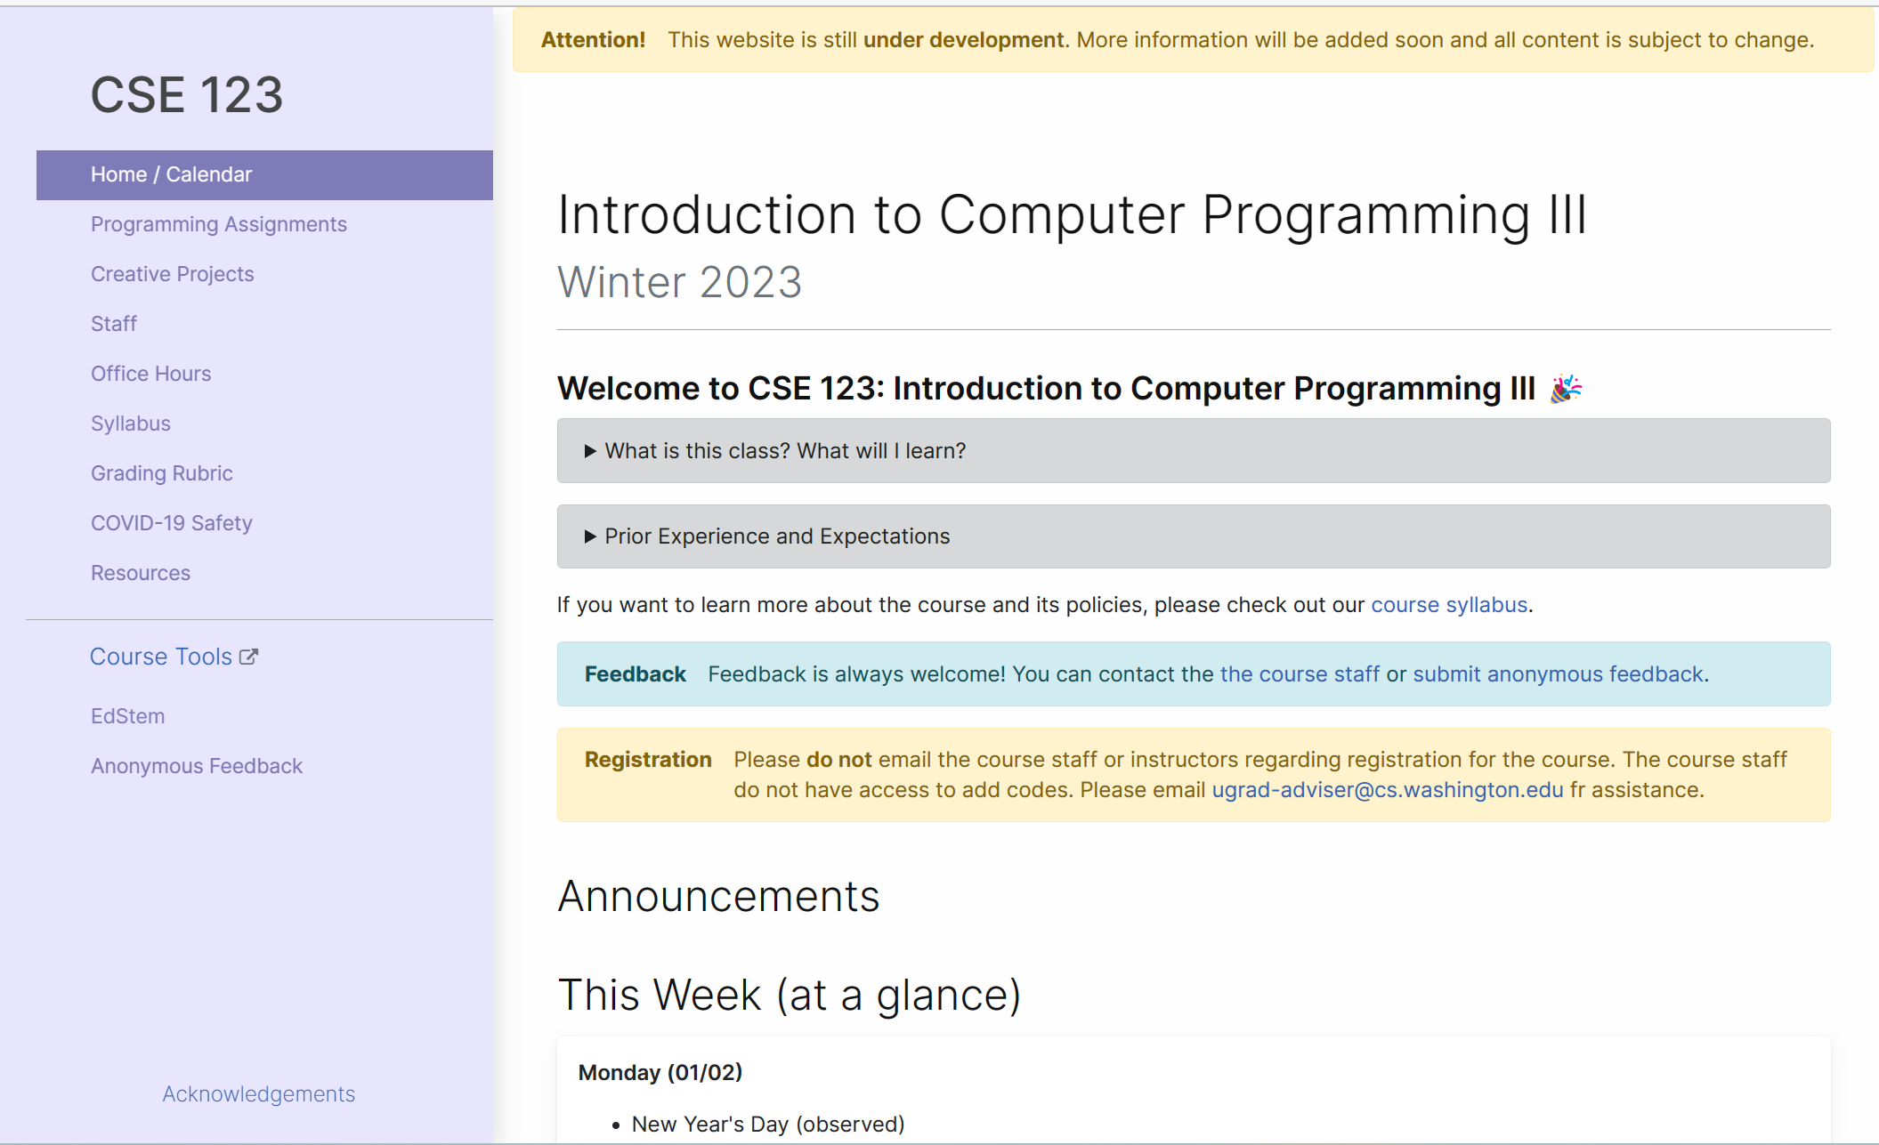
Course Website
cs.uw.edu/123
Primary source of course information (not Canvas)
Calendar will contain links to (almost) all resources
Notes:
Elba

Slide 22
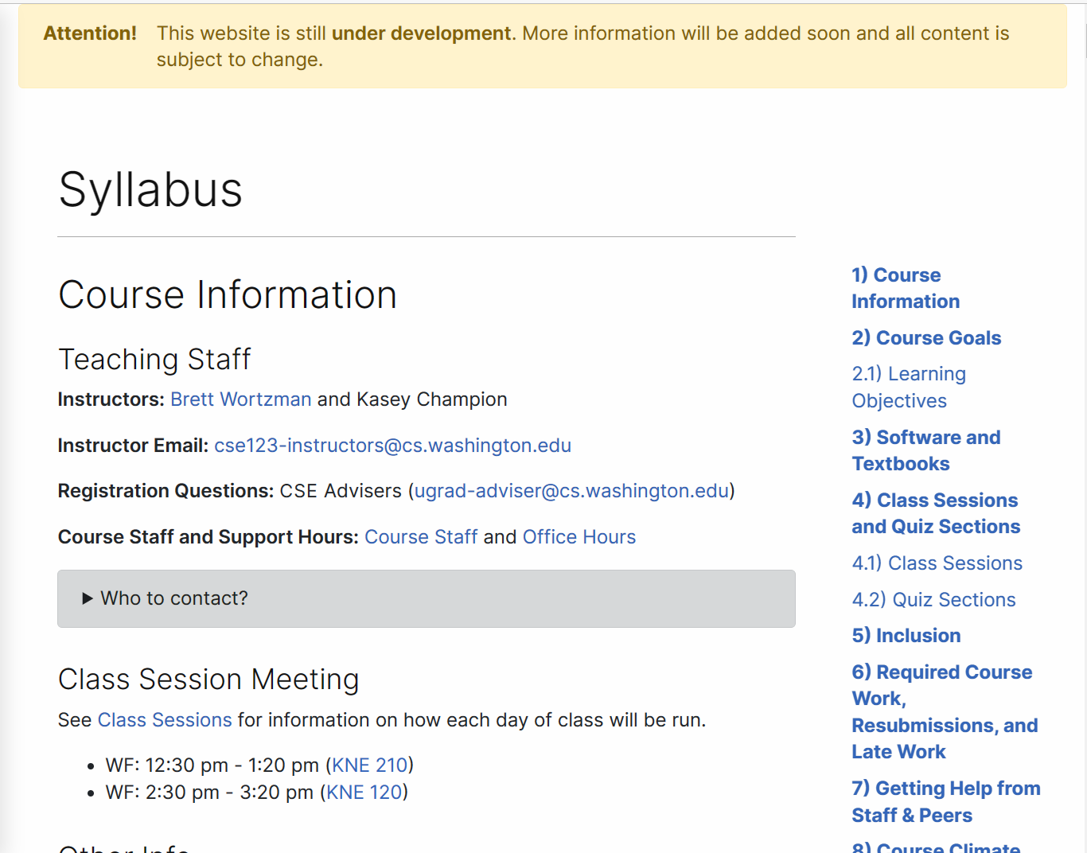
Course Website
Please review the syllabus ASAP.
Notes:
Elba

Slide 23
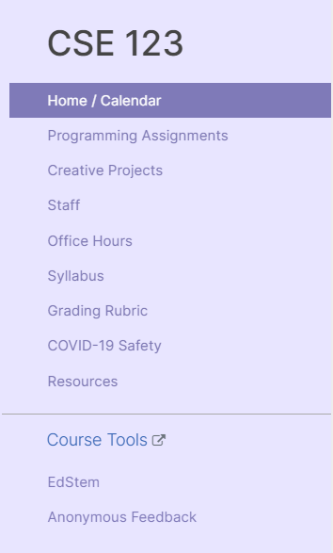
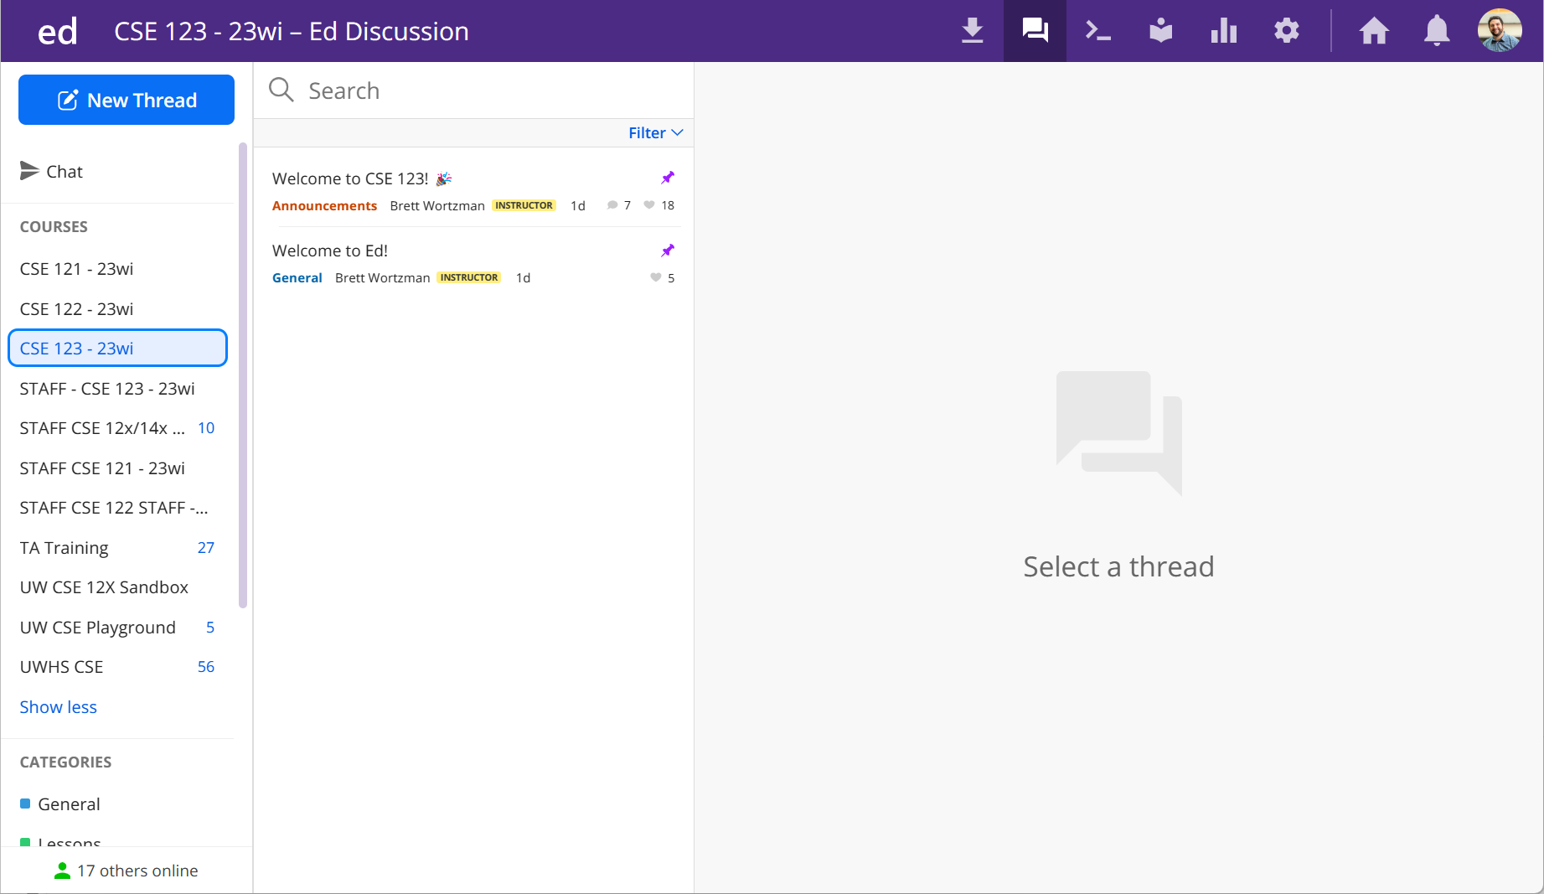
Ed
Our online learning platform
Lessons, sections, assignments posted
Linked from calendar
Submit graded work
Receive/View feedback
Message board
Including announcements
Notes:
Elba
Mention other tools coming soon: IntelliJ, MyDigitalHand, Sli.do

Slide 24
💻 Defining Classes Review
Notes:
:05
Elba

Slide 25
Agenda
About us
About this course
Learning objectives
Other similar courses
Course components
Our learning model
Tools and resources
Course Website
Ed
Defining Classes Review
Assessment and grading
Collaboration
Notes:
Here on down comes Friday.

Slide 26
Assignments and Grading
Our goal in the course is for you to gain proficiency the concepts and skills we teach
We assess your proficiency by asking you to apply the concepts and skills on tasks or problems
By necessity, we are assessing your work as a proxy for your proficiency

Slide 27
Assignments
Your learning in this course will be assessed in four ways:
Programming Assignments (~biweekly, 4 total)
Structured programming assignments to assess your proficiency of programming concepts
Creative Projects (~biweekly, 4 total)
Smaller, more open-ended assignments to give you space to explore
Quizzes (3 total, in section)
Series of problems covering all material up to that point
Final Exam (Tuesday, March 14)
Final, culminating assessment of all your skills and knowledge

Slide 28
Resubmission/Retakes
Learning takes time, and doesn’t always happen on the first try
One previous Programming Assignment or Creative Project can be resubmitted each week
Must be accompanied by a write-up describing changes (via Google Form)
Grade on resubmission will replace original grade
Each assignment should only be resubmitted once
Each Quiz can be retaken once
If missed or to improve performance (but not both)
Grades taken “best-per-problem”
Retakes scheduled at certain times– details forthcoming
See the syllabus for more details

Slide 29
Grading
Grades should reflect your proficiency in the course objectives
All assignments will be graded E (Excellent), S (Satisfactory), or N (Not yet)
Under certain circumstances, a grade of U (Unassessable) may be assigned
In some cases, not all grades will be given
Final grades will be assigned based on the amount of work at each level
See the syllabus for more details

Slide 30
Agenda
About us
About this course
Learning objectives
Other similar courses
Course components
Our learning model
Tools and resources
Course Website
Ed
Defining Classes Review
Assessment and grading
Collaboration

Slide 31
Collaboration Policy
Learning is hard, but it’s easier when you learn from each other
You are encouraged to form study groups; work together on pre-class work, practice and review; and discuss your ideas and approaches
All work you submit for grading must be predominantly and substantially your own
Work that violates policy may be withdrawn within 72 hours
See the syllabus for more details

