Slide 1
Binary Trees
Hitesh Boinpally
Summer 2023

Slide 2
Agenda
Binary Trees
Traversals
Reminders

Slide 3
Agenda
Binary Trees
Traversals
Reminders

Slide 4
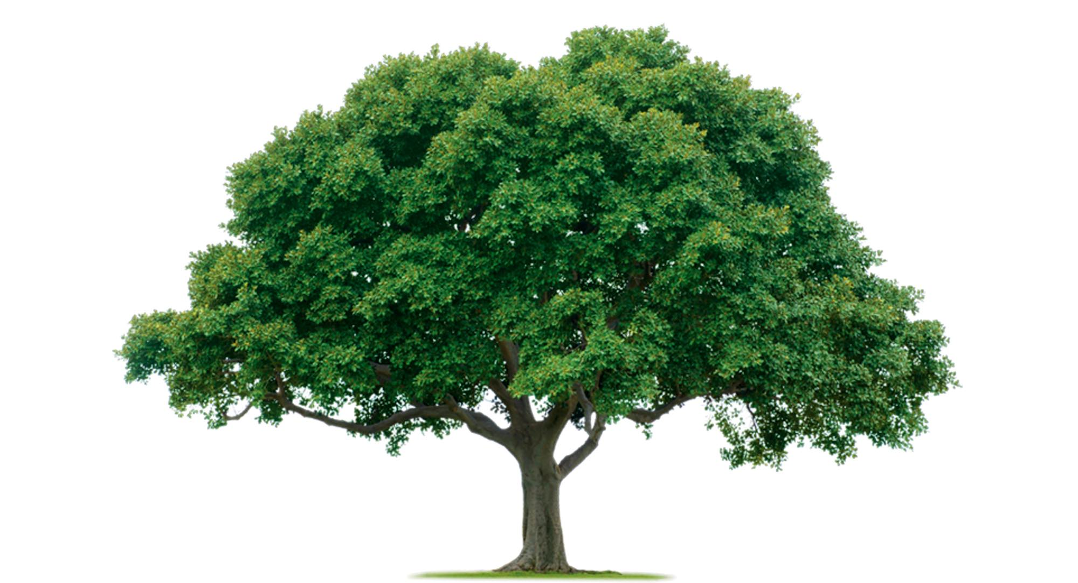
Trees in Computer Science

Slide 5
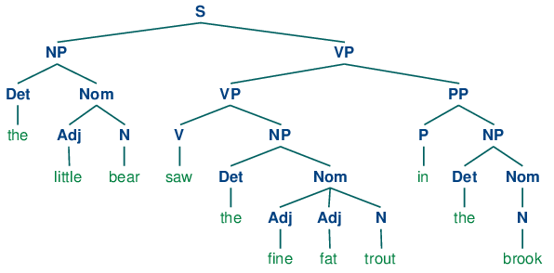
Trees in Computer Science
Implementation for TreeMap / TreeSet
Decision Trees
How files / folders are represented
Family Trees, Org Charts
Parse trees
a = (b + c) * d
Natural language processing

Slide 6
Trees Defined
Tree: Nodes linked together in some hierarchical fashion
Binary Tree: A tree where each node has at most 2 children
Recursive Definition:
A tree is either:
Empty
A node with data, and a left and right subtree

Slide 7
Trees Defined
root
Tree: Nodes linked together in some hierarchical fashion
Binary Tree: A tree where each node has at most 2 children
Recursive Definition:
A tree is either:
Empty
A node with data, and a left and right subtree
1
2
3
4
5
6

Slide 8
Trees Defined
A tree is either:
Empty
A node with data, and a left and right subtree
root
root
root
root
root
1
12
-1
1
2
3
2
13
9
4
4
5
6

Slide 9
Printing Trees
root
Want to print out the contents of the tree
Our intended output:
48 21 5 10 8 6
48
21
10
5
8
6

Slide 10
Agenda
Binary Trees
Traversals
Reminders

Slide 11
Printing Trees
root
Want to print out the contents of the tree
Different ways to do so:
48
21
10
Pre-order | 48 21 5 10 8 6
In-order | 5 21 48 8 10 6
Post-order | 5 21 8 6 10 48
5
8
6

Slide 12
What’s the in-order traversal of this tree?
slido.com code: #su_cse123
root
12
16
10
5
23
6
4
42
8

Slide 13
What’s the in-order traversal of this tree?
slido.com code: #su_cse123
root
12
16
10
5
23
6
4
42
8
Answer: 5 4 16 12 42 23 10 6 8

Slide 14
Practice: pathSum
root
Given a number, print out all sums that have value greater than or equal to the given number for a tree in a pre-order fashion.
For the tree pictured, the call pathSum(13) would result in the following:
3
10
-2
pathSum(13)
Output:
13
23
13
10
12
6

