Slide 1
Exhaustive Search
Hitesh Boinpally
Summer 2023

Slide 2
Agenda
Exhaustive Search
Gambling
Phone Numbers

Slide 3
Agenda
Exhaustive Search
Gambling
Phone Numbers

Slide 4
Exhaustive Search

Slide 5
Exhaustive Search
Brute force algorithm!
Not smart
Simply trying all possibilities, find the ones that work
Often solved recursively

Slide 6
fourAB
Write a method to print out all Strings four letters long made up of only 'a's and 'b's
Notes:
Ask for some examples

Slide 7
fourAB
Write a method to print out all Strings four letters long made up of only 'a's and 'b's
aaaa | baaa
aaab | baab
aaba | baba
aabb | babb
abaa | bbaa
abab | bbab
abba | bbba
abbb | bbbb
Notes:
First pick the first letter either a or b, then we have to generate a string of 3 letters with only a’s and b’s. Pick the second letter, then generate a string of 2 letters with only a’s and b’s, etc. (Hence recursive method)

Slide 8
fourAB Visualized
_ _ _ _

Slide 9
fourAB Visualized
_ _ _ _
a _ _ _
b _ _ _

Slide 10
fourAB Visualized
_ _ _ _
a _ _ _
b _ _ _
a a _ _
a b _ _

Slide 11
fourAB Visualized
_ _ _ _
a _ _ _
b _ _ _
a a _ _
a b _ _
a a a _
a a b _

Slide 12
fourAB Visualized
_ _ _ _
a _ _ _
b _ _ _
a a _ _
a b _ _
a a a _
a a b _
a a a a

Slide 13
fourAB Visualized
_ _ _ _
a _ _ _
b _ _ _
a a _ _
a b _ _
a a a _
a a b _
a a a a

Slide 14
fourAB Visualized
_ _ _ _
a _ _ _
b _ _ _
a a _ _
a b _ _
a a a _
a a b _
a a a a
a a a b

Slide 15
fourAB Visualized
_ _ _ _
a _ _ _
b _ _ _
a a _ _
a b _ _
a a a _
a a b _
a a a a
a a a b

Slide 16
fourAB Visualized
_ _ _ _
a _ _ _
b _ _ _
a a _ _
a b _ _
a a a _
a a b _
a a a a
a a a b
a a b a
a a b b

Slide 17
fourAB Visualized
_ _ _ _
a _ _ _
b _ _ _
a a _ _
a b _ _
…
a a a _
a a b _
a a a a
a a a b
a a b a
a a b b

Slide 18
fourAB Visualized
_ _ _ _
a _ _ _
b _ _ _
…
a a _ _
a b _ _
…
a a a _
a a b _
a a a a
a a a b
a a b a
a a b b

Slide 19
fourAB Execution Visualized
private static void fourAB(String soFar) { if (soFar.length() == 4) { System.out.println(soFar); } else { fourAB(soFar + "a"); fourAB(soFar + "b"); } }
soFar
Console output:

Slide 20
fourAB Execution Visualized
private static void fourAB(String soFar) { if (soFar.length() == 4) { System.out.println(soFar); } else { fourAB(soFar + "a"); fourAB(soFar + "b"); } }
soFar
Console output:

Slide 21
fourAB Execution Visualized
private static void fourAB(String soFar) { if (soFar.length() == 4) { System.out.println(soFar); } else { fourAB(soFar + "a"); fourAB(soFar + "b"); } }
private static void fourAB(String soFar) { if (soFar.length() == 4) { System.out.println(soFar); } else { fourAB(soFar + "a"); fourAB(soFar + "b"); } }
soFar
soFar | a
Console output:

Slide 22
fourAB Execution Visualized
private static void fourAB(String soFar) { if (soFar.length() == 4) { System.out.println(soFar); } else { fourAB(soFar + "a"); fourAB(soFar + "b"); } }
private static void fourAB(String soFar) { if (soFar.length() == 4) { System.out.println(soFar); } else { fourAB(soFar + "a"); fourAB(soFar + "b"); } }
soFar
soFar | a
Console output:

Slide 23
fourAB Execution Visualized
private static void fourAB(String soFar) { if (soFar.length() == 4) { System.out.println(soFar); } else { fourAB(soFar + "a"); fourAB(soFar + "b"); } }
private static void fourAB(String soFar) { if (soFar.length() == 4) { System.out.println(soFar); } else { fourAB(soFar + "a"); fourAB(soFar + "b"); } }
private static void fourAB(String soFar) { if (soFar.length() == 4) { System.out.println(soFar); } else { fourAB(soFar + "a"); fourAB(soFar + "b"); } }
soFar
soFar | a
soFar | aa
Console output:

Slide 24
fourAB Execution Visualized
private static void fourAB(String soFar) { if (soFar.length() == 4) { System.out.println(soFar); } else { fourAB(soFar + "a"); fourAB(soFar + "b"); } }
private static void fourAB(String soFar) { if (soFar.length() == 4) { System.out.println(soFar); } else { fourAB(soFar + "a"); fourAB(soFar + "b"); } }
private static void fourAB(String soFar) { if (soFar.length() == 4) { System.out.println(soFar); } else { fourAB(soFar + "a"); fourAB(soFar + "b"); } }
soFar
soFar | a
soFar | aa
Console output:

Slide 25
fourAB Execution Visualized
private static void fourAB(String soFar) { if (soFar.length() == 4) { System.out.println(soFar); } else { fourAB(soFar + "a"); fourAB(soFar + "b"); } }
private static void fourAB(String soFar) { if (soFar.length() == 4) { System.out.println(soFar); } else { fourAB(soFar + "a"); fourAB(soFar + "b"); } }
private static void fourAB(String soFar) { if (soFar.length() == 4) { System.out.println(soFar); } else { fourAB(soFar + "a"); fourAB(soFar + "b"); } }
private static void fourAB(String soFar) { if (soFar.length() == 4) { System.out.println(soFar); } else { fourAB(soFar + "a"); fourAB(soFar + "b"); } }
soFar
soFar | a
soFar | aa
Console output:
soFar | aaa

Slide 26
fourAB Execution Visualized
private static void fourAB(String soFar) { if (soFar.length() == 4) { System.out.println(soFar); } else { fourAB(soFar + "a"); fourAB(soFar + "b"); } }
private static void fourAB(String soFar) { if (soFar.length() == 4) { System.out.println(soFar); } else { fourAB(soFar + "a"); fourAB(soFar + "b"); } }
private static void fourAB(String soFar) { if (soFar.length() == 4) { System.out.println(soFar); } else { fourAB(soFar + "a"); fourAB(soFar + "b"); } }
private static void fourAB(String soFar) { if (soFar.length() == 4) { System.out.println(soFar); } else { fourAB(soFar + "a"); fourAB(soFar + "b"); } }
private static void fourAB(String soFar) { if (soFar.length() == 4) { System.out.println(soFar); } else { fourAB(soFar + "a"); fourAB(soFar + "b"); } }
soFar
soFar | a
soFar | aa
Console output:
soFar | aaa
soFar | aaaa

Slide 27
fourAB Execution Visualized
private static void fourAB(String soFar) { if (soFar.length() == 4) { System.out.println(soFar); } else { fourAB(soFar + "a"); fourAB(soFar + "b"); } }
private static void fourAB(String soFar) { if (soFar.length() == 4) { System.out.println(soFar); } else { fourAB(soFar + "a"); fourAB(soFar + "b"); } }
private static void fourAB(String soFar) { if (soFar.length() == 4) { System.out.println(soFar); } else { fourAB(soFar + "a"); fourAB(soFar + "b"); } }
private static void fourAB(String soFar) { if (soFar.length() == 4) { System.out.println(soFar); } else { fourAB(soFar + "a"); fourAB(soFar + "b"); } }
private static void fourAB(String soFar) { if (soFar.length() == 4) { System.out.println(soFar); } else { fourAB(soFar + "a"); fourAB(soFar + "b"); } }
soFar
soFar | a
soFar | aa
Console output:
soFar | aaa
soFar | aaaa

Slide 28
fourAB Execution Visualized
private static void fourAB(String soFar) { if (soFar.length() == 4) { System.out.println(soFar); } else { fourAB(soFar + "a"); fourAB(soFar + "b"); } }
private static void fourAB(String soFar) { if (soFar.length() == 4) { System.out.println(soFar); } else { fourAB(soFar + "a"); fourAB(soFar + "b"); } }
private static void fourAB(String soFar) { if (soFar.length() == 4) { System.out.println(soFar); } else { fourAB(soFar + "a"); fourAB(soFar + "b"); } }
private static void fourAB(String soFar) { if (soFar.length() == 4) { System.out.println(soFar); } else { fourAB(soFar + "a"); fourAB(soFar + "b"); } }
private static void fourAB(String soFar) { if (soFar.length() == 4) { System.out.println(soFar); } else { fourAB(soFar + "a"); fourAB(soFar + "b"); } }
soFar
soFar | a
soFar | aa
Console output:
aaaa
soFar | aaa
soFar | aaaa

Slide 29
fourAB Execution Visualized
private static void fourAB(String soFar) { if (soFar.length() == 4) { System.out.println(soFar); } else { fourAB(soFar + "a"); fourAB(soFar + "b"); } }
private static void fourAB(String soFar) { if (soFar.length() == 4) { System.out.println(soFar); } else { fourAB(soFar + "a"); fourAB(soFar + "b"); } }
private static void fourAB(String soFar) { if (soFar.length() == 4) { System.out.println(soFar); } else { fourAB(soFar + "a"); fourAB(soFar + "b"); } }
private static void fourAB(String soFar) { if (soFar.length() == 4) { System.out.println(soFar); } else { fourAB(soFar + "a"); fourAB(soFar + "b"); } }
soFar
soFar | a
soFar | aa
Console output:
aaaa
soFar | aaa

Slide 30
fourAB Execution Visualized
private static void fourAB(String soFar) { if (soFar.length() == 4) { System.out.println(soFar); } else { fourAB(soFar + "a"); fourAB(soFar + "b"); } }
private static void fourAB(String soFar) { if (soFar.length() == 4) { System.out.println(soFar); } else { fourAB(soFar + "a"); fourAB(soFar + "b"); } }
private static void fourAB(String soFar) { if (soFar.length() == 4) { System.out.println(soFar); } else { fourAB(soFar + "a"); fourAB(soFar + "b"); } }
private static void fourAB(String soFar) { if (soFar.length() == 4) { System.out.println(soFar); } else { fourAB(soFar + "a"); fourAB(soFar + "b"); } }
private static void fourAB(String soFar) { if (soFar.length() == 4) { System.out.println(soFar); } else { fourAB(soFar + "a"); fourAB(soFar + "b"); } }
soFar
soFar | a
soFar | aa
Console output:
aaaa
soFar | aaa
soFar | aaab

Slide 31
fourAB Execution Visualized
private static void fourAB(String soFar) { if (soFar.length() == 4) { System.out.println(soFar); } else { fourAB(soFar + "a"); fourAB(soFar + "b"); } }
private static void fourAB(String soFar) { if (soFar.length() == 4) { System.out.println(soFar); } else { fourAB(soFar + "a"); fourAB(soFar + "b"); } }
private static void fourAB(String soFar) { if (soFar.length() == 4) { System.out.println(soFar); } else { fourAB(soFar + "a"); fourAB(soFar + "b"); } }
private static void fourAB(String soFar) { if (soFar.length() == 4) { System.out.println(soFar); } else { fourAB(soFar + "a"); fourAB(soFar + "b"); } }
private static void fourAB(String soFar) { if (soFar.length() == 4) { System.out.println(soFar); } else { fourAB(soFar + "a"); fourAB(soFar + "b"); } }
soFar
soFar | a
soFar | aa
Console output:
aaaa
soFar | aaa
soFar | aaab

Slide 32
fourAB Execution Visualized
private static void fourAB(String soFar) { if (soFar.length() == 4) { System.out.println(soFar); } else { fourAB(soFar + "a"); fourAB(soFar + "b"); } }
private static void fourAB(String soFar) { if (soFar.length() == 4) { System.out.println(soFar); } else { fourAB(soFar + "a"); fourAB(soFar + "b"); } }
private static void fourAB(String soFar) { if (soFar.length() == 4) { System.out.println(soFar); } else { fourAB(soFar + "a"); fourAB(soFar + "b"); } }
private static void fourAB(String soFar) { if (soFar.length() == 4) { System.out.println(soFar); } else { fourAB(soFar + "a"); fourAB(soFar + "b"); } }
private static void fourAB(String soFar) { if (soFar.length() == 4) { System.out.println(soFar); } else { fourAB(soFar + "a"); fourAB(soFar + "b"); } }
soFar
soFar | a
soFar | aa
Console output:
aaaa
aaab
soFar | aaa
soFar | aaab

Slide 33
fourAB Execution Visualized
private static void fourAB(String soFar) { if (soFar.length() == 4) { System.out.println(soFar); } else { fourAB(soFar + "a"); fourAB(soFar + "b"); } }
private static void fourAB(String soFar) { if (soFar.length() == 4) { System.out.println(soFar); } else { fourAB(soFar + "a"); fourAB(soFar + "b"); } }
private static void fourAB(String soFar) { if (soFar.length() == 4) { System.out.println(soFar); } else { fourAB(soFar + "a"); fourAB(soFar + "b"); } }
private static void fourAB(String soFar) { if (soFar.length() == 4) { System.out.println(soFar); } else { fourAB(soFar + "a"); fourAB(soFar + "b"); } }
soFar
soFar | a
soFar | aa
Console output:
aaaa
aaab
soFar | aaa

Slide 34
fourAB Execution Visualized
private static void fourAB(String soFar) { if (soFar.length() == 4) { System.out.println(soFar); } else { fourAB(soFar + "a"); fourAB(soFar + "b"); } }
private static void fourAB(String soFar) { if (soFar.length() == 4) { System.out.println(soFar); } else { fourAB(soFar + "a"); fourAB(soFar + "b"); } }
private static void fourAB(String soFar) { if (soFar.length() == 4) { System.out.println(soFar); } else { fourAB(soFar + "a"); fourAB(soFar + "b"); } }
soFar
soFar | a
soFar | aa
Console output:
aaaa
aaab

Slide 35
fourAB Execution Visualized
private static void fourAB(String soFar) { if (soFar.length() == 4) { System.out.println(soFar); } else { fourAB(soFar + "a"); fourAB(soFar + "b"); } }
private static void fourAB(String soFar) { if (soFar.length() == 4) { System.out.println(soFar); } else { fourAB(soFar + "a"); fourAB(soFar + "b"); } }
private static void fourAB(String soFar) { if (soFar.length() == 4) { System.out.println(soFar); } else { fourAB(soFar + "a"); fourAB(soFar + "b"); } }
private static void fourAB(String soFar) { if (soFar.length() == 4) { System.out.println(soFar); } else { fourAB(soFar + "a"); fourAB(soFar + "b"); } }
soFar
soFar | a
soFar | aa
Console output:
aaaa
aaab
soFar | aab

Slide 36
fourAB Execution Visualized
private static void fourAB(String soFar) { if (soFar.length() == 4) { System.out.println(soFar); } else { fourAB(soFar + "a"); fourAB(soFar + "b"); } }
private static void fourAB(String soFar) { if (soFar.length() == 4) { System.out.println(soFar); } else { fourAB(soFar + "a"); fourAB(soFar + "b"); } }
private static void fourAB(String soFar) { if (soFar.length() == 4) { System.out.println(soFar); } else { fourAB(soFar + "a"); fourAB(soFar + "b"); } }
private static void fourAB(String soFar) { if (soFar.length() == 4) { System.out.println(soFar); } else { fourAB(soFar + "a"); fourAB(soFar + "b"); } }
soFar
soFar | a
soFar | aa
Console output:
aaaa
aaab
soFar | aab

Slide 37
fourAB Execution Visualized
private static void fourAB(String soFar) { if (soFar.length() == 4) { System.out.println(soFar); } else { fourAB(soFar + "a"); fourAB(soFar + "b"); } }
private static void fourAB(String soFar) { if (soFar.length() == 4) { System.out.println(soFar); } else { fourAB(soFar + "a"); fourAB(soFar + "b"); } }
private static void fourAB(String soFar) { if (soFar.length() == 4) { System.out.println(soFar); } else { fourAB(soFar + "a"); fourAB(soFar + "b"); } }
private static void fourAB(String soFar) { if (soFar.length() == 4) { System.out.println(soFar); } else { fourAB(soFar + "a"); fourAB(soFar + "b"); } }
private static void fourAB(String soFar) { if (soFar.length() == 4) { System.out.println(soFar); } else { fourAB(soFar + "a"); fourAB(soFar + "b"); } }
soFar
soFar | a
soFar | aa
Console output:
aaaa
aaab
soFar | aab
soFar | aaba

Slide 38
fourAB Execution Visualized
private static void fourAB(String soFar) { if (soFar.length() == 4) { System.out.println(soFar); } else { fourAB(soFar + "a"); fourAB(soFar + "b"); } }
private static void fourAB(String soFar) { if (soFar.length() == 4) { System.out.println(soFar); } else { fourAB(soFar + "a"); fourAB(soFar + "b"); } }
private static void fourAB(String soFar) { if (soFar.length() == 4) { System.out.println(soFar); } else { fourAB(soFar + "a"); fourAB(soFar + "b"); } }
private static void fourAB(String soFar) { if (soFar.length() == 4) { System.out.println(soFar); } else { fourAB(soFar + "a"); fourAB(soFar + "b"); } }
private static void fourAB(String soFar) { if (soFar.length() == 4) { System.out.println(soFar); } else { fourAB(soFar + "a"); fourAB(soFar + "b"); } }
soFar
soFar | a
soFar | aa
Console output:
aaaa
aaab
aaba
soFar | aab
soFar | aaba

Slide 39
fourAB Execution Visualized
private static void fourAB(String soFar) { if (soFar.length() == 4) { System.out.println(soFar); } else { fourAB(soFar + "a"); fourAB(soFar + "b"); } }
private static void fourAB(String soFar) { if (soFar.length() == 4) { System.out.println(soFar); } else { fourAB(soFar + "a"); fourAB(soFar + "b"); } }
private static void fourAB(String soFar) { if (soFar.length() == 4) { System.out.println(soFar); } else { fourAB(soFar + "a"); fourAB(soFar + "b"); } }
private static void fourAB(String soFar) { if (soFar.length() == 4) { System.out.println(soFar); } else { fourAB(soFar + "a"); fourAB(soFar + "b"); } }
soFar
soFar | a
soFar | aa
Console output:
aaaa
aaab
aaba
soFar | aab

Slide 40
fourAB Execution Visualized
private static void fourAB(String soFar) { if (soFar.length() == 4) { System.out.println(soFar); } else { fourAB(soFar + "a"); fourAB(soFar + "b"); } }
private static void fourAB(String soFar) { if (soFar.length() == 4) { System.out.println(soFar); } else { fourAB(soFar + "a"); fourAB(soFar + "b"); } }
private static void fourAB(String soFar) { if (soFar.length() == 4) { System.out.println(soFar); } else { fourAB(soFar + "a"); fourAB(soFar + "b"); } }
private static void fourAB(String soFar) { if (soFar.length() == 4) { System.out.println(soFar); } else { fourAB(soFar + "a"); fourAB(soFar + "b"); } }
private static void fourAB(String soFar) { if (soFar.length() == 4) { System.out.println(soFar); } else { fourAB(soFar + "a"); fourAB(soFar + "b"); } }
soFar
soFar | a
soFar | aa
Console output:
aaaa
aaab
aaba
soFar | aab
soFar | aabb

Slide 41
fourAB Execution Visualized
private static void fourAB(String soFar) { if (soFar.length() == 4) { System.out.println(soFar); } else { fourAB(soFar + "a"); fourAB(soFar + "b"); } }
private static void fourAB(String soFar) { if (soFar.length() == 4) { System.out.println(soFar); } else { fourAB(soFar + "a"); fourAB(soFar + "b"); } }
private static void fourAB(String soFar) { if (soFar.length() == 4) { System.out.println(soFar); } else { fourAB(soFar + "a"); fourAB(soFar + "b"); } }
private static void fourAB(String soFar) { if (soFar.length() == 4) { System.out.println(soFar); } else { fourAB(soFar + "a"); fourAB(soFar + "b"); } }
private static void fourAB(String soFar) { if (soFar.length() == 4) { System.out.println(soFar); } else { fourAB(soFar + "a"); fourAB(soFar + "b"); } }
soFar
soFar | a
soFar | aa
Console output:
aaaa
aaab
aaba
soFar | aab
soFar | aabb

Slide 42
fourAB Execution Visualized
private static void fourAB(String soFar) { if (soFar.length() == 4) { System.out.println(soFar); } else { fourAB(soFar + "a"); fourAB(soFar + "b"); } }
private static void fourAB(String soFar) { if (soFar.length() == 4) { System.out.println(soFar); } else { fourAB(soFar + "a"); fourAB(soFar + "b"); } }
private static void fourAB(String soFar) { if (soFar.length() == 4) { System.out.println(soFar); } else { fourAB(soFar + "a"); fourAB(soFar + "b"); } }
private static void fourAB(String soFar) { if (soFar.length() == 4) { System.out.println(soFar); } else { fourAB(soFar + "a"); fourAB(soFar + "b"); } }
private static void fourAB(String soFar) { if (soFar.length() == 4) { System.out.println(soFar); } else { fourAB(soFar + "a"); fourAB(soFar + "b"); } }
soFar
soFar | a
soFar | aa
Console output:
aaaa
aaab
aaba
aabb
soFar | aab
soFar | aabb

Slide 43
fourAB Execution Visualized
private static void fourAB(String soFar) { if (soFar.length() == 4) { System.out.println(soFar); } else { fourAB(soFar + "a"); fourAB(soFar + "b"); } }
private static void fourAB(String soFar) { if (soFar.length() == 4) { System.out.println(soFar); } else { fourAB(soFar + "a"); fourAB(soFar + "b"); } }
private static void fourAB(String soFar) { if (soFar.length() == 4) { System.out.println(soFar); } else { fourAB(soFar + "a"); fourAB(soFar + "b"); } }
private static void fourAB(String soFar) { if (soFar.length() == 4) { System.out.println(soFar); } else { fourAB(soFar + "a"); fourAB(soFar + "b"); } }
soFar
soFar | a
soFar | aa
Console output:
aaaa
aaab
aaba
aabb
soFar | aab

Slide 44
fourAB Execution Visualized
private static void fourAB(String soFar) { if (soFar.length() == 4) { System.out.println(soFar); } else { fourAB(soFar + "a"); fourAB(soFar + "b"); } }
private static void fourAB(String soFar) { if (soFar.length() == 4) { System.out.println(soFar); } else { fourAB(soFar + "a"); fourAB(soFar + "b"); } }
private static void fourAB(String soFar) { if (soFar.length() == 4) { System.out.println(soFar); } else { fourAB(soFar + "a"); fourAB(soFar + "b"); } }
soFar
soFar | a
soFar | aa
Console output:
aaaa
aaab
aaba
aabb

Slide 45
fourAB Execution Visualized
private static void fourAB(String soFar) { if (soFar.length() == 4) { System.out.println(soFar); } else { fourAB(soFar + "a"); fourAB(soFar + "b"); } }
private static void fourAB(String soFar) { if (soFar.length() == 4) { System.out.println(soFar); } else { fourAB(soFar + "a"); fourAB(soFar + "b"); } }
soFar
soFar | a
Console output:
aaaa
aaab
aaba
aabb

Slide 46
fourAB Execution Visualized
private static void fourAB(String soFar) { if (soFar.length() == 4) { System.out.println(soFar); } else { fourAB(soFar + "a"); fourAB(soFar + "b"); } }
private static void fourAB(String soFar) { if (soFar.length() == 4) { System.out.println(soFar); } else { fourAB(soFar + "a"); fourAB(soFar + "b"); } }
private static void fourAB(String soFar) { if (soFar.length() == 4) { System.out.println(soFar); } else { fourAB(soFar + "a"); fourAB(soFar + "b"); } }
soFar
soFar | a
soFar | ab
Console output:
aaaa
aaab
aaba
aabb
…

Slide 47
Exhaustive Search
Brute force algorithm!
Not smart
Simply trying all possibilities, find the ones that work
Often solved recursively

Slide 48
Exhaustive Search
Brute force algorithm!
Not smart
Simply trying all possibilities, find the ones that work
Often solved recursively
Two main cases
Found Solution: base case
Continue Exploring: recursive case
Multiple recursive calls
One per option
Public/Private pairs are essential

Slide 49
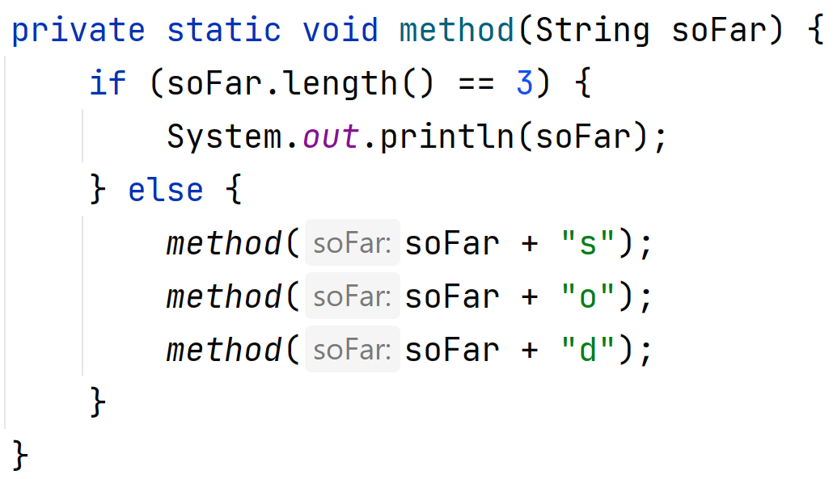
Practice
slido.com code: #su_cse123
What’s the fourth line of output produced by method()?
Notes:
“What row am I in?”

Slide 50
Agenda
Exhaustive Search
Gambling
Phone Numbers

Slide 51
Dice Rolls
Write a method that prints out all possible outcomes when rolling some n 6-sided dice.

Slide 52
Dice Rolls
Write a method that prints out all possible outcomes when rolling some n 6-sided dice.
Example: diceRoll(2)
[1, 1]
[1, 2]
[1, 3]
[1, 4]
[1, 5]
[1, 6]
[2, 1]
[2, 2]
[2, 3]
[2, 4]
[2, 5]
[2, 6]
[3, 1]
[3, 2]
[3, 3]
[3, 4]
[3, 5]
[3, 6]
[4, 1]
[4, 2]
[4, 3]
[4, 4]
[4, 5]
[4, 6]
[5, 1]
[5, 2]
[5, 3]
[5, 4]
[5, 5]
[5, 6]
[6, 1]
[6, 2]
[6, 3]
[6, 4]
[6, 5]
[6, 6]

Slide 53
diceRolls Decision Tree
Chosen | Dice Left
- | 4 dice

Slide 54
diceRolls Decision Tree
Chosen | Dice Left
- | 4 dice
1 | 3 dice

Slide 55
diceRolls Decision Tree
Chosen | Dice Left
- | 4 dice
1 | 3 dice
1, 1 | 2 dice

Slide 56
diceRolls Decision Tree
Chosen | Dice Left
- | 4 dice
1 | 3 dice
1, 1 | 2 dice
1, 1, 1 | 1 die

Slide 57
diceRolls Decision Tree
Chosen | Dice Left
- | 4 dice
1 | 3 dice
1, 1 | 2 dice
1, 1, 1 | 1 die
1, 1, 1, 1 | -

Slide 58
diceRolls Decision Tree
Chosen | Dice Left
- | 4 dice
1 | 3 dice
1, 1 | 2 dice
1, 1, 1 | 1 die
1, 1, 1, 1 | -

Slide 59
diceRolls Decision Tree
Chosen | Dice Left
- | 4 dice
1 | 3 dice
1, 1 | 2 dice
1, 1, 1 | 1 die
1, 1, 1, 1 | -
1, 1, 1, 2 | -

Slide 60
diceRolls Decision Tree
Chosen | Dice Left
- | 4 dice
1 | 3 dice
1, 1 | 2 dice
1, 1, 1 | 1 die
1, 1, 1, 1 | -
1, 1, 1, 2 | -

Slide 61
diceRolls Decision Tree
Chosen | Dice Left
- | 4 dice
1 | 3 dice
1, 1 | 2 dice
1, 1, 1 | 1 die
1, 1, 1, 1 | -
1, 1, 1, 2 | -
…

Slide 62
diceRolls Decision Tree
Chosen | Dice Left
- | 4 dice
1 | 3 dice
1, 1 | 2 dice
1, 1, 1 | 1 die
1, 1, 2 | 1 die
1, 1, 1, 1 | -
1, 1, 1, 2 | -
…

Slide 63
diceRolls Decision Tree
Chosen | Dice Left
- | 4 dice
1 | 3 dice
1, 1 | 2 dice
1, 1, 1 | 1 die
1, 1, 2 | 1 die
1, 1, 1, 1 | -
1, 1, 1, 2 | -
…
1, 1, 2, 1 | -

Slide 64
diceRolls Decision Tree
Chosen | Dice Left
- | 4 dice
1 | 3 dice
1, 1 | 2 dice
1, 1, 1 | 1 die
1, 1, 2 | 1 die
1, 1, 1, 1 | -
1, 1, 1, 2 | -
…
1, 1, 2, 1 | -

Slide 65
diceRolls Decision Tree
Chosen | Dice Left
- | 4 dice
1 | 3 dice
1, 1 | 2 dice
1, 1, 1 | 1 die
1, 1, 2 | 1 die
1, 1, 1, 1 | -
1, 1, 1, 2 | -
…
1, 1, 2, 1 | -
1, 1, 2, 2 | -

Slide 66
diceRolls Decision Tree
Chosen | Dice Left
- | 4 dice
1 | 3 dice
1, 1 | 2 dice
1, 1, 1 | 1 die
1, 1, 2 | 1 die
1, 1, 1, 1 | -
1, 1, 1, 2 | -
…
1, 1, 2, 1 | -
1, 1, 2, 2 | -
…

Slide 67
diceRolls Decision Tree
Chosen | Dice Left
- | 4 dice
1 | 3 dice
1, 1 | 2 dice
1, 1, 1 | 1 die
1, 1, 2 | 1 die
…
1, 1, 1, 1 | -
1, 1, 1, 2 | -
…
1, 1, 2, 1 | -
1, 1, 2, 2 | -
…

Slide 68
diceRolls Decision Tree
Chosen | Dice Left
- | 4 dice
1 | 3 dice
1, 1 | 2 dice
1, 1 | 2 dice
1, 1, 1 | 1 die
1, 1, 2 | 1 die
…
1, 1, 1, 1 | -
1, 1, 1, 2 | -
…
1, 1, 2, 1 | -
1, 1, 2, 2 | -
…

Slide 69
diceRolls Decision Tree
Chosen | Dice Left
- | 4 dice
1 | 3 dice
1, 1 | 2 dice
1, 1 | 2 dice
…
1, 1, 1 | 1 die
1, 1, 2 | 1 die
…
1, 1, 1, 1 | -
1, 1, 1, 2 | -
…
1, 1, 2, 1 | -
1, 1, 2, 2 | -
…

Slide 70
diceRolls Decision Tree
Chosen | Dice Left
- | 4 dice
1 | 3 dice
2 | 3 dice
1, 1 | 2 dice
1, 1 | 2 dice
…
1, 1, 1 | 1 die
1, 1, 2 | 1 die
…
1, 1, 1, 1 | -
1, 1, 1, 2 | -
…
1, 1, 2, 1 | -
1, 1, 2, 2 | -
…

Slide 71
diceRolls Decision Tree
Chosen | Dice Left
- | 4 dice
1 | 3 dice
2 | 3 dice
…
1, 1 | 2 dice
1, 1 | 2 dice
…
1, 1, 1 | 1 die
1, 1, 2 | 1 die
…
1, 1, 1, 1 | -
1, 1, 1, 2 | -
…
1, 1, 2, 1 | -
1, 1, 2, 2 | -
…

Slide 72
Agenda
Exhaustive Search
Gambling
Phone Numbers

Slide 73
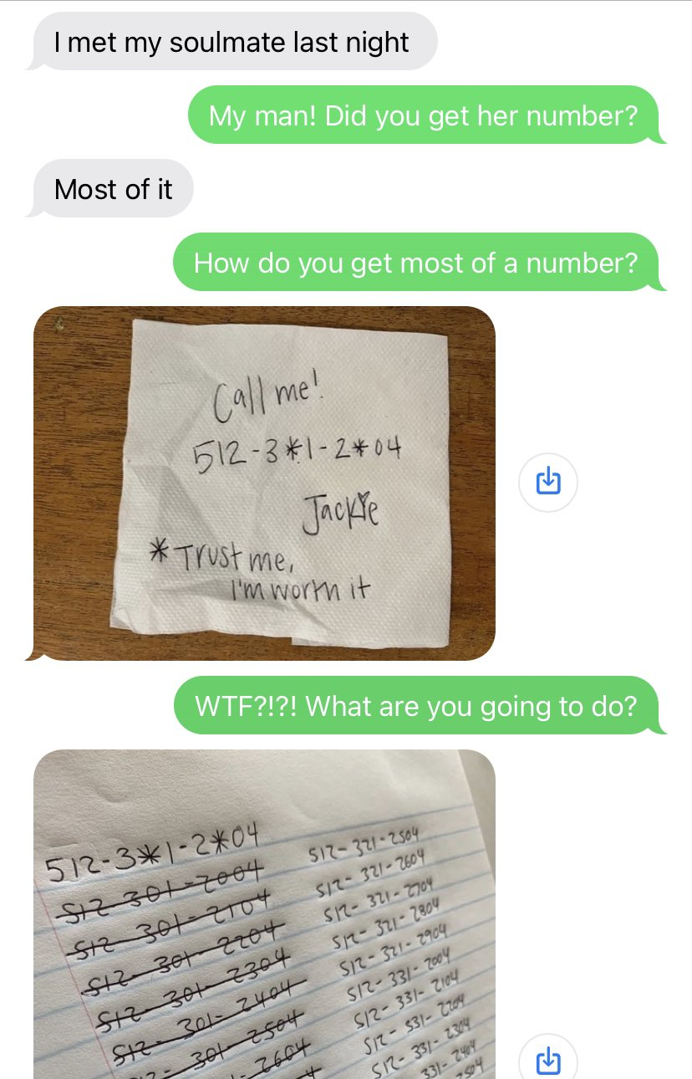
Phone Numbers
Write a program that will produce all possible combinations of a phone number that is missing 2 numbers.

