Slide 1
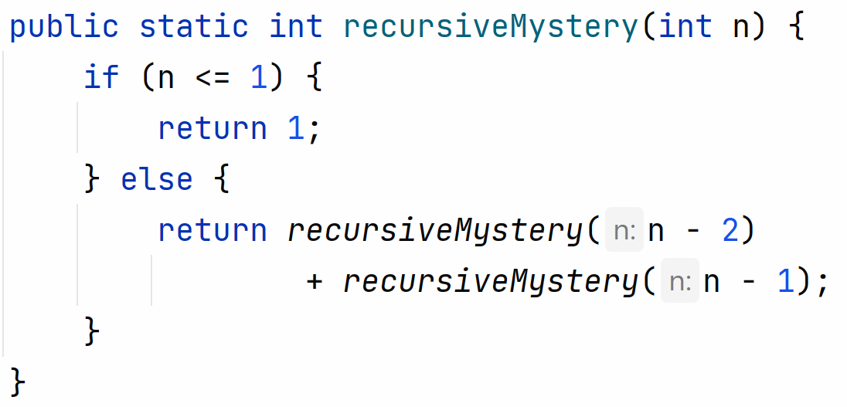
Warm Up
slido.com code: #su_cse123
What’s the output of recursiveMystery(5)?
Notes:
“What row am I in?”

Slide 2
Recursive Programming
Hitesh Boinpally
Summer 2023

Slide 3
Agenda
Recursion Review
Practice
Recursion with Files

Slide 4
Agenda
Recursion Review
Practice
Recursion with Files

Slide 5
Road Map - Recursion
Friday
Introduce idea of “recursion”
Goal: Understand idea of recursion and read recursive code
Tuesday
Practice reading recursive code
Wednesday (Today)
More complex recursive examples
Goal: Identify recursive structure in problems and write recursive code
Thursday
Practice writing recursive code
Notes:
Flip to solutions from last lesson

Slide 6
Recursion Intro
Recursion: Defining something in terms of itself
Recursive Programming: Writing methods that call themselves to solve problems
Helpful to solve specific problems
Equally as powerful as iterative solutions
Notes:
Talk about Fibonacci numbers, what are the two cases

Slide 7
Recursive Programming
Two cases to always keep in mind:
Base Case:
Stopping point, how to know we’re “done”
Easiest / smallest thing to calculate
Recursive Case:
Do “one step” of the problem
Pass on the work to the next method call
Some problems may have multiple base / recursive cases!

Slide 8
Warm-Up Visualized
public int method(int n) { if (n <= 1) {
return 1;
else {
return method(n – 2) + method(n – 1); } }
n | 5

Slide 9
Warm-Up Visualized
public int method(int n) { if (n <= 1) {
return 1;
else {
return method(n – 2) + method(n – 1); } }
n | 5

Slide 10
Warm-Up Visualized
public int method(int n) { if (n <= 1) {
return 1;
else {
return method(n – 2) + method(n – 1); } }
public int method(int n) { if (n <= 1) {
return 1;
else {
return method(n – 2) + method(n – 1); } }
n | 5
n

Slide 11
Warm-Up Visualized
public int method(int n) { if (n <= 1) {
return 1;
else {
return method(n – 2) + method(n – 1); } }
public int method(int n) { if (n <= 1) {
return 1;
else {
return method(n – 2) + method(n – 1); } }
n | 5
n | 3

Slide 12
Warm-Up Visualized
public int method(int n) { if (n <= 1) {
return 1;
else {
return method(n – 2) + method(n – 1); } }
public int method(int n) { if (n <= 1) {
return 1;
else {
return method(n – 2) + method(n – 1); } }
n | 5
n | 3

Slide 13
Warm-Up Visualized
public int method(int n) { if (n <= 1) {
return 1;
else {
return method(n – 2) + method(n – 1); } }
public int method(int n) { if (n <= 1) {
return 1;
else {
return method(n – 2) + method(n – 1); } }
public int method(int n) { if (n <= 1) {
return 1;
else {
return method(n – 2) + method(n – 1); } }
n | 5
n | 3
n | 1

Slide 14
Warm-Up Visualized
public int method(int n) { if (n <= 1) {
return 1;
else {
return method(n – 2) + method(n – 1); } }
public int method(int n) { if (n <= 1) {
return 1;
else {
return method(n – 2) + method(n – 1); } }
public int method(int n) { if (n <= 1) {
return 1;
else {
return method(n – 2) + method(n – 1); } }
n | 5
n | 3
n | 1

Slide 15
Warm-Up Visualized
public int method(int n) { if (n <= 1) {
return 1;
else {
return method(n – 2) + method(n – 1); } }
public int method(int n) { if (n <= 1) {
return 1;
else {
return method(n – 2) + method(n – 1); } }
1
n | 5
n | 3

Slide 16
Warm-Up Visualized
public int method(int n) { if (n <= 1) {
return 1;
else {
return method(n – 2) + method(n – 1); } }
public int method(int n) { if (n <= 1) {
return 1;
else {
return method(n – 2) + method(n – 1); } }
public int method(int n) { if (n <= 1) {
return 1;
else {
return method(n – 2) + method(n – 1); } }
1
n | 5
n | 3
n | 2

Slide 17
Warm-Up Visualized
public int method(int n) { if (n <= 1) {
return 1;
else {
return method(n – 2) + method(n – 1); } }
public int method(int n) { if (n <= 1) {
return 1;
else {
return method(n – 2) + method(n – 1); } }
public int method(int n) { if (n <= 1) {
return 1;
else {
return method(n – 2) + method(n – 1); } }
1
n | 5
n | 3
n | 2

Slide 18
Warm-Up Visualized
public int method(int n) { if (n <= 1) {
return 1;
else {
return method(n – 2) + method(n – 1); } }
public int method(int n) { if (n <= 1) {
return 1;
else {
return method(n – 2) + method(n – 1); } }
public int method(int n) { if (n <= 1) {
return 1;
else {
return method(n – 2) + method(n – 1); } }
public int method(int n) { if (n <= 1) {
return 1;
else {
return method(n – 2) + method(n – 1); } }
1
n | 5
n | 3
n | 2
n | 0

Slide 19
Warm-Up Visualized
public int method(int n) { if (n <= 1) {
return 1;
else {
return method(n – 2) + method(n – 1); } }
public int method(int n) { if (n <= 1) {
return 1;
else {
return method(n – 2) + method(n – 1); } }
public int method(int n) { if (n <= 1) {
return 1;
else {
return method(n – 2) + method(n – 1); } }
public int method(int n) { if (n <= 1) {
return 1;
else {
return method(n – 2) + method(n – 1); } }
1
n | 5
n | 3
n | 2
n | 0

Slide 20
Warm-Up Visualized
public int method(int n) { if (n <= 1) {
return 1;
else {
return method(n – 2) + method(n – 1); } }
public int method(int n) { if (n <= 1) {
return 1;
else {
return method(n – 2) + method(n – 1); } }
public int method(int n) { if (n <= 1) {
return 1;
else {
return method(n – 2) + method(n – 1); } }
1
1
n | 5
n | 3
n | 2

Slide 21
Warm-Up Visualized
public int method(int n) { if (n <= 1) {
return 1;
else {
return method(n – 2) + method(n – 1); } }
public int method(int n) { if (n <= 1) {
return 1;
else {
return method(n – 2) + method(n – 1); } }
public int method(int n) { if (n <= 1) {
return 1;
else {
return method(n – 2) + method(n – 1); } }
public int method(int n) { if (n <= 1) {
return 1;
else {
return method(n – 2) + method(n – 1); } }
1
1
n | 5
n | 3
n | 2
n | 1

Slide 22
Warm-Up Visualized
public int method(int n) { if (n <= 1) {
return 1;
else {
return method(n – 2) + method(n – 1); } }
public int method(int n) { if (n <= 1) {
return 1;
else {
return method(n – 2) + method(n – 1); } }
public int method(int n) { if (n <= 1) {
return 1;
else {
return method(n – 2) + method(n – 1); } }
1
1
1
n | 5
n | 3
n | 2

Slide 23
Warm-Up Visualized
public int method(int n) { if (n <= 1) {
return 1;
else {
return method(n – 2) + method(n – 1); } }
public int method(int n) { if (n <= 1) {
return 1;
else {
return method(n – 2) + method(n – 1); } }
1
2
n | 5
n | 3

Slide 24
Warm-Up Visualized
public int method(int n) { if (n <= 1) {
return 1;
else {
return method(n – 2) + method(n – 1); } }
3
n | 5

Slide 25
Warm-Up Visualized
public int method(int n) { if (n <= 1) {
return 1;
else {
return method(n – 2) + method(n – 1); } }
3
n | 5

Slide 26
Warm-Up Visualized
public int method(int n) { if (n <= 1) {
return 1;
else {
return method(n – 2) + method(n – 1); } }
3
5
n | 5

Slide 27
Agenda
Recursion Review
Practice
Recursion with Files

Slide 28
Agenda
Recursion Review
Practice
Recursion with Files

Slide 29
Recursion with Files
Exercise: Write a recursive method print that takes in a File and prints out information about it.
If the File object represents a normal file print its name
If the File object represents a directory, print out its name and information about every file/directory inside of it indented by a level.

Slide 30
Recursion with Files
Exercise: Write a recursive method print that takes in a File and prints out information about it.
If the File object represents a normal file print its name
If the File object represents a directory, print out its name and information about every file/directory inside of it indented by a level.

Slide 31
Recursion with Files
Exercise: Write a recursive method print that takes in a File and prints out information about it.
If the File object represents a normal file print its name
If the File object represents a directory, print out its name and information about every file/directory inside of it indented by a level.
123_folder
assignments
warm-up
mini-git
practice
lesson1
lesson2
syllabus
LinkedIntList

Slide 32
Definition of a File
A File is either:
A simple file
A directory containing more files
A directory can be nested to any depth

Slide 33
File Methods
getName() – Returns the name of this file
isDirectory() – Returns whether this file is a directory or not
listFiles() – Returns a File[] of all subfiles in this directory

Slide 34
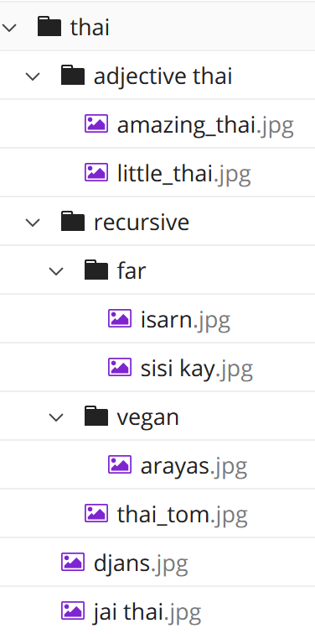
print Visualization
public static void print(File file, int indent) { for (int i = 0; i < indent; i++) { System.out.print(" "); } System.out.println(file.getName()); if (file.isDirectory()) { File[] subFiles = file.listFiles(); for (File subFile : subFiles) { print(subFile, indent + 1); } } }
Console output:
thai
file | thai
indent | 0
subFile

Slide 35
print Visualization
public static void print(File file, int indent) { for (int i = 0; i < indent; i++) { System.out.print(" "); } System.out.println(file.getName()); if (file.isDirectory()) { File[] subFiles = file.listFiles(); for (File subFile : subFiles) { print(subFile, indent + 1); } } }
Console output:
thai
file | thai
indent | 0
subFile | adjective thai

Slide 36
print Visualization
public static void print(File file, int indent) { for (int i = 0; i < indent; i++) { System.out.print(" "); } System.out.println(file.getName()); if (file.isDirectory()) { File[] subFiles = file.listFiles(); for (File subFile : subFiles) { print(subFile, indent + 1); } } }
public static void print(File file, int indent) { for (int i = 0; i < indent; i++) { System.out.print(" "); } System.out.println(file.getName()); if (file.isDirectory()) { File[] subFiles = file.listFiles(); for (File subFile : subFiles) { print(subFile, indent + 1); } } }
Console output:
thai
adjective thai
file | thai
indent | 0
subFile | adjective thai
file | adjective thai
indent | 1
subFile

Slide 37
print Visualization
public static void print(File file, int indent) { for (int i = 0; i < indent; i++) { System.out.print(" "); } System.out.println(file.getName()); if (file.isDirectory()) { File[] subFiles = file.listFiles(); for (File subFile : subFiles) { print(subFile, indent + 1); } } }
public static void print(File file, int indent) { for (int i = 0; i < indent; i++) { System.out.print(" "); } System.out.println(file.getName()); if (file.isDirectory()) { File[] subFiles = file.listFiles(); for (File subFile : subFiles) { print(subFile, indent + 1); } } }
Console output:
thai
adjective thai
file | thai
indent | 0
subFile | adjective thai
file | adjective thai
indent | 1
subFile | amazing_thai.jpg

Slide 38
print Visualization
public static void print(File file, int indent) { for (int i = 0; i < indent; i++) { System.out.print(" "); } System.out.println(file.getName()); if (file.isDirectory()) { File[] subFiles = file.listFiles(); for (File subFile : subFiles) { print(subFile, indent + 1); } } }
public static void print(File file, int indent) { for (int i = 0; i < indent; i++) { System.out.print(" "); } System.out.println(file.getName()); if (file.isDirectory()) { File[] subFiles = file.listFiles(); for (File subFile : subFiles) { print(subFile, indent + 1); } } }
public static void print(File file, int indent) { for (int i = 0; i < indent; i++) { System.out.print(" "); } System.out.println(file.getName()); if (file.isDirectory()) { File[] subFiles = file.listFiles(); for (File subFile : subFiles) { print(subFile, indent + 1); } } }
Console output:
thai
adjective thai
amazing_…
file | thai
indent | 0
subFile | adjective thai
file | adjective thai
indent | 1
subFile | amazing_thai.jpg
file | amazing_thai.jpg
indent | 2
subFile

Slide 39
print Visualization
public static void print(File file, int indent) { for (int i = 0; i < indent; i++) { System.out.print(" "); } System.out.println(file.getName()); if (file.isDirectory()) { File[] subFiles = file.listFiles(); for (File subFile : subFiles) { print(subFile, indent + 1); } } }
public static void print(File file, int indent) { for (int i = 0; i < indent; i++) { System.out.print(" "); } System.out.println(file.getName()); if (file.isDirectory()) { File[] subFiles = file.listFiles(); for (File subFile : subFiles) { print(subFile, indent + 1); } } }
Console output:
thai
adjective thai
amazing_…
file | thai
indent | 0
subFile | adjective thai
file | adjective thai
indent | 1
subFile | little_thai.jpg

Slide 40
print Visualization
public static void print(File file, int indent) { for (int i = 0; i < indent; i++) { System.out.print(" "); } System.out.println(file.getName()); if (file.isDirectory()) { File[] subFiles = file.listFiles(); for (File subFile : subFiles) { print(subFile, indent + 1); } } }
public static void print(File file, int indent) { for (int i = 0; i < indent; i++) { System.out.print(" "); } System.out.println(file.getName()); if (file.isDirectory()) { File[] subFiles = file.listFiles(); for (File subFile : subFiles) { print(subFile, indent + 1); } } }
public static void print(File file, int indent) { for (int i = 0; i < indent; i++) { System.out.print(" "); } System.out.println(file.getName()); if (file.isDirectory()) { File[] subFiles = file.listFiles(); for (File subFile : subFiles) { print(subFile, indent + 1); } } }
Console output:
thai
adjective thai
amazing_…
little_…
file | thai
indent | 0
subFile | adjective thai
file | adjective thai
indent | 1
subFile | little_thai.jpg
file | little_thai.jpg
indent | 2
subFile

Slide 41
print Visualization
public static void print(File file, int indent) { for (int i = 0; i < indent; i++) { System.out.print(" "); } System.out.println(file.getName()); if (file.isDirectory()) { File[] subFiles = file.listFiles(); for (File subFile : subFiles) { print(subFile, indent + 1); } } }
public static void print(File file, int indent) { for (int i = 0; i < indent; i++) { System.out.print(" "); } System.out.println(file.getName()); if (file.isDirectory()) { File[] subFiles = file.listFiles(); for (File subFile : subFiles) { print(subFile, indent + 1); } } }
Console output:
thai
adjective thai
amazing_…
little_…
file | thai
indent | 0
subFile | adjective thai
file | adjective thai
indent | 1
subFile

Slide 42
print Visualization
public static void print(File file, int indent) { for (int i = 0; i < indent; i++) { System.out.print(" "); } System.out.println(file.getName()); if (file.isDirectory()) { File[] subFiles = file.listFiles(); for (File subFile : subFiles) { print(subFile, indent + 1); } } }
Console output:
thai
adjective thai
amazing_…
little_…
file | thai
indent | 0
subFile | recursive

Slide 43
C2 – Mondrian Art
This is a difficult assignment conceptually
It can be challenging to debug / understand
Make sure to start early
(Possibly) multiple base / recursive cases

