Slide 1
Recursive Tracing
Hitesh Boinpally
Summer 2023

Slide 2
Agenda
Recursion Intro
Practice
Visualizations
Reminders

Slide 3
Agenda
Recursion Intro
Practice
Visualizations
Reminders

Slide 4
Road Map - Recursion
Friday (Today)
Introduce idea of “recursion”
Goal: Understand idea of recursion and read recursive code
Tuesday
Practice reading recursive code
Wednesday
More complex recursive examples
Goal: Identify recursive structure in problems and write recursive code
Thursday
Practice writing recursive code
Notes:
Flip to solutions from last lesson

Slide 5
Road Map - Recursion
Friday (Today)
Introduce idea of “recursion”
Goal: Understand idea of recursion and read recursive code
Tuesday
Practice reading recursive code
Wednesday
More complex recursive examples
Goal: Identify recursive structure in problems and write recursive code
Thursday
Practice writing recursive code
Notes:
Flip to solutions from last lesson

Slide 6
Recursion Intro
Notes:
“What row am I in?”

Slide 8
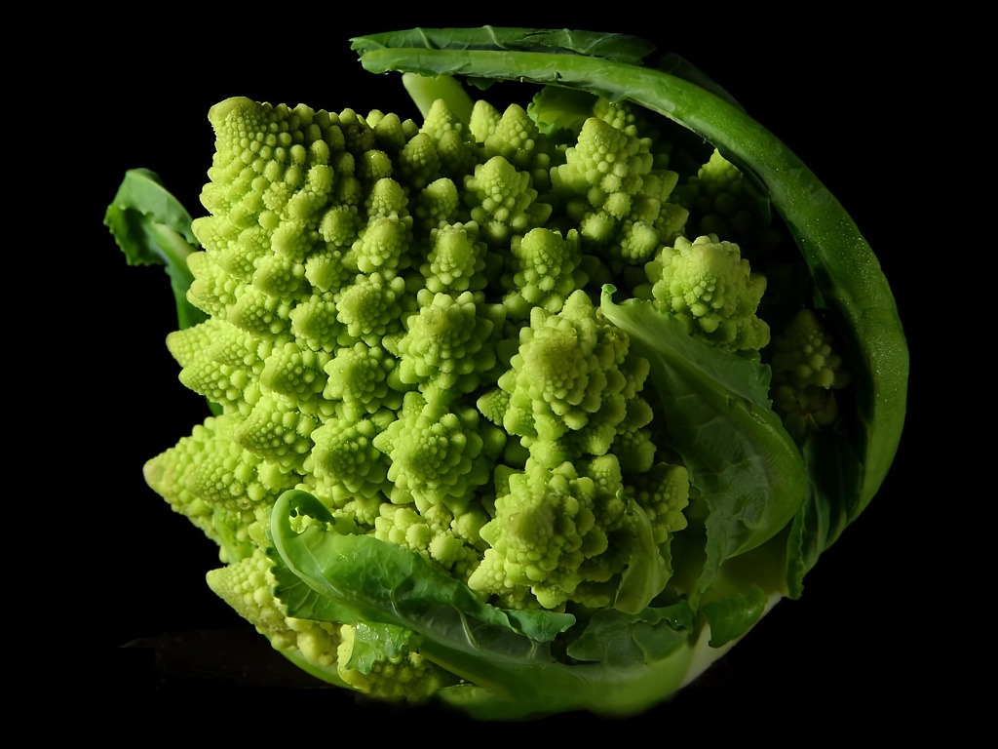

Slide 9
Recursion Intro
Recursion: Defining something in terms of itself
Recursive Programming: Writing methods that call themselves to solve problems
Helpful to solve specific problems
Equally as powerful as iterative solutions
Notes:
Talk about Fibonacci numbers, what are the two cases

Slide 10
Recursive Programming
Two cases to always keep in mind:
Base Case:
Stopping point, how to know we’re “done”
Easiest / smallest thing to calculate
Recursive Case:
Do “one step” of the problem
Pass on the work to the next method call
Some problems may have multiple base / recursive cases!

Slide 11
Agenda
Recursion Intro
Practice
Visualizations
Reminders

Slide 12
Recursive Tracing Practice
slido.com code: #su_cse123
public static int recursiveMystery(int n) { if (n == 0 || n == 1) { return 1; } else { return n * recursiveMystery(n - 1); } }

Slide 13
Recursive Tracing Practice
slido.com code: #su_cse123
public static int recursiveMystery(int n) { if (n == 0 || n == 1) { return 1; } else { return n * recursiveMystery(n - 1); } }
Think of some example calls. What do they execute?
recursiveMystery(0)
recursiveMystery(2)
recursiveMystery(4)

Slide 14
Recursive Tracing Practice
slido.com code: #su_cse123
public static int recursiveMystery(int n) { if (n == 0 || n == 1) { return 1; } else { return n * recursiveMystery(n - 1); } }
recursiveMystery(4):
Notes:
Draw visual here of output

Slide 15
Agenda
Recursion Intro
Practice
Visualizations
Reminders

Slide 16
reverse Visualization
public static void reverse(Scanner file) { if (file.hasNextLine()) { String text = file.nextLine(); reverse(file); System.out.println(text); } }
file
text

Slide 17
reverse Visualization
Contents of file:
1. Suits 2. Barry 3. Modern Family 4. The Good Place
public static void reverse(Scanner file) { if (file.hasNextLine()) { String text = file.nextLine(); reverse(file); System.out.println(text); } }
file | Reference to Scanner
text | “1. Suits”

Slide 18
reverse Visualization
Contents of file:
1. Suits 2. Barry 3. Modern Family 4. The Good Place
public static void reverse(Scanner file) { if (file.hasNextLine()) { String text = file.nextLine(); reverse(file); System.out.println(text); } }
file | Reference to Scanner
text | “1. Suits”

Slide 19
reverse Visualization
Contents of file:
1. Suits 2. Barry 3. Modern Family 4. The Good Place
public static void reverse(Scanner file) { if (file.hasNextLine()) { String text = file.nextLine(); reverse(file); System.out.println(text); } }
public static void reverse(Scanner file) { if (file.hasNextLine()) { String text = file.nextLine(); reverse(file); System.out.println(text); } }
file | Reference to Scanner
text | “1. Suits”
file | Reference to Scanner
text | “2. Barry”

Slide 20
reverse Visualization
Contents of file:
1. Suits 2. Barry 3. Modern Family 4. The Good Place
public static void reverse(Scanner file) { if (file.hasNextLine()) { String text = file.nextLine(); reverse(file); System.out.println(text); } }
public static void reverse(Scanner file) { if (file.hasNextLine()) { String text = file.nextLine(); reverse(file); System.out.println(text); } }
file | Reference to Scanner
text | “1. Suits”
file | Reference to Scanner
text | “2. Barry”

Slide 21
reverse Visualization
Contents of file:
1. Suits 2. Barry 3. Modern Family 4. The Good Place
public static void reverse(Scanner file) { if (file.hasNextLine()) { String text = file.nextLine(); reverse(file); System.out.println(text); } }
public static void reverse(Scanner file) { if (file.hasNextLine()) { String text = file.nextLine(); reverse(file); System.out.println(text); } }
public static void reverse(Scanner file) { if (file.hasNextLine()) { String text = file.nextLine(); reverse(file); System.out.println(text); } }
file | Reference to Scanner
text | “1. Suits”
file | Reference to Scanner
text | “2. Barry”
file | Reference to Scanner
text | “3. Modern Family”

Slide 22
reverse Visualization
Contents of file:
1. Suits 2. Barry 3. Modern Family 4. The Good Place
public static void reverse(Scanner file) { if (file.hasNextLine()) { String text = file.nextLine(); reverse(file); System.out.println(text); } }
public static void reverse(Scanner file) { if (file.hasNextLine()) { String text = file.nextLine(); reverse(file); System.out.println(text); } }
public static void reverse(Scanner file) { if (file.hasNextLine()) { String text = file.nextLine(); reverse(file); System.out.println(text); } }
public static void reverse(Scanner file) { if (file.hasNextLine()) { String text = file.nextLine(); reverse(file); System.out.println(text); } }
file | Reference to Scanner
text | “1. Suits”
file | Reference to Scanner
text | “2. Barry”
file | Reference to Scanner
text | “3. Modern Family”
file | Reference to Scanner
text | “4. The Good Place”

Slide 23
reverse Visualization
Contents of file:
1. Suits 2. Barry 3. Modern Family 4. The Good Place
public static void reverse(Scanner file) { if (file.hasNextLine()) { String text = file.nextLine(); reverse(file); System.out.println(text); } }
public static void reverse(Scanner file) { if (file.hasNextLine()) { String text = file.nextLine(); reverse(file); System.out.println(text); } }
public static void reverse(Scanner file) { if (file.hasNextLine()) { String text = file.nextLine(); reverse(file); System.out.println(text); } }
public static void reverse(Scanner file) { if (file.hasNextLine()) { String text = file.nextLine(); reverse(file); System.out.println(text); } }
public static void reverse(Scanner file) { if (file.hasNextLine()) { String text = file.nextLine(); reverse(file); System.out.println(text); } }
file | Reference to Scanner
text | “1. Suits”
file | Reference to Scanner
text | “2. Barry”
file | Reference to Scanner
text | “3. Modern Family”
file | Reference to Scanner
text | “4. The Good Place”
file | Reference to Scanner
text

Slide 24
reverse Visualization
Contents of file:
1. Suits 2. Barry 3. Modern Family 4. The Good Place
public static void reverse(Scanner file) { if (file.hasNextLine()) { String text = file.nextLine(); reverse(file); System.out.println(text); } }
public static void reverse(Scanner file) { if (file.hasNextLine()) { String text = file.nextLine(); reverse(file); System.out.println(text); } }
public static void reverse(Scanner file) { if (file.hasNextLine()) { String text = file.nextLine(); reverse(file); System.out.println(text); } }
public static void reverse(Scanner file) { if (file.hasNextLine()) { String text = file.nextLine(); reverse(file); System.out.println(text); } }
file | Reference to Scanner
text | “1. Suits”
file | Reference to Scanner
text | “2. Barry”
Console output:
4. The Good Place
file | Reference to Scanner
text | “3. Modern Family”
file | Reference to Scanner
text | “4. The Good Place”

Slide 25
reverse Visualization
Contents of file:
1. Suits 2. Barry 3. Modern Family 4. The Good Place
public static void reverse(Scanner file) { if (file.hasNextLine()) { String text = file.nextLine(); reverse(file); System.out.println(text); } }
public static void reverse(Scanner file) { if (file.hasNextLine()) { String text = file.nextLine(); reverse(file); System.out.println(text); } }
public static void reverse(Scanner file) { if (file.hasNextLine()) { String text = file.nextLine(); reverse(file); System.out.println(text); } }
file | Reference to Scanner
text | “1. Suits”
file | Reference to Scanner
text | “2. Barry”
Console output:
4. The Good Place
3. Modern Family
file | Reference to Scanner
text | “3. Modern Family”

Slide 26
reverse Visualization
Contents of file:
1. Suits 2. Barry 3. Modern Family 4. The Good Place
public static void reverse(Scanner file) { if (file.hasNextLine()) { String text = file.nextLine(); reverse(file); System.out.println(text); } }
public static void reverse(Scanner file) { if (file.hasNextLine()) { String text = file.nextLine(); reverse(file); System.out.println(text); } }
file | Reference to Scanner
text | “1. Suits”
file | Reference to Scanner
text | “2. Barry”
Console output:
4. The Good Place
3. Modern Family
2. Barry

Slide 27
reverse Visualization
Contents of file:
1. Suits 2. Barry 3. Modern Family 4. The Good Place
public static void reverse(Scanner file) { if (file.hasNextLine()) { String text = file.nextLine(); reverse(file); System.out.println(text); } }
file | Reference to Scanner
text | “1. Suits”
Console output:
4. The Good Place
3. Modern Family
2. Barry
1. Suits

Slide 28
Agenda
Recursion Intro
Practice
Visualizations
Reminders

Slide 29
Reminders
Resub 0 Due tonight
Updated to allow for C0 submissions

Slide 30
Reminders
Resub 0 Due tonight
Updated to allow for C0 submissions
Quiz 0 Monday (7/10)
Logistic details to be posted today
Topics: Linked Nodes, Linked Lists
Take-home, open 8:30am – 11:59pm
Will get instant feedback
Open collaboration (with a caveat), Open note
Reach out ASAP with any extenuating circumstances

