Slide 1
Linked Lists
Hitesh Boinpally
Summer 2023

Slide 2
Agenda
Linked Nodes review
Linked Lists
Practice
Reminders

Slide 3
Agenda
Linked Nodes review
Linked Lists
Practice
Reminders

Slide 4
Linked Nodes So Far
Sequences of nodes connected together
Using the ListNode class
Traversals over these sequences with while loops
data | next
121
data | next
122
node
Notes:
Flip to solutions from last lesson

Slide 5
Agenda
Linked Nodes review
Linked Lists
Practice
Reminders

Slide 6
Introducing the LinkedIntList!
New collection named LinkedIntList

Slide 7
Introducing the LinkedIntList!
New collection named LinkedIntList
Same kinds of methods as the ArrayIntList
add, add, get, indexOf, remove, size, toString

Slide 8
Introducing the LinkedIntList!
New collection named LinkedIntList
Same kinds of methods as the ArrayIntList
add, add, get, indexOf, remove, size, toString
Implemented with chain of linked nodes

Slide 9
Introducing the LinkedIntList!
New collection named LinkedIntList
Same kinds of methods as the ArrayIntList
add, add, get, indexOf, remove, size, toString
Implemented with chain of linked nodes
Keeps reference to its front as a field
null is the end of the list
If front is null, list is empty

Slide 10
Introducing the LinkedIntList!
Implemented with chain of linked nodes
Keeps reference to its front as a field
null is the end of the list; if front is null, list is empty
LinkedIntList
front
add(index)
add(index, value)
indexOf(value)
remove(index)
size()
toString()

Slide 11
Introducing the LinkedIntList!
Implemented with chain of linked nodes
Keeps reference to its front as a field
null is the end of the list; if front is null, list is empty
LinkedIntList
front
ListNode
add(index)
add(index, value)
indexOf(value)
remove(index)
size()
toString()
data | next
16

Slide 12
Introducing the LinkedIntList!
Implemented with chain of linked nodes
Keeps reference to its front as a field
null is the end of the list; if front is null, list is empty
LinkedIntList
front
ListNode
ListNode
ListNode
add(index)
add(index, value)
indexOf(value)
remove(index)
size()
toString()
data | next
16
data | next
-3
data | next
27
Notes:
Flip to actual implementation at this point

Slide 13
remove(int value) Visualization

Slide 14
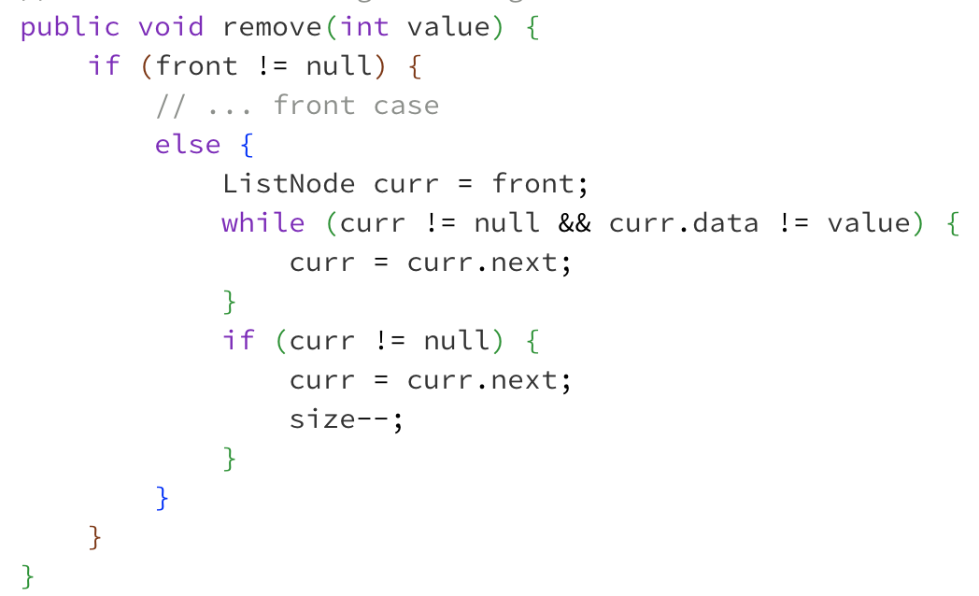
⚠️ Without “Stopping One Early” ⚠️
Client calls list.remove(-3)
front
data | next
16
data | next
42
data | next
-3
data | next
27

Slide 15
⚠️ Without “Stopping One Early” ⚠️
Client calls list.remove(-3)
front
data | next
16
data | next
42
data | next
-3
data | next
27
curr

Slide 16
⚠️ Without “Stopping One Early” ⚠️
Client calls list.remove(-3)
front
data | next
16
data | next
42
data | next
-3
data | next
27
curr

Slide 17
⚠️ Without “Stopping One Early” ⚠️
Client calls list.remove(-3)
front
data | next
16
data | next
42
data | next
-3
data | next
27
curr

Slide 18
⚠️ Without “Stopping One Early” ⚠️
Client calls list.remove(-3)
front
data | next
16
data | next
42
data | next
-3
data | next
27
curr

Slide 19
⚠️ Without “Stopping One Early” ⚠️
Client calls list.remove(-3)
This is the reference we need to change!
front
data | next
16
data | next
42
data | next
-3
data | next
27
curr

Slide 20
⚠️ Without “Stopping One Early” ⚠️
Client calls list.remove(-3)
This is the reference we need to change!
front
data | next
16
data | next
42
data | next
-3
data | next
27
curr

Slide 21
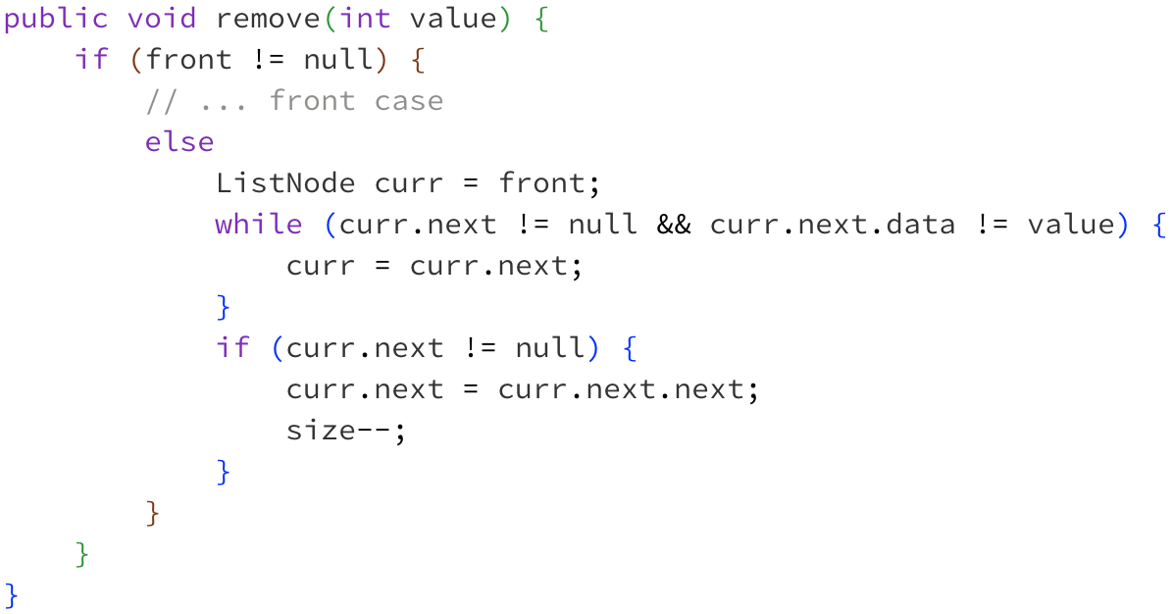
✅ With “Stopping One Early” ✅
Client calls list.remove(-3)
This is the reference we need to change!
front
data | next
16
data | next
42
data | next
-3
data | next
27

Slide 22
✅ With “Stopping One Early” ✅
Client calls list.remove(-3)
This is the reference we need to change!
front
data | next
16
data | next
42
data | next
-3
data | next
27
curr

Slide 23
✅ With “Stopping One Early” ✅
Client calls list.remove(-3)
This is the reference we need to change!
front
data | next
16
data | next
42
data | next
-3
data | next
27
curr

Slide 24
✅ With “Stopping One Early” ✅
Client calls list.remove(-3)
This is the reference we need to change!
front
data | next
16
data | next
42
data | next
-3
data | next
27
curr

Slide 25
Changing a list
There are only two ways to change a linked list:
Change the value of front (modify the front of the list)
Change the value of <node>.next (modify middle or end of list to point somewhere else)
Implications:
To add in the middle, need a reference to the previous node
Front is often a special case

