Slide 1
Linked Nodes w/ Loops
Hitesh Boinpally
Summer 2023

Slide 2
Agenda
Linked Nodes review
Traversing ListNode sequences
Modifying ListNode sequences
Reminders

Slide 3
Agenda
Linked Nodes review
Traversing ListNode sequences
Modifying ListNode sequences
Reminders

Slide 4
Linked Nodes Review
New data structure to represent non-contiguous memory
“Building blocks” for Linked Lists
“Legos”
Today: arbitrary length sequences

Slide 5
Problems so far
What statements turn this picture:
data | next
10
data | next
20
data | next
40
list1
data | next
30
list2
Into this picture?
(1 Possible) Answer:
ListNode temp = list1.next;
list1.next = list1.next.next;
temp.next = list2;
list2 = temp;
data | next
10
data | next
40
list1
data | next
20
data | next
30
list2
Lesson 3 - Summer 2023
Notes:
Just to show this is what we were doing

Slide 6
Agenda
Linked Nodes review
Traversing ListNode sequences
Modifying ListNode sequences
Reminders

Slide 7
Printing a Sequence
data | next
10
data | next
20
data | next
800
list
…
Suppose we have a sequence of nodes like the above
With unknown number of elements
How would we print all the values out?

Slide 8
Printing a Sequence
Pseudocode:

Slide 9
Printing a Sequence
Pseudocode:
Start at the front of the list
While there are nodes to print:
Print the current node’s data
Go to the next node

Slide 10
Printing a Sequence
Pseudocode:
Start at the front of the list
While there are nodes to print:
Print the current node’s data
Go to the next node
How to go to the next node?
list = list.next;
Console:
list
data | next
10
data | next
20
data | next
800
…

Slide 11
Printing a Sequence
Pseudocode:
Start at the front of the list
While there are nodes to print:
Print the current node’s data
Go to the next node
How to go to the next node?
list = list.next;
Console:
10
list
data | next
10
data | next
20
data | next
800
…

Slide 12
Printing a Sequence
Pseudocode:
Start at the front of the list
While there are nodes to print:
Print the current node’s data
Go to the next node
How to go to the next node?
list = list.next;
Console:
10
20
list
data | next
10
data | next
20
data | next
800
…

Slide 13
Printing a Sequence
Pseudocode:
Start at the front of the list
While there are nodes to print:
Print the current node’s data
Go to the next node
How to go to the next node?
list = list.next;
Console:
10
20
…
800
list
data | next
10
data | next
20
data | next
800
…

Slide 14
Printing a Sequence
Pseudocode:
Start at the front of the list
While there are nodes to print:
Print the current node’s data
Go to the next node
How to go to the next node?
list = list.next;
Console:
10
20
…
800
list
data | next
10
data | next
20
data | next
800
…

Slide 15
Printing a Sequence
Pseudocode:
Start at the front of the list
While there are nodes to print:
Print the current node’s data
Go to the next node
How to go to the next node?
list = list.next; Destroys the list!
Console:
10
20
…
800
list
data | next
10
data | next
20
data | next
800
…

Slide 16
Printing a Sequence
Pseudocode:
Start at the front of the list
While there are nodes to print:
Print the current node’s data
Go to the next node
How to go to the next node?
Create a new variable and change it
ListNode current = list
current = current.next
Console:
data | next
10
data | next
20
data | next
800
…
list
Notes:
New reference, not a new object (no NEW keyword)
Note a big deal to add because of this!

Slide 17
Printing a Sequence
Pseudocode:
Start at the front of the list
While there are nodes to print:
Print the current node’s data
Go to the next node
How to go to the next node?
Create a new variable and change it
ListNode current = list
current = current.next
Console:
current
data | next
10
data | next
20
data | next
800
…
list

Slide 18
Printing a Sequence
Pseudocode:
Start at the front of the list
While there are nodes to print:
Print the current node’s data
Go to the next node
How to go to the next node?
Create a new variable and change it
ListNode current = list
current = current.next
Console:
10
current
data | next
10
data | next
20
data | next
800
…
list

Slide 19
Printing a Sequence
Pseudocode:
Start at the front of the list
While there are nodes to print:
Print the current node’s data
Go to the next node
How to go to the next node?
Create a new variable and change it
ListNode current = list
current = current.next
Console:
10
20
current
data | next
10
data | next
20
data | next
800
…
list

Slide 20
Printing a Sequence
Pseudocode:
Start at the front of the list
While there are nodes to print:
Print the current node’s data
Go to the next node
How to go to the next node?
Create a new variable and change it
ListNode current = list
current = current.next
Console:
10
20
…
800
current
data | next
10
data | next
20
data | next
800
…
list

Slide 21
Printing a Sequence
Pseudocode:
Start at the front of the list
While there are nodes to print:
Print the current node’s data
Go to the next node
How to go to the next node?
Create a new variable and change it
ListNode current = list
current = current.next
Console:
10
20
…
800
current
data | next
10
data | next
20
data | next
800
…
list

Slide 22
Printing a Sequence
Pseudocode:
Start at the front of the list
While there are nodes to print:
Print the current node’s data
Go to the next node
How to go to the next node?
list = list.next; Destroys the list!
ListNode current = list
current = current.next
Console:
10
20
…
800
List is still intact!
current
data | next
10
data | next
20
data | next
800
…
list

Slide 23
Agenda
Linked Nodes review
Traversing ListNode sequences
Modifying ListNode sequences
Reminders

Slide 24
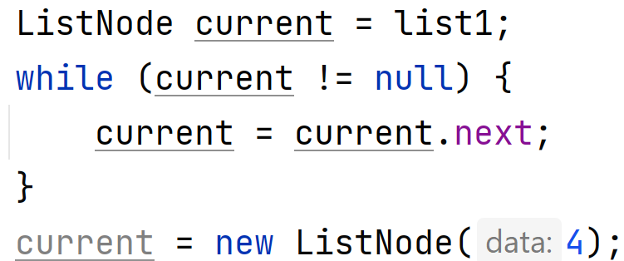
Adding to a Sequence
slido.com code: #su_cse123
Suppose we had the following sequence:
What happens when we execute the below code?
data | next
1
data | next
2
data | next
3
list1
Notes:
More work done in in-class activity

Slide 25
Agenda
Linked Nodes review
Traversing ListNode sequences
Modifying ListNode sequences
Reminders

Slide 26
Reminders
First resubmission form released tomorrow
Due next Friday
Can only resubmit assignments we have given feedback on!
No section on Tuesday
We will still post materials
Optional like always

