Slide 1
Hashing (cont.) + Wrap-Up
Hitesh Boinpally
Summer 2023

Slide 2
Agenda
General Reminders
Hashing (cont.)
Victory Lap

Slide 3
Agenda
General Reminders
Hashing (cont.)
Victory Lap

Slide 4
General Reminders
Final exam next Wednesday (8/16) and Friday (8/18)
Seating chart posted
Practice Exams posted (solutions will be posted tonight)
Review session next Monday (8/14), 10:30 – 1:00pm
TA-led in GUG 220
Will give another practice exam (will be recorded and posted too)
Resub 5 due tonight
Resub 6 (last one) due next Friday
Course evals will open soon
Important to hear what went well and what can improve!

Slide 5
Agenda
General Reminders
Hashing (cont.)
Victory Lap

Slide 6
Hashing
Idea: Map every value for some object to some integer index
Store these values in an array based on the index (hash table)
Hash Function: An algorithm to do this mapping

Slide 7
Hashing
Idea: Map every value for some object to some integer index
Store these values in an array based on the index (hash table)
Hash Function: An algorithm to do this mapping
Requirements:
The same object should always have the same number
If two objects are considered “equal” they should have the same hash code
To be good:
Results should be distributed approximately uniformly
Should “look random”

Slide 8
Collisions
Collision: When hash function maps 2 values to same index
Collision Resolution: An algorithm for fixing collisions
set.add(11);
set.add(49);
set.add(24);
set.add(7);
set.add(54); // collides with 24! Where should it go?
index | 0 | 1 | 2 | 3 | 4 | 5 | 6 | 7 | 8 | 9
value | 0 | 11 | 0 | 0 | 24 | 0 | 0 | 7 | 0 | 49

Slide 9
Probing
Probing: Resolving a collision by moving to another index
Linear Probing: Moves to the next index
set.add(11);
set.add(49);
set.add(24);
set.add(7);
set.add(54); // collides with 24; utilize probing
index | 0 | 1 | 2 | 3 | 4 | 5 | 6 | 7 | 8 | 9
value | 0 | 11 | 0 | 0 | 24 | 0 | 0 | 7 | 0 | 49

Slide 10
Probing
Probing: Resolving a collision by moving to another index
Linear Probing: Moves to the next index
set.add(11);
set.add(49);
set.add(24);
set.add(7);
set.add(54); // collides with 24; utilize probing
index | 0 | 1 | 2 | 3 | 4 | 5 | 6 | 7 | 8 | 9
value | 0 | 11 | 0 | 0 | 24 | 54 | 0 | 7 | 0 | 49

Slide 11
Probing
Probing: Resolving a collision by moving to another index
Linear Probing: Moves to the next index
Another version of this is Quadratic Probing – moves to indices by squares (increasingly far away)
set.add(11);
set.add(49);
set.add(24);
set.add(7);
set.add(54); // collides with 24; utilize probing
index | 0 | 1 | 2 | 3 | 4 | 5 | 6 | 7 | 8 | 9
value | 0 | 11 | 0 | 0 | 24 | 54 | 0 | 7 | 0 | 49

Slide 12
Clustering
Clustering: Clumps of elements at neighboring indexes
slows down the hash table lookup; you must loop through them
set.add(11);
set.add(49);
set.add(24);
set.add(7);
set.add(54); // collides with 24; utilize probing
set.add(14); // collides with 24, then 54
set.add(86); // collides with 14, then 7
index | 0 | 1 | 2 | 3 | 4 | 5 | 6 | 7 | 8 | 9
value | 0 | 11 | 0 | 0 | 24 | 54 | 14 | 7 | 86 | 49

Slide 13
Clustering
Clustering: Clumps of elements at neighboring indexes
slows down the hash table lookup; you must loop through them
Think about what would happen if we were checking 94 now?
set.add(11);
set.add(49);
set.add(24);
set.add(7);
set.add(54); // collides with 24; utilize probing
set.add(14); // collides with 24, then 54
set.add(86); // collides with 14, then 7
index | 0 | 1 | 2 | 3 | 4 | 5 | 6 | 7 | 8 | 9
value | 0 | 11 | 0 | 0 | 24 | 54 | 14 | 7 | 86 | 49

Slide 14
Alternative: Chaining
Chaining: Resolving collisions by storing a list at each index
add/search/remove must traverse lists, but the lists are short
impossible to "run out" of indexes
index | 0 | 1 | 2 | 3 | 4 | 5 | 6 | 7 | 8 | 9
value | 0 | 11 | 0 | 0 | 24 | 54 | 14 | 7 | 86 | 49

Slide 15
Alternative: Chaining
Chaining: Resolving collisions by storing a list at each index
add/search/remove must traverse lists, but the lists are short
impossible to "run out" of indexes
index | 0 | 1 | 2 | 3 | 4 | 5 | 6 | 7 | 8 | 9
value
11
24
86
7
49
54
14

Slide 16
Rehashing
Rehashing: Growing to a larger array when the table is too full
Cannot simply copy the old array to a new one
Load Factor: ratio of (# of elements ) / (hash table length )
Many collections rehash w when load factor ≅ ¾
Big prime numbers as hash table sizes help reduce collisions
0 | 1 | 2 | 3 | 4 | 5 | 6 | 7 | 8 | 9 | 10 | 11 | 12 | 13 | 14 | 15 | 16 | 17 | 18 | 19
24
7
49
11
14
54

Slide 17
Hash Maps
A hash map is a set, but with key, value pairs as elements:
// key value
map.put("Marty", 14);
map.put("Jeff", 21);
map.put("Kasey", 20);
map.put("Stef", 35);
Instead of a List<Integer>,write an inner Entry node class with key and value fields; the map stores a List<Entry>
index | 0 | 1 | 2 | 3 | 4 | 5 | 6 | 7 | 8 | 9
value
"Stef" | 35
"Marty" | 14
"Jeff" | 21
"Kasey" | 20

Slide 18
Agenda
General Reminders
Hashing (cont.)
Victory Lap

Slide 19
Learning Objectives
or, “What did I learn in this class?”
Seven themes:
Computational Thinking
Code Comprehension
Code Writing
Communication
Testing
Debugging
Ethics/Impact
Notes:
Brett

Slide 20
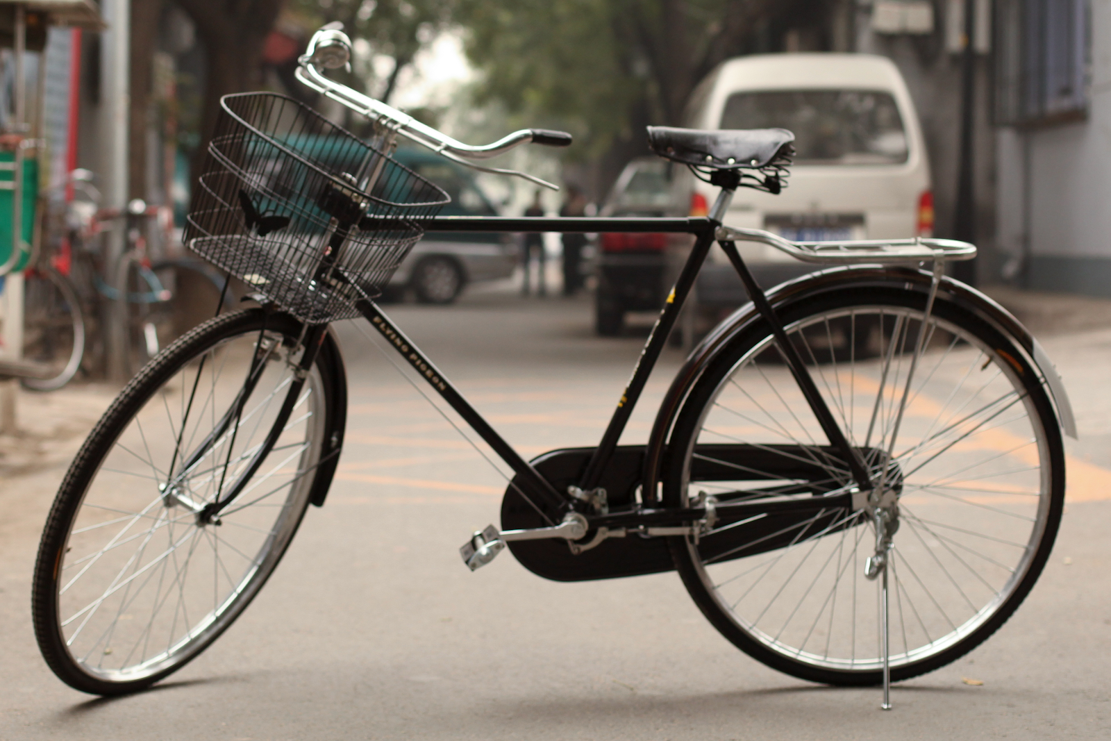

Slide 21
Applications of CS
or “What can I do with what I learned?”
Detect and prevent toxicity online
Digitize basketball players
Help DHH people identify sounds
Figure out how to best distribute relief funds
Recognize disinformation online
Make movies
Improve digital collaboration
Fix Olympic badminton
And so much more!

Slide 22
Future Courses
or “What can I do next?”
CSE Majors
Non-CSE Majors/Open to All (*)
Course | Overview
CSE 311 | Mathematical foundations
CSE 351 | Low-level computer organization/abstraction
CSE 331 | Software design/implementation
CSE 340 | Interaction programming
CSE 341 | Programming languages (!)
Course | Overview
CSE 154* | Intro. to web programming (several languages)
CSE 163* | Intermediate programming, data analysis (Python)
CSE 180* | Introduction to data science (Python)
CSE 373 | Data structures and algorithms
CSE 374 | Low-level programming and tools (C/C++)
CSE 412 | Data Visualization
CSE 416 | Intro. to Machine Learning
See: https://www.cs.washington.edu/academics/ugrad/current-students and https://www.cs.washington.edu/academics/ugrad/nonmajor-options/nonmajor-courses

Slide 23
Frequently Asked Questions
How can I get better at programming?
Practice!
How can I learn to X?
Search online, read books, look at examples
What should I work on next?
Anything you can think of! (Here are some ideas)
Beware: it’s hard to tell what’s easy and what’s hard.
Should I learn another language? Which one?
That depends–what do you want to do?
What’s the best programming language?

Slide 24
Thank you!!!
Notes:
Thank your TAs! — regardless of what I do here, your TAs are the ones taht really make the course run. I do some small decisions here and there, but your TAs allow for resubmissions, extra review, etc. – please please thank them!
Thank you for bearing with us, we tried some new things this quarter – IntelliJ, assignment revisions, take-home quizzes, and more engaging reflection questions
Bearing with me as a first time instructor, I hope you enjoyed the course and that you feel like you have properly understood the materials. I am always happy to hear from you in the future, so please don’t be a stranger and if you have things you want to talk about, reach out!

