Slide 1
Abstract Classes + Hashing
Hitesh Boinpally
Summer 2023

Slide 2
Agenda
Inheritance Review
Abstract Classes
Hashing

Slide 3
Agenda
Inheritance Review
Abstract Classes
Hashing

Slide 4
Inheritance
Inheritance: Forming hierarchial relationships between classes
Allows for sharing / reusing of code between classes
Superclass: The class being extended
Subclass: The class that inherits behavior from superclass
Gains copy of every method

Slide 5
Inheritance
Inheritance: Forming hierarchial relationships between classes
Allows for sharing / reusing of code between classes
Superclass: The class being extended
Subclass: The class that inherits behavior from superclass
Gains copy of every method
Inheritance forms an “is-a” relationship
Tiger extends Cat
Means that Tiger “is-a” Cat
Cat
Tiger

Slide 6
public class MusicPlayer { public void m1() { S.o.pln("MusicPlayer1"); } }
public class TapeDeck extends MusicPlayer { public void m3() { S.o.pln("TapeDeck3"); } }
public class IPod extends MusicPlayer { public void m2() { S.o.pln("IPod2"); m1(); } } public class IPhone extends IPod { public void m1() { S.o.pln("IPhone1"); super.m1(); } public void m3() { S.o.pln("IPhone3"); } }
 | m1() | m2() | m3()
MusicPlayer
TapeDeck
IPod
IPhone

Slide 7
public class MusicPlayer { public void m1() { S.o.pln("MusicPlayer1"); } }
public class TapeDeck extends MusicPlayer { public void m3() { S.o.pln("TapeDeck3"); } }
public class IPod extends MusicPlayer { public void m2() { S.o.pln("IPod2"); m1(); } } public class IPhone extends IPod { public void m1() { S.o.pln("IPhone1"); super.m1(); } public void m3() { S.o.pln("IPhone3"); } }
 | m1() | m2() | m3()
MusicPlayer | MP1 | / | /
TapeDeck | MP1 | / | TD3
IPod | MP1 | IPod2 m1() | /
IPhone | IPhone1 MP1 | IPod2 m1() | IPhone3

Slide 8
 | m1() | m2() | m3()
MusicPlayer | MP1 | / | /
TapeDeck | MP1 | / | TD3
IPod | MP1 | IPod2 m1() | /
IPhone | IPhone1 MP1 | IPod2 m1() | IPhone3
MusicPlayer var1 = new TapeDeck(); MusicPlayer var2 = new IPod(); MusicPlayer var3 = new IPhone(); IPod var4 = new IPhone(); Object var5 = new IPod(); Object var6 = new MusicPlayer();
((TapeDeck) var1).m2();
((IPod) var3).m2();
((IPhone) var2).m1();
((TapeDeck) var3).m2();

Slide 9
 | m1() | m2() | m3()
MusicPlayer | MP1 | / | /
TapeDeck | MP1 | / | TD3
IPod | MP1 | IPod2 m1() | /
IPhone | IPhone1 MP1 | IPod2 m1() | IPhone3
MusicPlayer var1 = new TapeDeck(); MusicPlayer var2 = new IPod(); MusicPlayer var3 = new IPhone(); IPod var4 = new IPhone(); Object var5 = new IPod(); Object var6 = new MusicPlayer();
((TapeDeck) var1).m2(); Compiler Error (CE) ((IPod) var3).m2(); IPod2 / IPhone1 / MusicPlayer1 ((IPhone) var2).m1(); Runtime Error (RE) ((TapeDeck) var3).m2(); Compiler Error (CE)

Slide 10
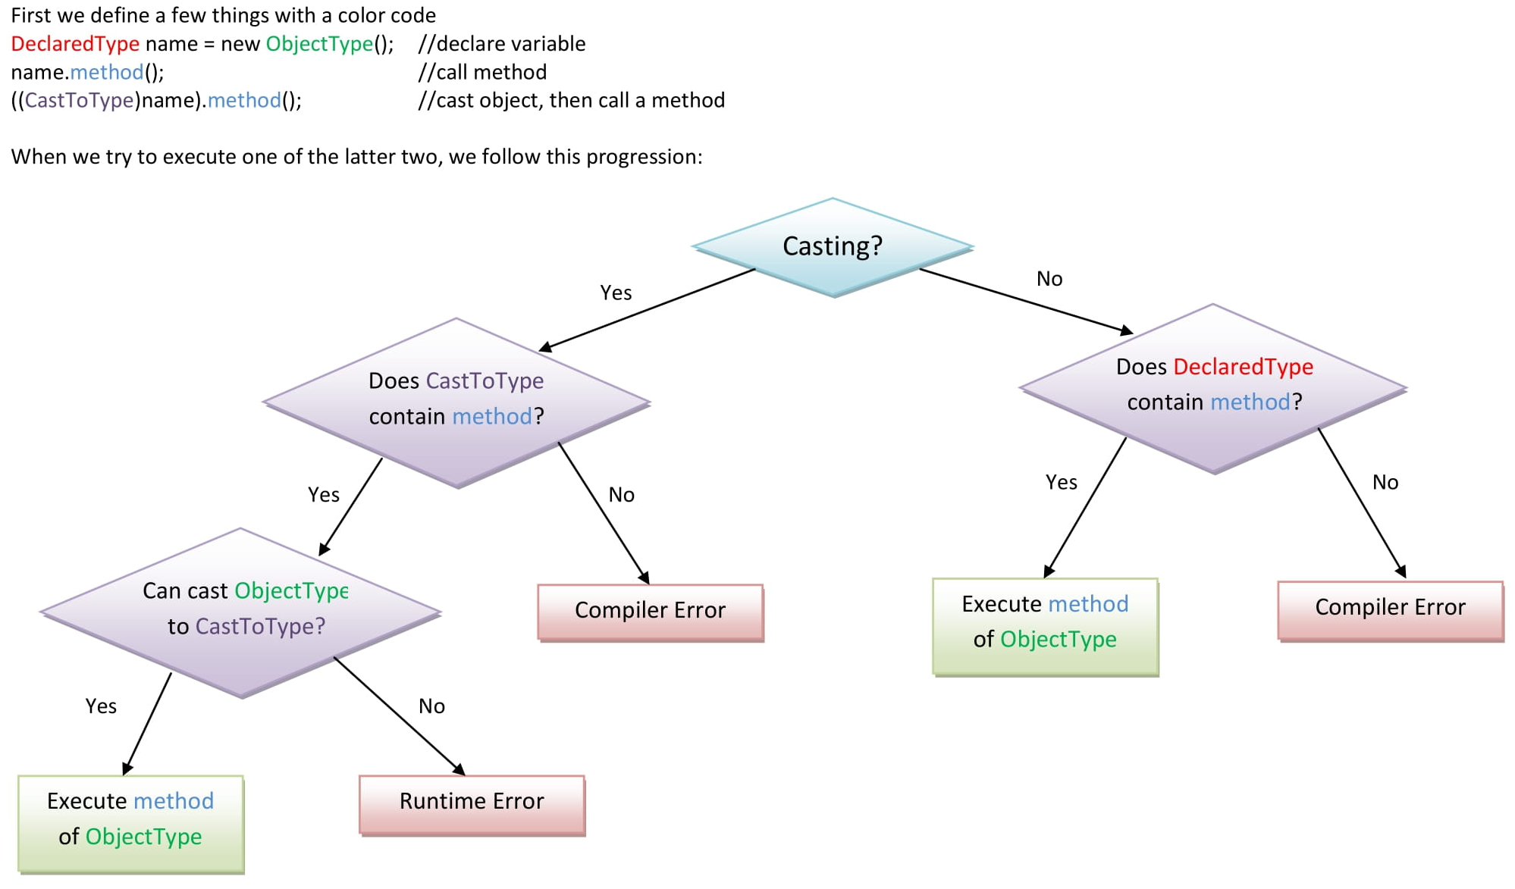
The Rules

Slide 11
Agenda
Inheritance Review
Abstract Classes
Hashing

Slide 12
Abstract Classes
Allow us to construct classes that leverage both inheritance and interface ideas
Abstract classes cannot be instantiated (like interfaces)
Include method implementations that can be leveraged with inheritance
Can define abstract methods, which must be implemented by any subclass (like interfaces)

Slide 13
Agenda
Inheritance Review
Abstract Classes
Hashing

Slide 14
Recall: Arrays
Allow for random access (continguous memory)
Have fast access if we know the index we are looking for
Runtime of adding a value to an unsorted array?
Runtime of checking if a value exists in an unsorted array?

Slide 15
Hashing
Idea: Map every value for some object to some integer index
Store these values in an array based on the index (hash table)
Hash Function: An algorithm to do this mapping
Idea for integers: HF(x) = x % table.length

Slide 16
Hashing
Idea: Map every value for some object to some integer index
Store these values in an array based on the index (hash table)
Hash Function: An algorithm to do this mapping
Idea for integers: HF(x) = x % table.length
set.add(11); // 11 % 10 == 1
set.add(49); // 49 % 10 == 9
set.add(24); // 24 % 10 == 4
set.add(7); // 7 % 10 == 7
index | 0 | 1 | 2 | 3 | 4 | 5 | 6 | 7 | 8 | 9
value | 0 | 11 | 0 | 0 | 24 | 0 | 0 | 7 | 0 | 49
Notes:
There are clearly problems with this approach (what we pass in 29 for example, we’ll deal with that Friday)

Slide 17
Hashing Efficiency
public static int hashFunction(int i) {
return Math.abs(i) % elementData.length;
}
Add: set elementData[HF(i)] = i;
Search: check if elementData[HF(i)] == i
Remove: set elementData[HF(i)] = 0;
What is the runtime of add, contains, and remove?
O(1)!
Are there any problems with this approach?

Slide 18
“Good” Hash Functions
Goal: Map an object to a number
Requirements:
The same object should always have the same number
If two objects are considered “equal” they should have the same hash code

Slide 19
“Good” Hash Functions
Goal: Map an object to a number
Requirements:
The same object should always have the same number
If two objects are considered “equal” they should have the same hash code
To be good:
Results should be distributed approximately uniformly
Should “look random”

Slide 20
“Good” Hash Functions
Goal: Map an object to a number
Requirements:
The same object should always have the same number
If two objects are considered “equal” they should have the same hash code
To be good:
Results should be distributed approximately uniformly
Should “look random”
How to write a hash function for String objects?
Notes:
first letter? length of word? Sum of ASCII values?

Slide 21
Hashing Objects
The hashCode function inside String objects looks like this:
public int hashCode() { int hash = 0; for (int i = 0; i < this.length(); i++) { hash = 31 * hash + this.charAt(i); } return hash; }
As with any general hashing function, collisions are possible.
Example: "Ea" and "FB" have the same hash value.
Early versions of Java examined only the first 16 characters. For some common data this led to poor hash table performance.

Slide 22
Hashing Objects
Hashing integers is easy (just mod by length)
For objects, all Java objects contain the hashCode method (inherited from Object class)
public int hashCode()
Returns the hash code for an object
hashCode’s implementation varies based on the object
You can define your own for your objects!

Slide 23
Hash function for objects
public static int hashFunction(E e) {
return Math.abs(e.hashCode()) % elements.length;
}
Add: set elements[HF(o)] = o;
Search: check if elements[HF(o)].equals(o)
Remove: set elements[HF(o)] = null;

