Slide 1
Inheritance + Polymorphism
Hitesh Boinpally
Summer 2023

Slide 2
Agenda
Final Logistics
Inheritance
Different Errors
Polymorphism

Slide 3
Agenda
Final Logistics
Inheritance
Different Errors
Polymorphism

Slide 4
Inheritance
Inheritance: Forming hierarchial relationships between classes
Allows for sharing / reusing of code between classes
Superclass: The class being extended
Subclass: The class that inherits behavior from superclass
Gains copy of every method

Slide 5
Inheritance
Inheritance: Forming hierarchial relationships between classes
Allows for sharing / reusing of code between classes
Superclass: The class being extended
Subclass: The class that inherits behavior from superclass
Gains copy of every method
Inheritance forms an “is-a” relationship
Tiger extends Cat
Means that Tiger “is-a” Cat
Cat
Tiger

Slide 6
Agenda
Final Logistics
Inheritance
Different Errors
Polymorphism

Slide 7
public class MusicPlayer { public void m1() { S.o.pln("MusicPlayer1"); } }
public class TapeDeck extends MusicPlayer { public void m3() { S.o.pln("TapeDeck3"); } }
public class IPod extends MusicPlayer { public void m2() { S.o.pln("IPod2"); m1(); } } public class IPhone extends IPod { public void m1() { S.o.pln("IPhone1"); super.m1(); } public void m3() { S.o.pln("IPhone3"); } }
 | m1() | m2() | m3()
MusicPlayer
TapeDeck
IPod
IPhone

Slide 8
public class MusicPlayer { public void m1() { S.o.pln("MusicPlayer1"); } }
public class TapeDeck extends MusicPlayer { public void m3() { S.o.pln("TapeDeck3"); } }
public class IPod extends MusicPlayer { public void m2() { S.o.pln("IPod2"); m1(); } } public class IPhone extends IPod { public void m1() { S.o.pln("IPhone1"); super.m1(); } public void m3() { S.o.pln("IPhone3"); } }
 | m1() | m2() | m3()
MusicPlayer | MP1 | / | /
TapeDeck | MP1 | / | TD3
IPod | MP1 | IPod2 m1() | /
IPhone | IPhone1 MP1 | IPod2 m1() | IPhone3

Slide 9
 | m1() | m2() | m3()
MusicPlayer | MP1 | / | /
TapeDeck | MP1 | / | TD3
IPod | MP1 | IPod2 m1() | /
IPhone | IPhone1 MP1 | IPod2 m1() | IPhone3
MusicPlayer var1 = new TapeDeck(); MusicPlayer var2 = new IPod(); MusicPlayer var3 = new IPhone(); IPod var4 = new IPhone(); Object var5 = new IPod(); Object var6 = new MusicPlayer();
var1.m1();
var3.m1(); var4.m2(); var3.m2(); var5.m1();

Slide 10
 | m1() | m2() | m3()
MusicPlayer | MP1 | / | /
TapeDeck | MP1 | / | TD3
IPod | MP1 | IPod2 m1() | /
IPhone | IPhone1 MP1 | IPod2 m1() | IPhone3
MusicPlayer var1 = new TapeDeck(); MusicPlayer var2 = new IPod(); MusicPlayer var3 = new IPhone(); IPod var4 = new IPhone(); Object var5 = new IPod(); Object var6 = new MusicPlayer();
var1.m1(); MusicPlayer1 var3.m1(); IPhone1 / MusicPlayer1 var4.m2(); IPod2 / IPhone1 / MusicPlayer1 var3.m2(); Compiler Error (CE) var5.m1(); Compiler Error (CE)

Slide 11
 | m1() | m2() | m3()
MusicPlayer | MP1 | / | /
TapeDeck | MP1 | / | TD3
IPod | MP1 | IPod2 m1() | /
IPhone | IPhone1 MP1 | IPod2 m1() | IPhone3
MusicPlayer var1 = new TapeDeck(); MusicPlayer var2 = new IPod(); MusicPlayer var3 = new IPhone(); IPod var4 = new IPhone(); Object var5 = new IPod(); Object var6 = new MusicPlayer();
((TapeDeck) var1).m2();
((IPod) var3).m2();
((IPhone) var2).m1();
((TapeDeck) var3).m2();

Slide 12
 | m1() | m2() | m3()
MusicPlayer | MP1 | / | /
TapeDeck | MP1 | / | TD3
IPod | MP1 | IPod2 m1() | /
IPhone | IPhone1 MP1 | IPod2 m1() | IPhone3
MusicPlayer var1 = new TapeDeck(); MusicPlayer var2 = new IPod(); MusicPlayer var3 = new IPhone(); IPod var4 = new IPhone(); Object var5 = new IPod(); Object var6 = new MusicPlayer();
((TapeDeck) var1).m2(); Compiler Error (CE) ((IPod) var3).m2(); IPod2 / IPhone1 / MusicPlayer1 ((IPhone) var2).m1(); Runtime Error (RE) ((TapeDeck) var3).m2(); Compiler Error (CE)

Slide 13
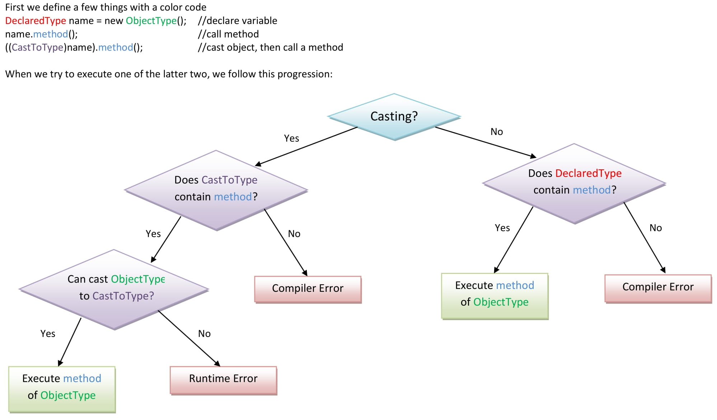
The Rules

