Slide 1
Runtime Analysis
Hitesh Boinpally
Summer 2023

Slide 2
Agenda
Motivation
Tactics
Practice

Slide 3
Agenda
Motivation
Tactics
Practice

Slide 4
Optimized Code
We now know lots of ways to write code
We want some way to determine the most “efficient” implementation
Efficiency can mean different things
Developer time
Memory
Time
Notes:
Code quality
Developer time is important!!
Memory
Working with a small computing system (cheap phone for example)
KiloBytes of space on older games
(Most often considered) Time
Scoped assignments to be pretty quick
Other courses (e.g. ML classes) take much, much longer
Shorter programs use less energy (helping environment)
But only good for one computer, one program – parallelized systems don’t handle this as well
User wait time (faster programs mean faster loading for users too)

Slide 5
Optimized Code
We now know lots of ways to write code
We want some way to determine the most “efficient” implementation
Efficiency can mean different things
Developer time
Memory
Time
Notes:
Code quality
Developer time is important!!
Memory
Working with a small computing system (cheap phone for example)
KiloBytes of space on older games
(Most often considered) Time
Scoped assignments to be pretty quick
Other courses (e.g. ML classes) take much, much longer
Shorter programs use less energy (helping environment)
But only good for one computer, one program – parallelized systems don’t handle this as well
User wait time (faster programs mean faster loading for users too)

Slide 6
Agenda
Motivation
Tactics
Practice

Slide 7
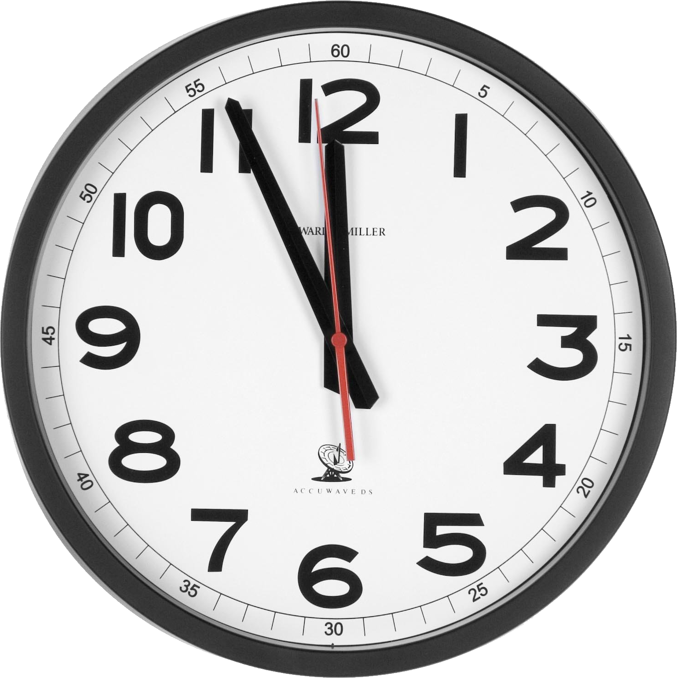
Initial Idea: Time the Program
An intuitive solution – just time the program
Check time when it starts, run the program, then see what the time is afterwards
Compare other programs using this
Called “wall-clock time”
Notes:
Big trick is “multi-tasking” being possible – only kinda true though based on number of CPUs
You can only do number of CPUs things at a time
But we switch around really fast to hide it
The Java program doesn’t get the highest priority – for example the cooling fan is more important
Leads to program speed varying
EdStem is multi-server – lots of users hopping on and off
Computer specs can be vastly different

Slide 8
Initial Idea: Time the Program
An intuitive solution – just time the program
Check time when it starts, run the program, then see what the time is afterwards
Compare other programs using this
Called “wall-clock time”
Problem: Too many variables in the runtime of a program
“Multi-Tasking”
Computer specs
Different servers
Notes:
Big trick is “multi-tasking” being possible – only kinda true though based on number of CPUs
You can only do number of CPUs things at a time
But we switch around really fast to hide it
The Java program doesn’t get the highest priority – for example the cooling fan is more important
Leads to program speed varying
EdStem is multi-server – lots of users hopping on and off
Computer specs can be vastly different

Slide 9
Next Idea: Count # of Steps
Rather than worry about precise times, instead we’ll focus on “counting steps”
We won’t be too particular in what is and isn’t a “step”
x += 5: could be considered 1 or 3 steps
Gives us a fast, easy way to compare programs
Care about how programs perform for massive inputs

Slide 10
Next Idea: Count # of Steps
Rather than worry about precise times, instead we’ll focus on “counting steps”
We won’t be too particular in what is and isn’t a “step”
x += 5: could be considered 1 or 3 steps
Gives us a fast, easy way to compare programs
Care about how programs perform for massive inputs

Slide 11
Example
Care about how programs perform for massive inputs
What’s the runtime for the following program?
public static void loopAnalysis(int n) { for (int i = 0; i < n; i++) { System.out.println("some basic action"); } }

Slide 12
Agenda
Motivation
Tactics
Practice

