Slide 1
Binary Search Trees
Hitesh Boinpally
Summer 2023

Slide 2
Agenda
Review of Trees
Binary Search Trees
Modifying a Tree

Slide 3
Agenda
Review of Trees
Binary Search Trees
Modifying a Tree

Slide 4
Trees Defined
root
Tree: Nodes linked together in some hierarchical fashion
Binary Tree: A tree where each node has at most 2 children
Recursive Definition:
A tree is either:
Empty
A node with data, and a left and right subtree
1
2
3
4
5
6

Slide 5
Printing Trees
root
Want to print out the contents of the tree
Different ways to do so:
48
21
10
Pre-order | 48 21 5 10 8 6
In-order | 5 21 48 8 10 6
Post-order | 5 21 8 6 10 48
5
8
6

Slide 6
Agenda
Review of Trees
Binary Search Trees
Modifying a Tree

Slide 7
Aside: Searching
Given an array of numbers, check if a certain number is in it.
How many elements do we have to go through in the worst case?

Slide 8
Aside: Searching
Given an array of numbers, check if a certain number is in it.
How many elements do we have to go through in the worst case?
All of them if the element isn’t in the list ☹

Slide 9
Aside: Searching
Given an array of numbers, check if a certain number is in it.
How many elements do we have to go through in the worst case?
All of them if the element isn’t in the list ☹
What if the array was sorted?

Slide 10
Aside: Searching
Given an array of numbers, check if a certain number is in it.
How many elements do we have to go through in the worst case?
All of them if the element isn’t in the list ☹
What if the array was sorted?
Find the element 27
-10 | -6 | 5 | 18 | 27 | 48 | 301

Slide 11
Binary Search Trees
root
We can apply these properties to trees to speed up our searching ability
Think: TreeSets
Binary Search Tree (BST): A binary tree with the following property:
For every non-empty node `root`:
elements of root's left subtree contain data "less than" root's data
elements of root's right subtree contain data "greater than" root’s data
root's left and right subtrees are also binary search trees
18
-6
48
-10
5
27
301
Notes:
Let’s now go update contains accordingly

Slide 12
Agenda
Review of Trees
Binary Search Trees
Modifying a Tree

Slide 13
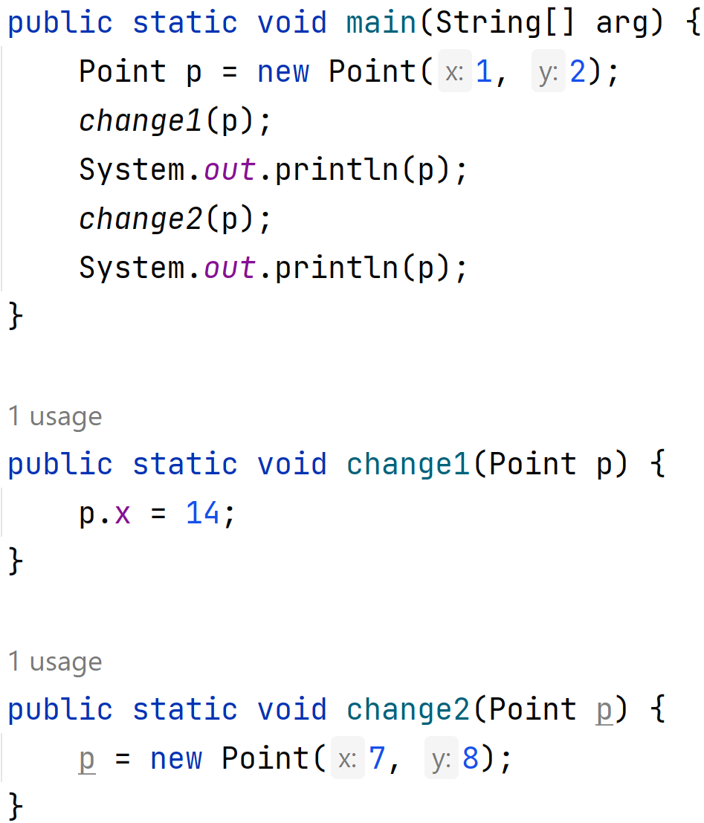
What’s the output of this program?
slido.com code: #su_cse123

Slide 14
x = change(x)
To modify a binary tree, need to change the overallRoot or a root’s .left / .right
Similar to the front or .next of a linked node
For trees we utilize the x = change(x) pattern
A few components:
Pass in the original value of x
Change the value somehow in the method change
Return the updated value of x
Re-assign the updated value to x
Notes:
Let’s now go update contains accordingly

