Slide 1
Implementing Data Structures; Pre-/Post-Conditions
Hitesh Boinpally
Summer 2023

Slide 2
Agenda
OOP Review
ArrayIntList
Pre-/Post-Conditions
P0

Slide 3
Agenda
OOP Review
ArrayIntList
Pre-/Post-Conditions
P0

Slide 4
Classes vs Objects
class
A complete program or
A template for some entity or type
State and behavior
“blueprint”

Slide 5
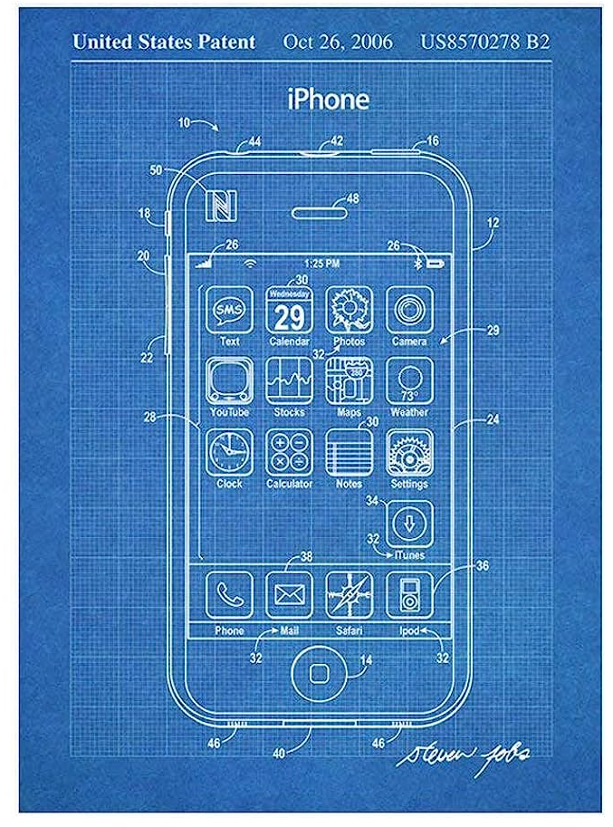
Classes vs Objects
class
A complete program or
A template for some entity or type
State and behavior
“blueprint”

Slide 6
Classes vs Objects
class
A complete program or
A template for some entity or type
State and behavior
“blueprint”
Object
A particular instance of a class, contains state and behavior
ArrayIntList myList = new ArrayIntList();

Slide 7
Classes vs Objects
class
A complete program or
A template for some entity or type
State and behavior
“blueprint”
Object
A particular instance of a class, contains state and behavior
ArrayIntList myList = new ArrayIntList();

Slide 8
Client vs Implementer
Client
Working with objects – what you’ve seen so far
Constructing objects, calling their methods, etc.
Programs that utilize implemented classes

Slide 9
Client vs Implementer
Client
Working with objects – what you’ve seen so far
Constructing objects, calling their methods, etc.
Programs that utilize implemented classes
Implementer
Designing classes for others to use
Provide abstraction layer

Slide 10
Agenda
OOP Review
ArrayIntList
Pre-/Post-Conditions
P0
Notes:
Switch to in-class work on IntelliJ / Ed

Slide 11
Agenda
OOP Review
ArrayIntList
Pre-/Post-Conditions
P0

Slide 12
P0 – Warm Up
First programming assignment!
Review of previous concepts that you are expected to know
Make sure to complete all components
Due next Wednesday 6/28
Workflow
Use IntelliJ to develop and debug
Mark your homework on Ed to turn it in
Ed test cases should be treated as final check!
Don’t try to debug from these cases
Instead use IntelliJ to debug your work

Slide 13
P0 – Warm Up
To be making effective progress in the course:
You should be passing all test cases on Ed
You should be following good code quality principles
Resubmissions exist, but don’t let that be a crutch!
We’re here to help!
Review content covered in pre-class work, lessons, section, etc.
Stop by IPL / Hitesh’s OH
Post on the Ed Board
Notes:
Briefly explain virtual IPL

