Slide 1
Lesson 7
Linked Lists
Lesson 7 - Spring 2023

Slide 2
Linked Nodes So Far
Small sequences of nodes connected together
Using the ListNode class
Traversals over these sequences with while loops
data | next
121
data | next
122
node
Lesson 7 - Spring 2023
Notes:
Flip to solutions from last lesson

Slide 3
Introducing the LinkedIntList!
New collection named LinkedIntList
Lesson 7 - Spring 2023

Slide 4
Introducing the LinkedIntList!
New collection named LinkedIntList
Same kinds of methods as the ArrayIntList
add, add, get, indexOf, remove, size, toString
Lesson 7 - Spring 2023

Slide 5
Introducing the LinkedIntList!
New collection named LinkedIntList
Same kinds of methods as the ArrayIntList
add, add, get, indexOf, remove, size, toString
Implemented with chain of linked nodes
Lesson 7 - Spring 2023

Slide 6
Introducing the LinkedIntList!
New collection named LinkedIntList
Same kinds of methods as the ArrayIntList
add, add, get, indexOf, remove, size, toString
Implemented with chain of linked nodes
Keeps reference to its front as a field
null is the end of the list
If front is null, list is empty
Lesson 7 - Spring 2023

Slide 7
Introducing the LinkedIntList!
Implemented with chain of linked nodes
Keeps reference to its front as a field
null is the end of the list; if front is null, list is empty
LinkedIntList
front
add(index)
add(index, value)
indexOf(value)
remove(index)
size()
toString()
Lesson 7 - Spring 2023

Slide 8
Introducing the LinkedIntList!
Implemented with chain of linked nodes
Keeps reference to its front as a field
null is the end of the list; if front is null, list is empty
LinkedIntList
front
ListNode
add(index)
add(index, value)
indexOf(value)
remove(index)
size()
toString()
data | next
16
Lesson 7 - Spring 2023

Slide 9
Introducing the LinkedIntList!
Implemented with chain of linked nodes
Keeps reference to its front as a field
null is the end of the list; if front is null, list is empty
LinkedIntList
front
ListNode
ListNode
ListNode
add(index)
add(index, value)
indexOf(value)
remove(index)
size()
toString()
data | next
16
data | next
-3
data | next
27
Lesson 7 - Spring 2023
Notes:
Flip to actual implementation at this point

Slide 10
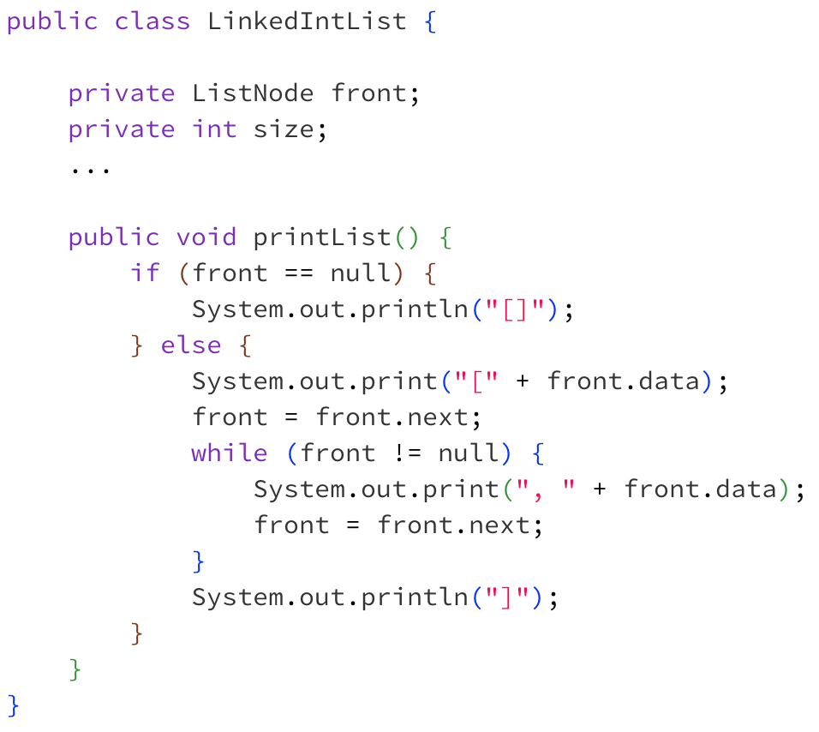
printList Revisited
Lesson 7 - Spring 2023

Slide 11
printList Revisited
Client Code:
Lesson 7 - Spring 2023

Slide 12
printList Revisited
Client Code:
What will be the output of this program?
Lesson 7 - Spring 2023

Slide 13
printList Revisited
Client Code:
What will be the output of this program?
We’re losing the front of our list!
Lesson 7 - Spring 2023

Slide 14
Client Code:
front
data | next
16
data | next
-3
data | next
27
Lesson 7 - Spring 2023

Slide 15
Client Code:
front
data | next
16
data | next
-3
data | next
27
Lesson 7 - Spring 2023

Slide 16
Client Code:
front
data | next
16
data | next
-3
data | next
27
Lesson 7 - Spring 2023

Slide 17
Client Code:
front
data | next
16
data | next
-3
data | next
27
Lesson 7 - Spring 2023

Slide 18
Client Code:
front
data | next
-3
data | next
27
Lesson 7 - Spring 2023

Slide 19
Client Code:
front
data | next
-3
data | next
27
Lesson 7 - Spring 2023

Slide 20
Client Code:
front
data | next
-3
data | next
27
Lesson 7 - Spring 2023

Slide 21
Client Code:
front
data | next
-3
data | next
27
Lesson 7 - Spring 2023

Slide 22
Client Code:
front
data | next
27
Lesson 7 - Spring 2023

Slide 23
Client Code:
front
data | next
27
Lesson 7 - Spring 2023

Slide 24
Client Code:
front
Lesson 7 - Spring 2023

Slide 25
Client Code:
front
Lesson 7 - Spring 2023

Slide 26
public void printList() {
if (front == null) {
System.out.println(“[]”);
} else {
System.out.print(“[” + front.data);
front = front.next;
while (front != null) {
System.out.print(“, ” + front.data);
front = front.next;
}
System.out.println(“]”);
}
}
Client Code:
Lesson 7 - Spring 2023

Slide 27
public void printList() {
if (front == null) {
System.out.println(“[]”);
} else {
System.out.print(“[” + front.data);
ListNode curr = front.next;
while (curr != null) {
System.out.print(“, ” + curr.data);
curr = curr.next;
}
System.out.println(“]”);
}
}
Client Code:
front
data | next
16
data | next
-3
data | next
27
Lesson 7 - Spring 2023

Slide 28
public void printList() {
if (front == null) {
System.out.println(“[]”);
} else {
System.out.print(“[” + front.data);
ListNode curr = front.next;
while (curr != null) {
System.out.print(“, ” + curr.data);
curr = curr.next;
}
System.out.println(“]”);
}
}
Client Code:
front
data | next
16
data | next
-3
data | next
27
Lesson 7 - Spring 2023

Slide 29
public void printList() {
if (front == null) {
System.out.println(“[]”);
} else {
System.out.print(“[” + front.data);
ListNode curr = front.next;
while (curr != null) {
System.out.print(“, ” + curr.data);
curr = curr.next;
}
System.out.println(“]”);
}
}
Client Code:
curr
front
data | next
16
data | next
-3
data | next
27
Lesson 7 - Spring 2023

Slide 30
public void printList() {
if (front == null) {
System.out.println(“[]”);
} else {
System.out.print(“[” + front.data);
ListNode curr = front.next;
while (curr != null) {
System.out.print(“, ” + curr.data);
curr = curr.next;
}
System.out.println(“]”);
}
}
Client Code:
curr
front
data | next
16
data | next
-3
data | next
27
Lesson 7 - Spring 2023

Slide 31
public void printList() {
if (front == null) {
System.out.println(“[]”);
} else {
System.out.print(“[” + front.data);
ListNode curr = front.next;
while (curr != null) {
System.out.print(“, ” + curr.data);
curr = curr.next;
}
System.out.println(“]”);
}
}
Client Code:
curr
front
data | next
16
data | next
-3
data | next
27
Lesson 7 - Spring 2023

Slide 32
public void printList() {
if (front == null) {
System.out.println(“[]”);
} else {
System.out.print(“[” + front.data);
ListNode curr = front.next;
while (curr != null) {
System.out.print(“, ” + curr.data);
curr = curr.next;
}
System.out.println(“]”);
}
}
Client Code:
front
data | next
16
data | next
-3
data | next
27
Lesson 7 - Spring 2023

Slide 33
remove(int value) Visualization
Lesson 7 - Spring 2023

Slide 34
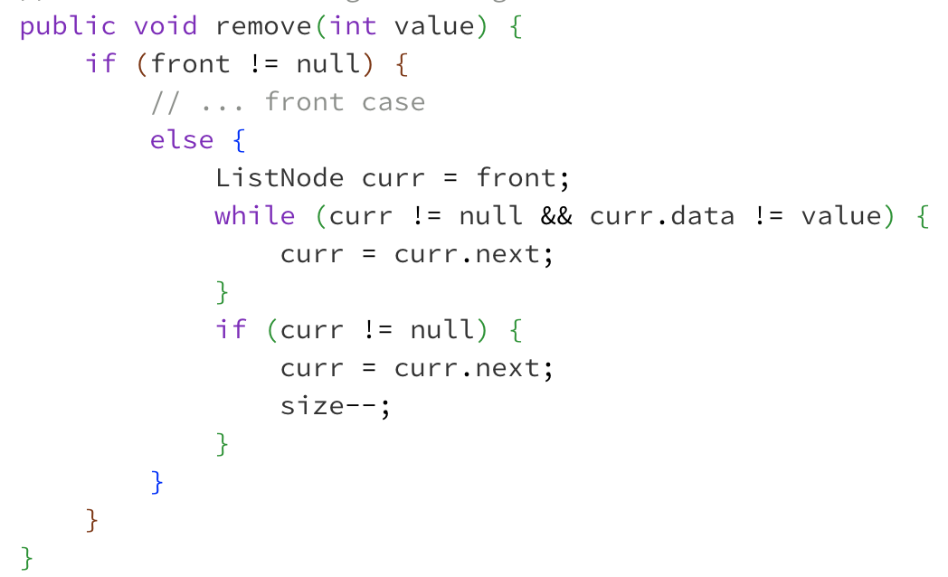
⚠️ Without “Stopping One Early” ⚠️
Client calls list.remove(-3)
front
data | next
16
data | next
42
data | next
-3
data | next
27
Lesson 7 - Spring 2023

Slide 35
⚠️ Without “Stopping One Early” ⚠️
Client calls list.remove(-3)
front
data | next
16
data | next
42
data | next
-3
data | next
27
curr
Lesson 7 - Spring 2023

Slide 36
⚠️ Without “Stopping One Early” ⚠️
Client calls list.remove(-3)
front
data | next
16
data | next
42
data | next
-3
data | next
27
curr
Lesson 7 - Spring 2023

Slide 37
⚠️ Without “Stopping One Early” ⚠️
Client calls list.remove(-3)
front
data | next
16
data | next
42
data | next
-3
data | next
27
curr
Lesson 7 - Spring 2023

Slide 38
⚠️ Without “Stopping One Early” ⚠️
Client calls list.remove(-3)
front
data | next
16
data | next
42
data | next
-3
data | next
27
curr
Lesson 7 - Spring 2023

Slide 39
⚠️ Without “Stopping One Early” ⚠️
Client calls list.remove(-3)
This is the reference we need to change!
front
data | next
16
data | next
42
data | next
-3
data | next
27
curr
Lesson 7 - Spring 2023

Slide 40
⚠️ Without “Stopping One Early” ⚠️
Client calls list.remove(-3)
This is the reference we need to change!
front
data | next
16
data | next
42
data | next
-3
data | next
27
curr
Lesson 7 - Spring 2023

Slide 41
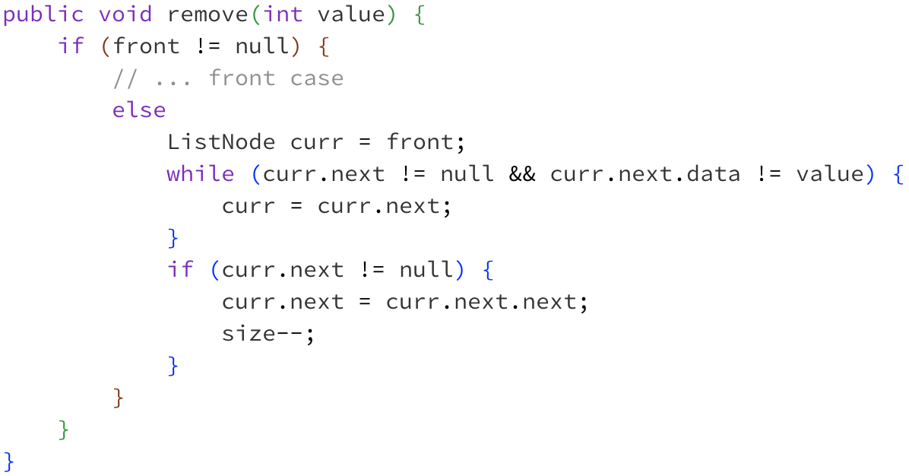
✅ With “Stopping One Early” ✅
Client calls list.remove(-3)
This is the reference we need to change!
front
data | next
16
data | next
42
data | next
-3
data | next
27
Lesson 7 - Spring 2023

Slide 42
✅ With “Stopping One Early” ✅
Client calls list.remove(-3)
This is the reference we need to change!
front
data | next
16
data | next
42
data | next
-3
data | next
27
curr
Lesson 7 - Spring 2023

Slide 43
✅ With “Stopping One Early” ✅
Client calls list.remove(-3)
This is the reference we need to change!
front
data | next
16
data | next
42
data | next
-3
data | next
27
curr
Lesson 7 - Spring 2023

Slide 44
✅ With “Stopping One Early” ✅
Client calls list.remove(-3)
This is the reference we need to change!
front
data | next
16
data | next
42
data | next
-3
data | next
27
curr
Lesson 7 - Spring 2023

Slide 45
Changing a list
There are only two ways to change a linked list:
Change the value of front (modify the front of the list)
Change the value of <node>.next (modify middle or end of list to point somewhere else)
Implications:
To add in the middle, need a reference to the previous node
Front is often a special case

