Slide 1
You Made It!

Slide 2
Announcements
P3 due tonight Friday at 11:59pm
R8 due Friday (12/8)
New: R9 due next Wednesday (12/13)
Final exam next Tuesday (12/12), 12:30-2:20
Read exam policies
One note page, no more than 8.5” x 11”
Reference sheet posted
Assigned seats

Slide 3
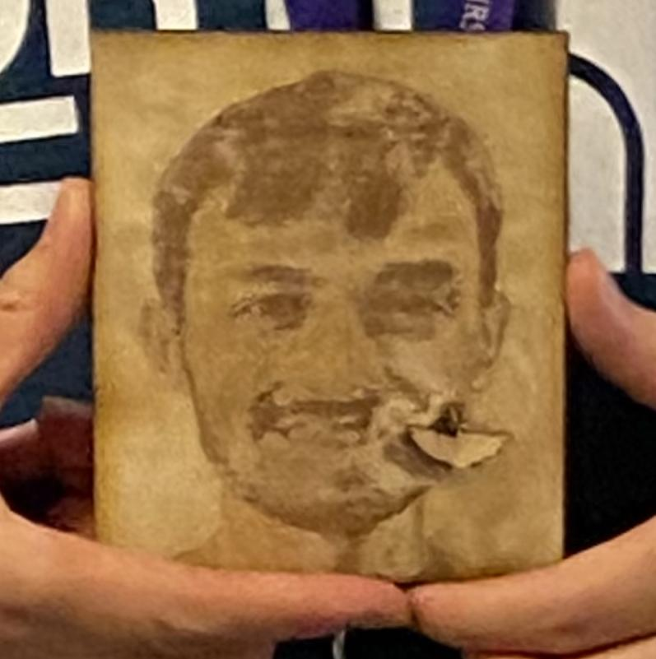
Thank your TAs!
Notes:
Elba

Slide 4
Learning Objectives
or, “What did I learn in this class?”
Seven themes:
Computational Thinking
Code Comprehension
Code Writing
Communication
Testing
Debugging
Ethics/Impact
Notes:
Brett

Slide 6
Digression: My New Hobby
Amigurumi: Japanese art of creating crocheted or knitted stuffed toys

Slide 7
Applications of CS
or “What can I do with what I learned?”
Detect and prevent toxicity online
Digitize basketball players
Help DHH people identify sounds
Figure out how to best distribute relief funds
Recognize disinformation online
Make movies
Improve digital collaboration
Fix Olympic badminton
And so much more!

Slide 8
Future Courses
or “What can I do next?”
CSE Majors
Non-CSE Majors/Open to All (*)
Course | Overview
CSE 311 | Mathematical foundations
CSE 351 | Low-level computer organization/abstraction
CSE 331 | Software design/implementation
CSE 340 | Interaction programming
CSE 341 | Programming languages (!)
Course | Overview
CSE 154* | Intro. to web programming (several languages)
CSE 163* | Intermediate programming, data analysis (Python)
CSE 180* | Introduction to data science (Python)
CSE 373 | Data structures and algorithms
CSE 374 | Low-level programming and tools (C/C++)
CSE 412 | Data Visualization
CSE 416 | Intro. to Machine Learning
See: https://www.cs.washington.edu/academics/ugrad/current-students and https://www.cs.washington.edu/academics/ugrad/nonmajor-options/nonmajor-courses

Slide 9
Frequently Asked Questions
How can I get better at programming?
Practice!
How can I learn to X?
Search online, read books, look at examples
What should I work on next?
Anything you can think of! (Here are some ideas)
Beware: it’s hard to tell what’s easy and what’s hard.
Should I learn another language? Which one?
That depends–what do you want to do?
What’s the best programming language?
😠 (take CSE 341/CSE 413)

Slide 10
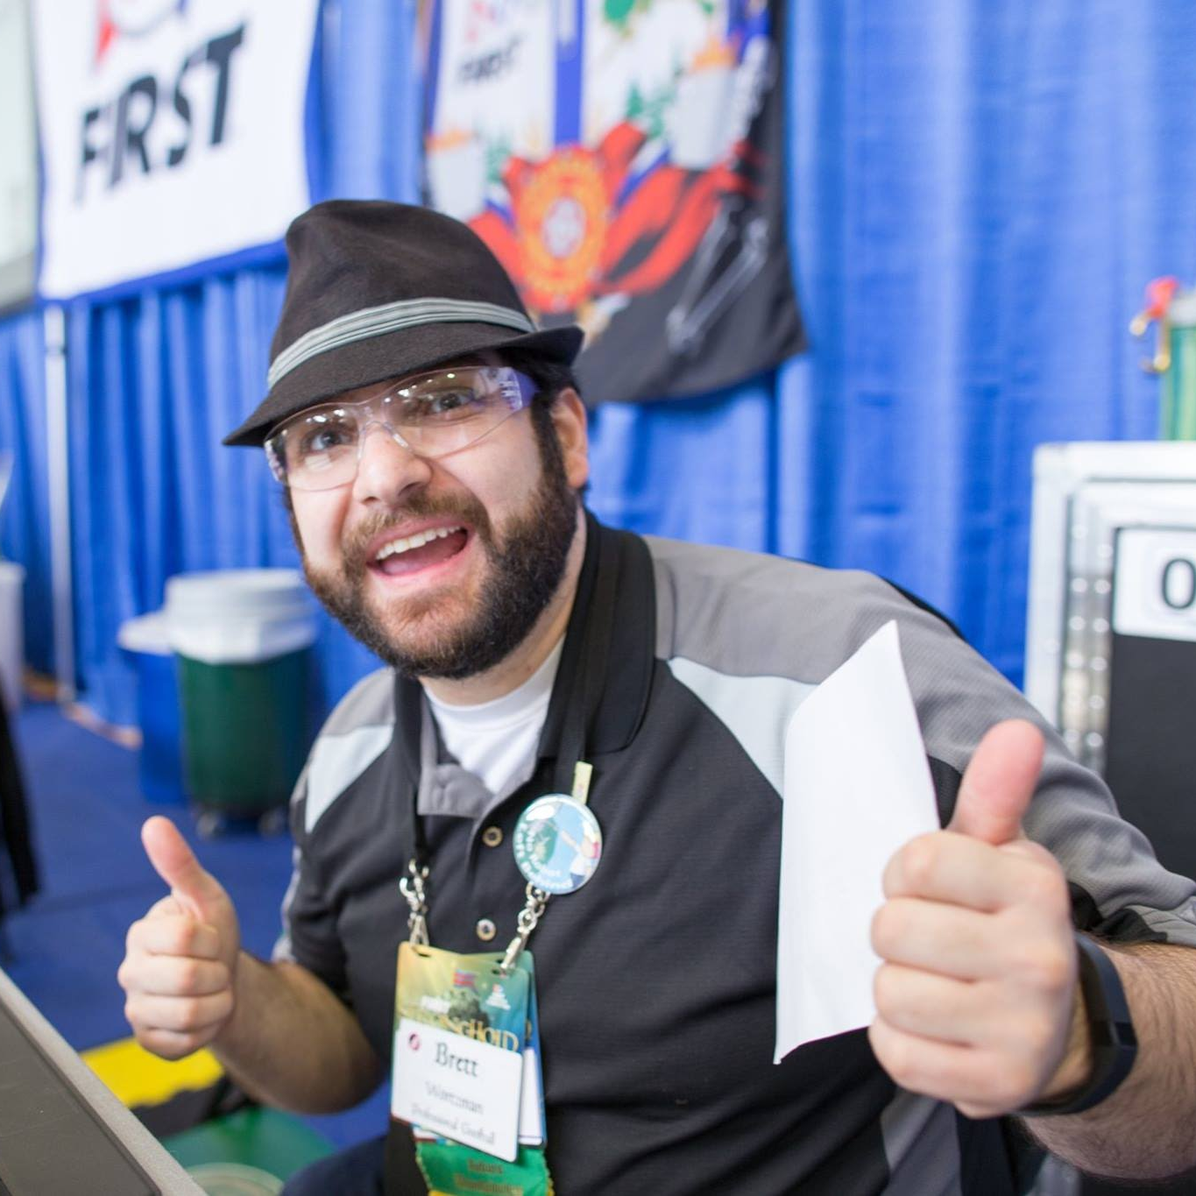
Thank you!!!
Ask Me (Almost) Anything!

