Slide 1
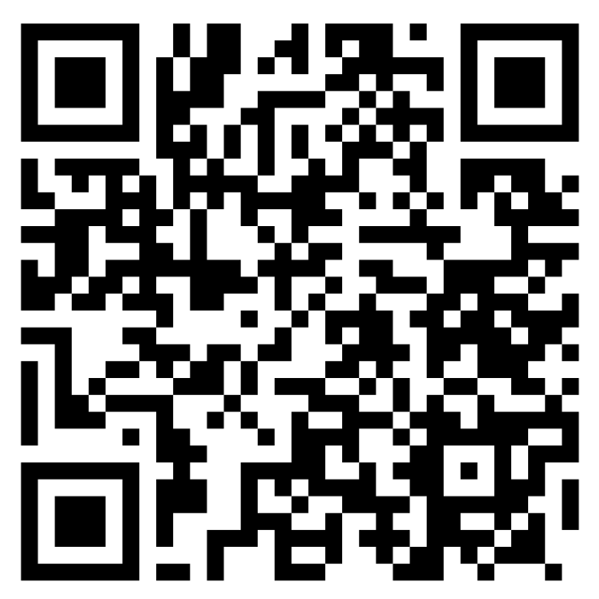
Nested Collections
BEFORE WE START
Talk to your neighbors:
What’s your favorite holiday, and why?
(Mine is Diada de Saint Jordi, so cool.)
Music: Las Babys - Aitana

Slide 2
Agenda
Announcements
Review/Finish: mostFrequentStart
Recap: Nested Collections
Practice: Search Engine
Images Debrief

Slide 3
Announcements
Programming Assignment 2 (P2) will be out later today!
  Seriously, start early! This assignment is much more involved…
  Due November 9th by 11:59 PM
Quiz 1 on October 31st 🎃
  Topics: Reference Semantics, Stacks and Queues, 2D Arrays, Sets
Resubmission Cycle 2 (R2) form out, due October 31st by 11:59 PM

Slide 4
Agenda
Announcements
Review/Finish: mostFrequentStart
Recap: Nested Collections
Practice: Search Engine
Images Debrief

Slide 5
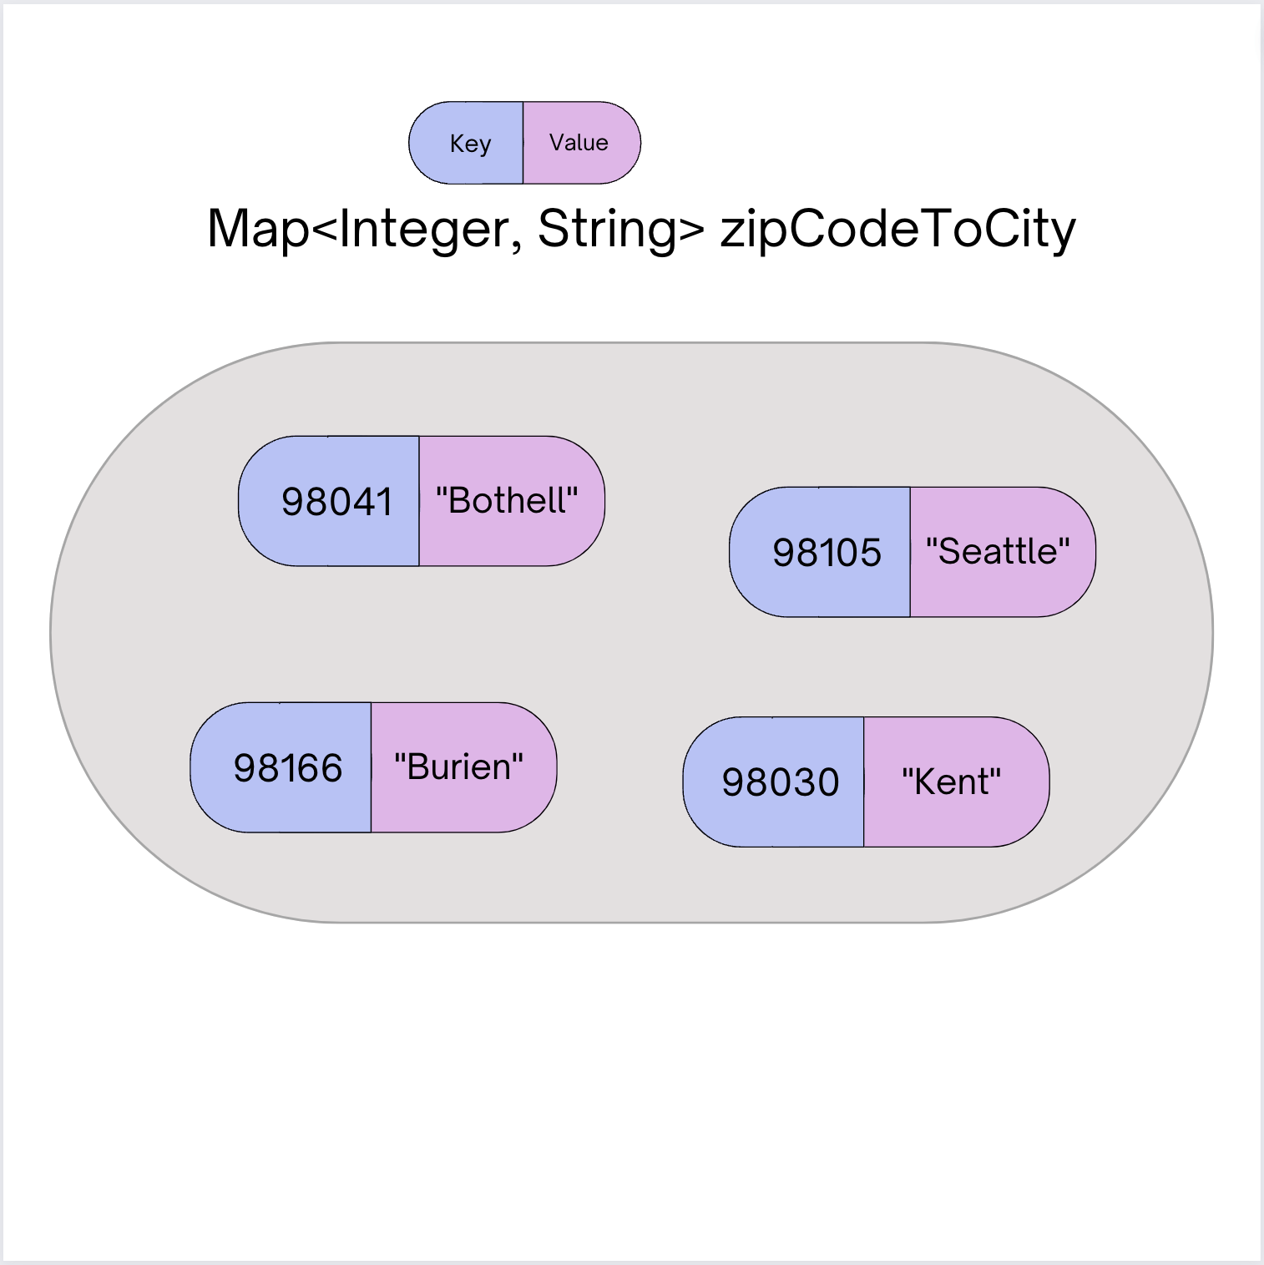
Map ADT
Data structure to map keys to values
  Keys can be any* type; Keys must be unique
  Values can be any type
Example: Mapping nucleotides to counts
in P0!
Operations
  put(key, value): Associate key to value
    Overwrites duplicate keys
  get(key): Get value for key
  remove(key): Remove key/value pair
Same as Python’s dict

Slide 6
mostFrequentStart
Write a method called mostFrequentStart that takes a Set of words and does the following steps:
Organizes words into “word families” based on which letter they start with
Selects the largest “word family” as defined as the family with the most words in it
Returns the starting letter of the largest word family (and if time, should update the Set of words to only have words from the selected family).

Slide 7
mostFrequentStart
For example, if the Set words stored the values
["hello", "goodbye", "library", "literary", "little", "repel"]
The word families produced would be
'h' -> 1 word ("hello")
'g' -> 1 word ("goodbye")
'l' -> 3 words ("library", "literary", "little")
'r' -> 1 word ("repel")
Since 'l' has the largest word family, we return 3 and modify the Set to only contain Strings starting with 'l'.

Slide 8
Agenda
Announcements
Review/Finish: mostFrequentStart
Recap: Nested Collections
Practice: Search Engine
Images Debrief

Slide 9
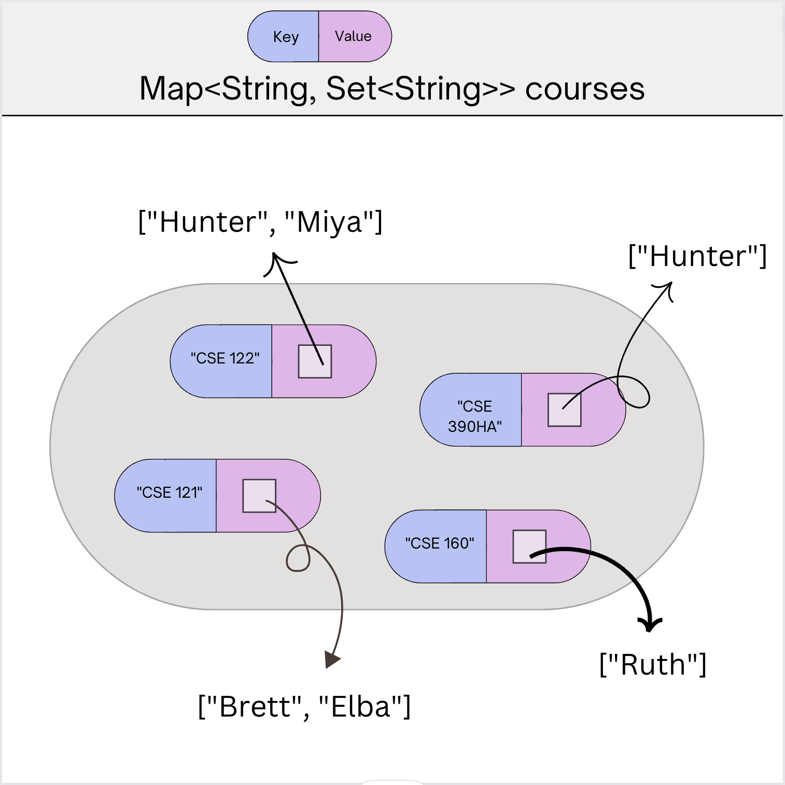
Nested Collections
The values inside a Map can be any type, including data structures
Common examples:
  Mapping: Section ➔ Set of students in that section
  Mapping: Recipe ➔ Set of ingredients in that recipe
    Or even Map<String, Map<String, Double>> for units!

Slide 10
Updating Nested Collections
The “value” inside the Map is a reference
to the data structure!
  Think carefully about number of references
  to a particular object
courses.put("CSE 123", new HashSet<String>());
courses.get("CSE 123").add("Kasey");
Set<String> cse123 = courses.get("CSE 123");
cse123.add("Brett");

Slide 11
Suppose map had the following state. What would its state be after running this code?
map: {”KeyA"=[1, 2], ”KeyB"=[3], ”KeyC"=[4, 5, 6]}
Set<Integer> nums = map.get("KeyA");
nums.add(7);
map.put("KeyB", nums);
map.get("KeyA").add(8);
map.get("KeyB").add(9);
{"KeyA"=[1, 2], "KeyB"=[1, 2, 7], "KeyC"=[4, 5, 6]}
{"KeyA"=[1, 2, 8], "KeyB"=[1, 2, 7, 9], "KeyC"=[4, 5, 6]}
{"KeyA"=[1, 2, 7, 8], "KeyB"=[1, 2, 7, 9], "KeyC"=[4, 5, 6]}
{"KeyA"=[1, 2, 7, 8, 9], "KeyB"=[1, 2, 7, 8, 9], "KeyC"=[4, 5, 6]}

Slide 12
Suppose map had the following state. What would its state be after running this code?
map: {”KeyA"=[1, 2], ”KeyB"=[3], ”KeyC"=[4, 5, 6]}
nums →
Set<Integer> nums = map.get("KeyA");
nums.add(7);
map.put("KeyB", nums);
map.get("KeyA").add(8);
map.get("KeyB").add(9);
[1, 2]
[1, 2, 7, 8]
A:
[1, 2, 7]
[1, 2, 7, 8, 9]
nums
B:
[3]
C:
[4, 5, 6]
{"KeyA"=[1, 2], "KeyB"=[1, 2, 7], "KeyC"=[4, 5, 6]}
{"KeyA"=[1, 2, 8], "KeyB"=[1, 2, 7, 9], "KeyC"=[4, 5, 6]}
{"KeyA"=[1, 2, 7, 8], "KeyB"=[1, 2, 7, 9], "KeyC"=[4, 5, 6]}
{"KeyA"=[1, 2, 7, 8, 9], "KeyB"=[1, 2, 7, 8, 9], "KeyC"=[4, 5, 6]}

Slide 13
Agenda
Announcements
Review/Finish: mostFrequentStart
Recap: Nested Collections
Practice: Search Engine
Images Debrief

Slide 14
Background: Search Engines
A search engine receives a query and returns a set of relevant documents. Examples: Google.com, Mac Finder, more.
  Queries often can have more
A search engine involves two main components
  An index to efficiently find the set of documents for a query
    Will focus on “single word queries” for today’s example
  A ranking algorithm to order the documents from most to least relevant
    Not the focus of this example
Goal: Precompute a data structure that helps find the relevant documents for a given query

Slide 15
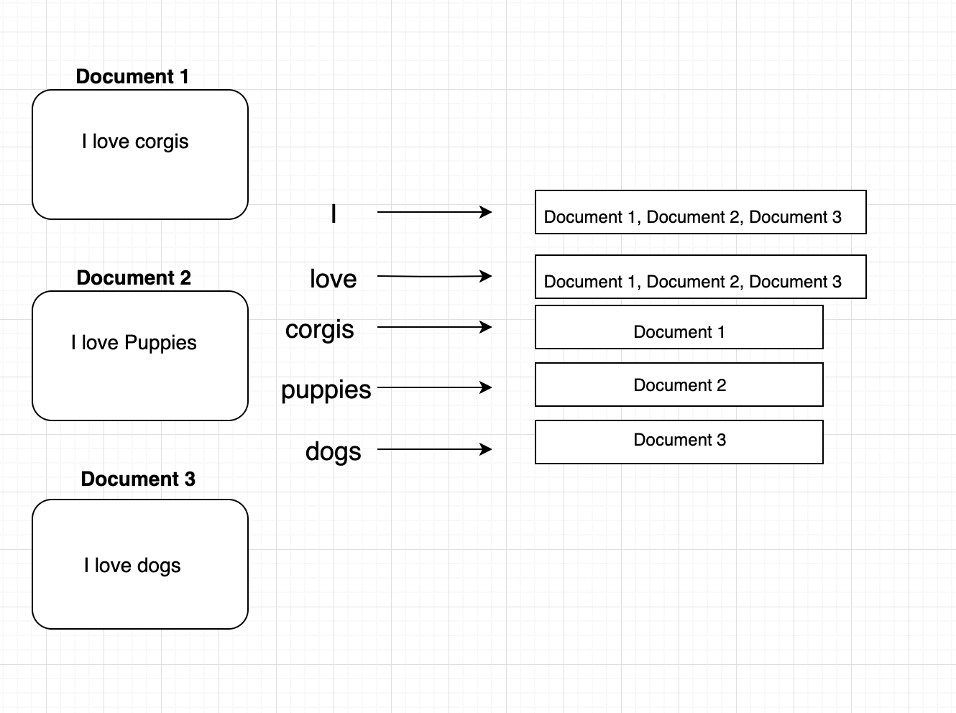
Inverted Index
An inverted index is a Mapping from possible query words to the set of documents that contain that word
  Answers the question:
  “What documents contain
  the word ‘corgis’?”

Slide 16
(Optional) Ranking Results
There is no one right way to define which documents are “most relevant” There are approximations, but make decisions about what relevance means
Idea 1: Documents that have more hits of the query should come first
  Pro: Simple
  Con: Favors longer documents (query: “the dogs” will favor long documents with lots of “the”s)
Idea 2: Weight query terms based on their “uniqueness”. Often use some sort of score for “Term Frequency – Inverse Document Frequency (TF-IDF)
  Pro: Doesn’t put much weight on common words like “the”
  Cons: Complex, many choices in how to compute that yield pretty different rankings
Idea 3: Much more! Most companies keep their ranking algorithms very very secret ☺

Slide 17
Agenda
Announcements
Review/Finish: mostFrequentStart
Recap: Nested Collections
Practice: Search Engine
Images Debrief

Slide 18
Data Bias
Common Misconception: Models or Artificial Intelligence (AI) are somehow “less biased” or “more objective” than humans. Not true.
The programs we use operate on real-world data, and will often reflect the biases that data contains
Have to carefully consider the context and limitations of the data we gather. If the data an algorithm is built on is vastly different than the context in which it’s used, some pretty awful outcomes can happen

Slide 19
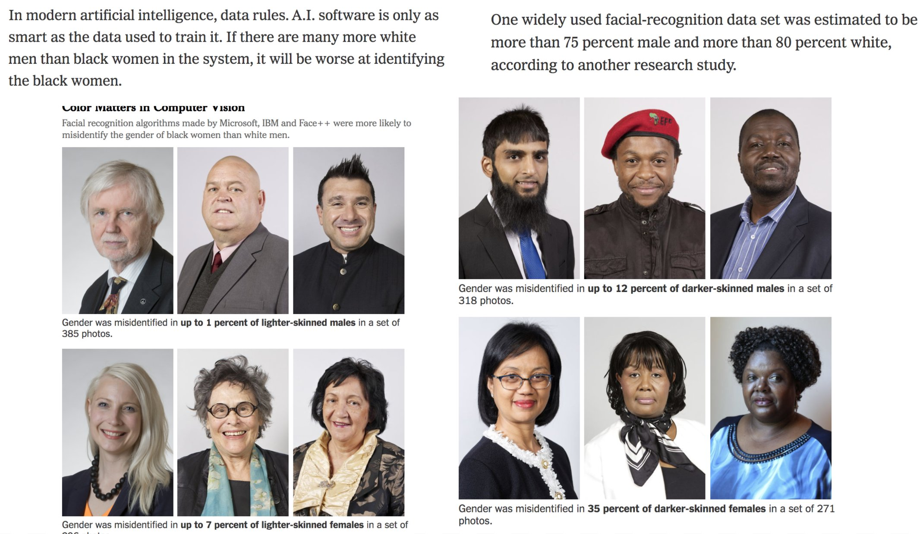
Data Bias

Slide 20
What to do?
Obviously, ideal to have datasets that aren’t biased in the first place.
  But might not always be possible if we can’t fix the sources of the bias in the real world...
AI/Models aren’t “neutral” or “more objective”, they just quickly and automatically codify the status quo (and perpetuate biases)
  Garbage in → Garbage out
Lots of work going into how to de-bias models even if they are trained on biased data. Active area of research!
  Key take-away: None of this comes “for free”, requires hard work to fight bias
Ask ourselves:
  What biases might be present in my data?
  What assumptions might I be making about who is using my program?
  How can I write code to be more inclusive?
  What happens when (not if) mistakes happen? Who potentially benefits and who is potentially harmed?

