Slide 1
Maps
BEFORE WE START
Talk to your neighbors:
If you had to choose one meal to eat repetitively for the rest of your life, what would it be?
(Mine’s definitely oatmeal.)
Music: The Middle - Jimmy Eat World

Slide 2
Lecture Outline
Announcements
Map Review
Debrief PCM: Count Words
Practice: joinRosters
Practice: mostFrequentStart

Slide 3
Announcements
Quiz 1 is Tuesday, October 31st
Resubmission Cycle 2 (R2) form opens up tomorrow!
  Due Tuesday, October 31st by 11:59 PM
Creative Project 1 (C1) due tomorrow by 11:59 PM!
Programming Assignment 2 (P2) released Friday
  Due Thursday, November 9th by 11:59 PM

Slide 4
Lecture Outline
Announcements
Map Review
Debrief PCM: Count Words
Practice: joinRosters
Practice: mostFrequentStart

Slide 5
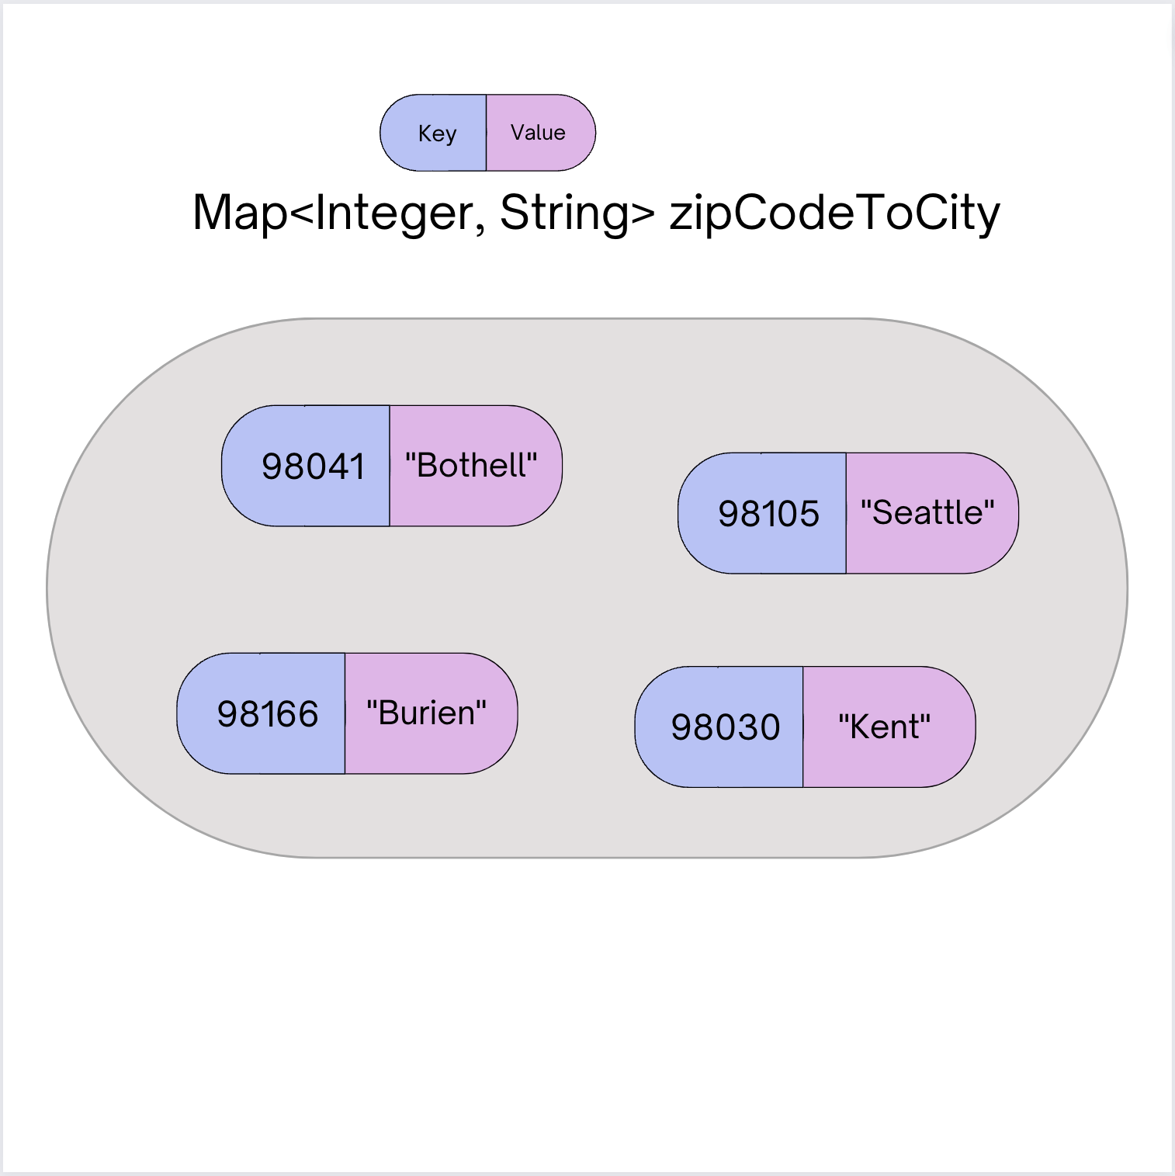
Map ADT
Data structure to map keys to values
  Keys can be any* type; Keys must be unique
  Values can be any type
Example: Mapping nucleotides to counts
in P0!
Operations
  put(key, value): Associate key to value
    Overwrites duplicate keys
  get(key): Get value for key
  remove(key): Remove key/value pair
Same as Python’s dict

Slide 6
Programming with Maps in Java
Interface: Map
Implementations: TreeMap, HashMap
// Making a Map
Map<String, String> favArtistToSong = new TreeMap<>();
// adding elements to the above Map
favArtistToSong.put(”Iron Maiden", ”Wasted Years");
favArtistToSong.put(”Foxes", ”Body Talk");
favArtistToSong.put(”Vampire Weekend", ”Campus");
// Getting a value for a key
String song = favArtistToSong.get(”Vampire Weekend");
System.out.println(song);

Slide 7
Programming with Maps in Java
Methods | Description
put(key, value) | adds a mapping from the given key to the given value; if the key already exists, replaces its value with the given one
get(key) | returns the value mapped to the given key (null if not found)
containsKey(key) | returns true if the map contains a mapping for the given key
remove(key) | removes any existing mapping for the given key
clear() | removes all key/value pairs from the map
size() | returns the number of key/value pairs in the map
isEmpty() | returns true if the map's size is 0
toString() | returns a string such as "{a=90, d=60, c=70}"
keySet() | returns a set of all keys in the map
values() | returns a collection of all values in the map

Slide 8
Map Implementations
Our first data structures with marked differences in how their implementations behave
One Map ADT / Interface
Two Map implementations
  TreeMap – Pretty fast, but sorted keys
  HashMap – Extremely fast, unsorted keys
Map<String, Integer> map1 = new TreeMap<>();
Map<String, Integer> map2 = new HashMap<>();
...

Slide 9
Select the method calls required to modify the given map m as follows:
Assume m’s contents are
98030="Kent"
98178="Seattle"
98166="Burien"
98041="Bothell"
We want to modify m so that its contents are
98030="Kent"
98178="Tukwila"
98166="Burien"
98041="Bothell"
98101="Seattle"
98126="Seattle"
m.put(98178, "Tukwila");
m.remove(98178);
m.put(98126, "Seattle");
m.get(98178, "Seattle");
m.put(98101, "Seattle");

Slide 10
Select the method calls required to modify the given map m as follows:
Assume m’s contents are
98030="Kent"
98178="Seattle"
98166="Burien"
98041="Bothell"
We want to modify m so that its contents are
98030="Kent"
98178="Tukwila"
98166="Burien"
98041="Bothell"
98101="Seattle"
98126="Seattle"
m.put(98178, "Tukwila");
m.remove(98178);
m.put(98126, "Seattle");
m.get(98178, "Seattle");
m.put(98101, "Seattle");

Slide 11
Lecture Outline
Announcements
Map Review
Debrief PCM: Count Words
Practice: joinRosters
Practice: mostFrequentStart

Slide 12
Lecture Outline
Announcements
Map Review
Debrief PCM: Count Words
Practice: joinRosters
Practice: mostFrequentStart

Slide 13
joinRosters
Write a method joinRosters that combines a Map from student name to quiz section, and a Map from TA name to quiz section and prints all pairs of students/TAs.
For example, if studentSections stores the following map:
{Alan=AC, Jerry=AB, Yueying=AA, Sharon=AB, Steven=AB, Zewditu=BA}
And taSections stores the following map
{Marcus=BA, Arthur=AA, Atharva=AB, Rucha=AC}
AC: Alan - Rucha
AB: Jerry - Atharva AB: Sharon - Atharva AB: Steven - Atharva AA: Yueying - Arthur BA: Zewditu - Marcus

Slide 14
Lecture Outline
Announcements
Map Review
Debrief PCM: Count Words
Practice: joinRosters
Practice: mostFrequentStart

Slide 15
mostFrequentStart
Write a method called mostFrequentStart that takes a Set of words and does the following steps:
Organizes words into “word families” based on which letter they start with
Selects the largest “word family” as defined as the family with the most words in it
Returns the starting letter of the largest word family (and if time, should update the Set of words to only have words from the selected family).

Slide 16
mostFrequentStart
For example, if the Set words stored the values
["hello", "goodbye", "library", "literary", "little", "repel"]
The word families produced would be
'h' -> 1 word ("hello")
'g' -> 1 word ("goodbye")
'l' -> 3 words ("library", "literary", "little")
'r' -> 1 word ("repel")
Since 'l' has the largest word family, we return 3 and modify the Set to only contain Strings starting with 'l'.

