Slide 1
2D Arrays
BEFORE WE START
Talk to your neighbors:
Pineapple on pizza—sacrilege or delicious?
Music: Las Dudas – Sebastian Yatra, Aitana

Slide 2
Lecture Outline
Announcements
2D Arrays Review
Images
Images with 2D Arrays!

Slide 3
Announcements
Quiz 0 grades ➔ end of the week!
Programming Assignment 1 is due tomorrow by 11:59 PM
Creative Project 1 (C1) releasing on Friday
Due next Thursday, October 26th by 11:59 PM
Resubmission Cycle 1 opens Tonight
Eligible assignment(s): P0 and C0 (upon C0 feedback being released!)
Quiz 1 scheduled for Tuesday, October 31st 🎃

Slide 4
Lecture Outline
Announcements
2D Arrays Review
Images
Images with 2D Arrays!

Slide 5
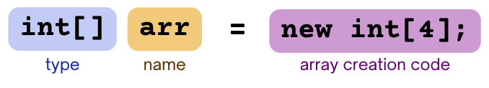
Arrays
The type of an array is ElementType[]
ElementType can be any type!
Can store multiple elements of the same type
Need to specify length of array and type of elements it will store at creation
String[]
int[]
double[]
char[]
boolean[]

Slide 6
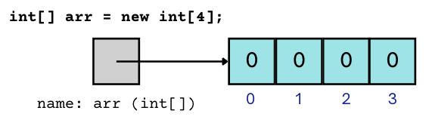
Arrays
The type of an array is ElementType[]
ElementType can be any type!
Can store multiple elements of the same type
Need to specify length of array and type of elements it will store at creation

Slide 7

2D Arrays
An array of arrays!
The ElementType of the array is another array itself!
Your first example of “nested data structures”
There will be more!
String[][]
int[][]
double[][]
char[][]
boolean[][]

Slide 8
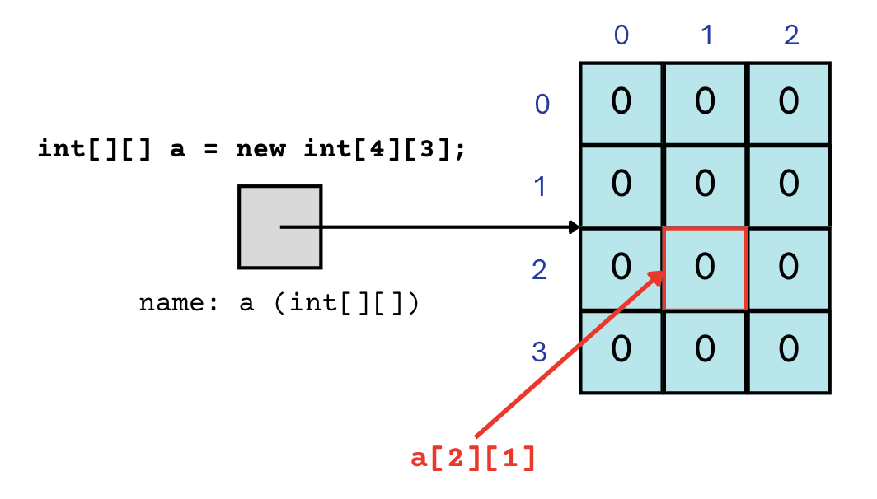
2D Arrays
An array of arrays!
The two dimensions are “rows” and “columns”

Slide 9
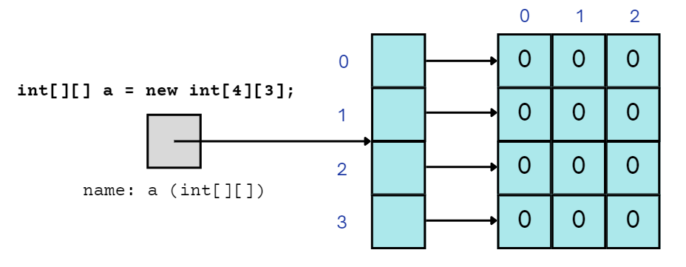
2D Arrays
A slightly more accurate view… thanks, reference semantics

Slide 10
2D Array Traversals
for (int i = 0; i < list.length; i++) {
for (int j = 0; j < list[i].length; j++) {
// do something with list[i][j]
}
}
for each row
for each element
23 | 96 | 18 | 4 | 64
45 | 40 | 18 | 44 | 34
92 | 13 | 77 | 71 | 12
23 | 96 | 18 | 4 | 64
45 | 40 | 18 | 44 | 34
92 | 13 | 77 | 71 | 12

Slide 11
Arrays Utility Class
Method | Description
Arrays.toString(array); | Returns a String representing the array, such as "[10, 30, -25, 17]"
Arrays.fill(array, value); | Sets every element to the given value
Arrays.equals(array1, array2); | Returns true if the two arrays contain the same elements in the same order
Arrays.deepToString(array); | Returns a String representing the array; if the array contains other arrays as elements, the String represents their contents, and so on. For example, "[[99, 151], [30, 5]]"
Arrays.deepEquals(array1, array2); | Returns true if the two arrays contain the same elements in the same order; if the array(s) contain other arrays as elements, their contents are tested for equality, and so on.

Slide 12
Applications of 2D Arrays
Matrices
Useful in various applications requiring complex math!
Board games
(e.g., chess/checkerboard, tic tac toe, sudoku)
Representing information in a grid or table
(e.g., scorekeeping, gradebook)
Image processing

Slide 13
matrixAdd
23 | 96 | 18 | 4 | 64
45 | 40 | 18 | 44 | 34
92 | 13 | 77 | 71 | 12
70 | 73 | 66 | 79 | 39
91 | 75 | 73 | 99 | 47
27 | 64 | 21 | 34 | 1
70 | 73 | 66 | 79 | 39
91 | 75 | 73 | 99 | 47
27 | 64 | 21 | 34 | 1

Slide 14
matrixAdd
23 | 96 | 18 | 4 | 64
45 | 40 | 18 | 44 | 34
92 | 13 | 77 | 71 | 12
70 | 73 | 66 | 79 | 39
91 | 75 | 73 | 99 | 47
27 | 64 | 21 | 34 | 1
70 | 73 | 66 | 79 | 39
91 | 75 | 73 | 99 | 47
27 | 64 | 21 | 34 | 1

Slide 15
matrixAdd
23 | 96 | 18 | 4 | 64
45 | 40 | 18 | 44 | 34
92 | 13 | 77 | 71 | 12
93
70 | 73 | 66 | 79 | 39
91 | 75 | 73 | 99 | 47
27 | 64 | 21 | 34 | 1

Slide 16
matrixAdd
23 | 96 | 18 | 4 | 64
45 | 40 | 18 | 44 | 34
92 | 13 | 77 | 71 | 12
93 | 169
70 | 73 | 66 | 79 | 39
91 | 75 | 73 | 99 | 47
27 | 64 | 21 | 34 | 1

Slide 17
matrixAdd
23 | 96 | 18 | 4 | 64
45 | 40 | 18 | 44 | 34
92 | 13 | 77 | 71 | 12
93 | 169 | 84
70 | 73 | 66 | 79 | 39
91 | 75 | 73 | 99 | 47
27 | 64 | 21 | 34 | 1

Slide 18
matrixAdd
23 | 96 | 18 | 4 | 64
45 | 40 | 18 | 44 | 34
92 | 13 | 77 | 71 | 12
93 | 169 | 84 | 83
70 | 73 | 66 | 79 | 39
91 | 75 | 73 | 99 | 47
27 | 64 | 21 | 34 | 1

Slide 19
matrixAdd
23 | 96 | 18 | 4 | 64
45 | 40 | 18 | 44 | 34
92 | 13 | 77 | 71 | 12
93 | 169 | 84 | 83 | 103
70 | 73 | 66 | 79 | 39
91 | 75 | 73 | 99 | 47
27 | 64 | 21 | 34 | 1

Slide 20
matrixAdd
23 | 96 | 18 | 4 | 64
45 | 40 | 18 | 44 | 34
92 | 13 | 77 | 71 | 12
93 | 169 | 84 | 83 | 103
136
70 | 73 | 66 | 79 | 39
91 | 75 | 73 | 99 | 47
27 | 64 | 21 | 34 | 1

Slide 21
matrixAdd
23 | 96 | 18 | 4 | 64
45 | 40 | 18 | 44 | 34
92 | 13 | 77 | 71 | 12
93 | 169 | 84 | 83 | 103
136 | 115
70 | 73 | 66 | 79 | 39
91 | 75 | 73 | 99 | 47
27 | 64 | 21 | 34 | 1

Slide 22
matrixAdd
23 | 96 | 18 | 4 | 64
45 | 40 | 18 | 44 | 34
92 | 13 | 77 | 71 | 12
93 | 169 | 84 | 83 | 103
136 | 115 | 91
70 | 73 | 66 | 79 | 39
91 | 75 | 73 | 99 | 47
27 | 64 | 21 | 34 | 1

Slide 23
matrixAdd
23 | 96 | 18 | 4 | 64
45 | 40 | 18 | 44 | 34
92 | 13 | 77 | 71 | 12
93 | 169 | 84 | 83 | 103
136 | 115 | 91 | 143
70 | 73 | 66 | 79 | 39
91 | 75 | 73 | 99 | 47
27 | 64 | 21 | 34 | 1

Slide 24
matrixAdd
23 | 96 | 18 | 4 | 64
45 | 40 | 18 | 44 | 34
92 | 13 | 77 | 71 | 12
93 | 169 | 84 | 83 | 103
136 | 115 | 91 | 143 | 81
70 | 73 | 66 | 79 | 39
91 | 75 | 73 | 99 | 47
27 | 64 | 21 | 34 | 1

Slide 25
matrixAdd
23 | 96 | 18 | 4 | 64
45 | 40 | 18 | 44 | 34
92 | 13 | 77 | 71 | 12
93 | 169 | 84 | 83 | 103
136 | 115 | 91 | 143 | 81
119
70 | 73 | 66 | 79 | 39
91 | 75 | 73 | 99 | 47
27 | 64 | 21 | 34 | 1

Slide 26
matrixAdd
23 | 96 | 18 | 4 | 64
45 | 40 | 18 | 44 | 34
92 | 13 | 77 | 71 | 12
93 | 169 | 84 | 83 | 103
136 | 115 | 91 | 143 | 81
119 | 77
70 | 73 | 66 | 79 | 39
91 | 75 | 73 | 99 | 47
27 | 64 | 21 | 34 | 1

Slide 27
matrixAdd
23 | 96 | 18 | 4 | 64
45 | 40 | 18 | 44 | 34
92 | 13 | 77 | 71 | 12
93 | 169 | 84 | 83 | 103
136 | 115 | 91 | 143 | 81
119 | 77 | 98
70 | 73 | 66 | 79 | 39
91 | 75 | 73 | 99 | 47
27 | 64 | 21 | 34 | 1

Slide 28
matrixAdd
23 | 96 | 18 | 4 | 64
45 | 40 | 18 | 44 | 34
92 | 13 | 77 | 71 | 12
93 | 169 | 84 | 83 | 103
136 | 115 | 91 | 143 | 81
119 | 77 | 98 | 105
70 | 73 | 66 | 79 | 39
91 | 75 | 73 | 99 | 47
27 | 64 | 21 | 34 | 1

Slide 29
matrixAdd
23 | 96 | 18 | 4 | 64
45 | 40 | 18 | 44 | 34
92 | 13 | 77 | 71 | 12
93 | 169 | 84 | 83 | 103
136 | 115 | 91 | 143 | 81
119 | 77 | 98 | 105 | 13
70 | 73 | 66 | 79 | 39
91 | 75 | 73 | 99 | 47
27 | 64 | 21 | 34 | 1

Slide 30
matrixAdd
23 | 96 | 18 | 4 | 64
45 | 40 | 18 | 44 | 34
92 | 13 | 77 | 71 | 12
93 | 169 | 84 | 83 | 103
136 | 115 | 91 | 143 | 81
119 | 77 | 98 | 105 | 13
70 | 73 | 66 | 79 | 39
91 | 75 | 73 | 99 | 47
27 | 64 | 21 | 34 | 1

Slide 31
Lecture Outline
Announcements
2D Arrays Review
Images
Images with 2D Arrays!

Slide 32

Images
From the computer’s perspective, images are just a big grid of values called pixels.
Each pixel shows a different color based on a specified value.
+
(0,0)
+
Also Pixel

Slide 33
Images
If images are just grids of pixels, and we can think of 2D arrays as grids,
We can represent images as 2D arrays of pixels!
Further, since each pixel is shown as a specific color,
We can represent images as 2D arrays of colors!

Slide 34
Images in Java
Picture.java
Represents the idea of a picture in your program
Color.java
Represents colors in your program!
Uses the RGB color scheme where each color is made up of some amount (0-255) of red, green, and blue

Slide 35


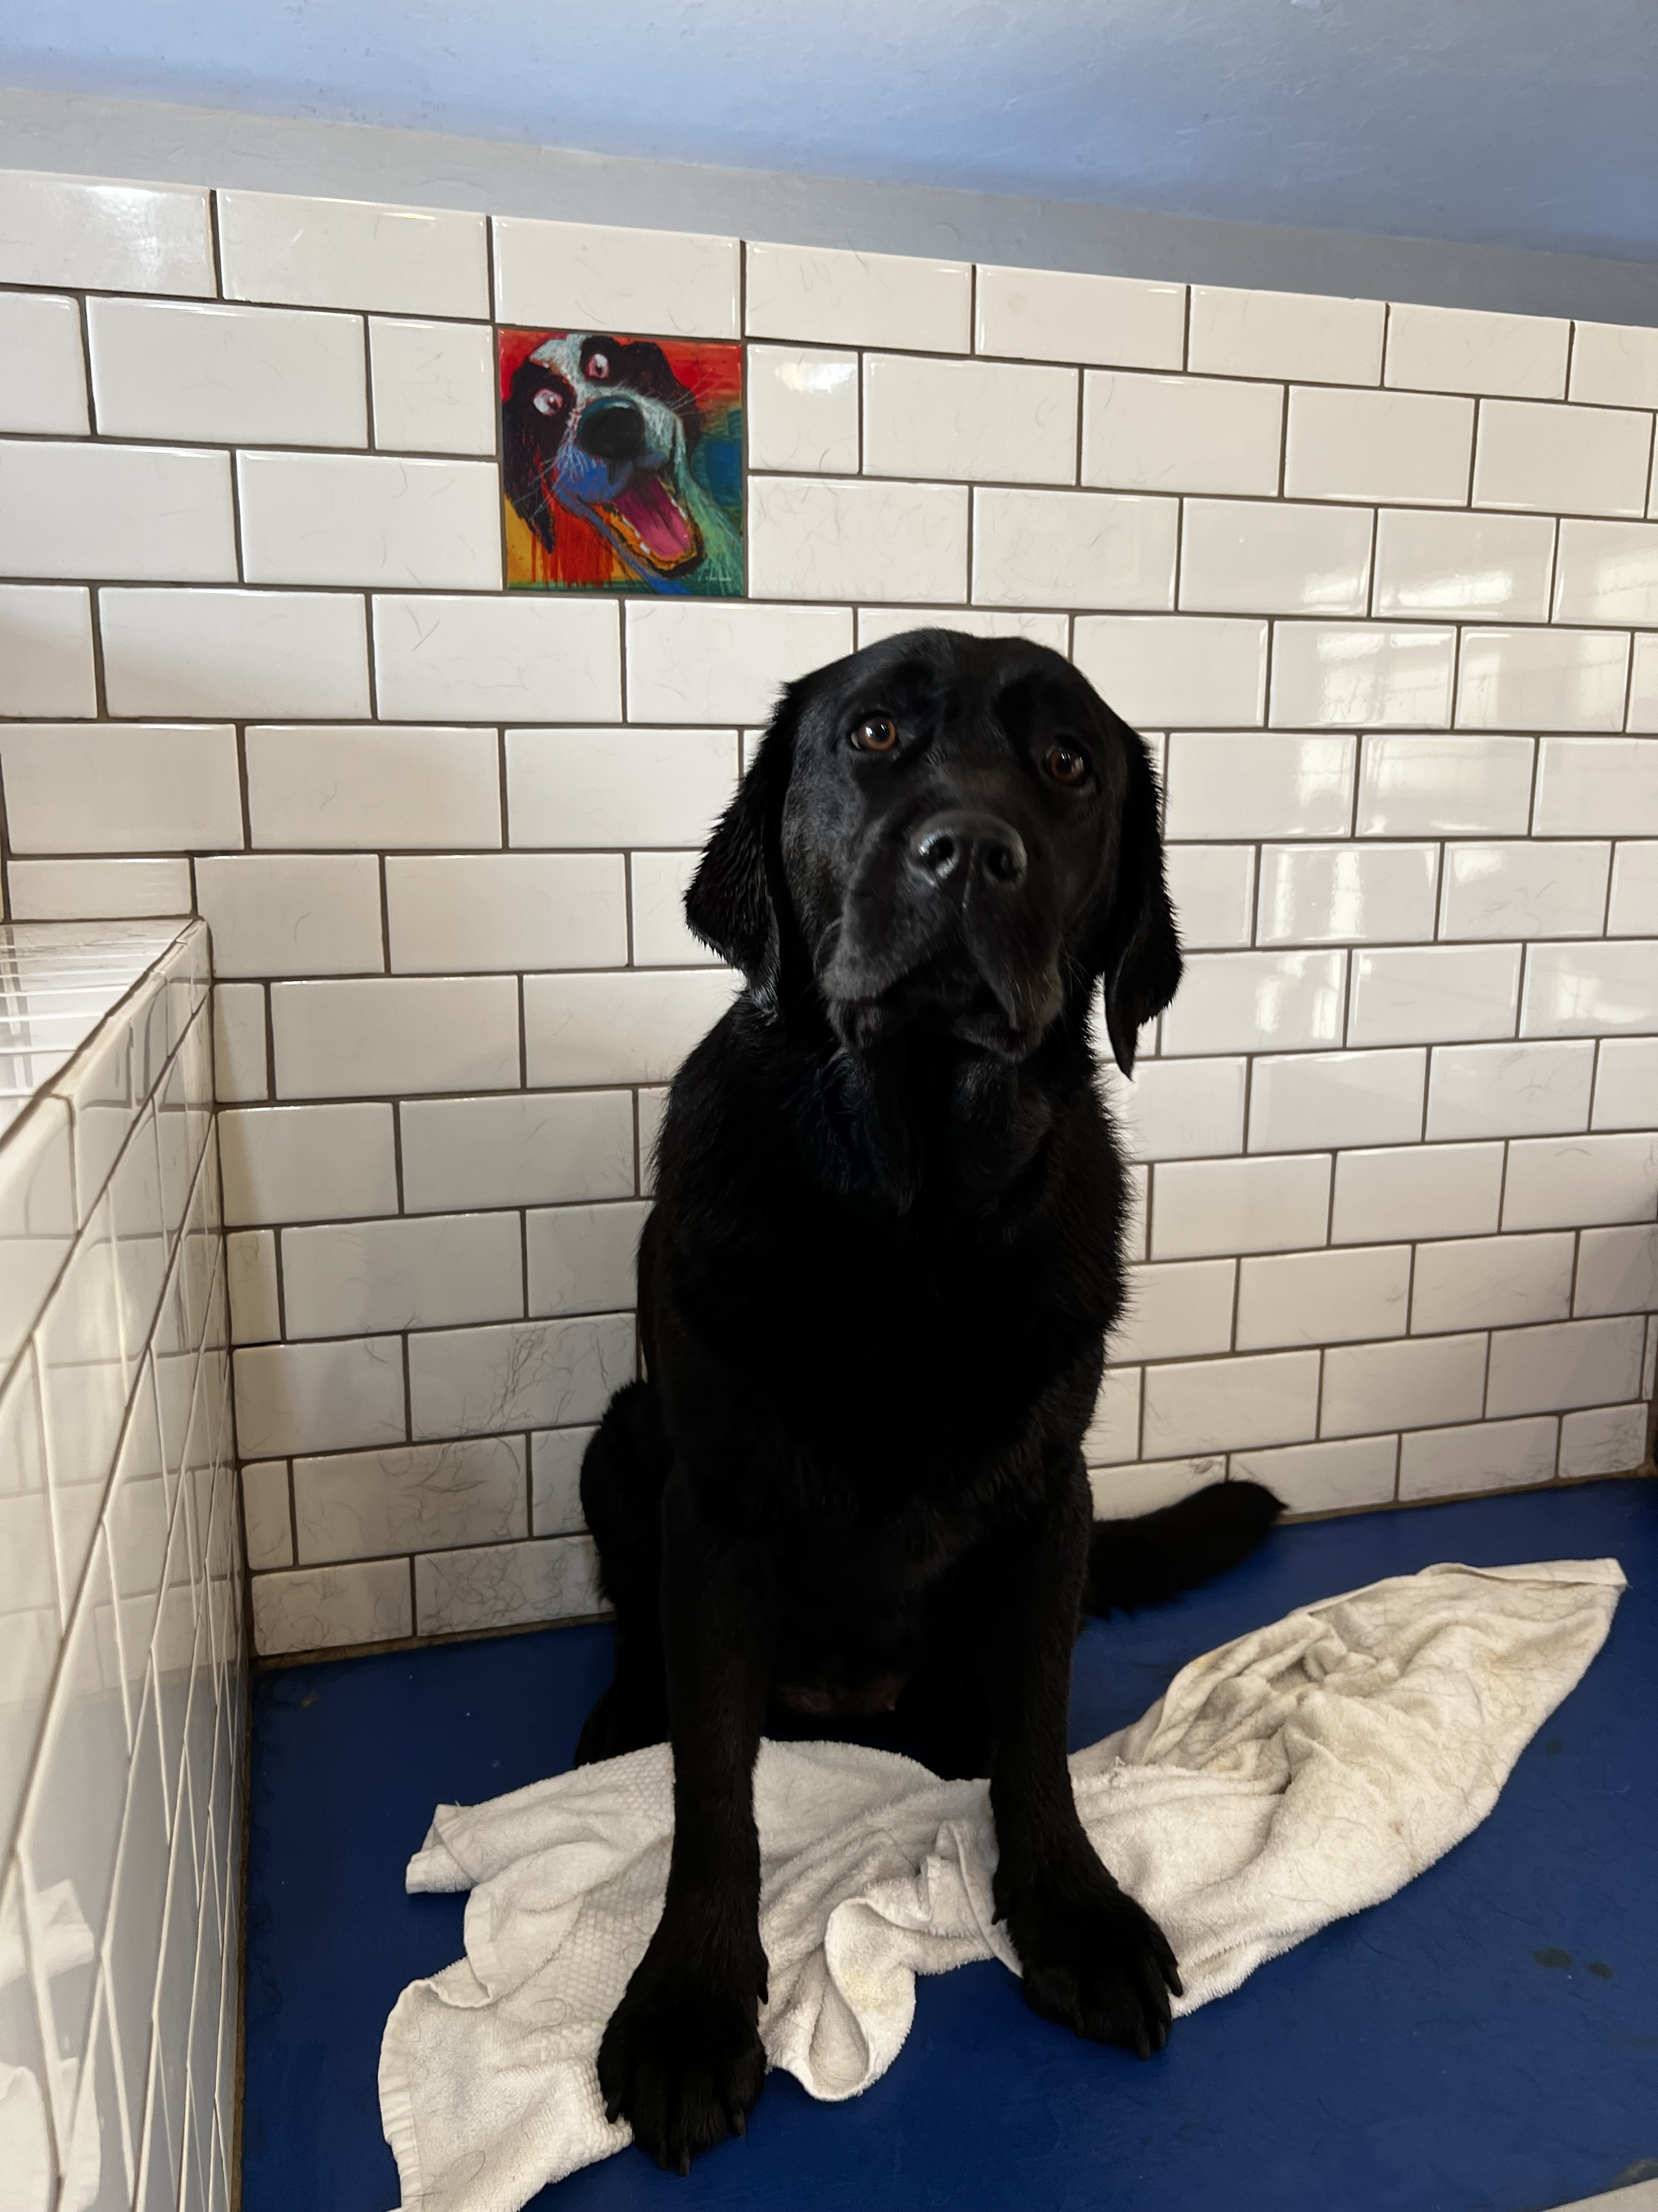

A Test Subject

Slide 36
Images in Java: Picture.java
Picture pic = new Picture("gigi.jpeg");
* This functionality doesn’t work perfectly on Ed, it’s probably easier to use the save() method!
Methods | Descriptions
pic.getPixels(); | Returns a Color[][] representing the colors in the grid of pixels.
pic.setPixels(colorArray); | Sets the grid of pixels in the picture based on the given colorArray.
pic.save(fileName); | Saves the current picture to a file with the given fileName.
pic.show(); | Shows the current picture in a window on the screen.*

Slide 37
Images in Java: Color.java
Color color = new Color(redVal, greenVal, blueVal);
Methods | Descriptions
color.getRed(); | Returns the color amount for red.
color.getGreen(); | Returns the color amount for green.
color.getBlue(); | Returns the color amount for blue.

Slide 38
Lecture Outline
Announcements
2D Arrays Review
Images
Images with 2D Arrays!

