Slide 1

Stacks & Queues
Practice
BEFORE WE START
Talk to your neighbors:
What’s your favorite animal? And why?
Music: Bad Thing Twice – Carly Rae Jepsen

Slide 2
Lecture Outline
Announcements
Quick Recap
copyStack Review
Structured Example: spliceStack

Slide 3
Announcements
Quiz 0
  Dropping Question 3 from quiz!
P0 feedback was released yesterday (Thanks TAs!)
  Resubmission logistics posted soon
P1 released today
  Due next Thursday, October 19th by 11:59 PM

Slide 4
Lecture Outline
Announcements
Quick Recap
copyStack Review
Structured Example: spliceStack

Slide 5
Stacks & Queues
Some collections are constrained, only use optimized operations
  Stack: retrieves elements in reverse order as added
  Queue: retrieves elements in same order as added
push
pop
👀 peek
top | 3
 | 2
bottom | 1
front |  | back
1 | 2 | 3
👀 peek
remove
add
queue
stack

Slide 6
Programming with Queues
add(value) | places given value at back of queue
remove() | removes value from front of queue and returns it; throws a NoSuchElementException if queue is empty
peek() | returns front value from queue without removing it; returns null if queue is empty
size() | returns number of elements in queue
isEmpty() | returns true if queue has no elements
17
-3
42
  Queue<Integer> q = new LinkedList<Integer>();
  q.add(42);
  q.add(-3);
  q.add(17);
  System.out.println(q.remove());
  🚨 IMPORTANT: When constructing a queue you must use a new LinkedList object instead of a new Queue object. (More on that with Interfaces.)

Slide 7
Programming with Stacks
Stack<E>() | constructs a new stack with elements of type E
push(value) | places given value on top of stack
pop() | removes top value from stack and returns it; throws EmptyStackException if stack is empty
peek() | returns top value from stack without removing it; throws EmptyStackException if stack is empty
size() | returns number of elements in stack
isEmpty() | returns true if stack has no elements
"c"
"b"
"a"
  Stack<String> s = new Stack<String>();
  s.push("a");
  s.push("b");
  s.push("c");
  System.out.println(s.pop());
  Stack has other methods that we will ask you not to use 😬

Slide 8
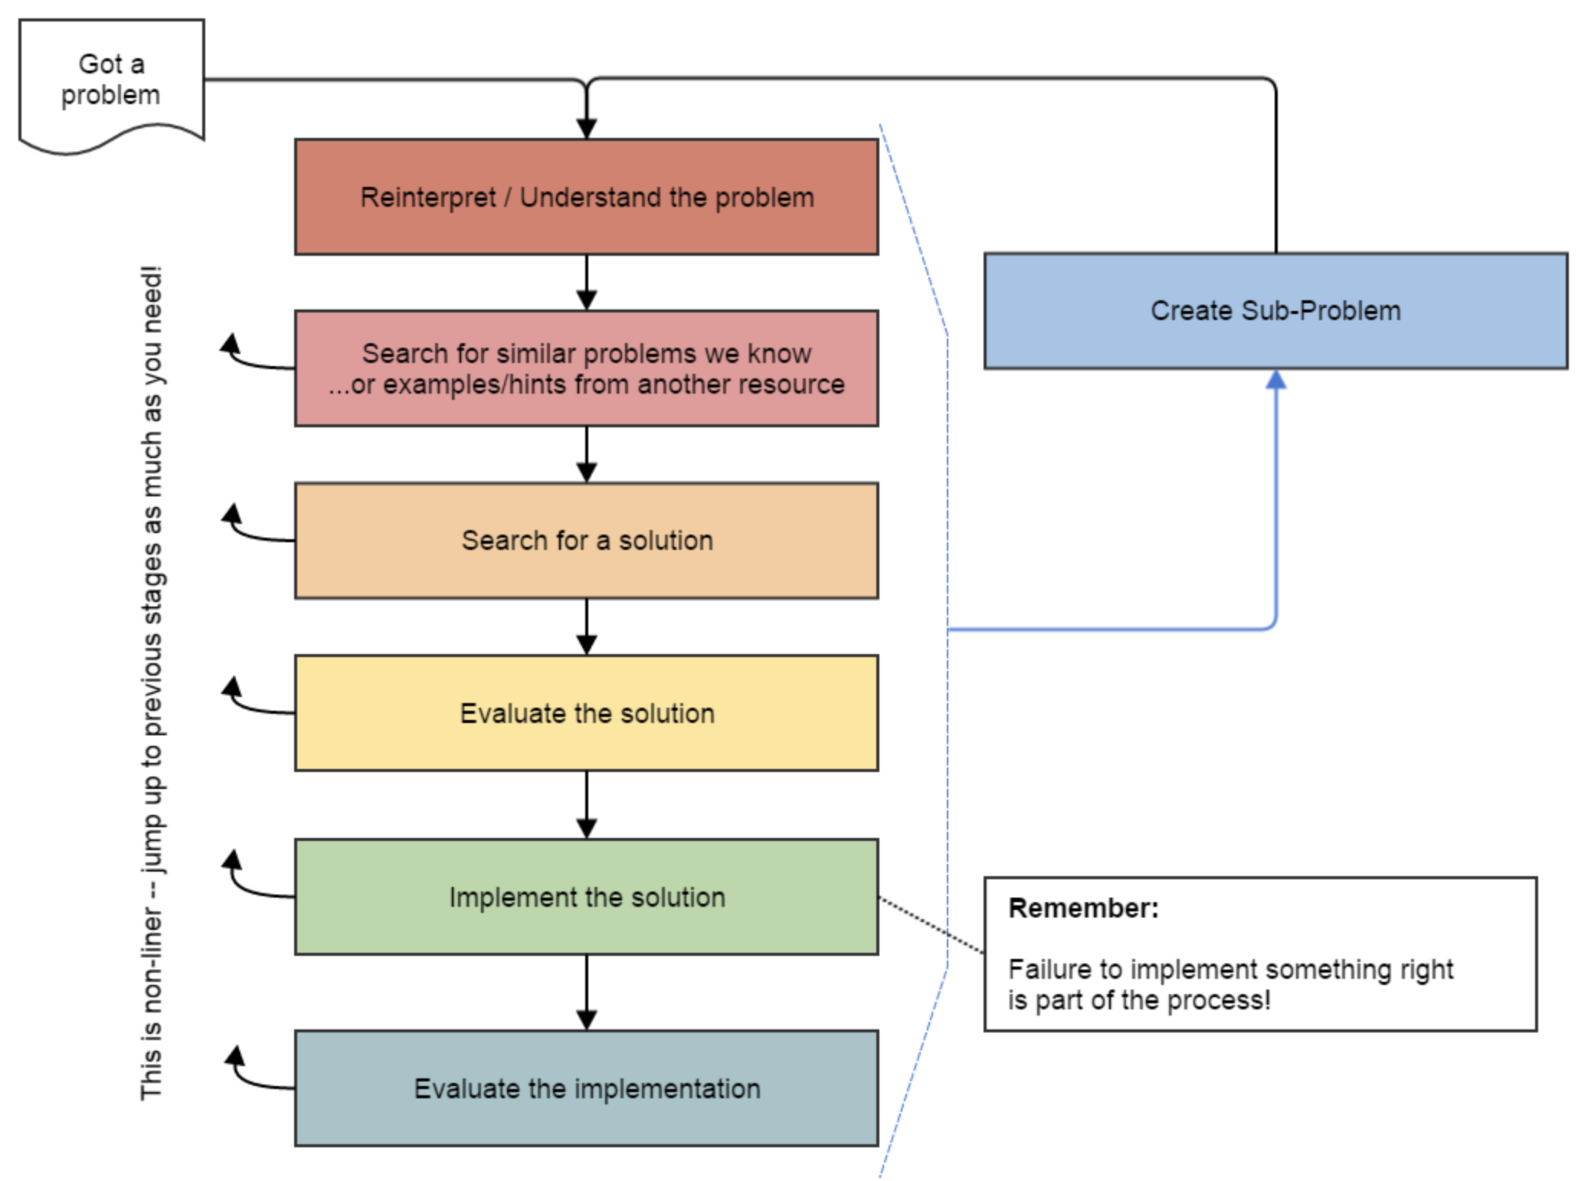
Fundamental Data Structures ➔ Problem Solving
On their own, Stacks & Queues are
quite simple with practice
(few methods, simple model)
Some of the problems we ask are
complex because the tools you have
to solve them are restrictive
  sum(Stack) is hard with a Queue as
  the auxiliary structure
We challenge you on purpose here
to practice problem solving
Source: Oleson, Ko (2016) - Programming, Problem Solving, and Self-Awareness: Effects of Explicit Guidance

Slide 9
Common Problem-Solving Strategies
Analogy – Is this similar to a problem you’ve seen?
  sum(Stack) is probably a lot like sum(Queue), start there!
Brainstorming – Consider steps to solve problem before writing code
  Try to do an example “by hand” → outline steps
Solve Sub-Problems – Is there a smaller part of the problem to solve?
  Move to queue first
Debugging – Does your solution behave correctly on the example input.
  Test on input from specification
  Test edge cases (“What if the Stack is empty?”)
Iterative Development – Can we start by solving a different problem that is easier?
  Just looping over a queue and printing elements

Slide 10
Metacognition
Metacognition: asking questions about your solution process.
Examples:
  While debugging: explain to yourself why you’re making this change to your program.
  Before running your program: make an explicit prediction of what you expect to see.
  When coding: be aware when you’re not making progress, so you can take a break or try a different strategy.
  When designing:
    Explain the tradeoffs with using a different data structure or algorithm.
    If one or more requirements change, how would the solution change as a result?
    Reflect on how you ruled out alternative ideas along the way to a solution.
  When studying: what is the relationship of this topic to other ideas in the course?

Slide 11
Common Stack & Queue Patterns
Stack → Queue and Queue → Stack
  We give you helper methods for this on problems
Reverse a Stack with a S→Q + Q→S
“Cycling” a queue: Inspect each element by repeatedly removing and adding to back size times
  Careful: Watch your loop bounds when queue’s size changes
A ”splitting” loop that moves some values to the Stack and others to the Queue

Slide 12
Lecture Outline
Announcements
Quick Recap
copyStack Review
Structured Example: spliceStack

Slide 13
sumStack
3
2
sum =
5
6
3
1
s
q

Slide 14
copyStack
Write a method copyStack that takes a stack of integers as a parameter and returns a copy of the original stack (i.e., a new stack with the same values as the original, stored in the same order as the original).
Your method should create the new stack and fill it up with the same values that are stored in the original stack. It is not acceptable to return the same stack passed to the method; you must create, fill, and return a new stack.
You may use one queue as auxiliary storage.

Slide 15
copyStack
3
2
1
s
q
s2
1
2
3

Slide 16
Lecture Outline
Announcements
Quick Recap
copyStack Review
Structured Example: spliceStack

Slide 17
spliceStack
Write a method called spliceStack that takes as parameters a stack of integers s, a start position i, and an ending position j, and that removes a sequence of elements from s starting at the i’th element from the bottom of the stack up to (but not including) the j’th element from the bottom of the stack (where position 0 is the bottom of the stack), returning these values in a new stack. The ordering of elements in both stacks should be preserved.
top
 | 8 | 4
 | 1 | 3
 | 3 | 2
 | 4 | 1
bottom | 1 | 0
top
 | 3
bottom | 4
spliceStack(s, 1, 3)
stack
New stack returned by method
s

