Slide 1
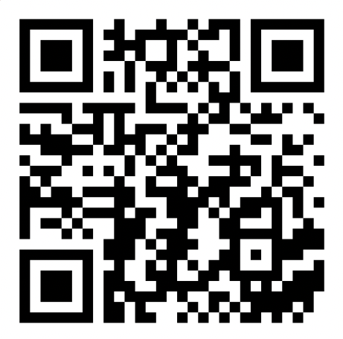
ArrayList
BEFORE WE START
Talk to your neighbors: Any weekend plans?
Music: New Romantics – Taylor Swift

Slide 2
Lecture Outline
Announcements
Warm Up
ArrayList Extended Application

Slide 3
Announcements
Quiz 0 next Tuesday, October 10th!
Topics: ArrayLists, Functional Decomposition
Taken in your registered quiz section
More details on quiz logistics in Ed announcement
Creative Assignment 0 (C0) out later today!
Due next Thursday, October 12th by 11:59 PM
P0 was due last night. How’d it go?
Being graded—expect grades back in a week-ish
Joined class late? Use Resubmission Cycle 0 to submit it!

Slide 4
Lecture Outline
Announcements
Warm Up
ArrayList Extended Application

Slide 5
addAll
Write a method called addAll that accepts two ArrayLists of Characters, list1 and list2 , and an integer location as parameters and inserts all of the elements from otherList into mainList at the specified location.

Slide 6
Lecture Outline
Announcements
Warm Up
ArrayList Extended Application

Slide 7
Movie Favorites
We will write a program called MovieFavorites.java that manages a list of favorite movies for a user (using an ArrayList) and allows the user to perform various different operations on their stored list of favorite movies.
Key skills used:
User Interaction (UI) loop
Iterative development strategies
Functional decomposition
Practice with ArrayList methods!

Slide 8
Movie Favorites: Operations
Load a list of favorites in from a file provided by the user.
Compare the stored list of favorites to another list of favorites provided by the user in another file.
Report the top n favorites according to the list, where the user can specify n.
Move a specific favorite down in the list.
Add a list of favorites in a user-provided file to the stored list of favorites at a specified location.
Save the current list of favorites to a file provided by the user.

Slide 9
Movie Favorites: Development Strategy
Set up the main scaffold code
Menu loop
Develop each operation, one at a time
You’ll see a similar development strategy in Creative Project 0’s specification — we recommend you follow it!

Slide 10
Movie Favorites: Operations
Load a list of favorites in from a file provided by the user.
Compare the stored list of favorites to another list of favorites provided by the user in another file.
Report the top n favorites according to the list, where the user can specify n.
Move a specific favorite down in the list.
Add a list of favorites in a user-provided file to the stored list of favorites at a specified location.
Save the current list of favorites to a file provided by the user.
ALREADY DONE!
See In-Class 2

