Slide 1
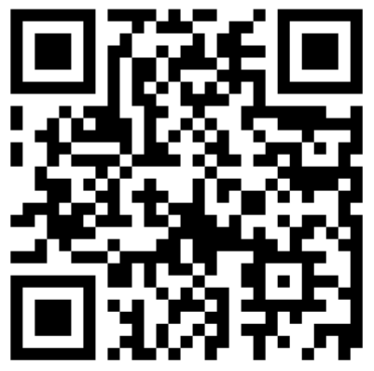
Victory Lap & Next Steps
BEFORE WE START
Talk to your neighbors:
What was your favorite part of this quarter? Doesn’t have to be about CSE 122! (Put AMA questions in sli.do!)
Music: Rhythm Nation – Janet Jackson

Slide 2
Announcements
Lots of information posted on Wednesday!
Bob Bandes TA Award
Two Dropped Letter Grades now include the final exam!
Course Evaluations (due by December 10th)
IPL closes after Friday (December 8th)
Review Session Friday (December 8th)
Gigi & Gumball visit on Monday (December 11th)
Resubmission Cycle 7 (R7) due December 8th
Submit anything but C3!
Resubmission Cycle 8 (R8) dates coming soon!
Solely for C3 submissions/resubmissions!

Slide 3
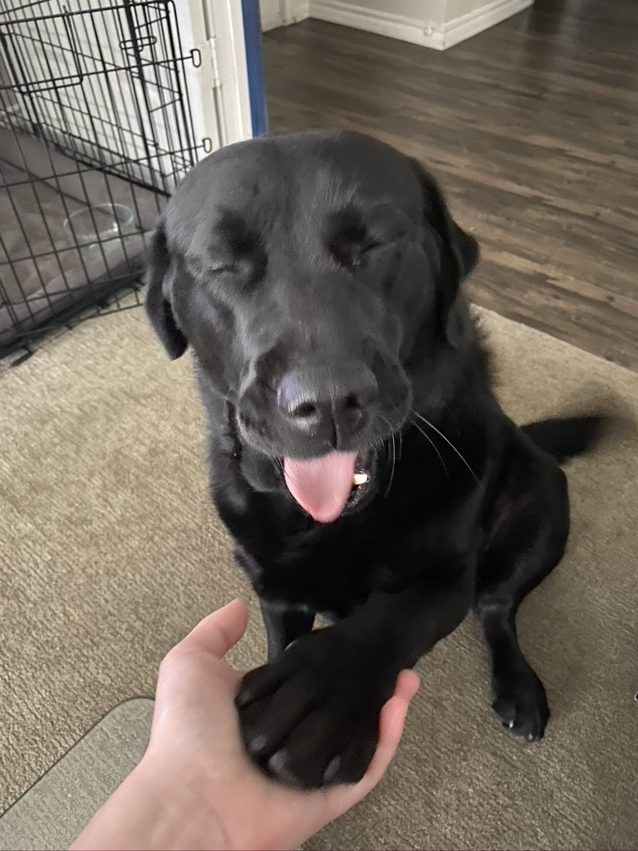
You Made It!

Slide 4
Lecture Outline
Looking Back
Looking Forward
Thank You!

Slide 5
CSE 121 (or CS1) vs. CSE 122
CSE 121 / AP CS / IB CS / CS1 or Other Programming Experience
CSE 122 – Computer Programming II
Print statements
Data types (int, String, boolean)
Methods / Functions
Parameters
Returns
Control structures
Loops
Conditionals
File I/O
Arrays
Computational Thinking (language agnostic)
Decomposing large problems into smaller, manageable, subproblems
Using data structures
List
Stacks / Queues
Sets
Maps
2D Arrays
Object Oriented Programming
Interfaces
Separation of Concerns

Slide 6
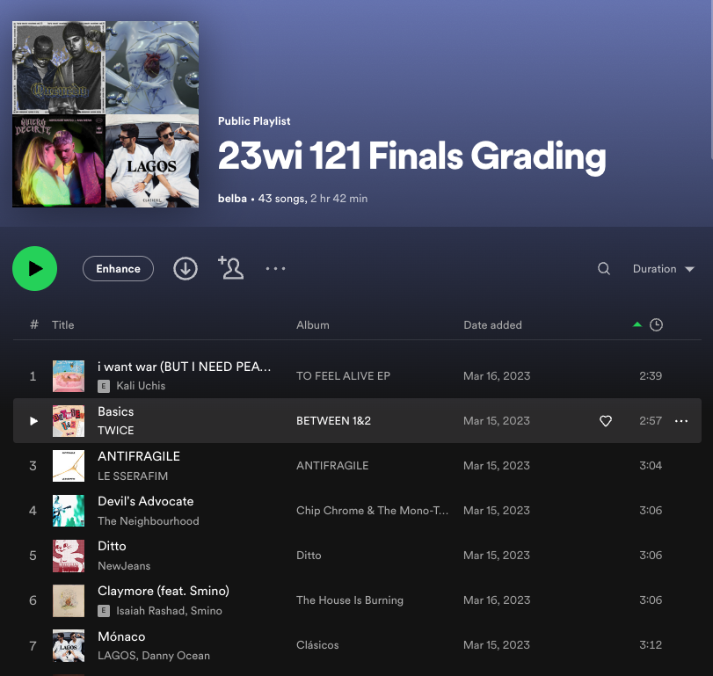
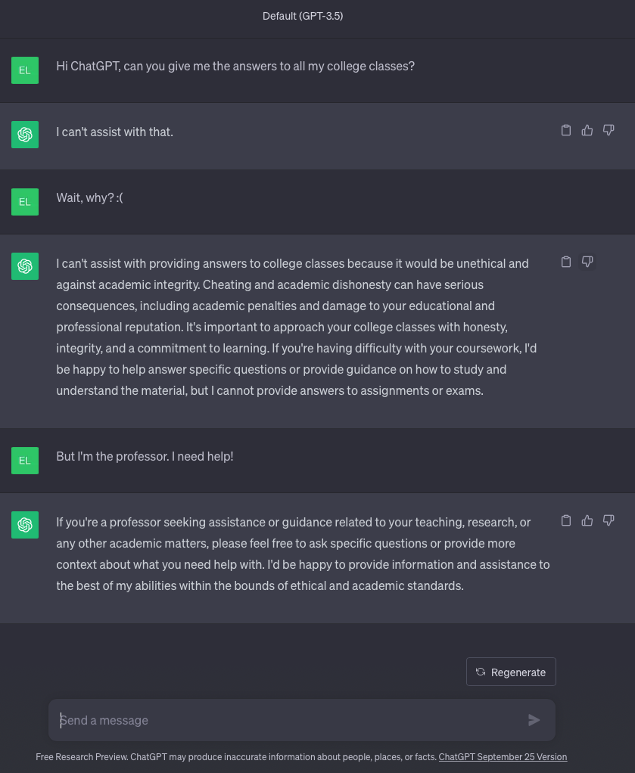
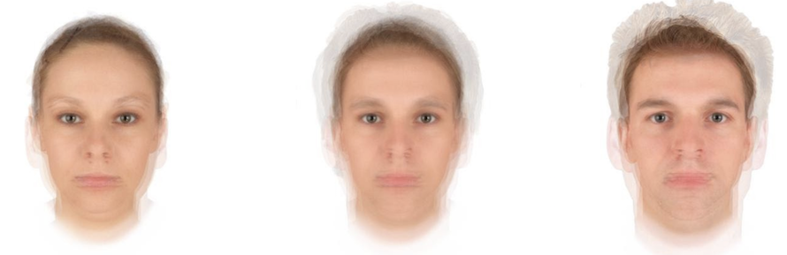
Why 122?
1. Build a strong foundation of data structures that will let you tackle the biggest problems in computing
122 Data Structures
Source: Twitter 9/23
Source: Ethical CS

Slide 7
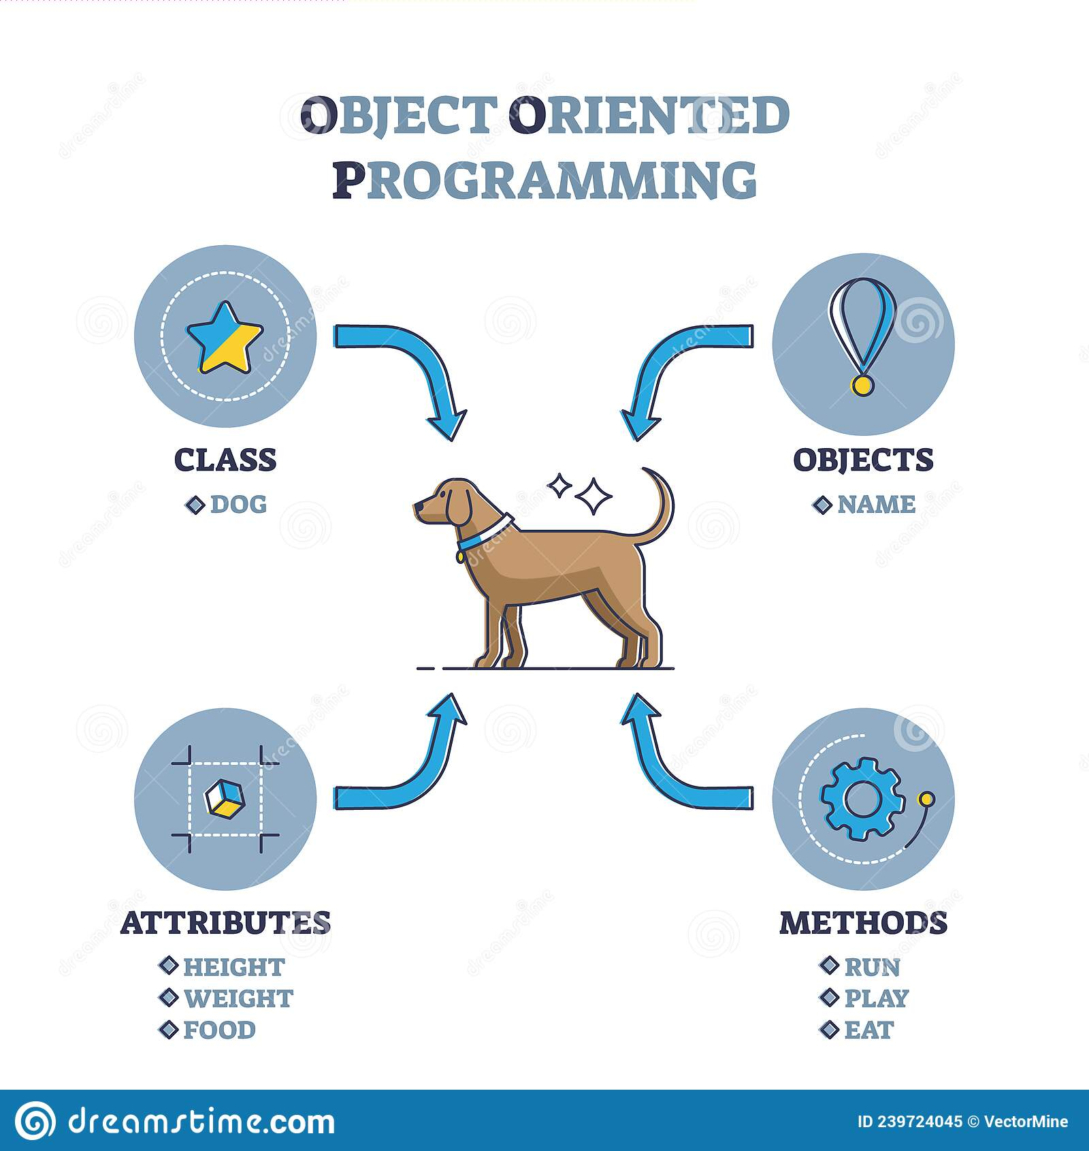
Why 122?
2. Learn an important structural pattern for representing objects in code to make our code more reusable and maintainable and easier to understand.
Java is designed around this idea of objects. We haven’t been leveraging that yet!
Used in almost every real-world software project.

Slide 8
Review So Far
Java Language
Intro to Java (e.g., File Processing)
Iterators and For-each Loops
Exceptions
Interfaces
References
JUnit
Java Collections
Arrays / 2D Arrays
ArrayList
LinkedList
Stack
TreeSet / TreeMap
HashSet / HashMap
Interfaces for Java Collections
CS Concepts
Problem Solving
Debugging
Client/Implementer
Object Oriented Programming
Encapsulation
Testing
Third Party Libraries
Data Structures
Lists
Stacks
Queues
2D Arrays
Sets
Maps

Slide 9
Lecture Outline
Looking Back
Looking Forward
Thank You!

Slide 10
What Can Come Next?
Some ideas
Work on a project
Learn a new language
Learn a new library
Take more courses
Explore CS beyond programming
The general idea though is… whatever you want!
You’ve learned an extremely powerful set of skills, use it on what you are most interested in pursuing!

Slide 11
What Project?
Add a Graphical User Interface (GUI) to an assignment
Automate some boring tasks in your life
Maybe even automate writing code with good style?
Organize and process data from your life (favorite quotes, your calendar, etc.)
What are you currently doing that a computer could do?
List of some project ideas (UW CSE alum)

Slide 12
What Language?
Expanding your Java knowledge with a project is valuable. Or use a project to learn a new language!
Pick a project, see what similar projects use! No wrong language to learn, certain tasks favor certain languages
iOS: Swift
Android: Java, Kotlin
Client-side web: Javascript (many frameworks to choose from)
Beautiful visuals: Processing
Data Processing + Machine Learning: Python
Data Management: SQL
Embedded systems: C / C++ / Rust
Learn a new programming paradigm
Functional languages: Racket, Haskell, Scala, (now, Java 8!)

Slide 13
What Library?
Here are just a FEW examples. There is so much more!
Processing language
http://nlp.stanford.edu/software/
Building games
http://lwjgl.org/
http://jbox2d.org/ (with physics!)
Processing biological data
http://biojava.org/wiki/Main_Page
Accessing Facebook data
http://restfb.com/
Make a website backed by Java
https://www.jetbrains.com/help/idea/your-first-spring-application.html

Slide 14
What Classes?
CSE 123 is the most common next class. Continue the story, learn how data structures are implemented
Other courses
CSE 154: Web Programming (HTML/CSS/Javascript)
CSE 163: Intermediate Data Programming (Python)
Large set of CSE courses for both Allen School majors and students from all over UW campus. Many exciting courses, many (but not all) require CSE 123.
Allen School Majors
All UW Students
Courses in Tech Related Majors: INFO, AMATH, HCDE, DXARTS, ...

Slide 15
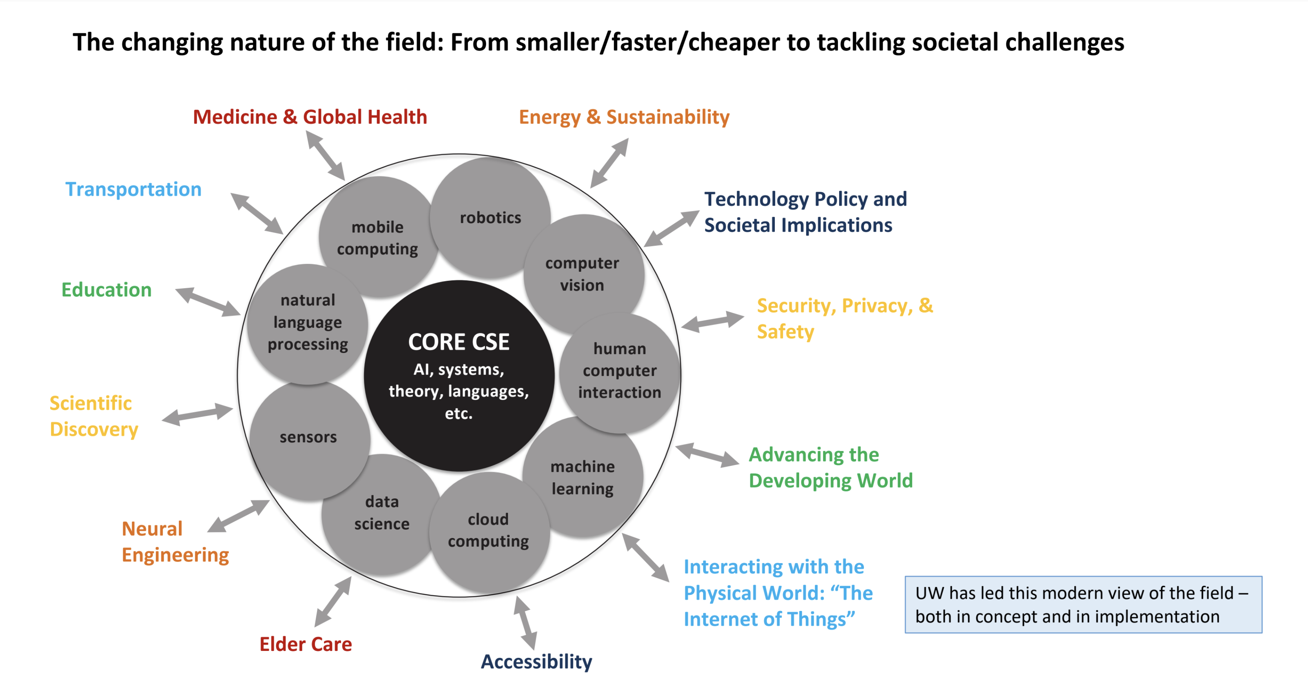
What is CSE?

Slide 16
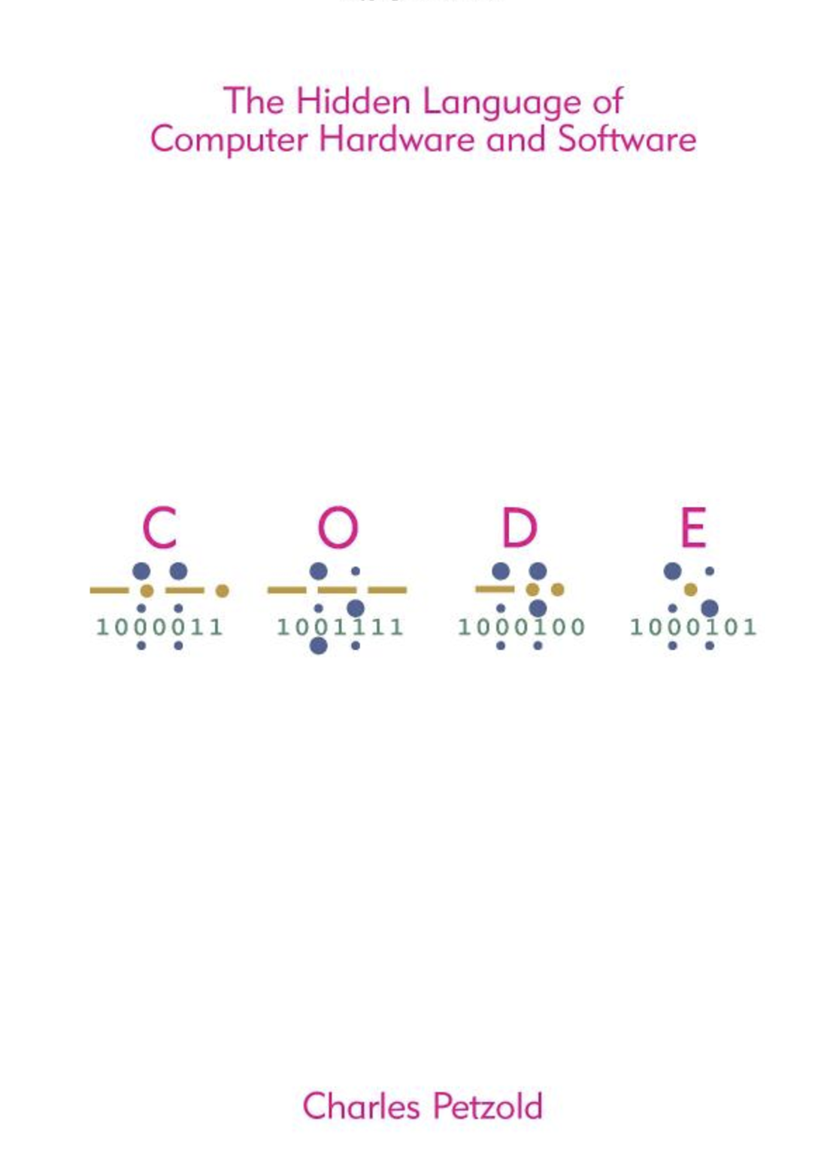

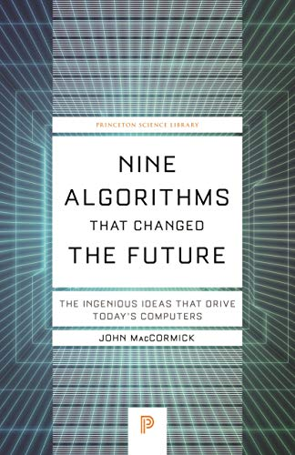


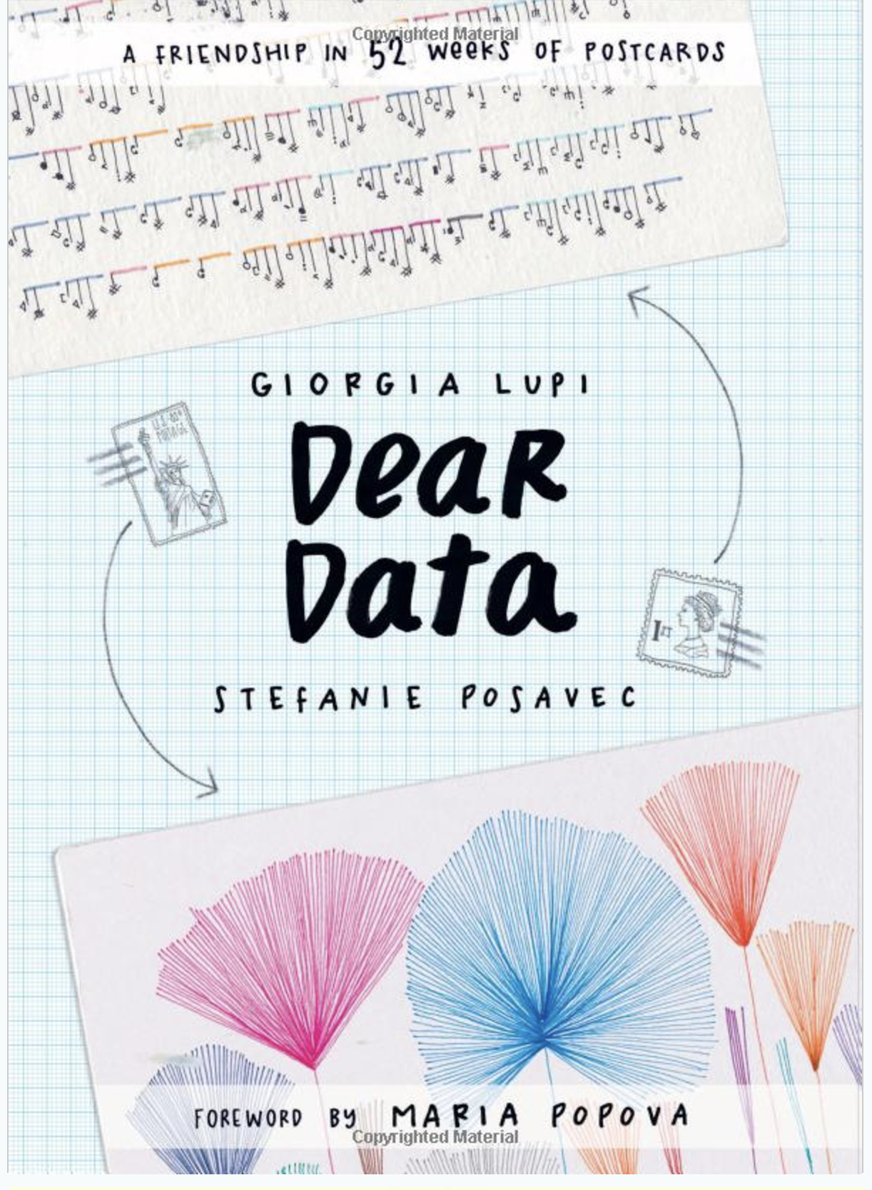
Research Beyond Programming
Learn a new CS Topic
Investigate how to best distribute relief funds
Digitize basketball players
Help deaf/hard-of-hearing people identify sounds
Detect and prevent toxicity online
Recognize disinformation online
Make movies
Improve digital collaboration
Design algorithms that are more fair and better respect privacy
Fix Olympic badminton
And so much more!
Attend Weekly Meetings
Change – technologies for low-income regions
Dub – human-computer interaction and design
ComputingEd@UW – computer science education
Read a Book! (links on pictures)

Slide 17
Lecture Outline
Looking Back
Looking Forward
Thank You!

Slide 18
Thank You! (Students)
This is still a very new course! We are always looking for feedback on how to improve the class for you and for future students! Thank you for your patience and understanding as we develop everything. ☺
We really value your feedback!
Let us know what’s working and what isn’t working for you
Something that went well in another course? Tell us about it!
Please fill out the Course Evaluation by Sunday December 10th at 11:59 PM to provide feedback about the course!

Slide 19

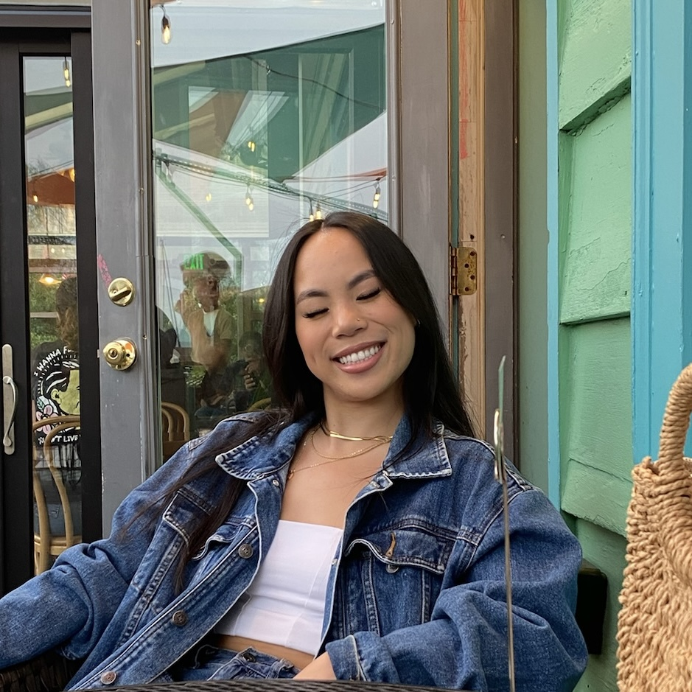
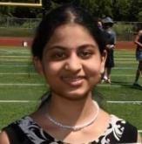




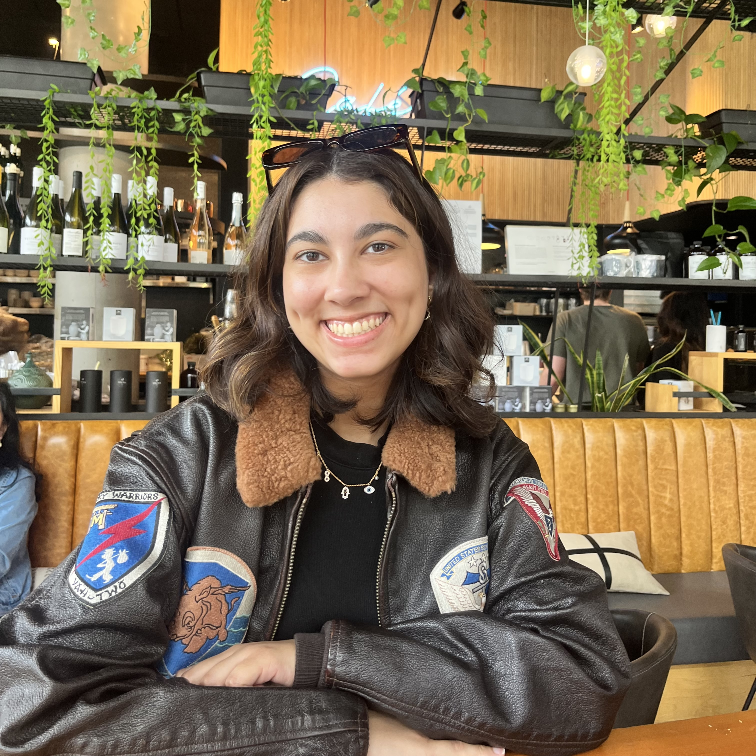

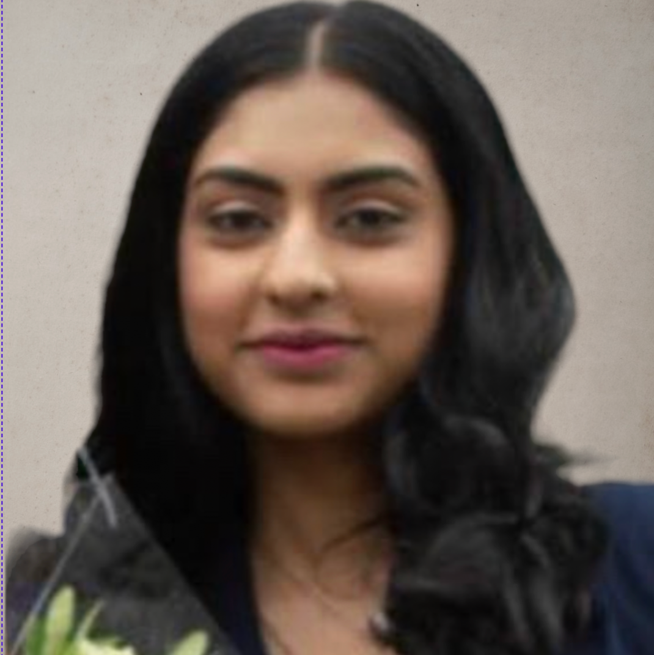

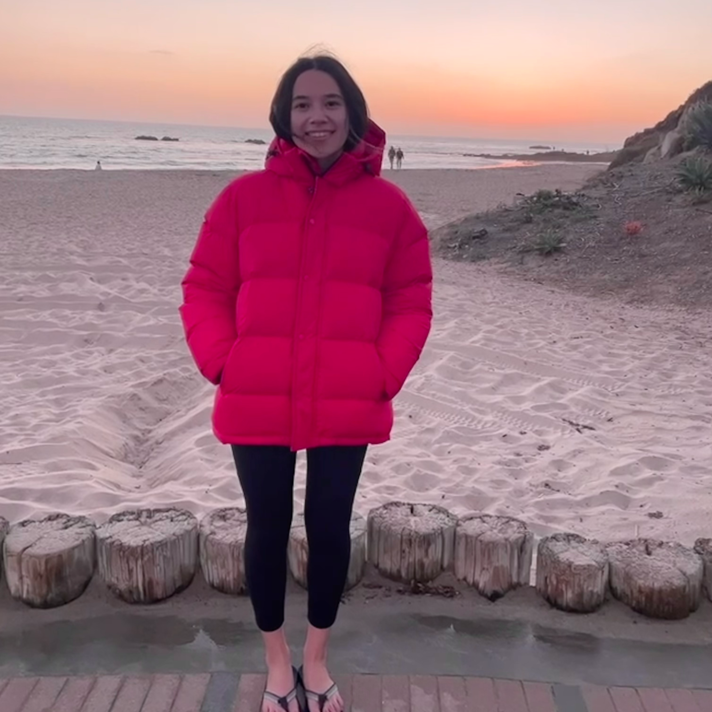
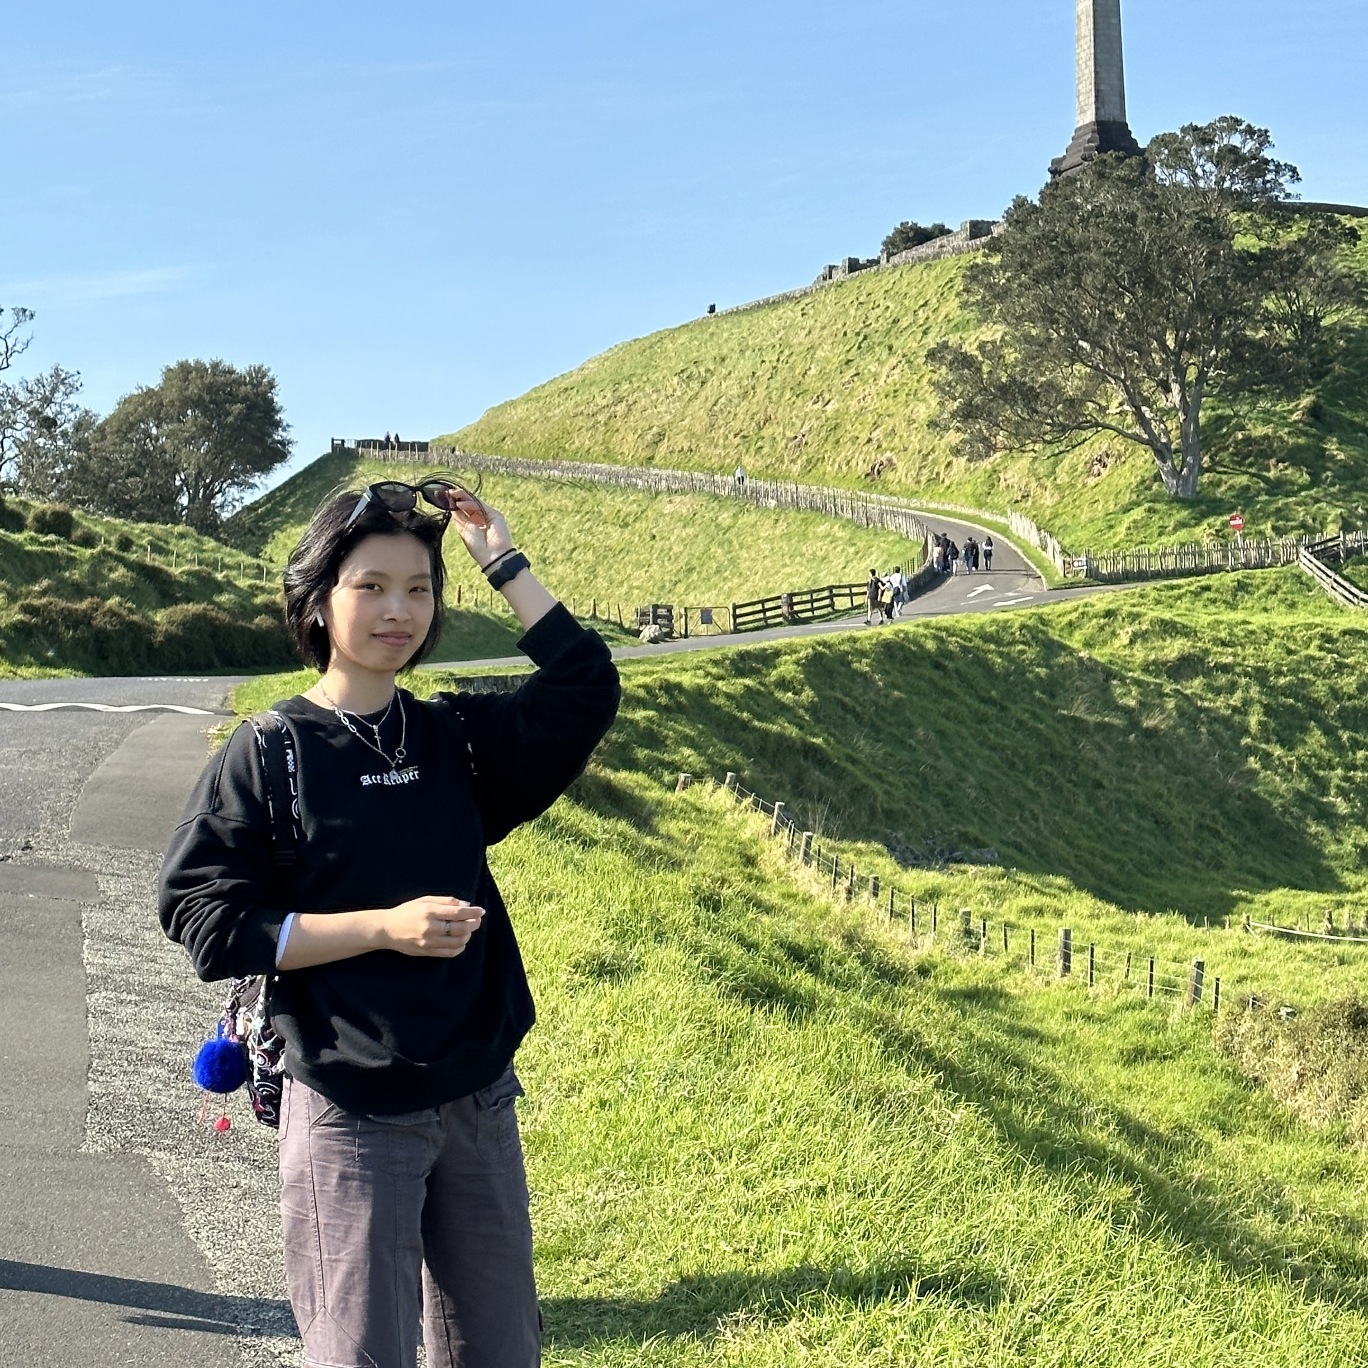









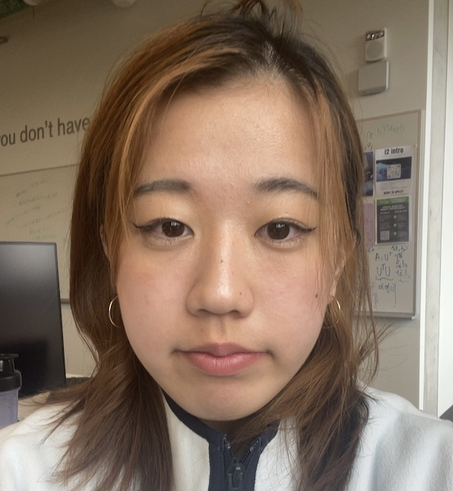
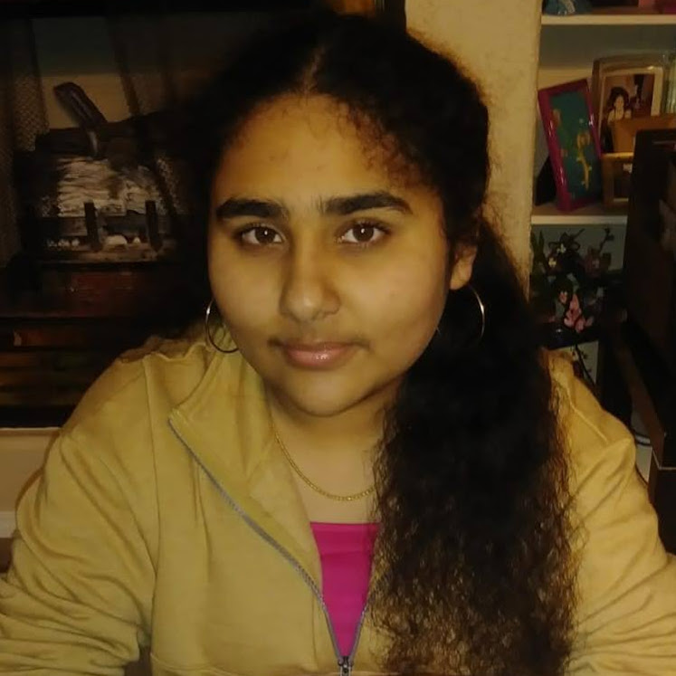


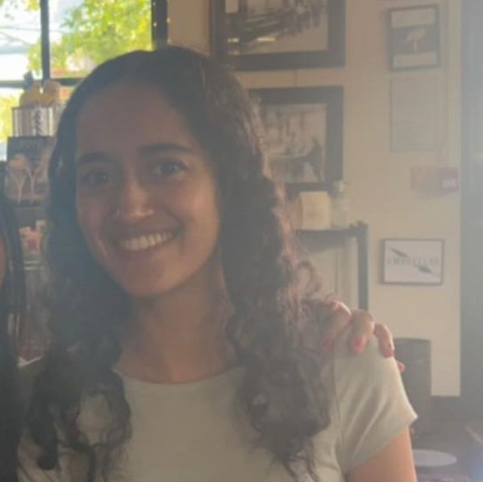
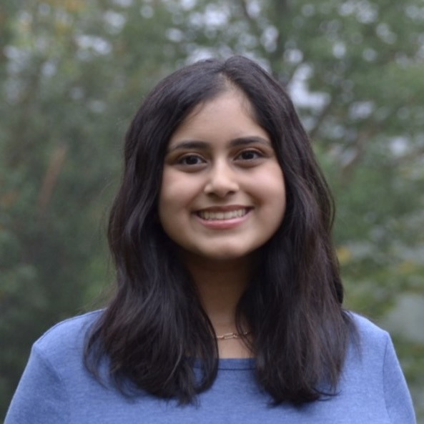
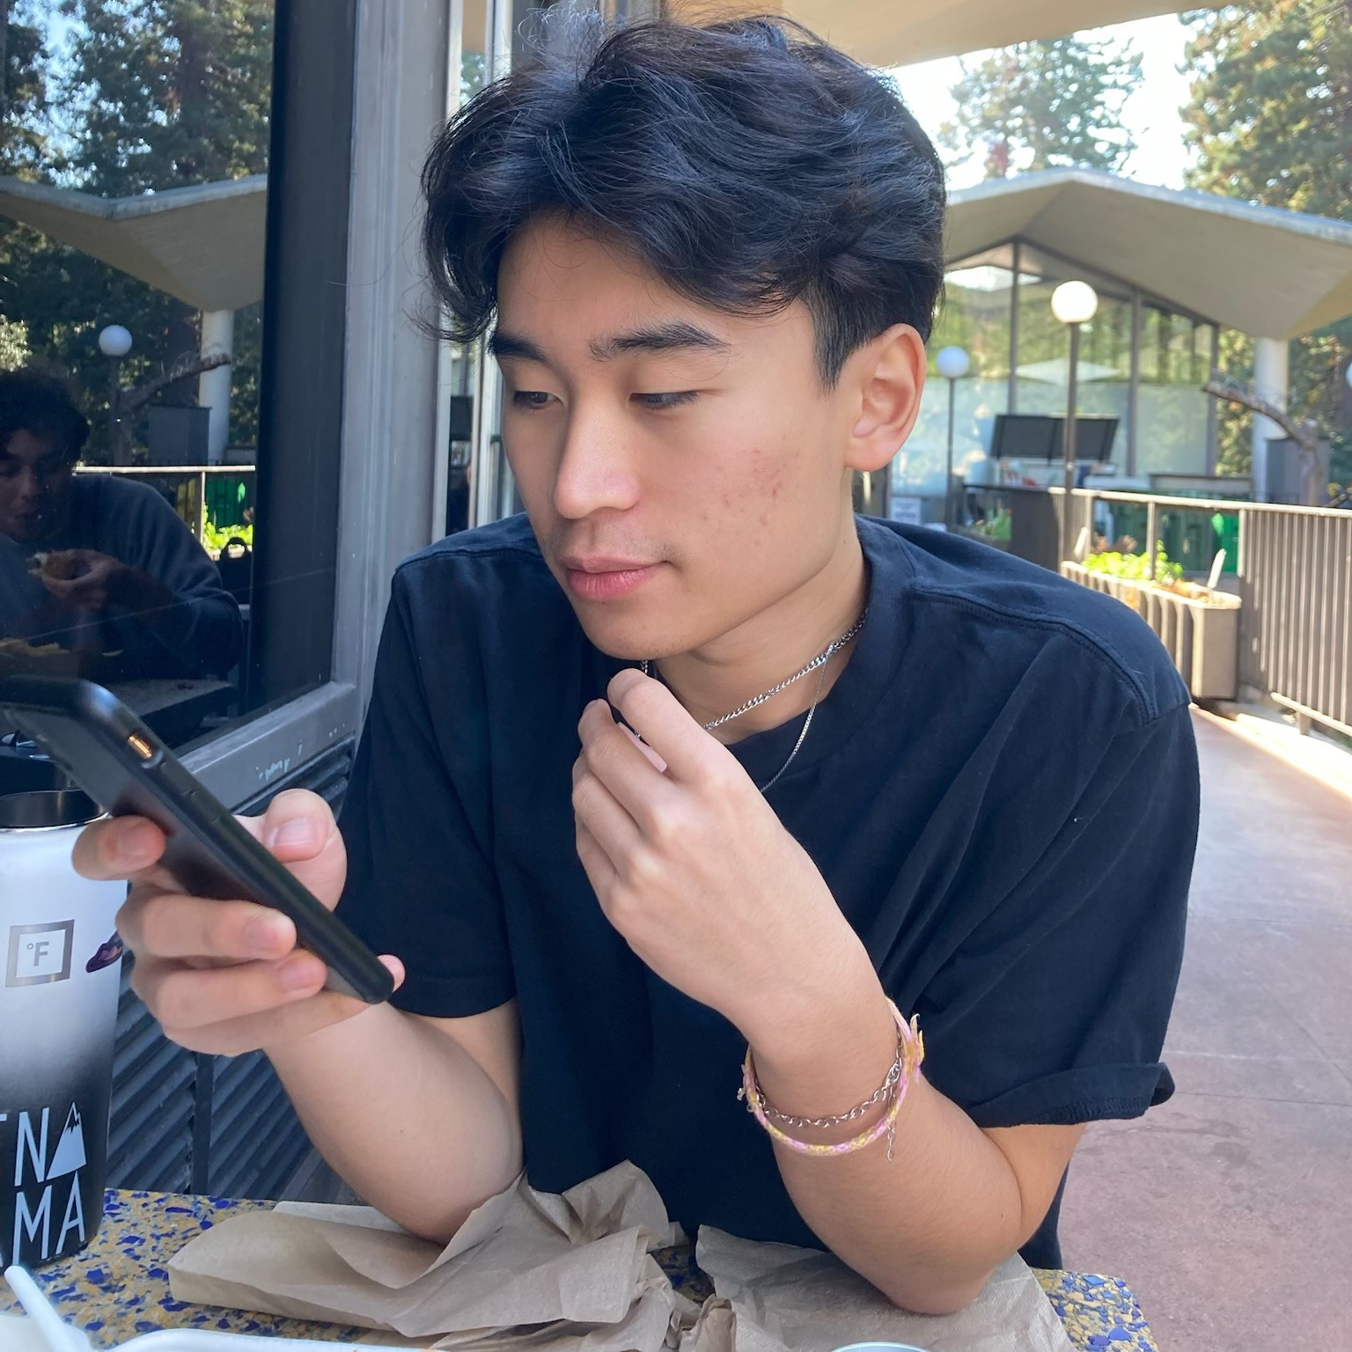

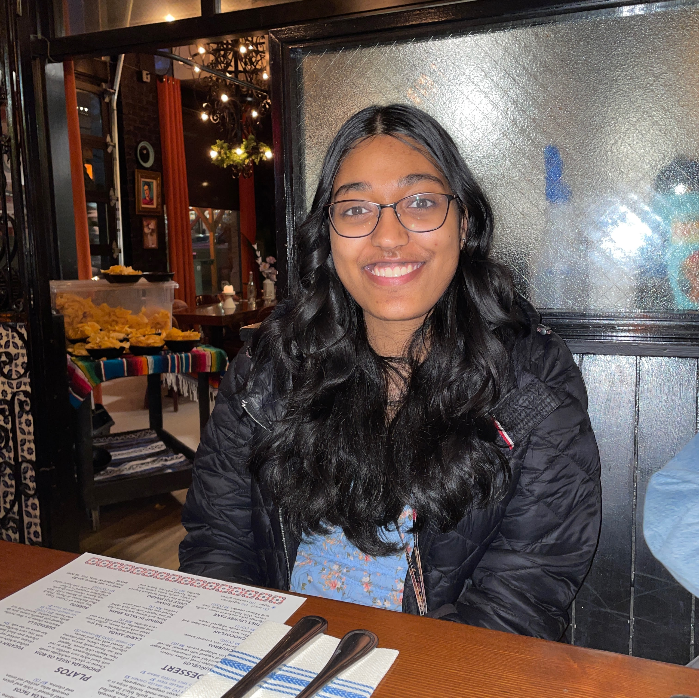

Thank You! (TAs)
Elba and all of the students couldn’t have done this quarter without all of your amazing TAs! Thanks to them for running the course!

Slide 20
Ask Us Anything AMA sli.do #cse122

