Slide 1
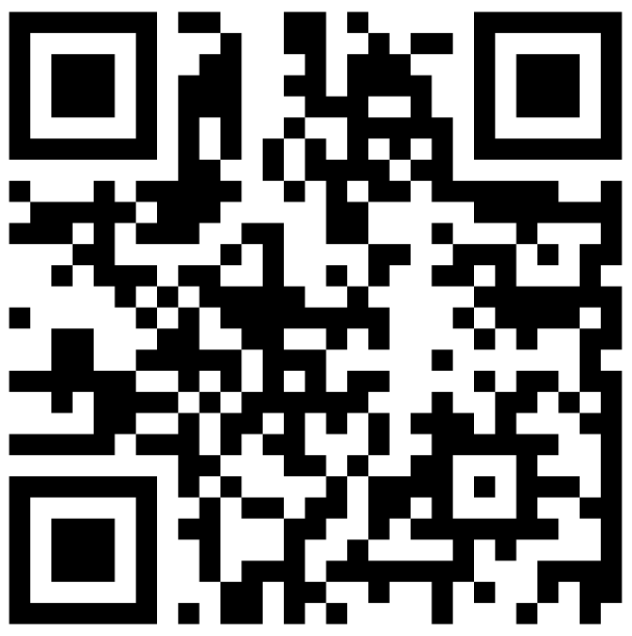
Putting It All Together (Review)
BEFORE WE START
Talk to your neighbors:
What’s the first thing you’ll do after finals is over? (Sleep is obvious…)
Music: The Whole of the Moon – The Waterboys

Slide 2
Lecture Outline
Announcements
Exam Logistics
Review
How to Study
Mind Maps

Slide 3
Announcements
Last few sessions of classes! ☠
Quick overview of class today!
Victory lap + AMA on Wednesday
In-class review on Friday
Creative Project 3 (C3) currently out
Due December 4th by 11:59 PM
Resubmission Cycle 7 (R7) opens December 4th
Due December 8th by 11:59 PM
Submit anything but C3!
Resubmission Cycle (R8) open during finals week
During finals week after C3: OOP It! feedback has been released
Will be added to course calendar soon!

Slide 4
Announcements
Final Exam Review: In Class on December 8th!
Led by TAs
Sections A & B will cover different materials (1 hr 40 min)
Recorded, so don’t worry if you can’t attend both!
Final Exam: Tuesday, December 12th 12:30 – 2:20 PM
Preliminary details are up on the course website!
Coming Soon:
Seating Chart
Left-handed? Respond to Jonathan’s post by December 4th!
Final Exam Study Guide/Resource Bank Document (Done!)
Past & Practice Exams (Done!)

Slide 5
Lecture Outline
Announcements
Exam Logistics
Review
How to Study
Mind Maps

Slide 6
Exam Format
6 questions in total, each will receive one ESN grade
Some questions might have sub-parts
Reminder: Quiz and Exam grades are all mixed into the same bucket
General format
3 Questions: Mix of Conceptual, Mechanical/Tracing, Debugging Problems
3 Questions: Programming Problems
See sections for the last 2 weeks for practice handwriting problems

Slide 7
Exam Logistics
Most important bits
Tuesday December 12th from 12:30 – 2:20 PM in KNE 110/120
Seat assignments will be posted soon!
Don’t cheat
Only have the exam open during the time (don’t start early; don’t work after)
No electronic devices
You can bring one 8.5x11 inch paper with notes (front and back)
Will also provide a reference sheet (see course website)
Questions? Raise hand or as on sli.do (cse122)

Slide 8
Review So Far
Java Language
Intro to Java (e.g., File Processing)
Iterators and For-each Loops
Exceptions
Interfaces
References
JUnit*
Java Collections
Arrays / 2D Arrays
ArrayList
LinkedList
Stack
TreeSet / TreeMap
HashSet / HashMap
Interfaces for Java Collections
CS Concepts
Problem Solving
Debugging
Client/Implementer
Object Oriented Programming
Encapsulation
Testing
Third Party Libraries
Data Structures
Lists
Stacks
Queues
2D Arrays
Sets
Maps

Slide 9
Review Resources
Final Exam Resource Bank
Pre-Class Materials + Lectures
Section Handouts
Quizzes so Far
Your Notes!
Helpful for contextualizing what you learned

Slide 10
Lecture Outline
Announcements
Exam Logistics
Review
How to Study
Mind Maps
Practice: Stacks & Queues

Slide 11
Study Strategies
Study Early and Often
Stay Healthy
Study Like you Test
Connect Problems: How is one problem similar/different to another?
Mixed Practice vs. Massed Practice
Embrace Difficulty
Reference Sheet: Iterative Refining

Slide 12
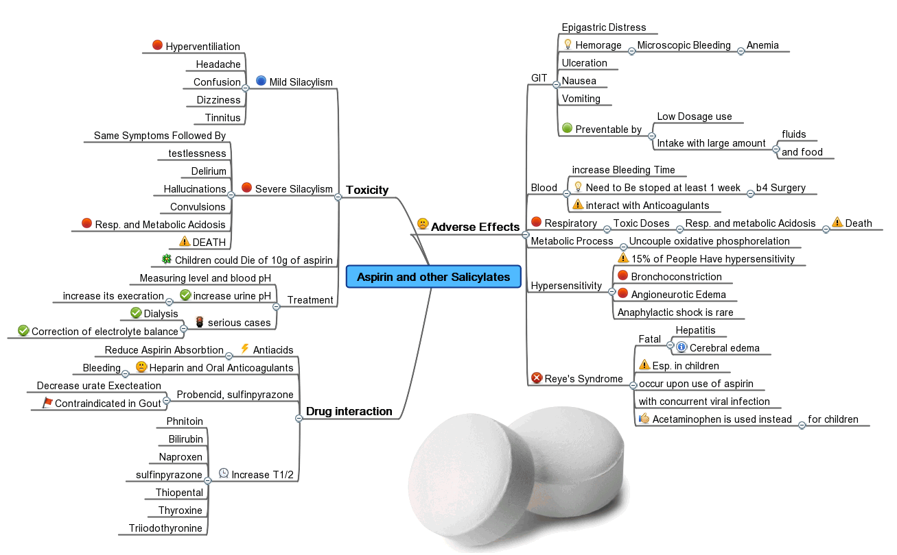
Mind Maps
One of the most important parts of learning is relating concepts to each other
Almost all learning is contextual: based on relating one thing to another
Transfer is challenging!
Mind Maps empower you to write out how topics relate to each other. Concretizing relations.
Can be incredibly helpful when reviewing and can be a great resource for looking back at this class

Slide 13
Lecture Outline
Exam Logistics
Review
How to Study
Mind Maps

