Slide 1
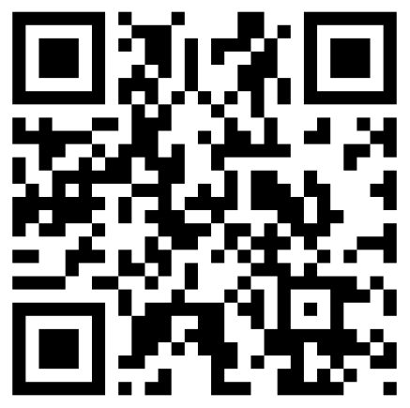
Third Party Libraries
BEFORE WE START
Talk to your neighbors:
How did your Spotify Wrapped look? How many minutes did you listen?
Music: Turn it Up - Grum

Slide 2
Lecture Outline
Announcements
Third Party Libraries

Slide 3
Announcements
Creative Project 3 (C3) is now out!
Final assignment of the quarter! 🎊
Due December 4th by 11:59 PM
Resubmission Cycle 7 (R7) out December 4th
Due December 8th by 11:59 PM
Coming soon: R8? Yes, R8, but only for C3. More details later… 🤫

Slide 4
Announcements
Final Exam Review: In Class on December 8th!
Led by TAs
Sections A & B will cover different materials (1 hr 40 min)
Recorded, so don’t worry if you can’t attend both!
Final Exam: Tuesday, December 12th 12:30 – 2:20 PM
Preliminary details are up on the course website!
Coming Soon:
Seating Chart: Left-handed? Respond to Jonathan’s post by December 4th!
Final Exam Study Guide/Resource Bank Document
Past & Practice Exams
Emotional Support…?

Slide 5
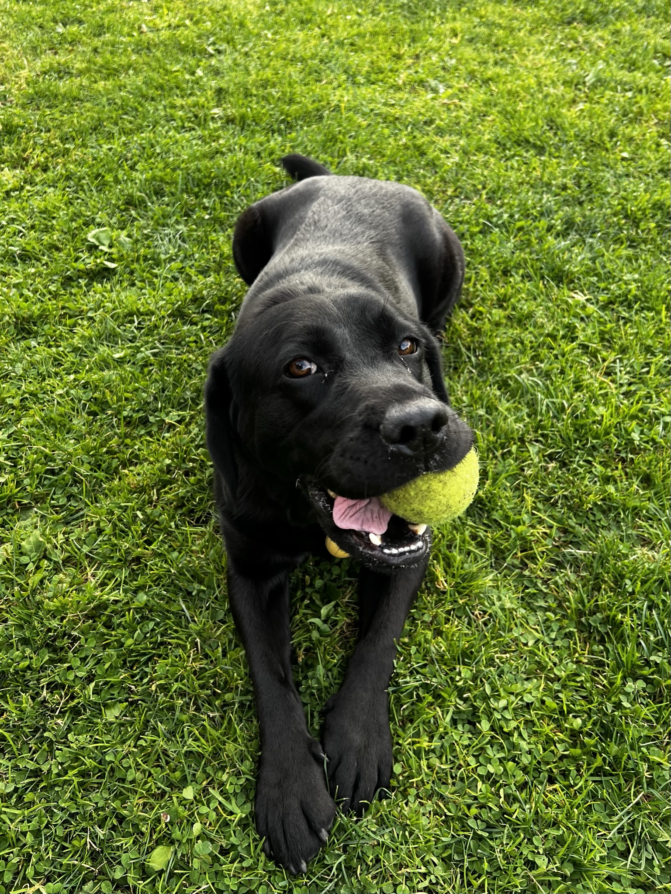
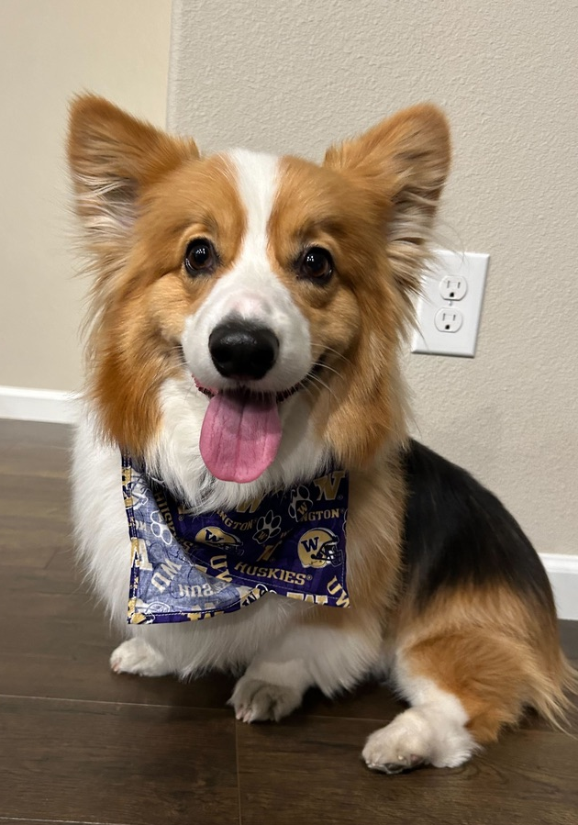
Announcements
Gigi + Gumball visit UW on Monday, December 11th!
1 PM near Drumheller Fountain

Slide 6
Lecture Outline
Announcements
Third Party Libraries

