Slide 1

JUnit Testing
BEFORE WE START
Talk to your neighbors:
What is your favorite thing to cook? If you don’t cook, what’s your favorite thing to eat :P
Music: Lavender Haze (Taylor Swift)

Slide 2
Lecture Outline
Announcements
Importance of Testing
JUnit
How Much Testing is Enough?
Example: Brainstorm Test Cases (TFTPlayer)
Challenge: Floating Point Precision

Slide 3
Announcements
Programming Assignment 3 (P3) due November 27th
Actively have very limited IPL access
Ask questions on Ed! Expect delays in answering, though... 🦃🍗🥧
Resubmission Cycle 6 (R6) out now; due November 28th
Quiz 2 delayed to November 28th
Creative Project 3 (C3) releasing November 28th
Final assignment of the quarter!! 🎊
Due December 4th by 11:59 PM
Final Exam: Tuesday, December 12th 12:30 – 2:20 PM
More details coming soon on the course website!

Slide 4
Lecture Outline
Announcements
Importance of Testing
JUnit
How Much Testing is Enough?
Example: Brainstorm Test Cases (TFTPlayer)
Challenge: Floating Point Precision

Slide 5
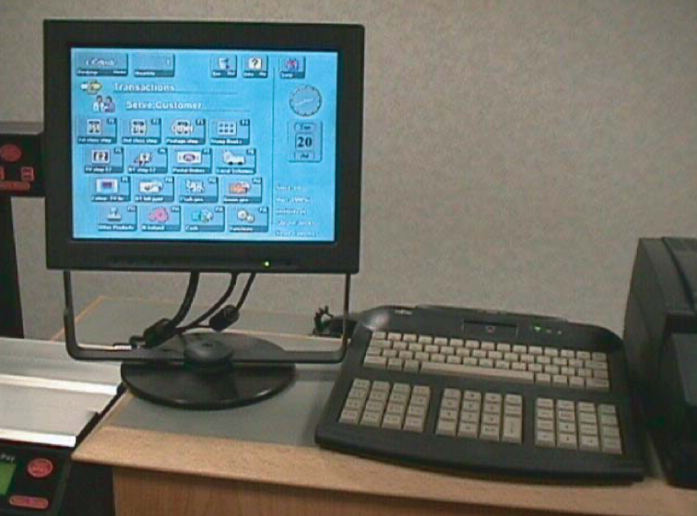
Importance of Testing
Software, written by people, controls more and more of our day-to-day lives.
Bugs (just like the ones we all write) are just as easy to write in this software.
Stakes can be quite high so bugs can have catastrophic effects
The Horizon IT System for The UK Post Office Source: Fujitsu.com

Slide 6

Importance of Testing
“The Horizon scandal, described as ‘the most widespread miscarriage of justice in UK history’, resulted in more than 700 post office operators being prosecuted between 1999 and 2015 for theft, fraud and false accounting because of faulty accounting software installed in the late 1990s… Some spent time in prison, and the scandal has been linked to four suicides.”
Source: The Guardian

Slide 7
Bugs you’ve experienced
Can you think of a bug(s) you’ve experienced or heard of that have had serious effects?
If you can’t, can you think of any absurd bugs you’ve seen?

Slide 8
Lecture Outline
Announcements
Importance of Testing
JUnit
How Much Testing is Enough?
Example: Brainstorm Test Cases (TFTPlayer)
Challenge: Floating Point Precision

Slide 9
JUnit Basics
import statements to give you access to JUnit method annotations and assertion methods!
Method Annotations
@Test
@DisplayName
…
Assertion Methods
assertEquals
assertTrue
assertFalse
…

Slide 10
JUnit Testing
import org.junit.jupiter.api.*;
import static org.junit.jupiter.api.Assertions.*;
import java.util.*; public class ArrayListTest { @Test public void testAddAndGet() { List<String> list = new ArrayList<>(); list.add("Hunter Schafer"); list.add("Miya Natsuhara"); list.add("CSE 122"); assertEquals("Hunter Schafer", list.get(0)); } }

Slide 11
JUnit Testing
import org.junit.jupiter.api.*;
import static org.junit.jupiter.api.Assertions.*;
import java.util.*; public class ArrayListTest { @Test public void testAddAndGet() { List<String> list = new ArrayList<>(); list.add("Hunter Schafer"); list.add("Miya Natsuhara"); list.add("CSE 122"); assertEquals("Hunter Schafer", list.get(0)); // TRUE!! } }

Slide 12
JUnit Testing
import org.junit.jupiter.api.*;
import static org.junit.jupiter.api.Assertions.*;
import java.util.*; public class ArrayListTest { @Test public void testAddAndGet() { List<String> list = new ArrayList<>(); list.add("Hunter Schafer"); list.add("Miya Natsuhara"); list.add("CSE 122"); assertEquals("Hunter Schafer", list.get(0)); assertEquals("Miya Natsuhara", list.get(2)); } }

Slide 13
JUnit Testing
import org.junit.jupiter.api.*;
import static org.junit.jupiter.api.Assertions.*;
import java.util.*; public class ArrayListTest { @Test public void testAddAndGet() { List<String> list = new ArrayList<>(); list.add("Hunter Schafer"); list.add("Miya Natsuhara"); list.add("CSE 122"); assertEquals("Hunter Schafer", list.get(0)); assertEquals("Miya Natsuhara", list.get(2)); // FALSE!! } }

Slide 14
JUnit Testing
import org.junit.jupiter.api.*;
import static org.junit.jupiter.api.Assertions.*;
import java.util.*; public class ArrayListTest { @Test public void testAddAndGet() { List<String> list = new ArrayList<>(); list.add("Hunter Schafer"); list.add("Miya Natsuhara"); list.add("CSE 122"); assertEquals("Hunter Schafer", list.get(0)); assertEquals("Miya Natsuhara", list.get(2)); assertEquals("CSE 122", list.get(2)); } }

Slide 15
JUnit Testing
import org.junit.jupiter.api.*;
import static org.junit.jupiter.api.Assertions.*;
import java.util.*; public class ArrayListTest { @Test public void testAddAndGet() { List<String> list = new ArrayList<>(); list.add("Hunter Schafer"); list.add("Miya Natsuhara"); list.add("CSE 122"); assertEquals("Hunter Schafer", list.get(0)); assertEquals("Miya Natsuhara", list.get(2)); assertEquals("CSE 122", list.get(2)); // TRUE!!! } }

Slide 16
JUnit Testing
import org.junit.jupiter.api.*;
import static org.junit.jupiter.api.Assertions.*;
import java.util.*; public class ArrayListTest { @Test public void testAddAndGet() { List<String> list = new ArrayList<>(); list.add("Hunter Schafer"); list.add("Miya Natsuhara"); list.add("CSE 122"); assertEquals("Hunter Schafer", list.get(0)); assertEquals("Miya Natsuhara", list.get(2)); assertEquals("CSE 122", list.get(2)); assertTrue(list.size() == 3); } }

Slide 17
JUnit Testing
import org.junit.jupiter.api.*;
import static org.junit.jupiter.api.Assertions.*;
import java.util.*; public class ArrayListTest { @Test public void testAddAndGet() { List<String> list = new ArrayList<>(); list.add("Hunter Schafer"); list.add("Miya Natsuhara"); list.add("CSE 122"); assertEquals("Hunter Schafer", list.get(0)); assertEquals("Miya Natsuhara", list.get(2)); assertEquals("CSE 122", list.get(2)); assertTrue(list.size() == 3); // TRUE!! } }

Slide 18
JUnit Tips
Write a test method for individual methods and test methods that combine different method calls in different combinations!
Write a test method per distinct case (i.e., empty case, one element, even, odd, some edge case, …)
Use assertEquals(expected, actual, message) to provide a description of what case that line is testing
Testing code is just code. Use good coding practices (e.g., helper methods to reduce redundancy) to help you write code.
It can take time, but if you do it well, developing your solution can be a breeze!

Slide 19
In-Class: Remix – Courses Taught

Slide 20
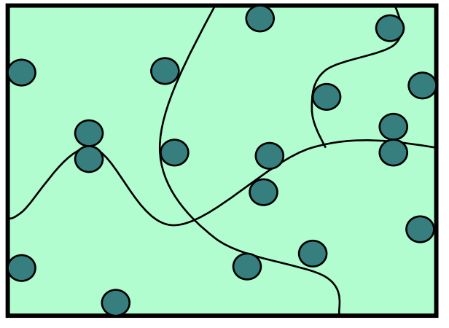
How Many Test Cases Is Enough?
In general, more diverse tests –> more confidence!
Try to think adversarially and try to break your own code with tests
Specification Testing (based on the spec) vs. Clear-box Testing (based on how you know your implementation works)
Specification Testing you can do before writing your solution!
Clear-box Testing you do after you've written your solution.
Test a wide variety of different cases
Think about boundary or "edge" cases in particular, where the behavior should change

Slide 21
Lecture Outline
Announcements
Importance of Testing
JUnit
How Much Testing is Enough?
Example: Brainstorm Test Cases (TFTPlayer)
Challenge: Floating Point Precision

Slide 22
What test cases can you test for the TFTPlayer class from the PCM?
Rules from the PCM changed a bit from when the lesson was first posted! All should be consistent now!
Rules
Start Game: 10 gold, 0 experiences, level 1
Buy Experience: Spend 4 gold to earn 4 experience
Must have sufficient gold. Can’t buy XP if already max level (9)
Every 20 experience points is converted to 1 level
Gain Gold: Every player earns 3 gold plus some interest
Interest: Gain 1 additional gold for each 5 gold owned, capped at interest of 5 gold
Example: Have 24 gold. Gold gained would be 7 (3 free gold + 4 interest gold)
Spend 2 minutes brainstorming specification testing
Then 2 minutes brainstorming clear-box testing

Slide 23
Lecture Outline
Announcements
Importance of Testing
JUnit
How Much Testing is Enough?
Example: Brainstorm Test Cases (TFTPlayer)
Challenge: Floating Point Precision

Slide 24

Challenge: Floating Point Numbers
Another name for doubles are floating point numbers
Floating point numbers are nice, but imprecise
Computers can only store a certain amount of precision (can’t store 0.3333333333 repeating forever)
Finite precision can lead to slightly incorrect calculations with floating point numbers
Take-away: Essentially can never rely on == for doubles. Instead, must define some notion of how far away they can be to be tolerated as the same
JUnit: assertEquals(expected, actual, delta)

