Slide 1
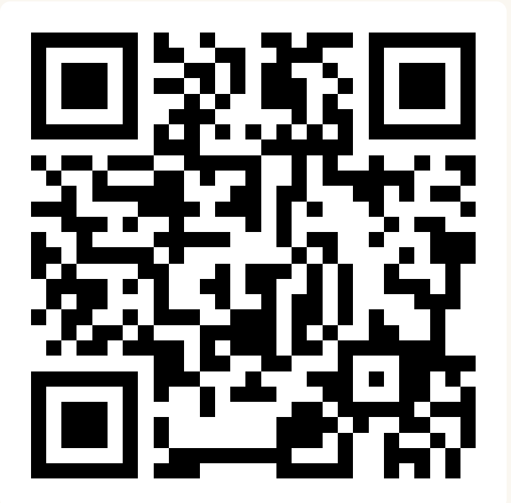
File I/O – Hybrid processing and Printing
BEFORE WE START
Slido input & discuss with neighbors:
What’s the last show or movie you watched?

Slide 2
Lecture Outline
Announcements/Reminders
Refresh Last Time
Scanners with Strings
  Hybrid Approach & Files
Using PrintStream for File Output
Example

Slide 3
Announcements
Programming Assignment 0 (P0) out later today!
  Due next Thursday, January 22nd!
  Focused on File I/O!
Creative Project 0 (C0) was due last night. How’d it go?
  Expect grades back about a week after the assignment was due
  Joined class late? Use Resubmission Cycle 0 to submit it!

Slide 4
Lecture Outline
Announcements/Reminders
Refresh Last Time
Scanners with Strings
  Hybrid Approach & Files
Using PrintStream for File Output
Example

Slide 5
(Last Time) Scanner/File for input
Scanner is defined in the java.util package
import java.util.*;
File is defined in the java.io package
import java.io.*;
Scanner console = new Scanner(System.in);
File newFile = new File("example.txt");
Scanner fileScan = new Scanner(newFile);
Scanner Methods | Description
nextInt() | Reads the next token from the user as an int and returns it
nextDouble() | Reads the next token from the user as a double and returns it
next() | Reads the next token from the user as a String and returns it
nextLine() | Reads an entire line from the user as a String and returns it
hasNextInt() | Returns true if the next token can be read as an int, false otherwise
hasNextDouble() | Returns true if the next token can be read as a double, false otherwise
hasNext() | Returns true if there is another token of input to be read in, false otherwise
hasNextLine() | Returns true if there is another line of input to be read in, false otherwise

Slide 6
(PCM) Typical Line-Processing Pattern
while (scan.hasNextLine()) {
String nextLine = scan.nextLine();
// do something with nextLine
}

Slide 7
(PCM) Typical Token-Processing Pattern
while (scan.hasNext______()) {
______ nextToken = scan.next______();
// do something with nextToken
}

Slide 8
Lecture Outline
Announcements/Reminders
Refresh Last Time
Scanners with Strings
  Hybrid Approach & Files
Using PrintStream for File Output
Example

Slide 9
(PCM) Scanners with Strings (not files!)
String str = "A quick, brown fox";
Scanner stringScan = new Scanner(str);
while (stringScan.hasNext__()) {
__ nextToken = stringScan.next__();
// do something with nextToken
}

Slide 10
(PCM) Scanners with Strings (not files!)
String str = "A quick, brown fox";
Scanner stringScan = new Scanner(str);
while (stringScan.hasNext()) {
String nextToken = stringScan.next();
System.out.println(nextToken);
}

Slide 11
(PCM) Scanners with Strings (not files!)
String str = "A quick, brown fox";
Scanner stringScan = new Scanner(str);
while (stringScan.hasNext()) {
String nextToken = stringScan.next();
System.out.println(nextToken);
}

Slide 12
(PCM) Scanners with Strings (not files!)
String str = "A quick, brown fox";
Scanner stringScan = new Scanner(str);
while (stringScan.hasNext()) {
String nextToken = stringScan.next();
System.out.println(nextToken);
}
A

Slide 13
(PCM) Scanners with Strings (not files!)
String str = "A quick, brown fox";
Scanner stringScan = new Scanner(str);
while (stringScan.hasNext()) {
String nextToken = stringScan.next();
System.out.println(nextToken);
}
quick,

Slide 14
(PCM) Scanners with Strings (not files!)
String str = "A quick, brown fox";
Scanner stringScan = new Scanner(str);
while (stringScan.hasNext()) {
String nextToken = stringScan.next();
System.out.println(nextToken);
}
brown

Slide 15
(PCM) Scanners with Strings (not files!)
String str = "A quick, brown fox";
Scanner stringScan = new Scanner(str);
while (stringScan.hasNext()) {
String nextToken = stringScan.next();
System.out.println(nextToken);
}
fox

Slide 16
Lecture Outline
Announcements/Reminders
Refresh Last Time
Scanners with Strings
  Hybrid Approach & Files
Using PrintStream for File Output
Example

Slide 17
(PCM) Typical Hybrid Pattern
File newFile = new File("in.txt");
Scanner fileScan = new Scanner(newFile);
while (fileScan.hasNextLine()) {
String line = fileScan.nextLine();
}
Scanner lineScan = new Scanner(line);
while (lineScan.hasNext__()) {
__ nextToken = lineScan.next__();
// do something with nextToken
}
Line-by-line and then token-by-token to do something

Slide 18
(PCM) Typical Hybrid Pattern
File newFile = new File("in.txt");
Scanner fileScan = new Scanner(newFile);
while (fileScan.hasNextLine()) {
String line = fileScan.nextLine();
}
Scanner lineScan = new Scanner(line);
while (lineScan.hasNext__()) {
__ nextToken = lineScan.next__();
// do something with nextToken
}
Let’s look at the example from last time…

Slide 19
(PCM) Token vs. Line vs. Hybrid?
(PCM) Token vs. Line vs. Hybrid?
We now know 3 different ways to use Files!
  Line
  Token
  Hybrid
Although this gives us flexibility – it can sometimes get confusing
Feel free to use the following diagram to help!
Are separate lines meaningful?
no
yes
Token-based
Do you need individual tokens?
no
yes
Line-based
Hybrid!

Slide 20
(PCM) Scanning Numeric Data
On Wednesday, we primarily used String-based Scanner methods to read input from a file. Let's work with some numeric data now!
We're going to make more use of
hasNextInt()
hasNextDouble()
nextInt()
nextDouble()
Assumptions about our file's format!
No element next or not the correct type?
Expect a NoSuchElementException or an InputMismatchException

Slide 21
What would be the result of executing the following code?
Scanner fileScan = new Scanner(new File("data.txt"));
while (fileScan.hasNextLine()) {
String line = fileScan.nextLine();
Scanner lineScan = new Scanner(line);
double min = lineScan.nextDouble();
double max = min;
while (lineScan.hasNextDouble()) {
double nextNum = lineScan.nextDouble();
min = Math.min(min, nextNum);
max = Math.max(max, nextNum);
}
System.out.println("Max: " + max + ", Min: " + min);
}
A) Max: 9.2, Min: 2.3
Max: 17.0, Min: 0.73
Max: -1.5, Min: -1.5
B) Max: 9.2, Min: -1.5
C) Max: 9.2, Min: 2.3
Max: 17, Min: 0.73
Max: 0.0, Min: -1.5
D) Error
data.txt
2.3 9.2
17 0.73
-1.5000
Notes:
public class Temperatures {
public static void main(String[] args) {
int[] nums = {1, 4, 4, 8, 13};
int totalDiff = 0;
for (int i = 1; i <= nums.length-1; i++) {
totalDiff += (nums[i] - nums[i - 1]);
}
System.out.println("Total Diff = " + totalDiff);
}
}

Slide 22
What would be the result of executing the following code?
Scanner fileScan = new Scanner(new File("data.txt"));
while (fileScan.hasNextLine()) {
String line = fileScan.nextLine();
Scanner lineScan = new Scanner(line);
double min = lineScan.nextDouble();
double max = min;
while (lineScan.hasNextDouble()) {
double nextNum = lineScan.nextDouble();
min = Math.min(min, nextNum);
max = Math.max(max, nextNum);
}
System.out.println("Max: " + max + ", Min: " + min);
}
A) Max: 9.2, Min: 2.3
Max: 17.0, Min: 0.73
Max: -1.5, Min: -1.5
B) Max: 9.2, Min: -1.5
C) Max: 9.2, Min: 2.3
Max: 17, Min: 0.73
Max: 0.0, Min: -1.5
D) Error
data.txt
2.3 9.2
17 0.73
-1.5000
Notes:
public class Temperatures {
public static void main(String[] args) {
int[] nums = {1, 4, 4, 8, 13};
int totalDiff = 0;
for (int i = 1; i <= nums.length-1; i++) {
totalDiff += (nums[i] - nums[i - 1]);
}
System.out.println("Total Diff = " + totalDiff);
}
}

Slide 23
Lecture Outline
Announcements/Reminders
Refresh Last Time
Scanners with Strings
  Hybrid Approach & Files
Using PrintStream for File Output
Example

Slide 24
(PCM) PrintStreams for output
PrintStream is defined in the java.io package
import java.io.*;
File outputFile = new File("out.txt");
PrintStream output = new PrintStream(outputFile);
PrintStream Methods | Description
print(…) | Prints the given value to the set output location.
println(…) | Prints the given value to the set output location, and then terminates the line.
System.out.print("Hello, world! ");
System.out.println("#1 Bee Movie fan!");
output.print("Hello, world! ");
output.println("#1 Bee Movie fan!");
Hello, world! #1 Bee Movie fan!

Slide 25
Lecture Outline
Announcements/Reminders
Refresh Last Time
Scanners with Strings
  Hybrid Approach & Files
Using PrintStream for File Output
Example

Slide 26
Movie Ratings
In this program, we'll be examining and altering data from a file of IMDB ratings for popular U.S. movies. This will happen through 3 major user-entered commands:
(F)ind movie, (A)dd a rating, and (S)ave.
small.tsv
5
Title Average Total
Pride_&_Prejudice 7.8 323647
Barbie 6.9 455488
Oppenheimer 8.4 588723
Poor_Things 8.5 20542
Spider-Man:_Across_the_Spider-Verse 8.6 329200

Slide 27
Movie Ratings
Welcome to the CSE 122 Movie Rating Program!
Loaded 5 movies from small.tsv!
Menu: (F)ind movie, (A)dd rating, (S)ave, (Q)uit
Enter your choice: F
What's the name of the movie? Pride_&_Prejudice
Movie Pride_&_Prejudice found!
Average Rating: 7.8
Total Ratings: 323647
Menu: (F)ind movie, (A)dd rating, (S)ave, (Q)uit
Enter your choice: A
What movie would you like to add your rating to? Pride_&_Prejudice
And what rating would you like to give? 100000
Menu: (F)ind movie, (A)dd rating, (S)ave, (Q)uit
Enter your choice: f
What's the name of the movie? Pride_&_Prejudice
Movie Pride_&_Prejudice found!
Average Rating: 8.1
Total Ratings: 323648
Menu: (F)ind movie, (A)dd rating, (S)ave, (Q)uit
Enter your choice: S
What's the name of the file you'd like to save to? out.txt
Menu: (F)ind movie, (A)dd rating, (S)ave, (Q)uit
Enter your choice: q
Thank you for using this program! Bye!
small.tsv
5
Title Average Total
Pride_&_Prejudice 7.8 323647
Barbie 6.9 455488
Oppenheimer 8.4 588723
Poor_Things 8.5 20542
Spider-Man:_Across_the_Spider-Verse 8.6 329200
[Pride_&_..., Barbie, Oppenheimer, Poor_Things, Spider-Man…]
[7.8, 6.9, 8.4, 8.5, 8.6]
[323647, 455488, 588723, 20542, 329200]

Slide 28
Movie Ratings: Development Strategy
Fill in the main method with a loop that calls a method to read the data in from the .tsv file and allows the user to select between the different options (find, add, save, quit) I was nice and did this for you 😇
Implement a method to load the movie rating data from the file and populate the appropriate arrays
Implement a method that allows users to find the rating for a movie
Implement a method that allows users to add a rating for a movie
Implement a method that allows users to save the movie ratings information to a file

