Slide 1
Nested Collections
Slido vote & chat with neighbors:
The weather is hot, what’re your plans to cool off?

Slide 2
Agenda (1/4)
Announcements
Recap: Nested Collections
Practice: Search Engines
Practice: Social Network

Slide 3
Announcements
Programming Assignment 1 (P1) due tomorrow, July 23rd 11:59pm!
Quiz 1 on July 28th in your registered Quiz Section
  Topics: (Reference Semantics), Stacks and Queues, Sets, Maps
  Practice Quiz 1 available soon
Resubmission Cycle 2 (R2) form released tomorrow, due July 28th by 11:59pm PT
  Available assignments: C0, P0, C1
  Reminder: to use a resubmission cycle you need to
    (1) submit your work (big blue "Submit" button on Ed)
    AND (2) fill out the resubmission form (linked from Ed + course calendar)

Slide 4
Agenda (2/4)
Announcements
Recap: Nested Collections
Practice: Search Engines
Practice: Social Network

Slide 5
Nested Collections (1/2)
The values inside a Map (or any data structure!) can be any type, including more data structures
Common examples:
  Mapping: Section ➔ Set of students in that section
  Mapping: Recipe ➔ Set of ingredients in that recipe
  (Or even Map<String, Map<String, Double>> for units!)

Slide 6
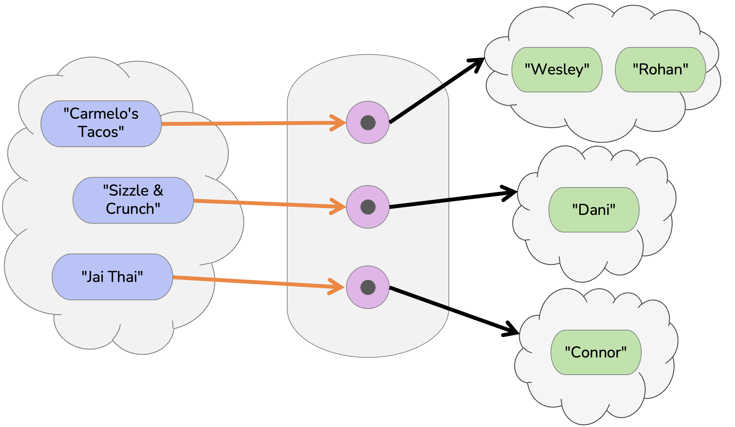
Nested Collections (2/2)
Keys
Values
Map<String, Set<String>> foods

Slide 7
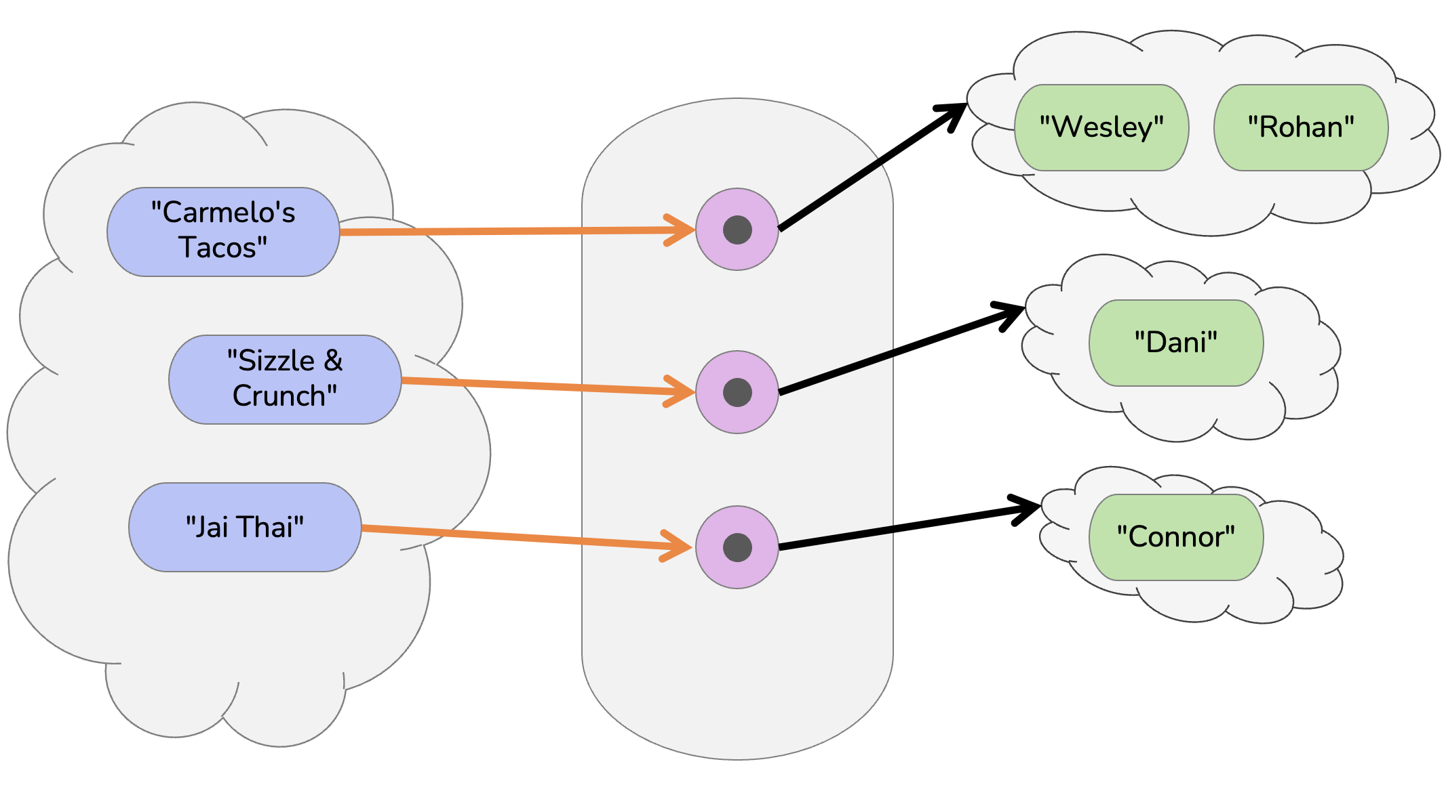
Updating Nested Collections
foods.put(”Kane Hall”,
new HashSet<String>());
foods.get(”Kane Hall”).add(”Connor”);
Set<String> kaneHall = foods.get(”Kane Hall”);
kaneHall.add(”Wesley”);
The “value” inside the Map is a reference
to the data structure!
  Think carefully about number of references to a particular object
kaneHall
"Connor"
“Kane Hall”
“Wesley”

Slide 8
"Wesley"
"Rohan"
"Carmelo's Tacos"
"Dani"
"Sizzle & Crunch"
"Jai Thai"
"Connor"

Slide 9
Suppose map had the following items. What would its items be after running this code?
map: {"KeyA"=[1, 2], "KeyB"=[3], "KeyC"=[4, 5, 6]}
Set<Integer> nums = map.get("KeyA");
nums.add(7);
map.put("KeyB", nums);
map.get("KeyA").add(8);
map.get("KeyB").add(9);
{"KeyA"=[1, 2], "KeyB"=[1, 2, 7], "KeyC"=[4, 5, 6]}
{"KeyA"=[1, 2, 8], "KeyB"=[1, 2, 7, 9], "KeyC"=[4, 5, 6]}
{"KeyA"=[1, 2, 7, 8], "KeyB"=[1, 2, 7, 9], "KeyC"=[4, 5, 6]}
{"KeyA"=[1, 2, 7, 8, 9], "KeyB"=[1, 2, 7, 8, 9], "KeyC"=[4, 5, 6]}

Slide 10
Suppose map had the following items. What would its items be after running this code?
nums
map: {”KeyA"=[1, 2], ”KeyB"=[3], ”KeyC"=[4, 5, 6]}
[1, 2]
[1, 2, 7, 8]
KeyA:
[1, 2, 7]
Set<Integer> nums = map.get("KeyA");
nums.add(7);
map.put("KeyB", nums);
map.get("KeyA").add(8);
map.get("KeyB").add(9);
[1, 2, 7, 8, 9]
KeyB:
[3]
KeyC:
[4, 5, 6]
{"KeyA"=[1, 2], "KeyB"=[1, 2, 7], "KeyC"=[4, 5, 6]}
{"KeyA"=[1, 2, 8], "KeyB"=[1, 2, 7, 9], "KeyC"=[4, 5, 6]}
{"KeyA"=[1, 2, 7, 8], "KeyB"=[1, 2, 7, 9], "KeyC"=[4, 5, 6]}
{"KeyA"=[1, 2, 7, 8, 9], "KeyB"=[1, 2, 7, 8, 9], "KeyC"=[4, 5, 6]}

Slide 11
Agenda (3/4)
Announcements
Recap: Nested Collections
Practice: Search Engines
Practice: Social Network

Slide 12
Background: Search Engines
A search engine receives a query and returns a set of relevant documents. Examples: Google, Mac Finder, more.
  Queries often can have more
A search engine involves two main components
  An index to efficiently find the set of documents for a query
    Will focus on “single word queries” for today’s example
  A ranking algorithm to order the documents from most to least relevant
    Not the focus of this example
Goal: Precompute a data structure that helps find the relevant documents for a given query

Slide 13
Inverted Index
An inverted index is a Mapping from possible query words to the set of documents that contain that word
  Answers the question:
  “What documents contain the word ‘burritos’?”
Inverted Index
Document 1
I
Document 1
Document 2
Document 3
I love tacos
love
Document 1
Document 2
Document 3
Document 2
I love burritos
tacos
Document 1
Document 3
burritos
Document 2
I love tlayudas
tlayudas
Document 3

Slide 14
Ranking Results
There is no one right way to define which documents are “most relevant” There are approximations, but make decisions about what relevance means
Idea 1: Documents that have more hits of the query should come first
  Pro: Simple
  Con: Favors longer documents (query: “the dogs” will favor long documents with lots of “the”s)
Idea 2: Weight query terms based on their “uniqueness”. Often use some sort of score for “Term Frequency – Inverse Document Frequency (TF-IDF)
  Pro: Doesn’t put much weight on common words like “the”
  Cons: Complex, many choices in how to compute that yield pretty different rankings
Idea 3: Much more! Most companies keep their ranking algorithms very very secret ☺

Slide 15
Agenda (4/4)
Announcements
Recap: Nested Collections
Practice: Search Engines
Practice: Social Network

