Slide 1
Maps
BEFORE WE START
Slido vote & chat with your neighbors:
What is your favorite song from the smallest artist you listen to?

Slide 2
Lecture Outline (1/4)
Announcements
Map Review
Practice: joinRosters
Practice: mostFrequentStart

Slide 3
Announcements/Reminders
Programming Assignment 1 (P1) releasing today due July 23rd 11:59pm!
Resubmission Cycle (R1) due Tuesday July 21st 11:59pm

Slide 4
Lecture Outline (2/4)
Announcements
Map Review
Practice: joinRosters
Practice: mostFrequentStart

Slide 5
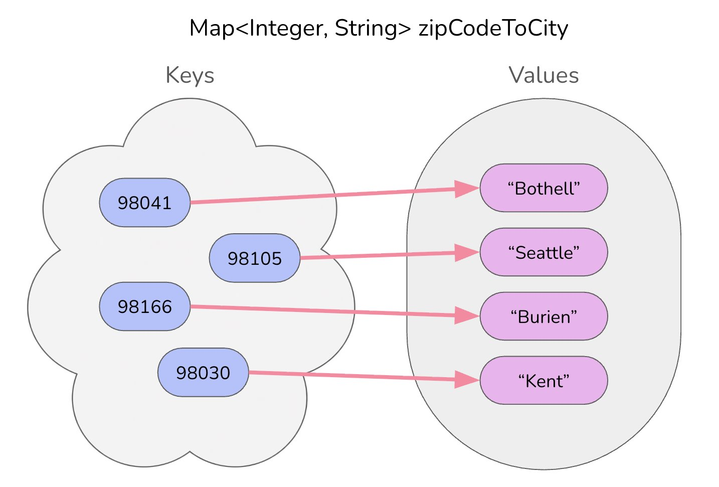
Map ADT
Data structure to map keys to values
  Keys can be any* type; Keys must be unique
  Values can be any type
Operations
  put(key, value): Associate key to value
    🚨 Overwrites duplicate keys 🚨
  get(key): Get value for key
  remove(key): Remove key/value pair
*Same as Python’s dict

Slide 6
Programming with Maps in Java (1/2)
Interface: Map
Implementations: TreeMap, HashMap
// Making a Map
Map<String, String> favArtistToSong = new TreeMap<>();
// adding elements to the above Map
favArtistToSong.put("PinkPantheress", "Stateside");
favArtistToSong.put("Rosalía", "La Perla");
favArtistToSong.put("Taylor Swift", "Dress");
favArtistToSong.put("Taylor Swift", "State of Grace"); // Overwrite!
// Getting a value for a key
String song = favArtistToSong.get(”Taylor Swift");
System.out.println(song); // “State of Grace”

Slide 7
Programming with Maps in Java (2/2)
Methods | Description
put(key, value) | adds a mapping from the given key to the given value; if the key already exists, replaces its value with the given one
get(key) | returns the value mapped to the given key (null if not found)
containsKey(key) | returns true if the map contains a mapping for the given key
remove(key) | removes any existing mapping for the given key
clear() | removes all key/value pairs from the map
size() | returns the number of key/value pairs in the map
isEmpty() | returns true if the map's size is 0
toString() | returns a string such as "{a=90, d=60, c=70}"
keySet() | returns a set of all keys in the map
values() | returns a collection of all values in the map

Slide 8
Map Implementations
Our first data structures with marked differences in how their implementations behave
One Map ADT / Interface
Two Map implementations
  TreeMap – Pretty fast, and sorted keys
  HashMap – Extremely fast, unsorted keys
Map<String, Integer> map1 = new TreeMap<>();
Map<String, Integer> map2 = new HashMap<>();
...

Slide 9
Select the method calls required to modify the given map m as follows:
Assume m’s contents are
98030="Kent"
98178="Seattle"
98166="Burien"
98041="Bothell"
We want to modify m so that its contents are
98030="Kent"
98178="Tukwila"
98166="Burien"
98041="Bothell"
98101="Seattle"
98126="Seattle"
m.put(98178, "Tukwila");
m.remove(98178);
m.put(98126, "Seattle");
m.get(98178, "Seattle");
m.put(98101, "Seattle");

Slide 10
Select the method calls required to modify the given map m as follows:
Assume m’s contents are
98030="Kent"
98178="Seattle"
98166="Burien"
98041="Bothell"
We want to modify m so that its contents are
98030="Kent"
98178="Tukwila"
98166="Burien"
98041="Bothell"
98101="Seattle"
98126="Seattle"
m.put(98178, "Tukwila");
m.remove(98178);
m.put(98126, "Seattle");
m.get(98178, "Seattle");
m.put(98101, "Seattle");

Slide 11
Lecture Outline (3/4)
Announcements
Map Review
Practice: joinRosters
Practice: mostFrequentStart

Slide 12
joinRosters
Write a method joinRosters that combines a Map from student name to quiz section, and a Map from TA name to quiz section and prints all pairs of students/TAs.
For example, if studentSections stores the following map:
{Alan=AC, Jerry=AB, Yueying=AA, Sharon=AB, Steven=AB, Zewditu=BA}
And taSections stores the following map
{Blake=BA, Nicolae=AA, Sushma=AB, Dani=AC}
AC: Alan - Dani
AB: Jerry - Sushma AB: Sharon - Sushma AB: Steven - Sushma AA: Yueying – Nicolae BA: Zewditu – Blake

Slide 13
Lecture Outline (4/4)
Announcements
Map Review
Practice: joinRosters
Practice: mostFrequentStart

Slide 14
mostFrequentStart (1/2)
Write a method called mostFrequentStart that takes a Set of words and does the following steps:
Organizes words into “word families” based on which letter they start with
Finds the size of the largest "word families"
Returns only the largest "word families" and the number of words in them

Slide 15
mostFrequentStart (2/2)
For example, if words stored the values
["hello", "goodbye", "library", "literary", "guile", "repel"]
The word families produced would be
'h' -> 1 word ("hello")
'g' -> 2 words ("goodbye", "guile")
'l' -> 2 words ("library", "literary")
'r' -> 1 word ("repel")
Since the "word families" with the most words are 'g' and 'l', each with 2 words, mostFrequentStart(words) would return the map
['g'=2,'l'=2]

