Slide 1
File I/O
BEFORE WE START
Slido input & discuss with neighbors:
What is your favorite brand of ice cream?

Slide 2
Lecture Outline (1/4)
Announcements
Review Scanners for User Input
Scanners for Files
  Token-based, Line-based, and Hybrid processing
Example

Slide 3
Announcements
Hope you had fun in your first quiz section yesterday!
Creative Project 0 (C0) releasing later today; due Thursday, July 2nd
  Focused on Java Review + Functional Decomposition
Office Hours Scheduled:
  Tuesday 11:30am–12:30pm & Wednesday 12:00–1:00pm
  Times don’t work? Email us!
IPL will also open on Monday, June 29th!
  MGH 334, schedule is on the course website; staffed by our awesome TAs!
  Open 1:30-5:30 most Mon-Thur, but check the schedule…
Java Review Session Module Releasing on this Monday, June 29th

Slide 4
Lecture Outline (2/4)
Announcements/Reminders
  Review Java
Review Scanners for User Input
Scanners for Files
  Token-based, Line-based, and Hybrid processing
Example

Slide 5
(Review) Scanner for User Input
Scanner is defined in the java.util package
import java.util.*;
Scanner console = new Scanner(System.in);
Scanner Methods | Description
nextInt() | Reads the next token from the user as an int and returns it
nextDouble() | Reads the next token from the user as a double and returns it
next() | Reads the next token from the user as a String and returns it
nextLine() | Reads an entire line from the user as a String and returns it
hasNextInt() | Returns true if the next token can be read as an int, false otherwise
hasNextDouble() | Returns true if the next token can be read as a double, false otherwise
hasNext() | Returns true if there is another token of input to be read in, false otherwise
hasNextLine() | Returns true if there is another line of input to be read in, false otherwise

Slide 6
Lecture Outline (3/4)
Announcements/Reminders
  Review Java
Review Scanners for User Input
Scanners for Files
  Token-based, Line-based, and Hybrid processing
Example

Slide 7
(PCM) Tokens
Tokens are units of input (as defined by the Scanner) that are separated by whitespace (spaces, tabs, new lines)

Slide 8
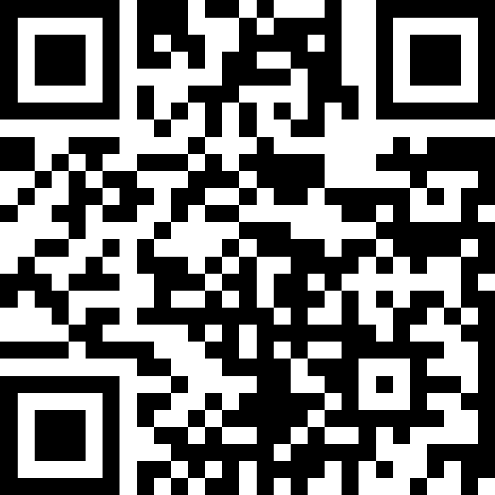
How many tokens are in the following line? (1/8)
“Hello world !” my-name is Dani
A) Four
B) Five
C) Six
D) Seven
Notes:
public class Temperatures {
public static void main(String[] args) {
int[] nums = {1, 4, 4, 8, 13};
int totalDiff = 0;
for (int i = 1; i <= nums.length-1; i++) {
totalDiff += (nums[i] - nums[i - 1]);
}
System.out.println("Total Diff = " + totalDiff);
}
}

Slide 9
How many tokens are in the following line? (2/8)
“Hello world !” my-name is Dani
A) Four
B) Five
C) Six
D) Seven
Notes:
public class Temperatures {
public static void main(String[] args) {
int[] nums = {1, 4, 4, 8, 13};
int totalDiff = 0;
for (int i = 1; i <= nums.length-1; i++) {
totalDiff += (nums[i] - nums[i - 1]);
}
System.out.println("Total Diff = " + totalDiff);
}
}

Slide 10
How many tokens are in the following line? (3/8)
“Hello world !” my-name is Dani
A) Four
B) Five
C) Six
D) Seven
Notes:
public class Temperatures {
public static void main(String[] args) {
int[] nums = {1, 4, 4, 8, 13};
int totalDiff = 0;
for (int i = 1; i <= nums.length-1; i++) {
totalDiff += (nums[i] - nums[i - 1]);
}
System.out.println("Total Diff = " + totalDiff);
}
}

Slide 11
How many tokens are in the following line? (4/8)
“Hello world !” my-name is Dani
A) Four
B) Five
C) Six
D) Seven
Notes:
public class Temperatures {
public static void main(String[] args) {
int[] nums = {1, 4, 4, 8, 13};
int totalDiff = 0;
for (int i = 1; i <= nums.length-1; i++) {
totalDiff += (nums[i] - nums[i - 1]);
}
System.out.println("Total Diff = " + totalDiff);
}
}

Slide 12
How many tokens are in the following line? (5/8)
“Hello world !” my-name is Dani
A) Four
B) Five
C) Six
D) Seven
Notes:
public class Temperatures {
public static void main(String[] args) {
int[] nums = {1, 4, 4, 8, 13};
int totalDiff = 0;
for (int i = 1; i <= nums.length-1; i++) {
totalDiff += (nums[i] - nums[i - 1]);
}
System.out.println("Total Diff = " + totalDiff);
}
}

Slide 13
How many tokens are in the following line? (6/8)
“Hello world !” my-name is Dani
A) Four
B) Five
C) Six
D) Seven
Notes:
public class Temperatures {
public static void main(String[] args) {
int[] nums = {1, 4, 4, 8, 13};
int totalDiff = 0;
for (int i = 1; i <= nums.length-1; i++) {
totalDiff += (nums[i] - nums[i - 1]);
}
System.out.println("Total Diff = " + totalDiff);
}
}

Slide 14
How many tokens are in the following line? (7/8)
“Hello world !” my-name is Dani
A) Four
B) Five
C) Six
D) Seven
Notes:
public class Temperatures {
public static void main(String[] args) {
int[] nums = {1, 4, 4, 8, 13};
int totalDiff = 0;
for (int i = 1; i <= nums.length-1; i++) {
totalDiff += (nums[i] - nums[i - 1]);
}
System.out.println("Total Diff = " + totalDiff);
}
}

Slide 15
How many tokens are in the following line? (8/8)
“Hello world !” my-name is Dani
A) Four
B) Five
C) Six
D) Seven
Notes:
public class Temperatures {
public static void main(String[] args) {
int[] nums = {1, 4, 4, 8, 13};
int totalDiff = 0;
for (int i = 1; i <= nums.length-1; i++) {
totalDiff += (nums[i] - nums[i - 1]);
}
System.out.println("Total Diff = " + totalDiff);
}
}

Slide 16
(PCM) Scanner for File I/O
Scanner is defined in the java.util package
import java.util.*;
File file = new File("Example.txt");
Scanner fileScan = new Scanner(file);
File is defined in the java.io package
import java.io.*;
Scanner Methods | Description
nextInt() | Reads the next token as an int and returns it
nextDouble() | Reads the next token as a double and returns it
next() | Reads the next token as a String and returns it
nextLine() | Reads an entire line as a String and returns it
hasNextInt() | Returns true if the next token can be read as an int, false otherwise
hasNextDouble() | Returns true if the next token can be read as a double, false otherwise
hasNext() | Returns true if there is another token of input to be read in, false otherwise
hasNextLine() | Returns true if there is another line of input to be read in, false otherwise

Slide 17
(PCM) Typical Line Processing Pattern
while (scan.hasNextLine()) {
String nextLine = scan.nextLine();
// do something with nextLine
}

Slide 18
(PCM) Typical Token Processing Pattern (1/2)
while (scan.hasNext______()) {
_______ nextToken = scan.next_______();
// do something with nextToken
}

Slide 19
(PCM) Typical Token Processing Pattern (2/2)
while (scan.hasNext______()) {
_______ nextToken = scan.next_______();
// do something with nextToken
}
Avoid mixing line- and token-based processing!

Slide 20
(PCM) Typical Hybrid Pattern (1/2)
while (fileScan.hasNextLine()) {
String line = fileScan.nextLine();
Scanner lineScan = new Scanner(line);
while (lineScan.hasNext__()) {
__ nextToken = lineScan.next__();
// do something with nextToken
}
}

Slide 21
(PCM) Typical Hybrid Pattern (2/2)
while (fileScan.hasNextLine()) {
String line = fileScan.nextLine();
Scanner lineScan = new Scanner(line);
while (lineScan.hasNext__()) {
__ nextToken = lineScan.next__();
// do something with nextToken
}
}
Line-by-line and then token-by-token to do something

Slide 22
(PCM) Scanners with Strings (not files!) (1/7)
String str = "A quick, brown fox";
Scanner stringScan = new Scanner(str);
while (stringScan.hasNext____()) {
____ nextToken = stringScan.next____();
// do something with nextToken
}

Slide 23
(PCM) Scanners with Strings (not files!) (2/7)
String str = "A quick, brown fox";
Scanner stringScan = new Scanner(str);
while (stringScan.hasNext()) {
String nextToken = stringScan.next();
System.out.println(nextToken);
}

Slide 24
(PCM) Scanners with Strings (not files!) (3/7)
String str = "A quick, brown fox";
Scanner stringScan = new Scanner(str);
while (stringScan.hasNext()) {
String nextToken = stringScan.next();
System.out.println(nextToken);
}

Slide 25
(PCM) Scanners with Strings (not files!) (4/7)
String str = "A quick, brown fox";
Scanner stringScan = new Scanner(str);
while (stringScan.hasNext()) {
String nextToken = stringScan.next();
System.out.println(nextToken);
}
A

Slide 26
(PCM) Scanners with Strings (not files!) (5/7)
String str = "A quick, brown fox";
Scanner stringScan = new Scanner(str);
while (stringScan.hasNext()) {
String nextToken = stringScan.next();
System.out.println(nextToken);
}
quick,

Slide 27
(PCM) Scanners with Strings (not files!) (6/7)
String str = "A quick, brown fox";
Scanner stringScan = new Scanner(str);
while (stringScan.hasNext()) {
String nextToken = stringScan.next();
System.out.println(nextToken);
}
brown

Slide 28
(PCM) Scanners with Strings (not files!) (7/7)
String str = "A quick, brown fox";
Scanner stringScan = new Scanner(str);
while (stringScan.hasNext()) {
String nextToken = stringScan.next();
System.out.println(nextToken);
}
fox

Slide 29
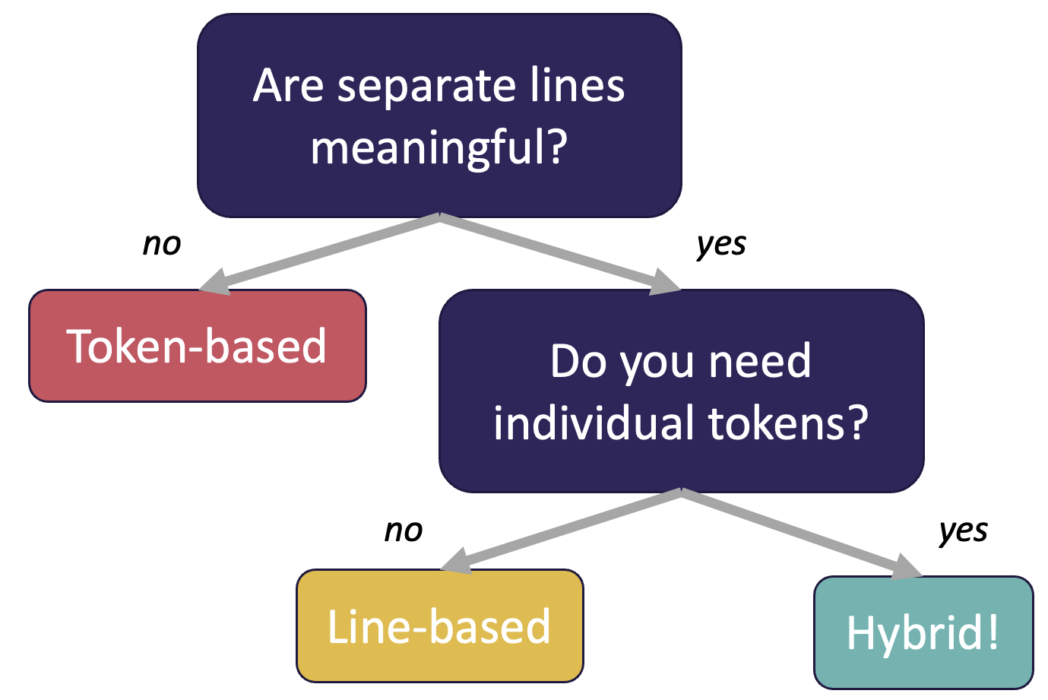
(PCM) Token vs. Line vs. Hybrid?
We now know 3 different ways to use Files!
  Line
  Token
  Hybrid
Although this gives us flexibility – it can sometimes get confusing
Feel free to use the following diagram to help!

Slide 30
Think: What is the output of this Java method?
File f = new File("Example.txt");
Scanner fileScan = new Scanner(f);
while (fileScan.hasNextLine()) {
String line = fileScan.nextLine();
Scanner lineScan = new Scanner(line);
while (lineScan.hasNext()) {
System.out.print(lineScan.next() + ", ");
}
System.out.println();
}
A) One, Two, Three,
B) One,
Two,
Three,
C) One, Two,
Three,
D) Error / Exception
Example.txt:
One Two
Three
Notes:
public class Temperatures {
public static void main(String[] args) {
int[] nums = {1, 4, 4, 8, 13};
int totalDiff = 0;
for (int i = 1; i <= nums.length-1; i++) {
totalDiff += (nums[i] - nums[i - 1]);
}
System.out.println("Total Diff = " + totalDiff);
}
}

Slide 31
Pair: What is the output of this Java method?
File f = new File("Example.txt");
Scanner fileScan = new Scanner(f);
while (fileScan.hasNextLine()) {
String line = fileScan.nextLine();
Scanner lineScan = new Scanner(line);
while (lineScan.hasNext()) {
System.out.print(lineScan.next() + ", ");
}
System.out.println();
}
A) One, Two, Three,
B) One,
Two,
Three,
C) One, Two,
Three,
D) Error / Exception
Example.txt:
One Two
Three
Notes:
public class Temperatures {
public static void main(String[] args) {
int[] nums = {1, 4, 4, 8, 13};
int totalDiff = 0;
for (int i = 1; i <= nums.length-1; i++) {
totalDiff += (nums[i] - nums[i - 1]);
}
System.out.println("Total Diff = " + totalDiff);
}
}

Slide 32
Initial Letter Count by Line (1/2)
Initial Letter Count
  Token-based processing!
Letter Count
  Line-based processing!
Task: Initial Letter Count by Line
  What kind of processing?

Slide 33
Initial Letter Count by Line (2/2)
Initial Letter Count
  Token-based processing!
Letter Count
  Line-based processing!
Task: Initial Letter Count by Line
  What kind of processing?
  Hybrid processing! Each line, and then each token per line.

Slide 34
Lecture Outline (4/4)
Announcements/Reminders
  Review Java
Review Scanners for User Input
Scanners for Files
  Token-based, Line-based, and Hybrid processing
Example

Slide 35
Movie Ratings (1/2)
In this program, we'll be examining and printing data from a file of IMDb ratings for popular U.S. movies. This will happen through 3 major user-entered commands:
(F)ind movie, (A)dd a rating, and (P)rint ratings.
small.tsv
5
Title Average Total
Pride_&_Prejudice 7.8 323647
Barbie 6.9 455488
Oppenheimer 8.4 588723
Poor_Things 8.5 20542
Spider-Man:_Across_the_Spider-Verse 8.6 329200

Slide 36
Movie Ratings (2/2)
Welcome to the CSE 122 Movie Rating Program!
Loaded 5 movies from small.tsv!
Menu: (F)ind movie, (A)dd rating, (P)rint ratings, (Q)uit
Enter your choice: F
What's the name of the movie? Pride_&_Prejudice
Movie Pride_&_Prejudice found!
Average Rating: 7.8
Total Ratings: 323647
Menu: (F)ind movie, (A)dd rating, (P)rint ratings, (Q)uit
Enter your choice: A
What movie would you like to add your rating to? Pride_&_Prejudice
And what rating would you like to give? 100000
Menu: (F)ind movie, (A)dd rating, (P)rint ratings, (Q)uit
Enter your choice: f
What's the name of the movie? Pride_&_Prejudice
Movie Pride_&_Prejudice found!
Average Rating: 8.1
Total Ratings: 323648
Menu: (F)ind movie, (A)dd rating, (P)rint ratings, (Q)uit
Enter your choice: P
5
Title Average Total
Pride_&_Prejudice 7.8 323647
Barbie 6.9 455488
Oppenheimer 8.4 588723
Poor_Things 8.5 20542
Spider-Man:_Across_the_Spider-Verse 8.6 329200
Menu: (F)ind movie, (A)dd rating, (P)rint ratings, (Q)uit
Enter your choice: q
Thank you for using this program! Bye!
small.tsv
5
Title Average Total
Pride_&_Prejudice 7.8 323647
Barbie 6.9 455488
Oppenheimer 8.4 588723
Poor_Things 8.5 20542
Spider-Man:_Across_the_Spider-Verse 8.6 329200
[Pride_&_..., Barbie, Oppenheimer, Poor_Things, Spider-Man…]
[7.8, 6.9, 8.4, 8.5, 8.6]
[323647, 455488, 588723, 20542, 329200]

Slide 37
Movie Ratings: Development Strategy
Implement a method to load the movie rating data from the file and populate the appropriate arrays.
Modify the print method to output to a file instead!
You are already given the rest of the program!

Slide 38
(PCM) PrintStreams for output
PrintStream is defined in the java.io package
import java.io.*;
File outputFile = new File("out.txt");
PrintStream output = new PrintStream(outputFile);
PrintStream Methods | Description
print(…) | Prints the given value to the set output location.
println(…) | Prints the given value to the set output location, and then terminates the line.
System.out.print("Hello, world! ");
System.out.println("#1 Bee Movie fan!");
output.print("Hello, world! ");
output.println("#1 Bee Movie fan!");
Hello, world! #1 Bee Movie fan!

Slide 39
Movie Ratings: Development Strategy
Implement a method to load the movie rating data from the file and populate the appropriate arrays. ✅
Modify the print method to output to a file instead!
You are already given the rest of the program!

Slide 40
(PCM) Checked Exceptions
If you try to compile a program working with file scanners, you may encounter this error message:
  error: unreported exception FileNotFoundException; must be caught or declared to be thrown
To resolve this, you need to include throws FileNotFoundException at the end of the header of any method containing file Scanner creation code, or any method that calls that method!
  This is like signing a waiver and telling Java—"Hey, I hereby promise to not get mad at you when you bug and crash my program if I give you a file that doesn't actually exist."

Slide 41
Movie Ratings
In this program, we'll be examining and altering data from a file of IMDb ratings for popular U.S. movies. This will happen through 3 major user-entered commands:
(F)ind movie, (A)dd a rating, and (S)ave to a file.
Instead of printing to console, we will now output to a file!

Slide 42
Movie Ratings
Welcome to the CSE 122 Movie Rating Program!
Loaded 5 movies from small.tsv!
Menu: (F)ind movie, (A)dd rating, (S)ave, (Q)uit
Enter your choice: F
What's the name of the movie? Pride_&_Prejudice
Movie Pride_&_Prejudice found!
Average Rating: 7.8
Total Ratings: 323647
Menu: (F)ind movie, (A)dd rating, (S)ave, (Q)uit
Enter your choice: A
What movie would you like to add your rating to? Pride_&_Prejudice
And what rating would you like to give? 100000
Menu: (F)ind movie, (A)dd rating, (S)ave, (Q)uit
Enter your choice: f
What's the name of the movie? Pride_&_Prejudice
Movie Pride_&_Prejudice found!
Average Rating: 8.1
Total Ratings: 323648
Menu: (F)ind movie, (A)dd rating, (S)ave, (Q)uit
Enter your choice: S
What's the name of the file you'd like to save to? out.txt
Menu: (F)ind movie, (A)dd rating, (S)ave, (Q)uit
Enter your choice: q
Thank you for using this program! Bye!
small.tsv
5
Title Average Total
Pride_&_Prejudice 7.8 323647
Barbie 6.9 455488
Oppenheimer 8.4 588723
Poor_Things 8.5 20542
Spider-Man:_Across_the_Spider-Verse 8.6 329200
[Pride_&_..., Barbie, Oppenheimer, Poor_Things, Spider-Man…]
[7.8, 6.9, 8.4, 8.5, 8.6]
[323647, 455488, 588723, 20542, 329200]

