Slide 1

Welcome!
BEFORE WE START
Talk to your neighbors:
Introduce yourself to your neighbor!
What is your name? Year? What did you do over summer break?
Instructors:
Ivory Wang & Colin Lim
TAs:
Dani
Rohan
Wesley
Connor
Yang

Slide 2
Lecture Outline (1/6)
Introductions
About this Course
  Course Components & Tools
  Grading
  Policies
Intro/Review Java
In-Class Activities
Functional Decomposition
Code Quality

Slide 3
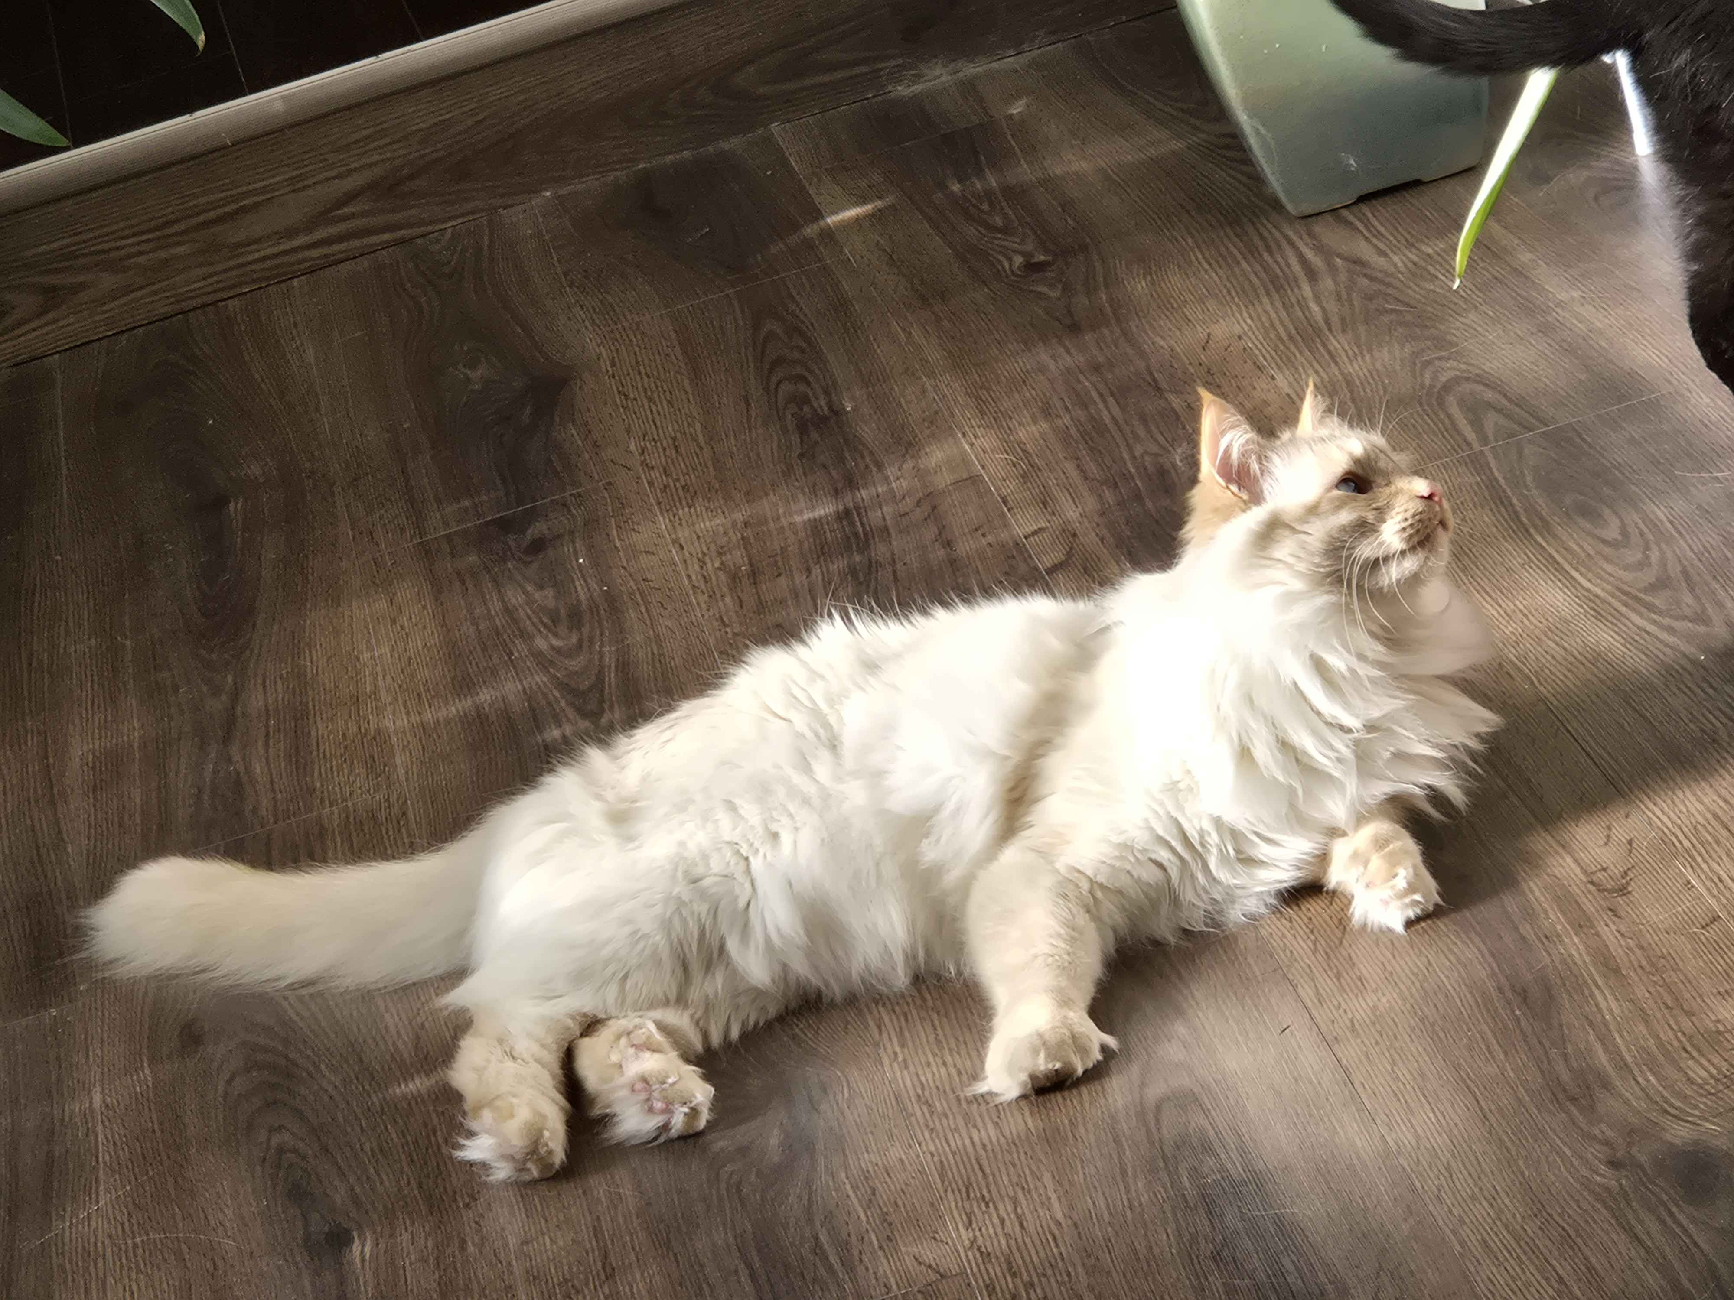
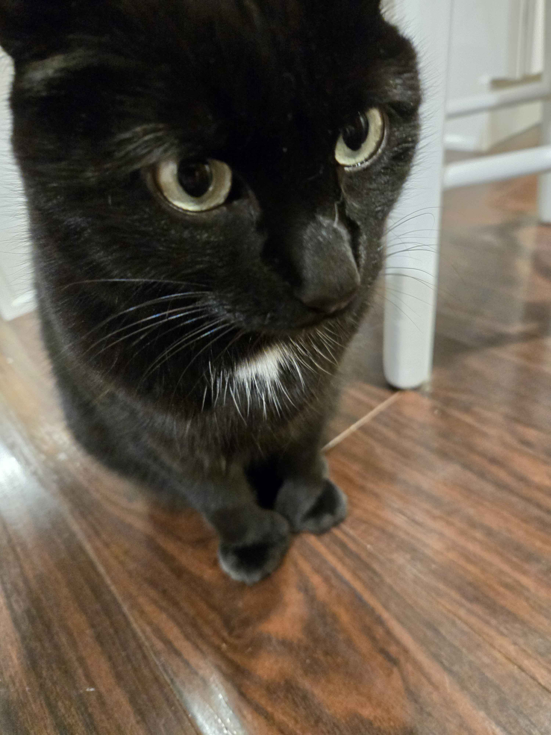
Course Staff
Instructors: Ivory Wang, Colin Lim
Call us: Ivy/Ivory & Colin
Teaching Assistants: 5 Fantastic TAs!
  Available in section, office hours,
  and discussion board
  Invaluable source of information & help in this course
We’re excited to get to know you!
  Our goal is to help you succeed ☺

Slide 4
Students
Currently 35 students registered for the course!
Strength in numbers
  With 35 students, if you’re confused about something, we guarantee someone else is too! Ask questions in Slido or in class 🗣️
  Students come from all different backgrounds, majors, & interests in future career goals.
Focus on us trying to help you build community
  Meet others in the class to form study groups or have people you can work with.

Slide 5
CSE 12x Behavioral Expectations
Be professional towards:
  Fellow Students
  TAs
  Instructor
Ask questions, help others, be a good 12X citizen!
Treat everyone as you wish to be treated.
You are in college—you have college-level responsibilities.

Slide 6
What is this Class?
CSE 121 – Computer Programming I
or Other Programming Experience
CSE 122 – Computer Programming II
  Print statements
  Data types (int, String, boolean)
  Methods / Functions
    Parameters
    Returns
  Control structures
    Loops
    Conditionals
  Arrays & 2D arrays
  Computational Thinking
  (language agnostic)
  Decomposing large problems into smaller, manageable subproblems
  File I/O
  Using data structures
    List
    Stacks / Queues
    Sets
    Maps
  Object Oriented Programming
    Interfaces

Slide 7
Prerequisite Knowledge
Students entering CSE 122 are coming from many of different backgrounds
  UW: CSE 121 or other intro programming course
  Community College: Intro Programming Course
  High School Programming Course (e.g., UWHS, AP CS, IB CS, etc.)
  Self-taught or other previous experience
Importantly: CSE 122 is in Java, but we do not expect prior experience in Java! Do expect knowing the list of CSE 121 topics in some language.
  Students who do not have experience in Java will be focusing on practicing the programming skills you know in a new language!
  You will find the Java Tutorial and Creative Project 0 very helpful!
If you want to know if this class is the right fit for you, take the Allen School Self-Placement Test

Slide 8
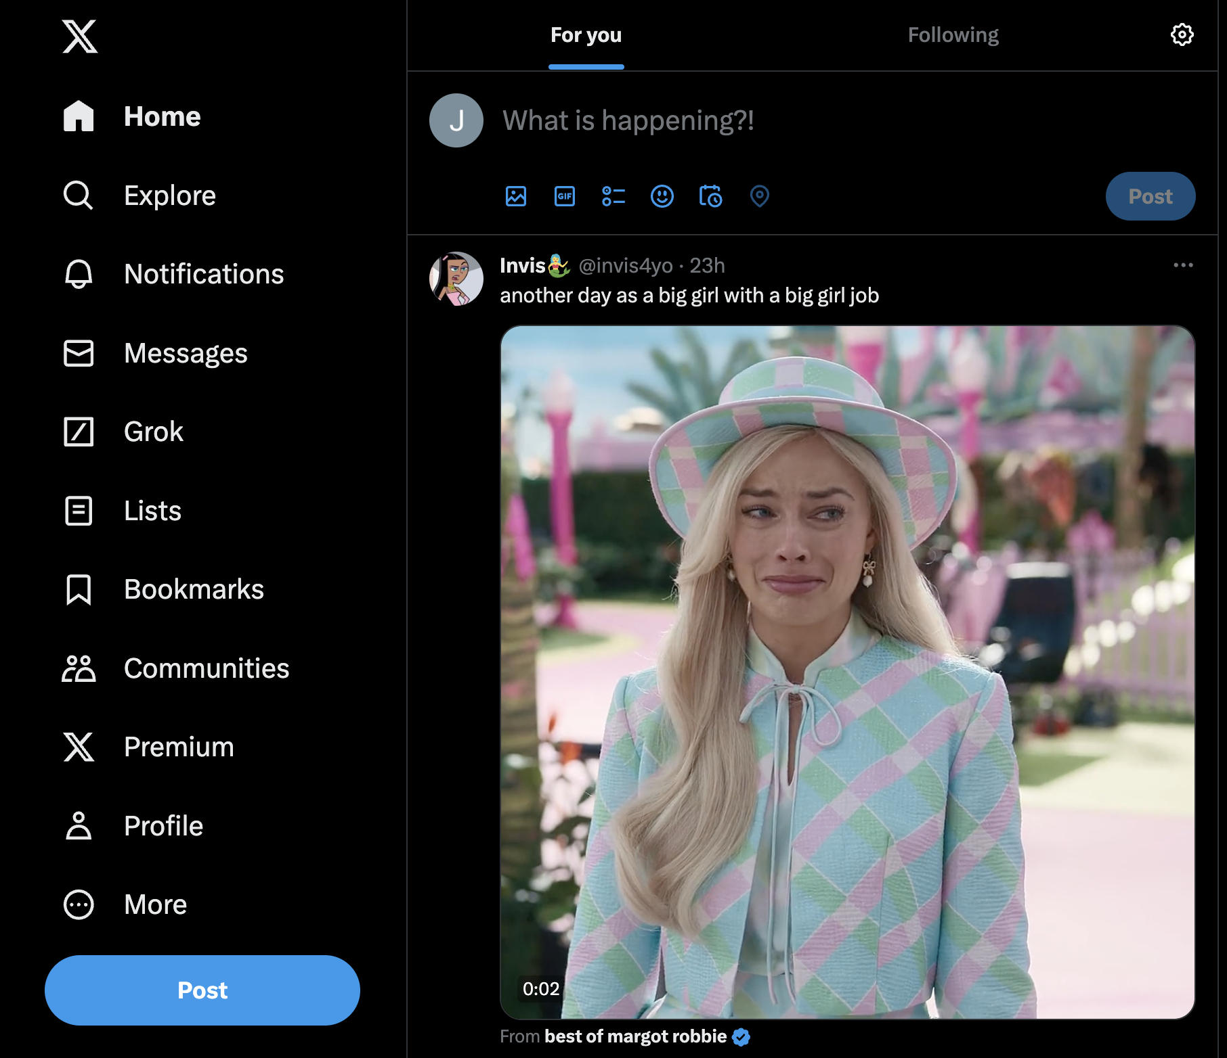
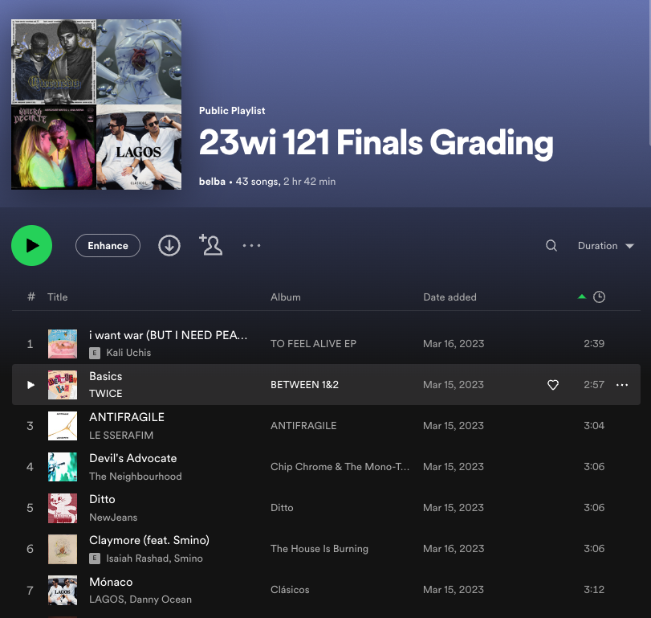
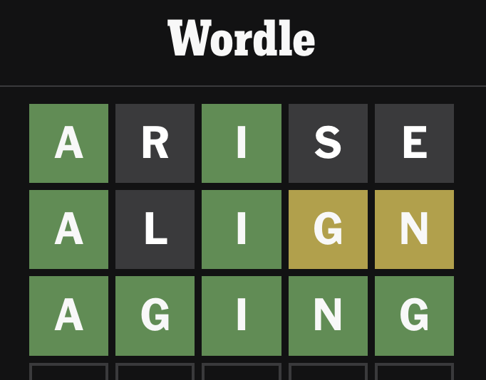
Why 122? (1/2)
1. Build a strong foundation of data structures that will let you tackle the biggest problems in computing
122 Data Structures

Slide 9
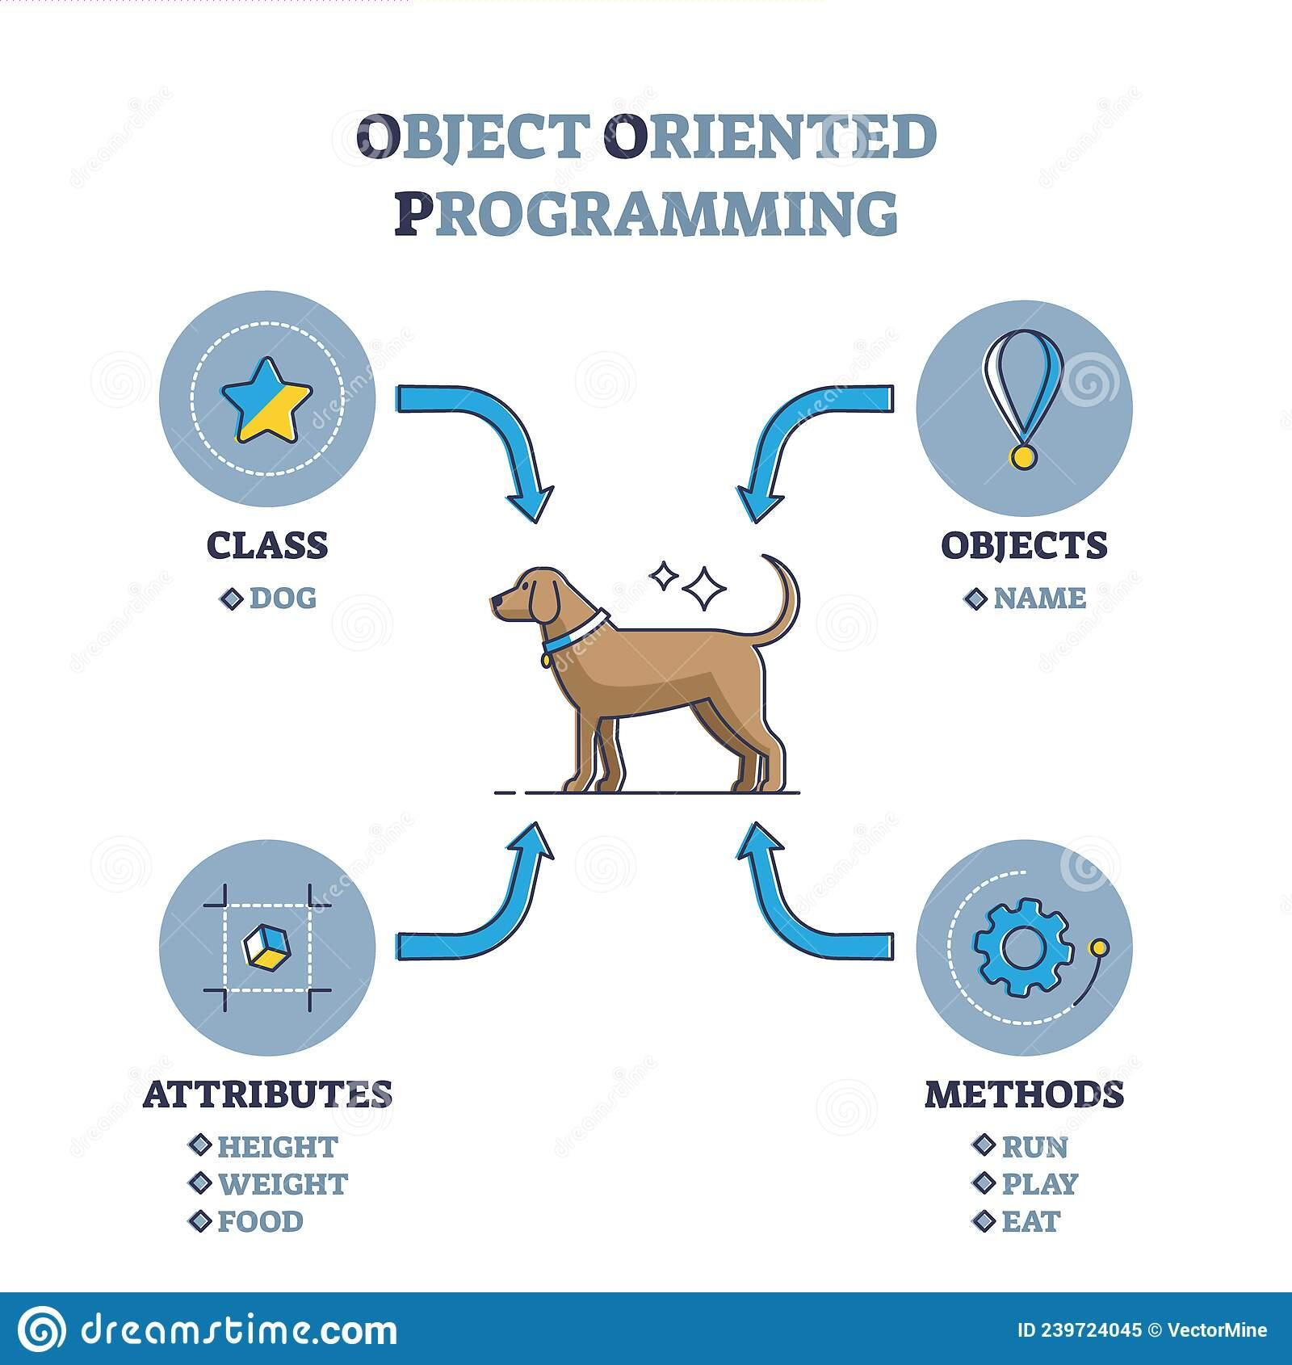
Why 122? (2/2)
2. Learn an important structural pattern for representing objects in code to make our code more reusable and maintainable and easier to understand.
Java is designed around this idea of objects. We haven’t been leveraging that yet!
Used in almost every real-world software project.

Slide 10
Lecture Outline (2/6)
Introductions
About this Course
  Course Components & Tools
  Grading
  Policies
Intro/Review Java
In-Class Activities
Functional Decomposition
Code Quality

Slide 11
Course Components
Meetings
LECTURES
(x14)
SECTIONS
(x13)
Introduce concepts, practice
ideas, discuss applications.
Pre-class materials to prepare for
class each day. Due before class.
Recorded 🎥
More practice, reviews, applications
TA advice, how to be an effective student
Preparation for quizzes / exams
Incentives to attend this quarter!
🚨 Not Recorded! 🚨
Assessments
PROGRAMMING ASSIGNMENTS
(x4)
CREATIVE PROJECTS
(x3)
QUIZZES
(x3)
EXAM
(x1)
Structured assignments
Programming in Java
Applying & implementing course concepts
More open-ended assignments
Explore new ideas and applications
Taken in quiz section
55 minutes on paper
Culminating exam
August 19 & 21, 2026 (both days required!)

Slide 12
Resubmissions
Learning is a challenging process that takes time, it doesn’t always happen on your first try.
Each week, one previous Programming Assignment or Creative Project can be resubmitted
  Must be accompanied by write-up explaining changes
  Grade on resubmission replaces original grade.
  An assignment can be resubmitted in the 3 cycles after feedback has been published
  Tip: Resubmit as early as possible
See syllabus for more details

Slide 13
Section Credit
Students receive "section credit" for a quiz section by attending and engaging in the quiz section's class and activities.
Section credit is logged and tracked by TAs on behalf of students.
Students will be able track and verify their participation credits on Gradescope.
Section 0 will be a freebie!

Slide 14
Section Credit
Students can earn one extra resubmission at the end of the quarter by participating in 8+ sections throughout 26su!
Missing a quiz section will not count against you, but attending section can help you earn that extra resubmission to use at the end of the quarter.

Slide 15
Graded Course Components
Each mark is graded on the scale:
  E(xcellent)
  S(atisfafactory)
  N(ot yet)
Your grade will consist of the following categories:
Category | # | Marks per | Total Marks
Programming Assignments | 4 | 4 (Behavior, Concepts, Quality, Testing/Reflection) | 16
Creative Projects | 3 | 4 (Behavior, Concepts, Quality, Testing/Reflection) | 12
Quizzes | 3 | 6 (3 questions) | 18
Exam | 1 | 12 (6 questions) | 12

Slide 16
Course Grades
In assigning course grades, we’ll use a bucket system:
  Marks earned place in an initial bucket, additional S+ marks improve grade.
  Must meet all requirements of a bucket for initial placement.
  These are minimum GPA guarantees – grade can always be higher than minimum promise.
Minimum Grade | Assignments | Quiz/Exam Problems
3.5 | 22 E AND 2 additional S+ AND no Us | 20 E AND 2 additional S+ AND no Us
3.0 | 18 E AND 4 additional S+ AND no Us | 16 E AND 4 additional S+ AND no Us
2.5 | 14 E AND 6 additional S+ AND no Us | 12 E AND 6 additional S+ AND no Us
2.0 | 18 S+ | 16 S+
1.5 | 11 S+ | 9 S+
S+ indicates S or E

Slide 17
Getting Help
Discussion Board
  Feel free to make a public or private post on Ed
  We encourage you to answer other peoples’ questions! A great way to learn
Introductory Programming Lab (Office Hours)
  TAs can help you face to face in office hours, and look at your code
  You can go to the IPL with any course questions, not just assignments
Section
  Work through related problems, get to know your TA who is here to support you
Your Peers
  We encourage you to form study groups! Discord or Ed are great places to do that
Email
  We prefer that all content and logistic questions go on the Ed discussion board (even if you make them private). 35 of you >>> 7 of us!
  For serious personal circumstances, you can email us directly. It never hurts to email us, but if it’s a common logistic question, we may politely ask you to post on the discussion board instead.

Slide 18
Collaboration & Resources
These concepts are challenging—we strongly encourage discussion + collaboration!
  Don’t attempt to gain credit for something you didn’t do
  In general, share ideas and work together, but don’t copy work. Never show someone else your code or solution write up.
  For any ungraded work (e.g., pre-class materials) there is no concern about academic misconduct! You should be collaborating on those without reservation.
  On graded assignments you should still collaborate, but the code you write should be of your own creation.
  Submitted work must be done completely without LLM/AI tool help.
  Be aware of and avoid use of Forbidden Features in submitted work
  Always cite the help you receive on graded work
Read full policy in Syllabus

Slide 19
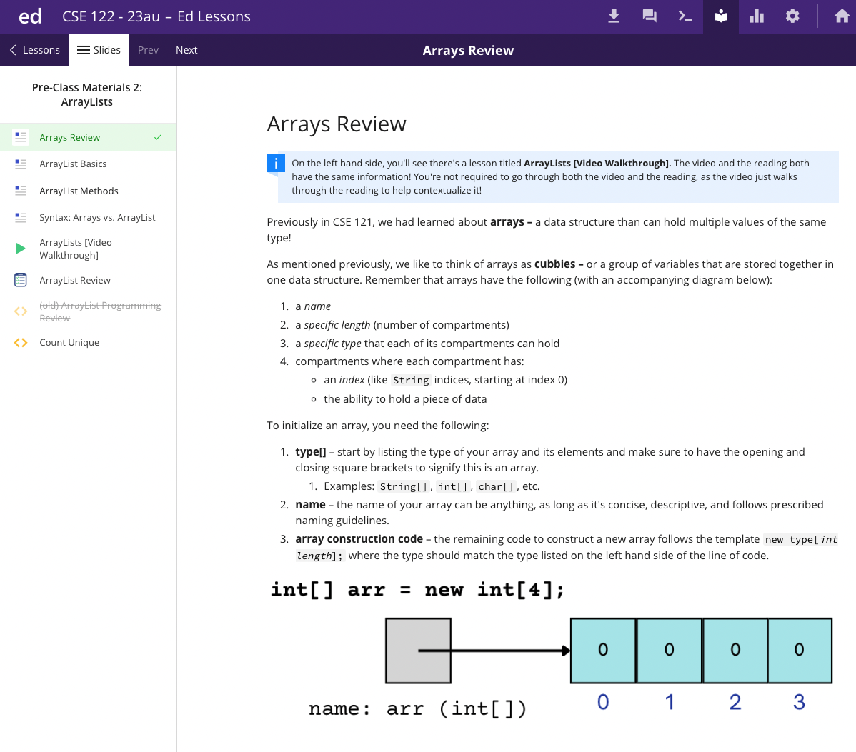
Textbook
Pre-class Materials
All required readings are available free on Ed!
Should be finished before class (not graded)
Optional Textbook
Building Java Programs by Reges and Stepp (5th Edition)
Not required but does add another perspective. Will reference relevant chapters.
Advice: only purchase if you learn best with a textbook, otherwise not recommended.

Slide 20
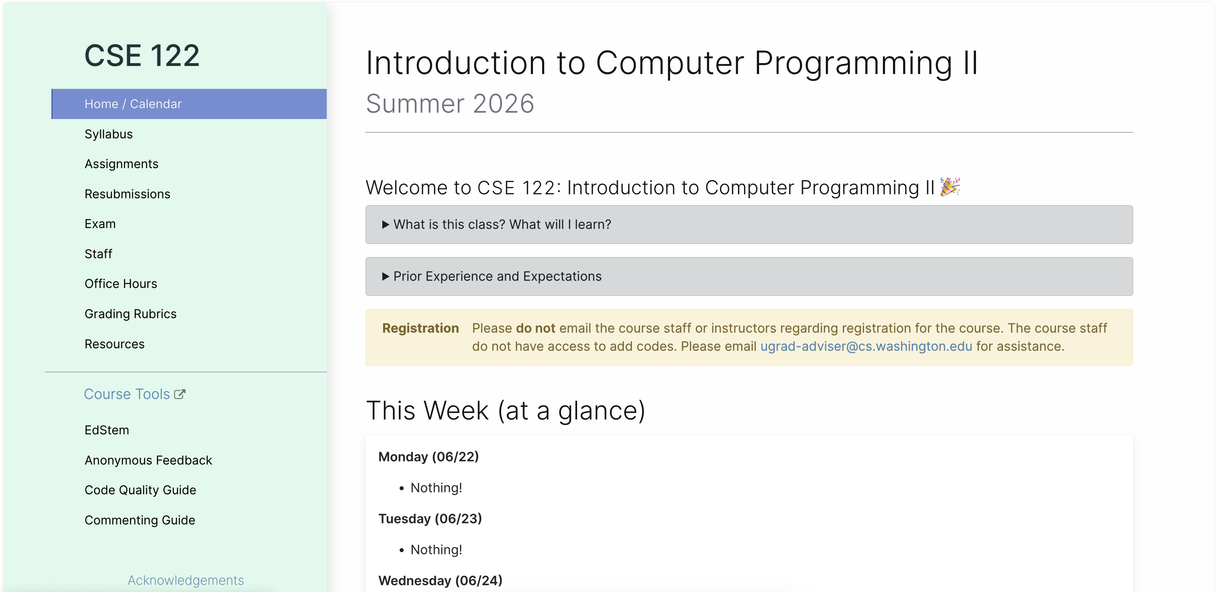
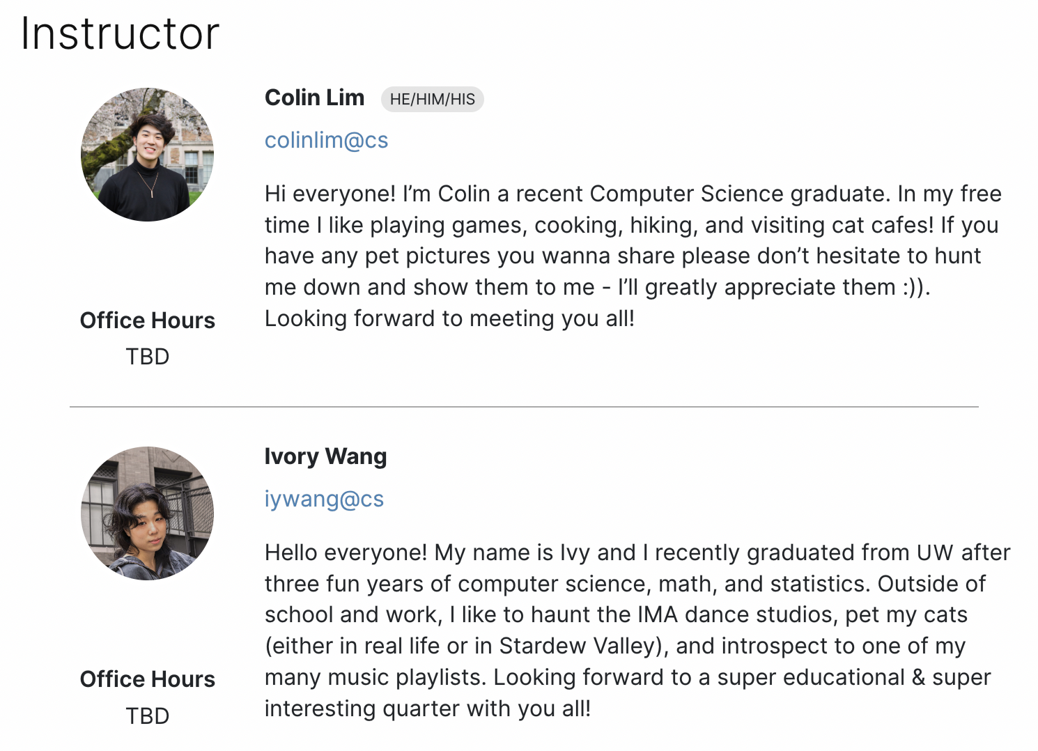
Course Website (1/2)
cs.uw.edu/122
Get to know the course staff
Contains most course info – check frequently!
Calendar, Lecture Slides, Office Hours schedule, Staff Bios, Important Links

Slide 21
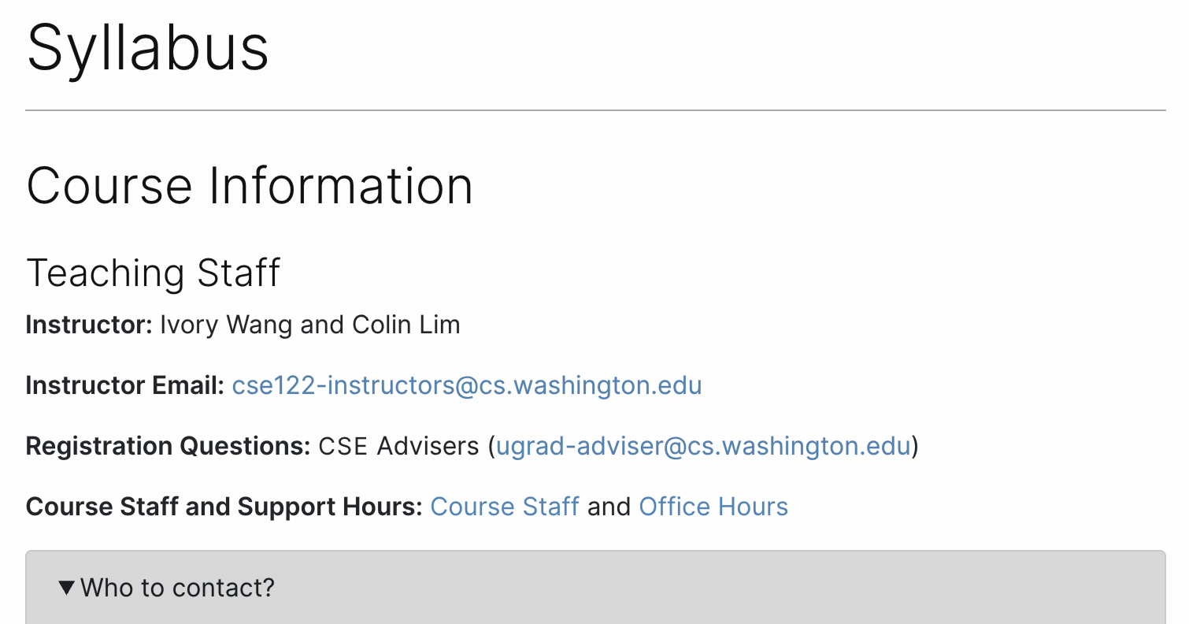
Course Website (2/2)
cs.uw.edu/122
Please familiarize yourself with the course syllabus this week!
Contains most course info – check frequently!
Calendar, Lecture Slides, Office Hours schedule, Staff Bios, Important Links

Slide 22
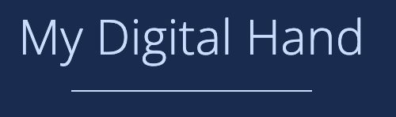




Other Course Tools
My Digital Hand
Queueing in office hours
VSCode (Optional)
Develop offline
Visual debugger
Ed
Community & Information
  Discussion Board
  (please ask & answer!; anonymous option)
  Chat
  Announcements
Pre-Class Materials / Section Handouts
Assignments
  Online IDE
  Submit assignments
  View Feedback
Canvas
Lecture recordings
Sli.do
In-class activities
(ungraded)
No account needed

Slide 23
Lecture Outline (3/6)
Introductions
About this Course
  Course Components & Tools
  Grading
  Policies
Intro/Review Java
In-Class Activities
Functional Decomposition
Code Quality

Slide 24
Review Java Syntax
Java Tutorial reviews all the relevant programming features you should be familiar with (even if you don’t know them in Java).
  Printing and comments
  Variables, types, expressions
  Conditionals (if/else if/ else)
  Loops (for and while)
  Strings
  Methods
  Arrays & 2D Arrays

Slide 25
Lecture Outline (4/6)
Introductions
About this Course
  Course Components & Tools
  Grading
  Policies
Intro/Review Java
In-Class Activities
Functional Decomposition
Code Quality

Slide 26
In-Class Activities
Goal: Get you actively participating in your learning
Typical Activity
  Question is posed
  Think (1 min): Think about the question on your own
  Pair (2 min): Talk with your neighbor to discuss question
    If you arrive at different conclusions, discuss your logic and figure out why you differ!
    If you arrived at the same conclusion, discuss why the other answers might be wrong!
  Share (1 min): We discuss the conclusions as a class
During each of the Think and Pair stages, you will respond to the question via a sli.do poll
  Not worth any points, just here to help you learn! 😉

Slide 27
What is the output of this Java program?
public class Demo {
public static void main(String[] args) {
int[] nums = {1, 4, 4, 8, 13};
int totalDiff = 0;
for (int i = 1; i <= nums.length; i++) {
totalDiff += (nums[i] - nums[i - 1]);
}
System.out.println("Total Diff = " + totalDiff);
}
}
Total Diff = 12
Total Diff = 10
Total Diff = 9
Exception!
Notes:
public class Temperatures {
public static void main(String[] args) {
int[] nums = {1, 4, 4, 8, 13};
int totalDiff = 0;
for (int i = 1; i <= nums.length-1; i++) {
totalDiff += (nums[i] - nums[i - 1]);
}
System.out.println("Total Diff = " + totalDiff);
}
}

Slide 28
What is the output of this Java program?
public class Demo {
public static void main(String[] args) {
int[] nums = {1, 4, 4, 8, 13};
int totalDiff = 0;
for (int i = 1; i <= nums.length; i++) {
totalDiff += (nums[i] - nums[i - 1]);
}
System.out.println("Total Diff = " + totalDiff);
}
}
Total Diff = 12
Total Diff = 10
Total Diff = 9
Exception!

Slide 29
Lecture Outline (5/6)
Introductions
About this Course
  Course Components & Tools
  Grading
  Policies
Intro/Review Java
In-Class Activities
Functional Decomposition
Code Quality

Slide 30

Functional Decomposition
Functional decomposition is the process of breaking down a complex problem or system into parts that are easier to conceive, understand, program, and maintain.
Wet
Mix butter and sugar
Beat in eggs & vanilla
Dry
Mix in flour, baking soda, and chocolate chips
Place
Make cookie-sized balls of dough
Place evenly on baking sheet
Bake
Bake at 350 degrees Fahrenheit for 10 minutes
Let cool after
“Bake the cookies”

Slide 31
Functional Decomposition
In our code, functional decomposition often means breaking a task into smaller methods (also called functions).
Example: Bingo
  Set up populated game card
  Roll and call a new number
  Mark your card if the number called is present
  Check card for bingo

Slide 32
Avoid Trivial Methods
Introduce methods to decompose a complex problem, not just for the sake of adding a method.
Bad example: Good Example:
Rule of thumb: A method should do at least two steps
  Ask yourself: Does adding this method make my code easier to understand?
public static void printMessage(String message) {
System.out.println(message);
System.out.println();
}
public static void sToQ(Stack<String> s, Queue<String> q) {
while (!s.isEmpty()) {
q.add(s.pop());;
}
}

Slide 33
Lecture Outline (6/6)
Introductions
About this Course
  Course Components & Tools
  Grading
  Policies
Intro/Review Java
In-Class Activities
Functional Decomposition
Code Quality

Slide 34
Code Quality
“Programs are meant to be read by humans and only incidentally for computers to execute.” – Abelson & Sussman, SICP
Code is about communication. Writing code with good code quality is important to communicate effectively.
Different organizations have different standards for code quality.
  Doesn’t mean any one standard is wrong! (e.g., APA, MLA, Chicago, IEEE, ...)
  Consistency is very helpful within a group project
  See our Code Quality Guide for the standards we will all use in CSE 122

Slide 35
CSE 122 Code Quality
Examples relevant for this week
Naming conventions
Descriptive variable names
Indentation
Long lines
Spacing
Good method decomposition
Writing documentation

Slide 36
“Homework” for Next Time
First assignment will be released Friday, but there are some things to do in the meantime.
TODO this week
  Fill out the introductory survey
  Go meet your TA and classmates in Thursday’s quiz section
  ⭐️ Complete the pre-class material for Friday (see calendar)
  Check over syllabus details

