Slide 1

Nested Collections
Slido vote & chat with neighbors:
The weather looks fabulous! What are your weekend plans?

Slide 2
Agenda (1/4)
Announcements
Review: Maps & mostFrequentStart
Recap: Nested Collections
Practice: Social Network

Slide 3
Announcements
Programming Assignment 2 (P2) releasing today!
  Seriously, start early! This assignment is much more involved…
  Due May 12th by 11:59pm PT
Quiz 1 on May 7th in your registered Quiz Section
  Topics: (Reference Semantics), Stacks and Queues, Sets, Maps
  Practice Quiz 1 available some time this weekend; solutions on Tuesday
Quiz 0 grades to be released this weekend!
Resubmission Cycle 2 (R2) form out, due May 5th by 11:59pm PT
  Available assignments: C0, P0, C1
  Reminder: to use a resubmission cycle you need to
    (1) submit your work (big blue "Submit" button on Ed)
    AND (2) fill out the resubmission form (linked from Ed + course calendar)

Slide 4
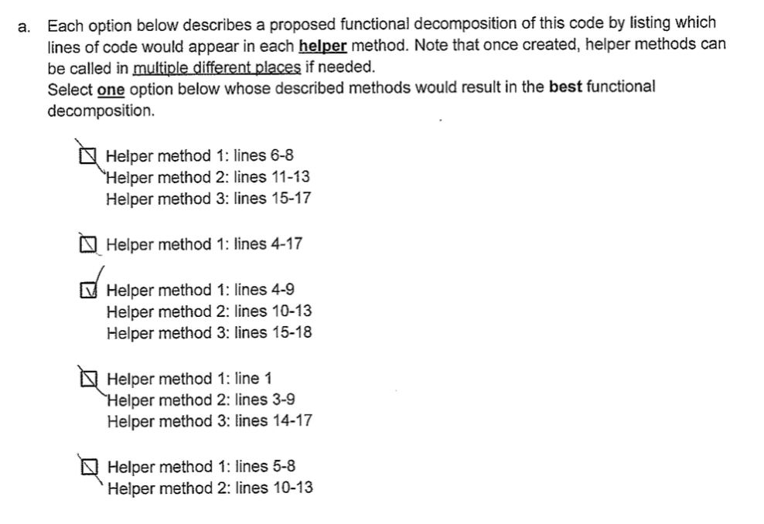
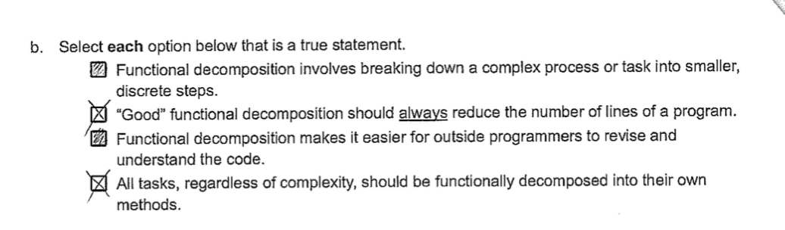
An aside for quizzes…
Please be legible and clear on your written answers 🥴

Slide 5
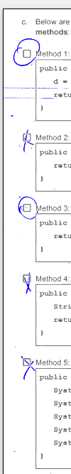
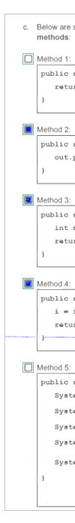
An aside for quizzes… (1/2)
Please be legible and clear on your written answers 🥴

Slide 6
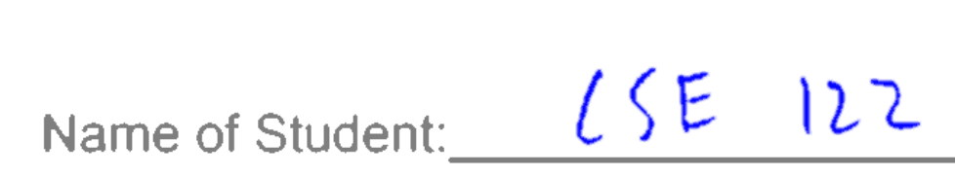
An aside for quizzes… (2/2)
Please write your name legibly!

Slide 7
Agenda (2/4)
Announcements
Review: Maps & mostFrequentStart
Recap: Nested Collections
Practice: Social Network

Slide 8
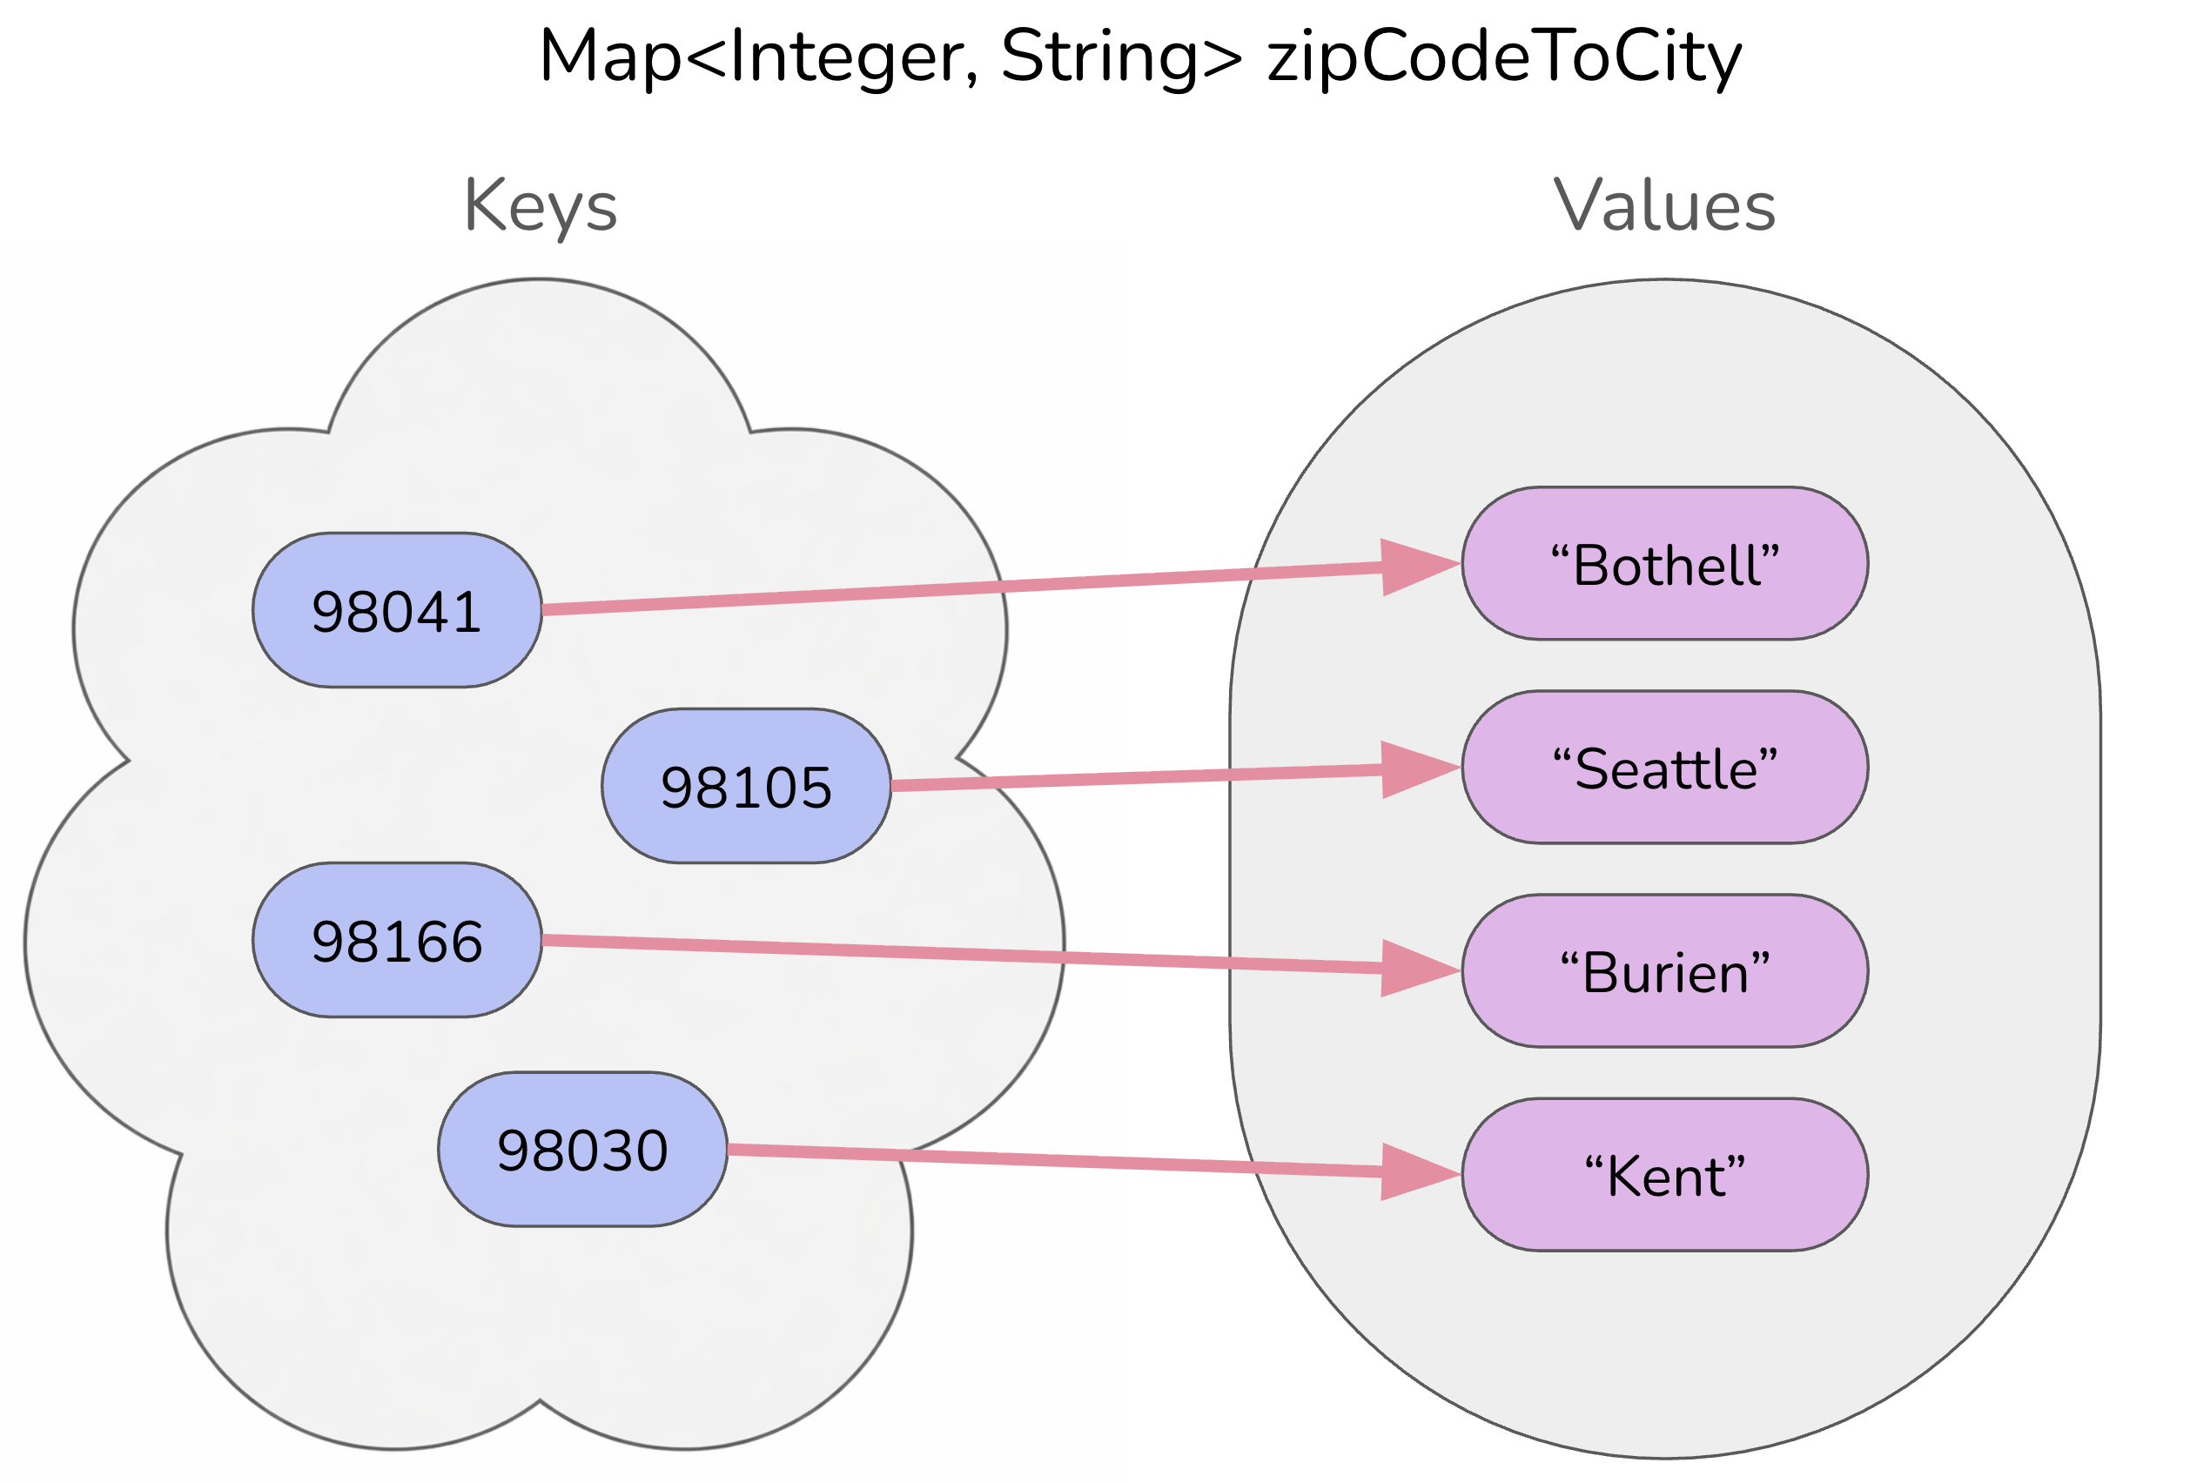
Map ADT
Data structure to map keys to values
  Keys can be any* type; Keys must be unique
  Values can be any type
Example: Mapping ticker to stock price in P0
Operations
  put(key, value): Associate key to value
    Overwrites duplicate keys
  get(key): Get value for key
  remove(key): Remove key/value pair
Same as Python’s dict

Slide 9
mostFrequentStart (2/2)
Write a method called mostFrequentStart that takes a Set of words and does the following steps:
Organizes words into “word families” based on which letter they start with
Selects the largest “word family” as defined as the family with the most words in it
Returns the starting letter of the largest word family (and should update the Set of words to only have words from the selected family).

Slide 10
mostFrequentStart (2/2)
For example, if the Set words stored the values:
["hello", "goodbye", "library", "literary", "little", "repel"]
The word families produced would be:
'h' -> 1 word ("hello")
'g' -> 1 word ("goodbye")
'l' -> 3 words ("library", "literary", "little")
'r' -> 1 word ("repel")
Since 'l' has the largest word family, we modify the Set to only contain Strings starting with 'l' and finally return 'l'.

Slide 11
Agenda (3/4)
Announcements
Review: Maps & mostFrequentStart
Recap: Nested Collections
Practice: Social Network

Slide 12
Nested Collections (1/2)
The values inside a Map can be any type, including data structures
Common examples:
  Mapping: Section ➔ Set of students in that section
  Mapping: Recipe ➔ Set of ingredients in that recipe
  (Or even Map<String, Map<String, Double>> for units!)

Slide 13
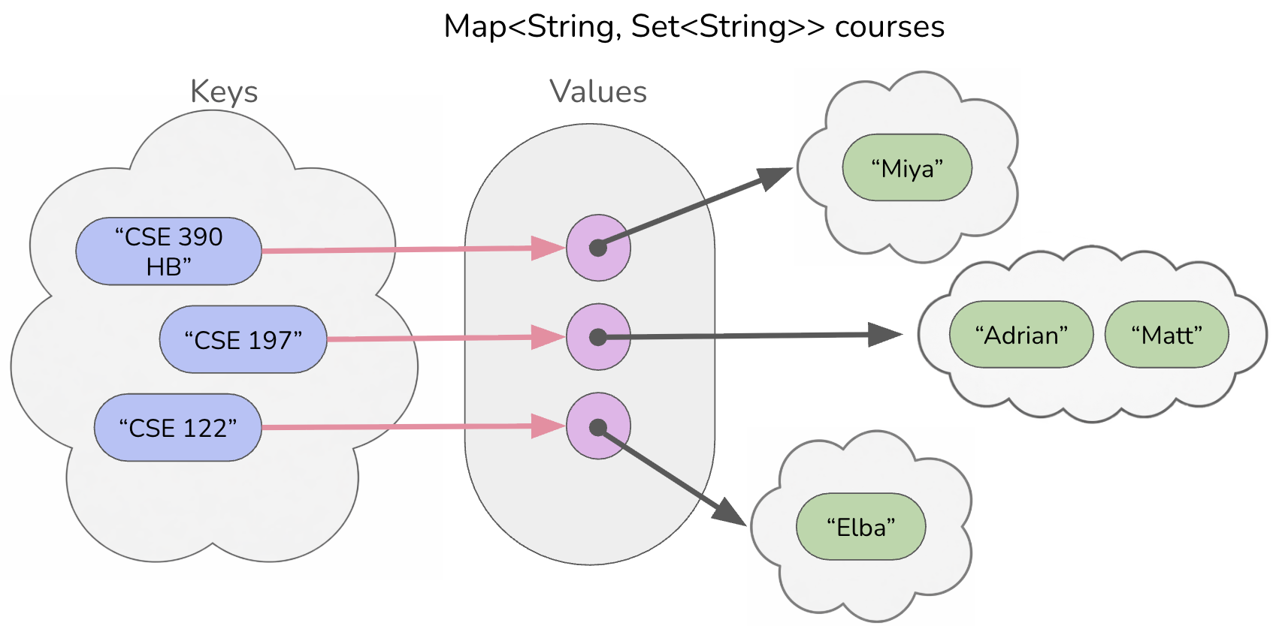
Nested Collections (2/2)

Slide 14
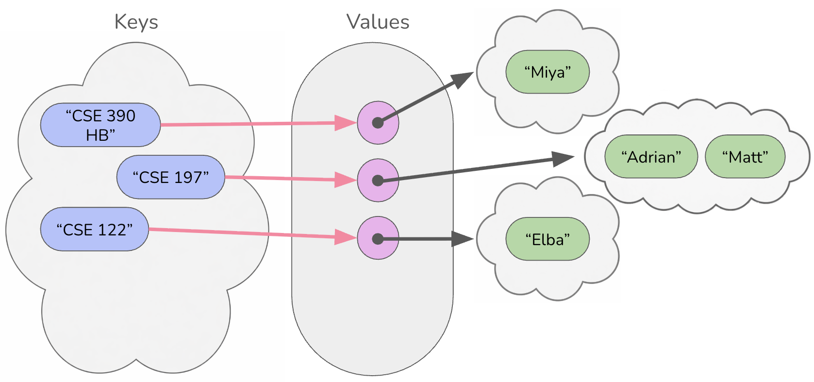

Updating Nested Collections
courses.put("CSE 123",
new HashSet<String>());
courses.get("CSE 123").add("James");
Set<String> cse123 = courses.get("CSE 123");
cse123.add("Gigi");
The “value” inside the Map is a reference
to the data structure!
  Think carefully about number of references to a particular object
cse123
“CSE 123”
“James”
“Gigi”

Slide 15
Suppose map had the following items. What would its items be after running this code?
map: {"KeyA"=[1, 2], "KeyB"=[3], "KeyC"=[4, 5, 6]}
Set<Integer> nums = map.get("KeyA");
nums.add(7);
map.put("KeyB", nums);
map.get("KeyA").add(8);
map.get("KeyB").add(9);
{"KeyA"=[1, 2], "KeyB"=[1, 2, 7], "KeyC"=[4, 5, 6]}
{"KeyA"=[1, 2, 8], "KeyB"=[1, 2, 7, 9], "KeyC"=[4, 5, 6]}
{"KeyA"=[1, 2, 7, 8], "KeyB"=[1, 2, 7, 9], "KeyC"=[4, 5, 6]}
{"KeyA"=[1, 2, 7, 8, 9], "KeyB"=[1, 2, 7, 8, 9], "KeyC"=[4, 5, 6]}

Slide 16
Suppose map had the following items. What would its items be after running this code?
nums
map: {”KeyA"=[1, 2], ”KeyB"=[3], ”KeyC"=[4, 5, 6]}
[1, 2]
[1, 2, 7, 8]
KeyA:
[1, 2, 7]
Set<Integer> nums = map.get("KeyA");
nums.add(7);
map.put("KeyB", nums);
map.get("KeyA").add(8);
map.get("KeyB").add(9);
[1, 2, 7, 8, 9]
KeyB:
[3]
KeyC:
[4, 5, 6]
{"KeyA"=[1, 2], "KeyB"=[1, 2, 7], "KeyC"=[4, 5, 6]}
{"KeyA"=[1, 2, 8], "KeyB"=[1, 2, 7, 9], "KeyC"=[4, 5, 6]}
{"KeyA"=[1, 2, 7, 8], "KeyB"=[1, 2, 7, 9], "KeyC"=[4, 5, 6]}
{"KeyA"=[1, 2, 7, 8, 9], "KeyB"=[1, 2, 7, 8, 9], "KeyC"=[4, 5, 6]}

Slide 17
Agenda (4/4)
Announcements
Review: Maps & mostFrequentStart
Recap: Nested Collections
Practice: Social Network

Slide 18
Background: Search Engines
A search engine receives a query and returns a set of relevant documents. Examples: Google.com, Mac Finder, more.
  Queries often can have more
A search engine involves two main components
  An index to efficiently find the set of documents for a query
    Will focus on “single word queries” for today’s example
  A ranking algorithm to order the documents from most to least relevant
    Not the focus of this example
Goal: Precompute a data structure that helps find the relevant documents for a given query

Slide 19
Inverted Index
An inverted index is a Mapping from possible query words to the set of documents that contain that word
  Answers the question:
  “What documents contain the word ‘burritos’?”
Inverted Index
Document 1
I
Document 1
Document 2
Document 3
I love tacos
love
Document 1
Document 2
Document 3
Document 2
I love burritos
tacos
Document 1
Document 3
burritos
Document 2
I love tlayudas
tlayudas
Document 3

Slide 20
Ranking Results
There is no one right way to define which documents are “most relevant” There are approximations, but make decisions about what relevance means
Idea 1: Documents that have more hits of the query should come first
  Pro: Simple
  Con: Favors longer documents (query: “the dogs” will favor long documents with lots of “the”s)
Idea 2: Weight query terms based on their “uniqueness”. Often use some sort of score for “Term Frequency – Inverse Document Frequency (TF-IDF)
  Pro: Doesn’t put much weight on common words like “the”
  Cons: Complex, many choices in how to compute that yield pretty different rankings
Idea 3: Much more! Most companies keep their ranking algorithms very very secret ☺

