Slide 1

Maps
BEFORE WE START
Slido vote & chat with your neighbors:
What one song would you add to our quarter’s playlist below?
👇

Slide 2
Lecture Outline (1/5)
Announcements
Map Review
Debrief PCM: CountWords
Practice: joinRosters
Practice: mostFrequentStart

Slide 3
Announcements/Reminders
Programming Assignment 1 (P1) due tomorrow by 11:59pm PT!
Resubmission Cycle 2 (R2) form opens tomorrow
  Due Tuesday, May 5th by 11:59pm PT
  Eligible Assignments: C0, P0, C1
Reminder: Quiz 1 is Thursday, May 7th
  Quiz 0 results coming soon™!
Programming Assignment 2 (P2) releasing Friday!
  Due Tuesday, May 12th by 11:59pm PT

Slide 4
Lecture Outline
Announcements
Sets, Iterators, For-each Loop Review
Map Review
Debrief PCM: Count Words
Practice: joinRosters
Practice: mostFrequentStart

Slide 5
Sets (ADT)
A collection of unique values (no duplicates allowed) that can perform the following operations efficiently:
  add
  remove
  search (contains)
We don’t think of a set as having indices; we just add things to the set in general and don’t worry about order
"hi"
"hola"
"Hallo"
"hello"
"tervetuloa"

Slide 6
Sets in Java
Set is an interface in Java
  In java.util
HashSet and TreeSet are classes that implement the Set interface in Java
  HashSet: Very fast! Implemented using a “hash table” array
    Elements are stored in an unpredictable order
  TreeSet: Pretty fast! Implemented using a “binary search tree”
    Elements are stored in sorted order

Slide 7
Set Methods
Method | Description
add(value) | Adds the given value to the set, returns whether or not the given value was added successfully
contains(value) | Returns true if the given value is found in this set
remove(value) | Removes the given value from the set; returns true if the set contained the value, false if not
clear() | Removes all elements from the set
size() | Returns the number of elements in list
isEmpty() | Returns true if the set’s size is 0; false otherwise
toString() | Returns a String representation of the set such as "[3, 42, -7, 15]"

Slide 8
For-Each Loop
A new kind of loop! ✨
Set<String> words = new HashSet<>();
for (String s : words) {
System.out.println(s);
}
BUT, you cannot modify the data structure inside a for-each loop
  You will get a ConcurrentModificationException
  They are “read-only”

Slide 9
Iterators
A new object that has access to all of the elements of a given collection and gives them to you one at a time—and it lets you modify the collection!
Set<String> lyrics = new HashSet<>();
Iterator<String> itr = lyrics.iterator();
while (itr.hasNext()) {
String next = itr.next();
if (next.contains("woo")) {
itr.remove();
}
}

Slide 10
Iterators
Returned by the iterator() method
You must use the iterator’s remove() method to remove things from what you’re iterating over – otherwise you will get a ConcurrentModificationException
Methods | Description
hasNext() | Returns true if there are more elements for the iterator to return
next() | Returns the next element in the iteration
remove() | Removes and returns the element that was last returned by next()

Slide 11
Lecture Outline (2/5)
Announcements
Map Review
Debrief PCM: CountWords
Practice: joinRosters
Practice: mostFrequentStart

Slide 12
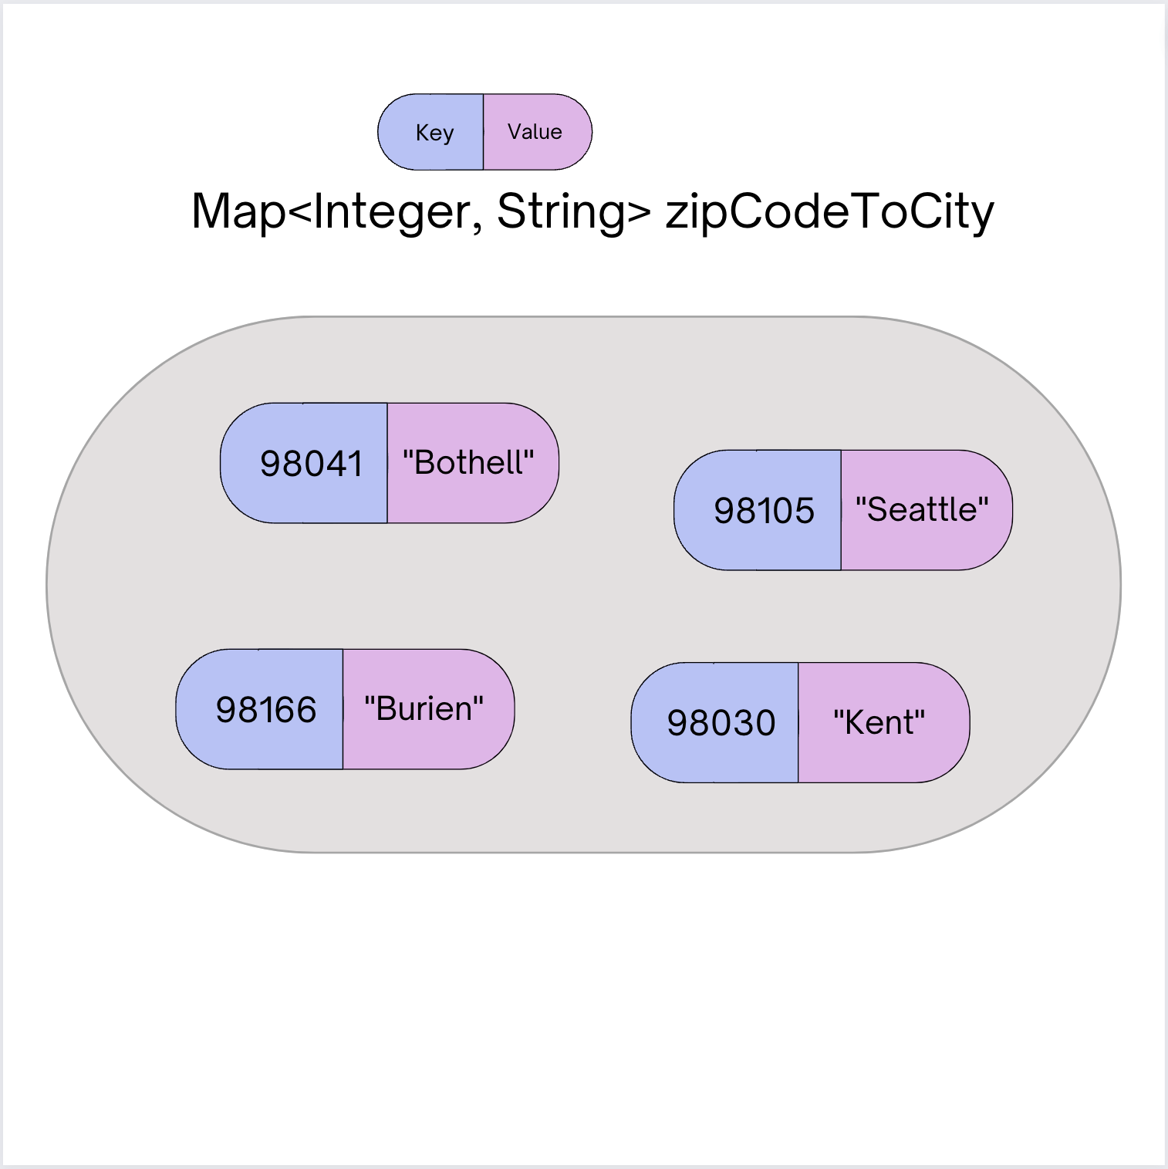
Map ADT
Data structure to map keys to values
  Keys can be any* type; Keys must be unique
  Values can be any type
Operations
  put(key, value): Associate key to value
    🚨 Overwrites duplicate keys 🚨
  get(key): Get value for key
  remove(key): Remove key/value pair
*Same as Python’s dict

Slide 13
Programming with Maps in Java (1/2)
Interface: Map
Implementations: TreeMap, HashMap
// Making a Map
Map<String, String> favArtistToSong = new TreeMap<>();
// adding elements to the above Map
favArtistToSong.put("PinkPantheress", "Stateside");
favArtistToSong.put("Rosalía", "La Perla");
favArtistToSong.put("Taylor Swift", "Dress");
favArtistToSong.put("Taylor Swift", "State of Grace"); // Overwrite!
// Getting a value for a key
String song = favArtistToSong.get(”PinkPantheress");
System.out.println(song);

Slide 14
Programming with Maps in Java (2/2)
Methods | Description
put(key, value) | adds a mapping from the given key to the given value; if the key already exists, replaces its value with the given one
get(key) | returns the value mapped to the given key (null if not found)
containsKey(key) | returns true if the map contains a mapping for the given key
remove(key) | removes any existing mapping for the given key
clear() | removes all key/value pairs from the map
size() | returns the number of key/value pairs in the map
isEmpty() | returns true if the map's size is 0
toString() | returns a string such as "{a=90, d=60, c=70}"
keySet() | returns a set of all keys in the map
values() | returns a collection of all values in the map

Slide 15
Map Implementations
Our first data structures with marked differences in how their implementations behave
One Map ADT / Interface
Two Map implementations
  TreeMap – Pretty fast, and sorted keys
  HashMap – Extremely fast, unsorted keys
Map<String, Integer> map1 = new TreeMap<>();
Map<String, Integer> map2 = new HashMap<>();
...

Slide 16
Select the method calls required to modify the given map m as follows:
Assume m’s contents are
98030="Kent"
98178="Seattle"
98166="Burien"
98041="Bothell"
We want to modify m so that its contents are
98030="Kent"
98178="Tukwila"
98166="Burien"
98041="Bothell"
98101="Seattle"
98126="Seattle"
m.put(98178, "Tukwila");
m.remove(98178);
m.put(98126, "Seattle");
m.get(98178, "Seattle");
m.put(98101, "Seattle");

Slide 17
Select the method calls required to modify the given map m as follows:
Assume m’s contents are
98030="Kent"
98178="Seattle"
98166="Burien"
98041="Bothell"
We want to modify m so that its contents are
98030="Kent"
98178="Tukwila"
98166="Burien"
98041="Bothell"
98101="Seattle"
98126="Seattle"
m.put(98178, "Tukwila");
m.remove(98178);
m.put(98126, "Seattle");
m.get(98178, "Seattle");
m.put(98101, "Seattle");

Slide 18
Lecture Outline (3/5)
Announcements
Map Review
Debrief PCM: CountWords
Practice: joinRosters
Practice: mostFrequentStart

Slide 19
Lecture Outline (4/5)
Announcements
Map Review
Debrief PCM: CountWords
Practice: joinRosters
Practice: mostFrequentStart

Slide 20
joinRosters
Write a method joinRosters that combines a Map from student name to quiz section, and a Map from TA name to quiz section and prints all pairs of students/TAs.
For example, if studentSections stores the following map:
{Alan=AC, Jerry=AB, Yueying=AA, Sharon=AB, Steven=AB, Zewditu=BA}
And taSections stores the following map
{Blake=BA, Nicolae=AA, Sushma=AB, Dani=AC}
AC: Alan - Dani
AB: Jerry - Sushma AB: Sharon - Sushma AB: Steven - Sushma AA: Yueying – Nicolae BA: Zewditu – Blake

Slide 21
Lecture Outline (5/5)
Announcements
Map Review
Debrief PCM: CountWords
Practice: joinRosters
Practice: mostFrequentStart

Slide 22
mostFrequentStart (1/2)
Write a method called mostFrequentStart that takes a Set of words and does the following steps:
Organizes words into “word families” based on which letter they start with
Selects the largest “word family” as defined as the family with the most words in it
Returns the starting letter of the largest word family (and if time, should update the Set of words to only have words from the selected family).

Slide 23
mostFrequentStart (2/2)
For example, if the Set words stored the values
["hello", "goodbye", "library", "literary", "little", "repel"]
The word families produced would be
'h' -> 1 word ("hello")
'g' -> 1 word ("goodbye")
'l' -> 3 words ("library", "literary", "little")
'r' -> 1 word ("repel")
Since 'l' has the largest word family, we return 'l' and modify the Set to only contain Strings starting with 'l'.

